Slide 1

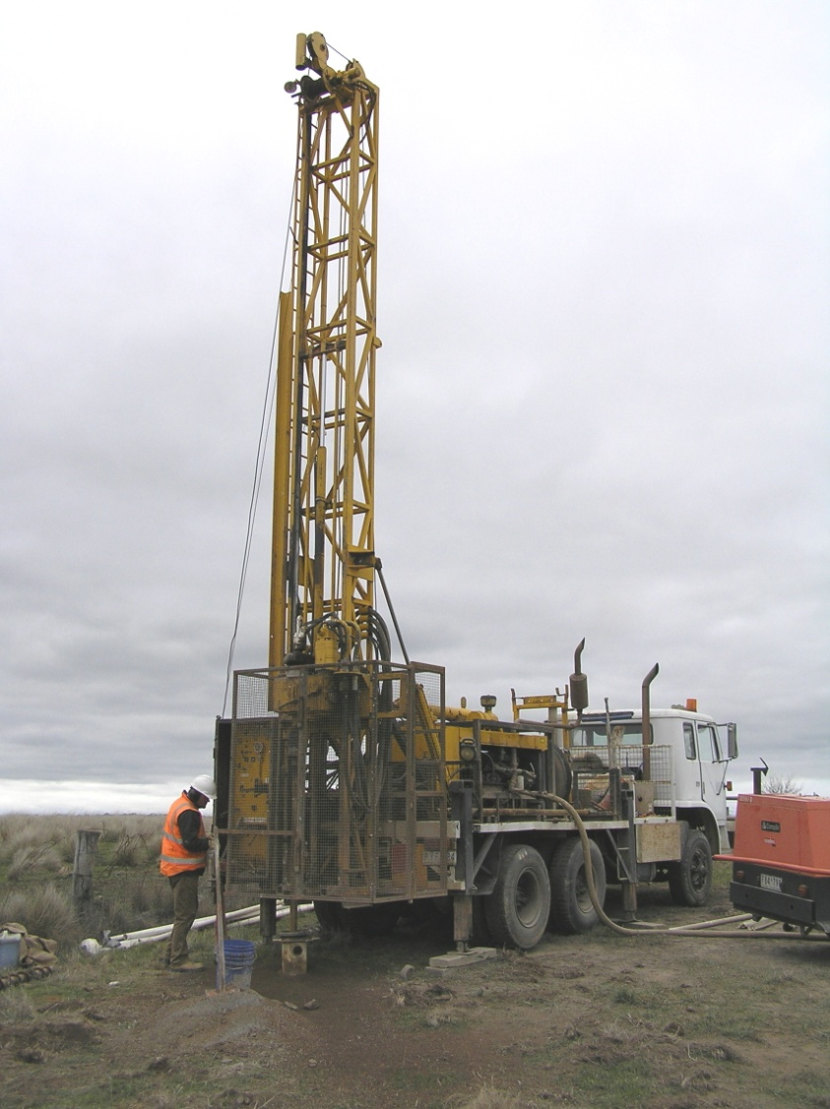
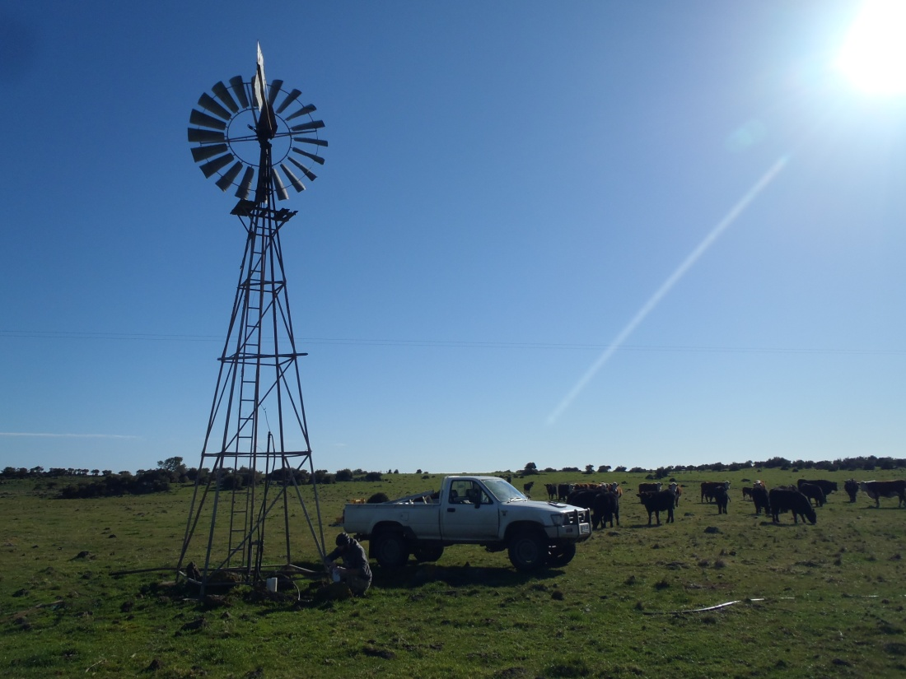
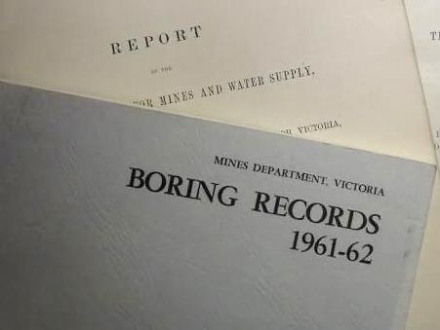
Launching the new VVG portal:
eResearch experiments in data democracy
Peter Dahlhaus
Andrew Macleod

Slide 2














July 2011 granted a Broadband Enabled Innovation Program
$320k BEIP cash + $160k partner cash + $1.745M in-kind
Soft launch June 2012
A collaboration of 17 partner organisations
An interoperative spatial information portal that federates groundwater data from disparate sources.
Primarily for research and investigation.
Non-government portal (unique?).

Slide 3
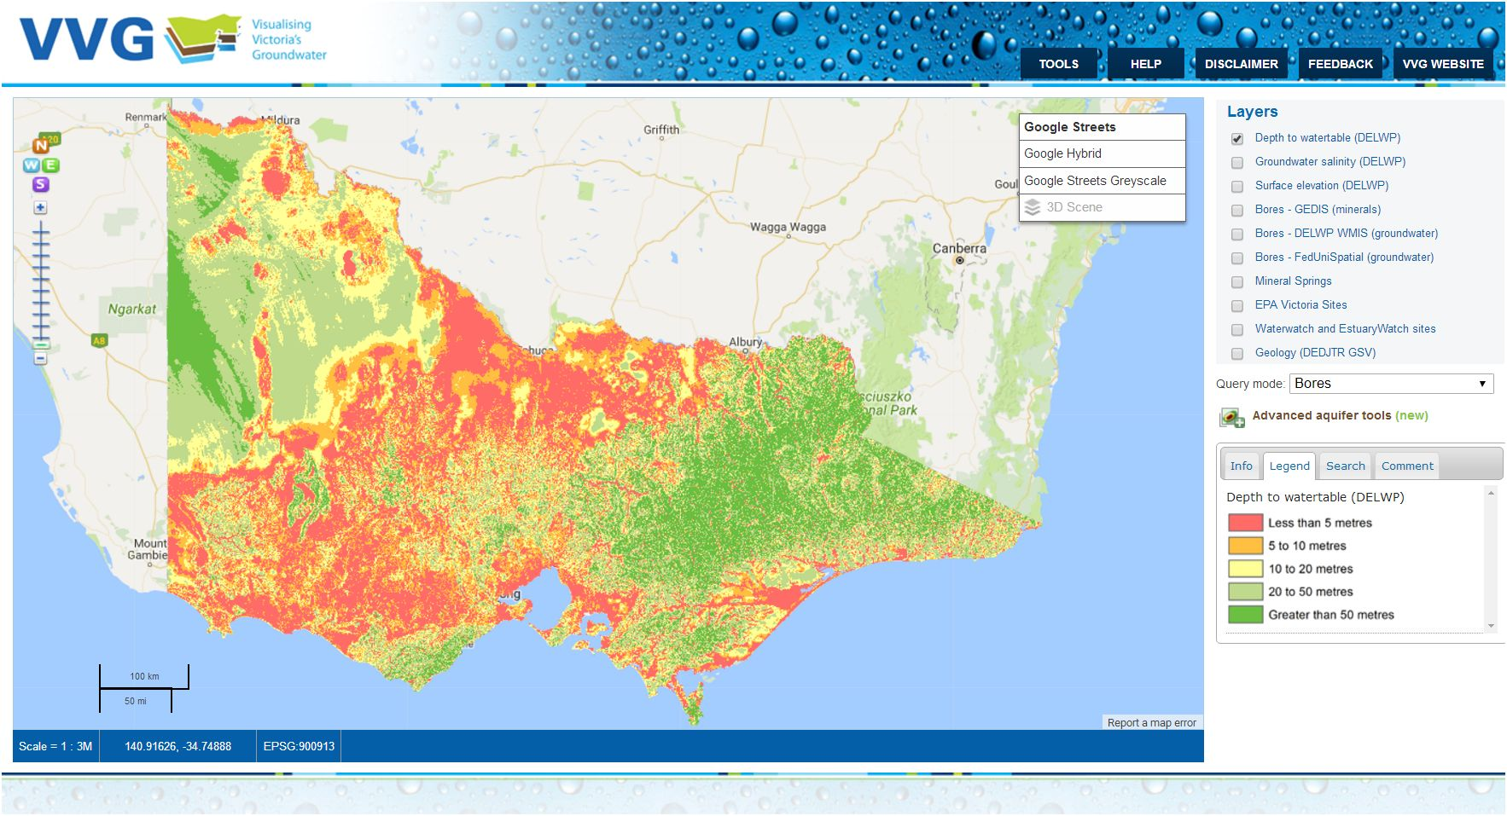
Federates around 80 groundwater data sets from 8 custodians. Some data are real-time, some are scheduled updates, some are linked data
www.vvg.org.au
Depth to watertable

Slide 4
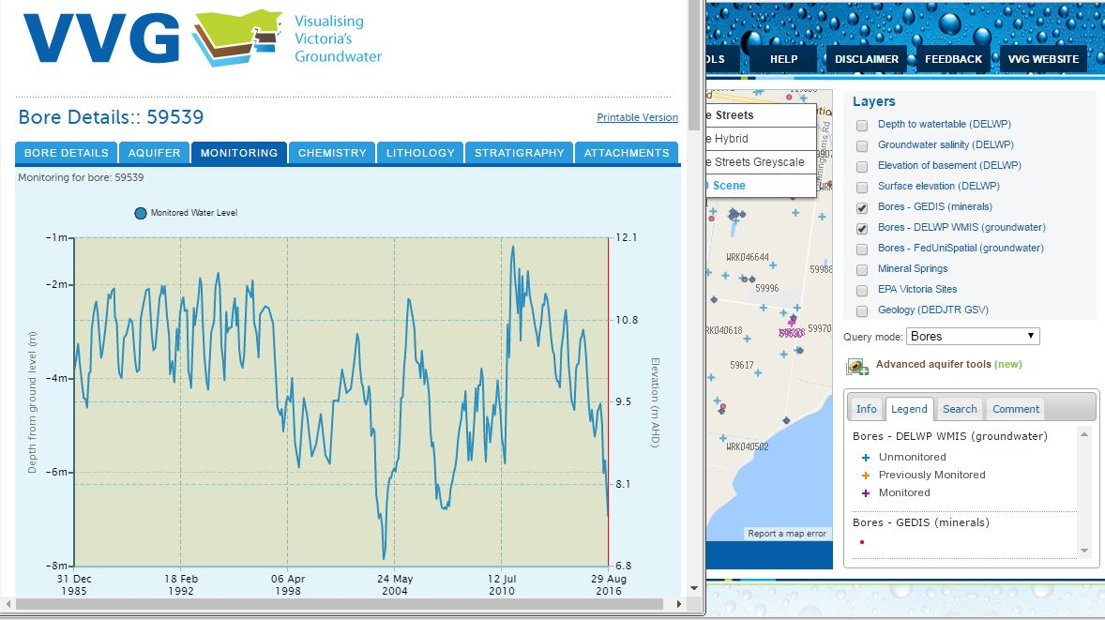
Bore parameters
Information on over 400,000 bores accessed from the source databases

Slide 5
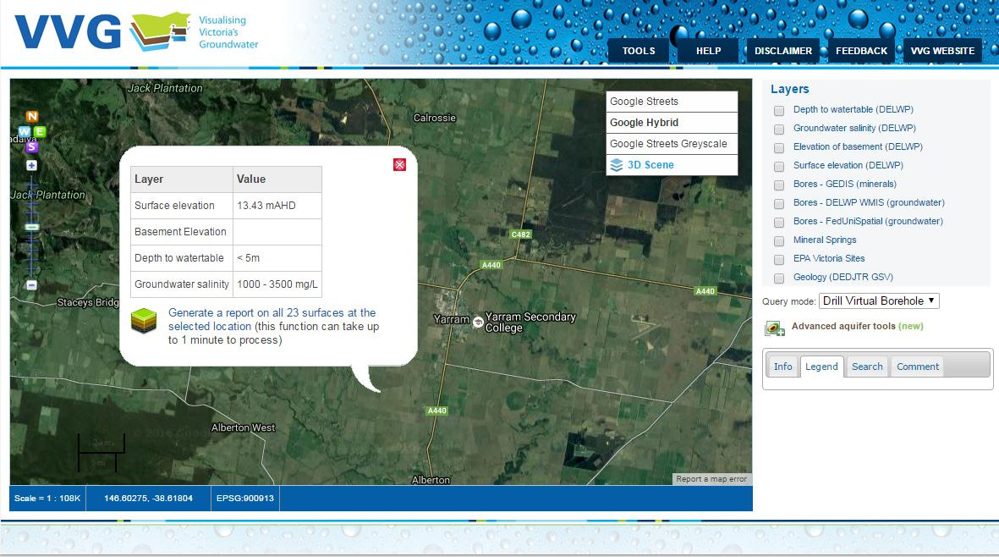
Predicted depth to watertable and groundwater quality

Slide 6
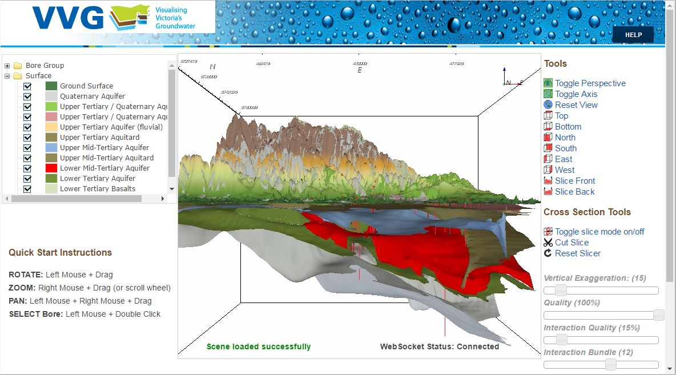
3d model of aquifers

Slide 7
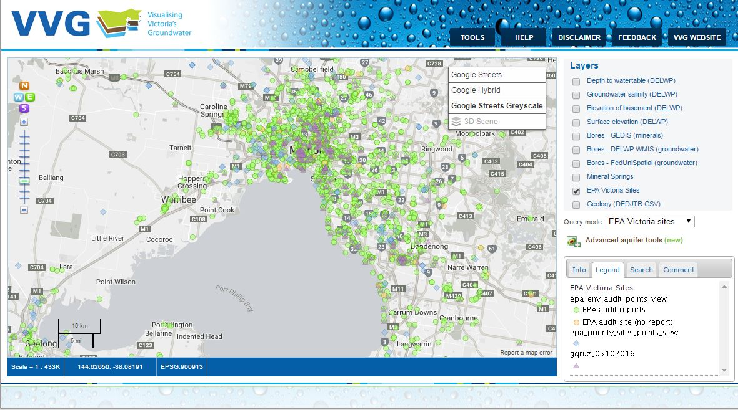
EPA audit sites, GQRUZ sites and priority sites

Slide 8
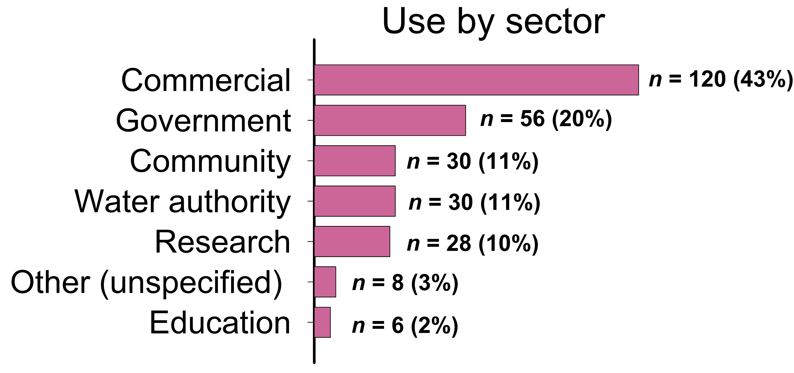
Primary impact
The VVG portal is frequently used by a wide cross-section of society
Analytics

Slide 9
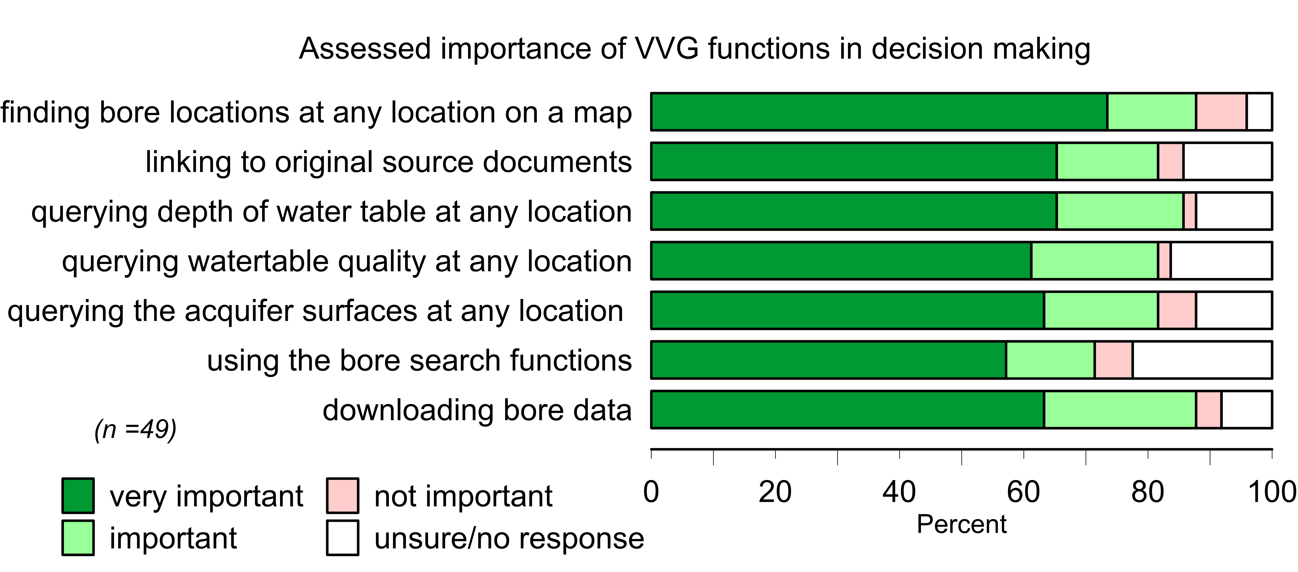
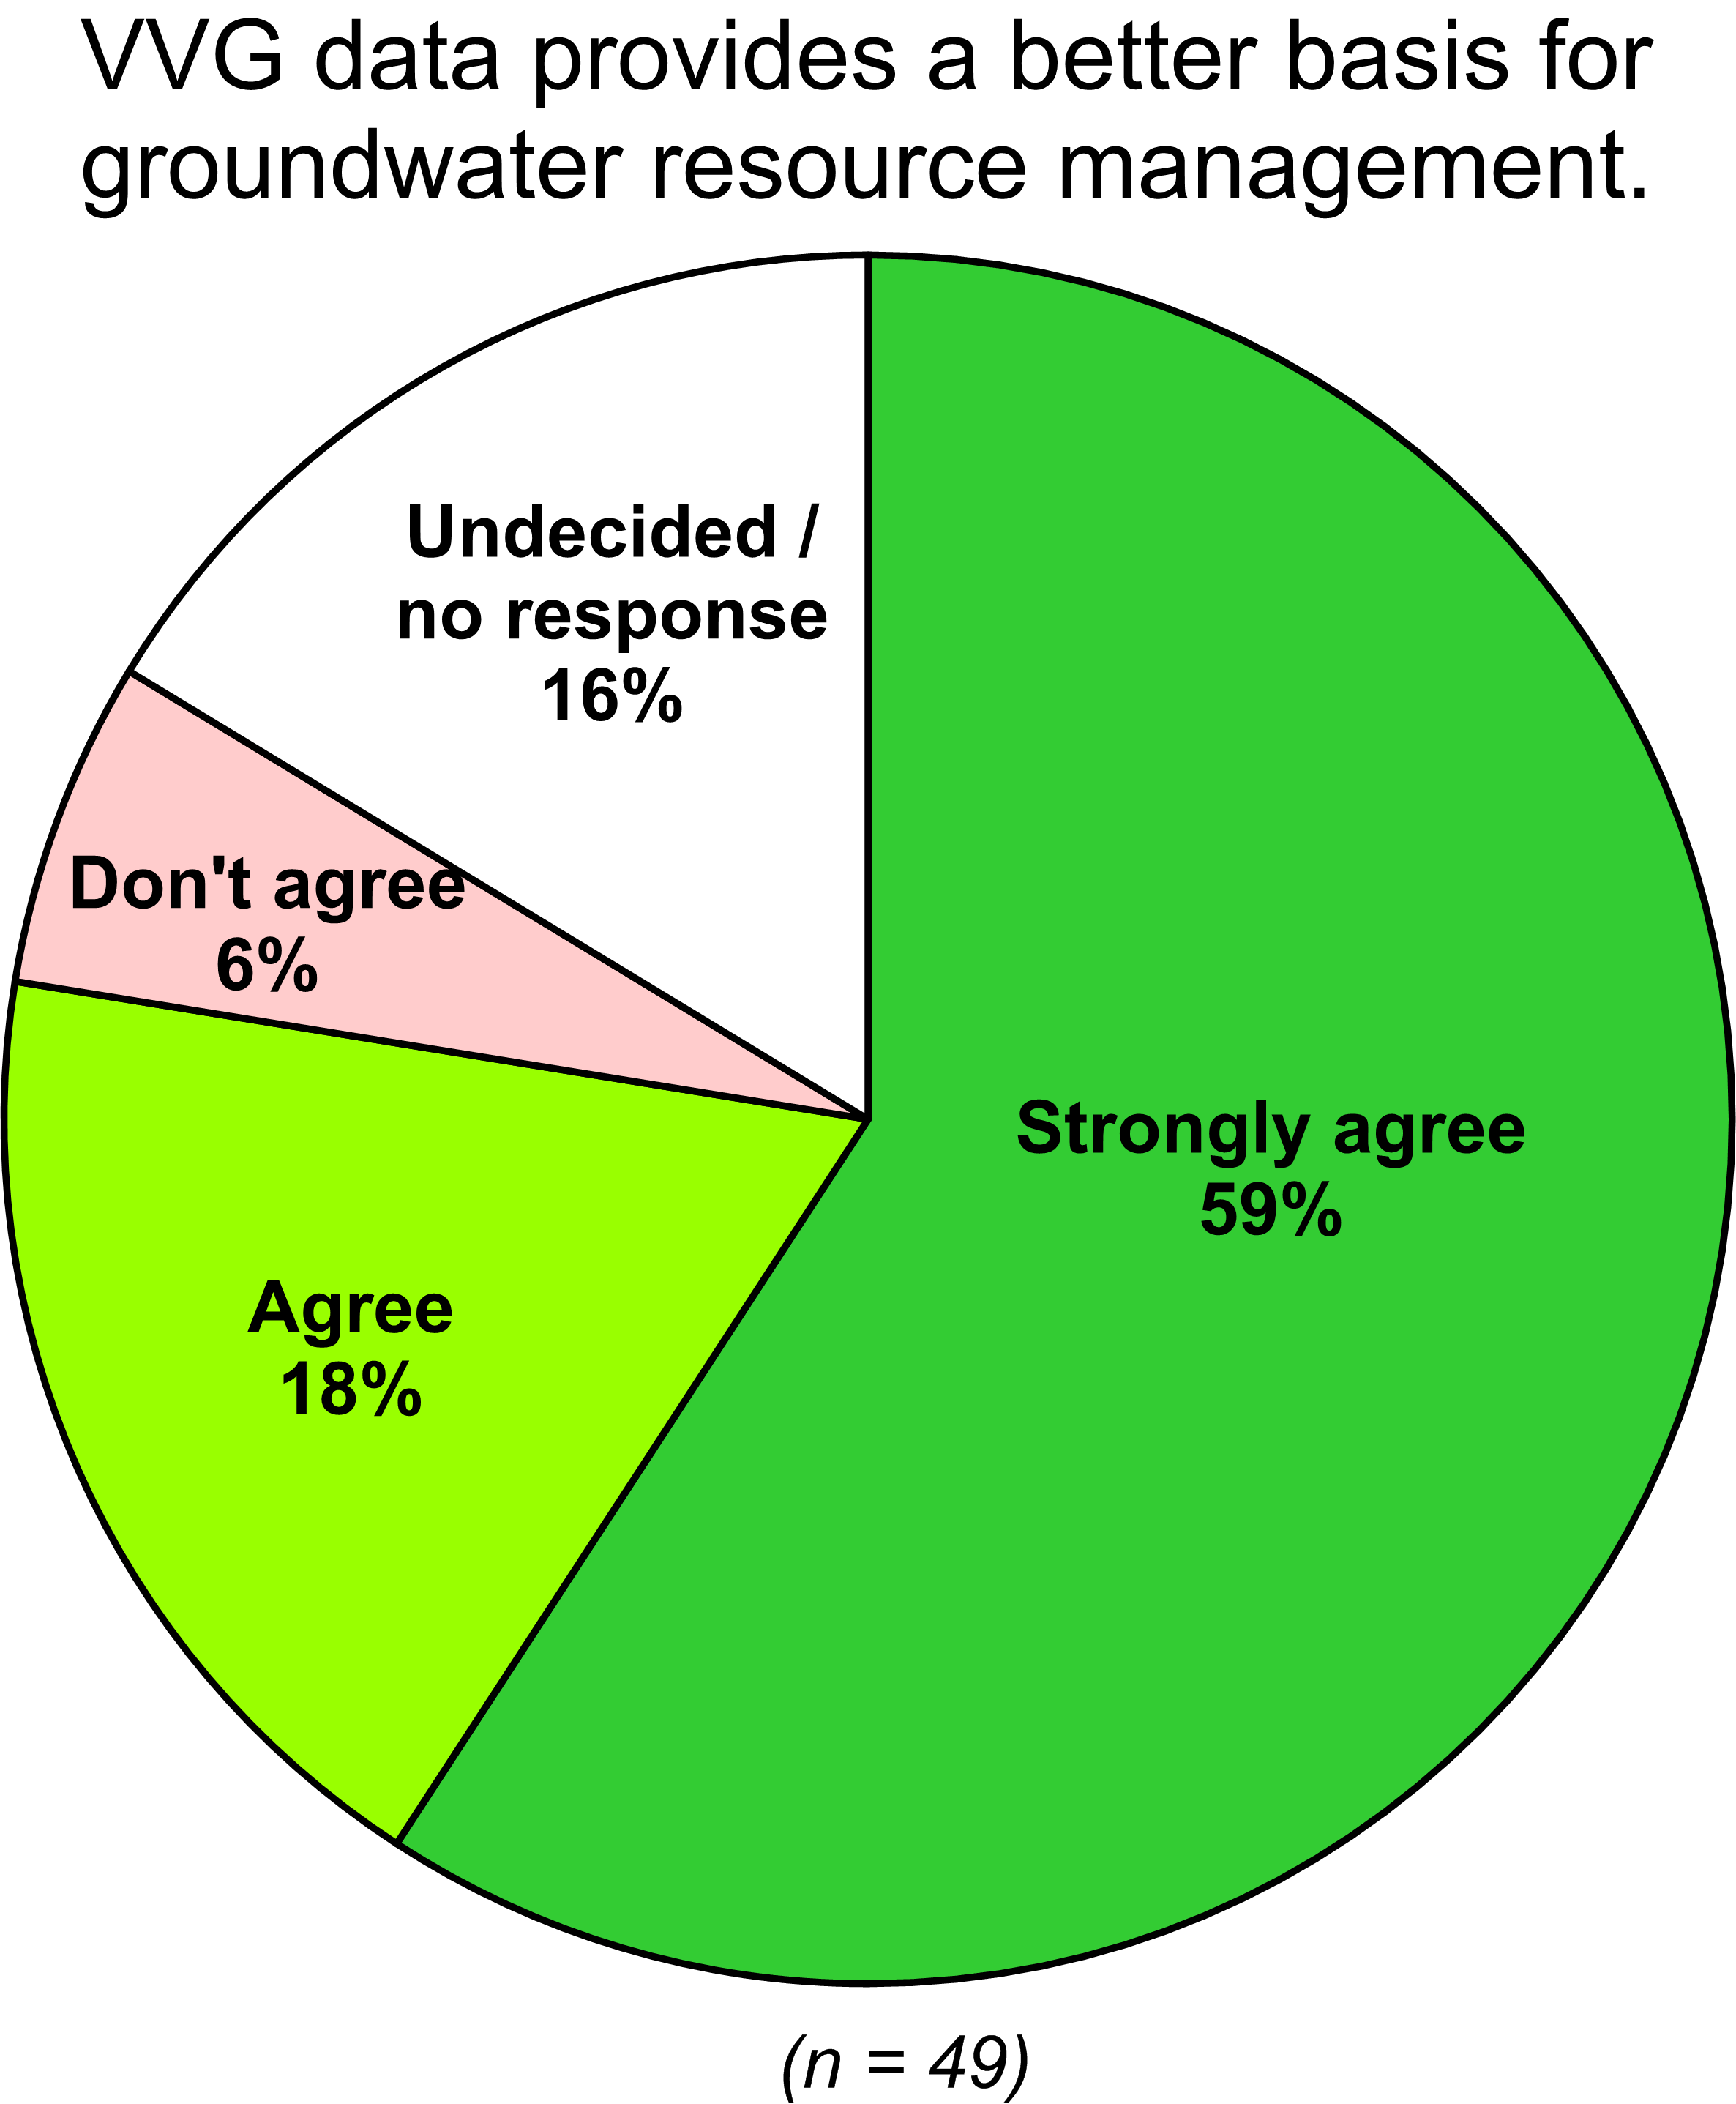
Practice impact
The portal has changed the way people find groundwater data

Slide 10
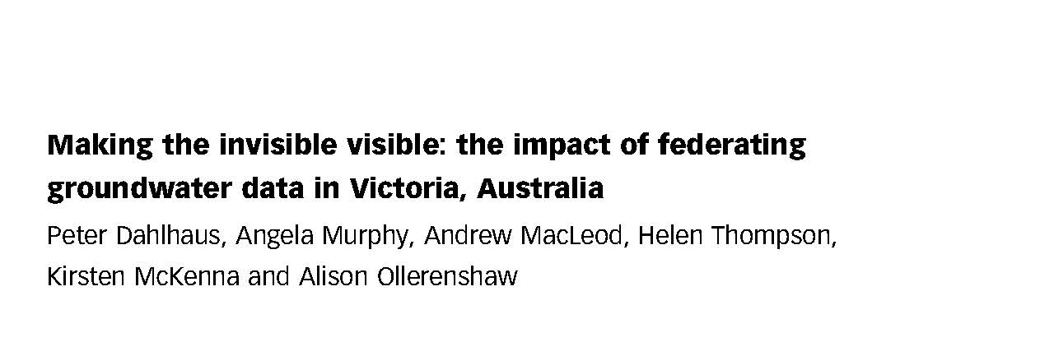
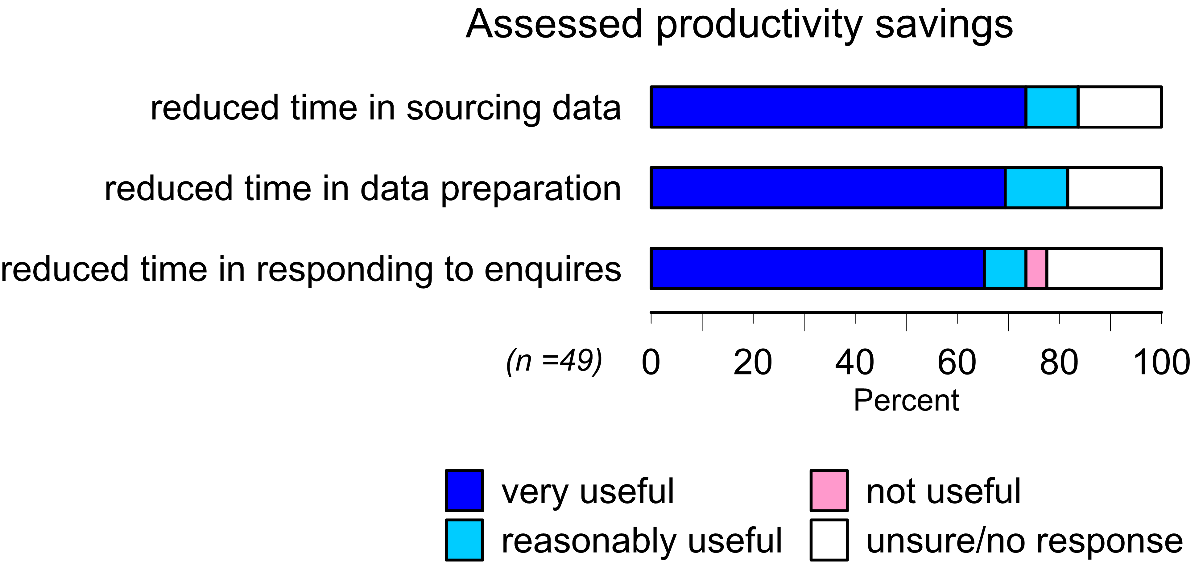
Sector impact
The provision of multiple groundwater datasets from disparate sources within a single internet portal has changed practices in the Victorian groundwater industry.
Journal of Hydroinformatics: 18/2 March 2016 (open access)

Slide 11
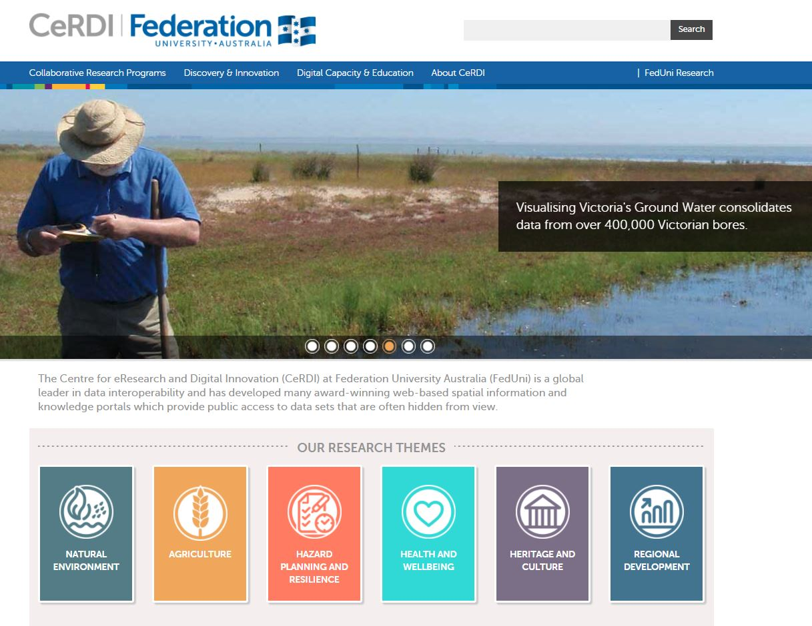
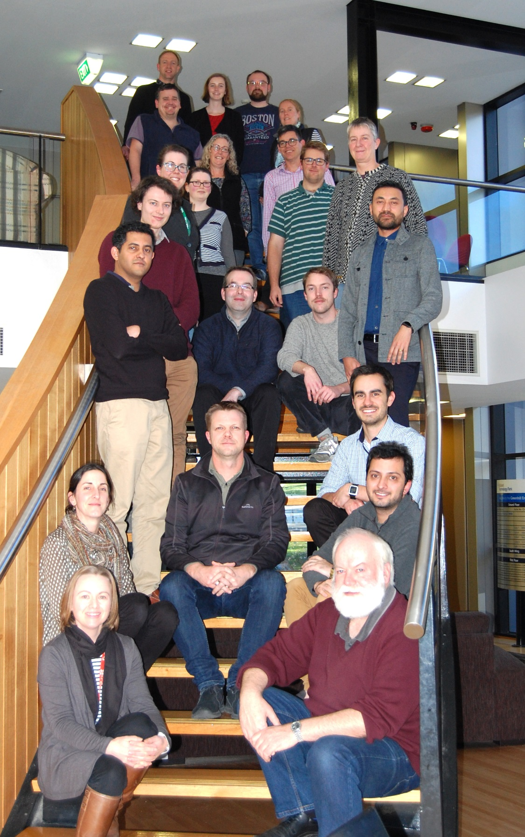
www.cerdi.edu.au
The VVG has spawned around 30 spatial data portals

Slide 13
Data interoperability
Full interoperability requires adopting common:
systems - communication protocols (e.g. for web services);
syntax - representation language (e.g. Extensible Markup Language (XML), JavaScript Object Notation (JSON) or others);
structure - data schema (e.g. GWML1);
semantics - content vocabulary (e.g. for water quality parameters); and
pragmatics - best practices in the collection and use of the data

Slide 14

Open Geospatial Consortium: an international consortium of companies, government agencies and universities that develops publically available international spatial data standards for data interoperability.
OGC^{(R)} standards are technical documents that detail interfaces or encodings used by software developers.
Groundwater Interoperability Experiment 2 (GW2IE)
http://external.opengis.org/twiki_public/HydrologyDWG/GroundwaterInteroperabilityExperiment2

Slide 15
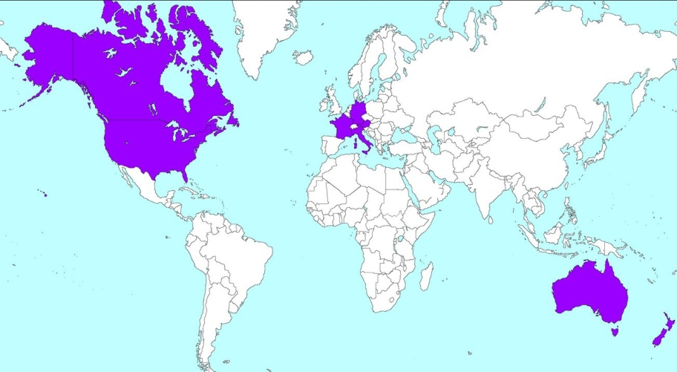
GWML2 interoperability experiment
Aims:
Develop an international groundwater information model
Develop a GML application schema, for groundwater data
Harmonize existing models (GWML, INSPIRE)
Regions:
North America
Europe
Australasia
5 years, 57 meetings

Slide 16
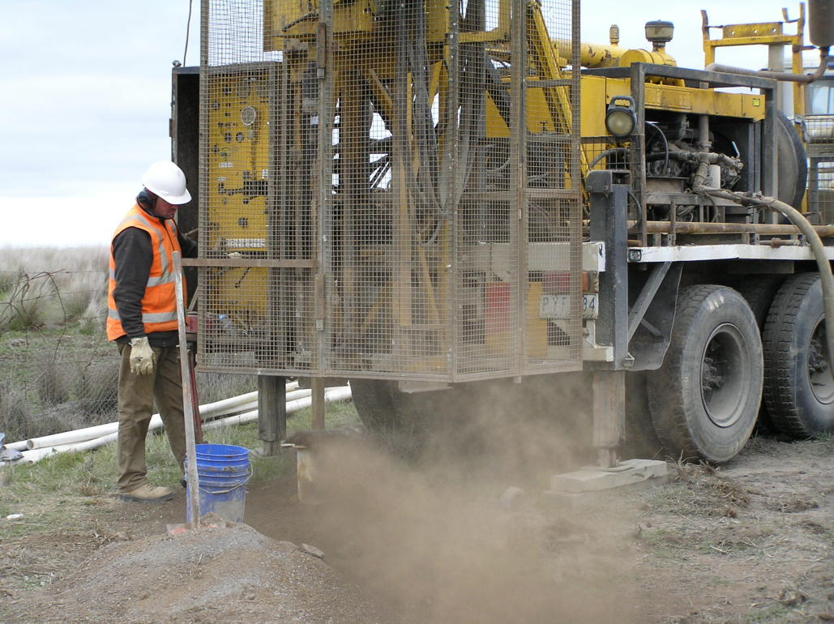
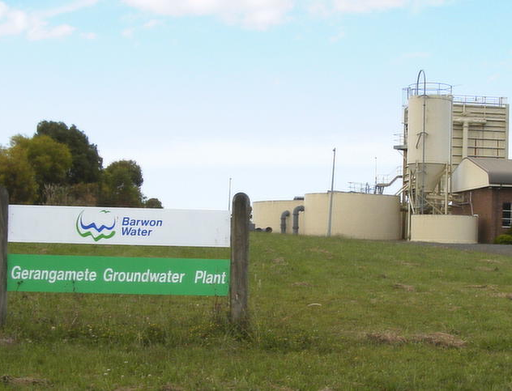
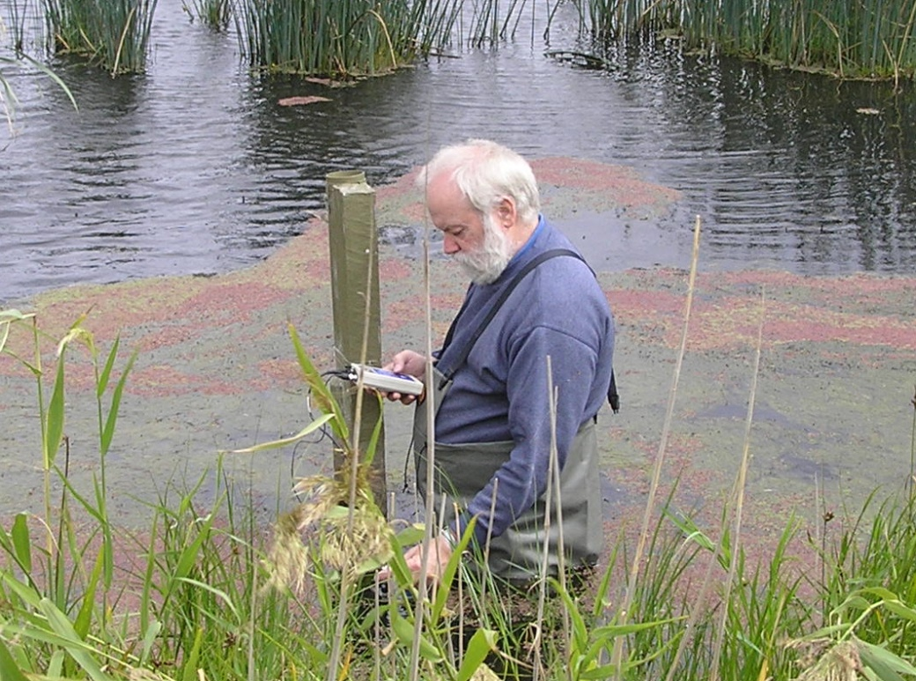
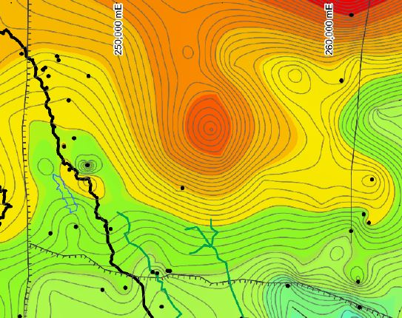
GWML2 interoperability experiment
Use Cases
Agreed entities
Conceptual Schema
Logical Schema
Physical Schema

Slide 17

Entities: HydrogeoUnits, Voids, Fluid Bodies
GW_Basin
GW_ManagementArea
GW_MonitoringSite
Wellfield
Groundwater basin
Observation
well
GW_AquiferSystem
Bedrock
aquifer
Unconfined aquifer
Aquifer
Well
GW_Aquifer
Confining bed
GW_Aquifer
GW_ConfiningBed
Fractured rock aquifer
Confined aquifer
GW_ConfiningBed
GW_Aquifer
Groundwater filling the pore space
Confining bed
GW_AquiferUnit
Particulate rock aquifer
GW_FluidBody
GW_HydrogeoVoid
Solutes, suspended solids, and organisms in groundwater
GW_ChemicalConstituent
GW_MaterialConstituent
GW_BiologicConstituent

Slide 18
Entities: Flow, Well
Pumping well
GW_Recharge
GW_Discharge
GW_Discharge
GW_Spring
Land
surface
GW_Divide
GW_BodySurface
GW_Well
Groundwater basin
Vadose zone
Unconfined
aquifer
Watertable
Confining bed
GW_ConfiningBed
flow
Ground
water
Confined aquifer
GW_Flow
Bedrock aquifer
GW_Aquifer
GW_IntraFlow
GW_InterFlow
GW_FlowSystem
GW_FlowSystem
GW_FlowSystem

Slide 19
simplified UML representation of the GWML2 conceptual schema. Colours denote distinct packages within the logical schema

Slide 20

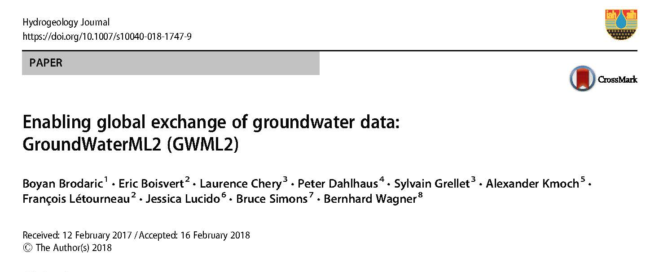
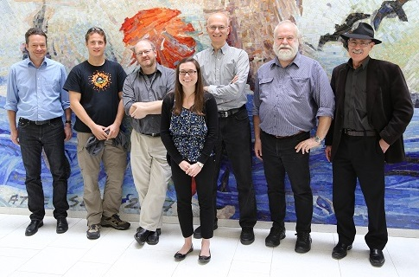
International data interoperability standards
OGC WaterML 2: Part 4 – GroundWaterML 2 (GWML2)
Is maintained by a Groundwater Standards Working Group
Google OGC GW SWG to find it!

Slide 21
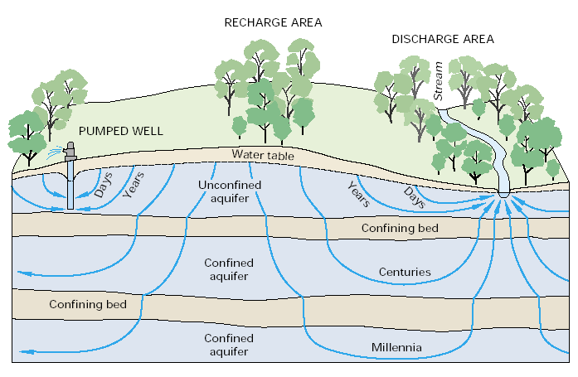
So what constitutes groundwater data?
Geomorphology
Terrain
Landscape
Climate
Rainfall
Runoff
Infiltration
Recharge
Environmental History
Land use
Soils
Salinity
Discharge
Springs
GDEs
Baseflow
River flows
Lake levels
Bore construction
Extraction
Water levels
Storage
Geology
Lithology
Stratigraphy
Hydrostratigraphy
Aquifers
Aquifer parameters
Hydrobiology
Phreatophytes
Stygofauna
Microbiology
Flow systems
Chemistry
Geophysics
Management
Beneficial uses
Licences
Age (dating)
Risk
Contamination

Slide 22
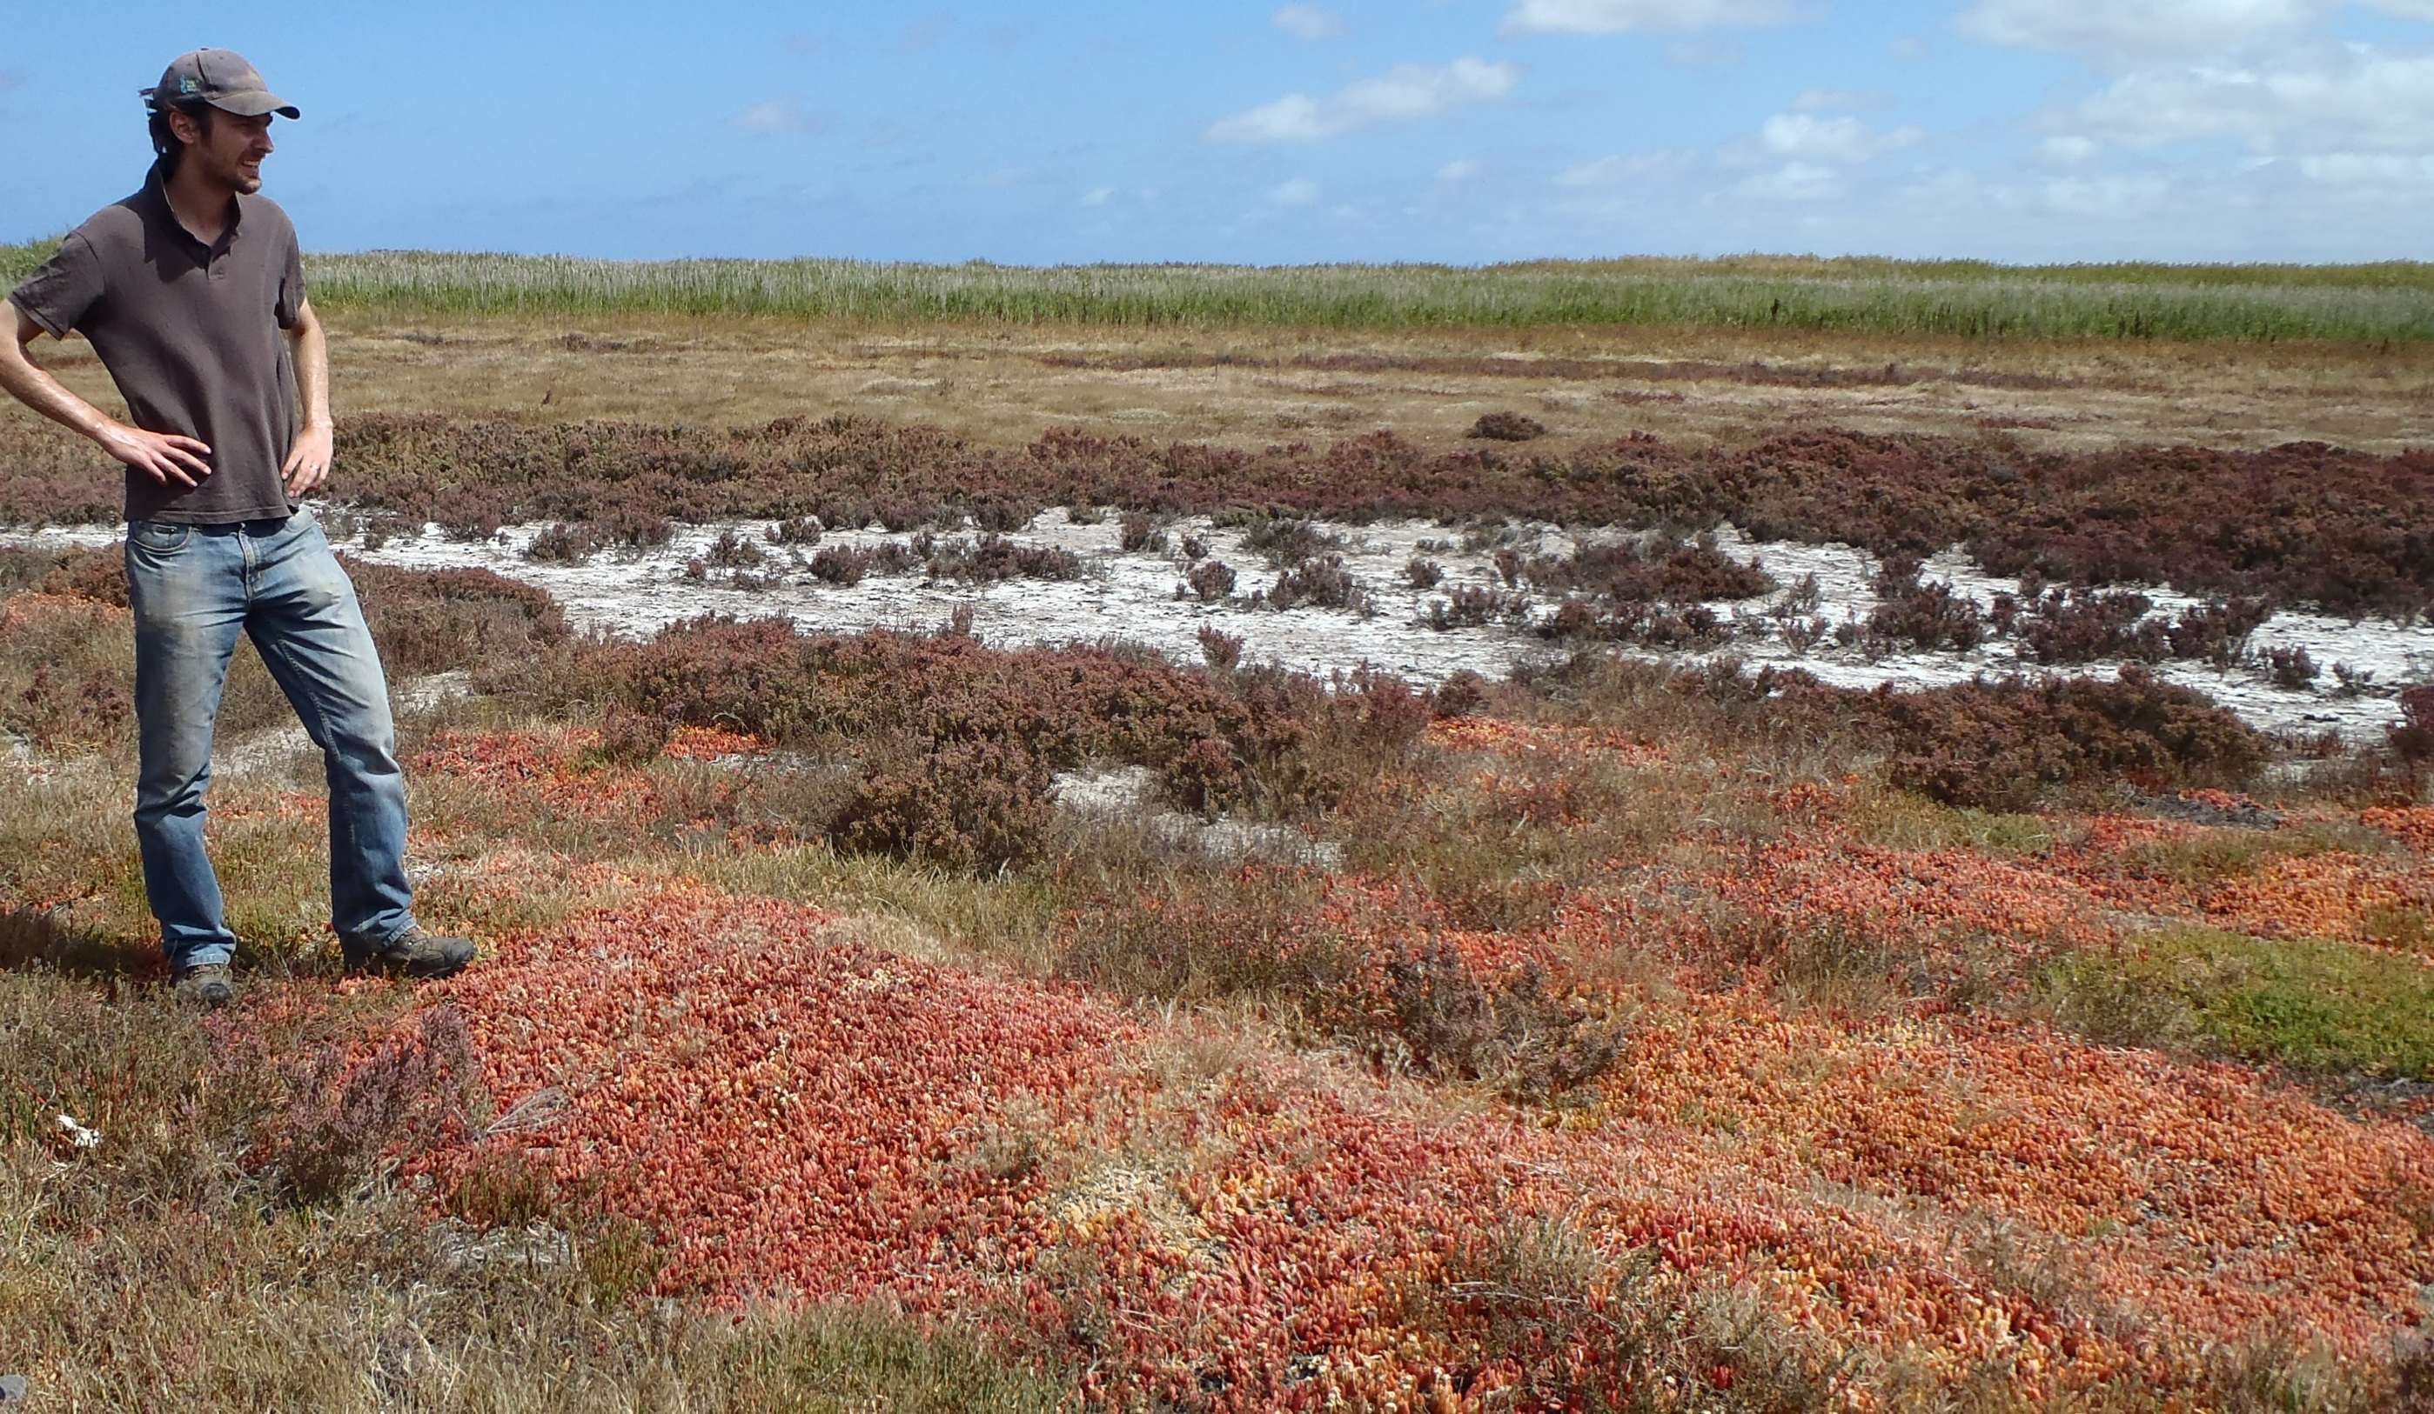
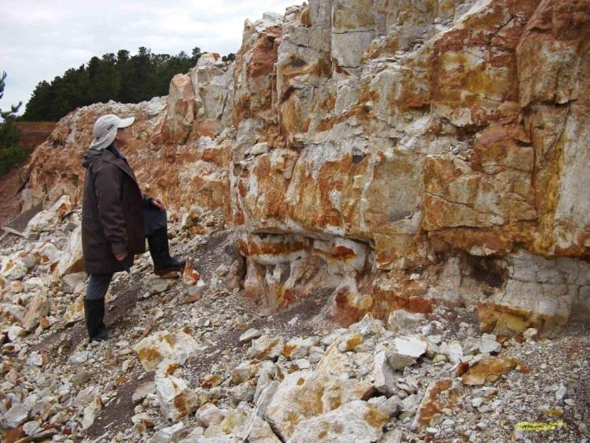
But what about the qualitative data?
Data often overlooked by scientists (hydrogeologists), but it can be critically important.
Examples include observations about landscape features, soil colours, vegetation types, seeps, springs, wetland ecosystems, and anecdotal information from long-term occupiers of the land.
Redoximorphic features in saprolite, Dundas Tableland, Vic

Slide 23
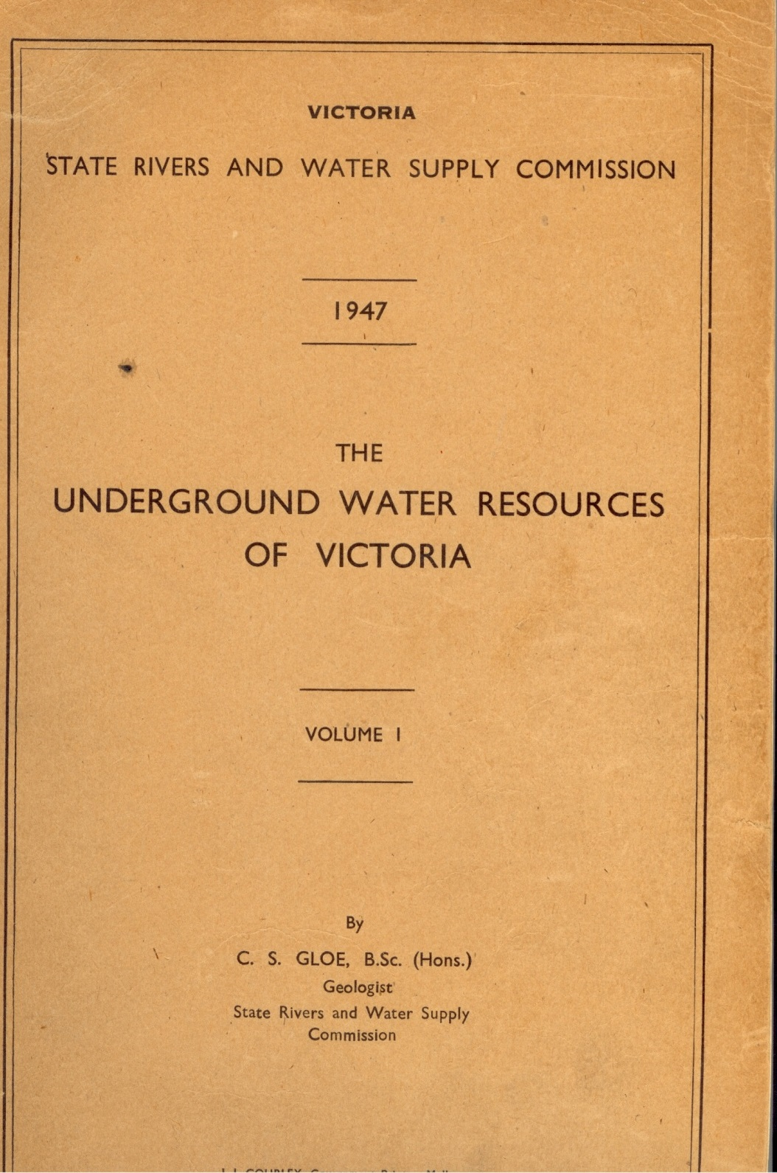
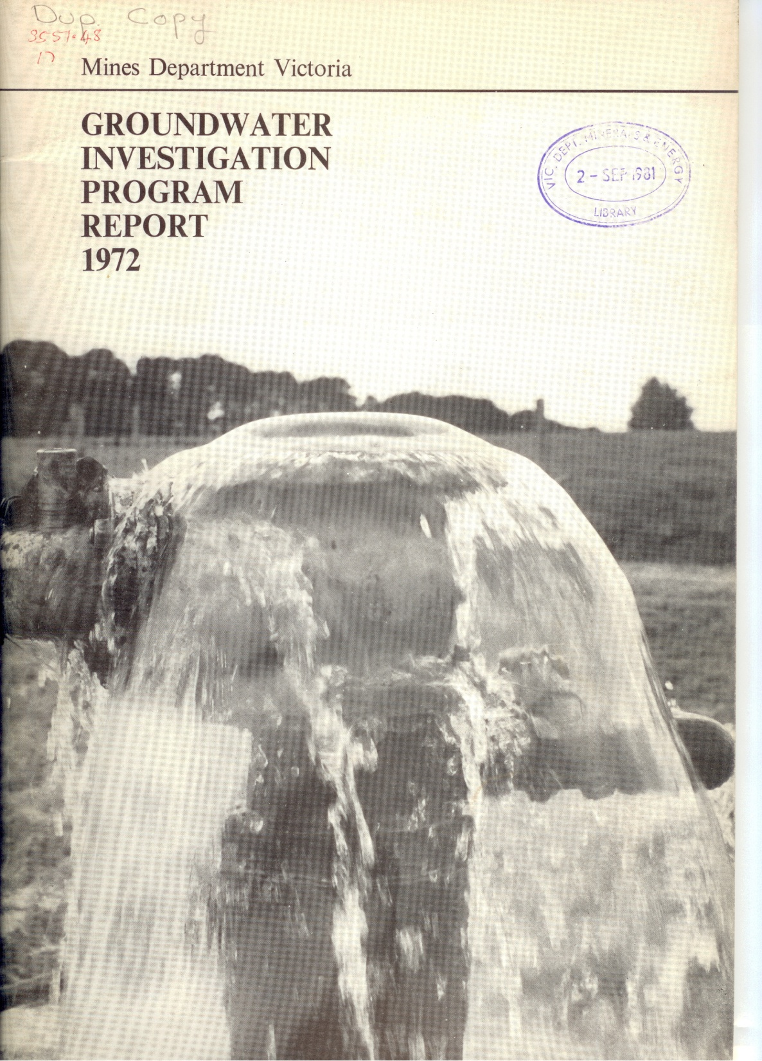
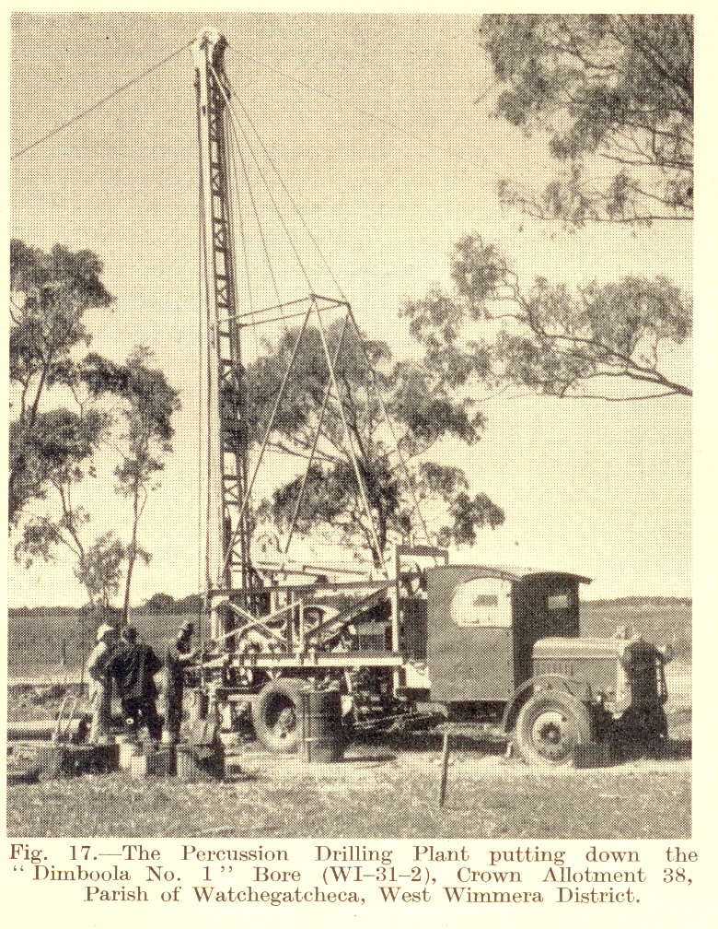
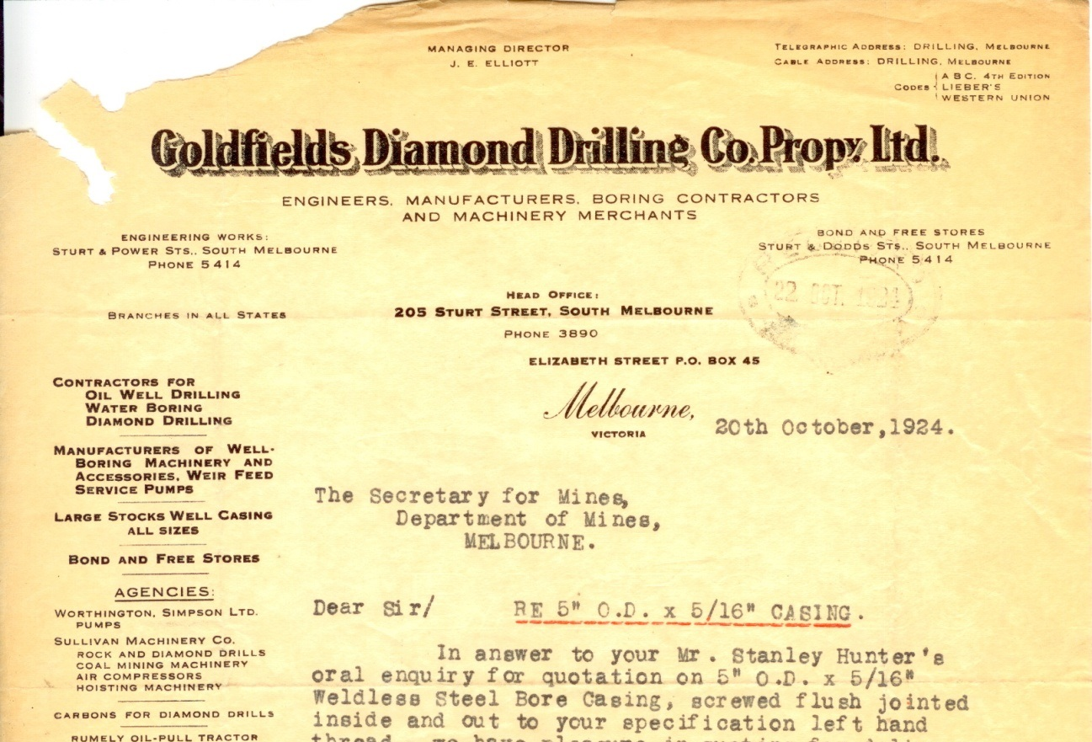
Original data sources are valuable
Archival boring records are particularly important sources of information.

Slide 24
Trends in data custodianship
Data volumes
Does not include social data
1970
1990
2010
2020

Slide 25
Data Regimes
Data Dictatorship: Data is controlled and its use restricted. Distribution of data is based on perceived necessity.
Data Aristocracy: Data analysts and scientists are required to provide meaning, and they have the power.
Data Anarchy: Users feel underserved and create their own datasets from available sources. Data sharing is ad-hoc.
Data Democracy: Everybody gets timey and equitable access to data. Users are empowered and they often own some of the data.

Slide 26
Antle, J.M., Basso, B., Conant, R.T., Godfray, H.C.J., Jones, J.W., Herrero, M., Howitt, R.E., Keating, B.A., Munoz-Carpena, R., Rosenzweig, C., Tittonell, P. and Wheeler, T.R. (2017). Towards a new generation of agricultural system data, models and knowledge products: Design and improvement. Agricultural Systems. DOI:http://dx.doi.org/10.1016/j.agsy.2016.10.002.

Slide 27
Data Democracy can interoperably federate:
Public and private data
Big data, sensors, internet of things
Legacy data
Crowdsourced data
To answer the frequently asked hydrogeological questions
To dynamically generate conceptual and predictive models
To make new discoveries and avoid repeating past mistakes
To reduce time wasted in litigious conflicts

Slide 28
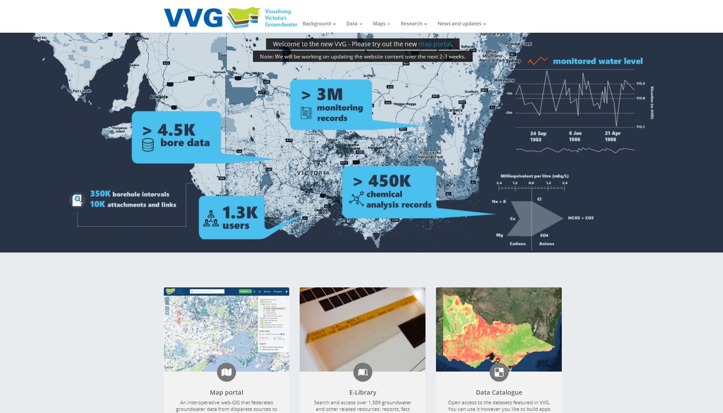
beta.vvg.org.au

