Slide 1
Summary of models

Slide 2
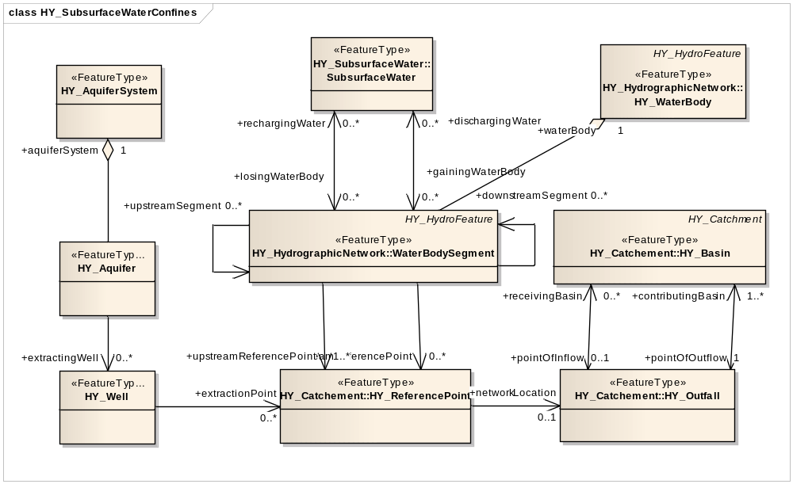
Common hydrologic model (WMO)
Notes:
The common model has very little when it comes to GW. Subsurface water

Slide 3
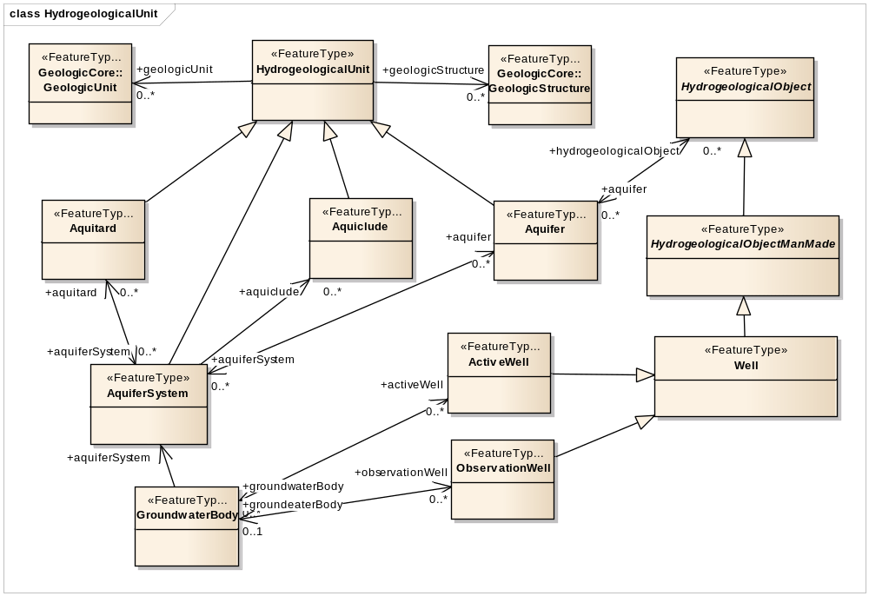
INSPIRE (core)

Slide 4
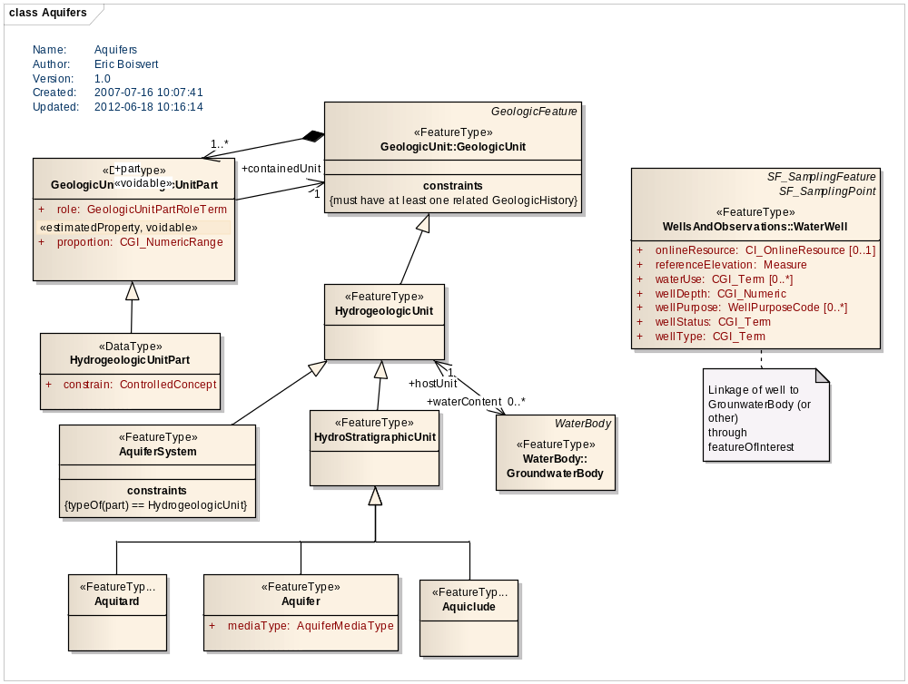
GWML

Slide 5
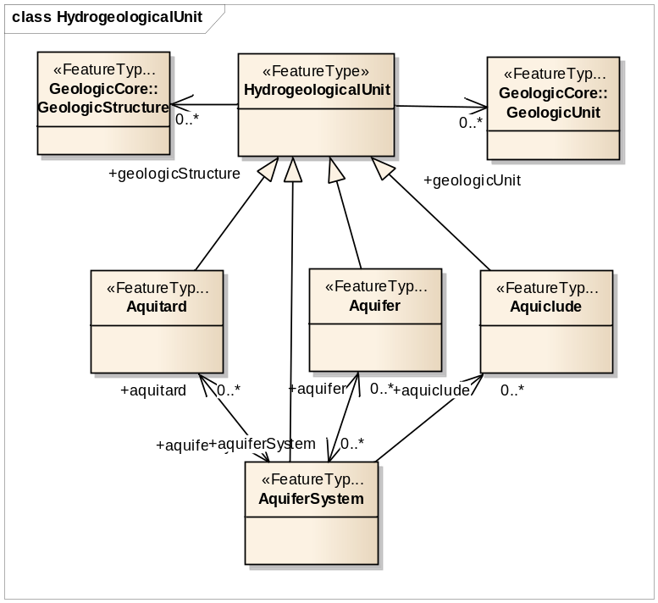
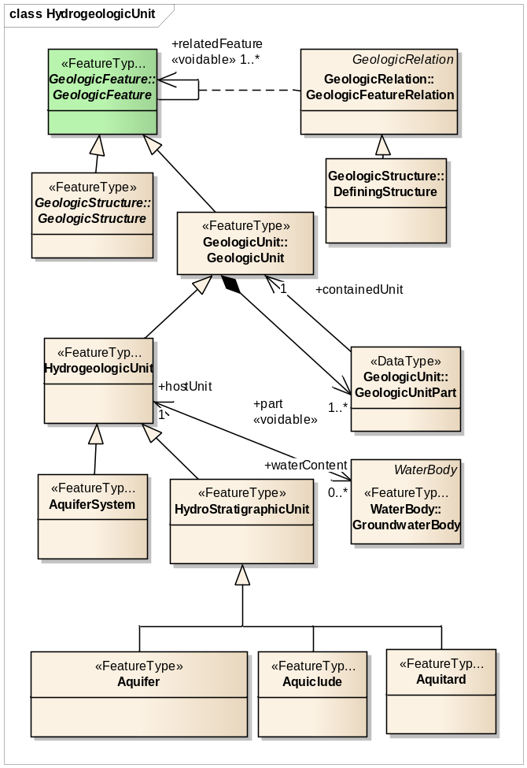
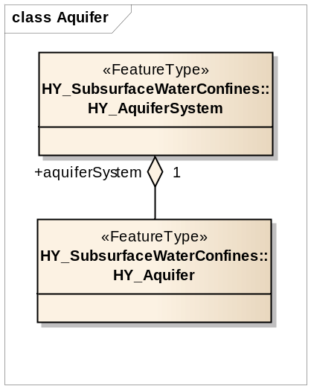
Aquifers
INSPIRE
GWML
CHyM

Slide 6
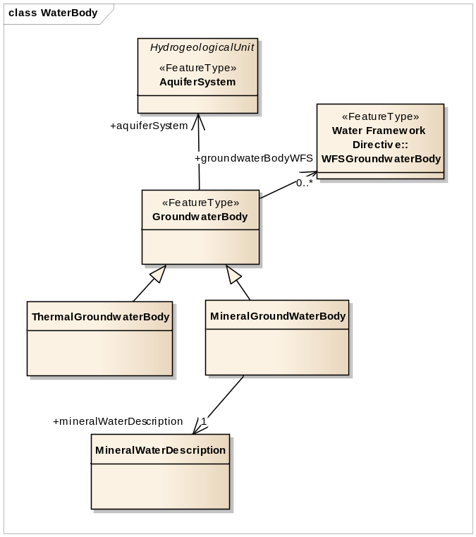
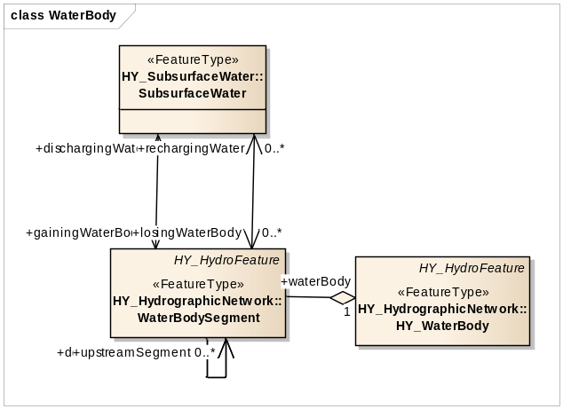
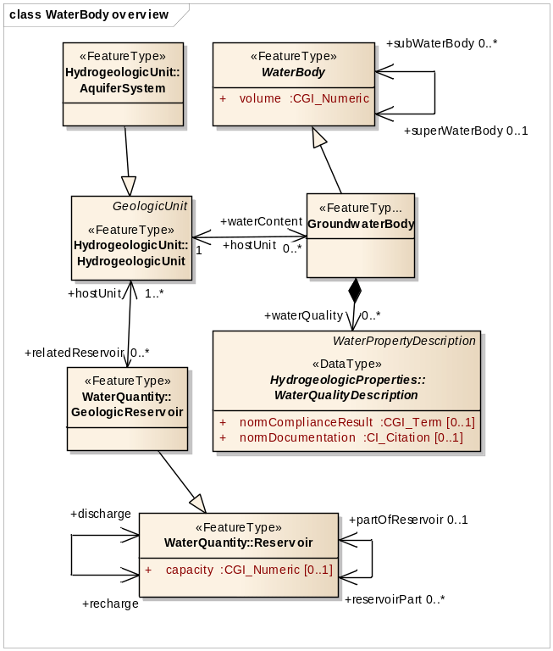
Groundwater (Waterbody)
No reservoir
No linkage between subsurface water and aquifer
GWML
?
INSPIRE
INSPIRE
INSPIRE
CHyM
CHyM

Slide 7
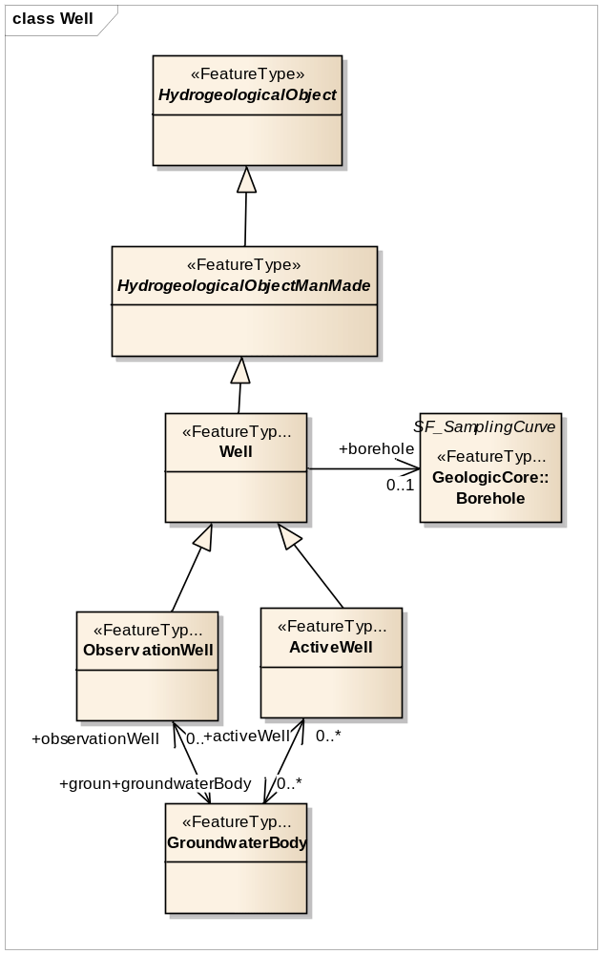
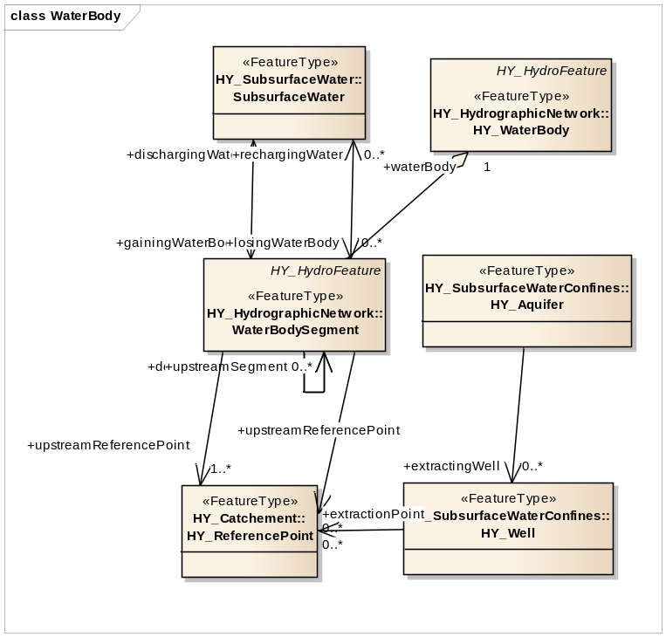
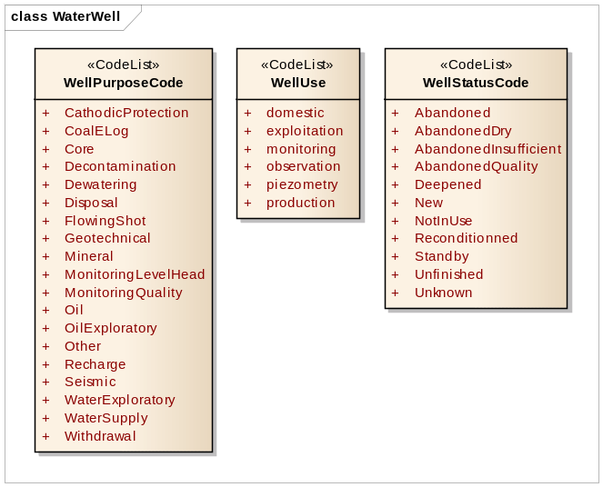
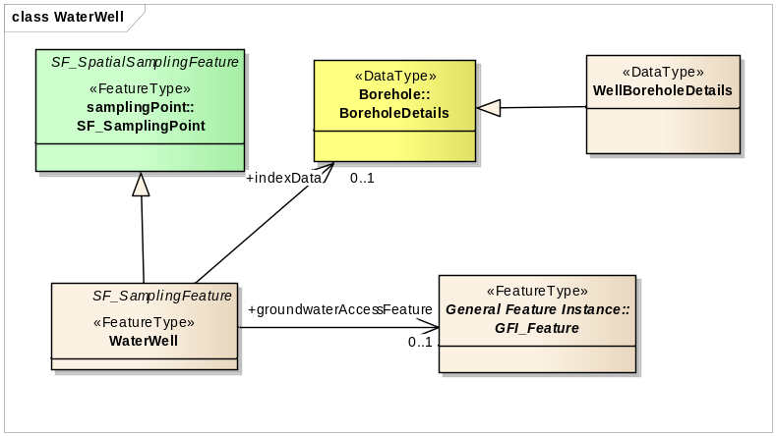
Wells
INSPIRE
CHyM
Refer to GWBody using well’s « sampledFeature »
Notes:
Amazingly enough, we don’t have a well status that just says « active »

Slide 8
Notes
INSPIRE
  Several rock properties that would normally be in the extended Geology model (not core)
  Reuses, but does not extend
WMO
  Too high level
  Unclear what « SubsurfaceWater » represents

