Slide 1
Project Overview WatERP
91st OGC Technical Committee
Geneva, Suisse
Dr Andreas Abecker, Disy Informationssysteme GmbH
Wednesday, 11 June 2014

Slide 2

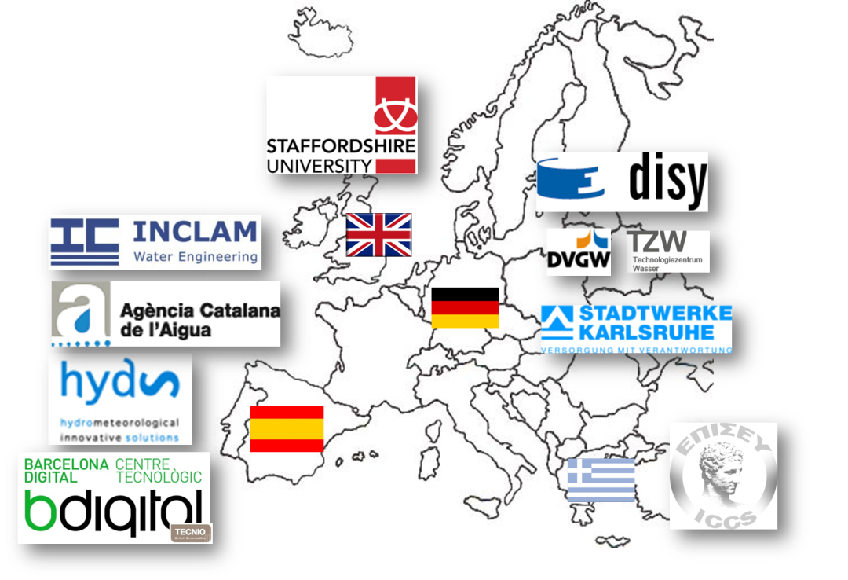
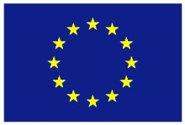

Project Fact Sheet

Slide 3
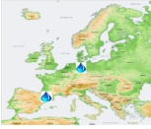
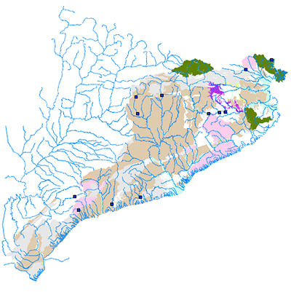
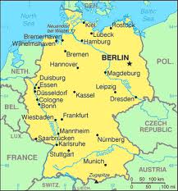
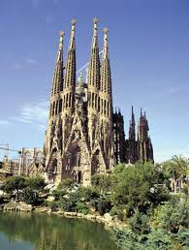
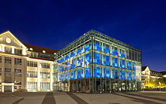


Two Complementary Use Cases
Ter-Llobregat
(Spain, Barcelona Area)
City of Karlsruhe
(Germany, Baden-Württemberg)
Water allocation
Focused on upper part of distribution chain
Irregular water supplies
Frequent water scarcity
Need to allocate water in function of availability and usage priorities
Energy efficiency
Focused on final water distribution system
Decreasing demand
Sufficient supply
Desire to reduce energy consumption

Slide 4
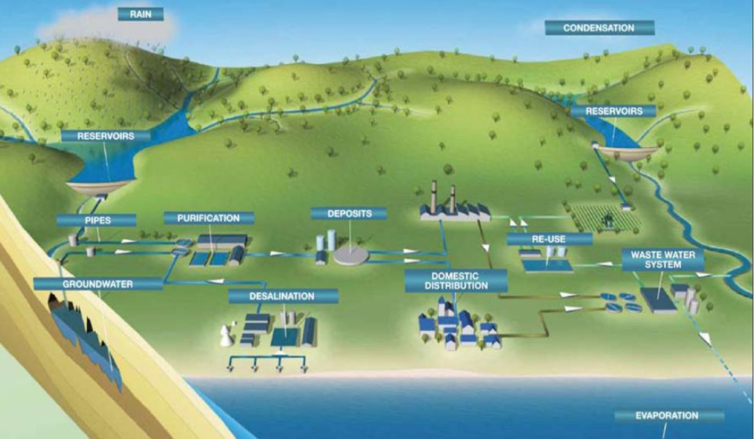
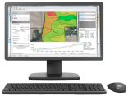
WatERP Goal: Enable Data Exchange Between Stakeholders

Slide 5
WatERP Software Framework

Slide 6
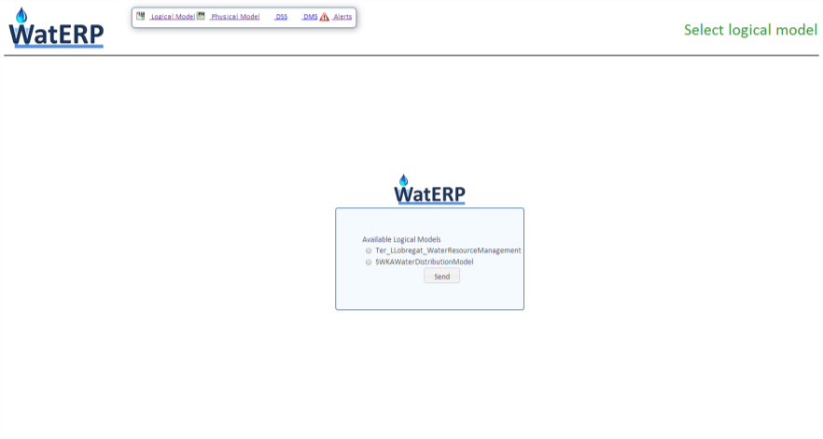
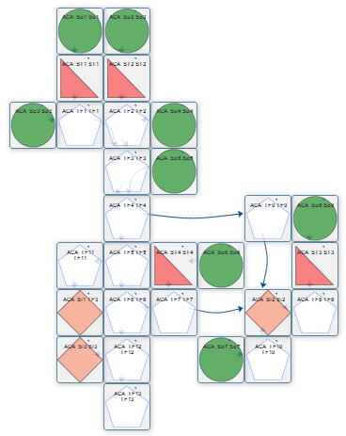
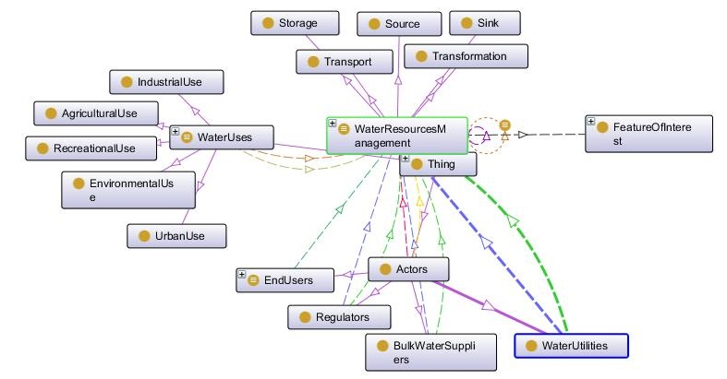
The WatERP Ontology Supports Intelligent System Services
Ter_Llobregat_WaterResourceManagement Logical Model

Slide 7
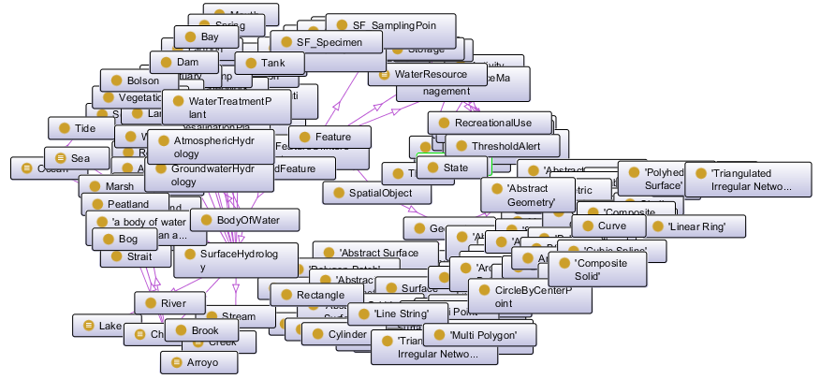




The WatERP Ontology is Based on Existing Models
SSN ontology
WatERP ontology
WaterML
HY_Features
Geo OWL
Notes:
Represent the human interaction and decisions in the water supply distribution chain
Aligned with external ontologies (CUAHSI, SWEET, W3C-SSN ontology, WaterML, HY_FEATURES, Geo OWL (GML))

Slide 8
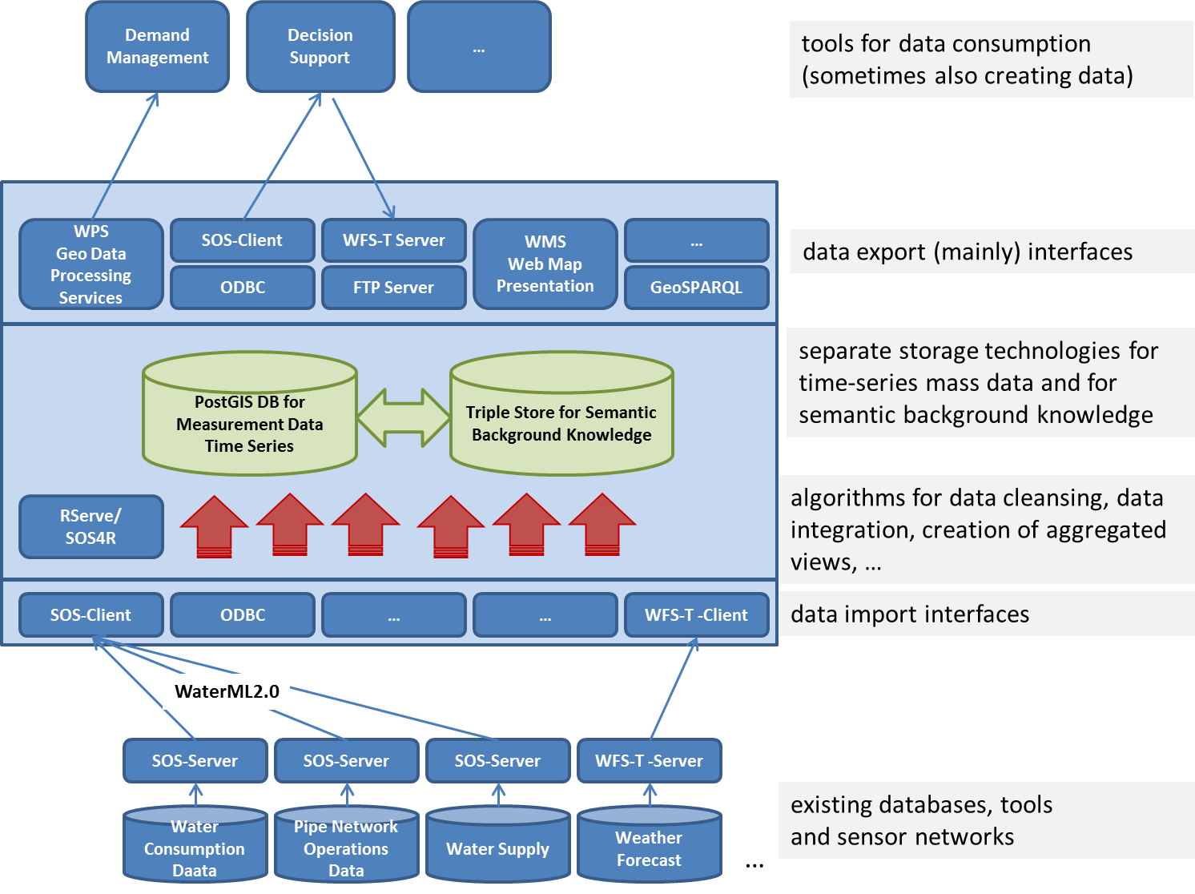
Simplified Architecture of Water Data Warehouse

Slide 9
WatERP Work Potentially Relevant for HDWG
Comprehensive ontological model of water supply chain
Hydrological and hydrometeorological aspects
Technosphere (pipeline network, …) and operation data
Human planning and interventions
Combination of semantic technologies and object-relational geo databases
Mass-data experiments about expressiveness, stability and performance of WaterML2.0 infrastructure in the two pilot environments

Slide 10
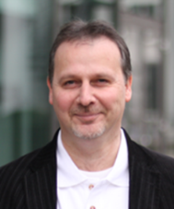

Thanks for Your Interest!
Project contact:
Gabriel Anzaldi Barcelona Digital Scientific Project Coordinator ganzaldi@bdigital.org
http://waterp-fp7.eu/
Dr. Andreas Abecker
Dipl.-Inform.
Head of Innovation Management
disy Informationssysteme GmbH
Ludwig-Erhard-Allee 6
76131 Karlsruhe, Germany
www.disy.net
Tel. +49 721 16006-256
Fax +49 721 16006-05
andreas.abecker@disy.net

