Slide 1
SOS 2.0 Profile For Hydrology
91st OGC Technical Committee
Geneva, Switzerland
Simon Jirka (52°North)
11 June 2014
Copyright © 2014 Open Geospatial Consortium

Slide 2
Background and Objectives
Need for technically and semantically interoperable web services for hydrological data
Create a fully interoperable SOS 2.0 profile for hydrological data
Rely on WaterML 2.0 as the model/encoding for time series data
Developed within the GEOWOW project
GEOWOW is a project co-funded under the European Community's Seventh Framework Programme
Support and input by the Hydrology Domain Working Group
Copyright © 2014 Open Geospatial Consortium

Slide 3
Profile Structure
‚Terms and Definitions‘ covers all entity related topics
‚Requests and Responses‘ covers all topics related to querying and retrieving data with the available requests
‚Technical Issues‘ covers purely technical topics like what to respond if e.g. a client requests half the database content
Where possible, definitions are expressed through e.g. extensions or schemas
Copyright © 2014 Open Geospatial Consortium

Slide 4
Profile Summary
Defines usage and encoding of entities like FeatureOfInterest, ObservedProperty and Procedure
Defines identification and labeling of entities
Defines a common discovery process from sampling features down to the time series data level
Prevents unintended and intended bulk data requests that normally are possible through SOS 2.0 specification
Additional GetDataAvailability operation
Copyright © 2014 Open Geospatial Consortium

Slide 5
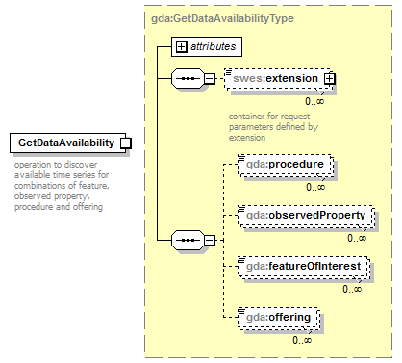
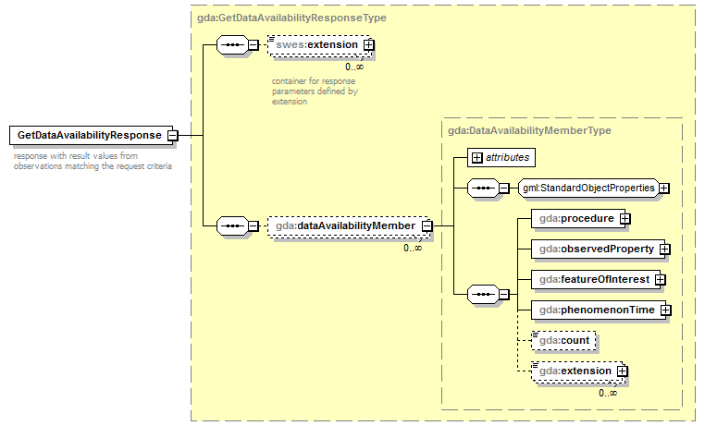
Progress since last TC Meeting
Included implementation section
GetDataAvailability Operation
  XSD Schemas are now available
Copyright © 2014 Open Geospatial Consortium

Slide 6
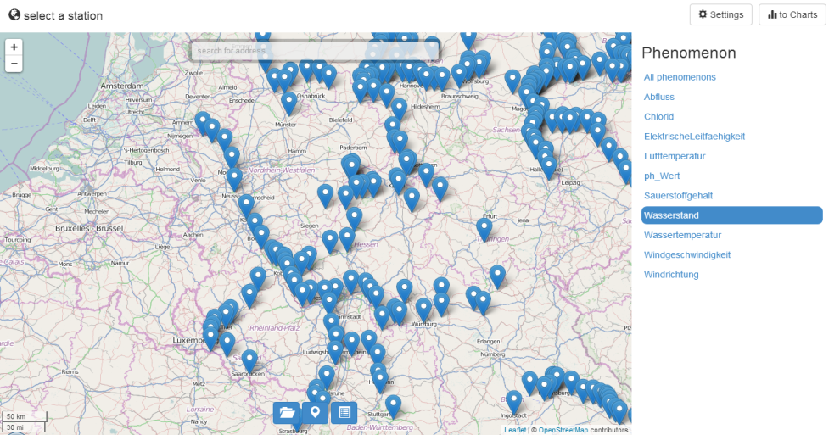
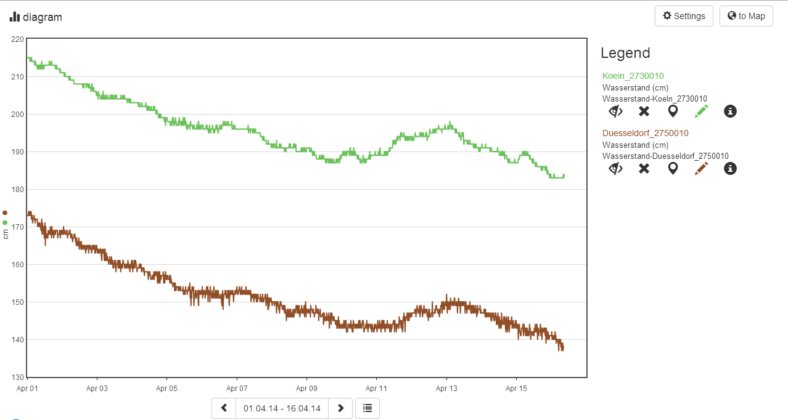
Implementation
52°North
  Server: 52°North SOS Server 4.0
  Clients:
    North Sensor Web Client API
    52°North JavaScript SOS Client
    52°North Thin SOS Client (Google Web Toolkit)
Copyright © 2014 Open Geospatial Consortium

Slide 7
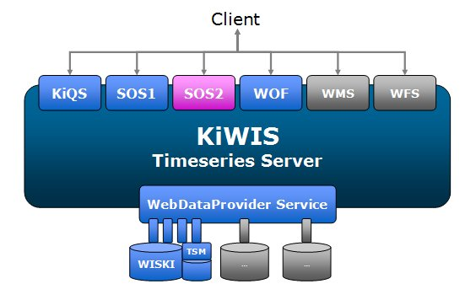
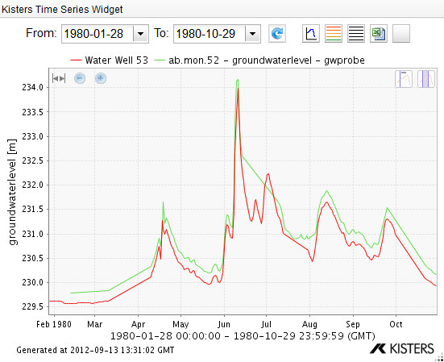
Implementation
KISTERS
  Server: KISTERS KiWIS SOS2
  Clients:
    KISTERS WISKI Client with The DataServiceConsumer
    KISTERS Timeseries Widget
Copyright © 2014 Open Geospatial Consortium

Slide 8
Remaining Work
Possibly submit a change request to a relevant SWG: Include human readable names (labels) in capabilities documents (e.g. for observed properties)
Publication as Best Practice Paper
Contribute to standardization of the GetDataAvailability operation
Further improvements and formal specification to advance the profile to an OGC standard
→ Discuss and resolve comments received for this version of the document
GEOWOW will end in August 2014
Copyright © 2014 Open Geospatial Consortium

Slide 9
Motion
The Hydrology DWG recommends that the OGC Technical Committee approve release of 14-004r1 “Sensor Observation Service 2.0 Hydrology Profile” as an OGC Best Practice Document
  Pending any final edits and review by OGC staff
  Motion: Simon Jirka (52°North)
  Second: David Arctur
  There was no objection to unanimous consent
https://portal.opengeospatial.org/files/?artifact_id=58916&version=1
Copyright © 2014 Open Geospatial Consortium

Slide 10
Thank you for your attention!
Any questions?
Copyright © 2014 Open Geospatial Consortium

