Slide 1
Improving access to groundwater data using GroundWaterML2
Bruce Simons, CSIRO Land and Water
Eloise Nation, Bureau of Meteorology
Peter Dahlhaus, Federation University Australia

Slide 2
Outline
The groundwater data exchange problem
GroundwaterML: a common data structure for data exchange
Open Geospatial Consortium groundwater interoperability experiment

Slide 3
Why data standards?
“Effective management of environmental resources requires the collection, management and delivery of related data”
Impeded by:
Availability – collected data are not all readily available and accessible
Distribution – available data is distributed across many agencies
Fragmentation – thematically fragmented
Heterogeneity – similar types of data are diversely structured

Slide 4




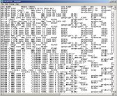


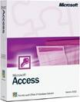



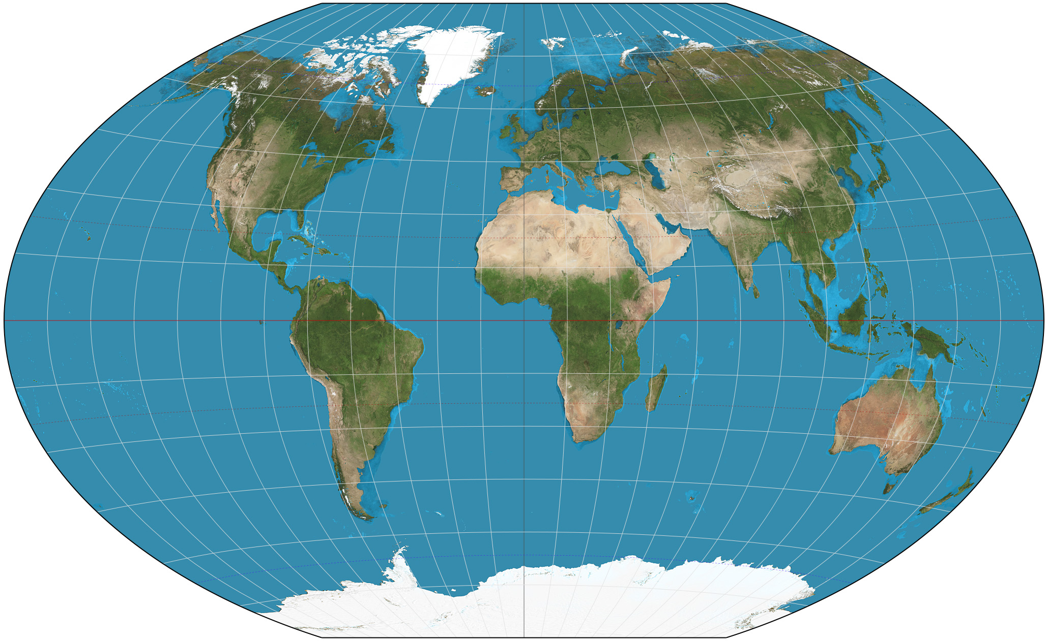
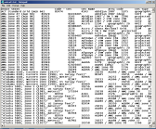
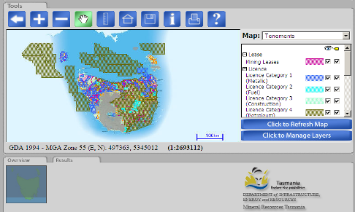
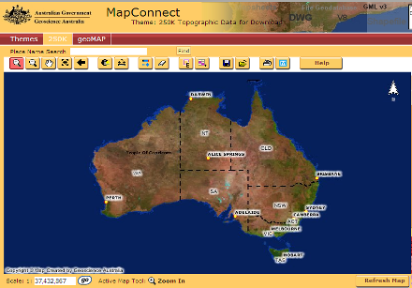
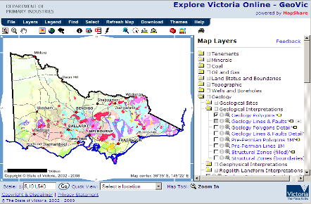
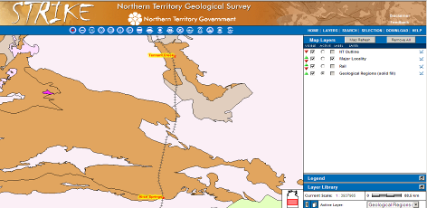
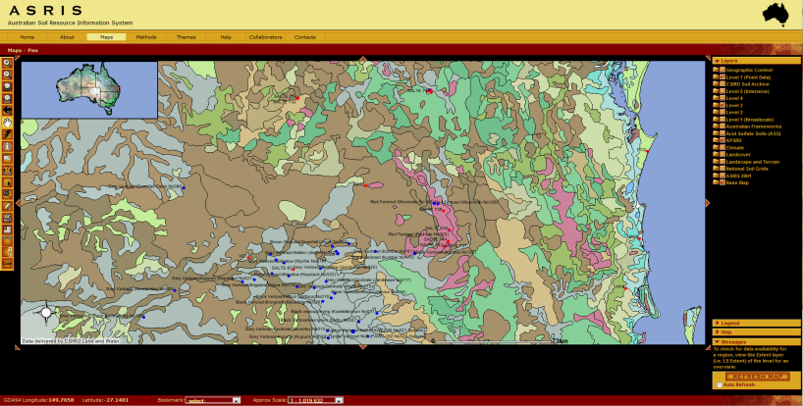
Proprietary Software
Versions of Software
Data Structures
Client
GWML2
Web Interfaces
Notes:
Consider the case of trying to combine information collected by multiple independent organisations…
Pre-competitive geoscience datasets held at state and territory geological surveys.
A substantial knowledge base for decision makers in both Government and Industry and useful for ongoing geoscientific research
Now – Different formats and standards – and it must be so

Slide 5
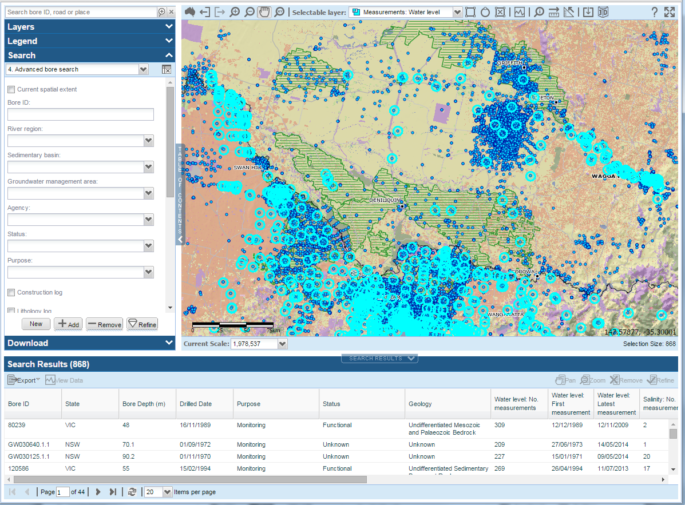
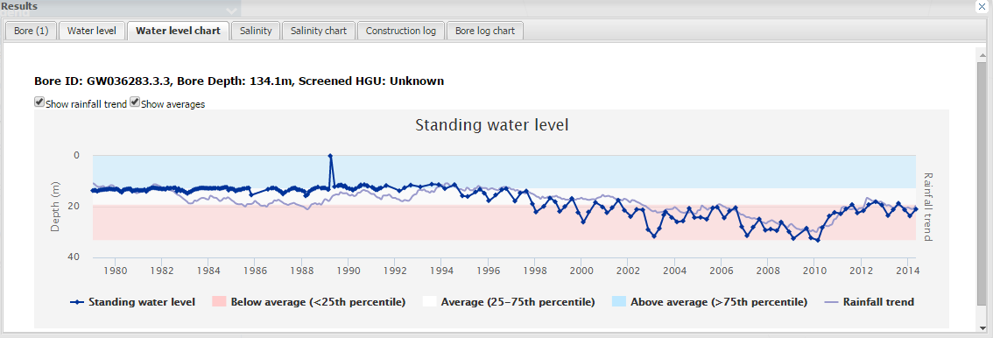
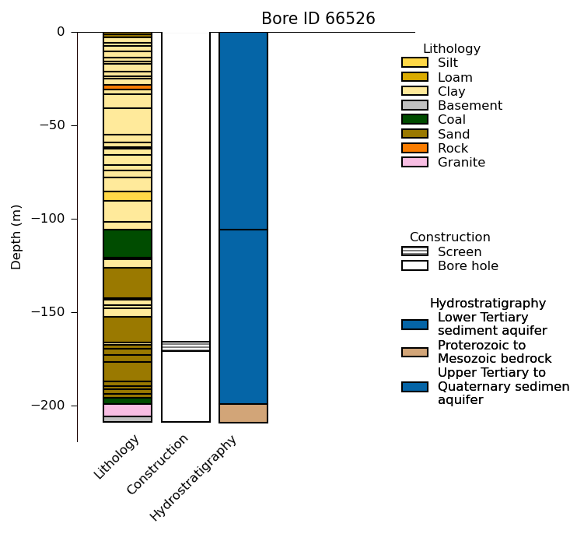
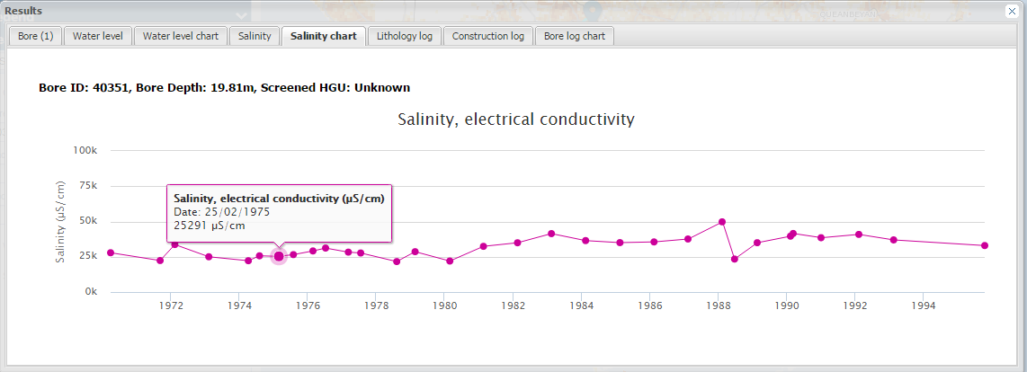
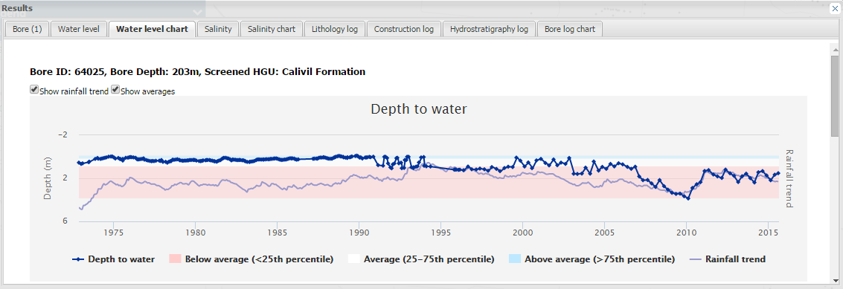
Australian Groundwater Explorer
Bureau of Meteorology groundwater portal
Australian Groundwater Explorer allows data export – but what format should it support?

Slide 6
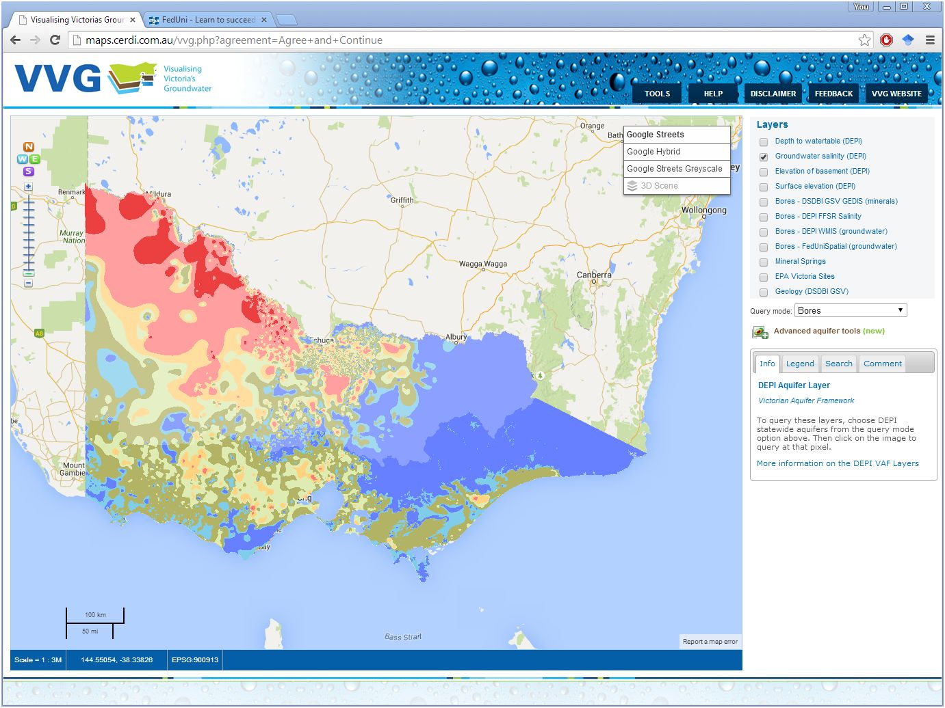
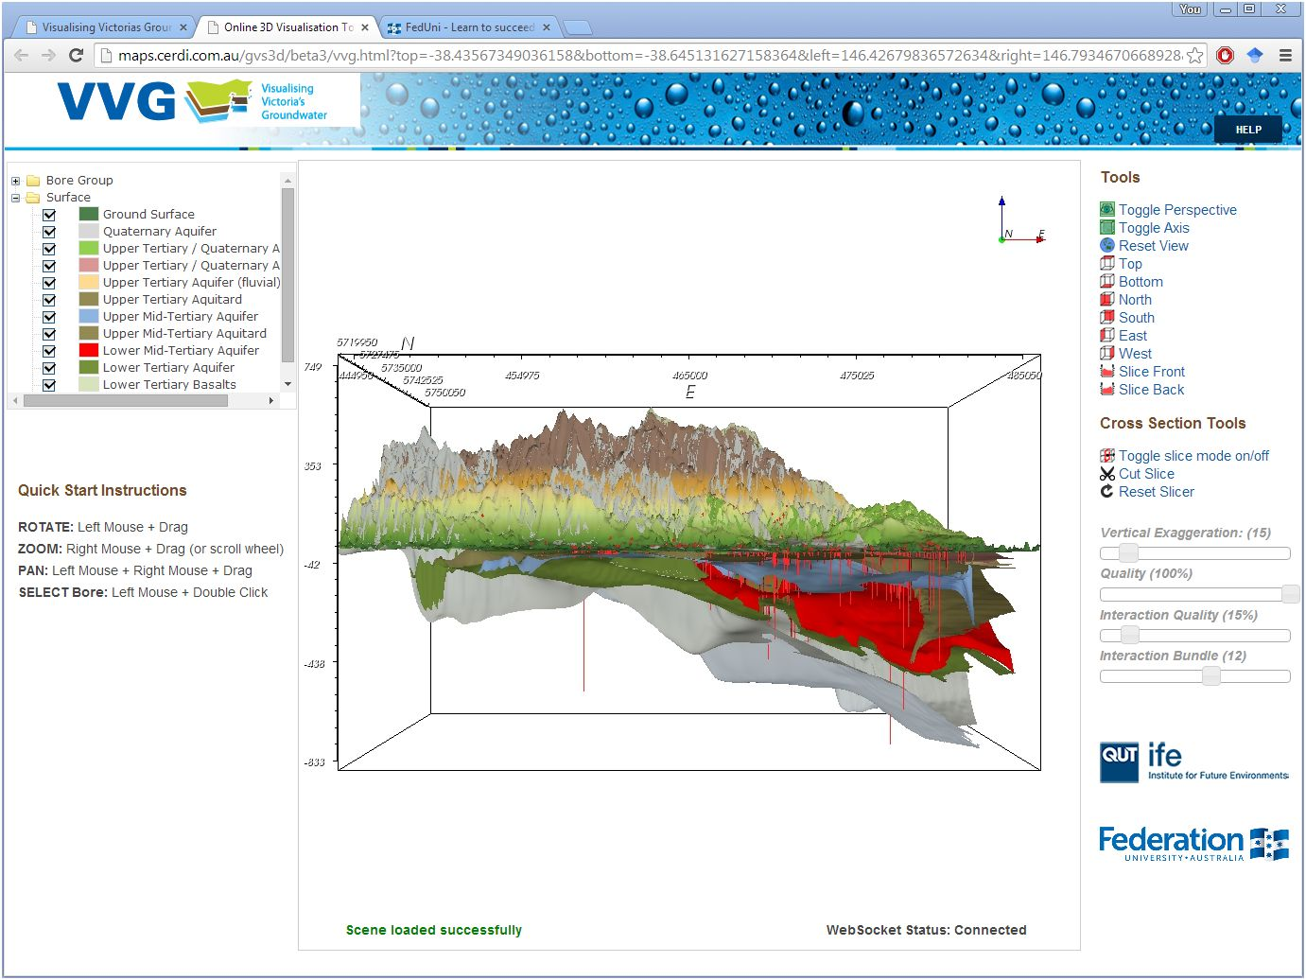
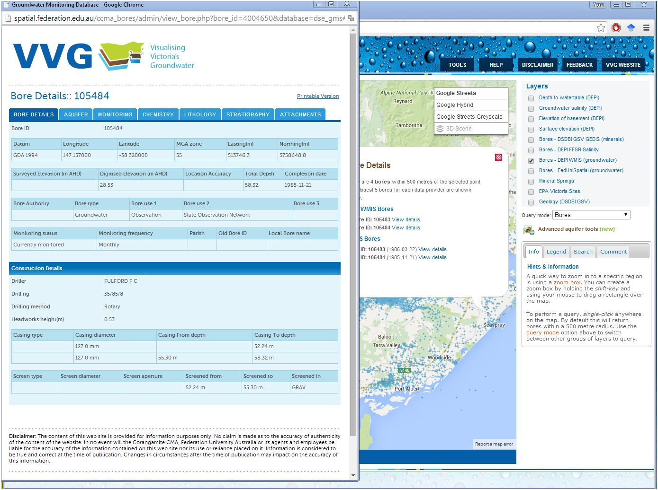
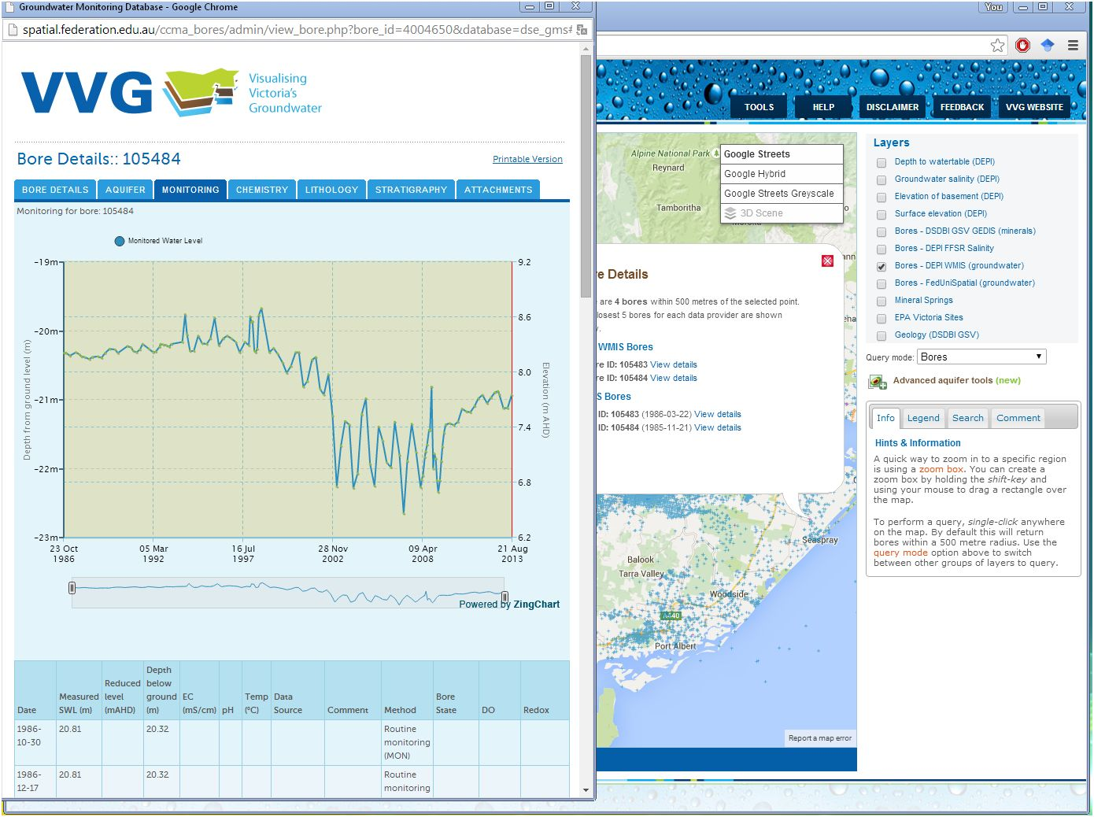
Visualising Victoria’s Groundwater
Federation University Australia’s groundwater portal
VVG requires input from multiple data providers

Slide 7
A Common data structure
Groundwater ML

Slide 8
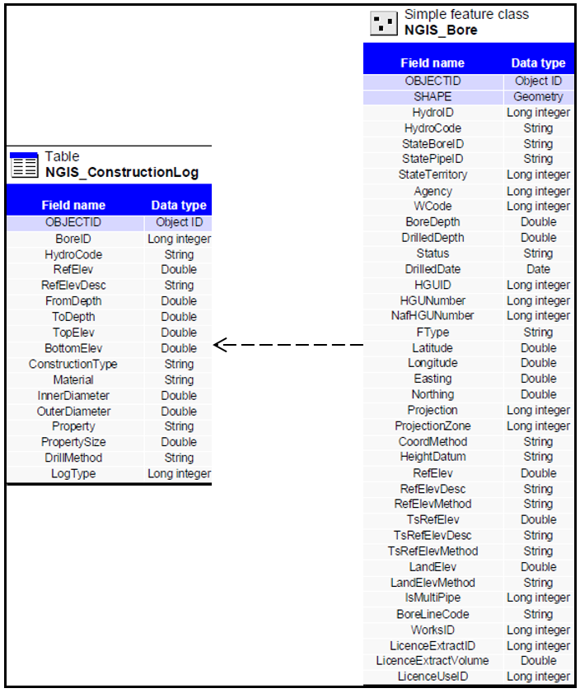
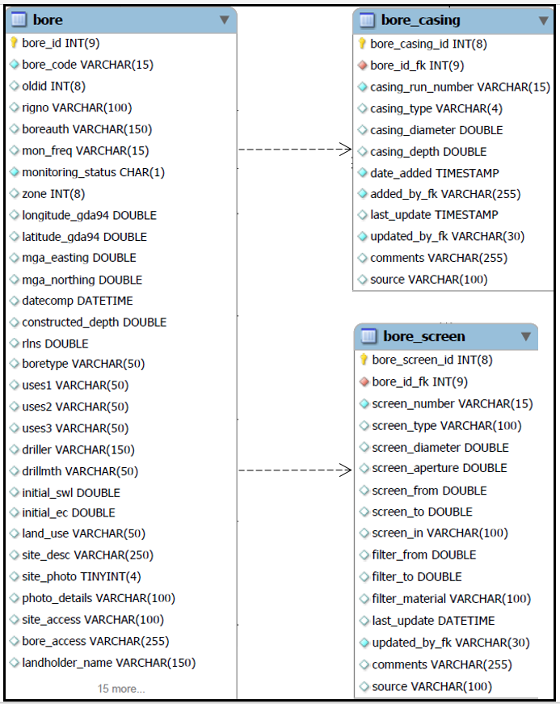
National Groundwater Information System
Federation University Australia database

Slide 9
Canadian Groundwater Information Network
Interoperability as a solution
Example from Canada

Slide 10
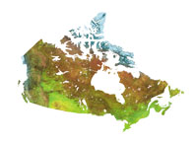
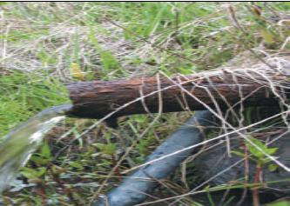
Groundwater Information Network (GIN)
Collaboration of NRCan and 6 provinces
Started with linked water well databases
Principles
Distributed: data stays with owners
Seamless: acts as one virtual database
Multi-access: multiple portals, tools
Standards-based: uses Groundwater ML
Groundwater ML overcame different database structure issues
Interoperability in GIN
B. Brodaric, E.Boisvert
OGC TC Meeting, Boston, June 22, 2009

Slide 11
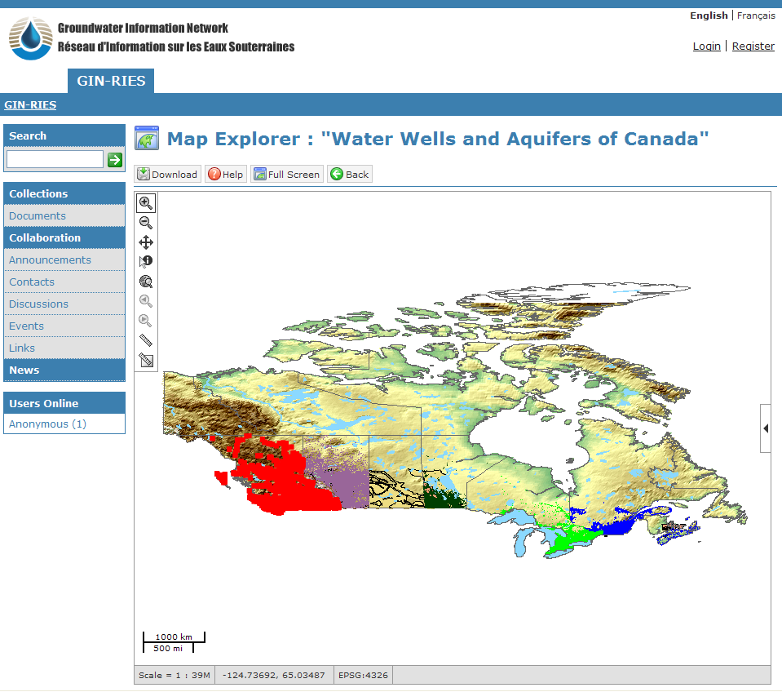
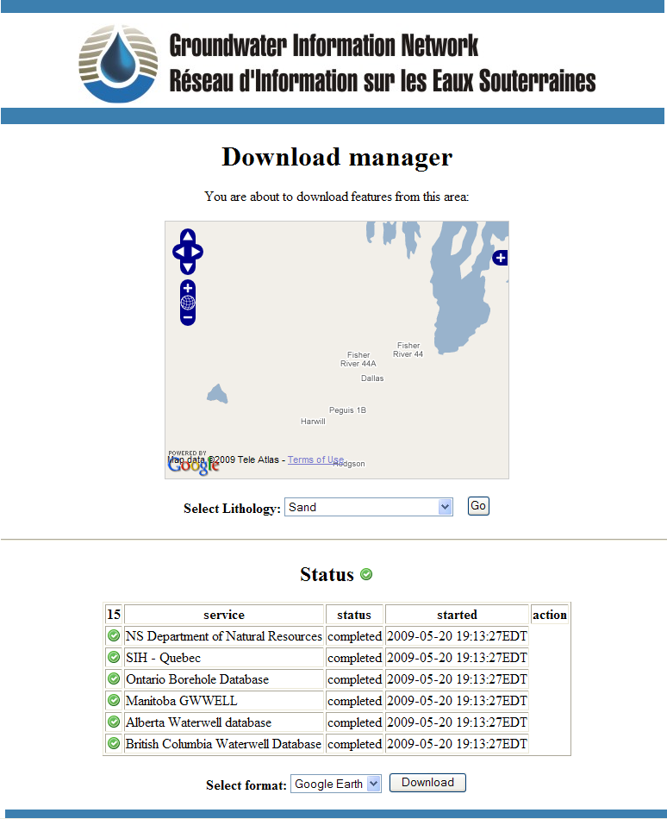
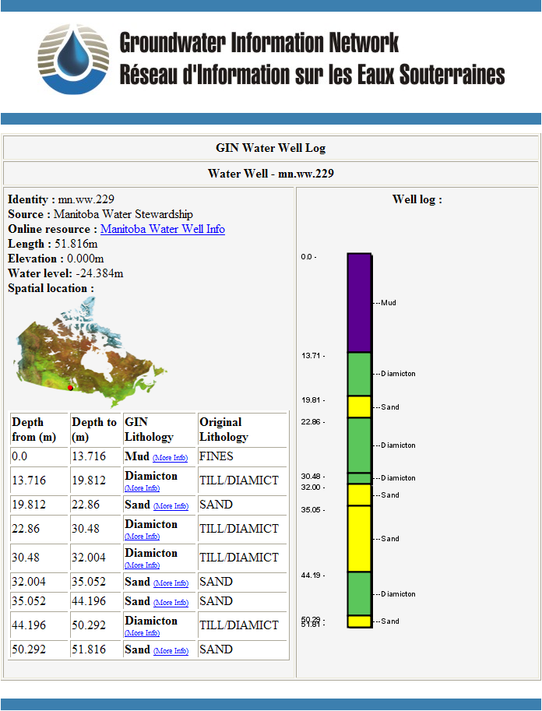
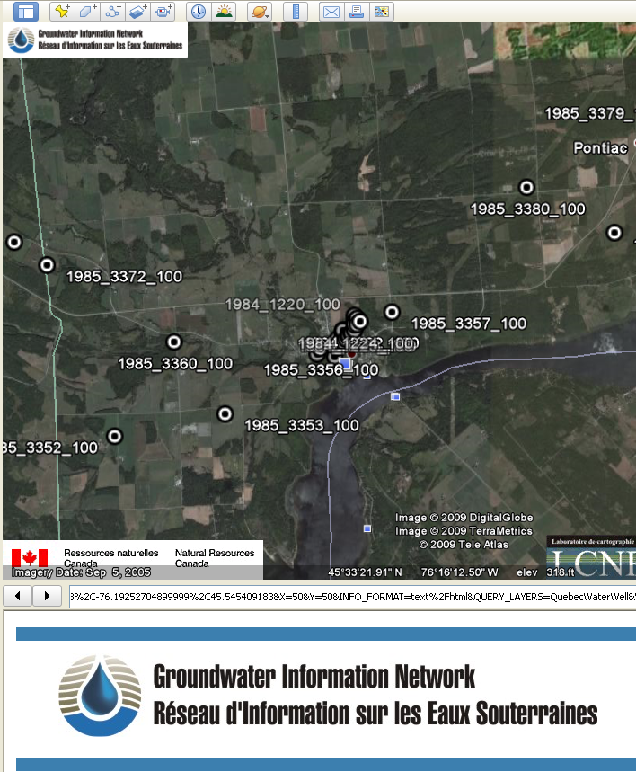
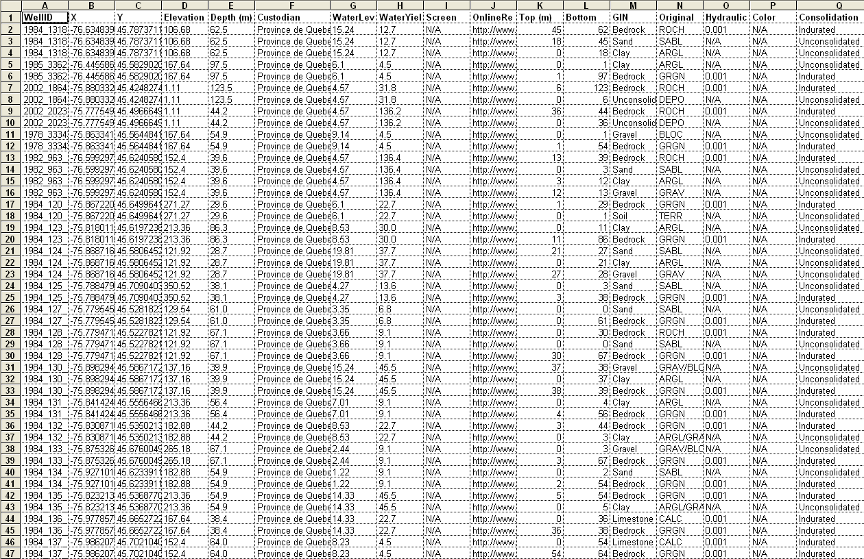
NRCan
Groundwater
Program
<gsml:lithology>
<gsml:ControlledConcept gml:id="gin.cc.2d-2">
<gsml:identifier codeSpace="urn:ietf:rfc:2141">urn:x-ngwd:vocabulary:gin:2d-2"</gsml:identifier>
<gsml:name codeSpace="urn:x-ngwd:classifierScheme:GIN:Lithology:2008" xml:lang="fr">Argile</gsml:name>
<gsml:name codeSpace="urn:x-ngwd:classifierScheme:GIN:Lithology:2008" xml:lang="eng">Clay</gsml:name>
<gml:description>A naturally occurring material composed primarily of fine-grained minerals.
It is generally plastic at appropriate water contents and will harden when
dried of fired (Neuendorf et al. 2005)</gml:description>
</gsml:lithology>
<gsml:material>
<gsml:UnconsolidatedMaterial>
<gsml:consolidationDegree>
<gsml:CGI_TermValue>
<gsml:value codeSpace="urn:cgi:classifierScheme:BGS:consolidationTerms">UNCONSOLIDATED</gsml:value>
</gsml:CGI_TermValue>
</gsml:consolidationDegree>
<gsml:physicalProperty>
<gwml:HydrogeologicDescription>
<gwml:hydraulicConductivity>
<gsml:CGI_NumericValue>
<gsml:qualifier>approximate</gsml:qualifier>
<gsml:principalValue uom="y_K_md-1">0.001</gsml:principalValue>
</gsml:CGI_NumericValue>
</gwml:hydraulicConductivity>
</gwml:HydrogeologicDescription>
</gsml:physicalProperty>
</gsml:UnconsolidatedMaterial>
</gsml:material>
GWML
Google Earth
Excel

Slide 12
OGC Groundwater interoperability experiment
Aims
Use cases
Conceptual model
Logical model
XML encoding
Testing

Slide 13
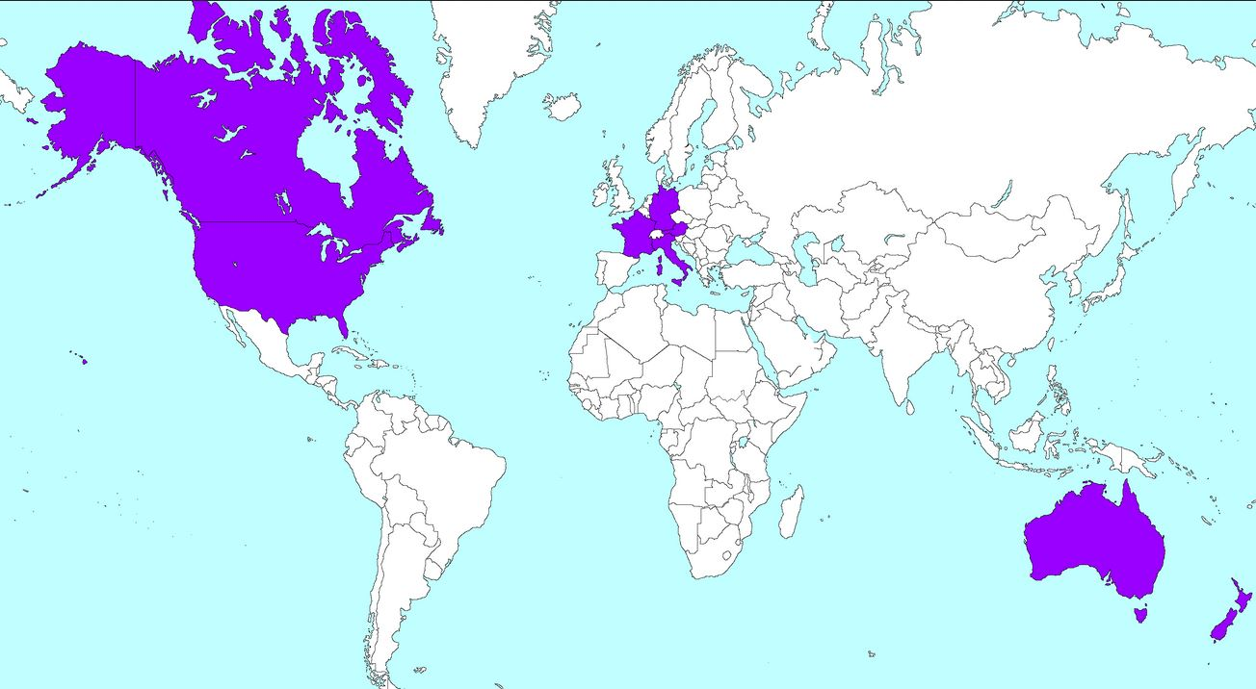
GWML2 interoperability experiment
Aims:
Develop an international groundwater information model
Develop a GML application schema, for groundwater data
Harmonize existing models (GWML, INSPIRE)
Participants:
GSC-NRCan, USGS, DG-JRC, BRGM, GSG, GNS, SalzburgUni, CSIRO, BoM, FedUni

Slide 14
Five use cases tested
Commercial – find water wells, estimate cost of water supply well
Policy – meet EU Water Framework Directive requirements
Environmental – assess risks to groundwater dependent ecosystems
Scientific – determine flow of groundwater via modelling software
Technologic – map GWML2 to existing models

Slide 15
Conceptual Entities
Hydrogeologic units, Voids
Fluid bodies, Constituents
Groundwater flow and flow systems
Wells, Springs, Monitoring sites, Borehole construction
Management areas, Aquifer testing

Slide 16
GWML2 Logical Model
UML-GML representation
Extends Observations & Measurements (O&M), GeoSciML (v3.2), Interleaved Coverages (TimeSeries)
6 GML XML application schema
Conformance & Requirements classes
Notes:
ISO19115, 19107, 19108, 19103, 19156, 19123, OGC SWE
Too much detail to cover here, so only present a flavour of the features and properties included in the model.

Slide 17
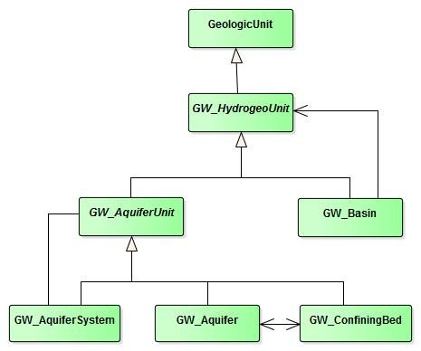
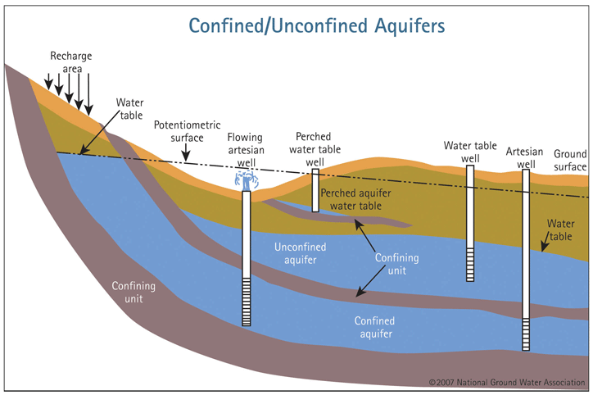
Hydrogeologic units
Notes:
Hydrogeologic units are modelled as specializations of GeoSciML geologic units:
Avoids having to redefine all the geological properties (earth materials, age, contacts, faults etc)
GWML2 covers Aquifers, Confining beds, Aquifer Systems and Basins
Not going to specify all the properties here – trust me

Slide 18
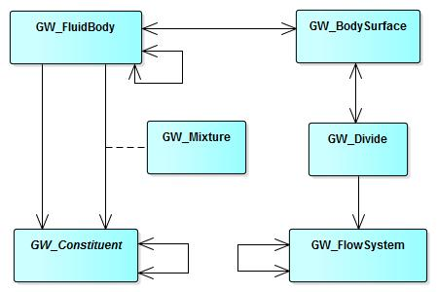
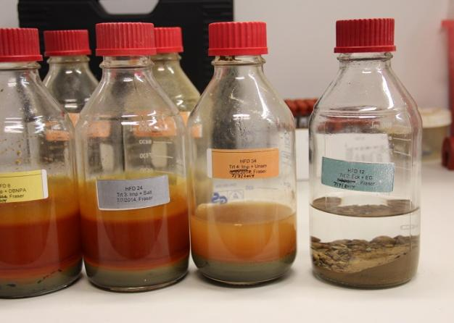
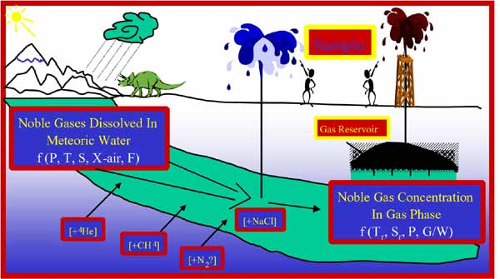
Fluid body (the ‘groundwater’)
Notes:
As well as describing the shape, volume, vulnerability, flow and constituents of the fluid body, the relationship between the fluid and it’s surfaces such as piezometric, potentiometric, water table, the divides and flow systems can be described.

Slide 19
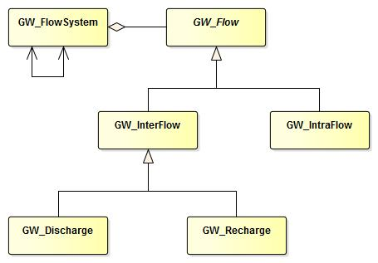
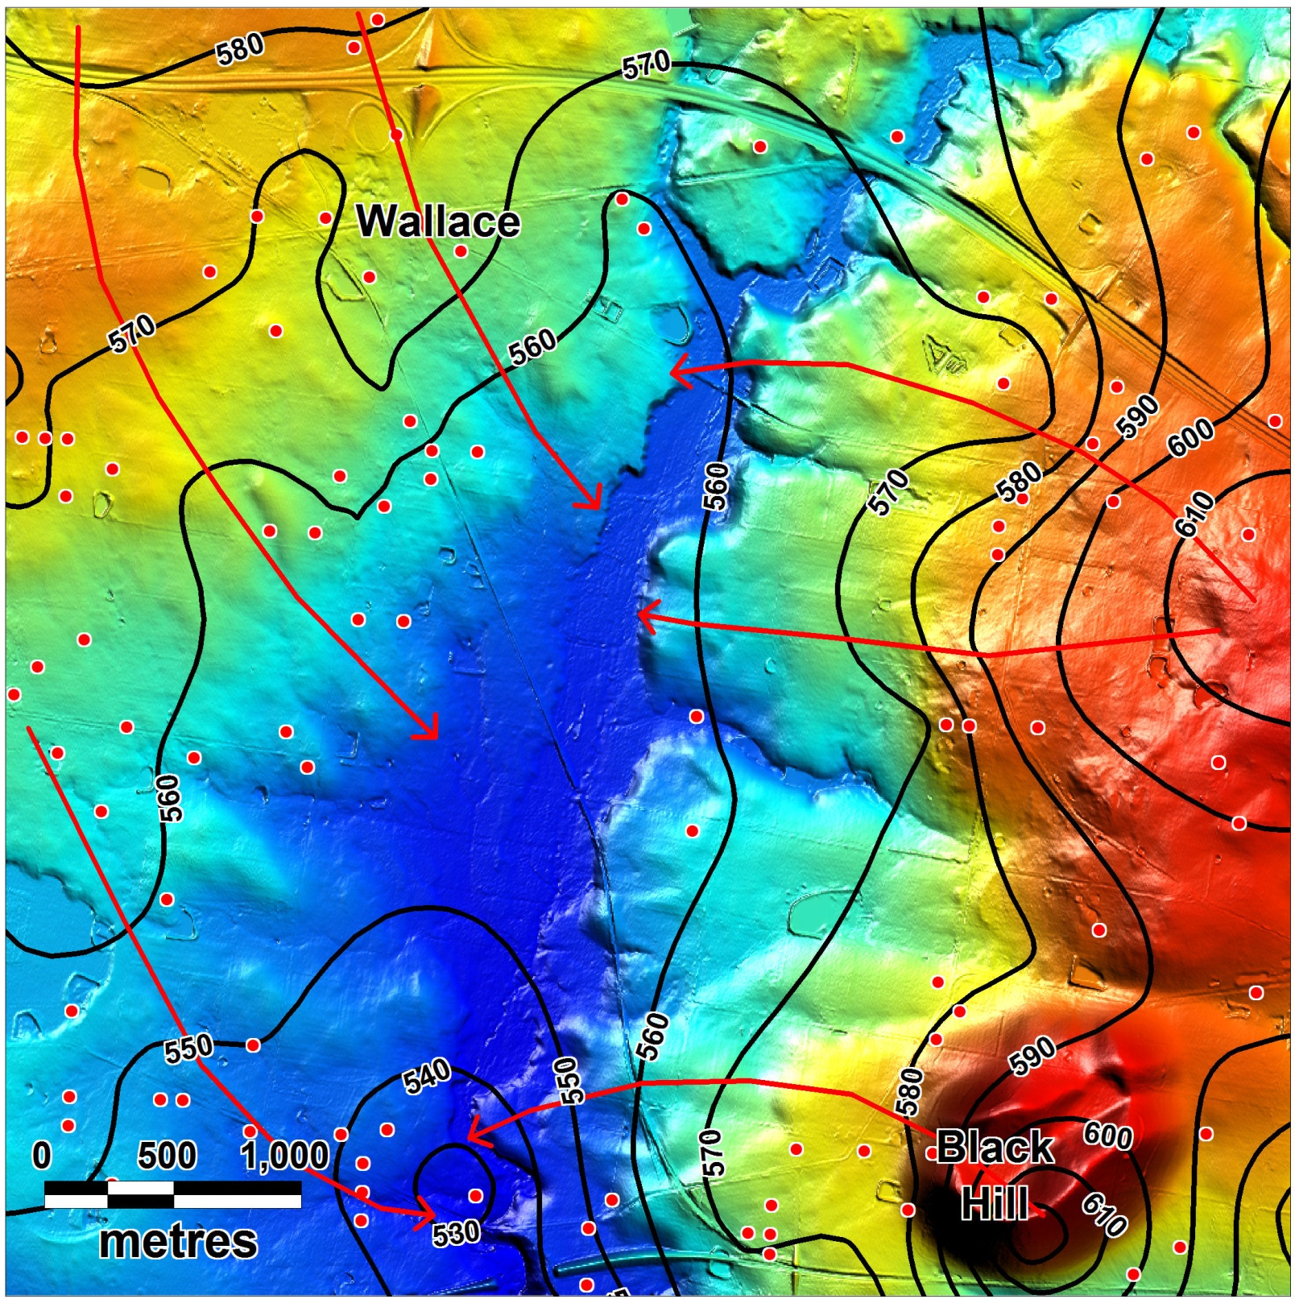
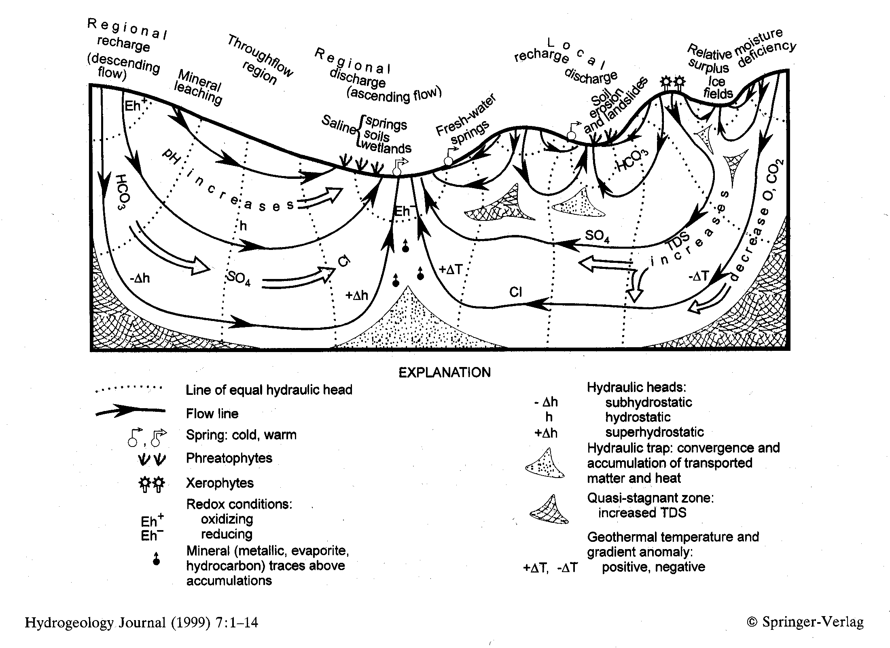
Groundwater flow
Notes:
The fluid flow properties, such as velocity, persistence, volume, and process, for interflow and intraflow fluid movement types are handled by the flow components.
Where the flow is between features, either discharge or recharge, the source and destination fluid, container and interface features may be described.
The various flow paths together define the flow system.

Slide 20
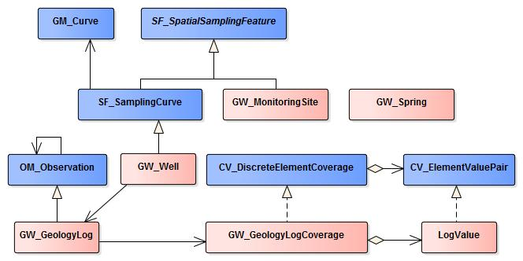
Sampling features
Notes:
Wells (Boreholes) and monitoring wells are all modelled as specializations of O&M spatial sampling features.
Additional properties include the geology details, the well purpose and use, drilling details, and related hydrogeology units and fluids.
The hydrogeology, persistence and licensing of springs is covered.

Slide 21
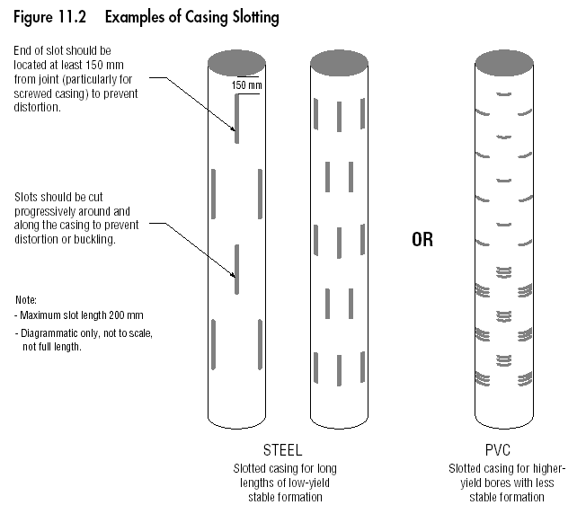
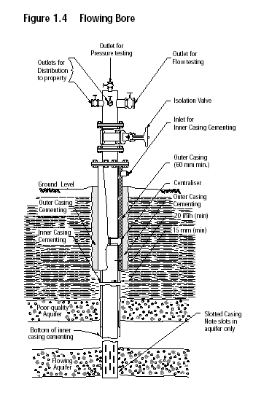
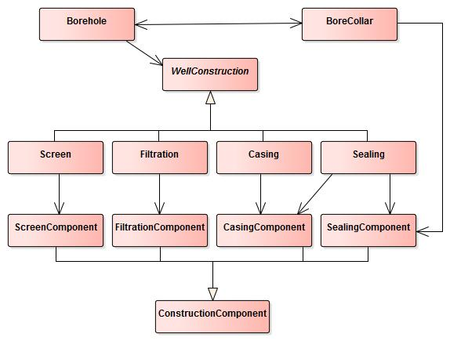
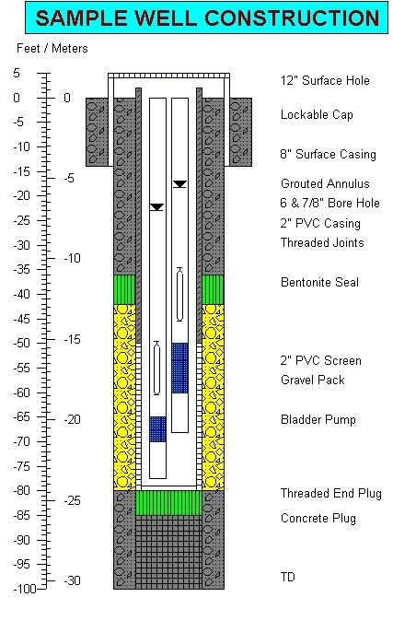
Well construction
Notes:
Re-used whole of GWMl1 well construction to describe the borehole construction details

Slide 22
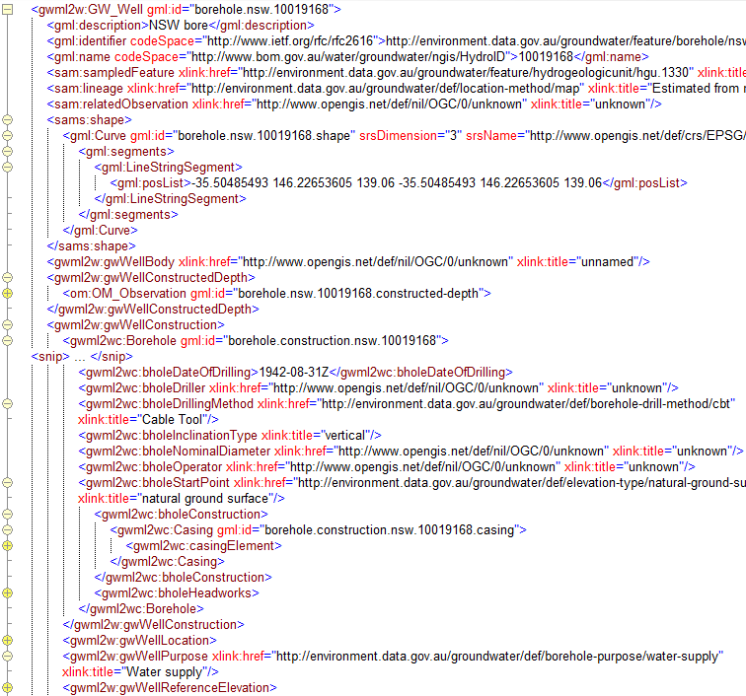
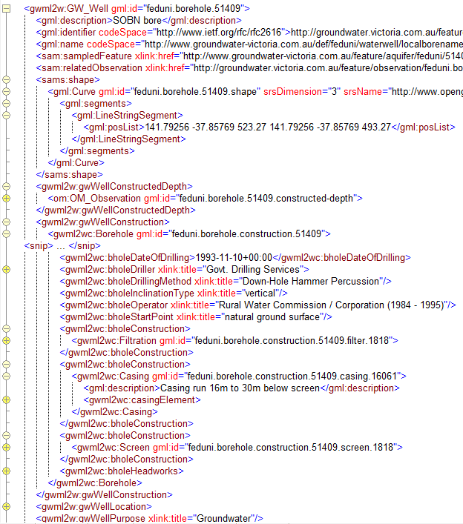
Australian demonstration WFS
http://external.opengis.org/twiki_public/HydrologyDWG/UseCaseWebServices

Slide 23
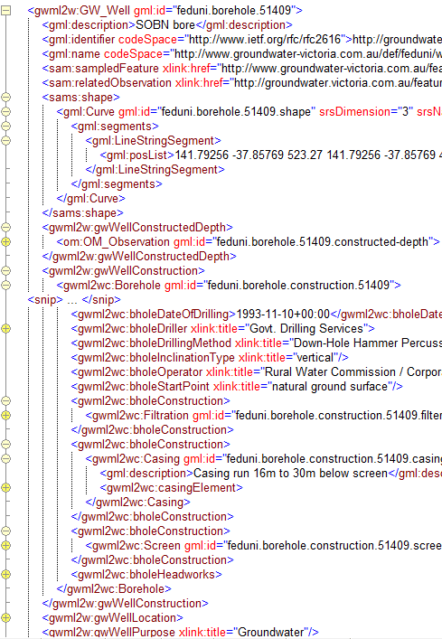

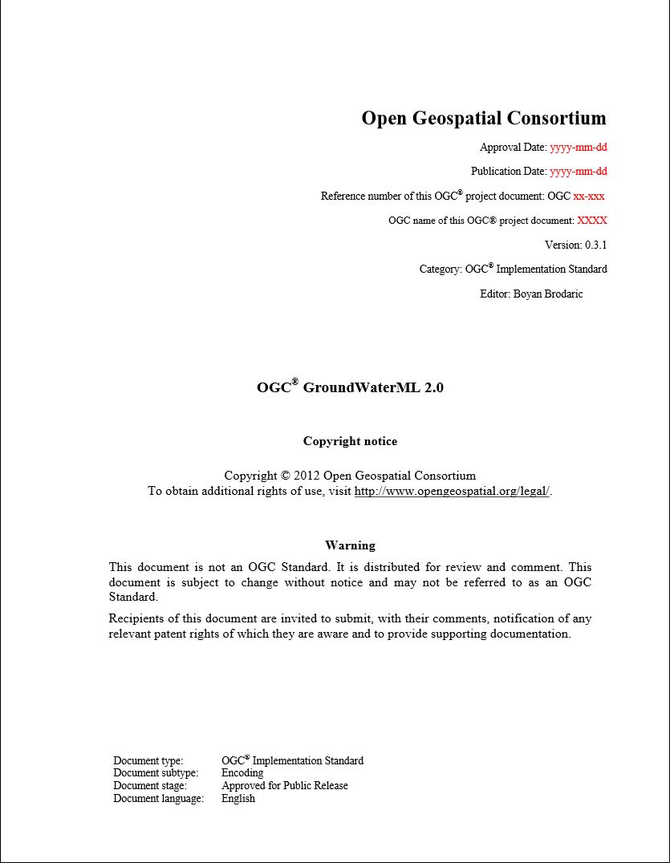
Demonstration services
OGC GWML2 Standard
Establish SWG
June 2015
September 2015
December 2015
March 2016
June 2016
Engineering Report
Draft GWML2 standard

Slide 24
Conclusions
BoM, CSIRO and Federation University Australia established services using the draft GroundWaterML2 standard
The OGC HydroDWG have established a Groundwater SWG to take GWML2 to OGC standard status by June 2016

