Slide 1


Hydrology Domain Working Group Standardization of Water Data Exchange: WaterML 2.0 and Beyond
http://www.waterp-fp7.eu/
Speaker: Gabriel Anzaldi
Contact: ganzaldi@bdigital.org
New York, 08-16-2014

Slide 2
Index
Need & Pilots
Architecture implemented
OGC© OWS, use and experiences
OGC© SOS
OGC© WPS
OGC© WMS & OGC© WFS
Water Management Ontology (WMO)
WaterML2.0 Experiences

Slide 3
Need & Pilots

Slide 4
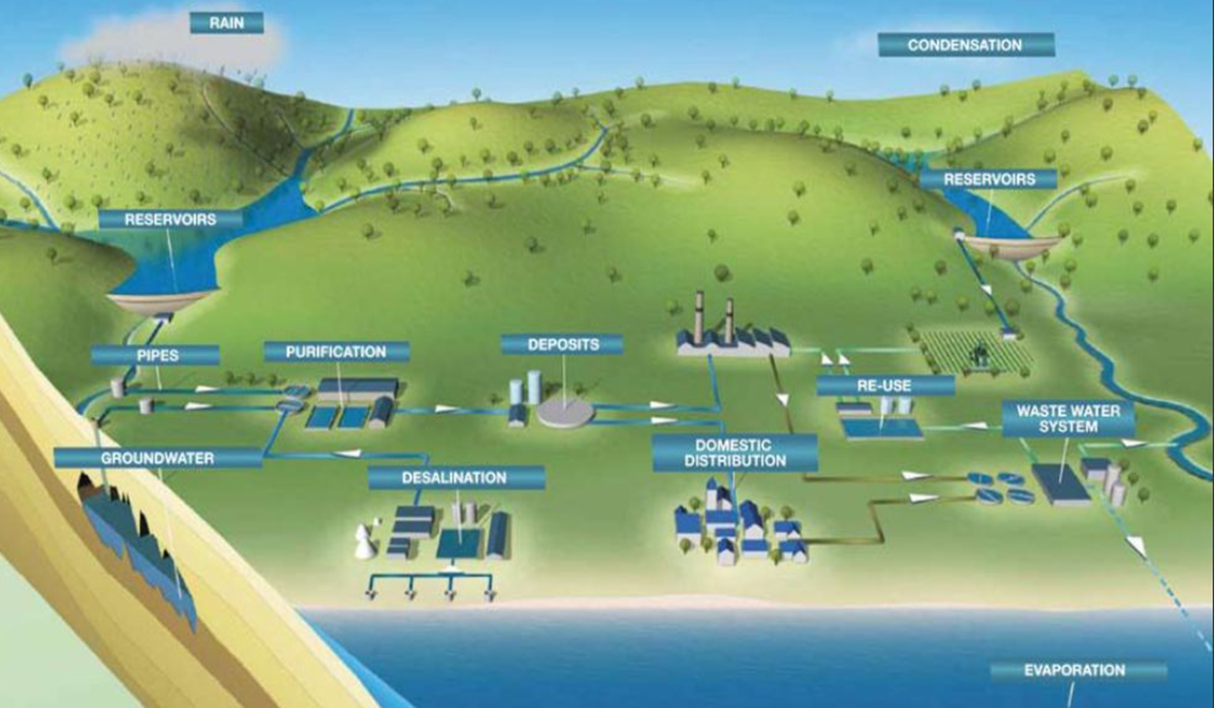
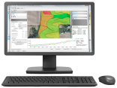
Water Domain Motivation

Slide 5
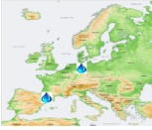
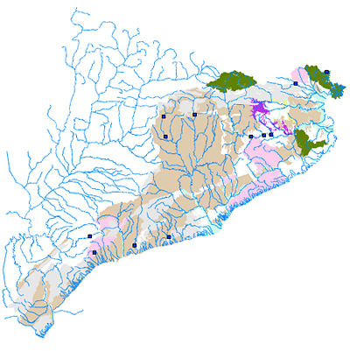
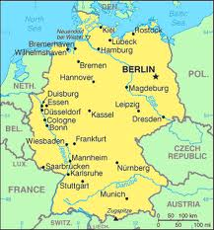
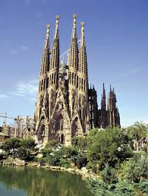
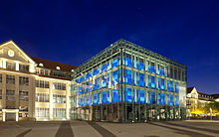


Pilots implementations
TER-Llobregat
(Spain, Barcelona Area)
City of Karlsruhe
(Germany, Baden-Wurtemberg)
Water Authority
Water Utility

Slide 6
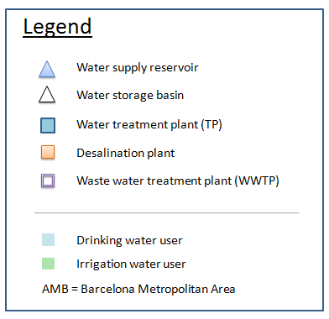
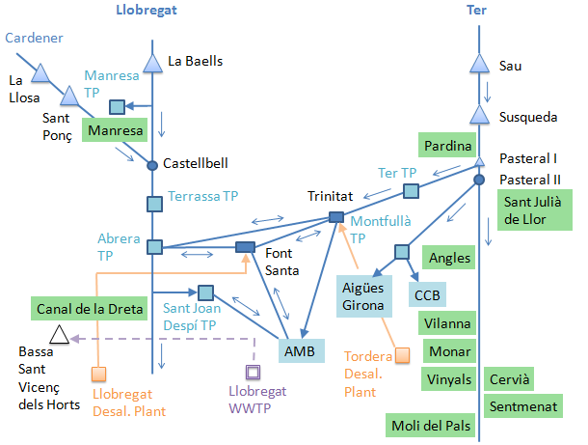
Description TER-Llobregat Pilot
Constrains:
Environmental flows
Hydroelectric power
Flood control
Recreational needs
Consumptive usage (agricultural, domestic)

Slide 7
Description City of Karlsruhe Pilot

Slide 8
Architecture Implemented

Slide 9
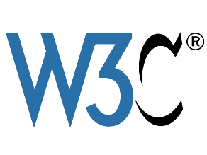
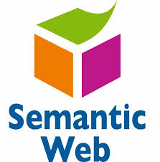


WatERP concept
Interoperability
&&
easy extension of the system
SOA
MAS
WMO
WaterML 2.0
WaterML 2.0

Slide 10
WatERP architecture

Slide 11
WatERP features
Link each decisional/informational system to help the integration in a collaborative framework.
Provide near real–time information/knowledge flow.
Distribute intelligence to generate actions and alerts related to management processes.
Perform orchestration of existing and new management tools.

Slide 12
OGC© OWS Uses and Experiences

Slide 13
WatERP architecture

Slide 14
OGC© SOS
OGC© SOS are being used in WatERP to:
To homogenize the integration of pilot data (52º North SOS)
Standardize the access protocol which allows to work with different datasources
An SOS-Server-Installation has to be prepared for each data source to be incorporated, homogenizing the resources used for data import and thus facilitating data source integration
SOS WaterML2.0 is the first step to ensure data integrity, while at the same time making it fast and easy to incorporate new data sources.
Every data source implementing a WaterML2.0 data scheme can be added, enabling a constant development and enlargement of the water data warehouse with almost no additional cost
To publish the observations inside the framework (52º North SOS)
Standardize the access protocol to consume the cleaned and validated data (SOS and WaterML2) facilitating the data consumption for third parties
Facilitate the queries data from R function calls using 52º North SOS4R

Slide 15
OGC© SOS Experiences
Need for a better implementation of WDSL OGC SOS within the most extended WS frameworks (e.g. apache-CXF, axis2, … Non-trivial use with the OGC© SOS wsdl due to the name spaces overlapping)
Implementation in the deployed framework
Direct sending of SOAP messages to the server.
Useful Contributions
Develop client libraries for the most used languages ​​(we can contribute with an already developed library in Java)

Slide 16
WatERP architecture

Slide 17
OGC© WPS
OGC© WPS are being used in WatERP to:
To publish database internal process (52º North)
To publish R processes (52º North with WPS4R) which queries data from standard conform SOS instances using simple R function calls (52º North SOS4R)
Integrate external process in the platform (52º North)
It provides a standardized way to facilitate the binding and discovering of processes

Slide 18
WatERP Matchmaking Orchestation
HF OGC WPS
DSS OGC WPS
OMP
interface
MAS
WDW
A_{HF}
A_{DSS}
A_{L}
SESAME
A_{HF}
A_{DSS}
A_{L}
A_{SES}
A_{G}
A_{S}
A_{S}
SOS Server
A_{SOS}
A_{DMS}
A_{WPS}
A_{DMS}
A_{WPS}
A_{YP}
DMS OGC WPS
OGC WPS

Slide 19
WatERP SOA Interface
1.- getCapabilities()
2.- listOfProcesses -CapabilitiesResponse-
3.- describeProcess(process)
4.- processDescription
5.- execute(process)
6.- result of execution
Difficulty to differentiate two process with similar sintaxis during matchmaking
SOLUTION: semantic annotations in OGC-WPS operations = semantic interoperability

Slide 20
WatERP
SOA Interface (characteristics)
Implementation of the building block inside an OGC® WPS Server.
Provide semantic annotations in :
the getCapabilities” operation response inside “ServiceIdentification” node to facilitate the classification of building block (DS tools, DM tools, HF tools).
“describeProcess” operation response to let the MAS understand the parameter nature.
The OGC© recommendations in reference to the semantic annotations (Houbie, Duchesne, & Maué, Best Practices document – OGC© Web Services with semantic annotations , 2012) was implemented in the service metadata level to use the keywords element as semantic annotations.

Slide 21
OGC© WPS Experiences
Facilitate the processes creation with the aim of being reused
Semantic annotations recommend by the OGC© minimizes the semantic lack and they are enough to perform the orchestration. A specific specific field for this purpose might be interesting to give more semantic power in WPS or other standards OWS.
Non-trivial use of the extended services frameworks (e.g. apache-CXF, axis2, …) with the OGC© WPS schema due to the name spaces overlapping
More options should be considered for exchanging data in standards (e.g. REST as an option to SOAP)

Slide 22
WatERP architecture
WMS
&
WFS
WMS
&
WFS

Slide 23
OGC© WMS & WFS
OGC© WMS are being used in WatERP to:
To publish geospatial map images (52º North WMS) in a homogeneous and standardized way
To consume standardized maps by the GUI using OpenLayers framework as OGC© WMS client
OGC© WFS are being used in WatERP to:
To publish SOS/WaterML2 transportable data through OGC© WFS, granting access to other clients either not being able to process SOS/WaterML2 or explicitly using WFS to avoid protocol overhead from WaterML2 (52º North WFS)
To consume standardized geographic features by the GUI using OpenLayers framework as OGC© WFS client with the aim of providing extra information to the maps
Experiences
The use of libraries (e.g. OpenLayers) to consume information facilitates integration with both standards avoiding typical problems of overlapping namespaces

Slide 24
Water Management Ontology

Slide 25
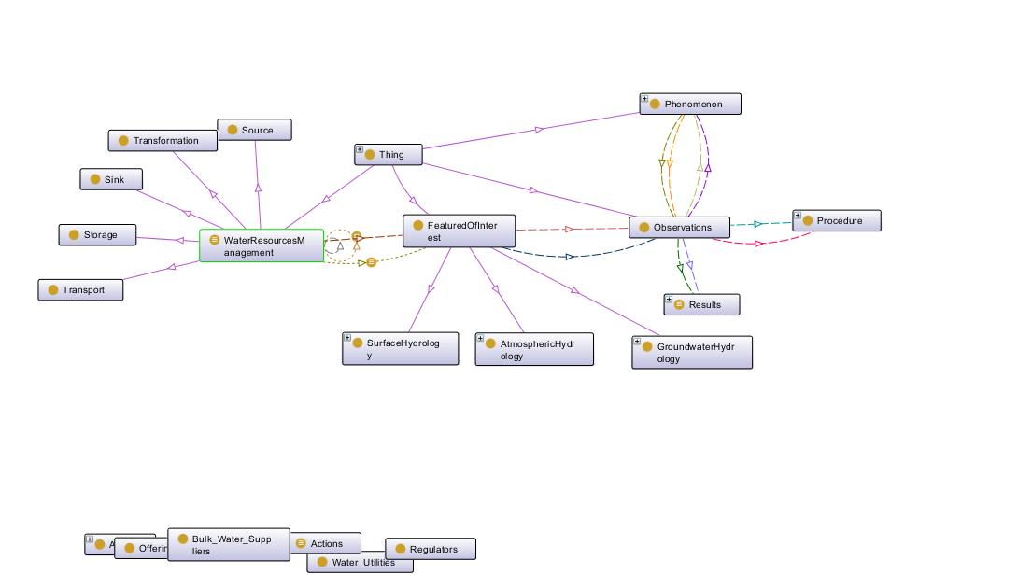
Water Management Ontology (WMO)
Human-made interactions and decision making;
Water resource availability;
Ecological, cultural and social functions of water resources and potential impacts of changes on hydro logical regimes;
Current water infrastructure/assets and the economic value of water
Administrative, policy or regulatory issues of relevance
Sectorial use and water hierarchy.
This allows alignment of water-physical objects (“FeaturesOfInterest”) with decisional concepts. This decisional correspondence is supported by the real-objects situation (“FeaturesOfInterest”) that gathers hydrological information by an observation-and-measurement process described by “observations”, “procedures”, “phenomena” and “results”.

Slide 26
WMO Mappings (I)
Mapping and alignment with WaterML2 schema to support the information exchange in all WatERP infrastructures
Geospatial entities of GML (“Geometry”, “Point”, “Polygon”, “LinearRing”, …) to provide geospatial characteristics (“FeaturesOfInterest”, “WaterResource”, …)
Time series quality measurement (“ObservationResultQuality”, “GoodQuality”, “EstimateQuality”, …) recommended on last WaterML2 revision
Ontological resources mapped with entities (e.g “Procedure” and “Results”), and data properties (e.g “date”, “idPhenomenon”, “unit”, “value”, etc)

Slide 27
WMO Mappings (II)
Semantic Sensor Network ontology
SSN ontology has been adapted in regards with the OGC recommendations about O&M system defining a mechanism to obtain the corresponding time series from elements that manages the water supply and distribution chain.
Mappings applied in (e.g “Features Of Interest”, “Observations”, “Results”, “Phenomenon”, …)

Slide 28


WMO Mappings (III)
Alignment with CUAHSI ontology
To acquire natural water paths and most representative variables are used in order to create the mechanism to include the human-engineered water paths
Merged CUASHI phenomena with WatERP phenomena
Alignment with SWEET ontology
Environmental and hydrologic processes (e.g “WaterManagement”).

Slide 29
WMO Aligment
HY_FEATURES
Alignment with HY_FEATURES information model
Taking in consideration HY_Features definitions. Including information related to “HY_Hydrofeature” and its sub-clases (HY_SurfaceHydrofeature, HY_SubsurfaceHydroFeature, etc.) with the objective to include this “Feature Of Interest” .

Slide 30
WMO Principles
Modeling natural water paths with human-engineered interactions
Using meta-data information (annotation) in order to standardize and make more readable the ontology
Using Linked Data principles (URIs resource identification) in order to make accessible the ontology and then, generate interaction with semantic world
Developing a mechanism that supports ontology inference over the water ontological resources in the water supply and distribution chain
Using knowledge discovering mechanism and mappings in order to elaborate a strategy for data provenance
Mappings in WatERP entities (e.g “Features Of Interest”, “Observations”, etc) and ontological relations (e.g “hasObservation”).

Slide 31
WMO Experiences
Alignment with OGC standards guarantees an highest level of interoperability.
Mapping of WatertML2 schema in an ontological representation allowing reasoning over it.
The incorporation of the human-engineered water permit to abstract decisional actions over the physical representations of the water supply distribution chain.

Slide 32
WaterML2.0

Slide 33
WaterML2 Experiences
Usage of WaterML2 as standard exchange format for time series and its nature (features of interest, phenomenon and procedure) across the whole architecture to maximize interoperability
WaterML2 is a large schema and it allows to encapsulating the same information in different ways. Therefore a WaterML2 subschema for water management was created.
Other options could be considered for exchanging data (e.g. JASON as an option to XML)
Non-trivial use of the extended XML frameworks (e.g. JAXB…) due to the name spaces overlapping (WatERP implements JAX-Bindings to provide rules that permit overcome conflicts)
Count with libraries for the most extended programing languages could be useful for extend the implementation (we have developed a Java library for WaterML)

Slide 34






Thank you very much for your attention!
Contact:
Gabriel Anzaldi
ganzaldi@bdigital.org
Phone. +34 93 553 45 40
M. +34 619 11 36 72
gabriel_anzaldi
@gabriel_anzaldi
es.linkedin.com/in/gabrielanzaldi/
http://www.waterp-fp7.eu/
http://ict4water.eu/

