Slide 1

OGC/WMO Hydrology Domain Working Group
Standardization of Water Data Exchange: WaterML2.0 and Beyond
HIC’2014 Seminar. Introduction.
August 16, 2014
CCNY, New York
Ilya Zaslavsky (USA), Tony Boston (Australia), Silvano Pecora (Italy)
HDWG Co-Chairs

Slide 2
Agenda
Time | Topic | Presenter(s)
09:00 | Welcome and Introduction | Ilya Zaslavsky, Tony Boston
09:15 | Hydrology Domain Working Group: history | Uli Looser
09:35 | Web services for hydrological sciences | Dave Blodgett
10:20 | Overview of hydrology suite of standards | Irina Dornblut
10:50 | Break
11:00 | Hydrology profile of the OGC Sensor Observation Service | Dave Blodgett
11:15 | WaterML 2.0 Part 1 Standards | Paul Sheahan
11:45 | WaterML 2.0 Part 1 Services demonstrations | Dave Briar, Boyan Brodaric
12:30 | Lunch (on your own)
1:30 | Ratings and Gaugings (WaterML 2.0 Part II) | Paul Sheahan
2:00 | Standard representation and encoding of hydrogeologic features | Boyan Broderic
3:00 | Break
3:15 | Federating regional and national data services; GEOSS projects | David Arctur
4:00 | Hydrological information exchange to support water management | Gabriel Anzaldi
4:20 | Discussion | All
5:00 | Close

Slide 3
Benefits of open standards
Prevents a single group from controlling a standard
Facilitates competition
Stimulates innovation
Customers benefit from not being locked into a particular supplier.
Source: Open Standards, Open Source, and Open Innovation: Harnessing the Benefits of Openness, April 2006. Committee For Economic Development. www.ced.org
Notes:
Prevents a single, self-interested party from controlling a standard
Facilitates competition by lowering the cost of entry
Stimulates innovation beyond the standard by companies that seek to differentiate themselves.
Customers value the interoperability that open standards provide and generally benefit from not being locked into a particular supplier.

Slide 4
What is the OGC?
The Open Geospatial Consortium, Inc. (OGC) is a non-profit, international voluntary consensus standards organization that is leading the development of standards for geospatial and location based services.
The OGC facilitates a consensus process in which government, private industry, NGOs, and academia collaborate to create open and extensible software application programming interfaces for geospatial and other mainstream information technologies
Notes:
The OGC is a not for profit consortium dedicated to the development of specifications that enable geospatial technologies to “plug and play” across any device, platform or network. The OGC consists of 380+ members - geospatial technology software vendors, systems integrators, government agencies and universities - participating in a consensus process to develop, test, and document publicly available interface specifications and encodings for the geospatial industry. Open interfaces and protocols defined by OpenGIS® Specifications are designed to support interoperable solutions that "geo-enable" the Web, wireless and location-based services, and mainstream IT, and to empower technology developers to make complex spatial information and services accessible and useful to all kinds of applications.

Slide 5
OGC Snapshot
A Voluntary Consensus Standards Organization, founded in 1994.
480 members
38 adopted standards
Hundreds of product implementations
Broad user community implementation worldwide
Alliance partnerships with 30+ standards & professional orgs
OGC Membership Distribution

Slide 6
OGC Snapshot
A Voluntary Consensus Standards Organization, founded in 1994.
480 members
38 adopted standards
Hundreds of product implementations
Broad user community implementation worldwide
Alliance partnerships with 30+ standards & professional orgs
OGC Membership Distribution

Slide 7
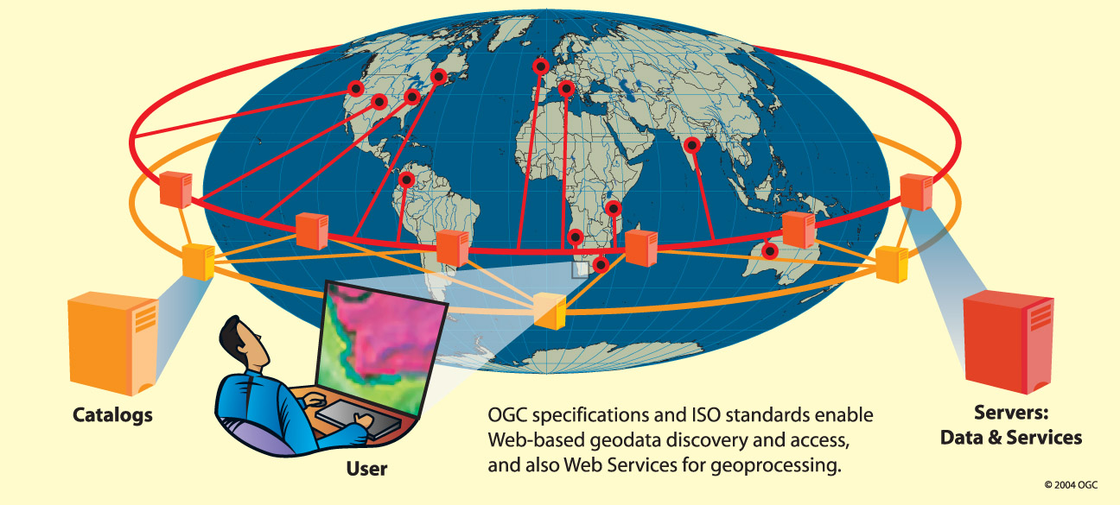
The OGC vision is global
Composed of many collaborating organizations... authoring and publishing open standards for geospatial interoperability
Notes:
Thus, OGC envisions the full integration of geospatial data and geoprocessing resources into mainstream computing and the widespread use of interoperable, commercial geoprocessing software throughout the information infrastructure. The work of the OGC is accomplished by our members working collaboratively to define, test, and publish open standards that enable geospatial interoperability. There are many market reasons for this:
1. Users need to integrate geographic information contained in heterogeneous data stores whose incompatible formats and data structures have prevented interoperability. This incompatibility has limited use of the technology in enterprise and Internet computing environments, and the time, cost, and expertise required for data conversion have slowed adoption of geoprocessing across all market segments.
2. The larger community needs improved access to public and private geospatial and location based sources, with preservation of the data’s semantics.
3. Agencies and vendors need to develop standardized approaches for specifying geoprocessing requirements for information system procurements.
4. The IT industry needs to incorporate geospatial and location based information and geoprocessing resources into national and enterprise information infrastructures, in order that these resources may be found and used as easily as any other network-resident data and processing resources.
5. Users need to preserve the value of their legacy geoprocessing systems and legacy geospatial content while incorporating new geoprocessing capabilities and spatially enabled content sources.
Note in the slide that implementing the vision requires both catalogs, or registries, and servers. The catalogs function something like search engines, or like automated service brokers, to help the user or the user's software process quickly discover geospatial data and services hosted on remote servers.

Slide 8
Standards
An OGC standard is a document, established by consensus and approved by the OGC Membership, that describe rules, guidelines or characteristics for interfaces and encodings aimed at the achievement of the optimum degree of interoperability.
Domain Working Groups (DWG or WG) provide a forum for discussion of key interoperability requirements and issues, discussion and review of implementation specifications, and presentations on key technology areas relevant to solving geospatial interoperability issues.
Standards Working Groups (SWG) have specific charter of working on a candidate standard prior to approval as an OGC standard or on making revisions to an existing OGC standard.

Slide 9
Other Document Types
Best Practices Documents contain discussion of best practices related to the use and/or implementation of an adopted OGC standard and for release to the public. Best Practices Documents are an official position of the OGC and thus represent an OGC Member endorsement of the content.
Discussion Papers (DP) provide discussion of some technology or standards development activity in the OGC approved for release to the public. Discussion Papers are not the official position of the OGC and contain a statement to that effect.
Public Engineering Reports (ER) are documents that report on some technical activity in an OGC Interoperability Program Initiative. A public ER is an ER that the OGC Members have approved for public release. An ER is not an official position of the OGC.

Slide 10
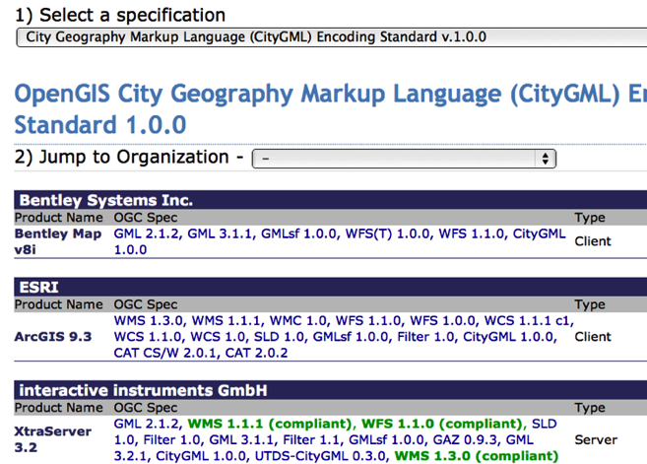
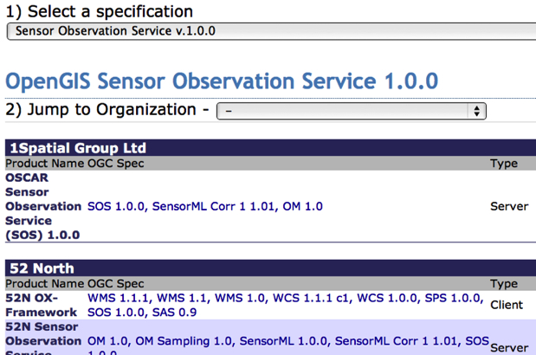
700+ implementing and certified products
http://www.opengeospatial.org/resource/products

Slide 11
The World Meteorological Organization (WMO)
‘... the UN system's authoritative voice on the state and behaviour of the Earth's atmosphere, its interaction with the oceans, the climate it produces and the resulting distribution of water resources’
‘... facilitates the free and unrestricted exchange of data and information, products and services in real- or near-real time ...’

Slide 12
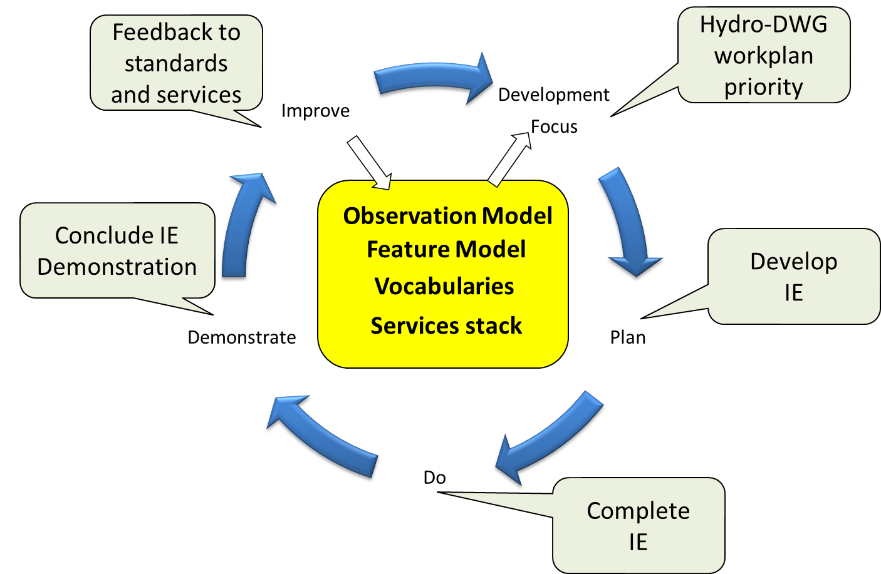
International Standardization for Water Data
Hydrology Domain Working Group
standards for water data: WaterML 2.0 suite
organizing Interoperability Experiments (IEs) focused on different sub-domains of water
Chairs:
Ilya Zaslavsky (USA)
Tony Boston (Australia)
Silvano Pecora (Italy)
Iterative Development
http://external.opengis.org/twiki_public/bin/view/HydrologyDWG/WebHome

