Slide 1

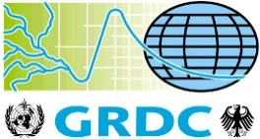
Suite of Water Information Standards
HIC-11 Tutorial: Standardization of Water Data Exchange
WMO/OGC Hydrology Domain Working Group
Irina Dornblut, GRDC of WMO at BfG
New York, CCNY, August 16, 2014

Slide 2
Suite of Water Information standards
Hydrologic data exchanged via Web Services
Water data exchange using standards
Interoperability of Web services
HY_Features common hydrologic feature model
Hydrologic data linked via shared spatial reference
WMO/OGC Hydrology Domain Working Group

Slide 3
Suite of Water Information standards
Sharing data in the Internet is common practice.
Data sharing is realized by Web services.

Slide 4

Hydrologic data via Web services
Internet
…
Notes:
universe of application-specific IT infrastructures, either as stand-alone systems or information networks,
intended to provide data and information for exchange in the Internet, and
on the other side a wide range of search engines are established to discover these information

Slide 5
Hydrologic data via Web services
…
WMS
…
…
WMS
…
…
…
…
SOS
…
Internet
…
WFS
…
…
…
CSW
WCS
…
…
…
…
…
…
…
…
…
Notes:
Over the last 10 yrs the use of standard web services such as WCS, WMS, WFS, SOS or CSW is widely accepted Community or domain-specific profiles are under development to cover specific needs such the Hydro Profile of SOS2.0 based on the WaterML2 implementation of the O&M model to make information discoverable (as capabilities) …

Slide 6
Hydrologic data via Web services
…
WMS
…
…
WMS
…
…
…
…
SOS
…
Internet
…
WFS
…
…
…
CSW
SOS
…
…
…
…
…
…
…
…
…
Notes:
… and in turn to provide access to map, features, observations, records, etc. via Internet portals, ...

Slide 7
Suite of Water Information standards
Interoperability ensures communication among Web services.
Rules for application schemas ensure interoperability between technical systems.

Slide 8
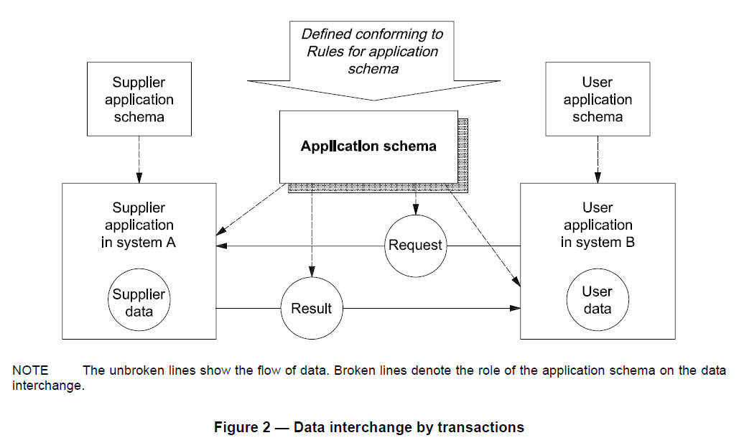
Water data exchange using standards
[ISO19109:2005, ]
Notes:
“The user application makes a request for data that is received by the supplier application. In response, the supplier
application delivers a resulting dataset. …” (ISO19109:2005, p8)

Slide 9
Water data exchange using standards
Common semantics used to define both the request and the result
[ISO19109:2005, ]
Notes:
“… Both the request and the resulting dataset are defined according to a
common application schema. The supplier application is responsible for transforming the data in system A into
the data in the exchanged dataset. After receipt, the user application is responsible for transforming the
exchanged data into data in system B. Data interchange by transaction is provided by geospatial services as
defined in ISO 19119. In particular, feature access services are defined in Geographic model/information
management services.” (ISO19109:2005, p8)

Slide 10

Water data exchange using standards
ISO19109: Rules for application schema.
Hydrology-specific application schemas
Supplying Service
Requesting Service
[ISO19109:2005, ]
Notes:
create and document hydrology–specific application schemas

Slide 11
Suite of Water Information standards
Use of standards today is widely accepted in geographic information.
Standard services ensure understanding how information is exchanged (technical interoperability).

Slide 12
Interoperability of Web services
Use of standard Web services widely accepted today,
Standard services ensure technical interoperability
concerned with understanding the syntax of requests and responses received
using standard interfaces, formats, protocols, etc.
Domain-specific profiles optimize general standards
covering specific needs of a community / domain
capturing domain perspectives (context relation)
Context / meaning of information is not easily accessible for technical systems such as Web services

Slide 13
Technical interoperability of Web services
…
WMS
…
…
WMS
…
…
API
…
API
…
API
SOS
API
…
Internet
API
…
WFS
API
…
API
…
…
API
CSW
API
WCS
…
…
…
…
…
…
…
…
…
Notes:
Standard Web services are widely accepted to link a provider’s app system (in terms of understanding the request received) and a user’s app system (in terms of understanding the response) while maintaining both sides technically independent from the other using standard interfaces for request and response.

Slide 14
Suite of Water Information standards
Content of information is not easily accessible for technical systems.
Mediation ensures understanding the context and meaning of exchanged information (semantic interoperability).

Slide 15
Semantic interoperability between Web services
Concerned with understanding the context and correct meaning of exchanged information
Requires representation of context (e.g. ontology) and concepts (terms)
May be achieved by linking references
Referencing shared concepts within a community / domain
Using an reference model / ontologies as mediator between conceptually overlapping perspectives (mapping semantics)
Mapping corresponding ontologies, assisted by a set of formal mapping rules based on the description logic of Semantic Web (semantic mapping)

Slide 16









Semantic interoperability of Web services
…
WMS
…
…
WMS
…
…
…
…
SOS
…
Talking about the same?
…
WFS
…
…
…
CSW
WCS
…
…
…
…
…
…
…
…
…
Notes:
While technical interoperability between Web services (understanding the structure of request/response) will be ensured by using standard services, the semantic interoperability (i.e. understanding the content and meaning of the request/response), usually requires human interaction to capture the meaning, to align and share overlapping concepts by their meaning.

Slide 17


Semantic interoperability of Web services
…
WMS
…
…
WMS
…
…
…
…
SOS
…
Community consensus !
…
WFS
…
…
…
CSW
WCS
…
…
…
…
…
…
…
…
…
…
Notes:
In a community wherein common semantics are shared, e.g. the community of WMO Member countries, consensus on concepts is usually based on agreed definitions documented in vocabularies/glossaries/ontologies etc., provided these exist.

Slide 18
Semantic interoperability of Web services
…
WMS
…
…
WMS
…
…
…
…
SOS
…
Referencing the same !!!
…
WFS
…
…
…
CSW
WCS
…
…
…
…
…
…
…
…
…
Notes:
With respect to cross-domain and interdisciplinary applications, application-specific concepts representing one aspect of a shared logical concept may reference the overarching concept. For example, a drainage basin and as well a groundwaterbasin refer to the overarching concept of a physiographic unit wherein all water (surface and groundwater) is channelled to a common outlet. Semantic interoperability may be established by mapping application-specific representations to the multiple represented concept …

Slide 19
Semantic interoperability of Web services
…
WMS
…
…
WMS
…
…
…
…
SOS
…
Catchment
…
WFS
…
…
…
CSW
WCS
…
…
…
…
…
…
…
…
…
Notes:
With respect to cross-domain and interdisciplinary applications, application-specific concepts representing an aspect of a shared logical concept may be reference the overarching concept. For example, a drainage basin and as well a groundwaterbasin refer to the overarching concept of a physiographic unit wherein all water (surface and groundwater) is channelled to a common outlet. Semantic interoperability may be established by mapping application-specific representations to the multiple represented concept, … such as those defined within the WMO/OGC HY_Features common hydrologic feature model.

Slide 20
Suite of Water Information standards
Consensus on context and meaning requires mediation by referencing shared concepts.
Common concepts mediate among overlapping concepts and multiple representations.

Slide 21
HY_Features, common hydrologic feature model
HY_Features, common hydrologic feature model
describes major components of the hydrosphere and their fundamental relationships incl. a segmentation of watercourses,
concepts which reflect hydrologic significance and network connectivity,
compatible concepts, based on definitions endorsed by WMO-CHy (documented in “WMO International Glossary of Hydrology”)

Slide 22
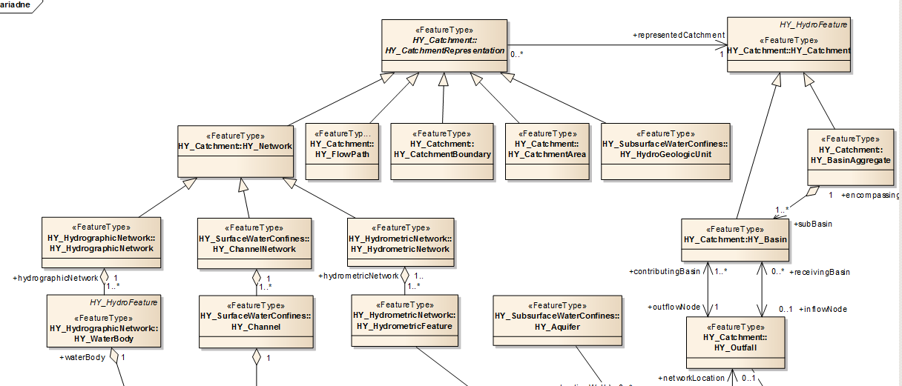
HY_Features – Basic concepts, 1(3)
Multiple represented catchment
Basin hierarchy
Basin and its common outlet (outfall)

Slide 23
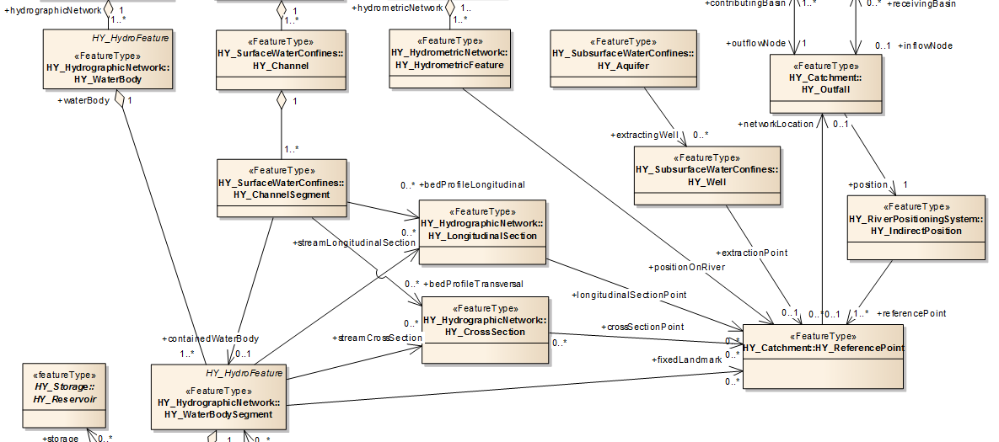
HY_Features – Basic concepts, 2(3)
Outfall, indirect position and reference point

Slide 24
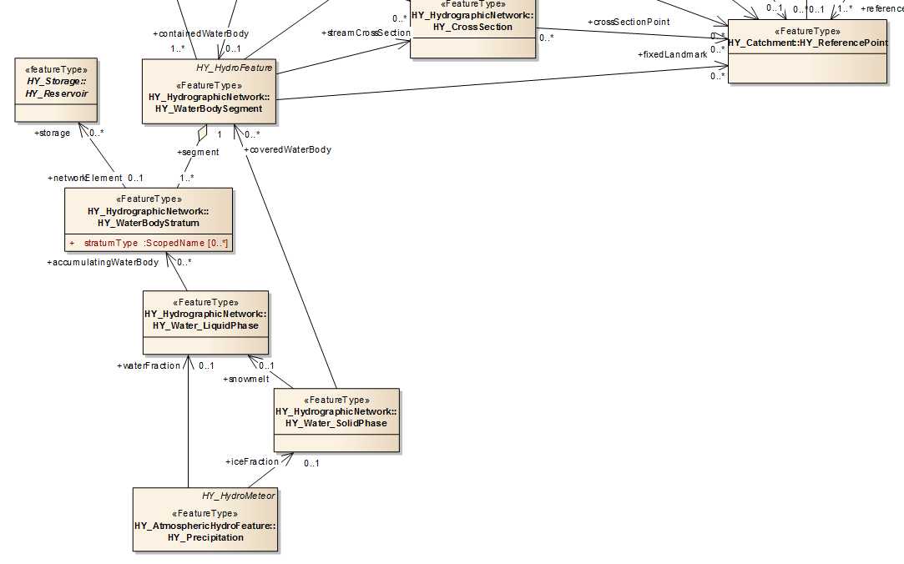
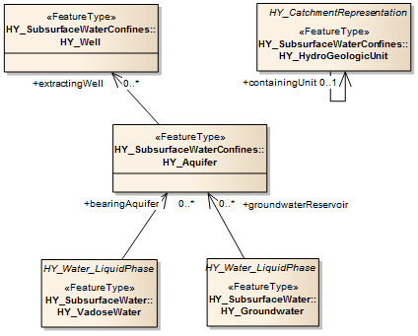
HY_Features – Basic concepts, 3(3)
Water, water accumulation and storage

Slide 25
HY_Features, implementation examples
set of inter-related Application Schemas using the GFM (ISO 19109)
expressed in UML (ISO 19103), GML (ISO 19136) and OWL (following the rules of ISO19150 under development)
HY_Features to be used:
AU Hydrological Geo Fabric (in terms of an ontology)
Read more: http://www.bom.gov.au/water/geofabric/index.shtml
OWS 10 CCI Hydro Model Interoperability (in terms of a mediator)
Read more: https://portal.opengeospatial.org/files/?artifact_id=58944
WatERP ontology (in terms of reference)
Read more: https://portal.opengeospatial.org/files/?artifact_id=59556

Slide 26
HY_Features, common hydrologic feature model
HY_Features, common hydrologic feature model
concepts, well-established and used in the hydrology domain
concepts should be addressed wherever real-world phenomena are considered to be hydrologic features, e.g. subject of
hydrologic measurement and observation,
water accumulation and storage,
water allocation and supply,
environmental reporting, etc.
concepts should be referenced wherever datasets and products represent a catchment, particularly a basin, or parts of these

Slide 27

HY_Features, hydrosphere objects related to the basin outlet
Hydro- graphic Network
Water Body
Water Body Segment
Water Body Stratum
Water Liquid Phase
Precipi tation
Cross Section / Longitu dinal Section
Ground water
Channel Network
Channel
Channel Segment
Well
Aquifer
Hydro- metric Network
Hydro-metric Feature
Common outlet of the corresponding basin
Soil water

Slide 28
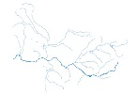
HY_Features associates datasets with the represented basin
Flowpath
Hydro- graphic Network
Water Body
Catchment Boundary
Any other
Catchment Area
Channel Network
Channel
Hydro- geologic
Unit
Hydro- metric Network
Hydro-metric Feature
Notes:
… such as those defined within the WMO/OGC HY_Features common hydrologic feature model.

Slide 29
Suite of Water Information standards
HY_Features common model enables semantic interoperability among Web services !
HY_Features common model will support the principle of Linked Data !

Slide 30
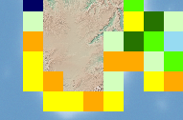
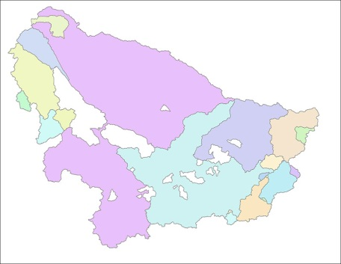
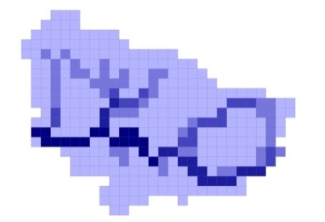
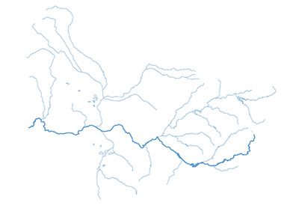
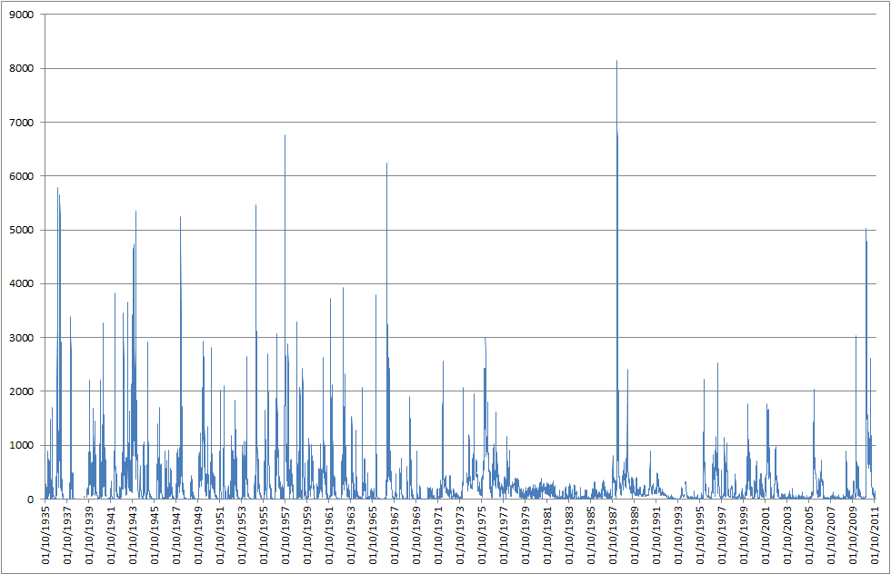
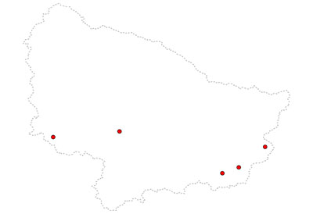
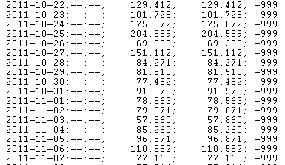
Hydrologic data linked via shared spatial reference
GIS Vector data:
GRDC Basins
(nested polygons)
GIS Raster data:
Freshwater fluxes
GIS Raster data:
Gridded Runoff
GIS Vector data:
GRDC Major Rivers
(polylines, multilines)
Examples of GRDC data sets and products
Time series data:
Daily river discharge
(ordered time value pairs)
Time series data:
Daily river discharge (line graph, but also bar graph)
GIS Vector data:
Hydrometric stations
(points, multipoints)
Notes:
Datasets and data product created by the GRDC for global exchange

Slide 31
Hydrologic data linked via shared spatial reference
GIS Vector data:
GRDC Basins
(nested polygons)
GIS Raster data:
Freshwater fluxes
GIS Raster data:
Gridded Runoff
GIS Vector data:
GRDC Major Rivers
(polylines, multilines)
Observation results, which can be related to a basin
Time series data:
Daily river discharge
(ordered time value pairs)
Time series data:
Daily river discharge (line graph, but also bar graph)
GIS Vector data:
Hydrometric stations
(points, multipoints)
Notes:
Datasets and data product created by the GRDC for global exchange

Slide 32
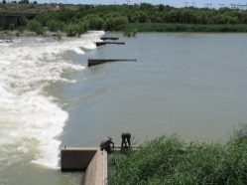
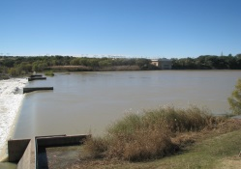
Hydrologic data linked…, hydrologically discrete
Basin:
hydrologic unit wherein all incoming water is channelled to a common outlet.
Note: The common outlet of a basin may be a particular location, but also a body of water. It may be a real place or a fictive one built from joining several places.
Source: HY_Features.HY_Basin, derived from IGH EN0360 and EN0552
Basin
Notes:
particularly representing a HY_Basin, the hydrologic unit wherein …

Slide 33

Hydrologic data linked …, context-dependent
WMO_BB:159
Notes:
… context dependent, i.e. depending on organizational goals and structures, e.g. the basin identified as WMO_BB 159

Slide 34
Hydrologic data linked …, context-dependent
Catchment:
distinct unit catching something, e.g. water.
Note: across scientific disciplines in the domain of hydrology, a catchment is commonly recognized as the basic unit of study and reporting.
Source: HY_Features.HY_Catchment
Management or
Reporting unit
Notes:
… or representing the higher-level reporting or management region, the containing HY_Catchment

Slide 35
Suite of Water Information standards
Hydrologic data result from observing a real-world hydrosphere phenomenon.
Water information standards reflect the specific needs of sharing hydrologic data.

Slide 36
Suite of Water Information Standards
Tools and services for the exchange of hydrologic data using Web services → technical interoperability
Tools and services for referencing hydrologic features, for the “mapping” of semantic concepts to preserve context and meaning across applications and domains → mediation between information systems
Tools and services to share water information across communities → semantic interoperability of services

Slide 37
WMO/OGC Hydrology Domain Working Group
WaterML2Part2: Gauging Observation
(OGC13-021)
WaterML2Part3: Water Quality Observation
(OGC14-003)
WaterML2Part1:
Water Quantity Observation
(OGC10-126)
Suite of Water Information Standards: towards the identification, observation and representation of hydrologic features using standards
HY_Features, common hydrologic feature model
(OGC11-039)

Slide 38
WMO/OGC Hydrology Domain Working Group
WaterML2Part2: Gauging Observation
(OGC13-021)
WaterML2Part3: Water Quality Observation
(OGC14-003)
WaterML2Part1:
Water Quantity Observation
(OGC10-126)
TimeSeries
(TSML, under development)
Suite of Water Information Standards: towards the identification, observation and representation of hydrologic features using standards
HY_Features, common hydrologic feature model
(OGC11-039)
WaterML2Part5: River Channel
(RiverML, under development)
WaterML2Part4: Groundwater
(GWML2, under development)

Slide 39
WMO/OGC Hydrology Domain Working Group
WaterML2Part2: Gauging Observation
(OGC13-021)
WaterML2Part3: Water Quality Observation
(OGC14-003)
WaterML2Part1:
Water Quantity Observation
(OGC10-126)
…..
…..
TimeSeries (TSML, under development)
Suite of Water Information Standards: towards the identification, observation and representation of hydrologic features using standards
HY_Features, common hydrologic feature model
(OGC11-039)
WaterML2Part5: River Channel
(RiverML, under development)
…..
WaterML2Part4: Groundwater
(GWML2, under development)
SoilML:
Soil-water component
CSML3:
Atmospheric-water
component
…..

Slide 40
Thank you !
Suite of Water Information Standards
HIC-11 Tutorial: Standardization of Water Data Exchange
WMO/OGC Hydrology Domain Working Group
New York, CCNY, August 16, 2014
Irina Dornblut, GRDC of WMO at BfG
(www.grdc.de ; dornblut@bafg.de)

Slide 41
Definitions
Data: notion of a documented value of some characteristics of a phenomenon.
Dataset: identifiable collection of data. [ISO19115:2003]
Coverage: set of attribute values arranged with respect to a particular domain. – function to return values from its range for any direct position within its spatial, temporal or spatiotemporal domain. [ISO19123:2005]
Feature: abstraction (abstract notion) of real-world phenomena. [ISO19101:2002]; the fundamental unit of geographic information. [ISO19109:2005]
Hydrologic Feature: abstract notion of the hydrology phenomenon. [OGC 11-039r3]
Property: notion of a characteristic property of a real-world phenomenon.
Observation: act of observing a property or phenomenon, with the goal of producing an estimate of the value of the property. [ISO19156:2011]
Variable: feature properties whose values may change with Space, Time, or Observation. A variable may take any value in a range of possible values [WMO, 1992].

