Slide 1
Federation, Discovery and Access to Global Water Data, Maps and Services
David K. Arctur University of Texas at Austin Open Geospatial Consortium (OGC)
OGC/WMO Standards Workshop, HIC 2014
City College New York, August 16, 2014
Research & development sponsored by U.S. National Science Foundation, NASA, Esri, Kisters AG, Microsoft Research
Notes:
This is a story about using the Global Earth Observation System of Systems (GEOSS).
How many of you know what GEOSS is about?
How many of you have registered datasets or services with GEOSS?
How many have searched GEOSS for data content?

Slide 2
Outline
Big picture: motivation for sharing and federating water data
GEOSS project intro
Finding, browsing, and accessing water data time series
Recommendations
Examples, demos
Notes:
GEOSS can be used for many types of data besides water, but the project I’ll be talking about has to do with water data.
Now it may seem obvious that sharing and understanding water resource information
can help improve farming, regional land management, and response to natural and manmade disasters. <click>
It’s also important to help improve skills in water management in developing countries <click> and in understanding the global water cycle. <click>
But it’s been surprisingly difficult until recently to share data effectively.
Water data sharing is greatly improved through the use of standards and best practices.
But there are a range of issues from technological to institutional to political that get in the way.
We focus on the technology & standards, not the politics, and on showing the ease and benefits of data sharing as it can be done today.

Slide 3
Why is it so important to share water data?
Improving agriculture
Water quality
Managing the economics and conflicts of shared access
Understanding, predicting and mitigating drought and flooding
Learning patterns of natural variability
Anticipating and mitigating other natural and manmade disasters
Debris flows, toxic spills
Helping improve skills in developing countries
Understanding global water cycle
Notes:
Not seen yet in google auto-complete….
It may seem obvious that sharing and understanding water resource information can help improve farming, regional land management, and response to natural and manmade disasters.

Slide 4
Standards enable water data sharing
Learning and applying standards for data encodings and exchange adds a level of complexity and coordination in early stages, BUT…
Using standards lowers costs and learning curves for equipment, software development, tools, training, and maintenance.
Using standards creates new markets for tools and practices beyond the scope imagined by its developers!

Slide 5
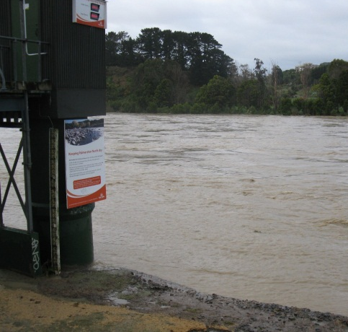
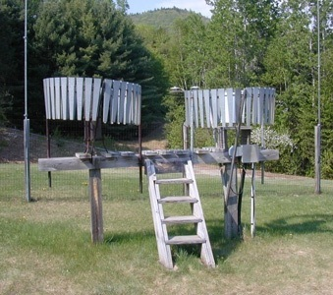
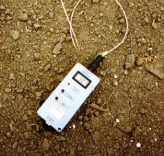
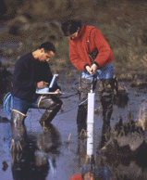
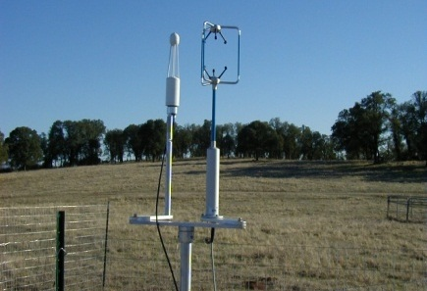
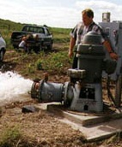
Water observations are a key to this understanding
Time series data at point locations
Water Quantity
Rainfall
Soil Water
Water Quality
Meteorology
Groundwater

Slide 6
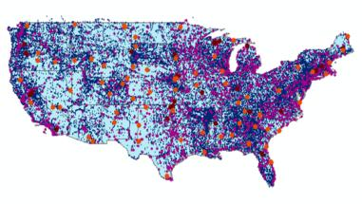
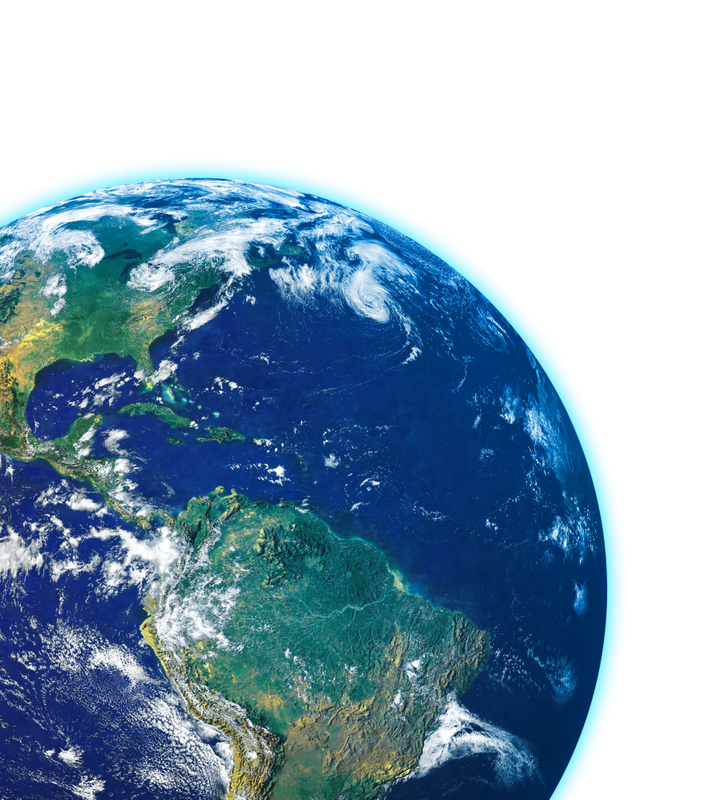
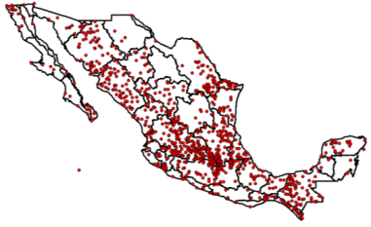
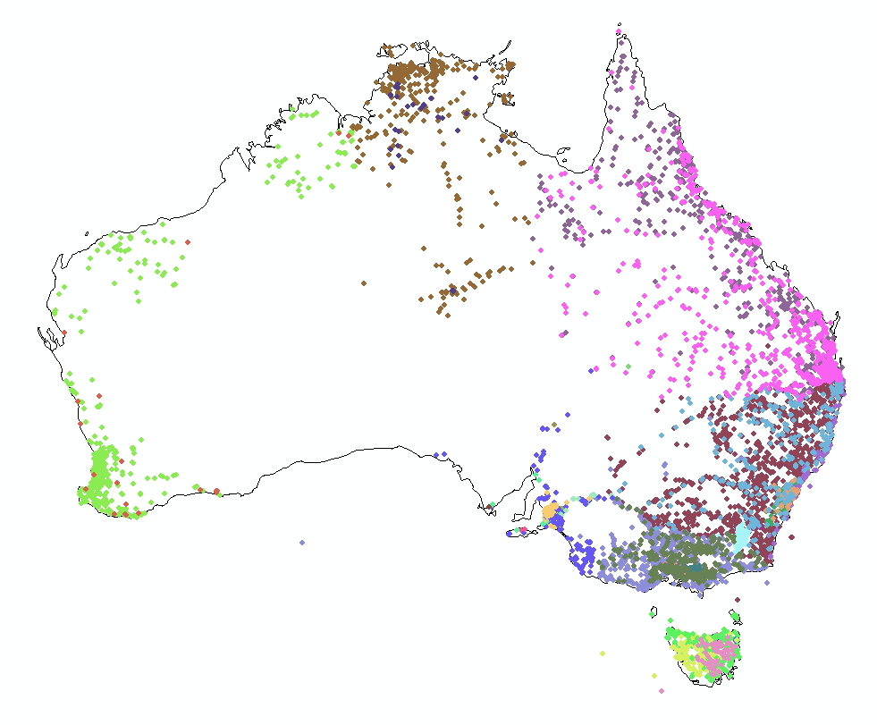
Every Country Collects These Data
We need
Global Water
Data Integration
United States
Mexico
Australia

Slide 7
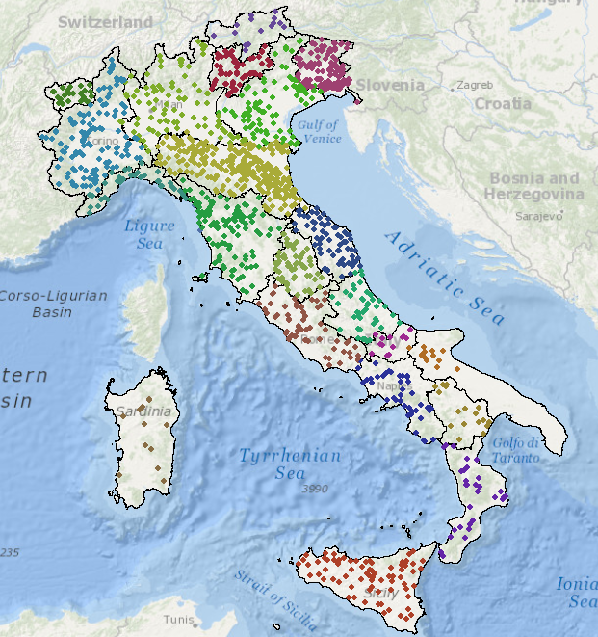
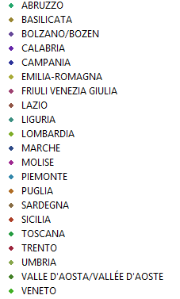

Italy – 22 regions
National Institute for Environmental Protection and Research (ISPRA)
ISPRA is the NIWA of Italy ….
….Hydrometric measurement was regionalized in 2002

Slide 8
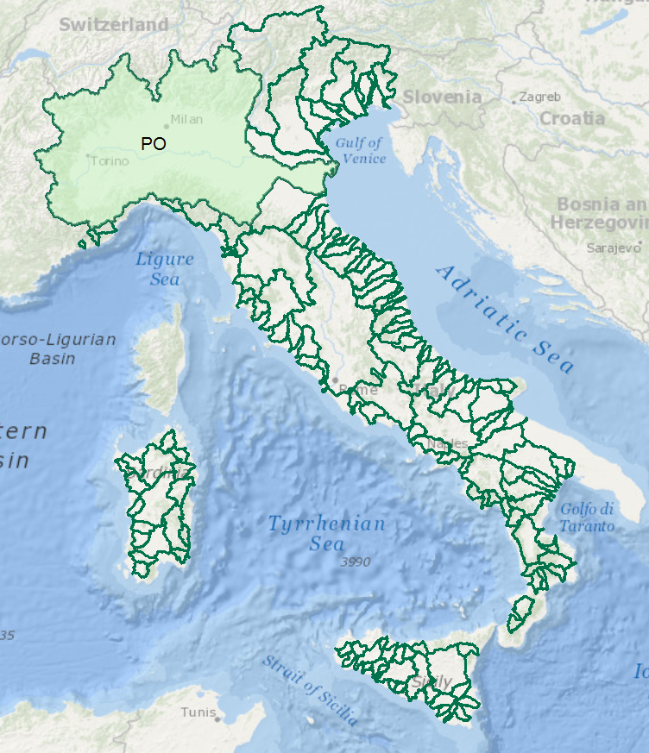
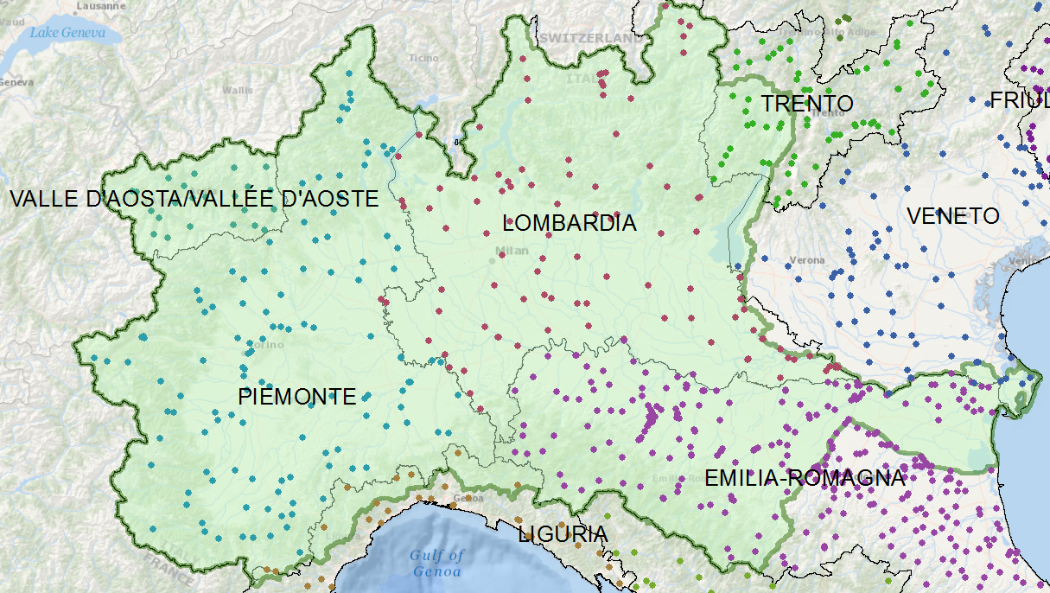

Italy – River Basins
Data for the Po River basin is managed by seven different regional authorities
One of these regions is Emilio-Romagna . . .
. . . they have fedeated the data for the Po Basin

Slide 9
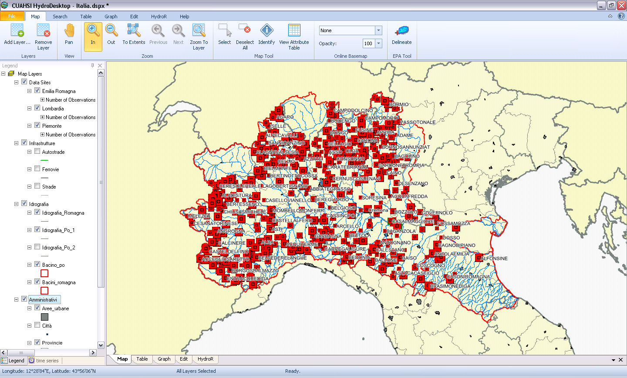
Prototype HIS for the Po Basin
Developed by Silvano Pecora (ARPA Emilio-Romagna)
Water data services published using CUAHSI Hydroserver ….
….. and ingested into CUAHSI Hydrodesktop

Slide 10
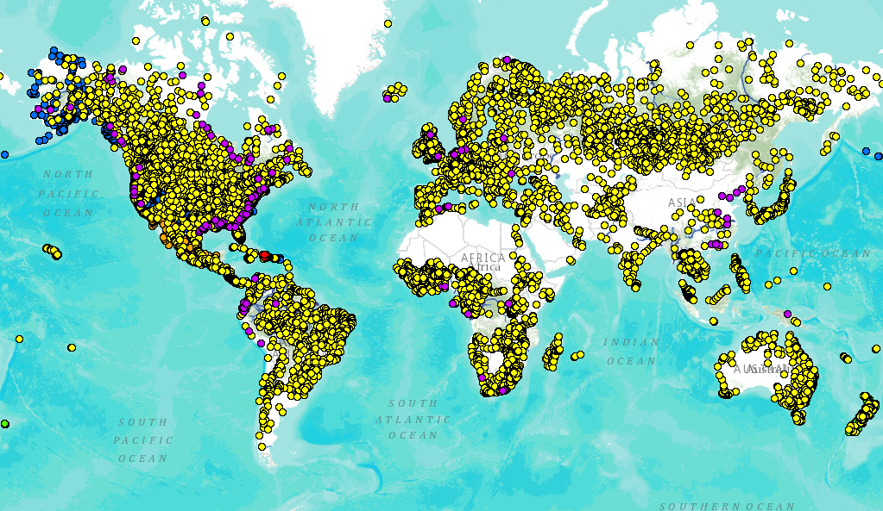
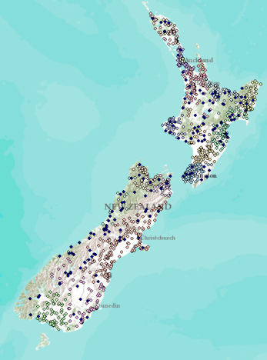
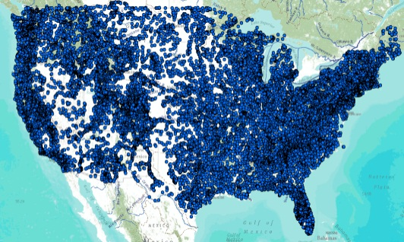
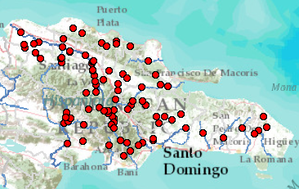
Global Streamflow Services
Building a national system federating regions. . .
. . . builds a global system federating countries
Global Runoff Data Centre
New Zealand
USA
Dominican Republic
http://www.arcgis.com/home/webmap/viewer.html?webmap=87ab07e2aba840828033e80b15fd6727

Slide 11
GEOSS Introduction
GEOSS: Global Earth Observation System of Systems
Hosted by GEO (Group on Earth Observations) to publish Earth observation datasets from 92 member countries
GEO home page: http://www.earthobservations.org/
GEOSS search portal: http://www.geoportal.org/
Enables distributed search among dozens of catalogs, accessing millions of data services, following international data exchange standards (ISO, WMO, OGC, …)
Data is organized around 9 Societal Benefit Areas (SBAs): Water, Weather, Climate, Biodiversity, Ecosystems, Energy, Agriculture, Health, Disasters
GEOSS AIP (Architecture Implementation Pilot)
Series of 1-year project cycles to implement GEOSS, started in 2007; AIP-6 complete in 2013; AIP-7 in progress.
Notes:
GEOSS is a portal to a registry and a broker framework to help with discovery and access to datasets and web services.
What’s useful about GEOSS is that it is a neutral space: not “owned” by any nation, agency, commercial entity or subject domain. The Group on Earth Observation (GEO) which created GEOSS started almost 10 years ago, and now has over 90 member countries and 77 participating organizations.
One of the ways GEOSS is getting built is through a series of Architecture Implementation Pilots, which are projects to develop GEOSS capabilities that run on an annual cycle. They started out to develop basic infrastructure, but now they’re really about applications across these many themes.
(This slide is normally hidden for use with GEOSS-aware audiences; but is kept in the slide set for use among audiences less familiar with GEOSS and AIP)

Slide 12
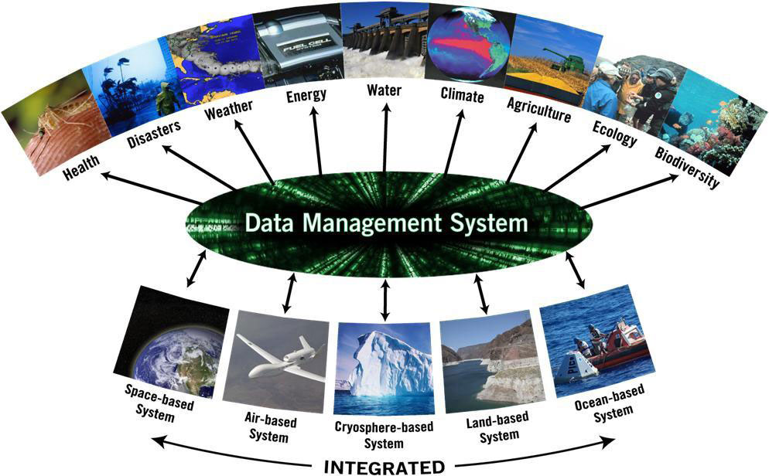

Slide 13
GEOSS Water Services: Key Objectives
Current international data exchange standards work mainly at the Internet level, still need refining for consistency of terms and usage within and across international hydrology communities…
This project advances water data sharing by:
Improving cross-domain discovery and access to global hydrology data
Integrating global drought and flood awareness capabilities among multiple international agencies and research centers
Enabling federation of regional & national water data around a common information model and service architecture, to enable national-level situation awareness on-demand
Working with WMO data centers (GRDC, GPCC), UNEP GEMS/Water, and UNESCO Institute for Hydrology Education (Delft) to advance & leverage authoritative sources with global outreach
Active capacity building in Latin America for a GEOSS of the Americas
Notes:
We have a goal of making water data sharing easier, and we chose these ways to tackle that: 1) by improving discovery and access to the data; 2) by integrating gridded and time series data sources; and 3) by showing how regional data within each country could be federated to develop a unified national picture – on demand. To accomplish these objectives, we formed a team of national agencies, academia, and commercial software companies. (will list the participants near the end)
I’ll talk first about the work we completed last year, then about what we’re doing now.

Slide 14
GEOSS AIP Water Services Team
(* new members)
Academic
University of Texas at Austin, USA
Brigham Young University, USA
University of Saskatchewan, Canada
Feng Chia University, Taiwan *
George Mason University, USA *
Community Labs, Portals
CUAHSI Water Data Center, USA
Dartmouth Flood Observatory, USA *
NASA Goddard Hydrological Science Lab, USA
NASA Goddard Earth Sciences DISC, USA
Federal Institute of Hydrology, Germany * (supporting GRDC, GEMS/Water)
EC Joint Research Centre (JRC), Italy
European Centre for Midrange Weather Forecasting (ECMWF), UK
Centre for Ecology and Hydrology, UK *
CEOS Water Portal (JAXA), Japan

Slide 15
GEOSS AIP Water Services Team, cont’d
National and regional agencies
Italian National Institute for Environmental Protection and Research (ISPRA)
Regional Agency for Environmental Protection in Emilia-Romagna (ARPA-ER), Italy
New Zealand National Institute of Water and Atmospheric Research (NIWA)
Horizons Regional Council (HRC), New Zealand
Commercial Engineering & Software
Esri, USA
Kisters AG, Germany
Microsoft Research, USA

Slide 16
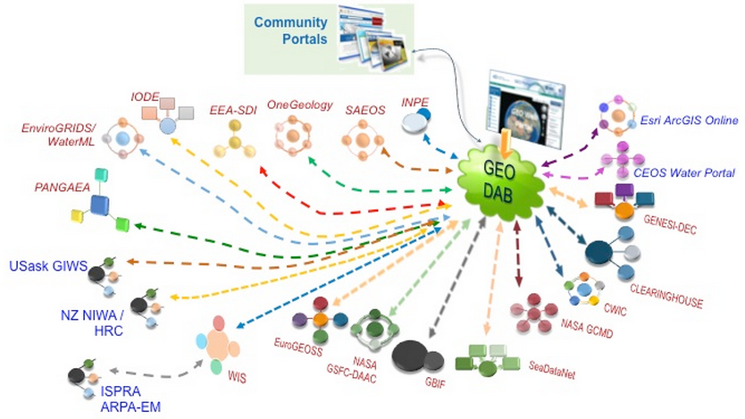
GEOSS Portal: connecting to community portals and other resources
GEOSS Discovery and Access Broker
Notes:
The GEOSS Discovery and Access Broker (DAB) distributes queries to dozens of community portals like the ones shown here. The data providers shown in blue are the participants of this project in 2013.

Slide 17
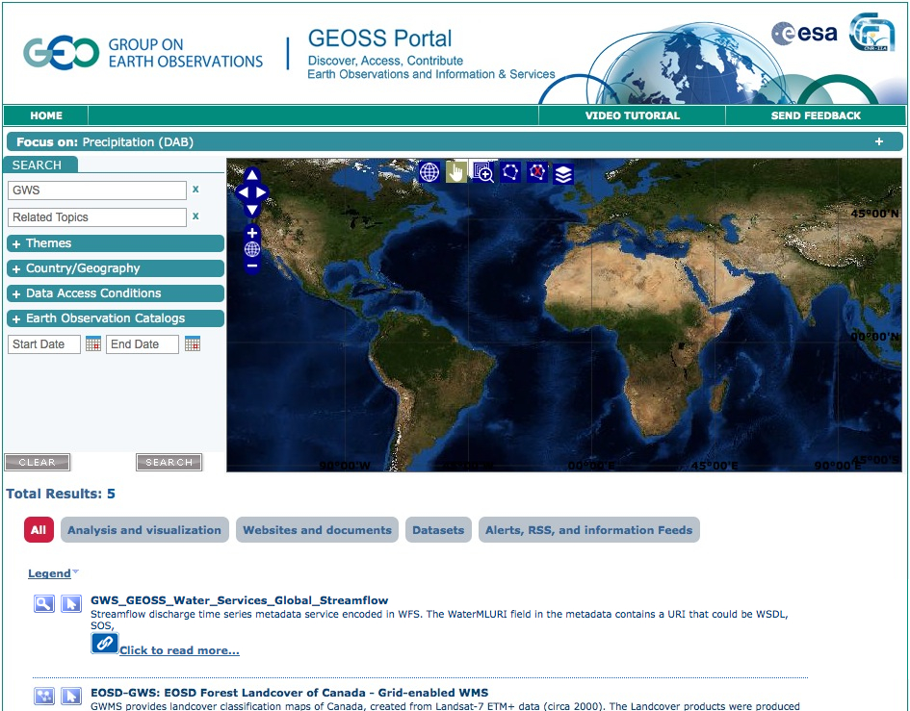
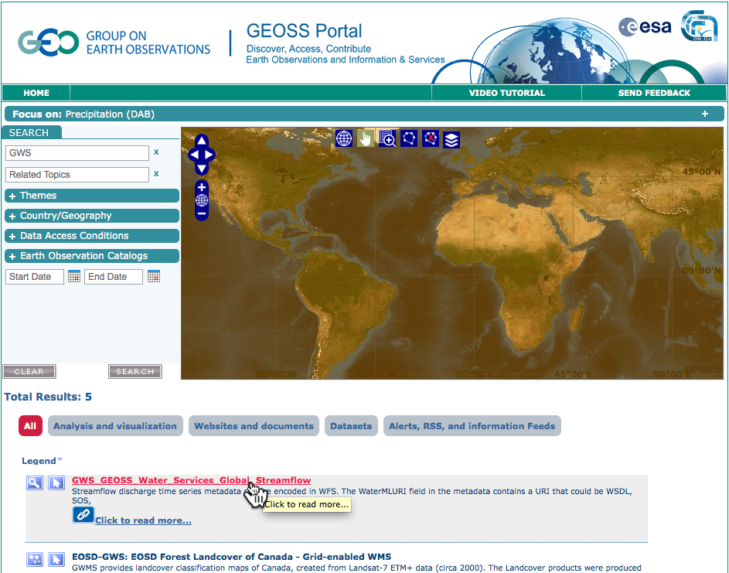
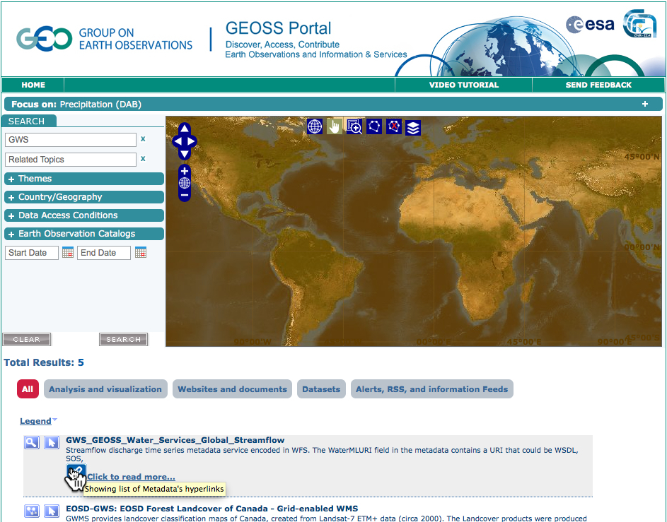
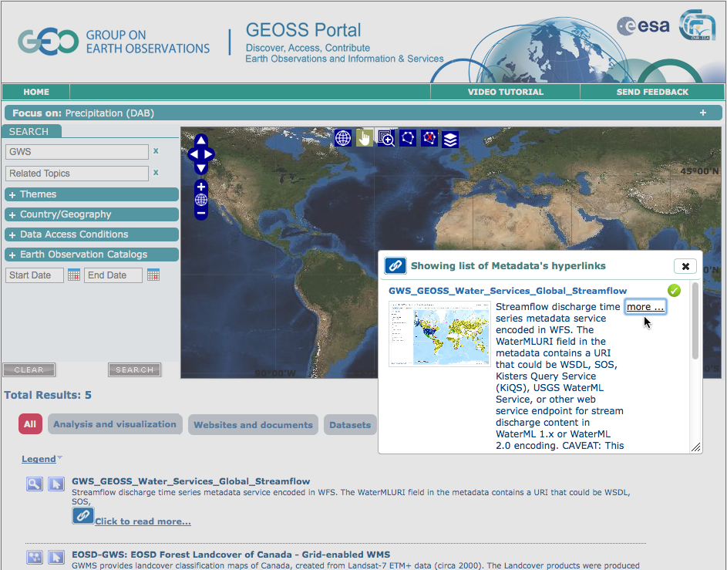
Notes:
This slide shows a sequence of steps for searching and accessing data through GEOSS Web Portal (www.geoportal.org)

Slide 18
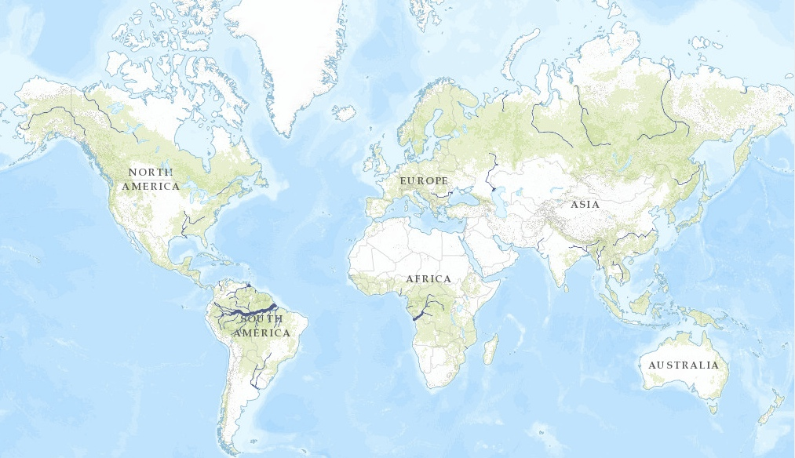
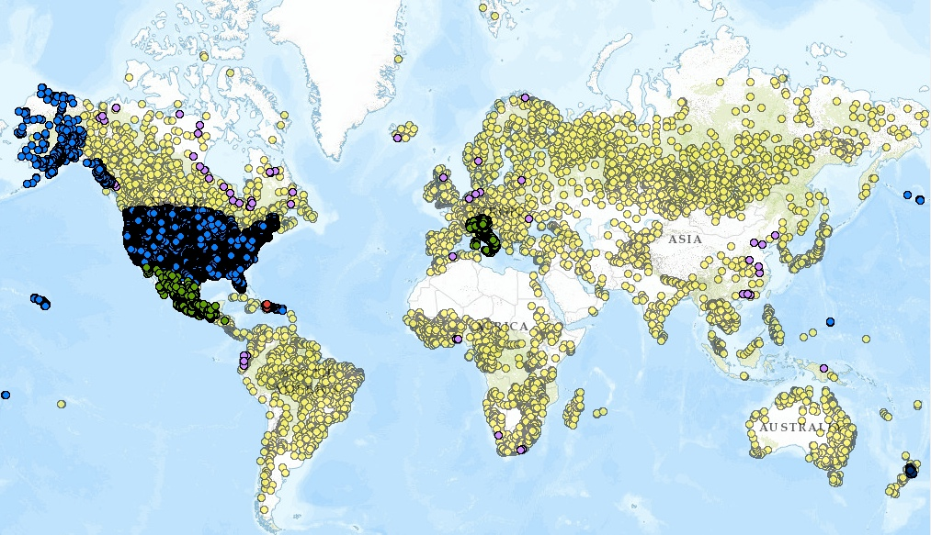

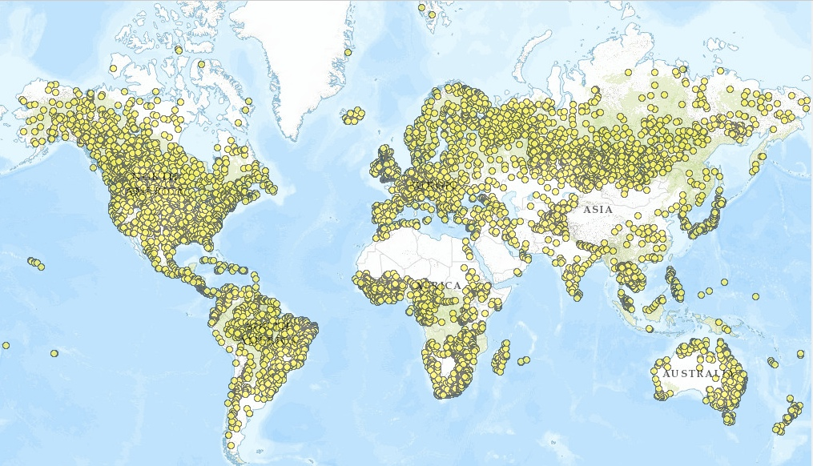
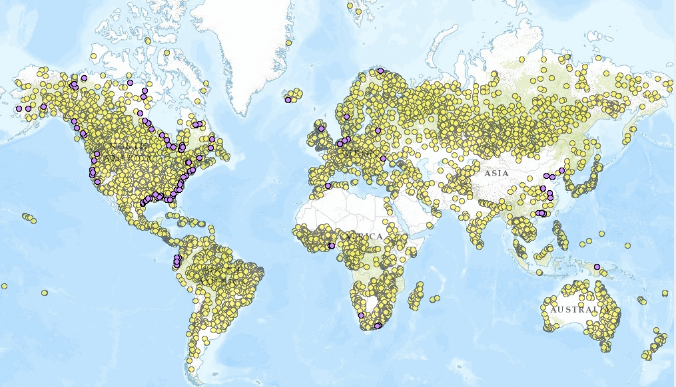
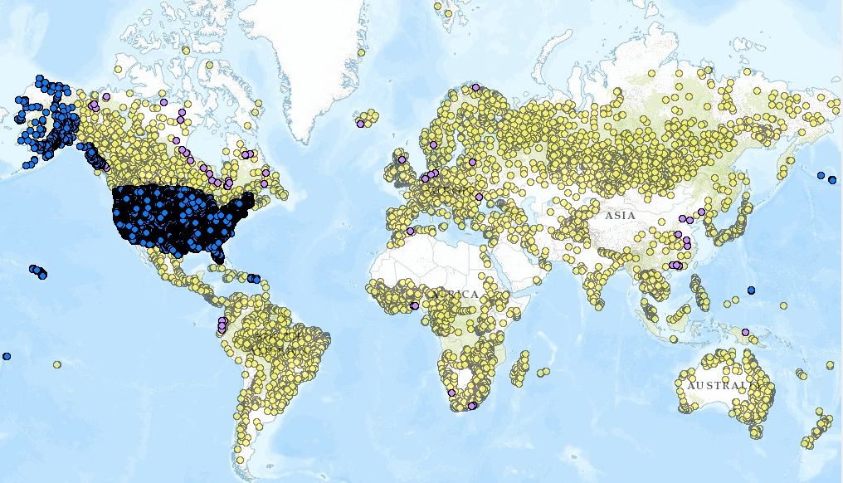

Water Data Maps: Global Stream Gauges
Not just seeing data providers’ bounding boxes, but actual locations of specific data… (Esri ArcGIS Online web map viewer)
Click to add layers
WMO GRDC (gauge descriptions only, no water data)
Kisters GRDC (WaterML 2 data for OGC Surface Water IE)
USGS NWIS (most have real-time data)
Mexico (some with historical data, hosted by Univ of Texas)
Dominican Republic (historical data hosted by BYU)
Italy & New Zealand (real-time data, developed for AIP-6)
http://bit.ly/19fUSPY
Notes:
Here is a map of the world’s major rivers, and <click>
locations of about 20,000 stream gauges registered in WMO’s Global Runoff Data Center in Germany. While the yellow dots represent locations where data has been collected, that data is not available in a standardized format, nor is it necessarily available without restriction. <click>
The purple dots are mainly coastal sites where Kisters has developed a WaterML2 web service from the GRDC data. They obtained agreements from the various countries to publish limited historical datasets. This was done for the OGC Surface Water Interoperability Experiment in 2011. <click>
The US <click> and Mexico maintain another 20,000 stream gauges, most of which provide ongoing data services. <click>
The red dots are for Dominican Republic, which started publishing its water data in 2012. <click>
As a result of this project, we can now add regional agencies’ gauges and data in Italy and New Zealand. <click> (next slide)

Slide 19
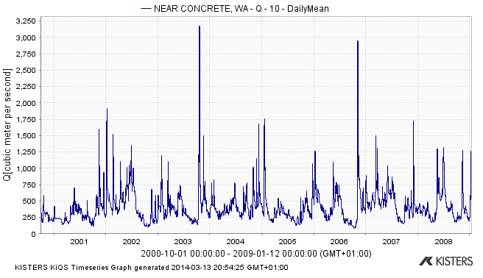
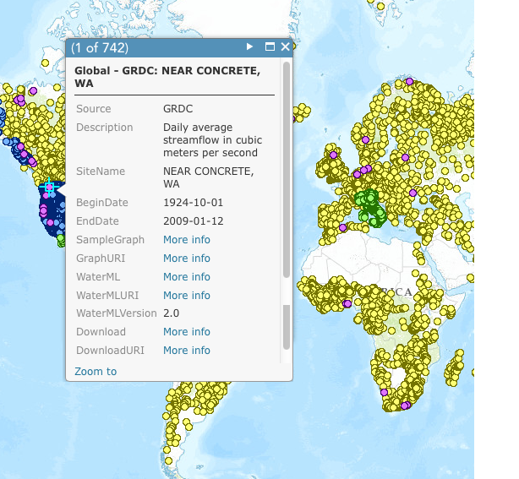
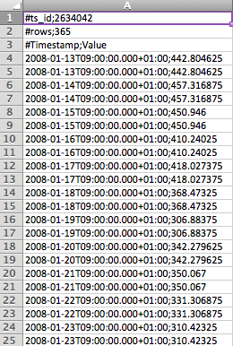
Gauge description and data links…
For quick overview
http://www.geoportal.org/
For easy analysis
WaterML for full details
Notes:
Clicking on a gage point brings up the basic time series description information.
This may include links to data and graphing services. The exact choice of time series description fields depends on the data provider. <click>

Slide 20
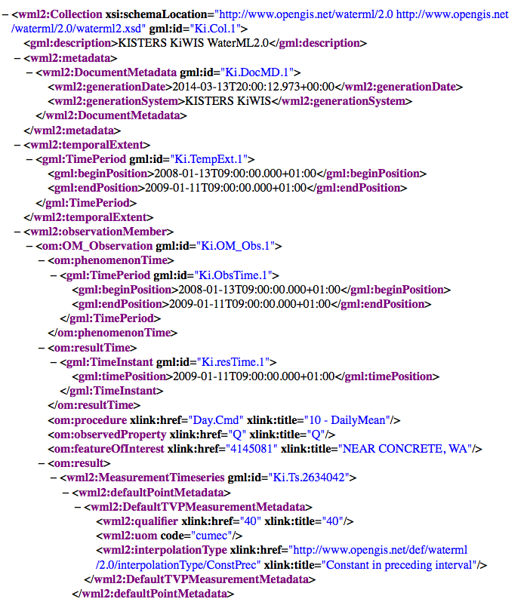
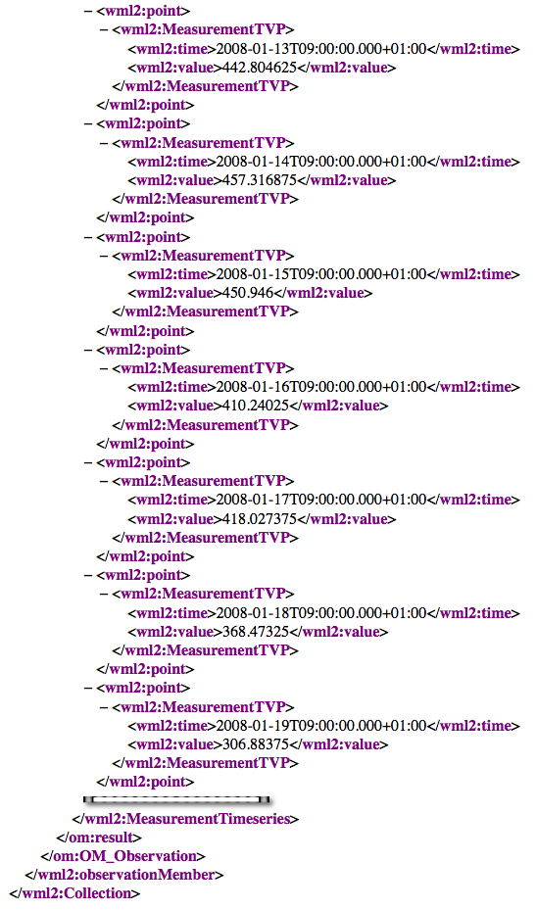
WaterML 2.0
Document metadata
Observation description
Phenomena time
Result time
Procedure
Observed property
Feature of interest
Result
Time series metadata
Time series data
Time series data, cont’d
Notes:
This is the actual WaterML exchange for a given stream gage, except for a bunch of data I cut out, to fit on the screen.
The metadata tells what variable & units of measure is represented, what kind of time series it is (instantaneous, cumulative, etc), and so on.
This is a profile of the OGC Observation & Measurement information model.

Slide 21
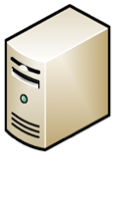
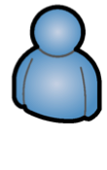

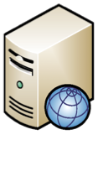
Behind the map…
6
Return time series data or graph (WaterML, CSV)
(SOS)
Data service
for time series
at one gauge
Community
Web Portal
Discovery, Access
and Visualization
5
Request data service for time series of selected gauge
1
Request data about [observed property]
4
Return gauge locations as a map layer (GML SF)
2
Return list of Data Providers’ map layers
3
Request map from each
Data Provider about
[observed property]
(WFS)
Map of gauges (one layer
per observed property) for
one Data Provider
(CSW)
Catalog of
Data Providers’ gauge layers
Notes:
(referring to slide 13 graphic showing streamgage map + popup + graph + CSV etc)
Here’s the wiring diagram for all that.
A data provider maintains its catalog of feature services and data services.
This is registered and periodically harvested by a community portal, which could be GEOSS, or CUAHSI HIS, or CEOS Water Portal, etc.
A user searching GEOSS or another community portal could find the feature services, see the maps, and click on the data service links.
The data service links would generate graphs, and CSV or WaterML output for download.

Slide 22
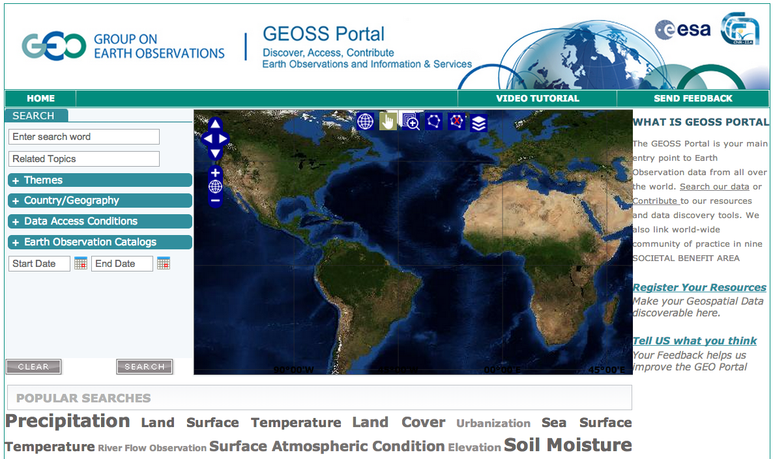
GEOSS promotes interdisciplinary discovery
www.geoportal.org
Community
Web Portal
Discovery, Access
and Visualization
GEOSS
(SOS)
Data service
for time series
at one gauge
By registering the community portal and its catalog in GEOSS, interdisciplinary users can more easily discover these resources
(CSW)
Catalog of
Data Providers’ gauge layers
(WFS)
Map of gauges (one layer
per observed property) for
one Data Provider
Notes:
For cases where the community portal is not actually GEOSS, then it could be registered in the GEOSS Discovery and Access Broker, which could then distribute queries. This enables more cross-domain discovery than is likely just from a given community portal.

Slide 23
Federating regional & national water data
Without consistent use of standards for data content and description, every water management agency would have a different way of telling their story
In this project, we have started convergence toward a common way of describing water data time series among these countries:
United States (USGS NWIS)
Italy (ISPRA/ARPA-ER)
New Zealand (NIWA/HRC)
Canada (USask GIWS for Environment Canada)
Dominican Republic (through BYU)
Honduras (through BYU)
Nicaragua (through BYU)
Guatemala (through BYU)

Slide 24
Summary of Recommendations
Use OGC WaterML 2 for water-variable time series data (streamflow, precipitation, runoff, etc).
Use OGC WFS or similar feature layer of water data sites; one WFS service per data layer / producer.
Use consistent & minimal subset of time series description fields in the WFS data service (this is a current discussion topic).
Use OGC SOS 2 as the web data service for WaterML 2, but be prepared for the many sites running CUAHSI WaterOneFlow (WOF) web service for WaterML 1.x data, and even WFS for WaterML time series data. Use ISO 8601 for time expressions in the data service.
Each data provider could install and manage a catalog registry of relevant time series descriptions (WFS feature layers), or use an established community catalog for that purpose (eg, CUAHSI HIS Central). This catalog should itself be registered in GEOSS.
WMO is advancing that the core WaterML be renamed TimeSeriesML, and the hydrology-specific portion (still to be called WaterML) become a profile of TimeSeriesML.
Notes:
WFS = Web Feature Service
SOS = Sensor Observation Service

Slide 25
Water Map Service Guidelines
There needs to be a consistent way of describing water data time series, that would be followed by data producers and software developers.
With this project we are defining a minimal set of feature attributes which characterize time series, for use between map viewer/client and WFS data service:
WaterMLURL for a REST call to a separate data service endpoint, that enables a time series to be queried from this location.
GraphURL and DownloadURL for graphing or downloading the data, if available.
BeginDate of the data (the time of first information, using ISO 8601 time format).
EndDate of the data (make Null if this is current time).
Descriptor – text descriptor of this feature (e.g. Site name for gaging station, COMID for NHDPlus, etc)
Source – text field that specifies the source of the data e.g. USGS, etc.
If the EndDate field is empty (null), this means the data service is a near-real-time feed, not just an historical dataset.
The WaterML time series data is served by OGC Sensor Observation Service (SOS), or in some cases, WFS as well.
FP7 GEOWOW (http://www.geowow.eu/) developed Hydrology Profile for SOS 2.0, to provide unambiguous conventions for data service REST calls (OGC 14-004)
Notes:
Ref from twiki: http://twiki.grumets.uab.es/twiki/bin/view/AIP6/Aip6GeossWaterServiceGuidelines
OGC 14-004, SOS 2.0 Hydrology Profile Discussion Paper, by 52North and Kisters AG, https://portal.opengeospatial.org/files/?artifact_id=57327&version=1, developed under European Commission FP7 project, GEOWOW (http://www.geowow.eu/). (Access to draft document may be restricted to OGC members; contact info@opengeospatial.org if you have difficulty downloading or opening this.)

Slide 26
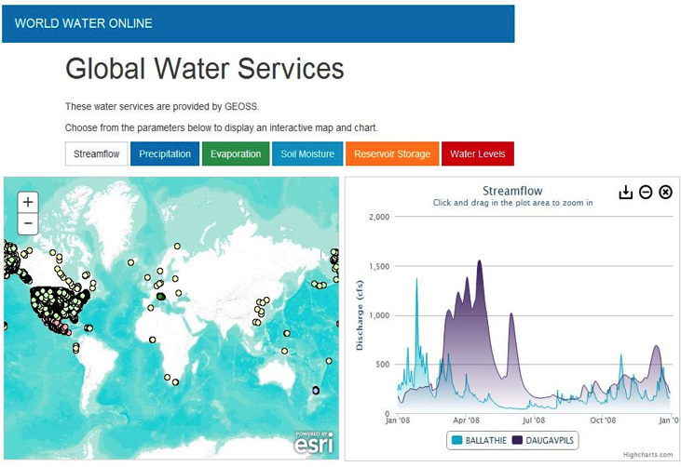
Open source client apps are in progress…
A browser-based WaterML Viewer (for all versions) is in development at UT Austin: https://github.com/crwr/wmlviewer

Slide 27
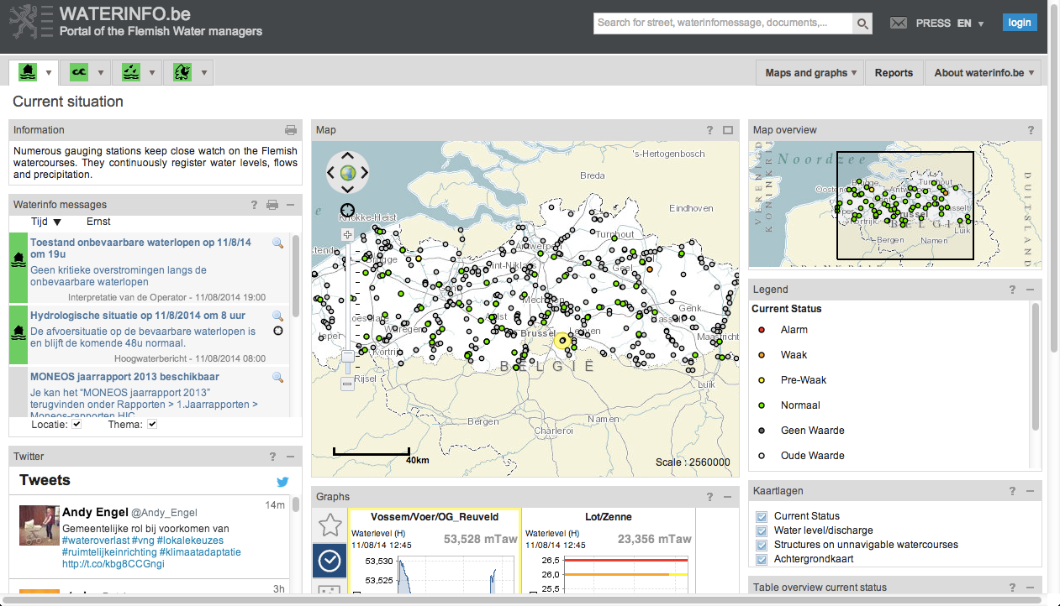
Flemish Water Resources
http://www.waterinfo.be/

Slide 28
Water Quality Services
OGC 14-004 WaterML – WQ Profile Best Practice
Single variable per time series
Keep the XML simple, if verbose
Use CSV/Excel format for multi-variable applications
Numerous application areas
Health, wastewater monitoring
Residential, industrial point sources
Stream nutrient loading

Slide 29
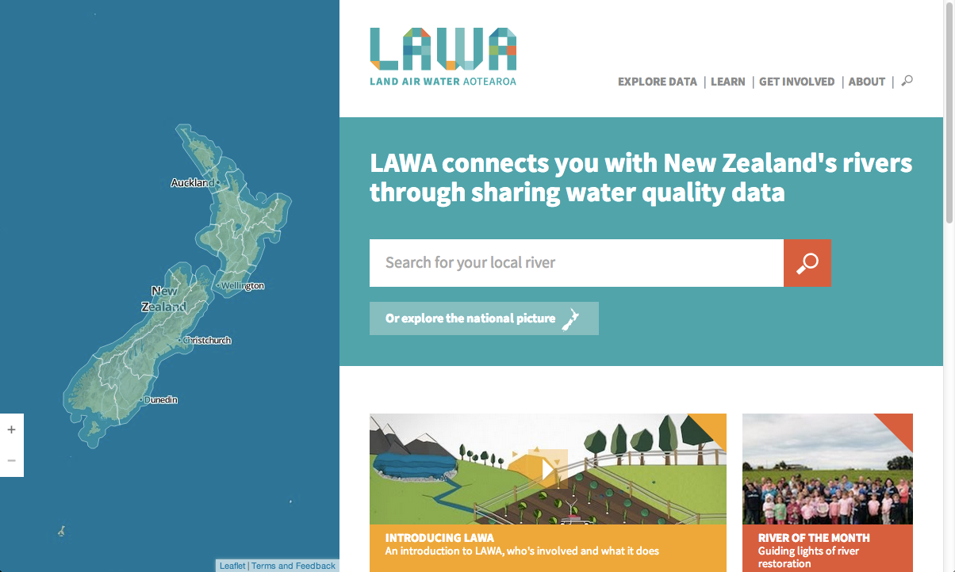
New Zealand WQ Browser: LAWA
http://www.lawa.org.nz/

Slide 30
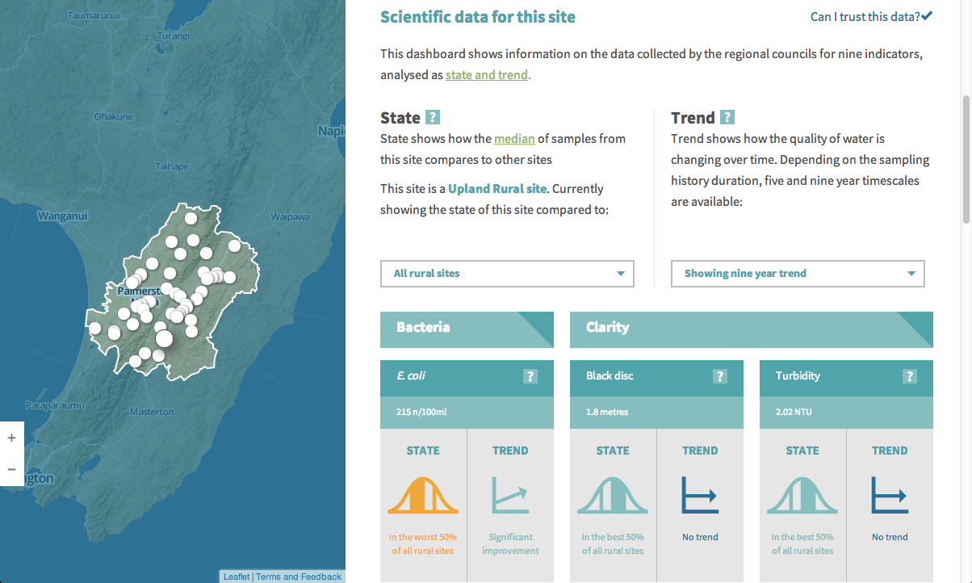
New Zealand WQ Browser: LAWA
http://www.lawa.org.nz/explore-data/manawatu-wanganui-region/manawatu/makakahi-at-hamua/

Slide 31
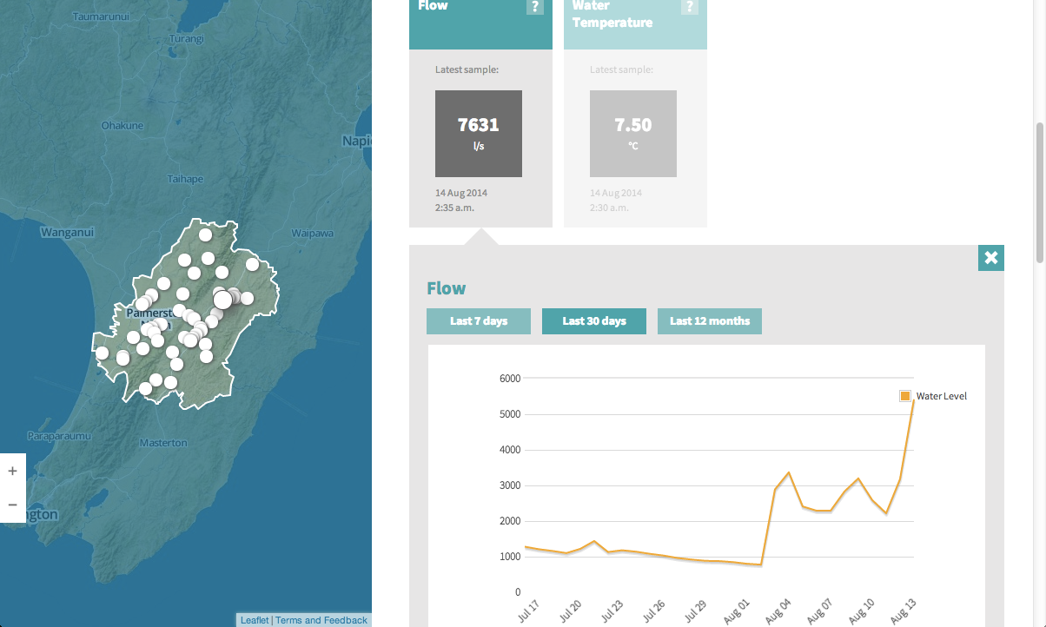
New Zealand WQ Browser: LAWA
http://www.lawa.org.nz/explore-data/manawatu-wanganui-region/manawatu/oruakeretaki-at-sh2-napier/#X

Slide 32
Summary
WMO Information System (WIS)
Global network of authoritative national agencies’ data
WIS is being integrated with GEOSS for distributed search
OGC/WMO Hydrology Domain Working Group develops core standards through OGC Interoperability Experiments & Pilots
GEO/GEOSS provides an organizing principle for implementing data and map catalogs and services that works across boundaries between nations, institutions, and scientific / societal domains
AIP-Water theme is providing a forum for developing coherent, consistent conventions and tools for data sharing that enable regional, national & global federation & cross-discipline interoperability – in coordination with Energy, Agriculture, Health, and other GEO societal benefit areas
We are building momentum; need to develop training & support

Slide 33

Thanks!
David Arctur
david.arctur@utexas.edu

