Slide 1
WaterML 2.0 Part 1 - Time Series
Hydro Informatics Conference Workshop
*Standardization of Water Data Exchange: WaterML2.0 and Beyond*
Presented by : Open Geospatial Consortium Hydrology Domain Working Group
Paul Sheahan
Australian Bureau of Meteorology
August 2014

Slide 2
WaterML2.0
WaterML2.0 is an interoperability contract that facilitates data exchange.
A conceptual model expressed in UML
An XML schema

Slide 3
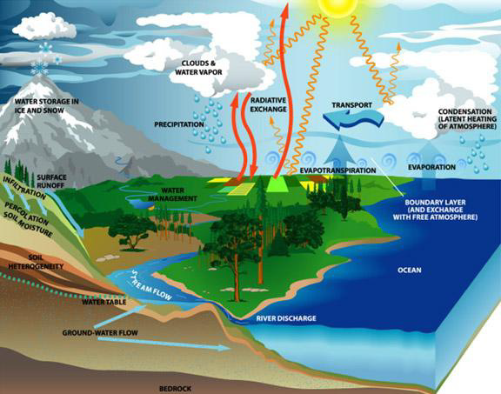
Hydrological observations
Broad categories of water observations
In-situ, fixed observation style
In-situ, manual observations
Ex-situ, complex processing observations
Remote-sensed observations
Complex data products
Generally, the more complex the process of making the measurement, the less likely it is to be available as a continuous observation.

Slide 4
Concepts harmonisation
Discussion Paper
Harmonising Standards for Water Observation Data (OGC 09-124r2)
Considered data exchange formats from:
Australian Water Data Transfer Format
WaterML1.0
XHydro
UK Environmental Agency time series data exchange
Climate Science Modelling Language
Ground Water Mark-up Language (GWML)
INSPIRE Hydrography model
GRDC Hydrologic Datasets - metadata
Integrated Ocean Observing System (IOOS)
Marine Metadata Interoperability
Sandre - Surface Water Quantity exchange
OpenMI
FEWS PI

Slide 5
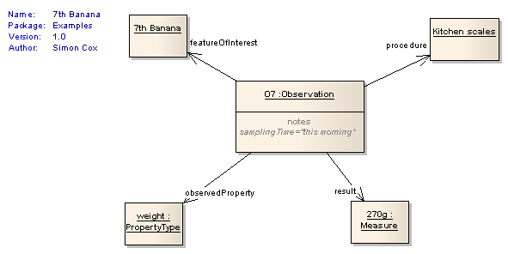
Standards based
WaterML2.0 is based on:
ISO19156 – Observations & Measurements
OGC Geography Markup Language v3.2.
Other ISO and OGC

Slide 6
O&M Feature mapping
Hydrological term | ISO19156 – Observations & Measurements
Monitoring station, gauging station, site | SF_SamplingPoint
Borehole, observation well, river profile | SF_SamplingCurve
River cross-section | SF_SamplingSurface

Slide 7
XML schema overview
Collection
MonitoringPoint
ObservationProcess
ObservationMetadata
Timeseries
MeasurementTimeseries
MeasurementTimeseriesMetadata
CategoricalTimeseries
TimeseriesMetadata
TimeValuePair
TVPMetadata
MeasurementTVP
TVPMeasurementMetadata
CategoricalTVP

Slide 8

Time series data
Is it all about the dots on a graph?

Slide 9
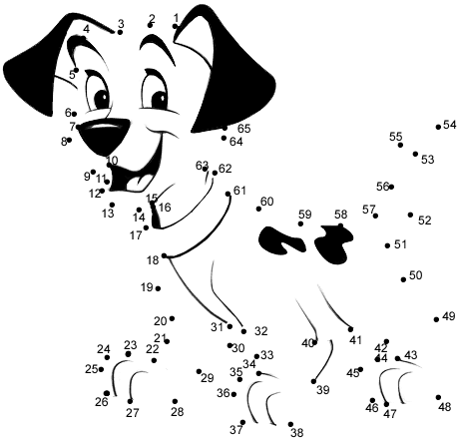
Discrete observations
The discrete observation is an accurate observation of a feature at a particular point in time.
The observation is a stand alone item, it is not related to other results.
Typically ex-situ analysis
Notes:
The dots outline the picture
Limited but adequate coverage of the subject – depending on monitoring regime

Slide 10
Continuous observations
Results are collected with a time resolution at which it is appropriate to consider the record to be a continuous representation of the observed phenomena.
The high data density allows users to fill in the gaps between the observations (dots).
Time series data is not about the dots, its about the lines.
Notes:
The line defines the assumed gaps
Typically logger, telemetry or digitized analogue record
The problem is when data systems only record the dots when what we need is information about the lines
Dots are line descriptors – not dots.

Slide 11
Time series point metadata
quality
nilReason
comment
qualifier
processing
source
censoredReason
accuracy
interpolationCode
aggregationDuration
By point, or set the default for the series

Slide 12
Interpolation code
Its all about the lines….
Continuous/Instantaneous
Discontinuous
Instantaneous total
Average in preceding interval
Maximum in preceding interval
Minimum in preceding interval
Preceding total
Average in succeeding interval
Succeeding total
Minimum in succeeding interval
Maximum in succeeding interval
Constant in preceding interval
Constant in succeeding interval
Statistical

Slide 13
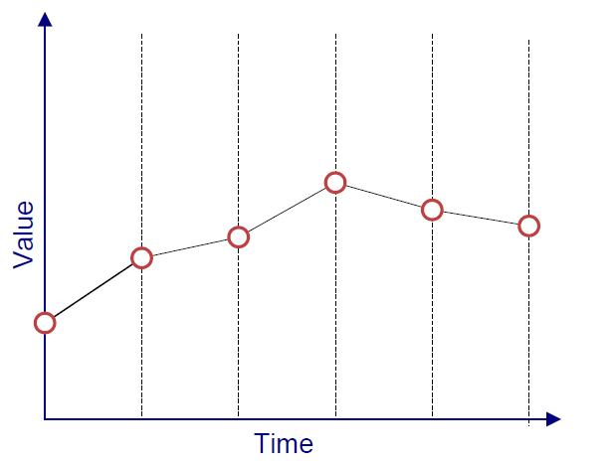
Continuous/Instantaneous

Slide 14
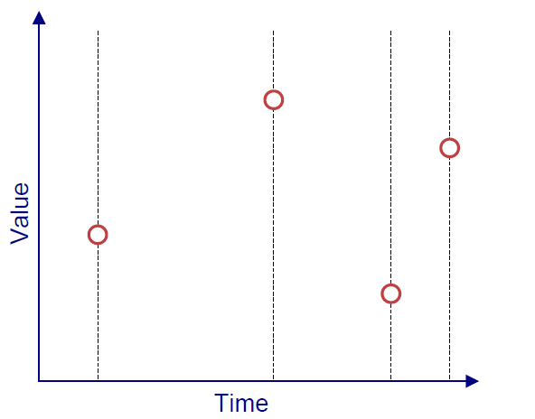
Discontinuous

Slide 15
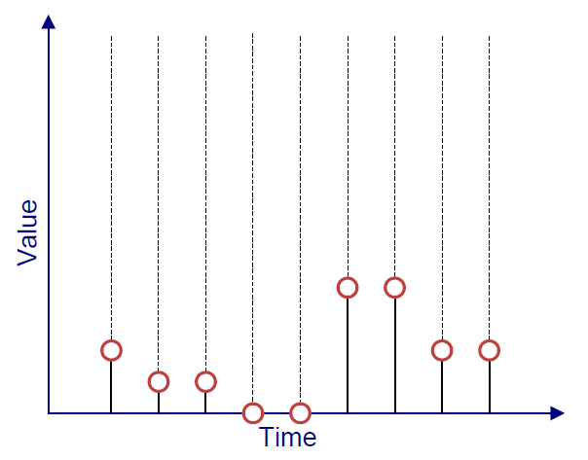
Instantaneous total

Slide 16
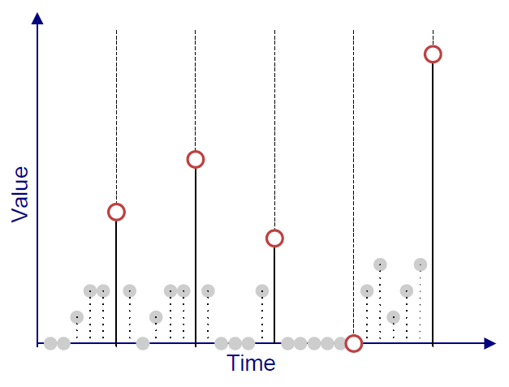
Preceding total

Slide 17
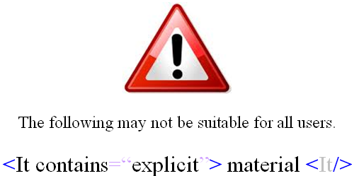
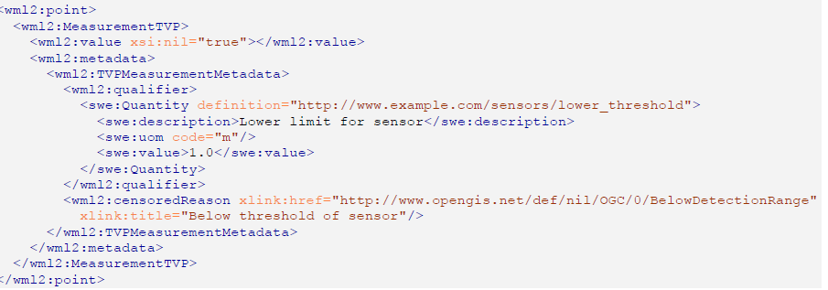

Slide 18
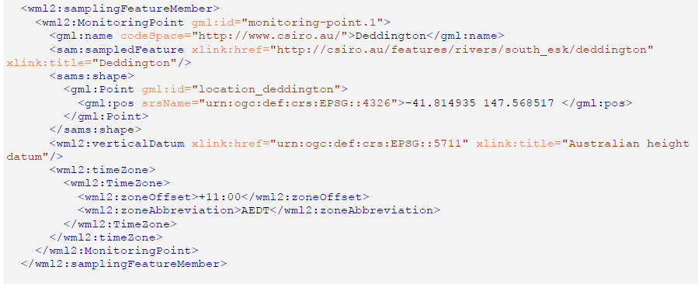

Slide 19
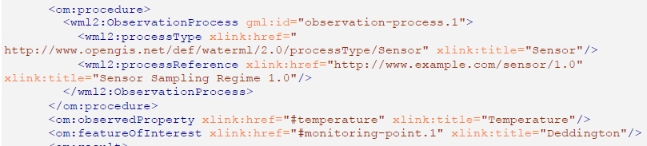

Slide 20
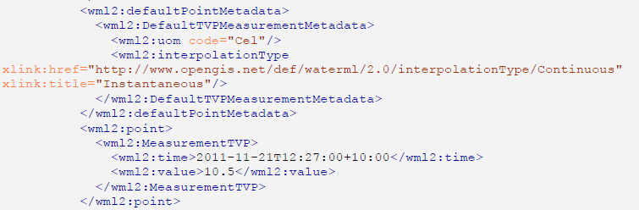
vocabulary

