Slide 1
WaterML 2.0 Part 2 – Ratings, Gaugings and Sections
Hydro Informatics Conference Workshop
*Standardization of Water Data Exchange: WaterML2.0 and Beyond*
Presented by : Open Geospatial Consortium Hydrology Domain Working Group
Paul Sheahan
Australian Bureau of Meteorology
August 2014

Slide 2
WaterML2.0
WaterML2.0 is an interoperability contract that facilitates data exchange.
A conceptual model expressed in UML
An XML schema

Slide 3
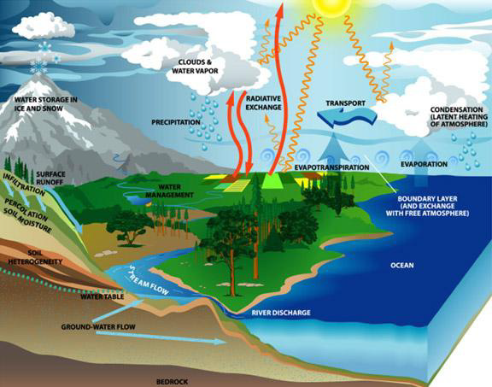
Hydrological observations
Broad categories of water observations
In-situ, fixed observation style
In-situ, manual observations
Ex-situ, complex processing observations
Remote-sensed observations
Complex data products
Generally, the more complex the process of making the measurement, the less likely it is to be available as a continuous observation.

Slide 4
Motivation
Enable the calculation of derived values, e.g. flow
Enable the investigation of quality issues.
E.g. Mass balance or model output has errors. Investigate the quality of the ratings – thus flow produced from the monitoring site.
Enable data user 'fitness for purpose' assessment.

Slide 5
Concepts harmonisation
Requirements and scope defined by
Unites States Geological Survey
Centre for Ecology & Hydrology , UK
San Diego Supercomputer Center, USA
Kisters , Germany
Aquatic Informatics, Canada
Commonwealth Scientific and Industrial Research Organisation, Australia
Bureau of Meteorology, Australia

Slide 6
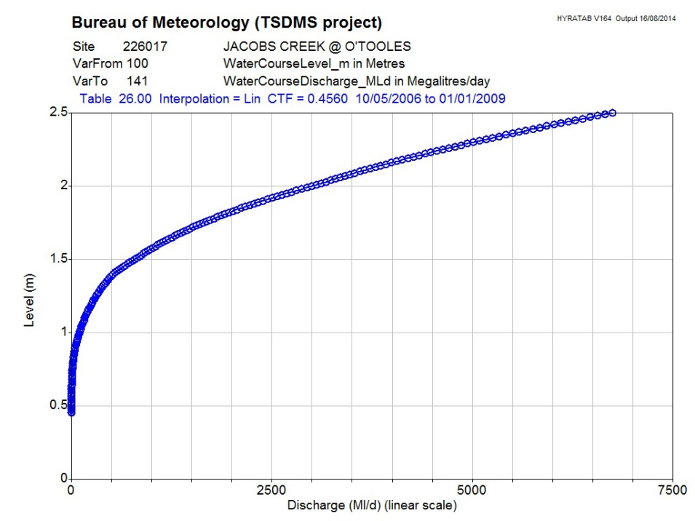
Ratings
Typically river discharge ratings
Established the relationship between river level and flow
Generalised to be any conversion though a linearly interpolated lookup table.
Does not encode work flow

Slide 7
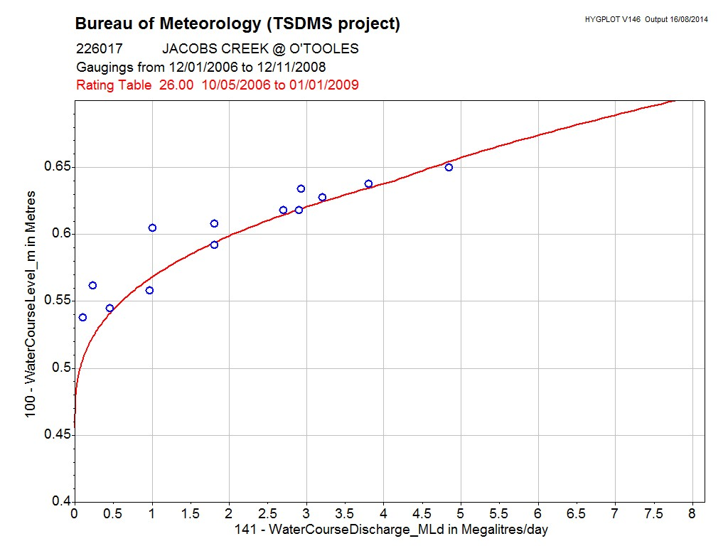
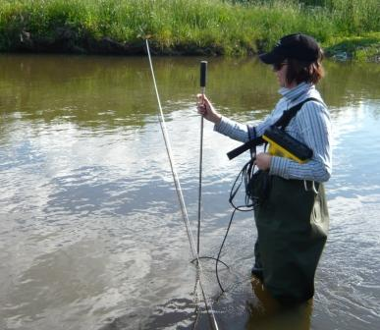
Ga(u)gings
Point observations used to create, maintain and validate ratings.
Result of the gauging, rather than all observations taken to complete the gauging

Slide 8
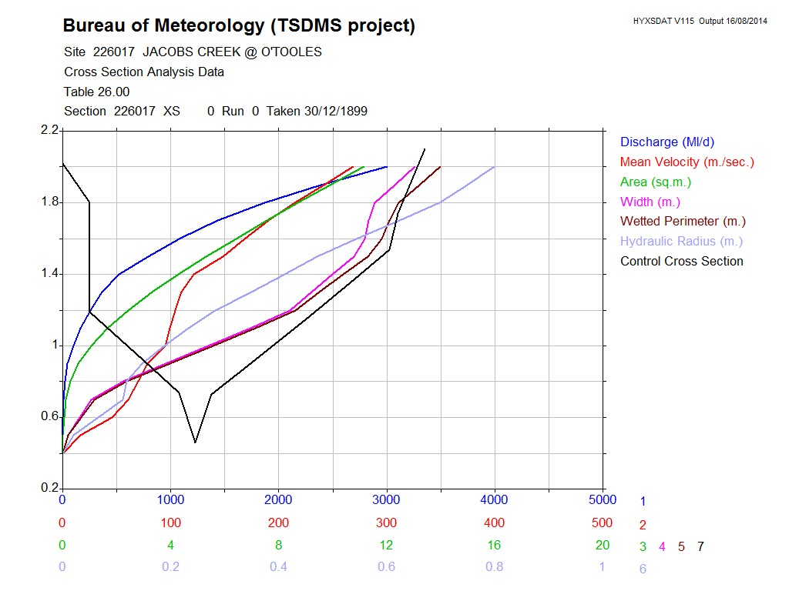
Sections
River cross sections or long sections

Slide 9
Development status
Requirements and Scope definition - 2012
Domain Modelling – 2012/13
Draft model submission - 2012
Interoperability Experiment
Engaged Participants - 2014
Architecture report – 2014
Standards Working Group Formed
Standard development
Candidate standard comment / review period
Adoption vote -> publication

Slide 10
Interoperability experiment
Scenarios for exchange
Flood forecasting - Exchange between USGS and US National Weather Service
Inter-agency exchange - exchange between the Aus Bureau, MDBA, NSW Office of Water, Tas DPIPWE, Vic DEPI
Public data publishing - publication of the UK’s National River Flow archive

Slide 11
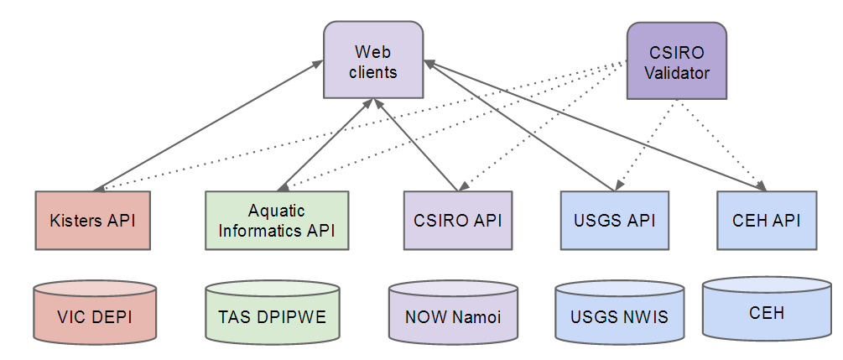
Web services

Slide 12
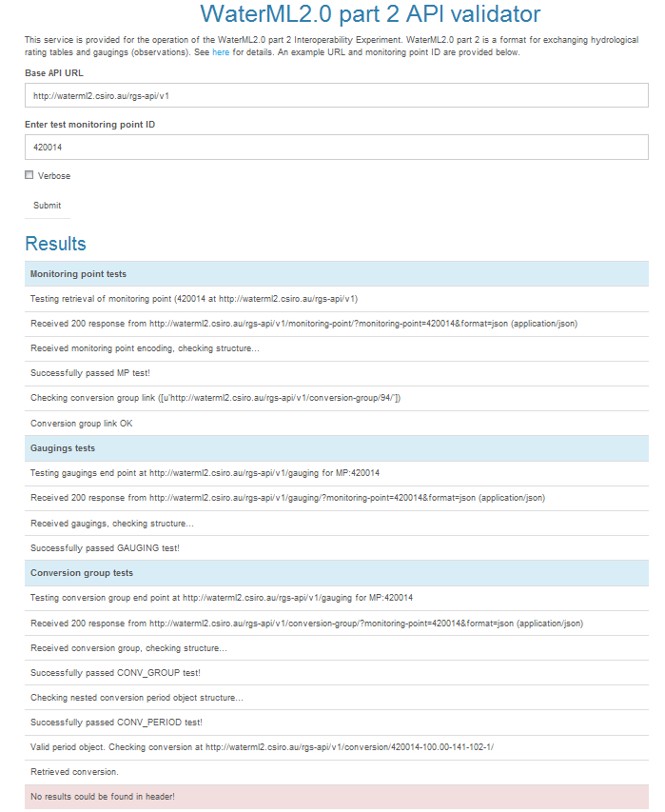
Validation service
http://waterml2.csiro.au/validator

Slide 13
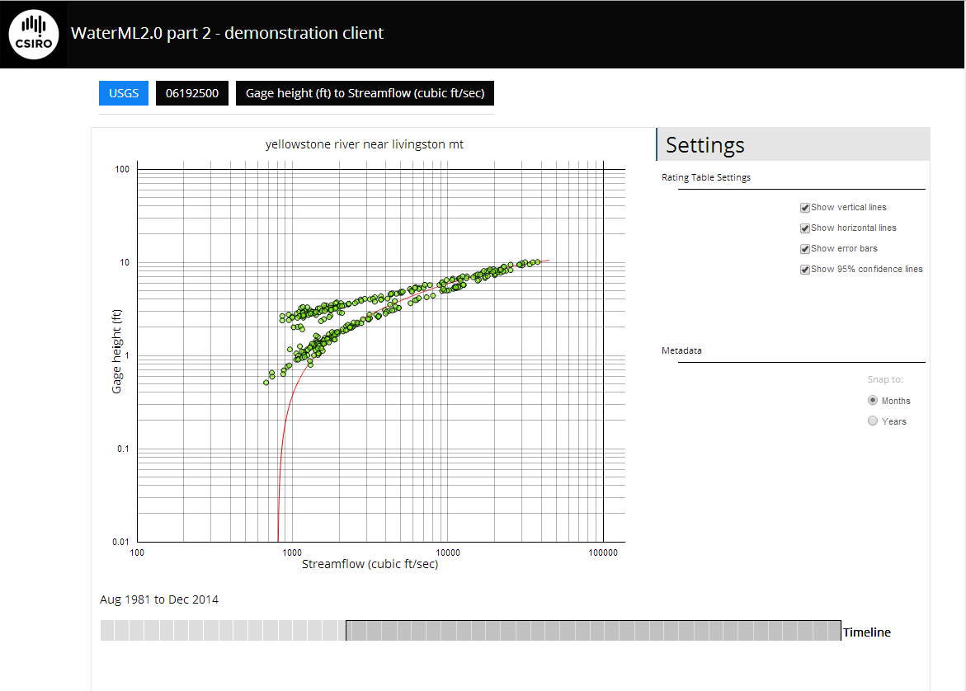
Clients - web
http://waterml2.csiro.au/rgs-api/v1/viz/

Slide 14
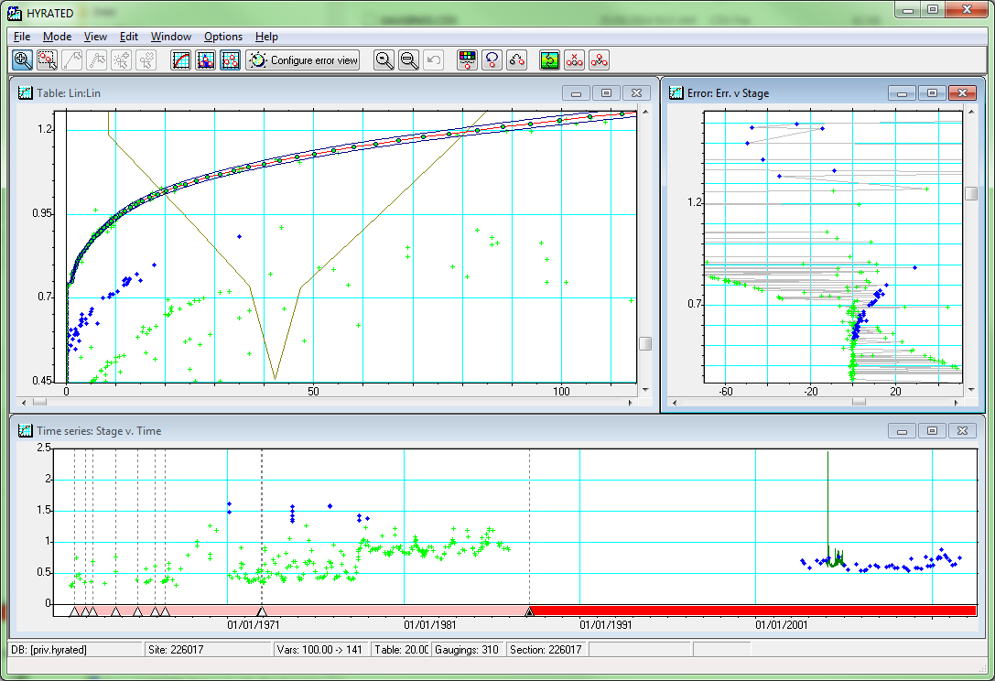
Client – Workbench integration

Slide 15
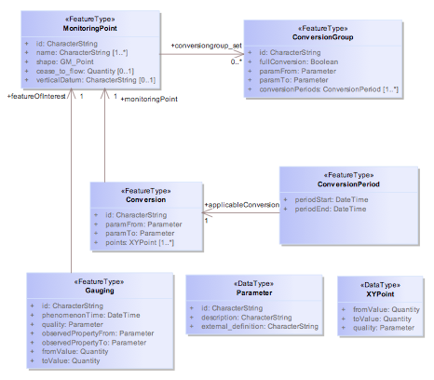
Interoperability experiment

Slide 16
Interoperability experiment
Implemented a RESTful API
Implemented XML encoding though the API
Implemented JSON encoding though the API
Returns | URL | Description
MonitoringPoint | /monitoring-point/ | Returns a list of all monitoring points. Current returns fully encoded descriptions rather than simple references.
MonitoringPoint | /monitoring-point/<mp-id> | Returns description of a specific monitoring point by ID.
ConversionGroup | /conversion-group/ | Returns a list of all available conversion groups (combinations of monitoring-points/paramFrom/paramTo
ConversionGroup | /conversion-group/<cg-id> | Returns a specific conversion group description.
Conversion | /conversion/ | Returns a list of all available conversions. Get latest rating also available.
Conversion | /conversion/<conv-id> | Returns a specific conversion by its identifier.
ConversionPeriod | /conversion-period/ | Returns a list of all available conversion periods.
Gauging | /gauging/ | Returns all available gauging observations.
Gauging | /gauging/<gauging-id> | Returns a specific gauging observation by its identifier.

