Slide 1
Water Data Sharing Using OGC Standards and the Internet
David Blodgett
USGS Center for Integrated Data Analytics
8/16/2014

Slide 2
The System Components
Catalog Service for the Web
Web Map Service
Web Feature Service
Web Coverage Service
Sensor Observation Service
WaterML2 Time Series
Observations and Measurements
Geography Markup Language
OGC Web Services - Core

Slide 3
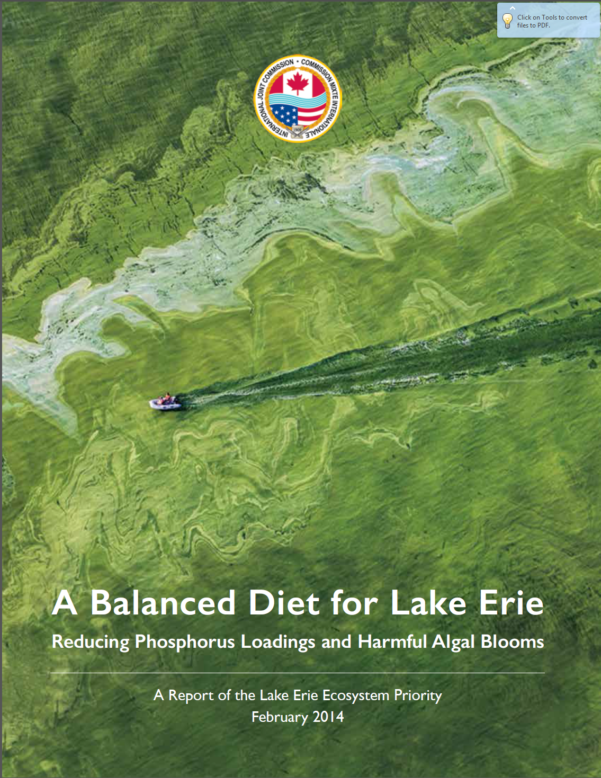
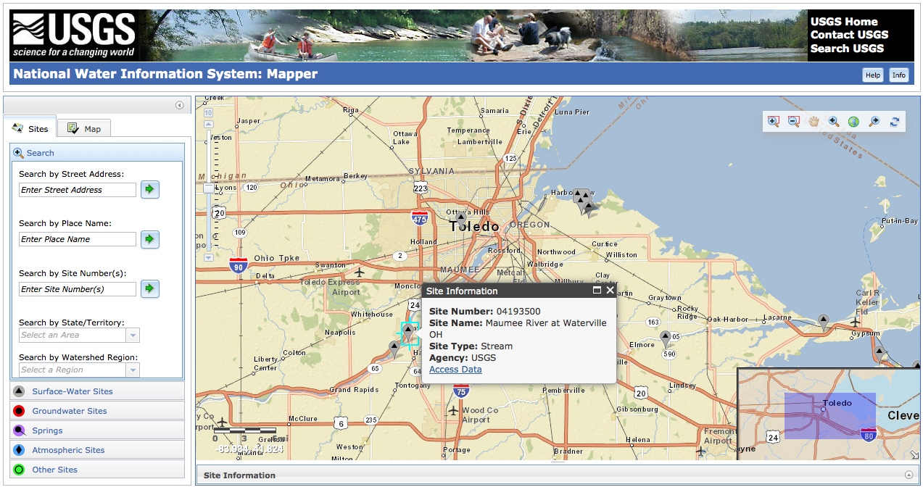
Toledo, OH Water Ban
Issue: Excess nutrient loading to Lake Erie from Maumee River causes toxin-producing harmful algal blooms
Locate relevant data: Maumee watershed discharge and phosphorus concentration identified on NWIS Mapper
Photo Credit: International Joint Commission 2014 LEEP Report

Slide 4
Demo #1
Use R-Studio ‘dataRetrieval’ and ‘Exploration and Graphics for RivEr Trends’ (EGRET) to look at flow and phosphorous trends.
See github.com USGS-R for packages.

Slide 5
Demo # 2
Web and R access to tabular streamflow statistics calculated on the server or locally.
National Water Census Data Portal
See github.com EFlowStats package

Slide 6
Demo # 3
Web and script access to a web processing service that can provide subsets of gridded weather data. Interpret in Python.
Geo Data Portal Web Processing Service.

