Slide 1
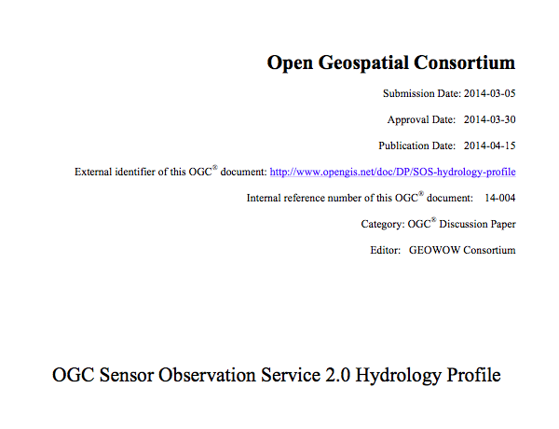

Slide 2
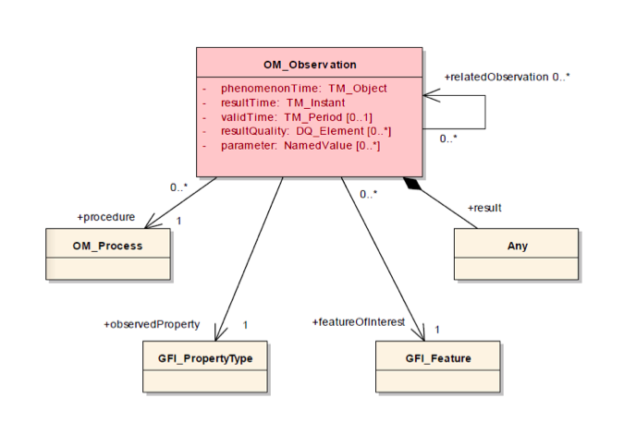
Observations and Measurements

Slide 3
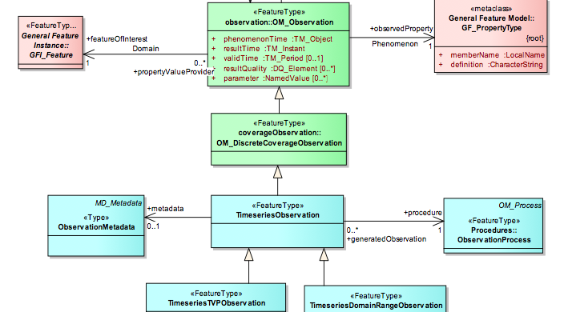
WaterML2 Core Model

Slide 4
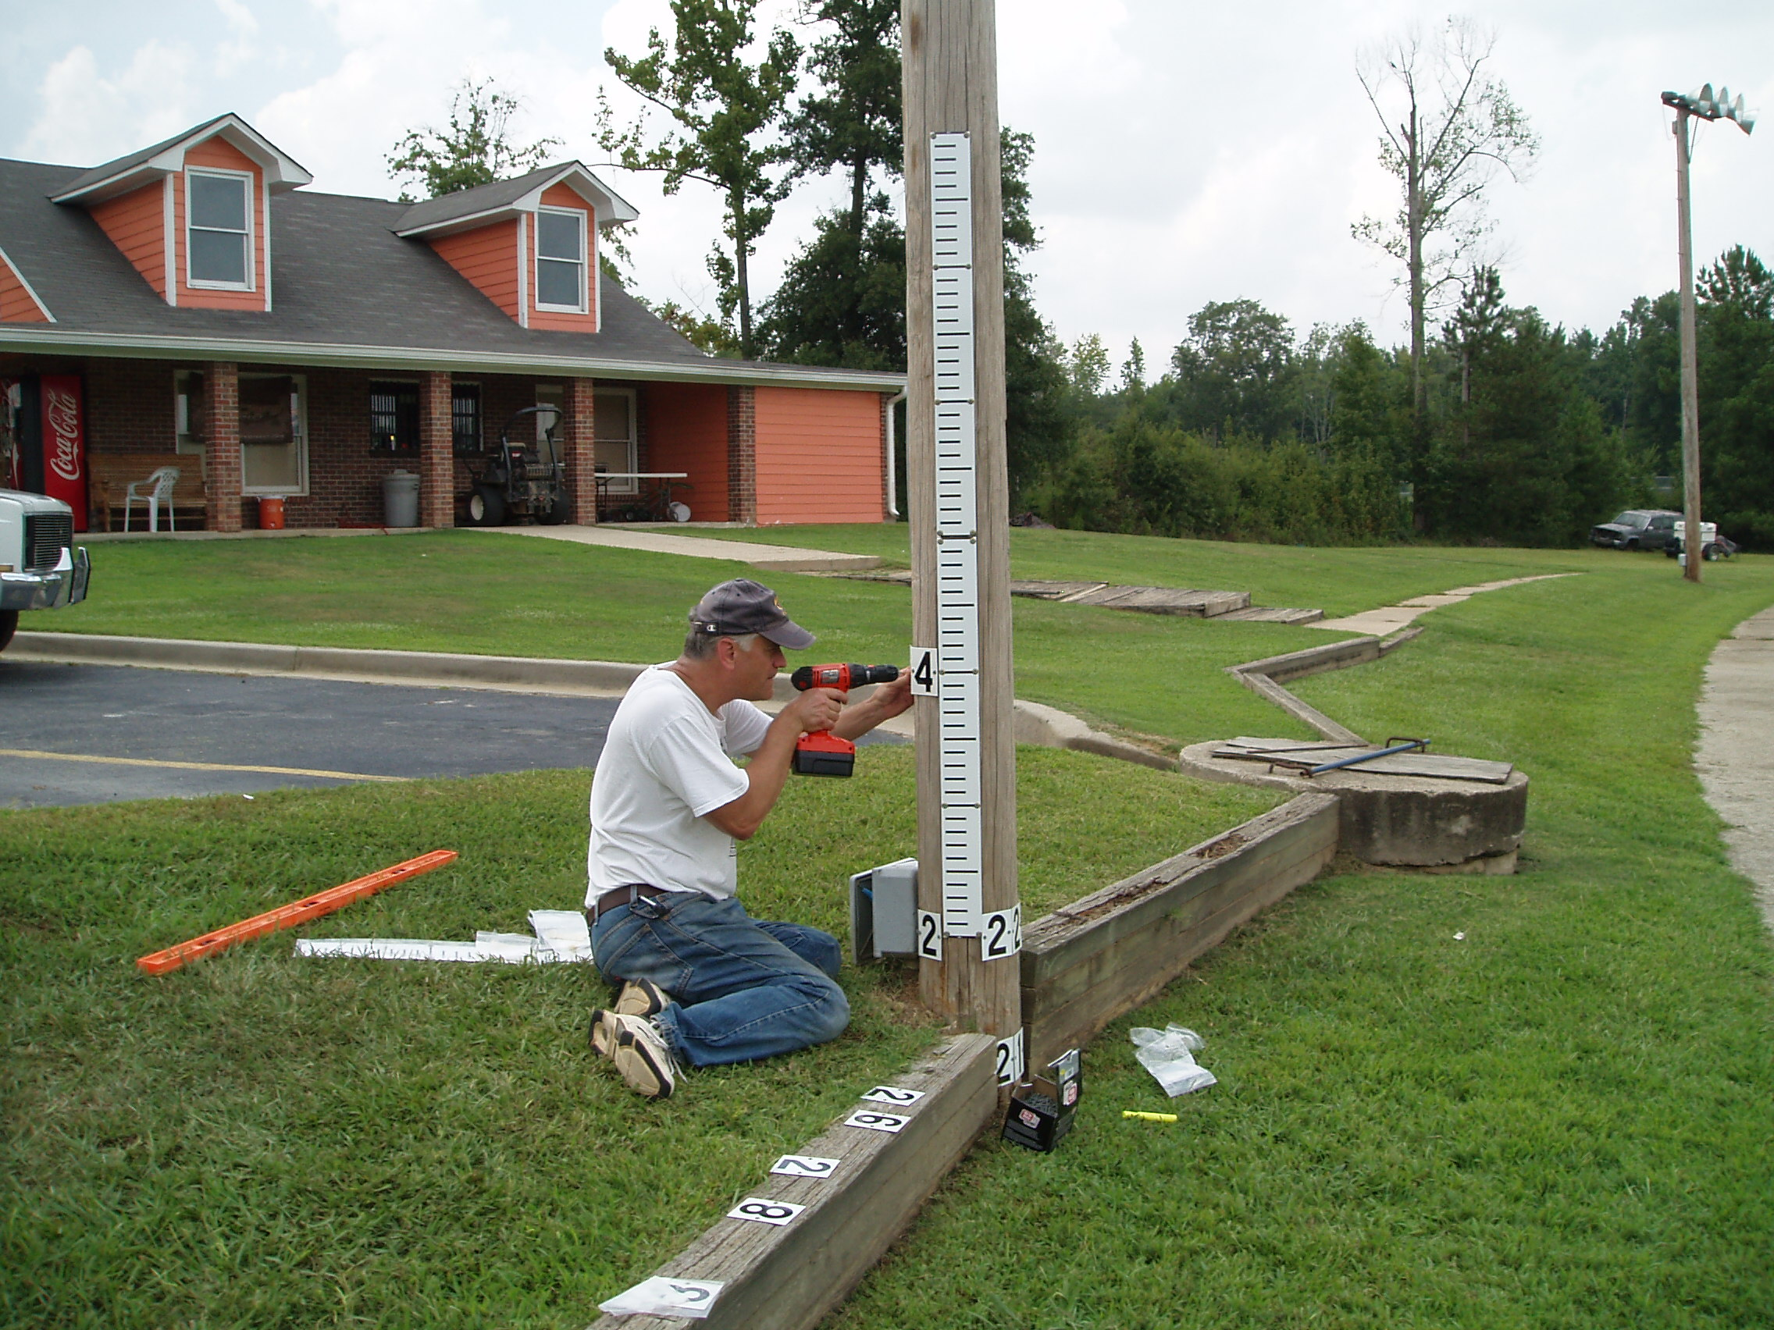
WaterML2:MonitoringPoint

Slide 5
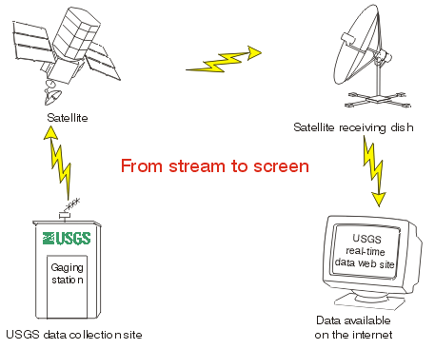
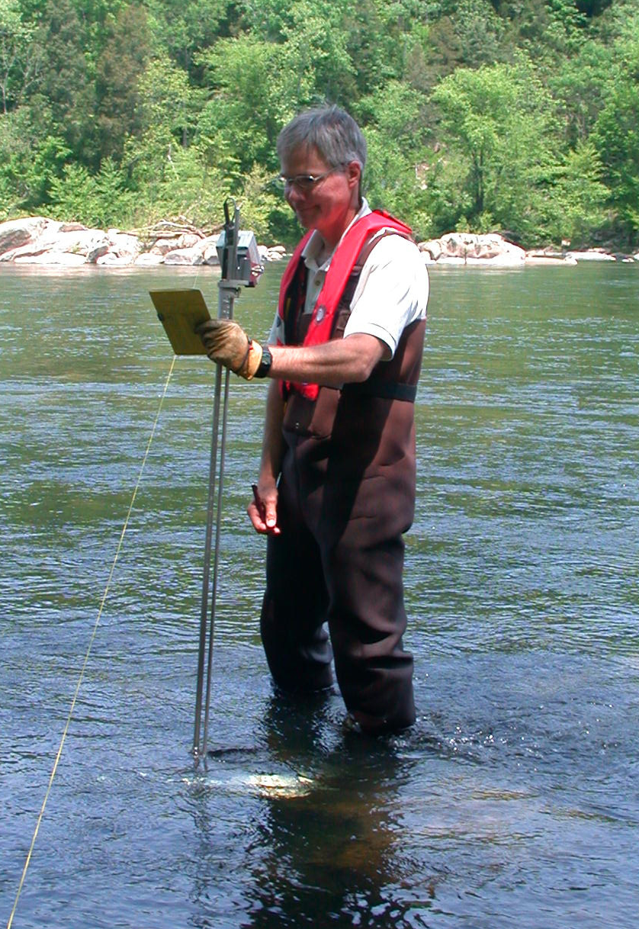
WaterML2:ObservationProcess

Slide 6
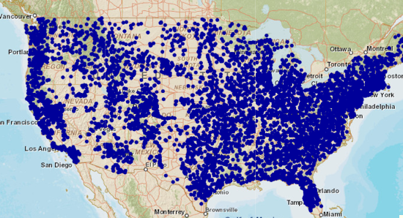
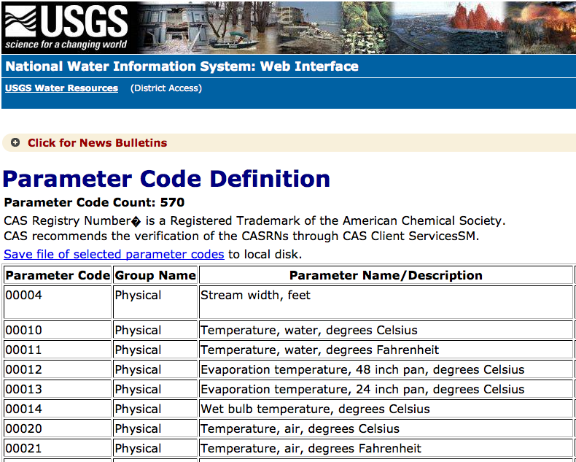
SOS:GetDataAvailability
-Search for existing time series.

Slide 7
SOS:GetFeatureofInterest
- Search for sampling features
SOS:DescribeSensor
- Get observation metadata

Slide 8
startTime: ?? endTime: ??
- Latest Value + Metadata
No Data Matches Query?
- Empty Response

