Slide 1
One national and one EU FAIR Water Data platform projects
Willing to contribute to the standardization dynamics
Sylvain Grellet, BRGM
30 May 2023 - HDWG Spring 2023

Slide 2
Context
France : One Water
Europe : Water 4 all
Shared approach between both
Synergies with OGC HydroDWG and RDA GWIIG

Slide 3

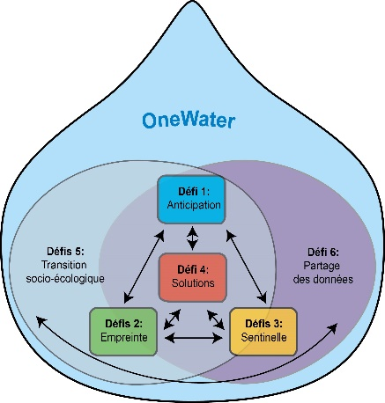
https://www.onewater.fr/
53 millions €, 10 years French research programme
To contribute to accelerate transitions a measure impacts of global changes on socio-ecological systems through 6 scientific challenges
Anticipation
of water resource availability (surface & ground) -> new sensors, models, forecast
Footprint
holistic approach human pressures and their consequences on hydrosystems and aquatic ecosystem
Sentinel
water as a environment health and human societies sentinel -> new approaches/methods/data/indicators
Anticipation
Solutions
enhance water resource resilience in the context of global change, circular use, ...
Socio-ecological transition
new governance modes/tools to protect water and elaborate public water policies with water as a common
Socio-ecological transition
Data sharing
Data sharing
FAIR Data / interoperability
We are here
Footprint
Sentinel

Slide 4
Data sharing challenge
Between all challenges
With other calls funded by the research programme
Encompassing public organisation (French Water Information) and water research data (Research Infrastructures, research labs, …).
Through FAIR Data / Interoperability

Slide 5

https://www.water4all-partnership.eu/
31 countries, 7 years
86 m€ fort the 1st phase
To tackle water challenges as means to face climate change, help to achieve the United Nations’ Sustainable Development Goals and boost the EU’s competitiveness and growth (EU Green Deal).
81 partners
research and innovation funders,
thematic authorities in charge of water issues and policy-makers,
local authorities,
associations and networks representing the economic sector in the field of water at the European, national or regional level,
research organisations.

Slide 6
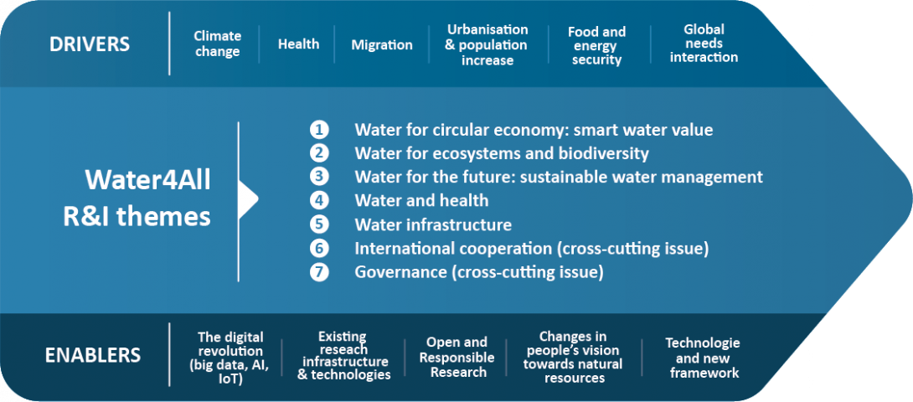
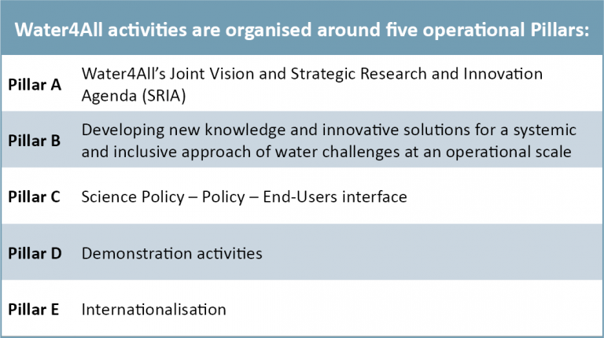
Task C.4: Developing open science & open access to projects outputs and connected observatories and research infrastructures
Data platform and relative tools, with regards to latest evolutions in FAIR data sharing
We are here

Slide 7
Shared elements between both
Targets : setting up FAIR water data platforms
applying OGC, W3C, INSPIRE, RDA practices
Activity period
These a long term projects : ~ 9 and 7 years
Starting now
Scope
Both a mixture of Public organization and research data
Funding
Both with a decent funding to do decent work provided we sync things properly

Slide 8
Shared elements between both
Topic -> water
Classic reference features: river networks, aquifer systems
Observation and monitoring systems
Could also embark other water information system aspect (waste water, industry, bathing, …)
opportunity to define shared standards/Best Practices, associated tools & training to share water data in FAIR way
opportunity to deploy, test, enhance, communicate on OGC standards (HydroDWG, OMS, API – Features, ST API etc…) in a coordinated approach
Shared approach (-> next slide)

Slide 9
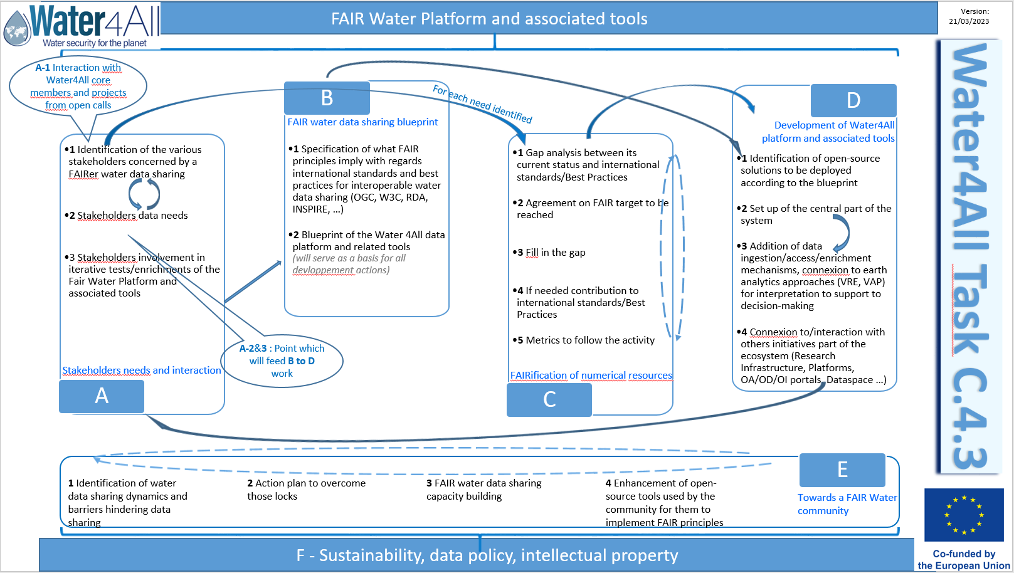
Shared elements between both
Organisation
RDA : FAIR
implementation profiles
activities
Enhance open-source implementation
of the standards
(traditionnal interoperability
tools)
Enhance semantics
and technical standards
Trainings, make water community tools standards ‘compliant’

Slide 10
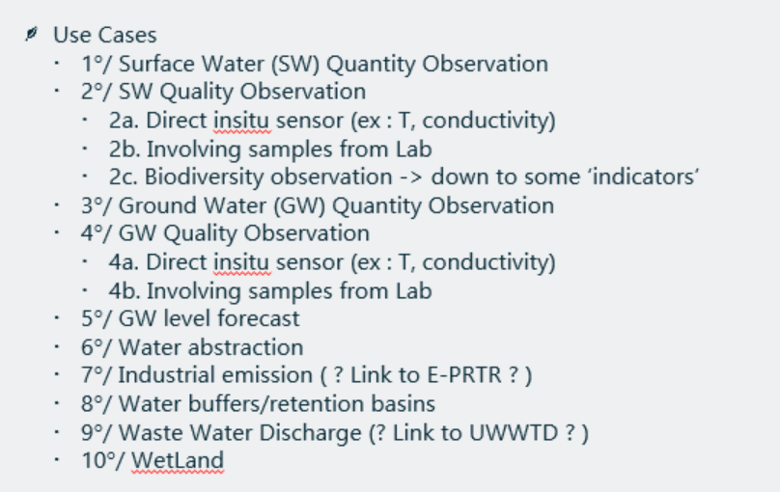
Synergies with OGC Hydro DWG and al.
Both projects are in the “A. Stakeholders needs and interaction” phase
To identify by which domain use case we will start
Screenshot from early May meeting

Slide 11
Synergies with OGC Hydro DWG and al.
We will feedback to
OGC HydroDWG
And also to the relevant group : OGC standards, ? W3C:SOSA ?, RDA GWIIG
And the relevant OpenSource community
Already starting support contracts on
Making QGIS ST API compliant : https://github.com/qgis/QGIS-Enhancement-Proposals/issues/257
SensorThings API / FROST => as a support to WQ IE activity
OGC API – Features / Geoserver => as a support to WQ IE activity

Slide 12
Synergies with OGC Hydro DWG and al.
Already identified synergies
Water Quality IE
WMO expert groups discussion
And some direct exchanges with some HydroDWG members
How can we make this work better ?
Bilateral discussions help but don’t create a group momentum
Do other organizations have “equivalent” projects starting/being written ?
Should we have more IEs on specific topics ?
Ex : already think about a Water Quality IE II ?

Slide 13
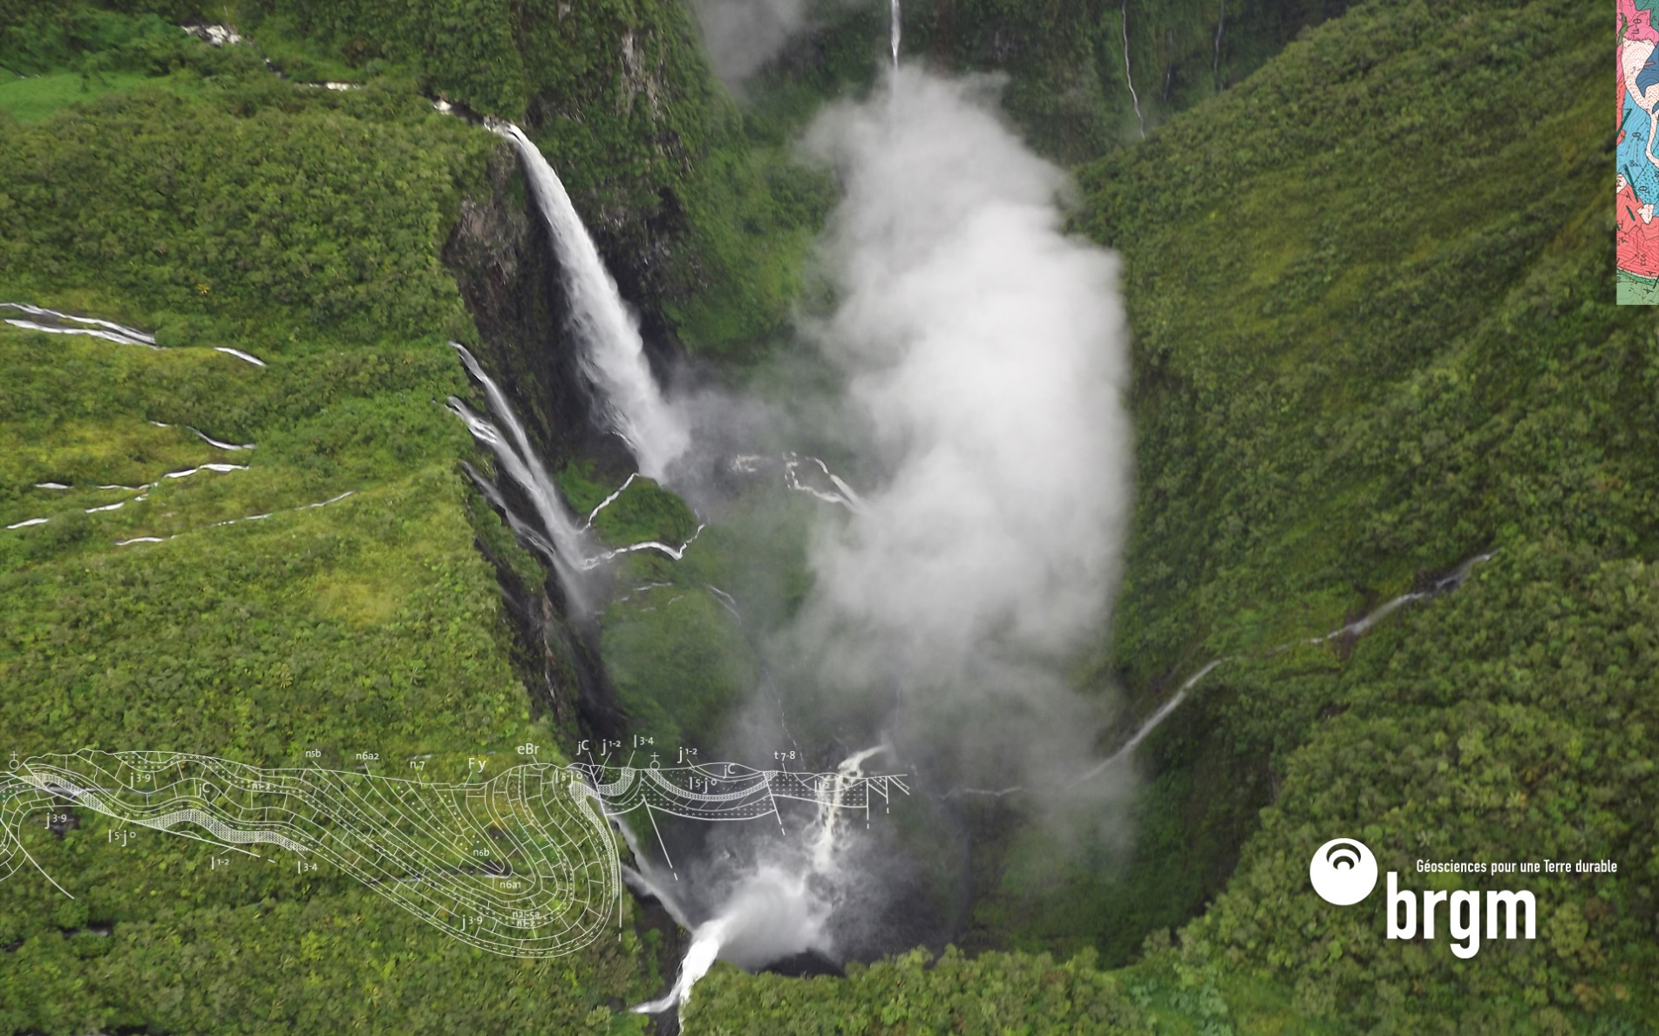
Thank you
s.grellet@brgm.fr

