Slide 1
Water quality IE update
Sylvain Grellet, BRGM
Kyle Onda, Lincoln Institute
Tony Boston, ANU
30 May 2023 - HDWG Spring 2023

Slide 2
Context
Water Quality workshop March 2022
Kick-off : 13/09/2022
Weekly webconf every Tuesday since then
The reference point : https://github.com/opengeospatial/WaterQualityIE/
Link to living G.Doc for minutes then GoToMeeting webconf link etc…,
Issues,
Model : now available under OGC Sparx Cloud.

Slide 3
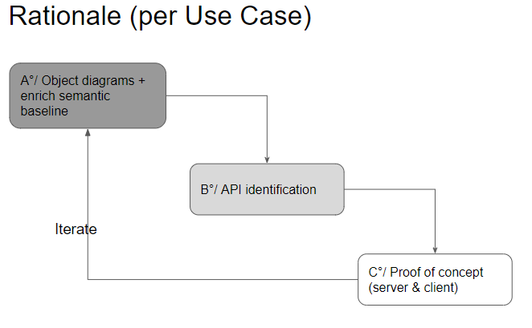
Use cases identifications and phasing

Slide 4
Progress overview
Partners expectations regarding the IE
OMS crash courses
Use cases identifications and phasing
Conceptual/Logical model -> Object diagrams
From doodles to real ones
Mapping with partners systems
Vocabularies => starting
Physical
Serializations examples & mapping to OGC APIs
Test implementations from the various partners: server, client
Report
I
T
E
R
A
T
E
80% done on Surface Water
We are here

Slide 5
Object diagrams
Now available under https://umltool.ogc.org/index.php
Also pushed HY_Features, GWML2 will join soon
Use Cases considered
Dissolved Oxygen <-> Temperature
pH <-> Arsenic
Flow <-> Dissolved Oxygen & Temperature
Joint pattern discussed and identified accross
“In-situ surface water quality observation” -> no Sample
And “Lab surface water quality observation”
Allows cross-walk between both

Slide 6
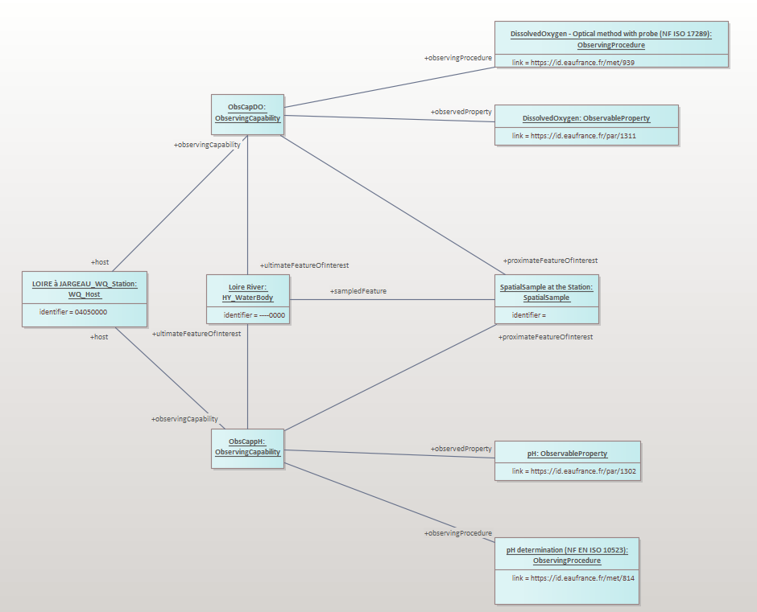
Object diagrams
In-situ surface water quality observation: 90% OMS + some additions
HY_Features

Slide 7
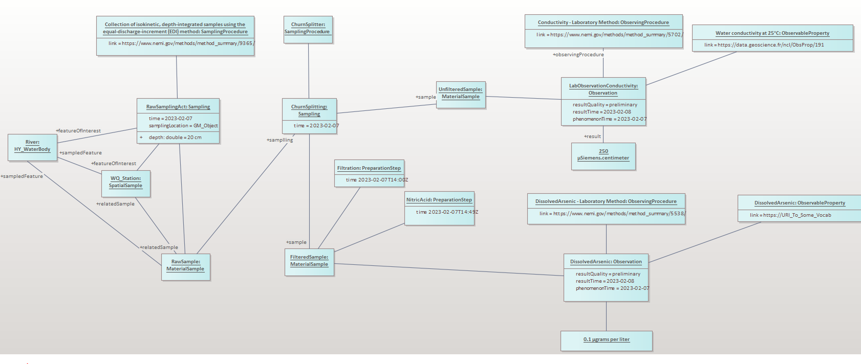
Object diagrams
Lab surface water quality observation: 90% OMS + some additions
HY_Features

Slide 8
Mapping with partners systems
WQX
Now regular WQX - WQ IE mapping sessions
https://docs.google.com/spreadsheets/d/1Fff2MAq7jciXRuMjogPCeuiv6ClT9gWf0-kku1VSUKQ/edit#gid=0
French Water information system : also on-going

Slide 9
Vocabularies - rationale
Method
Based on the Use Cases considered in the Object Diagrams
Identify
core vocabularies elements needed
those used in the current systems
Provide some guidance on generic ones
And check if I-ADOPT ontology helps

Slide 10
Vocabularies - example
iop:Variable “Arsenic concentration in the ‘phase particulaire’ of water”
iop:hasProperty : mass concentration => https://qudt.org/2.1/vocab/quantitykind#MassConcentration
iop:hasObjectOfInterest :
Sandre:Par:Parametre (@en ‘parameter’) : ‘Arsenic’ https://id.eaufrance.fr/par/1369
WQX ?
ChEBI: http://purl.obolibrary.org/obo/CHEBI_27563
iop:hasMatrix -> ? Sandre:Par:Support? (<-> Matrix) : water (http://id.eaufrance.fr/sup/3)
iop:hasConstraint (applies to the Matrix) : https://id.eaufrance.fr/fan/156 Sandre:Par:FractionAnalysee (@en ’Analyzed Fraction’) : ( l'ensemble des matières en suspension dans l'eau, récupérée généralement après centrifugation ou filtration)
iop:context object : ? is it assimilated to our ultimateFeatureOfInterest (thus ‘water sample’) ?
observingProcedure
Sandre : -> one potential : https://id.eaufrance.fr/met/960
WQX ?
Unit
Ex : mg/litre https://qudt.org/2.1/vocab/unit#MicroGM-PER-L
iop = https://w3id.org/iadopt/ont/

Slide 11
Vocabularies - example
iop:Variable
Arsenic concentration in the ‘phase particulaire’ of water
iop:hasContexObject
iop:hasProperty
iop:hasObjectOfInterest
iop:hasMatrix
iop:Property
Mass Concentration
QUDT: https://qudt.org/2.1/vocab/quantitykind#MassConcentration
iop:hasConstraint
iop:Entity
Arsenic
ChEBI: http://purl.obolibrary.org/obo/CHEBI_27563
Sandre: https://id.eaufrance.fr/par/1369
iop:Constraint
Particulate phase of water
Sandre: https://id.eaufrance.fr/fan/156
iop:Entity
Water
Sandre: http://id.eaufrance.fr/sup/3
iop:Entity
? Water Sample type?
Unit
Microgram per liter
QUDT: https://qudt.org/2.1/vocab/unit#MicroGM-PER-L
Sandre:
https://id.eaufrance.fr/urf/133
iop:constraints
ObservingProcedure
Sandre one potential candidate
https://id.eaufrance.fr/met/960
iop = https://w3id.org/iadopt/ont/

Slide 12
Serializations examples & mapping to OGC APIs
Just starting
OMS serializations example
? JSON only ?
+ « which API to serve what ? » discussion based on what GeoTech IE is doing
Then partners implementation

Slide 13
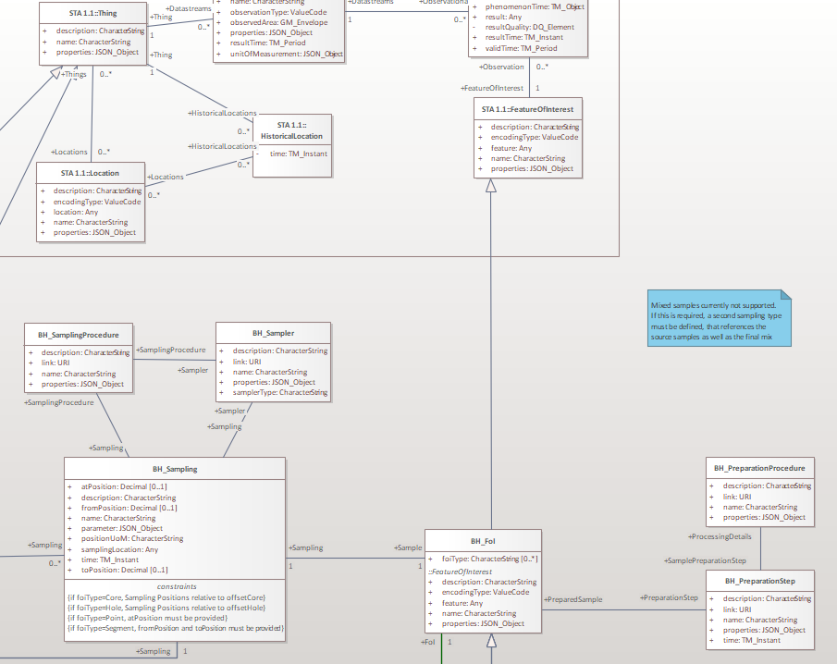
Serializations examples & mapping to OGC APIs
Geotech IE example
Implementation level
Each subclass will then have its own ‘access’ URL :
https://ogc-demo.k8s.ilt-dmz.iosb.fraunhofer.de/FROST-GeoTech/v1.1/BhTrajectoryThings
But for ‘generic’ ST API client,compatibility, an instance in the BhTrajectoryThings
will still be accessible
under https://ogc-demo.k8s.ilt-dmz.iosb.fraunhofer.de/FROST-GeoTech/v1.1/Things
(of course only with generic properties)
Elements identified in the Geotech IE conceptual model
extending ST API 1.1 classes

Slide 14
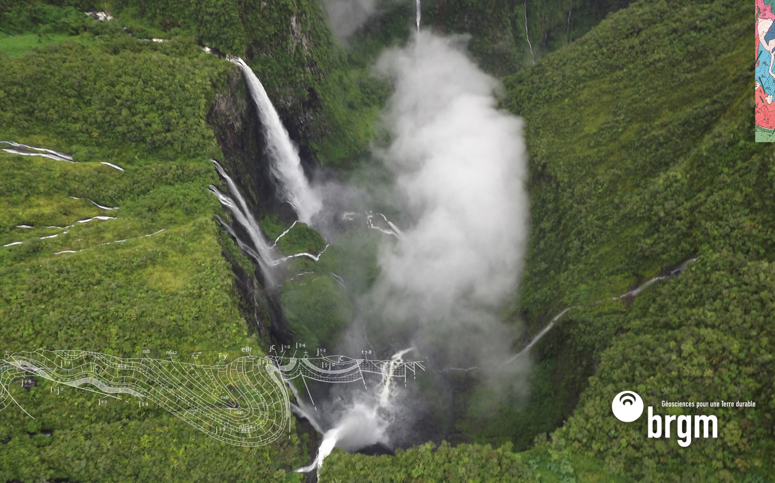
Thank you and thanks to
s.grellet@brgm.fr
The WaterQuality IE team

