Slide 1
EauFrance/Sandre – Water Web Services
Water web services description, translated from French to English using Google Translate:
http://translate.google.com/translate?hl=en&sl=fr&tl=en&u=http%3A%2F%2Fsandre.eaufrance.fr%2Frubrique.php3%3Fid_rubrique%3D128%26lang%3Dfr
Eric Hersh and David Maidment
The University of Texas at Austin
Center for Research in Water Resources
9/16/09

Slide 2
Links
Website is the following : http://sandre.eaufrance.fr/
Pages concerning data dictionaries are : http://sandre.eaufrance.fr/article.php3?id_article=57&lang=fr
Pages concerning exchange scenarios : http://sandre.eaufrance.fr/rubrique.php3?id_rubrique=44&lang=fr
Pages concerning web services : http://sandre.eaufrance.fr/rubrique.php3?id_rubrique=128&lang=fr
Monitoring station description : http://xml.sandre.eaufrance.fr/scenario/quesu/1/sandre_sc_quesu.xsd
Water quality data : http://xml.sandre.eaufrance.fr/scenario/sw_qu/1/sandre_sc_wsQualite.xsd

Slide 3
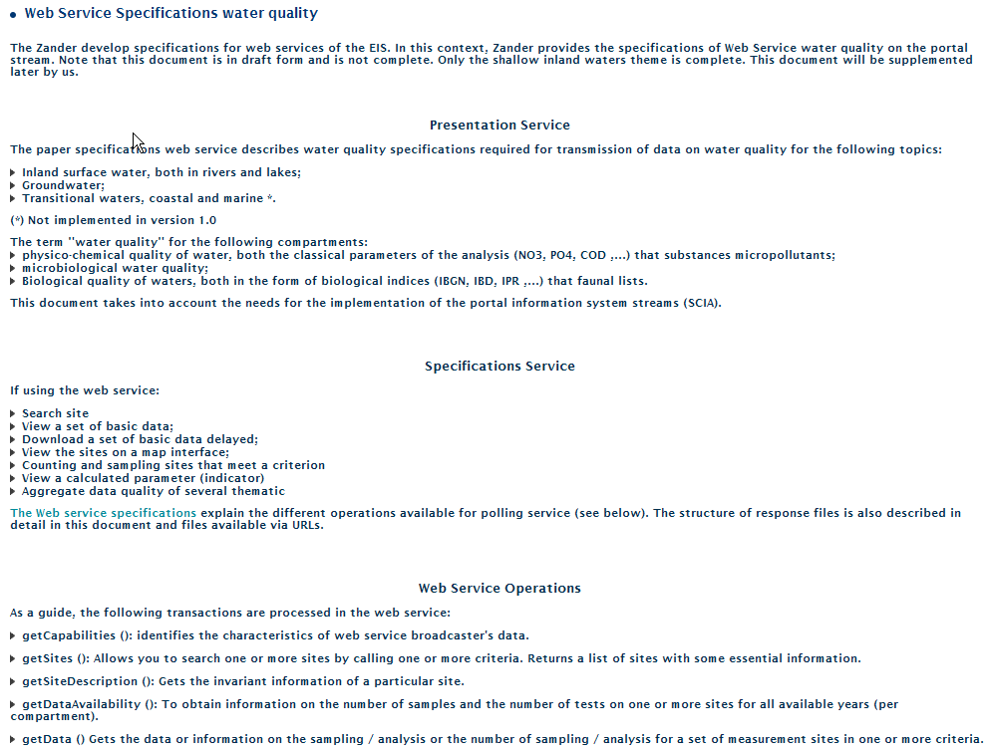

Slide 4
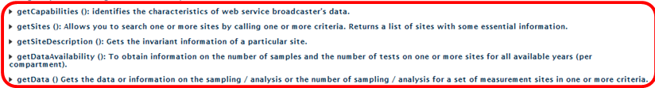
Sandre and CUAHSI
WaterOneFlow Methods
GetCapabilities
(GetCapabilities)
GetSites
GetSites
GetSiteDescription
GetSiteInfo
GetVariableInfo
GetDataAvailability
GetData
GetValues

Slide 5
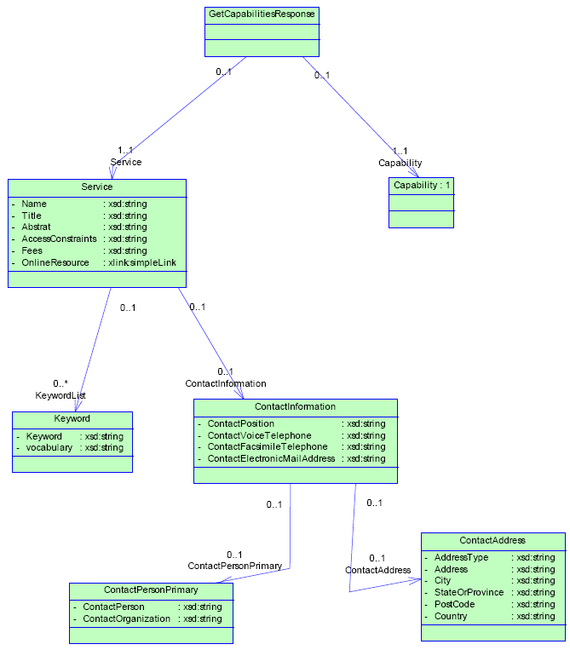
GetCapabilities
equivalent to
GetCapabilities
(in HydroExcel)
and similar to
Data Sources
in ODM

Slide 6
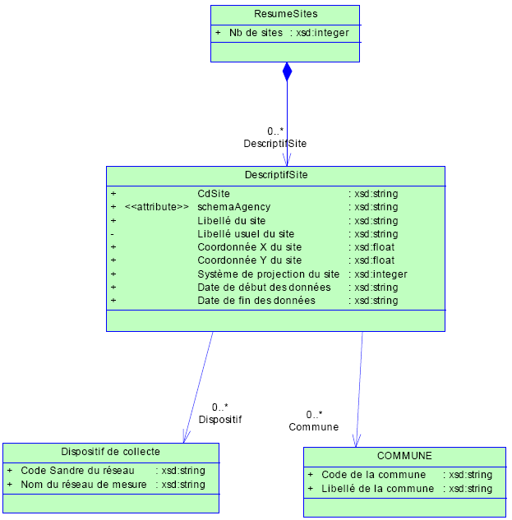
ResumeSites
equivalent to
GetSites
and similar to
Monitoring Site Locations
in ODM
Site Code
Agency?
Site name
Common site name
X coordinate
Y coordinate
Projection System
Start Date
End Date
Measurement code
Measurement name
Commune (~city) code
Commune (~city) name

Slide 7
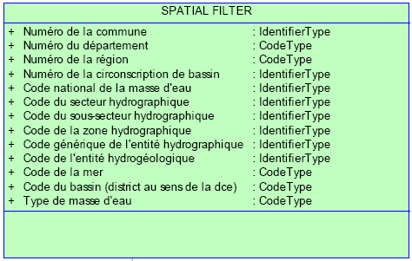
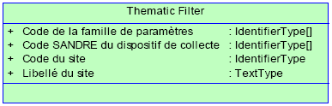
Spatial Filter:
By Commune (~City), Department, Region (~State), Basin, Water Body, Hydrographic Section, Hydrologic Entity, Sea, etc, by Code/Number/Type
Thematic Filter:
By Parameter Family, Sandre Collecting Entity, Site Code, Site Name

Slide 8
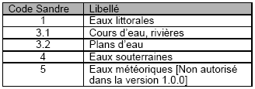

Domain:
Coastal waters
Streams and rivers
Water bodies
Groundwater
Atmospheric water (not in this version)
Temporal Filter:
Start Date
End Date

Slide 9
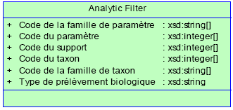
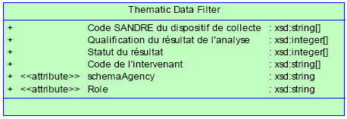
Analytic Filter:
Parameter Family Code
Parameter Code
Support Code?
Taxa Code
Taxonomic Family Code
Type of Biological Sample
Thematic Data Filter:
Measuring Device Code
Analytical Result Quantification?
Result Status
Code involved?
Agency Schema?
Role

Slide 10
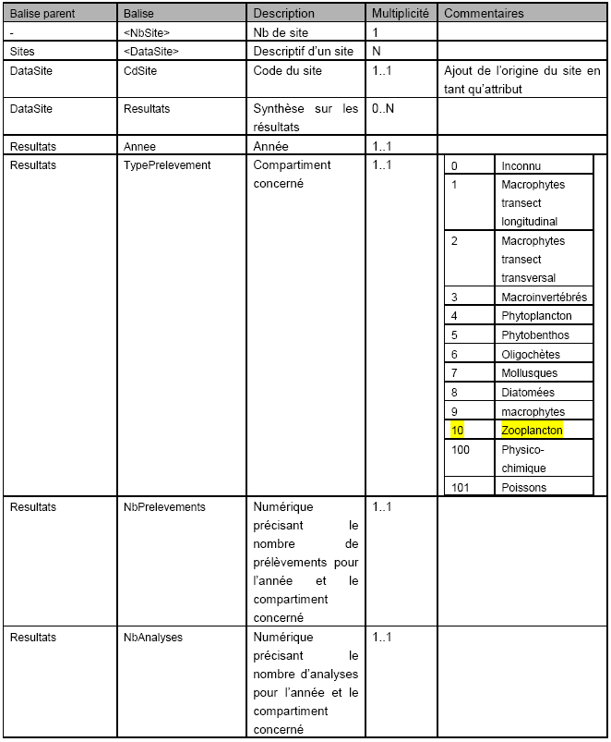
Aquatic Biology:
0 Unknown
1 Macrophytes (longitudinal transect) (plants)
2 Macrophytes (transverse transect)
3 Macroinvertebrates (animals)
4 Phytoplankton (drifting organisms)
5 Phytobenthos (benthic plants)
6 Oligochetes (worms)
7 Mollusks (snails, clams, squid, etc)
8 Diatoms (algae)
9 Macrophytes (plants)
10 Zooplankton (drifting animals)
100 Physicochemical
101 Fish

