Slide 1
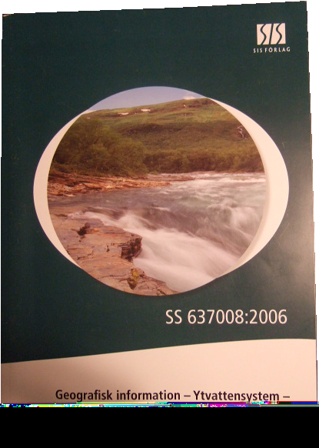





Swedish Standard for
Geographic Information on
Water System
Jakob Nisell
Swedish University of
Agricultural sciences
Swedish Standard Institute
Notes:
Jakob Nisell Participated in the work of developing a swedish standard för watersystem

Slide 2
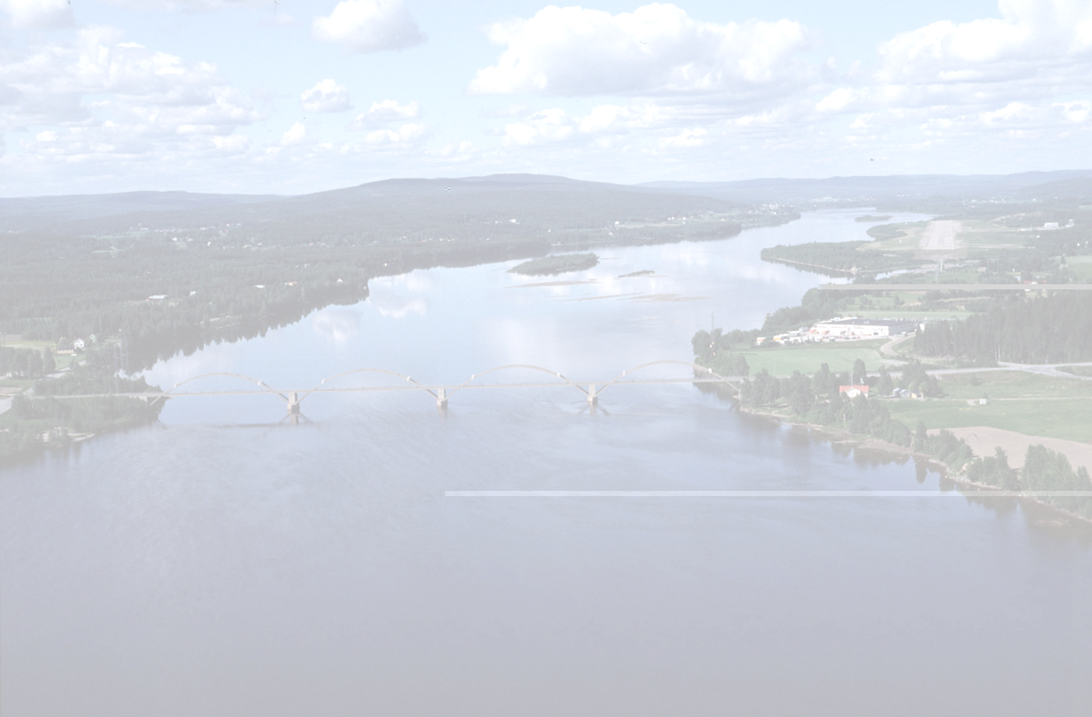
Scope
  supply a framework for information on geographic information on lakes, rivers, catchments and places
  supply a common set of terms and concepts
  facilitate exchange of data between organizations
  facilitate consolidation of data from several producers
  simplify development of software applications make data sampling more cost effective
  simplify generalizations between different scales
  supply a system independent exchange format
Notes:
The scope for the standard was agreed on by the main organizations handling information on water

Slide 3
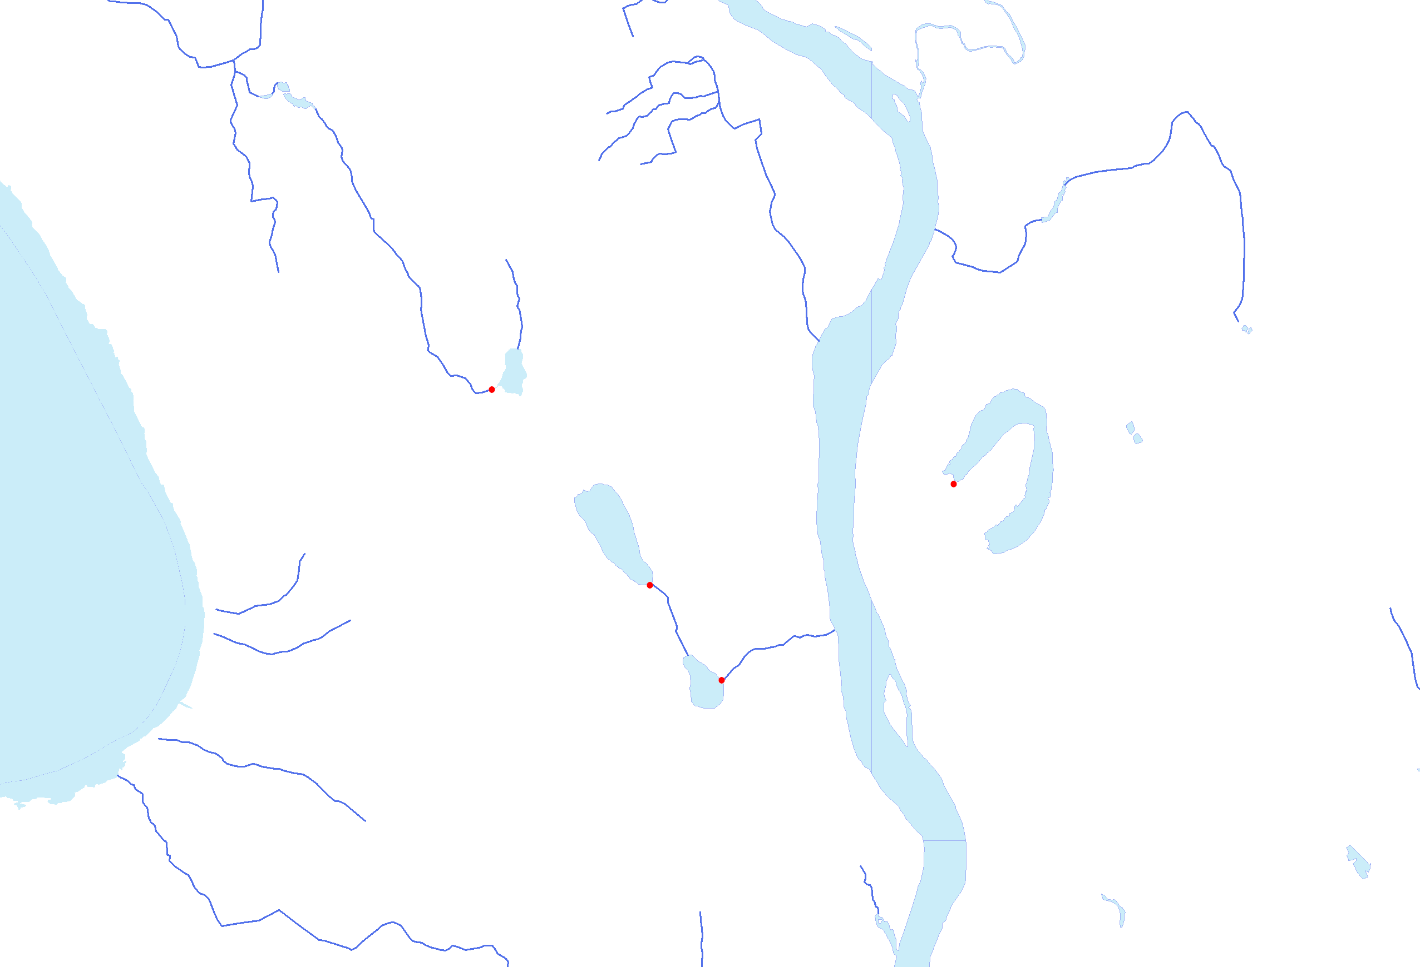
Content of the standard
    Definitions
    Hierarchy
    Network
    Hierarchy network
    Identifiers
    Versioning
    Geometry ISO 19107 and GML
    Temporal ISO 19108
    Metadata ISO 19115
    Application schema uses ISO 19109
    Data exchange XML (ISO 19118) and GML (ISO 19136)
Notes:
The content of the standard was defined by the scope. Existing geographic ISO standards was used

Slide 5


Object oriented approach
Attributes
Identity
Name
Geometry
Etc.
Relation to other objects
Ex) Part of a system
Or “Water received from”
Notes:
Information is object oriented not depending on geometry. Each object has a set of attributes as well as relations to other objects

Slide 6
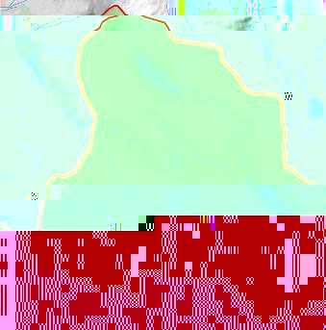
Object oriented approach
Objects are of a defined feature class
Lakes
River Reachs
Sampling Points
Catchment Areas
Surface Water Systems
Notes:
All water features can be classified into a feature class that has a certain set of attributes and properties

Slide 7

Logical network
Nodes –links-network
Each feature is a Node described as a HydroObject referenced by it’s identity UUID
Each feature can be connected to other using a Link (Flow_connection)
Not dependent on geometry
Simple to apply in database tables and queries
Notes:
A logical network was chosen to describe the water flow and topology that is independent of the objects geometry

Slide 8
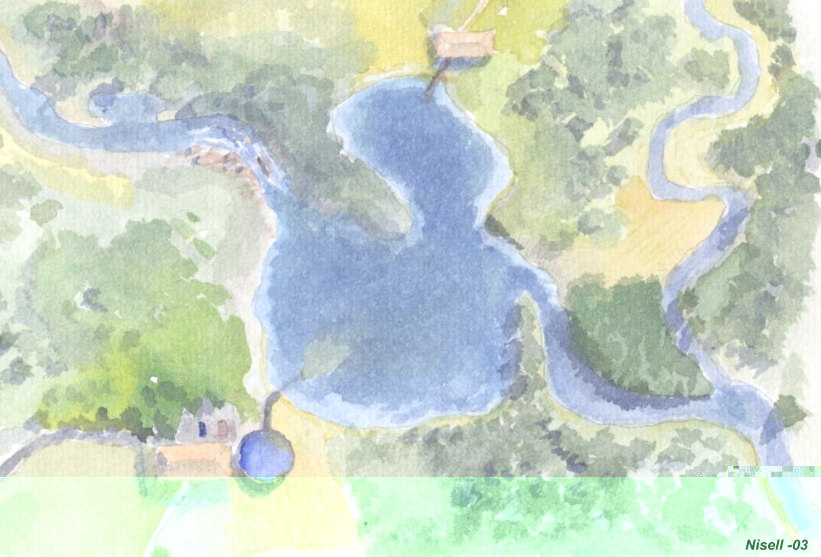
Notes:
Base of the information model is the network. The network consists of WaterNetNodes and WaterNetLinks the network is pure logical describing topology rather then geometry

Slide 9
Node link system
A HydroObject can be:
A Waterbody
A Water location
A Hydrological area
A Complex (Water System)
a complex of Hydrobjects of type 1-4
FlowConnection is the logical connections of HydroObjects.
Notes:
A NetWorkNode is a representation of a real world phenomenon such as a Lake, river sampling location etc.

Slide 10
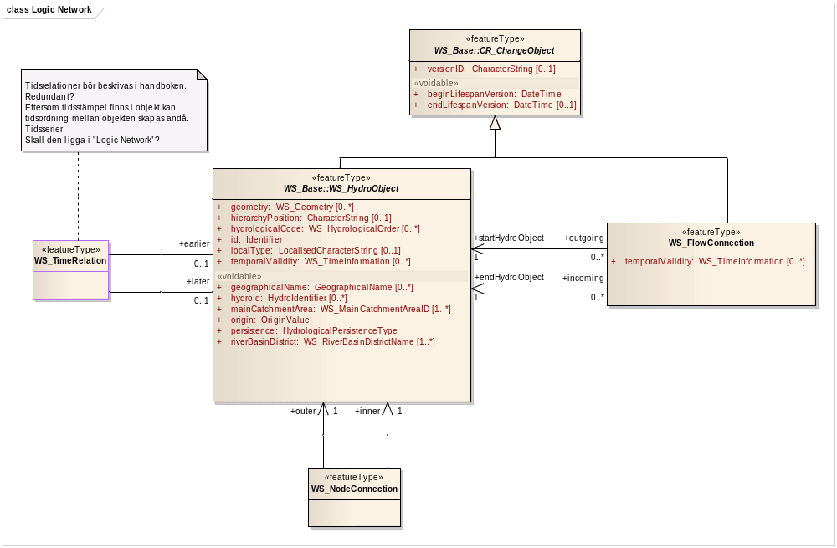
A Logical network

Slide 11
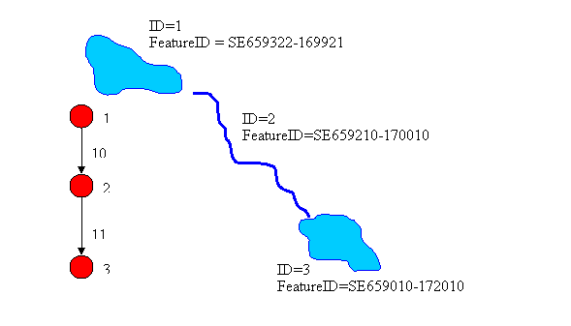
Example of logical network implementatation
linkID | startnode | endnode
10 | 1 | 2
11 | 2 | 3
HydroObjectID |  | Option | Option
ID | FeatureID | Incoming | outgoing
1 | SE659322-169921 |  | 10
2 | SE659210-170010 | 10 | 11
3 | SE659010-172010 | 11
Notes:
Examle on how a network description for a surfacewatersystem can be implemented in a database environment.

Slide 12
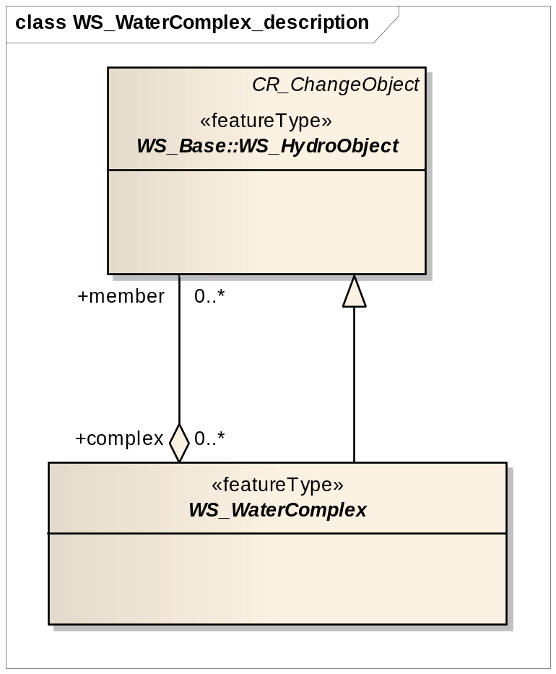
Level of details

Slide 13
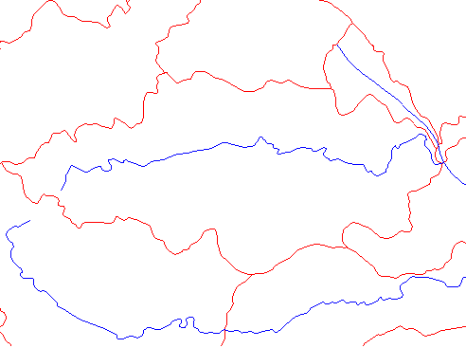
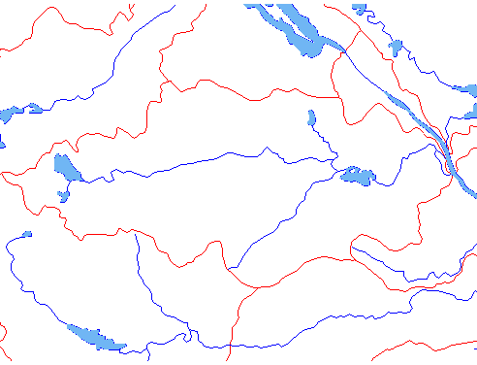
Hierarcical description
SE677018-142301
SE677012-142323
SE677096-142357
SE677096-142357
Members
SE677012-142323
SE677018-142301
…
SE677012-142323
Complex
SE677096-142357
SE677096-142357
Is of class Riverbody for Reporting
inherits from swedish standard
class ”Water Route”
Notes:
Each feature has an unique feature identiy

Slide 14
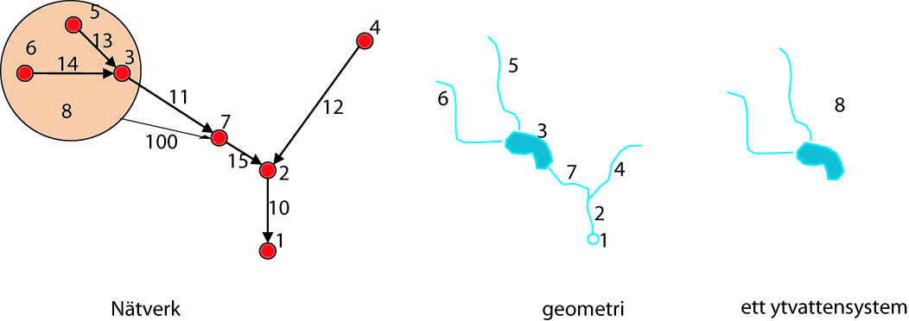
Link
UUID | startnode | endnode
10 | 2 | 1
11 | 3 | 7
12 | 4 | 2
13 | 5 | 3
14 | 6 | 3
15 | 7 | 2
100 | 8 | 7
HydroObject
UUID | class
1 | Outlet
2 | River Reach
3 | Lake
4 | River Reach
5 | River Reach
6 | River Reach
7 | River Reach
8 | SurfaceWaterSystem
Complex
member | complex
5 | 8
6 | 8
3 | 8
Notes:
Example how a hierarchical description of a waternetwork can be describe and implemented in a database

Slide 15
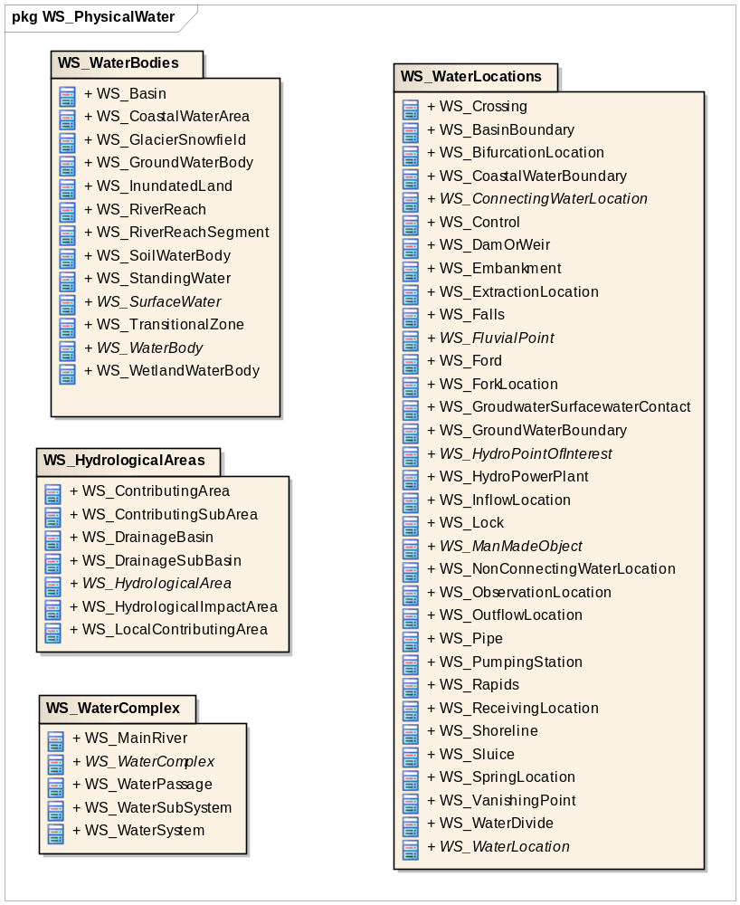

Slide 16
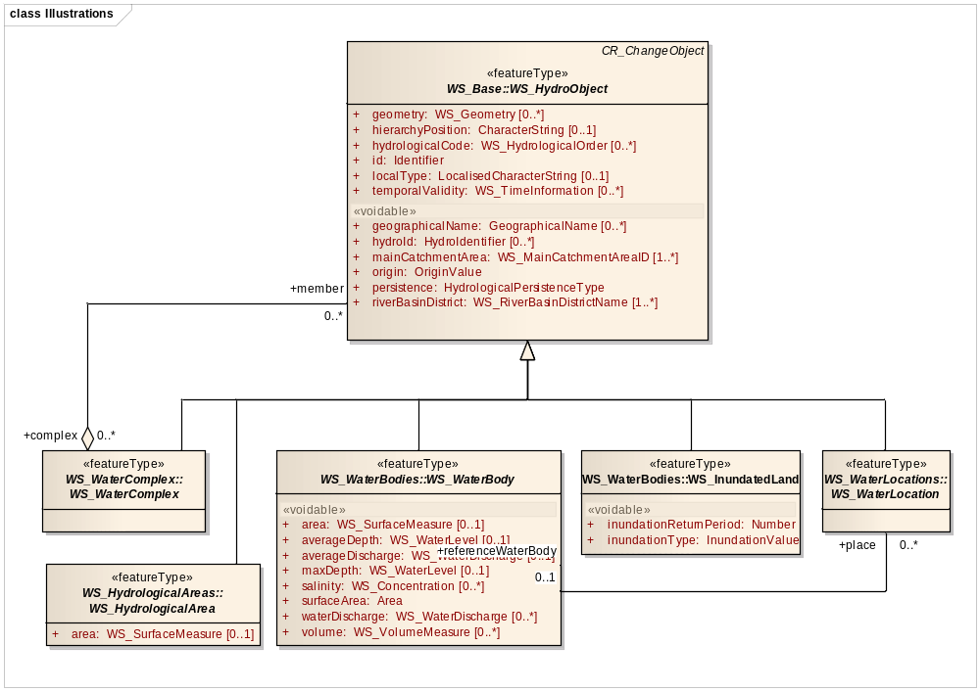
What is a Hydroobject

Slide 17
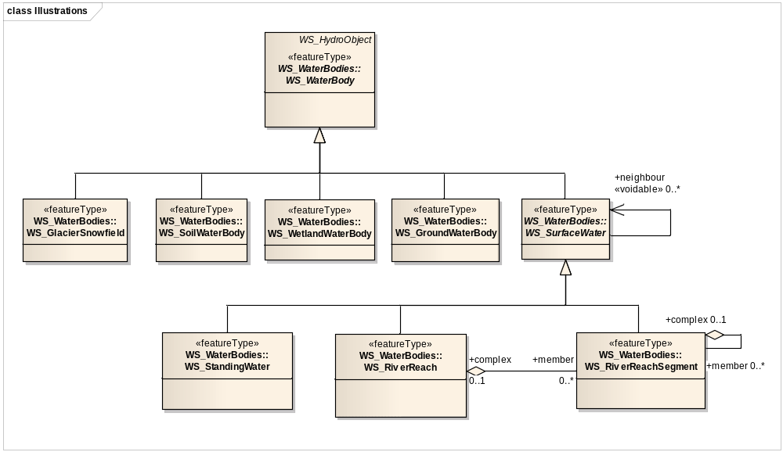
Waterbody

Slide 18
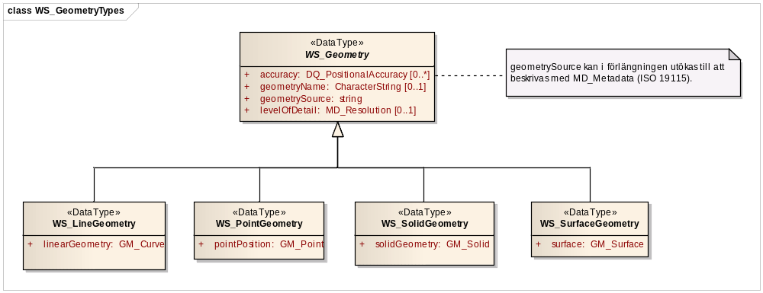
Datatypes – geometry, etc. uses complex datatypes
Geometry using complex types

Slide 19
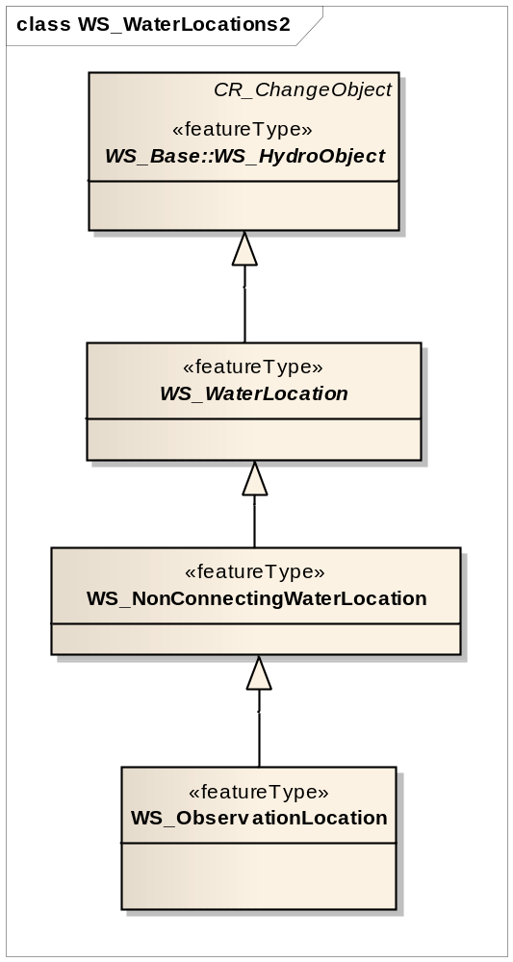
Waterlocation
Connecting or non connecting
Location where a observervation or measurement are made

Slide 20
Data exchange
Based on all features Unique ID UUID
Uses XML/GML
XML and GML schemas are frelly available
Possibility to extend XML-GML schemas
Notes:
XML/GML can be used for exchanging data, all features needs Unique Identities

Slide 21
Dataset
Sends an original dataset
<dataset>
<WS_Lake uuid=EISK-3432-AKEK-3113>
<PhenomenonIdentity>
”SE674383-152838”
</PhenomenonIdentity
<name>’Storsjön’ </NAME>
<area>26.5</area>
<geometry> …..
</WS_Lake>
<WS_Lake> ……
<dataset>
Notes:
How to send a dataset on lakes

Slide 22
Handling of version updates

Slide 23
Modify (update)
Sends a modification on the area of Storsjön
<update>
<modify>
<WS_Lake uuid=EISK-3432-AKEK-3113>
<area> 23.8 </area>
</WS_Lake>
<modify>
<update>
Notes:
How to send information to update a singel value in a dataset without having to send a new dataset.

Slide 24
Modify (add)
Send an update adding a new lake to the dataset.
<update>
<add>
<WS_Lake uuid=BKKE-2232-GTEK-8923>
<PhenomenonIdentity>
”SE654713-147901”
</PhenomenonIdentity
<name>’lillsjön’ </NAME>
<area>3.2</area>
<geometry> …..
</WS_Lake>
</add>
</update>
Notes:
How to send information to add a new lake to an already sent dataset

Slide 25
Modify (delete)
Sends an update deleting a lake from the dataset
<update>
<delete uuidref="EISK-3432-AKEK-3113" />
<update>
Notes:
How to delete a single lake in a dataset that was sent before

Slide 26
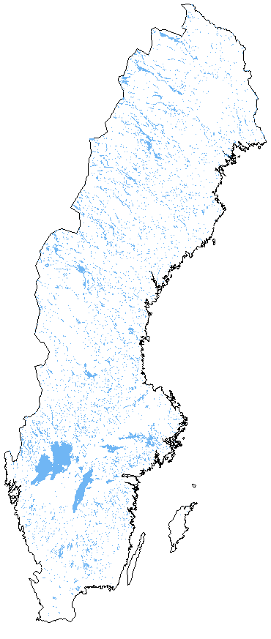
conclusions
There is benefits from a standard
It is difficult to change habits of users and producers.
Lots of work to build datasets
  300 000 lakes
  500 000 km river
Possibility to chose ambition
Notes:
conclusions

Slide 27
Q?

Slide 28
Notes:
Node represents real world features.
Nodes represents realworld features in a certain level of detail. The Node – Network relation describes how representations i different levels of detail is related.

Slide 29
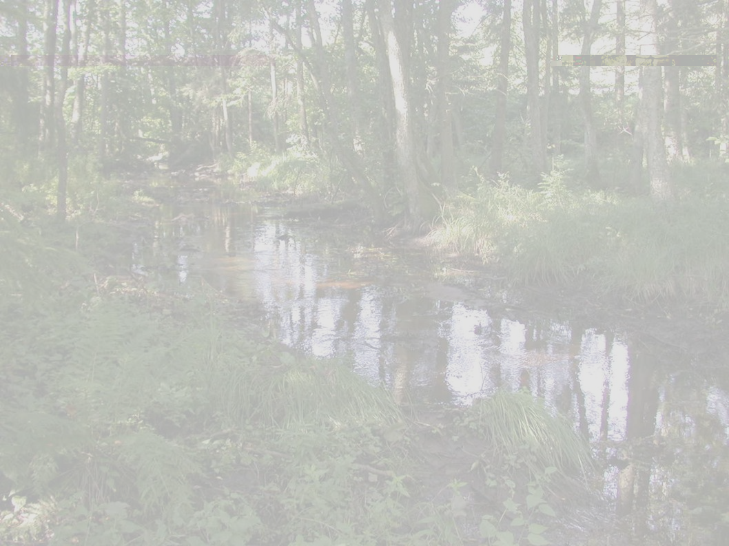
Advantages using a common XML-schema
Water chemistry, identities, topology, network, geometry, morfometry, water flow can be contributed from different organisations.
Data can be distributed as webservices
A unique ID UUID is used as a key.
Notes:
Advantagest to use a XML or GML schema

