Slide 1
ST API in the hydro Community –EU insights
The 121st OGC Member Meeting
Grellet Sylvain, BRGM
07 December 2021

Slide 2


French side
GroundWater quantity : level, temp, conductivity, ….
SurfaceWater quantity / quality
See
https://github.com/INSIDE-information-systems/SensorThingsAPI (include Marine – IFREMER and Soil – INRAE examples)
HydroDWG WQ seminar 2021 presentation https://external.ogc.org/twiki_public/HydrologyDWG/HydroDWGSeminarMarch2021
Endpoints used in EU API4INSPIRE project

Slide 3
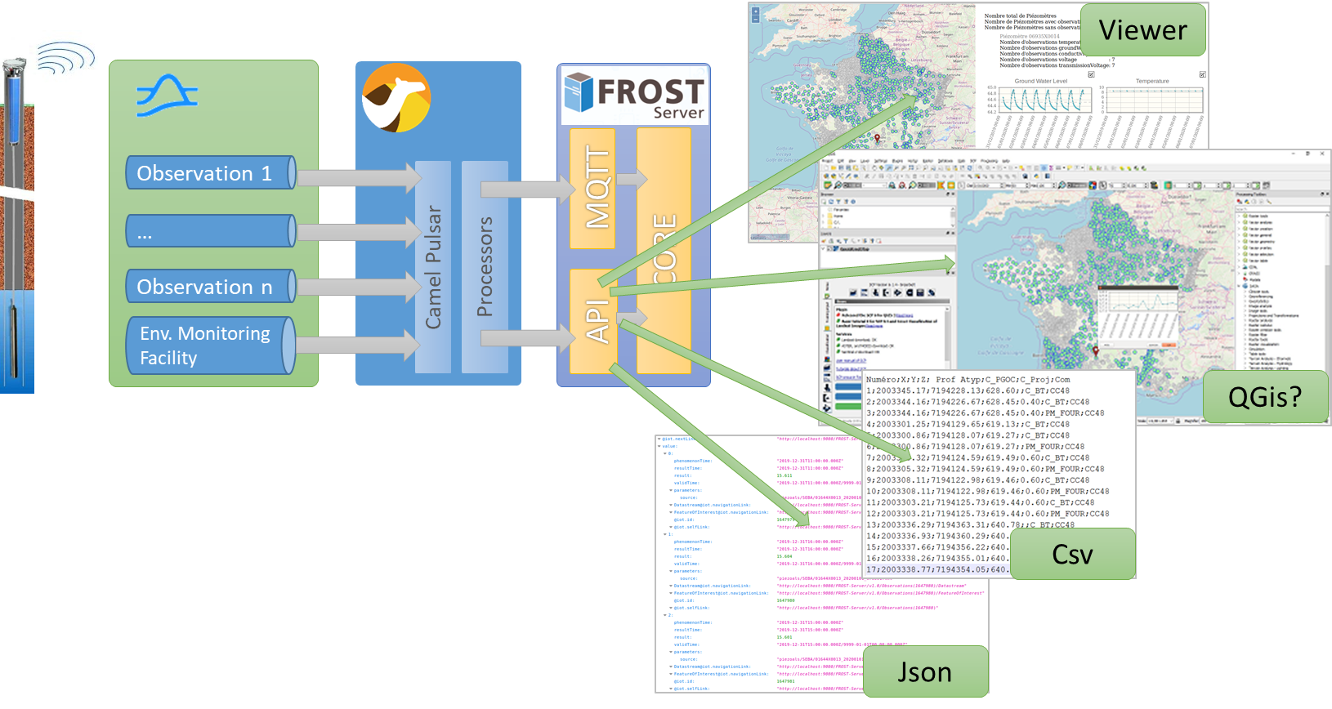
French side
Ground water quantity
From GPRS sensors (~1200) -> PubSub -> ST API
https://data.geoscience.fr/ncl/ObsProp/186

Slide 4
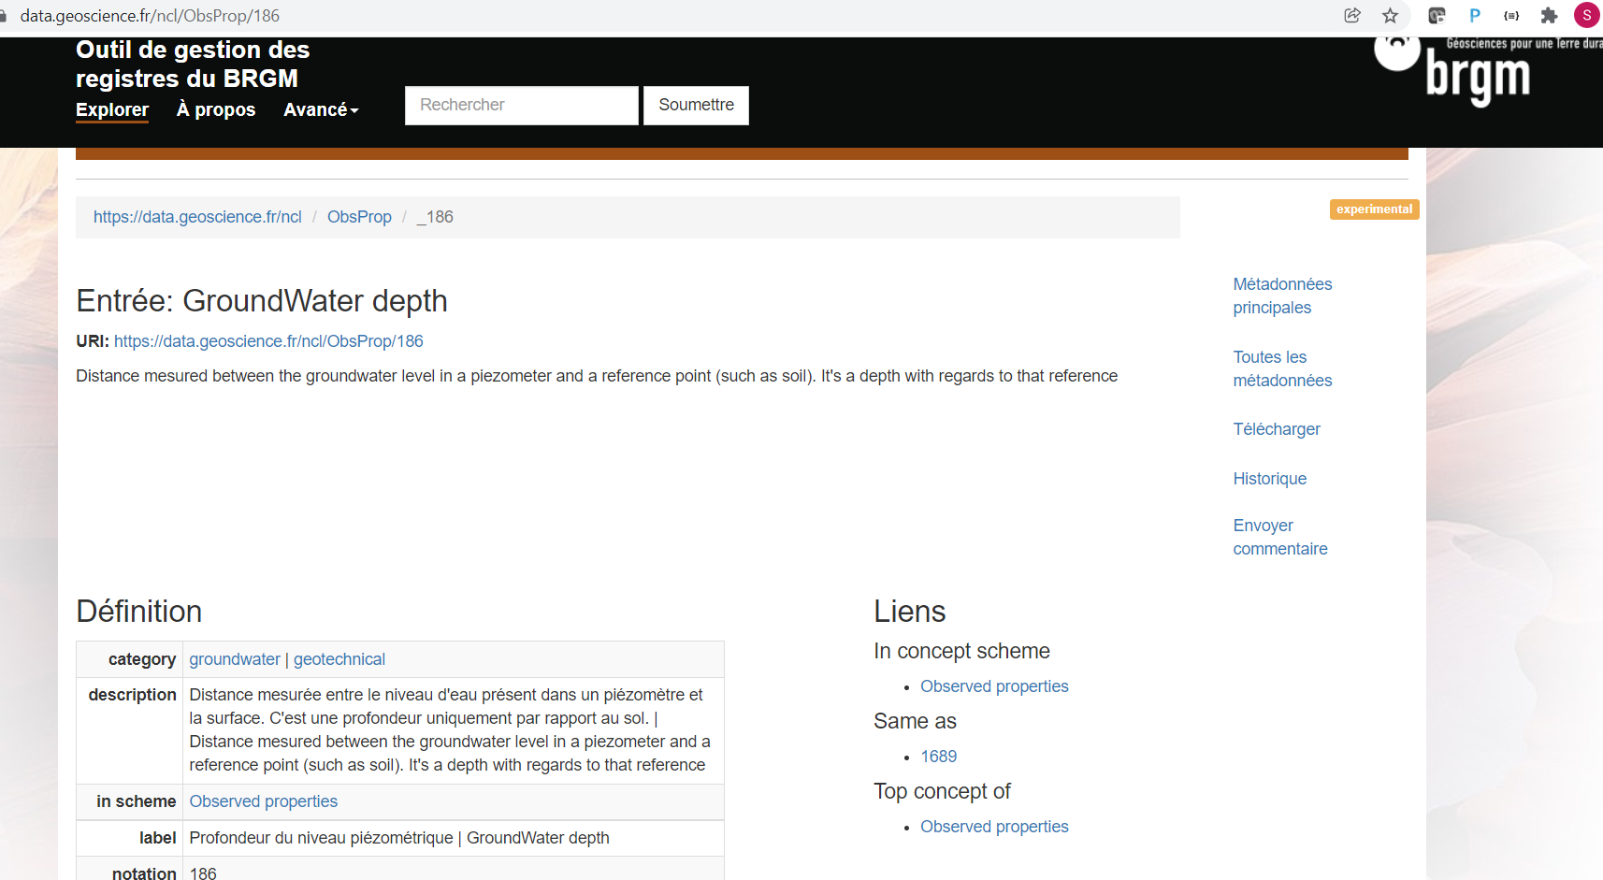
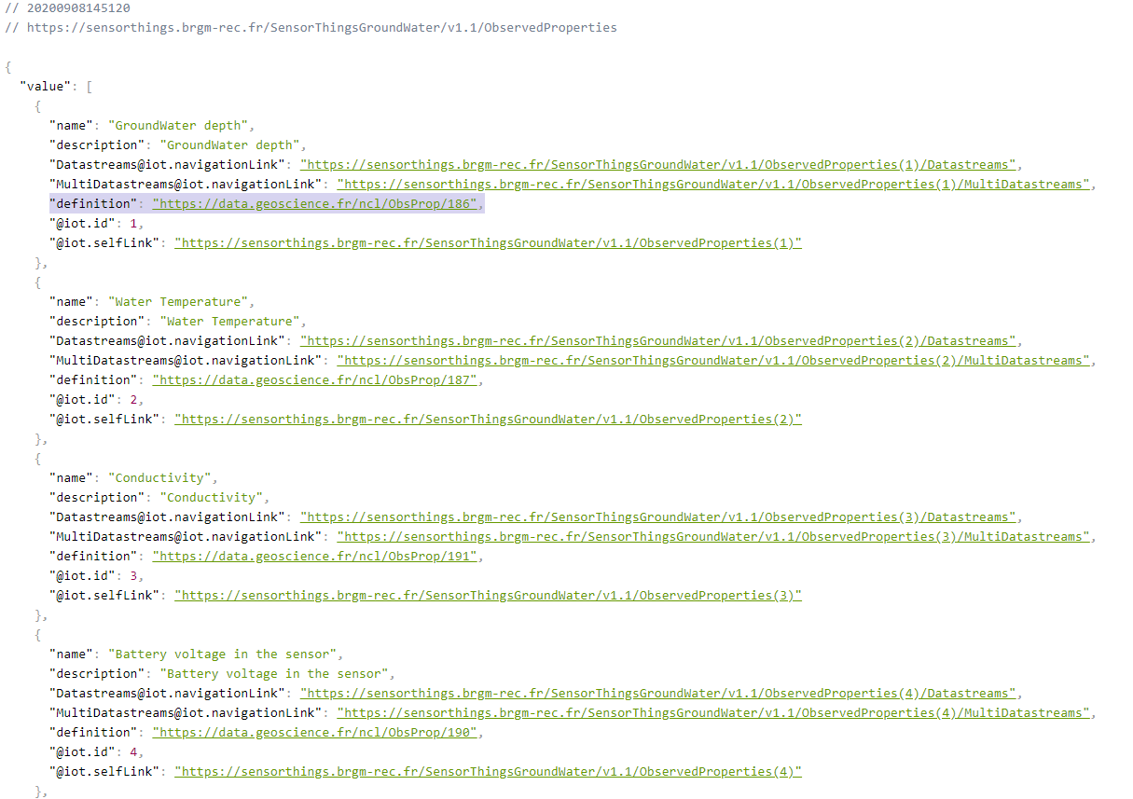
French side
Ground water quantity
Observed Properties linked to codeList registries

Slide 5
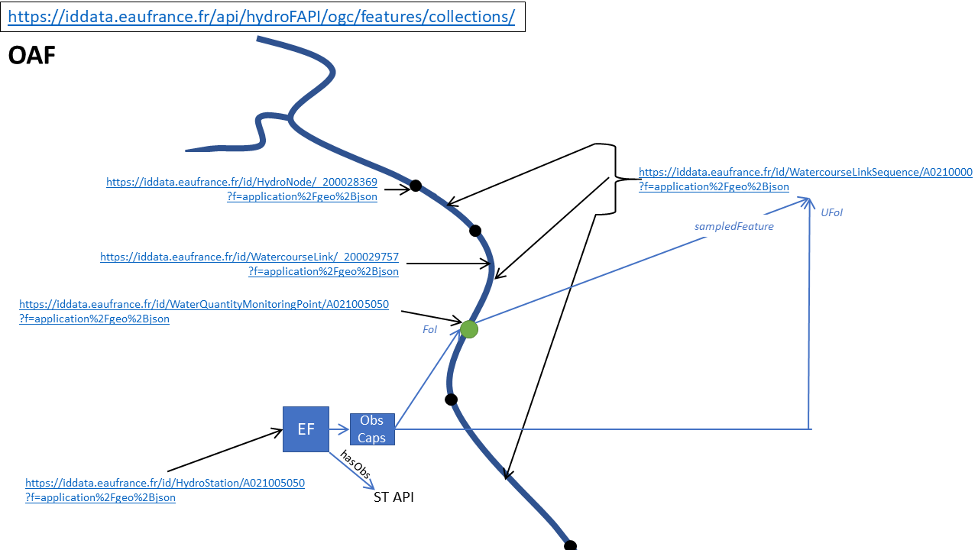
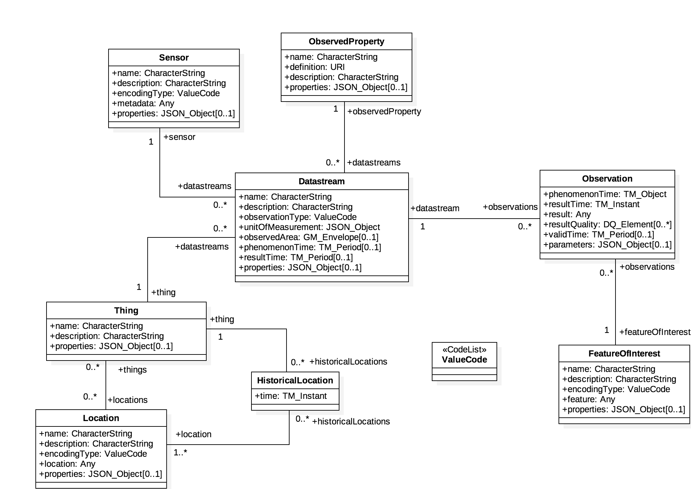
French side
Surface water quality
Every feature (hydro network, station, observation collection) has a URI enabling ST API <-> OGC API crosswalk

Slide 6
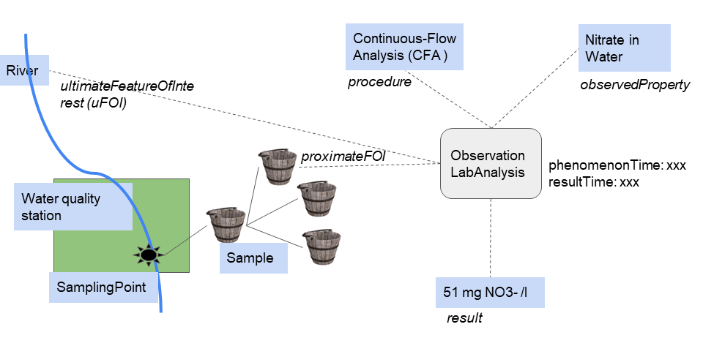
French side
Surface water quality
130 M+ observations

Slide 7
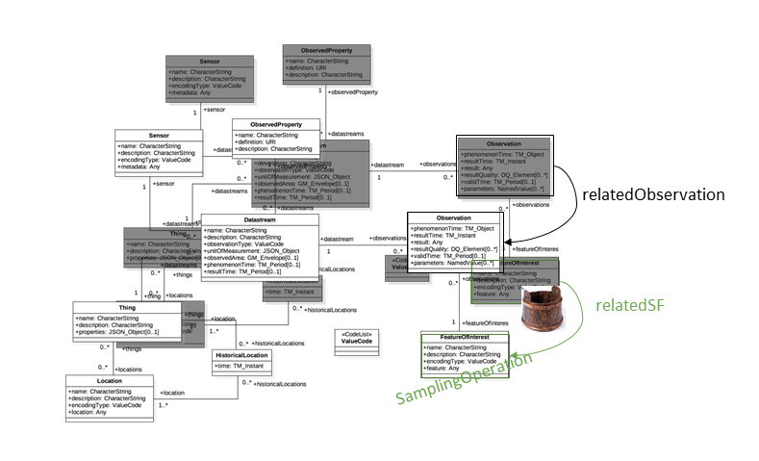
French side
Surface water quality
Definition of a pattern to use ST API Part1 for Water Quality : including Sampling

Slide 8
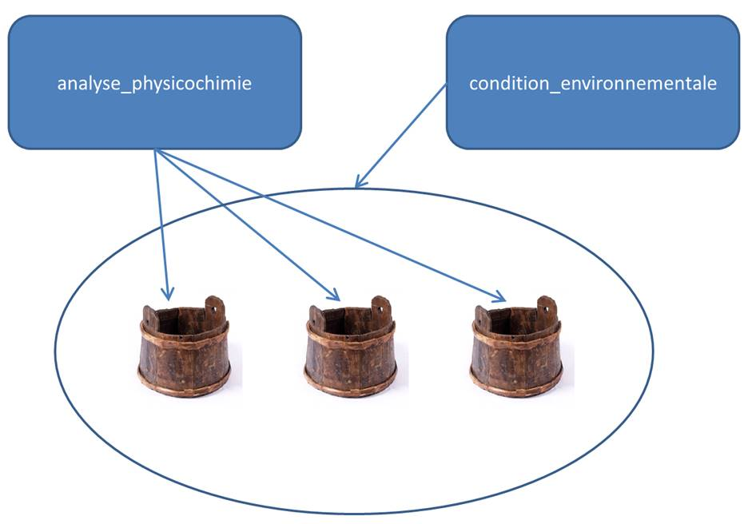
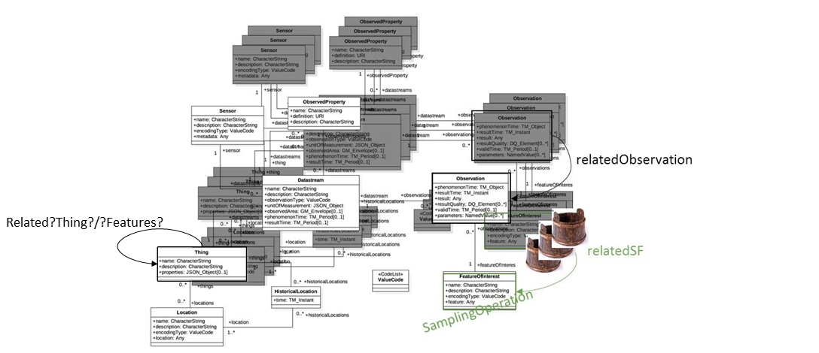
French side
Surface water quality
Definition of a pattern to use ST API Part1 for Water Quality : adding environmental conditions
Water Sample
Environmental conditions when sampling
White: one environmental
condition (at a given station)
Black : 3 water quality datastreams
(at the same station etc…)

Slide 9
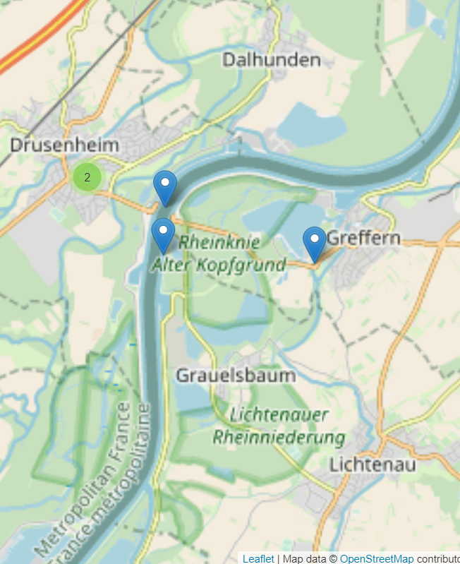
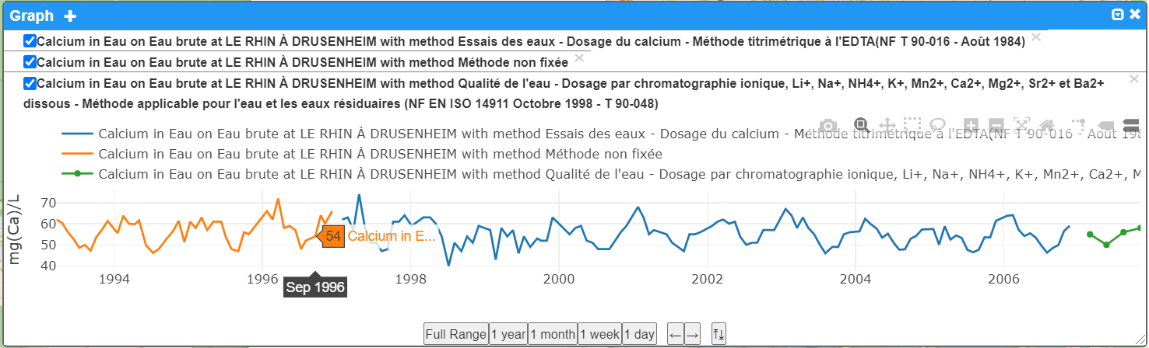
French side
Surface water quality
Examples
OFB : LE RHIN À DRUSENHEIM

Slide 10
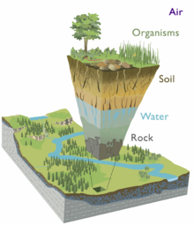
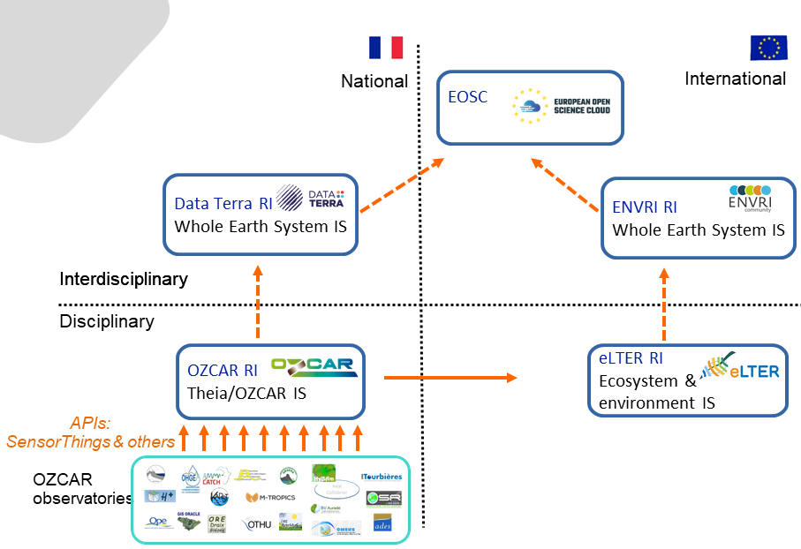
French side
OZCAR French Research Infrastructure on the ‘critical zone’
From https://en.wikipedia.org/wiki/Earth%27s_critical_zone
ST API pattern to feed the Reseach Infrastructure :
https://github.com/theia-ozcar-is/sensorthings-guidelines/

Slide 11

British side
Groundwater quantity: water level, temp, conductivity, ….
See https://sensors.bgs.ac.uk/
Documentation, videos, end-point (FROST)
Visible in Fraunhofer WebGenesis : https://wg-brgm.k8s.ilt-dmz.iosb.fraunhofer.de/servlet/is/193/
And also, « for fun »,
Available through OGC API Features server https://ogcapi.bgs.ac.uk/collections/BGSSTAThings/items
Using the STA provider function in pygeoapi - https://docs.pygeoapi.io/en/latest/data-publishing/ogcapi-features.html#sensorthings-api

Slide 12
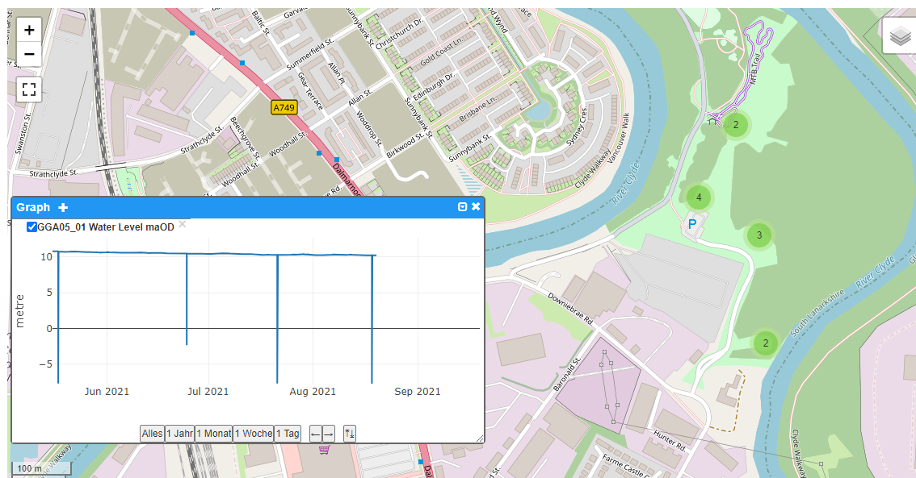
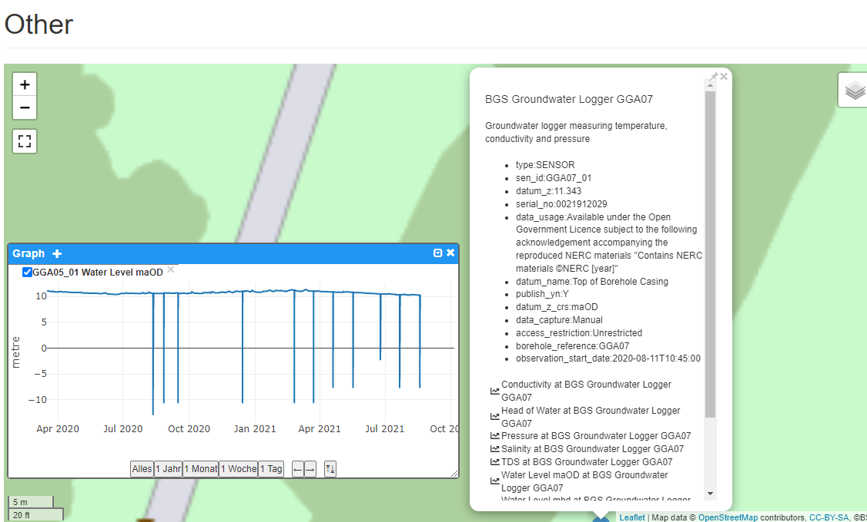
British side
In Fraunhofer WebGenesis

Slide 13



EU API4INSPIRE project
Project that supported the INSPIRE ST API good practices document (https://inspire.ec.europa.eu/good-practice/ogc-sensorthings-api-inspire-download-service) -> now ST API part 1 recognized valid EU INSPIRE download service
Various topics, water related are franco germanic related :
French flows related : see previous slides
Land Baden-Württemberg (via Fraunhofer) : surface water quality and groundwater quantity
Client view : https://wg-brgm.k8s.ilt-dmz.iosb.fraunhofer.de/servlet/is/110/
More on the project : https://datacoveeu.github.io/API4INSPIRE/

Slide 14
EU API4INSPIRE project
Water part
Data from 2 countries
OFB : LE RHIN À DRUSENHEIM
LUBV : bei Grauelsbaum (XX317.00)

Slide 15
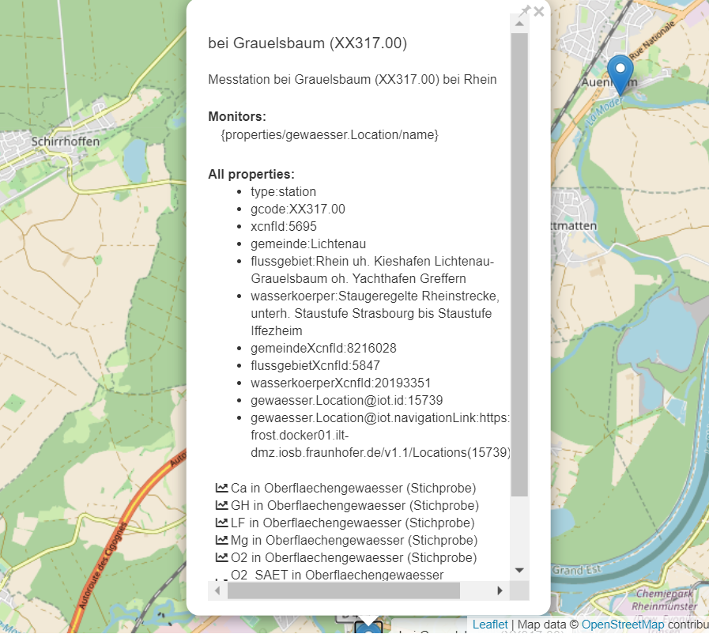
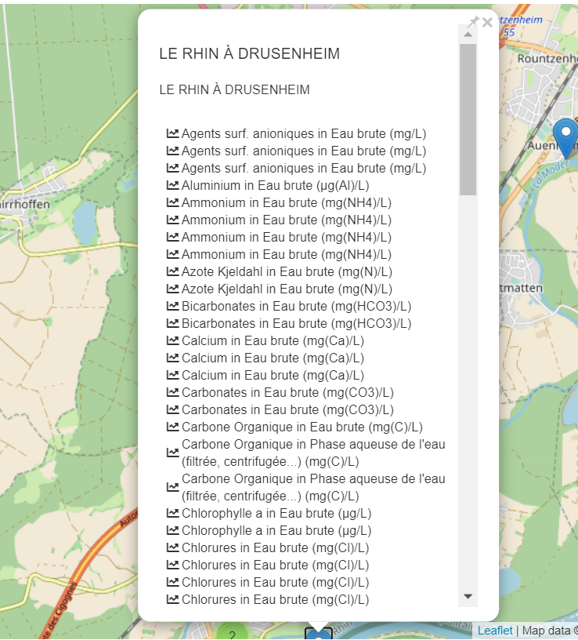
EU API4INSPIRE project
Water part
Different DataStreams
Vocabs not mapped yet,
would be the ideal next step

Slide 16
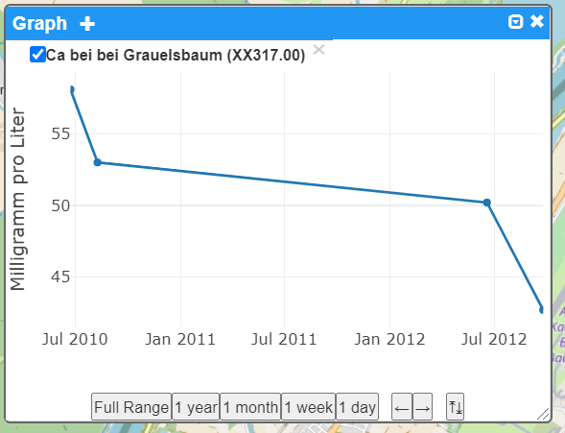
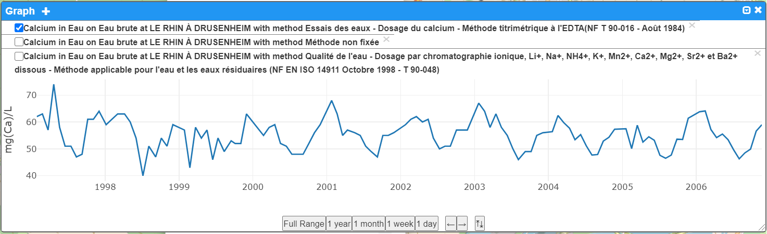
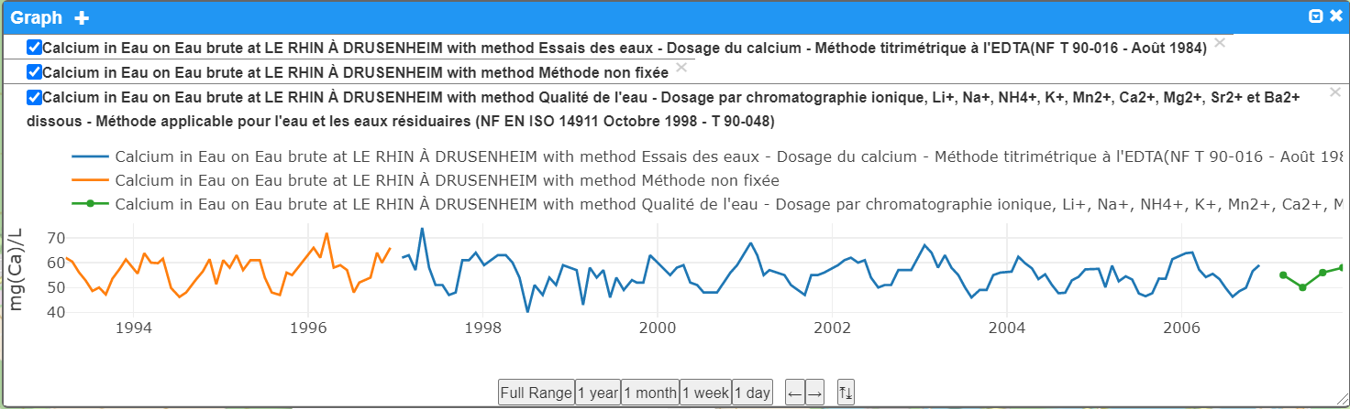
EU API4INSPIRE project
Water part
Plotting DataStreams

Slide 17
Conclusion
In EU, and water
Big momentum on implementing ST API for environmental observation
Way easier to engage people (domain & IT) than with SOS

Slide 18
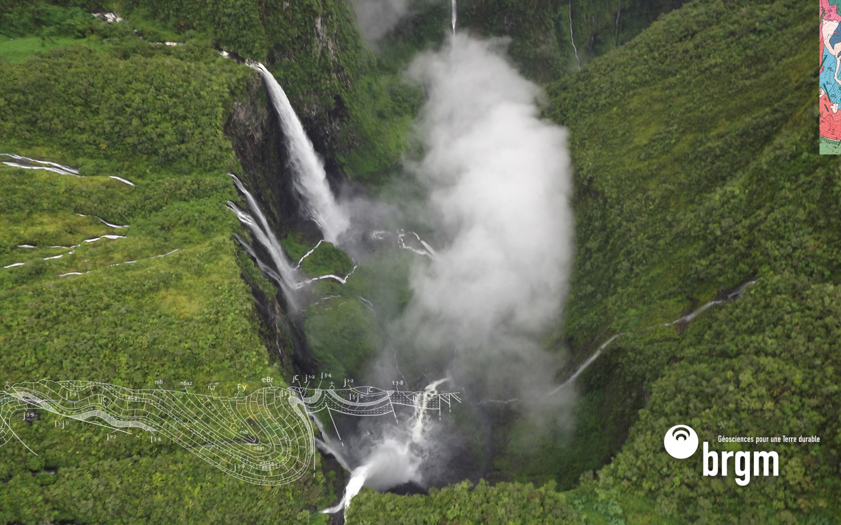
Thank you and thanks to
s.grellet@brgm.fr
m.beaufils@brgm.fr
h.bressan@brgm.fr
Kathi@DataCove.eu
hylke.vanderschaaf@iosb.fraunhofer.de
edlew@bgs.ac.uk

Slide 20
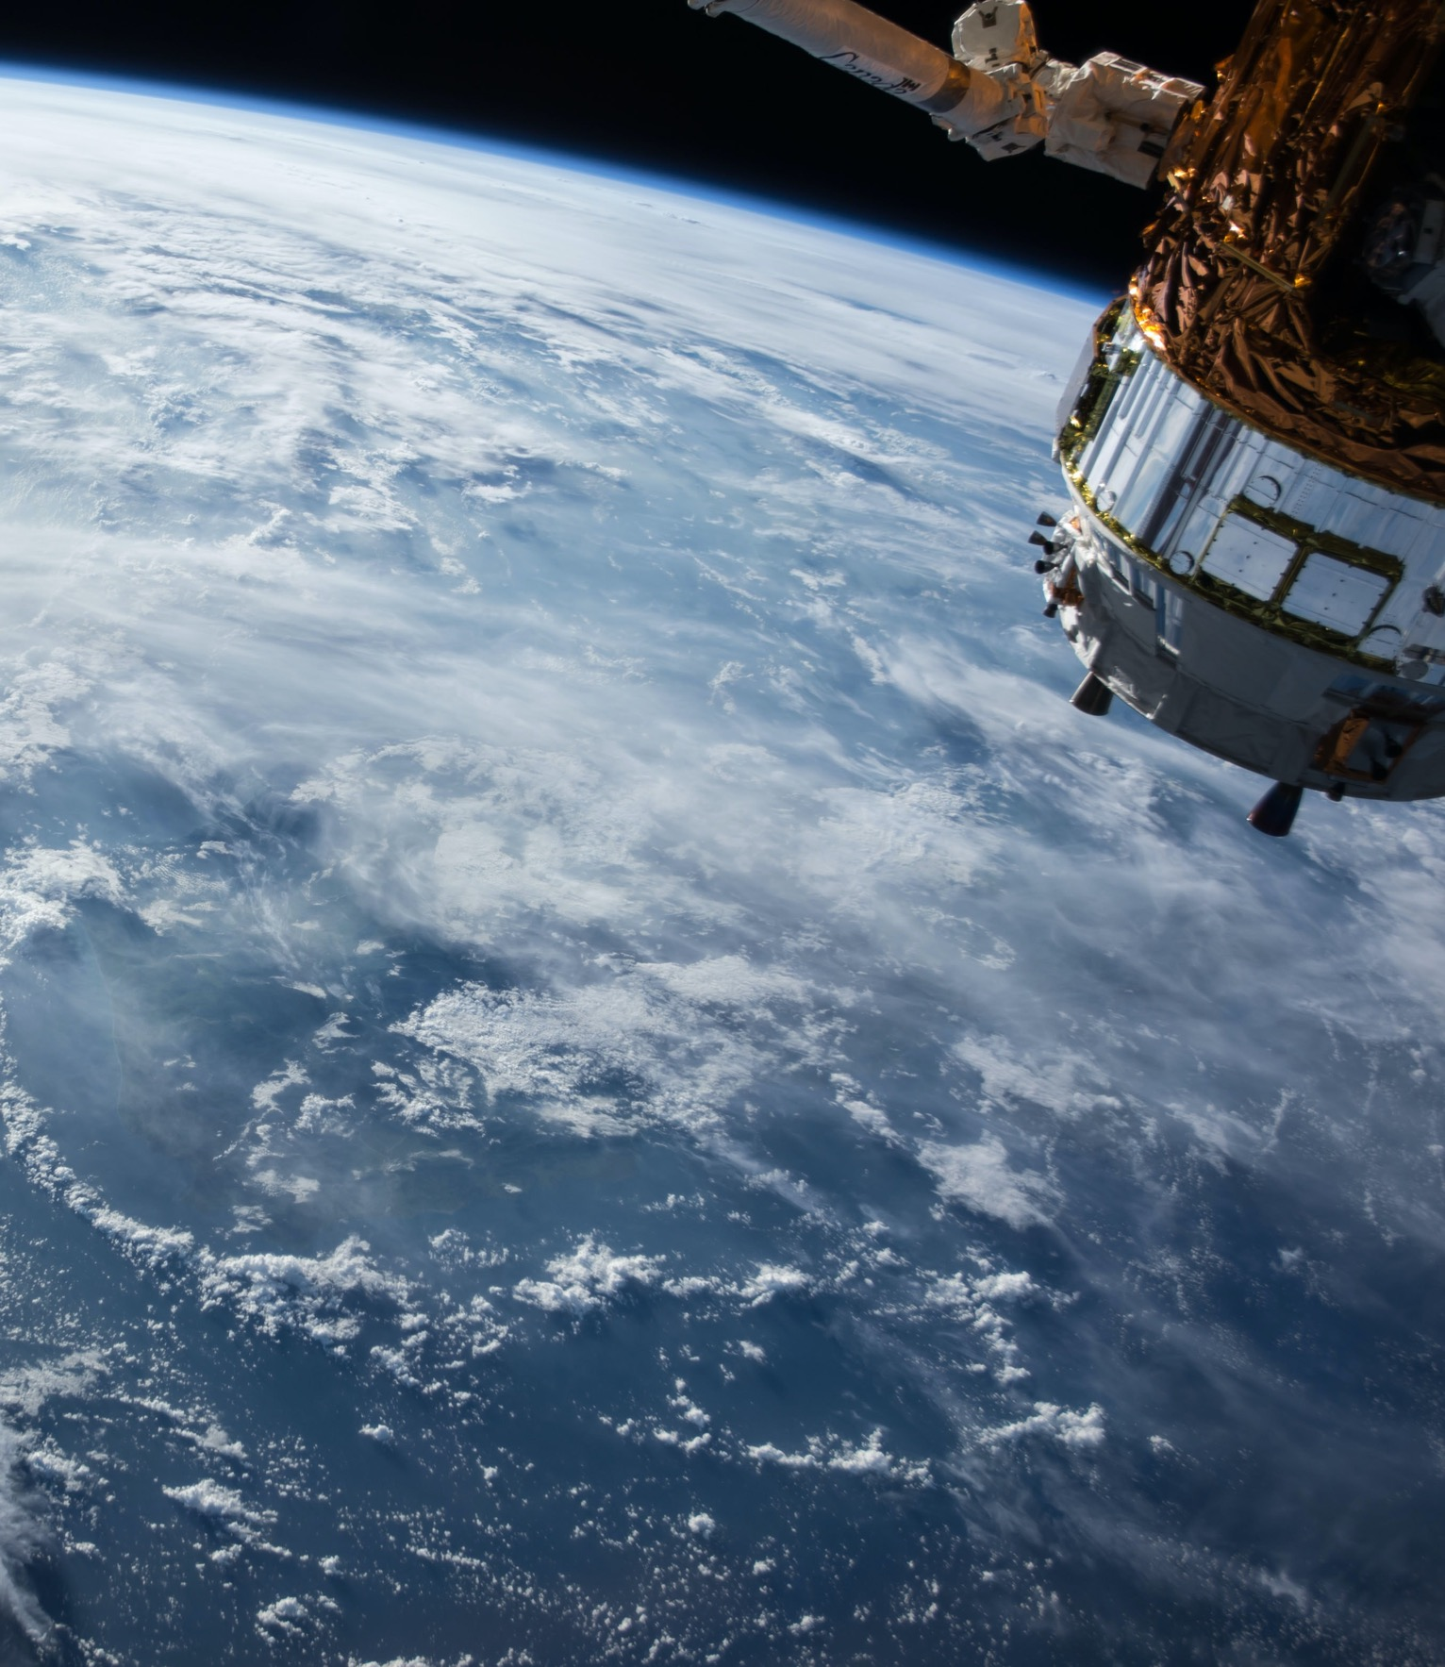
Thank You
Community

