Slide 1

Observations, measurements and samples, update
The 123rd OGC Member Meeting
Meeting sponsor
Sylvain Grellet, BRGM
13 June 2022

Slide 2
DIS Ballot result overview
19156 DIS ballot ended on 20th Apr 2022 with 100% approval votes
119 comments received in total of which a vast majority was labelled as editorial. All non-editorial comments considered Clause 3 (Terms and definitions, see next two slides)
Initial evaluation of the project team is that no technical changes are required, thus FDIS is not necessary – to be confirmed at the EC meeting
Many editorial changes are expected however, thus enough calendar time required to finalize the specification text and figures

Slide 3
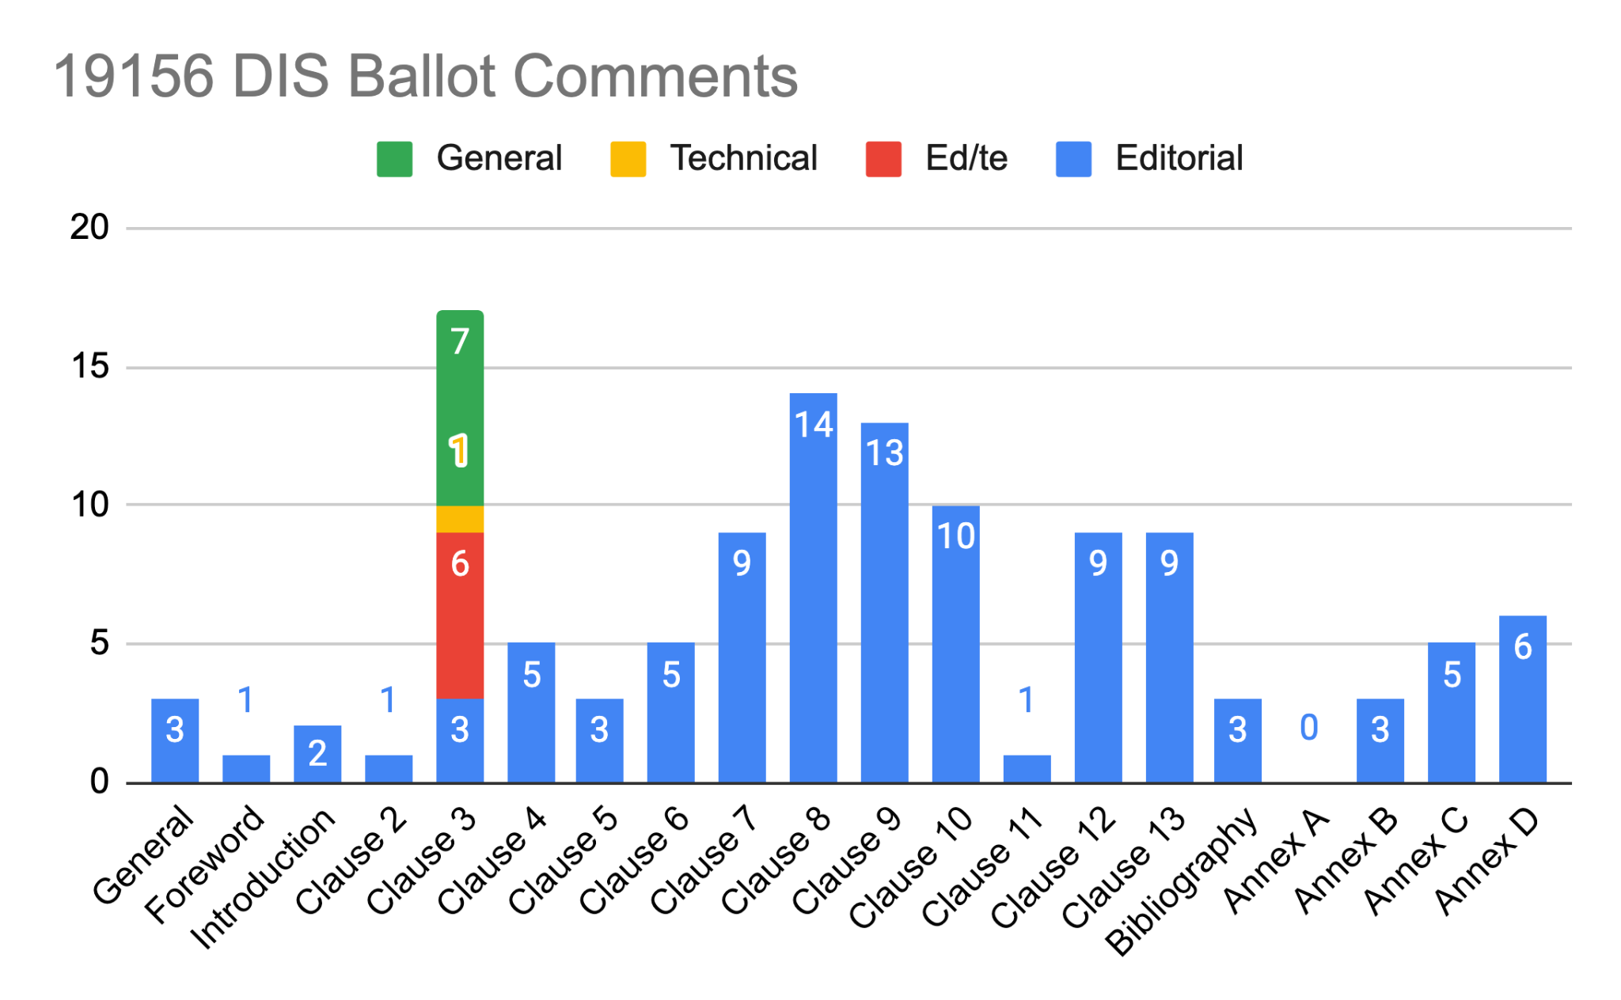

Slide 4
Ex : Comments for terms and definitions
3.6 ex-situ: Different categorization used in EO: in-situ (sensor in close proximity) vs. remote observations, not ex-situ (observation created from a sample removed from its natural surroundings) vs. in-situ (observation made in the natural surroundings of the target).
3.12 measurement: desire to bind term with the term "observation" as "observation of quantity"
3.13 observation and 3.14 observer: desire to limit the use observations to only sensor-based data acquisition, not model-based estimation.
3.17 property: desire to widen the ISO 19143 definition to include properties of non-object phenomena
3.21 sample: A wider definition is desired including sample pixels etc. which may not be "representative" of the target in EO domain.
Incl. some “last minutes discussions” in the GitHub that should have occurred in the previous commenting rounds

Slide 5
Comment resolution and Editing Committee meeting
OGC GitHub issues used for processing the proposed resolutions for all of the comments (same as before) : https://github.com/opengeospatial/om-swg/projects/3
Large number of editorial comments (including ISO secretariat ones regarding readability and color usage of some figures) and carefulness required revising the wordings in Clause 3
ISO 19156 Editing Committee meeting : June 21 2022
final comment resolutions agreed on

Slide 6
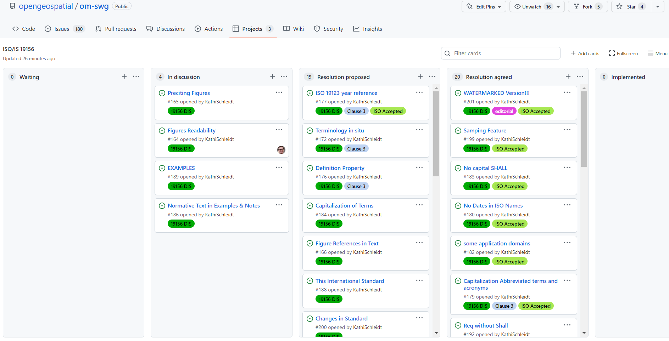
Comment resolution : Today’s status
After Editing Committee

Slide 7
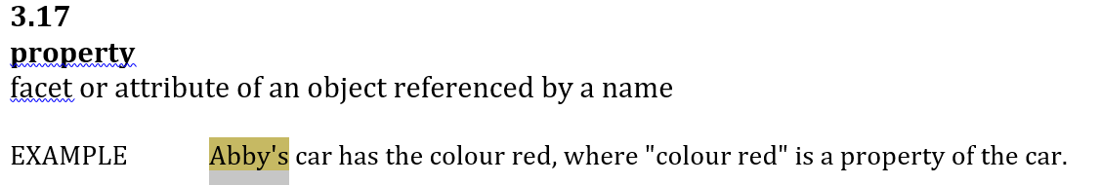
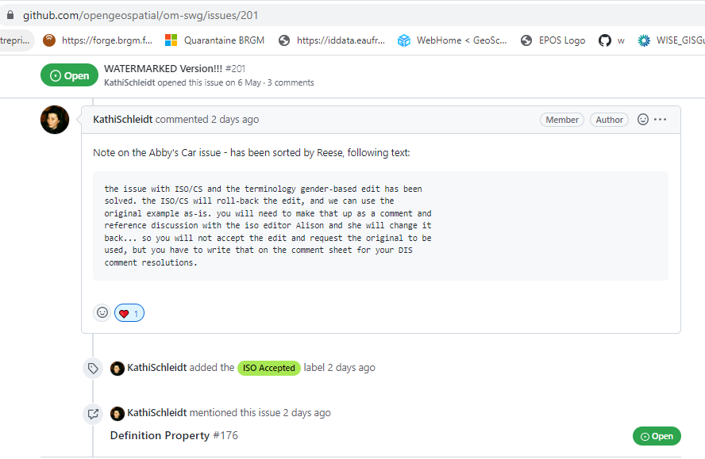
Abby’s car example saved

Slide 8
Timeline towards IS publication
10th May 2022 : ISO W9 meeting project status update
May - June 2022: Initial resolution proposals produced by the project team
21st June 2022: Online EC meeting, final comment resolutions agreed
June - August 2022: Final standard document editing
Stage 50 (Approval): early September 2022. Can be skipped in now FDIS (Final Draft International Standard) stage needed
Stage 60 (Publication) : November 2022

Slide 9
Thanks s.grellet@brgm.fr

Slide 10

Thank You
Community

