Slide 1

HydroDWG
The 123rd OGC Member Meeting
Meeting sponsor
Tony Boston, Australian National University
13 June 2022

Slide 2
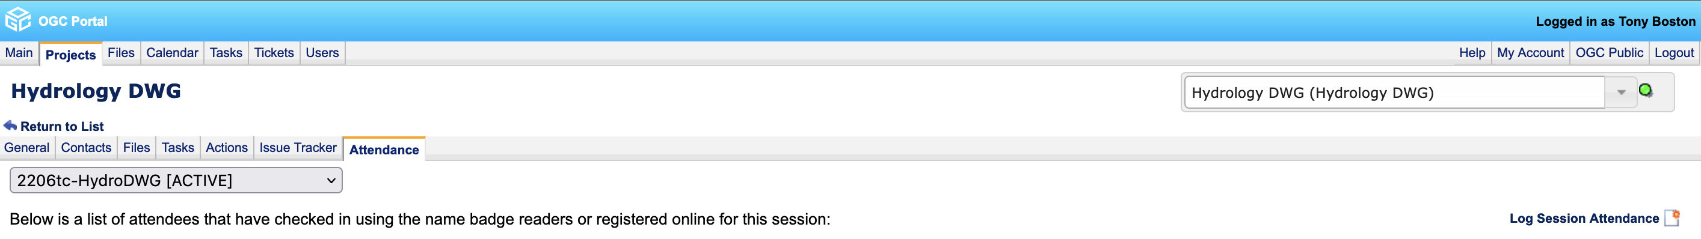
MEMBERS: Please record your attendance here:
https://portal.ogc.org/index.php?m=projects&a=view&project_id=301&tab=6
3. Add yourself to the session
1. Find the appropriate project
2. Go to the Attendance tab

Slide 3
Agenda
World Water Quality Alliance (WWQA) and Water Quality Monitoring initial workshop (Tony Boston)
Water Quality Interoperability Experiment (David Blodgett)
Observations & Measurements v3 status (Sylvain Grellet)
Sensor Things v2 and Soil Things demo (Hylke van der Schaaf)

Slide 4

World Water Quality Alliance (WWQA) www.unep.org/wwqa

Slide 5
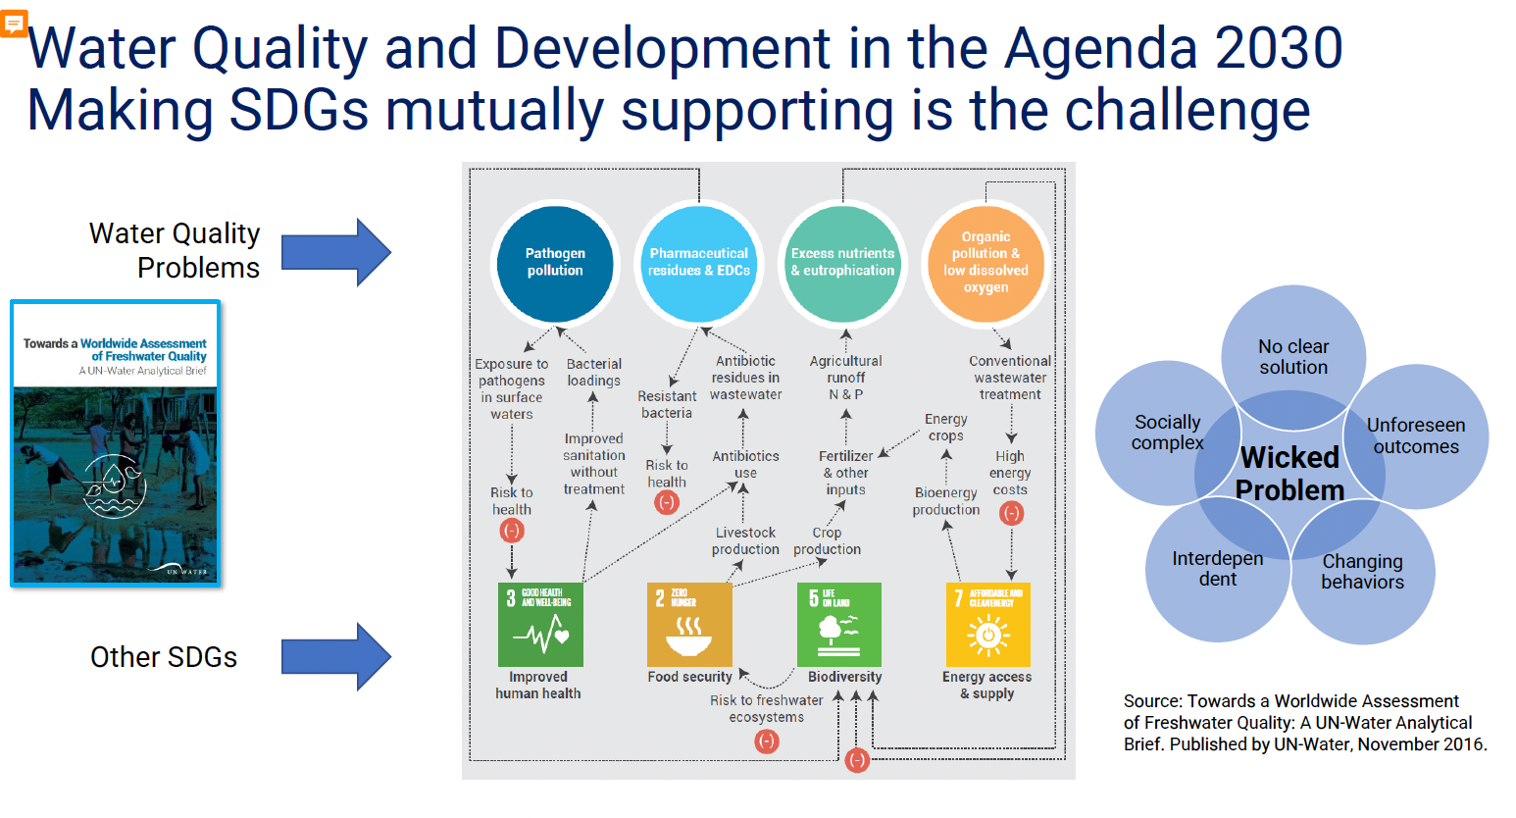
The Water Quality challenge

Slide 6
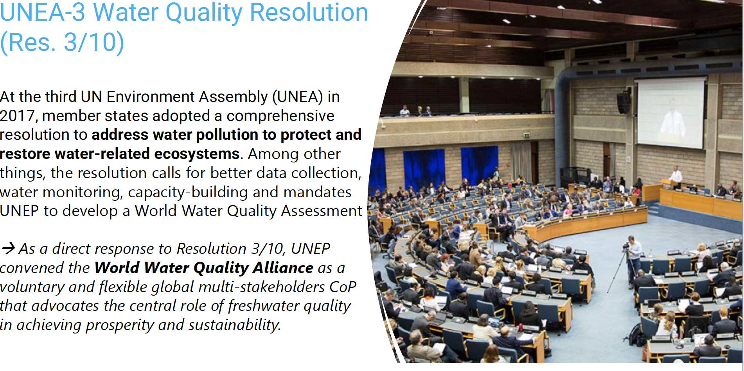
WWQA mandate

Slide 7
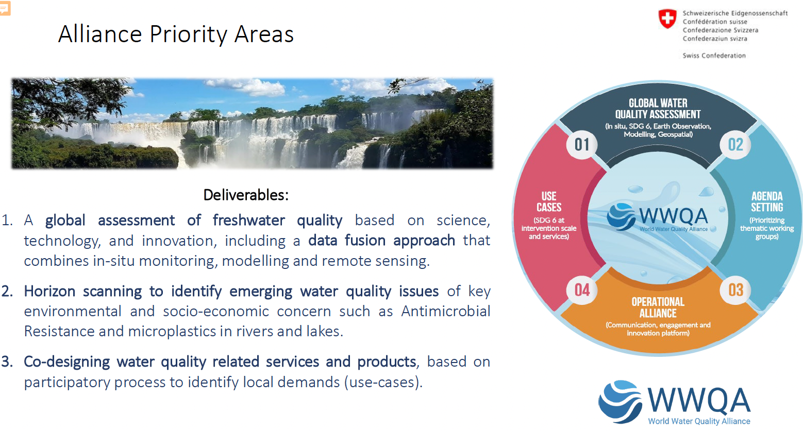
World Water Quality Assessment

Slide 8
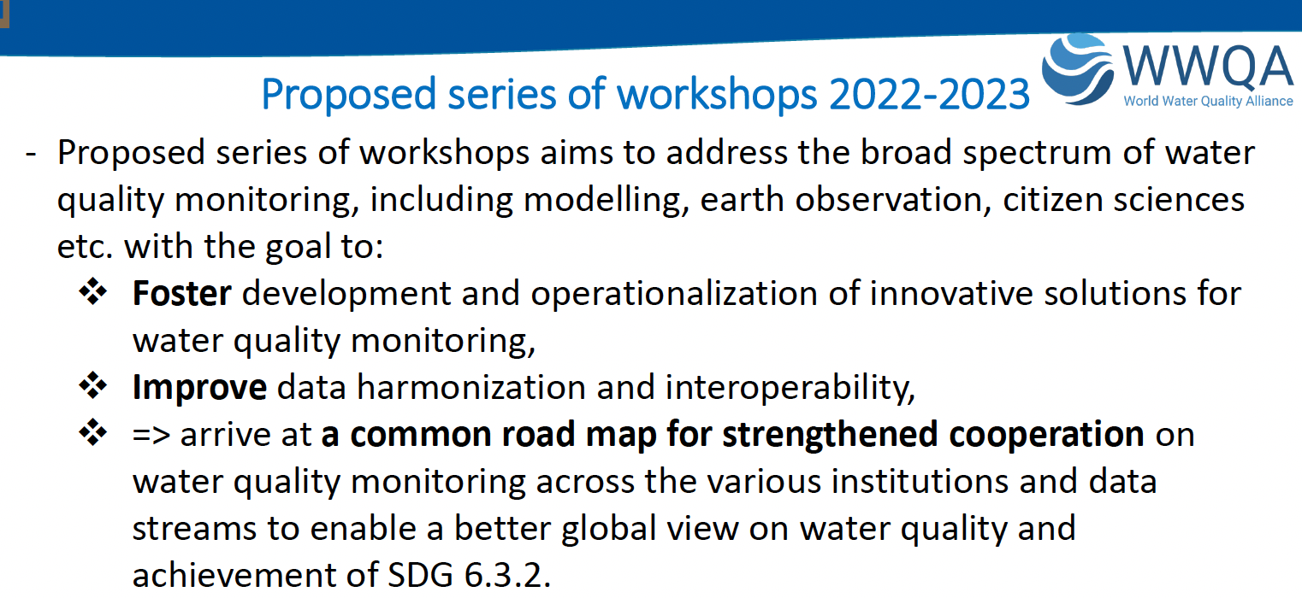
WWQA workshops

Slide 9
WWQA initial workshop – 29-31 March 2022
Day 1 – Regulatory and Guidance material on Water Quality
Day 2 – Coordinated operational support to UN Member States & WWQA
Day 3 – Water Data Quality Interoperability Experiment

Slide 10
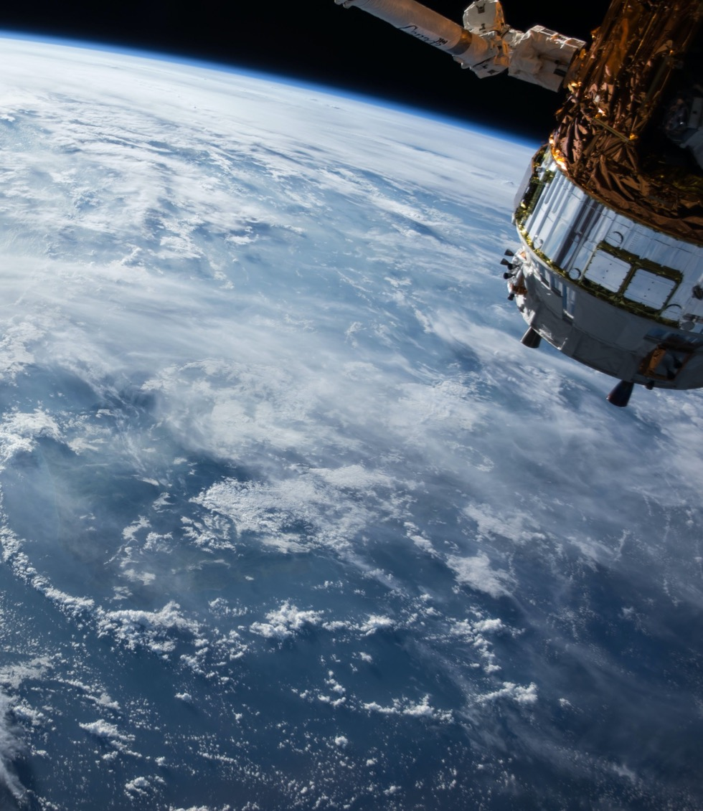
Thank You
Community

Slide 11
Agenda (cont.)
Water Quality Interoperability Experiment (David Blodgett)
Observations & Measurements v3 status (Sylvain Grellet)
Sensor Things v2 and Soil Things demo (Hylke van der Schaaf)

