Slide 1

STA v2 Update
The 123rd OGC Member Meeting
Meeting sponsor
Hylke van der Schaaf, Fraunhofer-Gesellschaft 13 June 2022

Slide 2
Agenda
Notes:
<number>

Slide 3
Things under active discussion
Observations, Measurements and Samples (O&M v3)
O&M v3 work took priority over STAv2
Better OData compatibility (#136)
JSON-LD Compatibility (#137)
Mapping to EDR (#135)
SWE Common to describe results (#122)
Verticality (#116, #139)

Slide 4
Things we need your help with
Observations, Measurements and Samples (O&M v3)
Implementation examples of samples!
How would you like to see Samples in STA?
Domain Models & SensorThings (See next presentation)

Slide 6
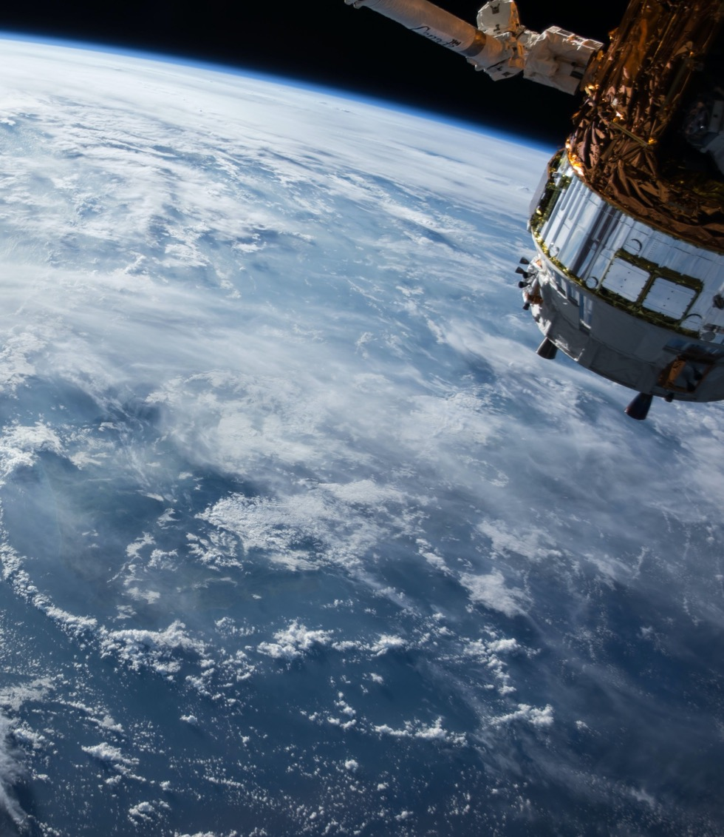
Thank You
Community

