Slide 1

JET-HYDMON FACE-TO-FACE MEETING 29 NOV - 1 DEC, 2022
WMO Activity Report
Task Team WIS for Hydrology (TT-W4H)
Philipp Saile (Co-Lead) - International Centre for Water Resources and Global Change (UNESCO), Federal Institute of Hydrology, Germany
Enrico Boldrini (Co-lead) - National Research Council of Italy (CNR/IIA)
Rania Kamel (Co-lead)– Nile Waters Department, Eygpt
Washington Otieno –WMO Secretariat, ESM
JET-HYDMON WHOS GROUP
WHOS ACTIVITIES UPDATE

Slide 2
Contents
Recap WMO System of Systems, WIS & WHOS
WHOS Implementations
WHOS – WIS Interoperability
WHOS future developments

Slide 3
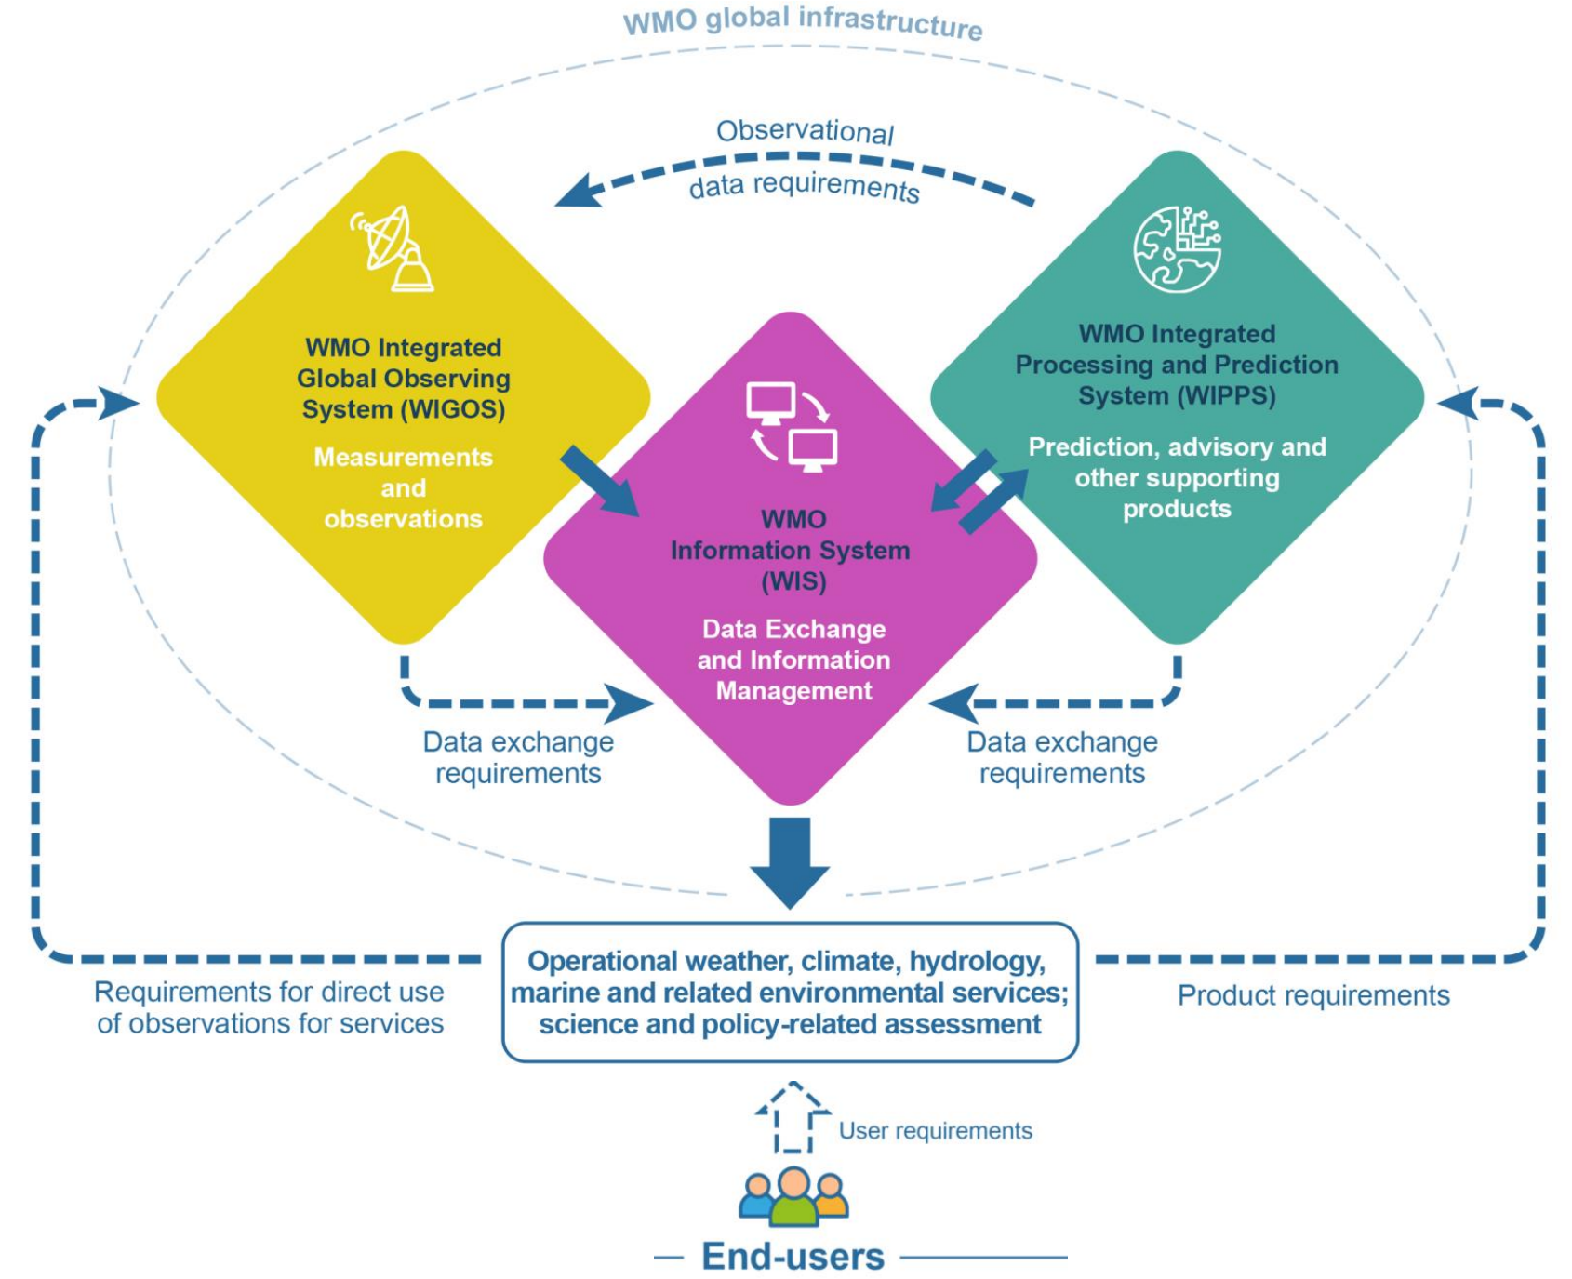
WMO System of Systems
WIGOS: WMO Integrated Global Observing System
Observation (meta)data
WIS: WMO Information System
Data exchange
WIPPS: WMO Integrated Processing and Prediction System
Data products (Forecasts, Indicators etc.)

Slide 4







WIS2 Components: Global Services
Data users
Global Monitoring
Discovers datasets
Subscribes to topics
Downloads core data
Global Discovery Catalogue
Global Broker
Global Cache
Downloads recommended data
Downloads recommended data
Downloads recommended data
Provides an API to discover datasets and services
Sends notifications of new data to be downloaded from Global Caches or WIS2 nodes
Provides users HTTP download of core data cached from WIS2 nodes
WIS2 node
WIS2 node
WIS2 node
Scale to highly-available, global data sharing

Slide 5
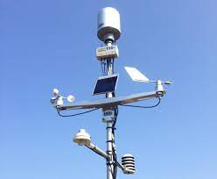


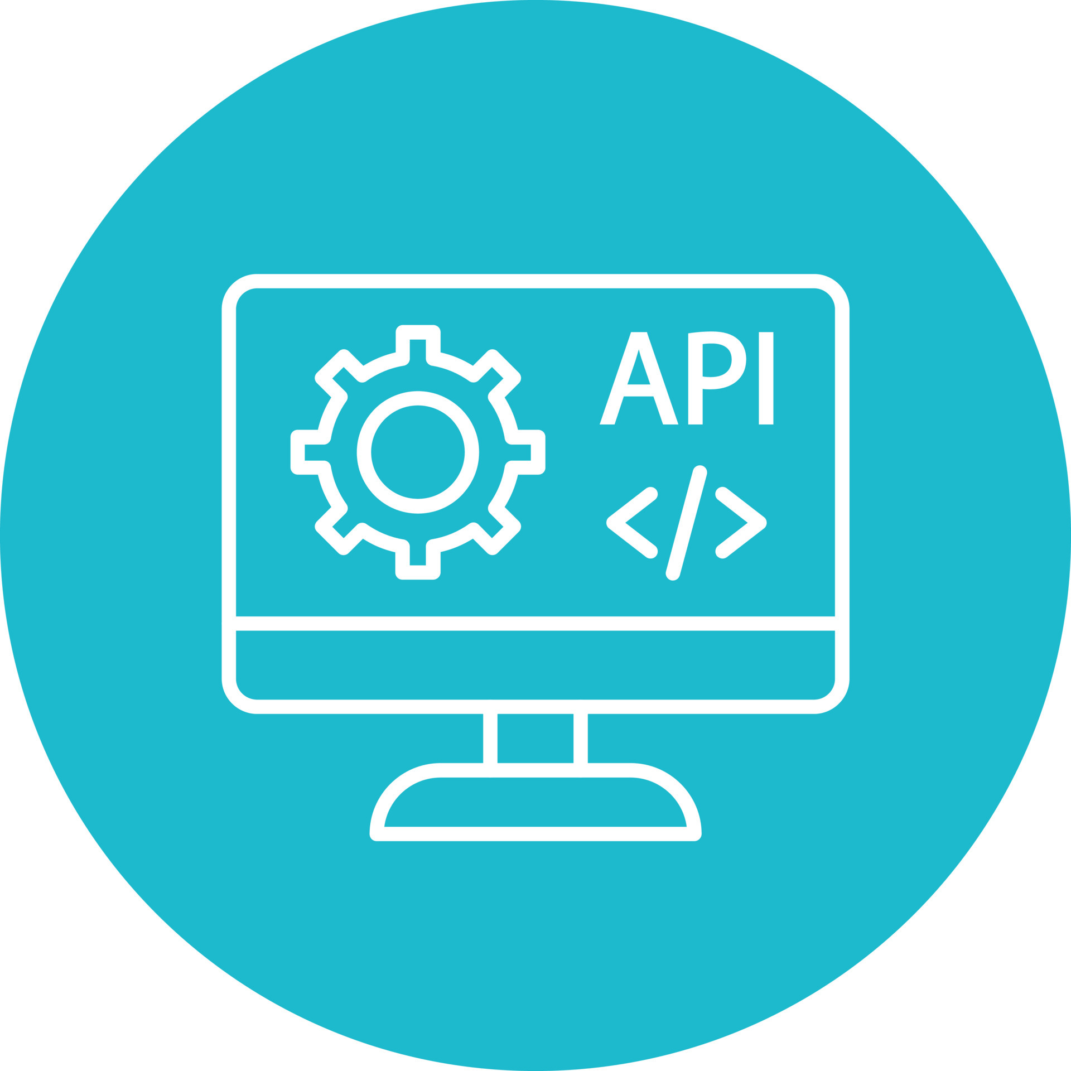





WIS2box: enabling broad participation in WIS2
WIS2 box
“WIS2 in a box” is a reference implementation of a WIS2 Node
MQTT
HTTP
Software (not hardware)
Publishing facility/capability compliant to WIS 2.0 Architecture
Provides basic data transformation
Can integrate with existing data management systems
CSV to BUFR
BUFR
SYNOP to BUFR
GeoJSON
Data Services
WEB API
WEB
ACCESSIBLE
FOLDER
Message
Queuing
Protocol
notification
download
subscribe
Global Cache
Global Broker

Slide 6
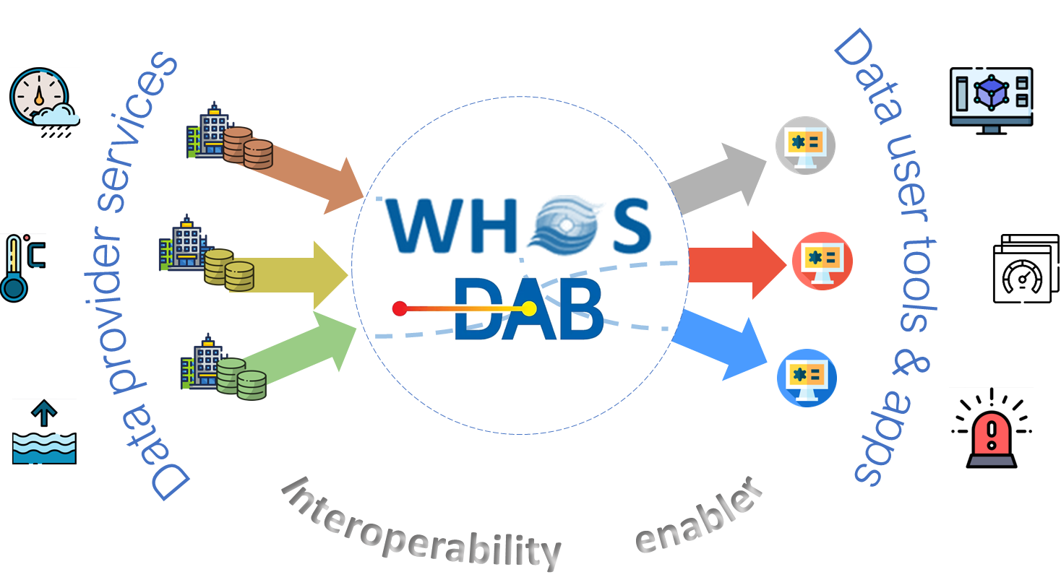
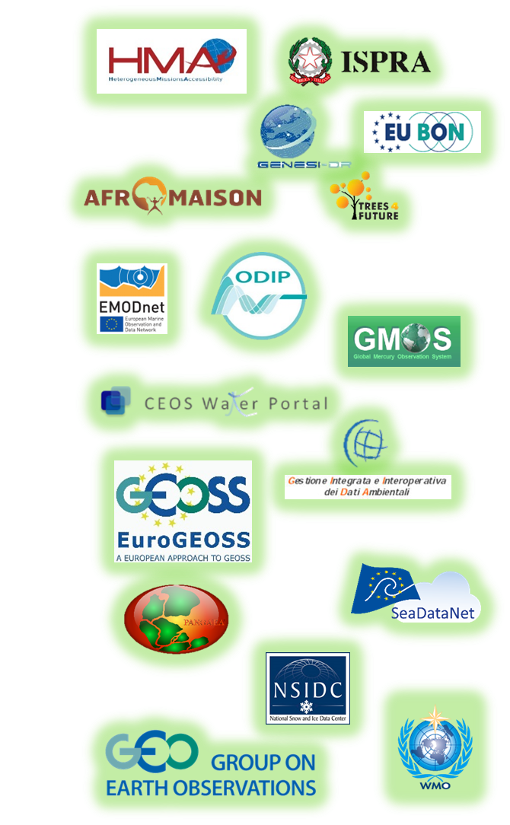

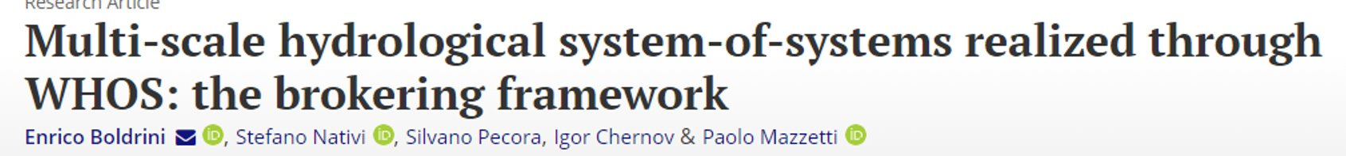

WHOS brokering approach
DAB successful deployments
NMHS
Private companies
Research centers
...
Web portals
Forecast models
End user apps
...
https://github.com/ESSI-Lab/DAB

Slide 7
WHOS latest implementations
Tested data sources
GRDC
Connection established, additional metadata elements could be added
CUAHSI HIS Central
Connection established, a complete harvesting is in progress
BRGM (France)
Connection established, additional metadata elements could be added
IGRAC
Connection established, a complete harvesting is in progress
Tested technologies
Useful in case the data provider needs to setup the publication system from scratch
WIS Nodes
Ready for tests with actual providers
HydroServer
Ready for tests with actual providers
HydroServer 2
Ready for tests with actual providers
In progress data sources
Aral Sea:RIHMI is working on improving the data publication system

Slide 8
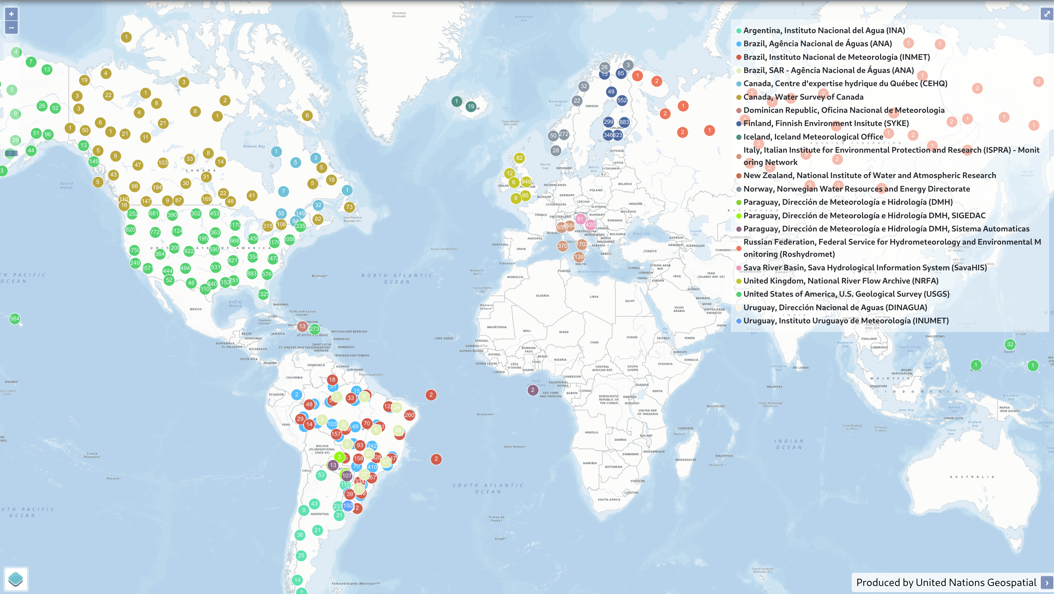
WHOS Implementations – WHOS Global portal
Production environment
22 data sources including:
La Plata river basin countries
Arctic region
Sava River Basin
https://wde.hydro.geodab.eu/apps/water-data-explorer-whos/

Slide 9
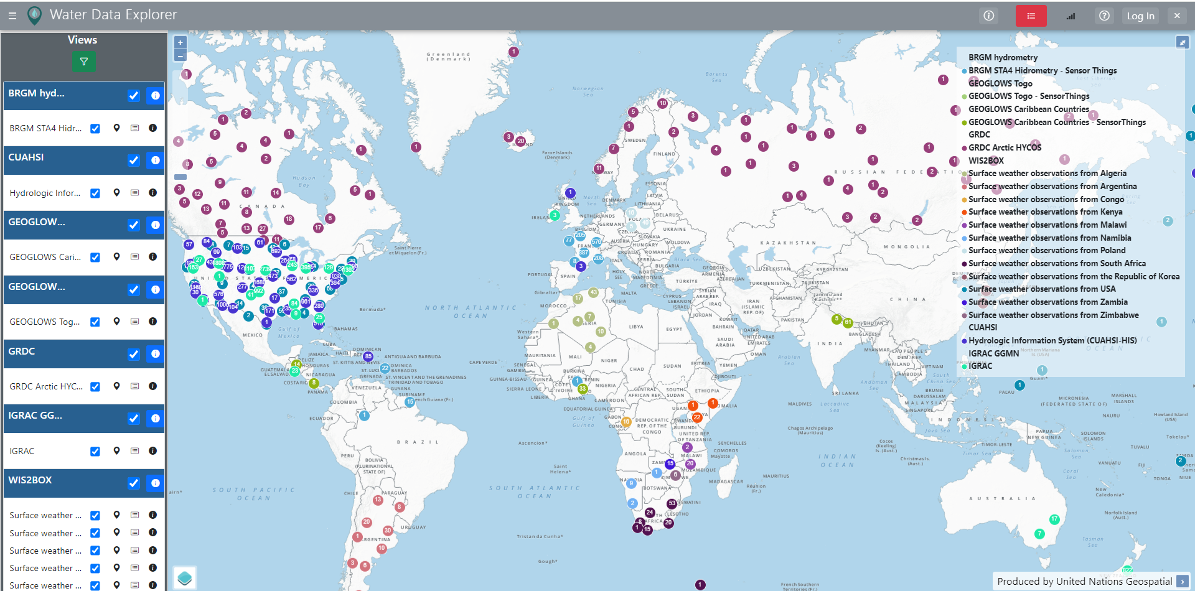
WHOS Implementations – test environment
Testing environment
CUAHSI HIS Central
GRDC
IGRAC
BRGM (France)
HydroServer (GeoGlows)
WIS Nodes
https://testwde.hydro.geodab.eu/apps/water-data-explorer-whos/

Slide 10
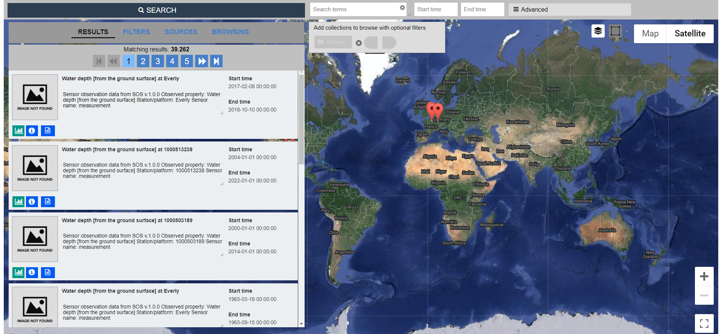
WHOS test implementations test portals
Testing environment
CUAHSI HIS Central https://whos.geodab.eu/gs-service/search?view=cuahsi-full
GRDC https://whos.geodab.eu/gs-service/search?view=grdc-arctic-hycos
IGRAC https://whos.geodab.eu/gs-service/search?view=igrac
BRGM (France) https://whos.geodab.eu/gs-service/search?view=whos-fra-brgm-hydrometry
HydroServer (GeoGlows) https://whos.geodab.eu/gs-service/search?view=whos-geoglowstogo
WIS Nodes https://whos.geodab.eu/gs-service/search?view=wis2box
Each portal focuses on a specific view

Slide 11
WHOS-WIS interoperability
OGC API Records
WHOS WCMP records validated
MQTT
Basic tests successfully executed
Test topic hierarchy being drafted

Slide 12
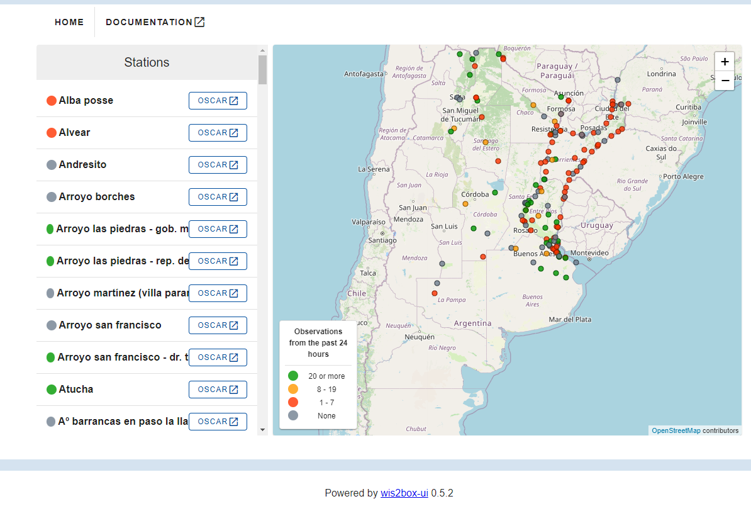
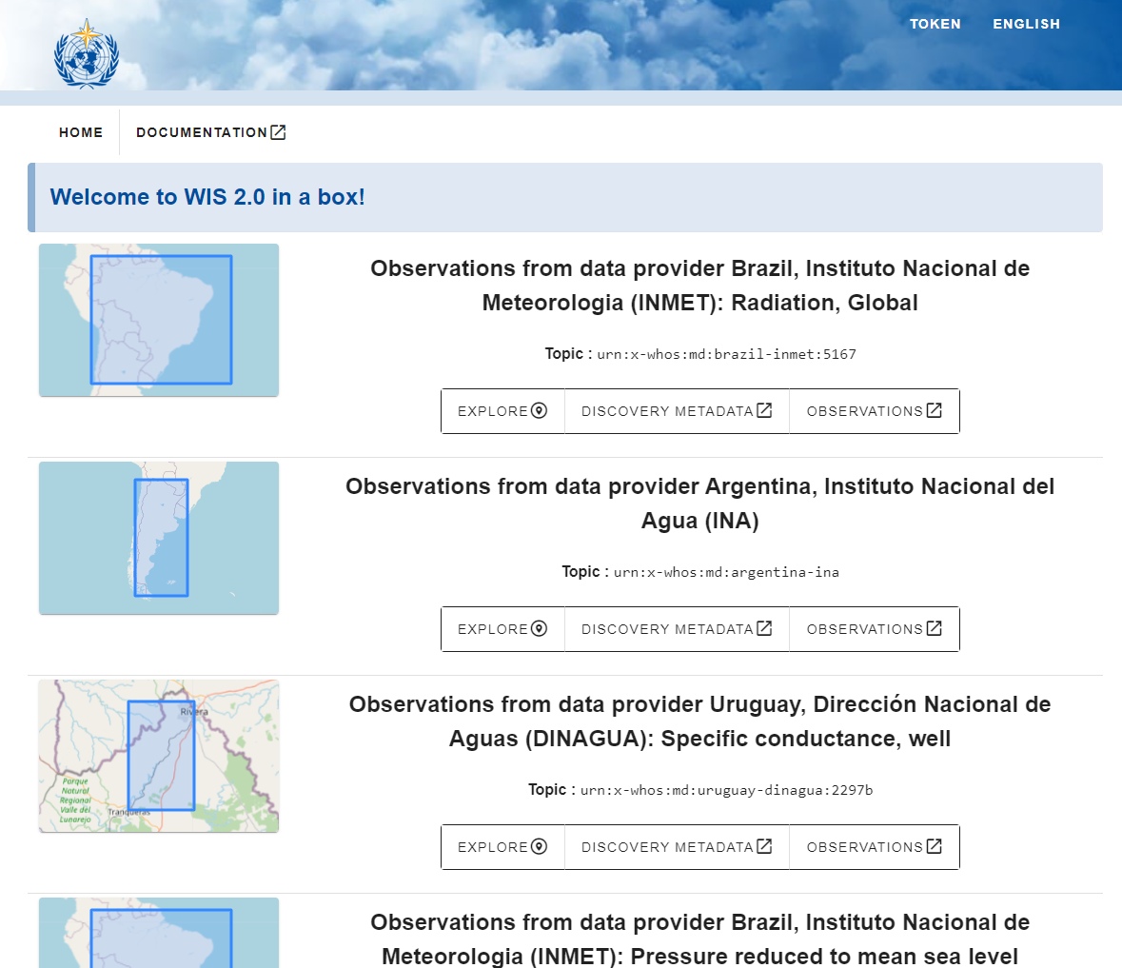
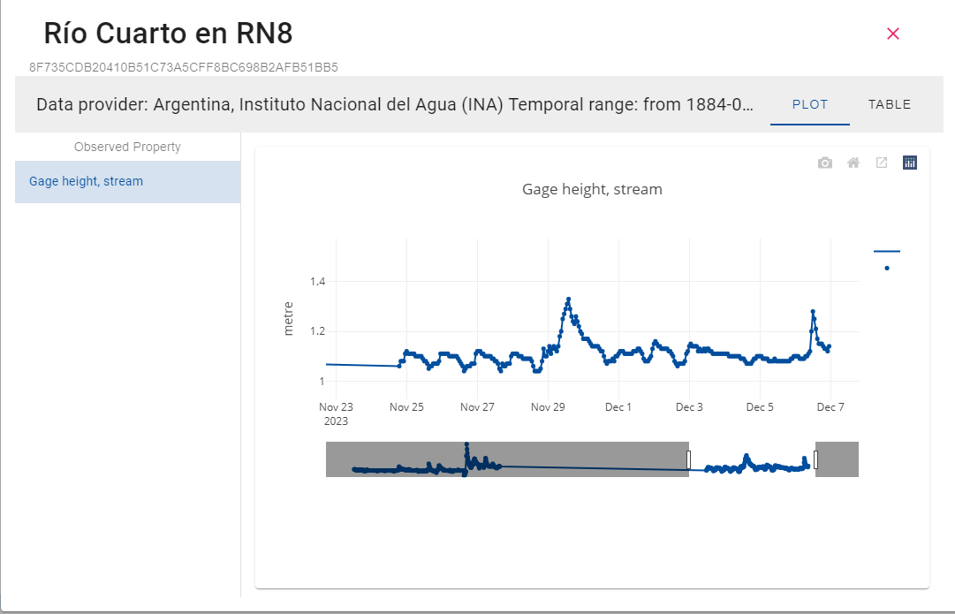
OAPI record profiler & accessor
DAB configuration of OAPI Record profiler for WIS2.0 for the test countries
WHOS OAPI service enables compliant clients such as WIS 2 box UI to discover and access WHOS data

Slide 13
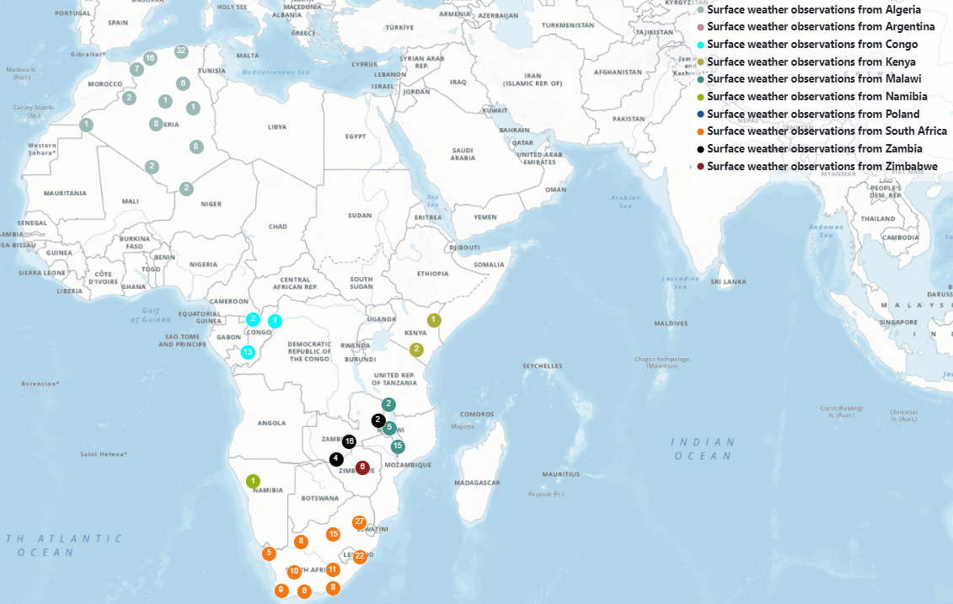
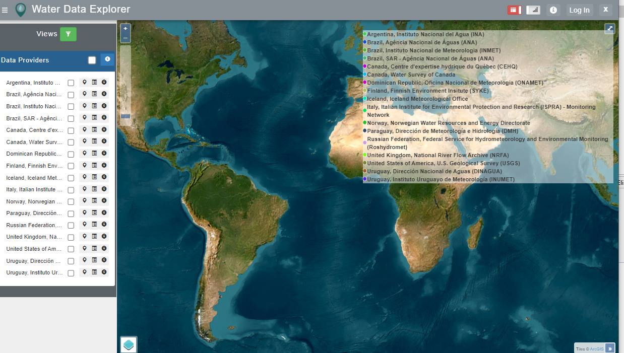
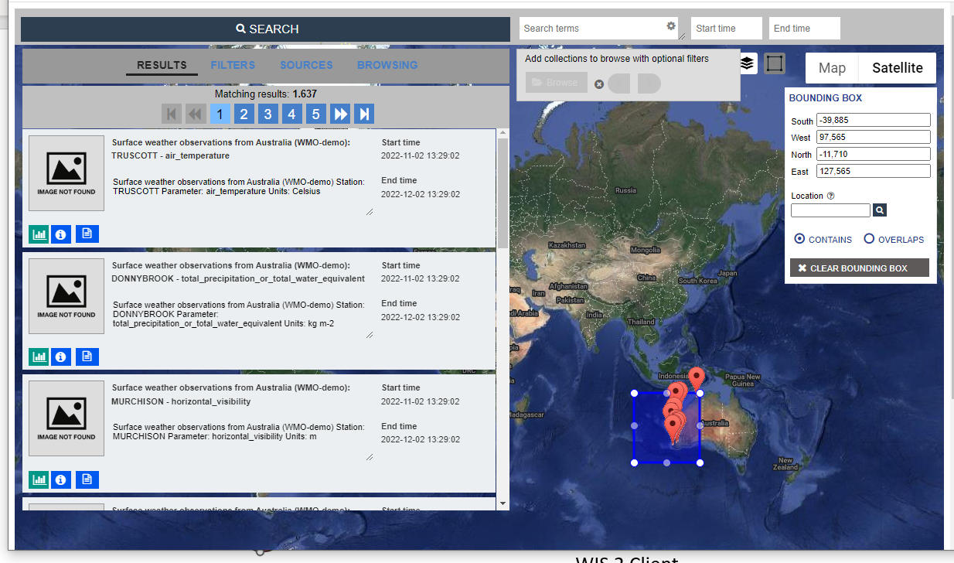
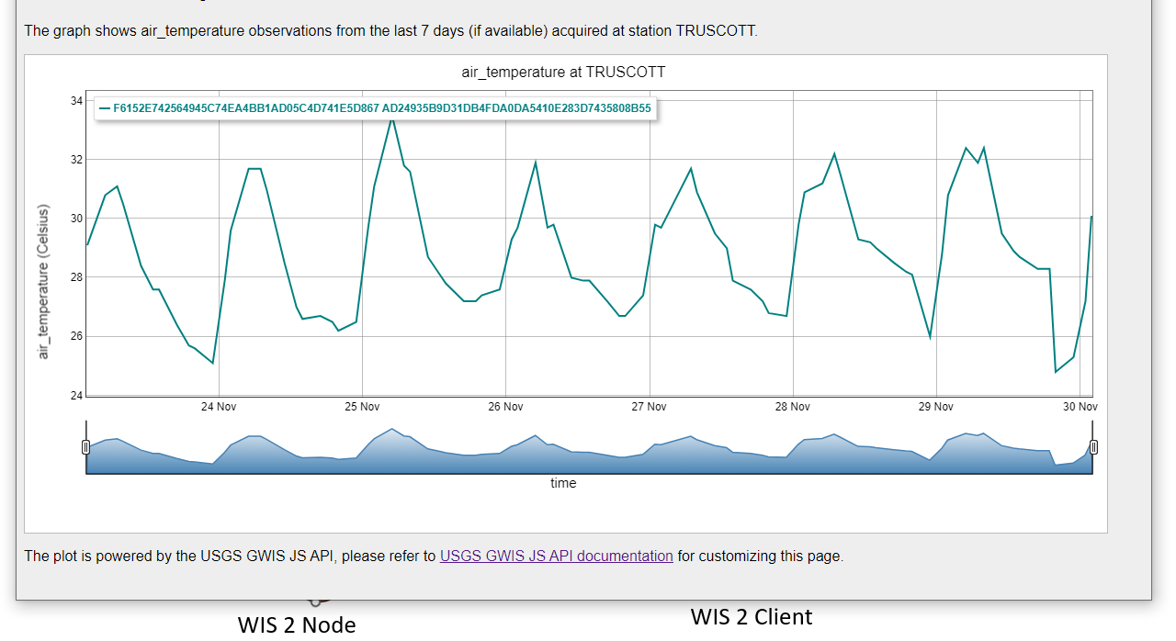
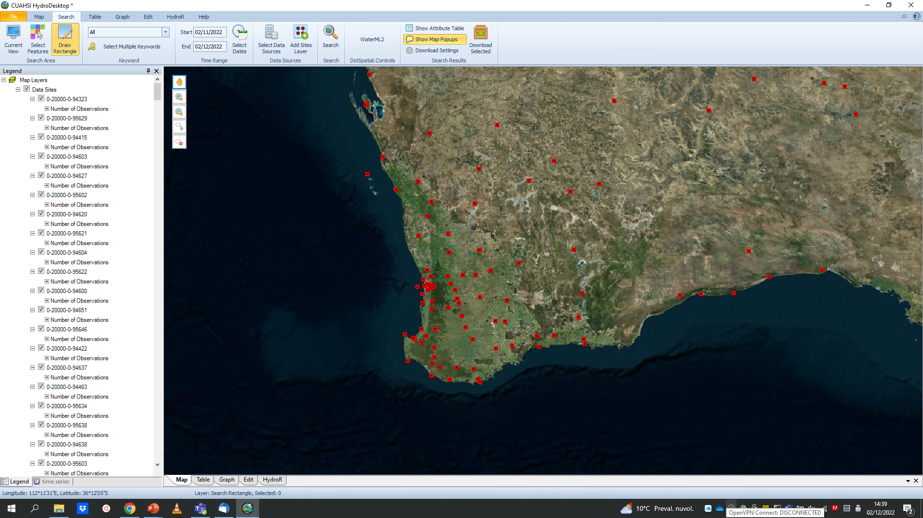
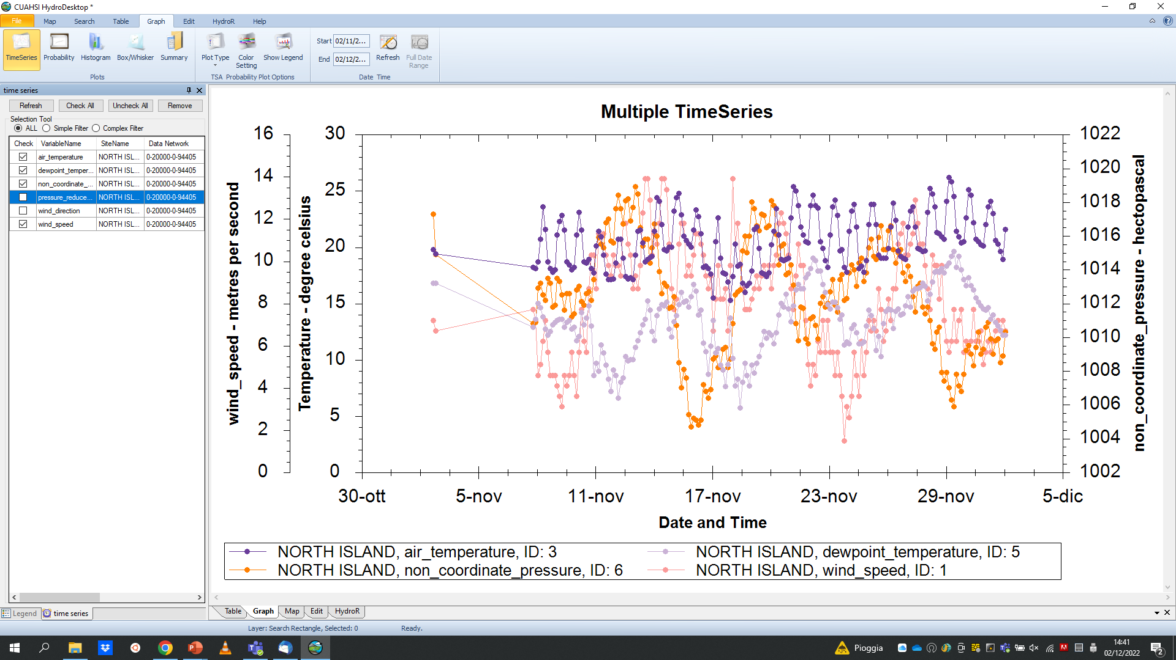
OAPI record profiler & accessor
OAPI record profiler & accessor
DAB configuration of OAPI Record accessor for WIS2.0 for the test countries
WHOS OAPI accessor enables WHOS clients such as WDE, GI-portal, HydroDesktop to discover and access WIS2 data

Slide 14







Discovery metadata (WCMP2)
WHOS broker produces WCMP 2.0 records from data provider records through mapping and aggregation
TT-W2FH document describing the target metadata model:
WCMP for Hydrology
WCMP core elements
Id
Title
Description
...
Possible additional elements:
Interpolation type (from WaterML)
Aggregation period in ISO8601 (e.g. P1D, PT1H)
Intended observing spacing in ISO8601
Reporting frequency
Quality control
Coordinate system
Mapping
Data provider
metadata records
(different standards)
WCMP 2.0 discovery metadata records
Validation ongoing using pywcmp
WEATHER CLIMATE WATER
Different aggregation levels:
Level 7 (Data provider level)
Level 8
Level 9
Level 10
Level 11
Aggregation
Time series level records
Data provider level records

Slide 15
Topic hierarchy for hydrology
Definition combining:
Bottom up approach (starting from hydro ontology and WMDR regsitry) and
Top down approach (starting from a general hierarchy that is useful for data discovery)
Level # | Level name | Example
7 | Earth-system-discipline | Hydrology
8 | Earth-system-discipline-subcategory | Surface water observations
9 | Sub-sub-category | Surface water quantity observations
10 | Water Body | Stream
11 | Parameter | level-stream http://hydro.geodab.eu/hydro-ontology/concept/11 (concept 11 from Hydro ontology) https://codes.wmo.int/wmdr/ObservedVariableTerrestrial/172 (concept 172 from WMO WMDR registry)
WEATHER CLIMATE WATER
Example: "origin/a/wis2/ke-wra/data /core/hydrology/surface-observations/surface-water-quantity-observations/stream/level
Experts are finalizing to GitHub the hydrology topic hierarchy definition

Slide 16
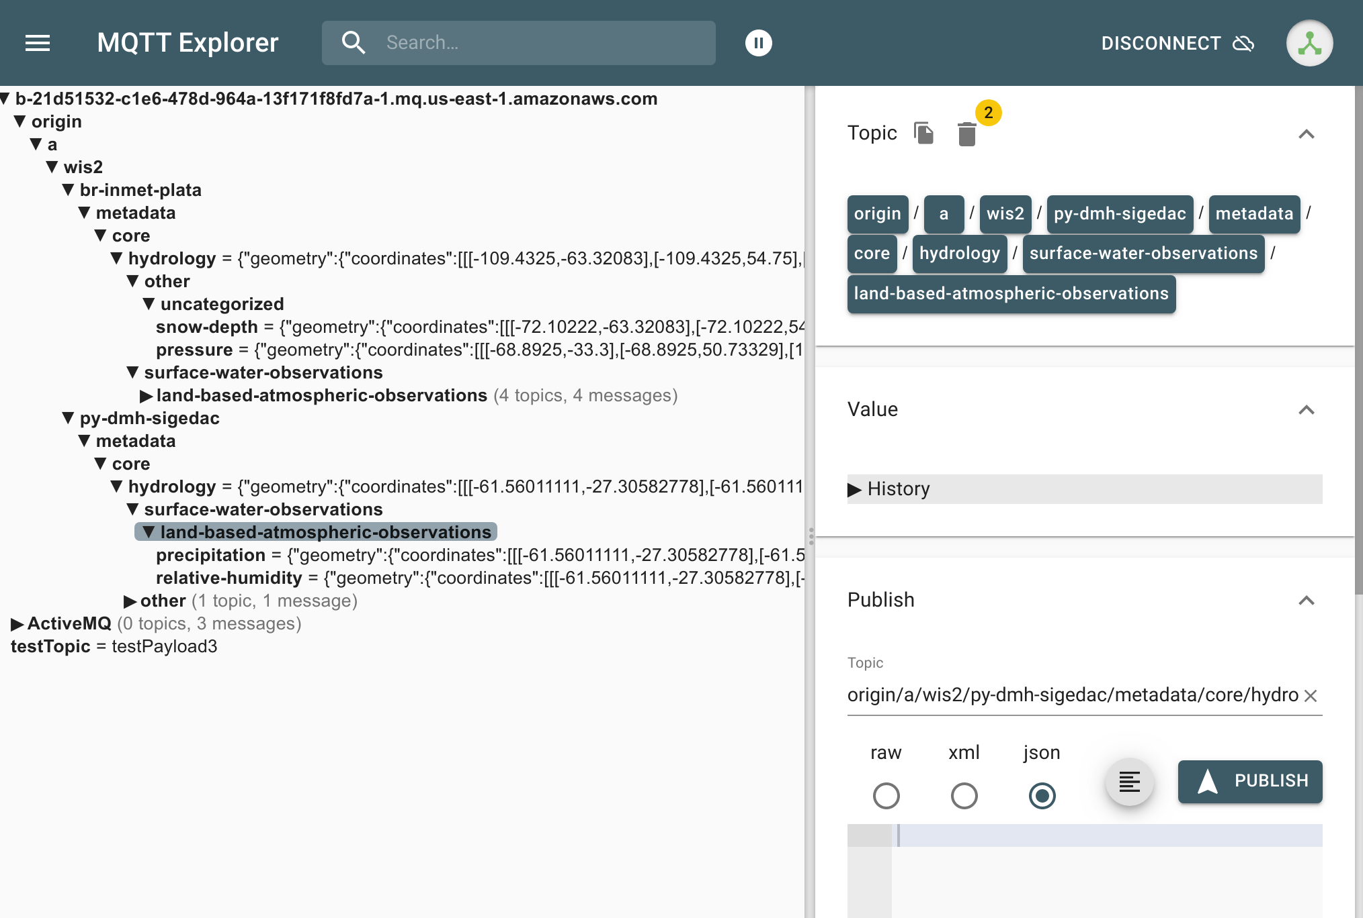
MQTT and WMCP 2.0 progress
MQTT
Implemented with a basic structure in WHOS broker
The actual topic hierarchy is being reviewed by hydrology expert. After this work is accomplished it will be pushed to WMCP GitHub and WHOS broker implemementation will be updated
WMCP
Implemented and first validation check using pywmcp accomplished
{"geometry": {"coordinates": [[[-72.8838888888889,-54.7975],[-72.8838888888889,-22.3266666666667],[-53.490223,-22.3266666666667],[-53.490223,-54.7975],[-72.8838888888889,-54.7975]]],"type": "Polygon"},"links": [{"rel": "canonical","href": "http://whos.geodab.eu/gs-service/services/essi/view/gs-view-and(whos,gs-view-source(argentina-ina))/oapi/collections/discovery-metadata/items/urn:wmo:md:argentina-ina:all","type": "application/json","title": "urn:wmo:md:argentina-ina:all"},{"rel": "collection","href": "http://whos.geodab.eu/gs-service/services/essi/view/gs-view-and(whos,gs-view-source(argentina-ina))/oapi/collections/urn:wmo:md:argentina-ina:all","type": "application/json","title": "urn:wmo:md:argentina-ina:all"}],"conformsTo": ["http://wis.wmo.int/spec/wcmp/2.0","http://wis.wmo.int/spec/wcmp/2/conf/core"],"id": "urn:wmo:md:argentina-ina:all","time": {"interval": ["1884-01-01T03:53:48Z","2024-04-10T12:15:11Z"]},"type": "Feature","properties": {"themes": [{"concepts": [{"id": "210","title": "Amount of precipitation","url": "http://codes.wmo.int/wmdr/ObservedVariableAtmosphere/210"},{"id": "171","title": "Stream discharge","url": "http://codes.wmo.int/wmdr/ObservedVariableTerrestrial/171"},{"id": "224","title": "Air temperature (at specified distance from reference surface)","url": "http://codes.wmo.int/wmdr/ObservedVariableAtmosphere/224"}],"scheme": "http://codes.wmo.int/wmdr/ObservedVariableAtmosphere"},{"concepts": [{"id": "65","title": "Precipitation","url": "http://hydro.geodab.eu/hydro-ontology/concept/65"},{"id": "12","title": "Gage height, stream","url": "http://hydro.geodab.eu/hydro-ontology/concept/12"},{"id": "78","title": "Discharge, stream","url": "http://hydro.geodab.eu/hydro-ontology/concept/78"},{"id": "133","title": "Relative humidity","url": "http://hydro.geodab.eu/hydro-ontology/concept/133"},{"id": "67","title": "Wind direction","url": "http://hydro.geodab.eu/hydro-ontology/concept/67"},{"id": "49","title": "Temperature, air","url": "http://hydro.geodab.eu/hydro-ontology/concept/49"},{"id": "5328","title": "Wind stress","url": "http://hydro.geodab.eu/hydro-ontology/concept/5328"},{"id": "34","title": "Sustained wind speed","url": "http://hydro.geodab.eu/hydro-ontology/concept/34"},{"id": "35","title": "Wind gust","url": "http://hydro.geodab.eu/hydro-ontology/concept/35"},{"id": "33","title": "Velocity, wind","url": "http://hydro.geodab.eu/hydro-ontology/concept/33"},{"id": "55b","title": "Pressure reduced to mean sea level","url": "http://hydro.geodab.eu/hydro-ontology/concept/55b"},{"id": "55","title": "Atmospheric pressure","url": "http://hydro.geodab.eu/hydro-ontology/concept/55"},{"id": "5167","title": "Radiation, Global","url": "http://hydro.geodab.eu/hydro-ontology/concept/5167"}],"scheme": "http://hydro.geodab.eu/hydro-ontology/"},{"concepts": [{"id": "hydrology","title": "Hydrology","url": "https://codes.wmo.int/wis/topic-hierarchy/earth-system-discipline/hydrology"}],"scheme": "http://codes.wmo.int/wis/topic-hierarchy/earth-system-discipline"}],"identifier": "urn:wmo:md:argentina-ina:all","wmo:dataPolicy": "core","keywords": ["DAB"],"created": "2024-04-10","description": "Data provider: Argentina, Instituto Nacional del Agua (INA) Temporal range: from 1884-01-01T03:53:48Z to 2024-04-10T12:15:11ZNumber of platforms: 584 Number of observed properties: 9 (Precipitation, Gage height, Discharge, Relative humidity, Wind direction, Temperature, Wind speed, Barometric pressure, Global Radiation)","language": "en","id": "urn:wmo:md:argentina-ina:all","type": "dataset","title": "Observations from data provider Argentina, Instituto Nacional del Agua (INA)","contacts": [{"organization": "Instituto Nacional del Agua (INA)","roles": ["producer"]}]}}

Slide 17
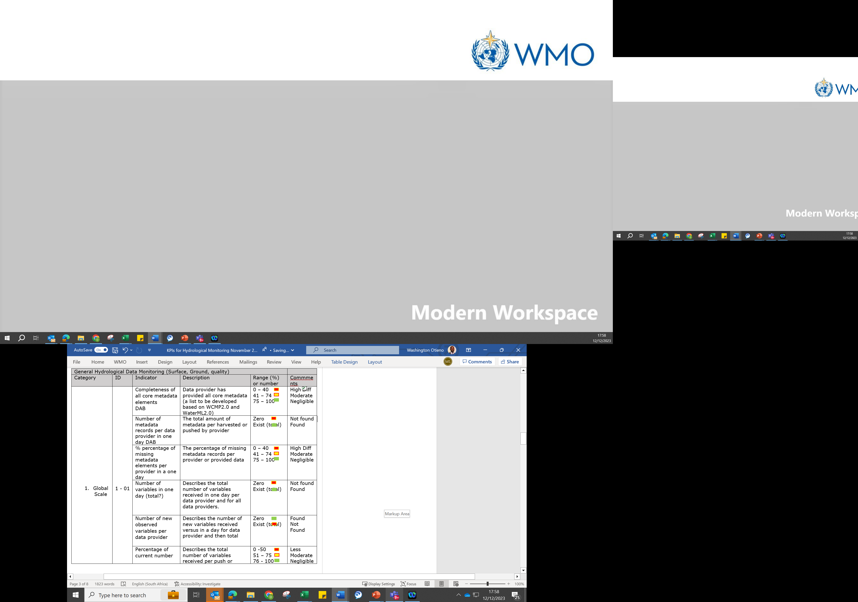
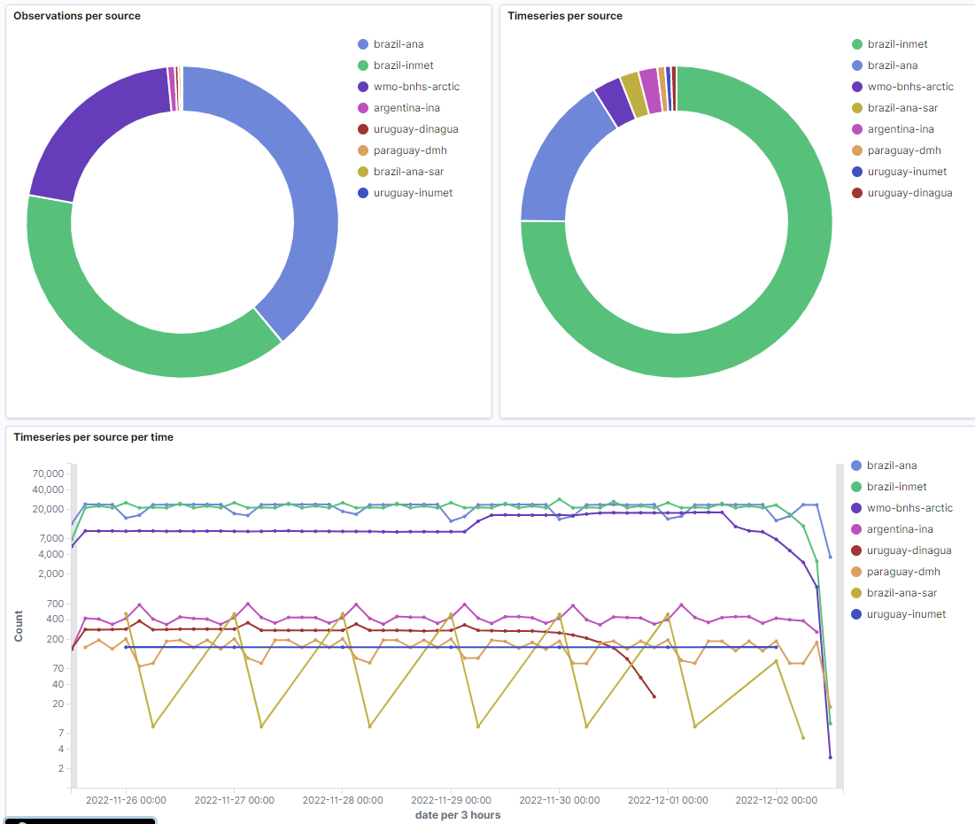

KPIs for hydrology and monitoring
TT-W2FH document describing the KPIs and possibly contributing to WIS KPIs as well
KPIs for Hydrology
KPIs definitions
Dashboard (in progress)
WEATHER CLIMATE WATER
A WHOS dashboard will be available to monitor KPIs (calculated globally, by data provider or by region) such as:
Data quantity (e.g. number of timeseries, observed variables, stations, …)
Metadata completeness
Temporal data resolution & data freshness

Slide 18
WHOS future development plans & ideas
Two-pronged approach for WHOS2
Standards-based
Selected API(s), harmonized format(s), encodings and vocabularies
Brokering/opportunity-driven
Using DAB &
Extending WHOS Hydro-Ontology beyond variables (=> BODC PUV/I-ADOPT)
WHOS2box
Combining WIS2box & STA to offer easier entry for data providers
Missing pieces/For discussion:
Standard file format/encodings => discussion in mailing list on WaterML 2, TSML, …
Better clients
Desktop integration (e.g. QGIS plugin)
Web applications for data search & visualization (extending WDE, …)

Slide 19
Additional slides

Slide 20

WIS2 Components: WIS2 Nodes
Data users
Each WMO Member shall implement at least one WIS2 Node to share data in WIS2
Publishes real-time notifications about data
A WIS2 Node replaces the GTS Message Switching System
Publishes Core and Recommended data
Advertises what data is available (discovery metadata)
Data and metadata are shared using a WIS2 Node
A WIS2 Node shares data via an HTTPS service and sends notifications to MQTT subscribers
WIS2 Node
WIS2 Node
WIS2 Node

Slide 21
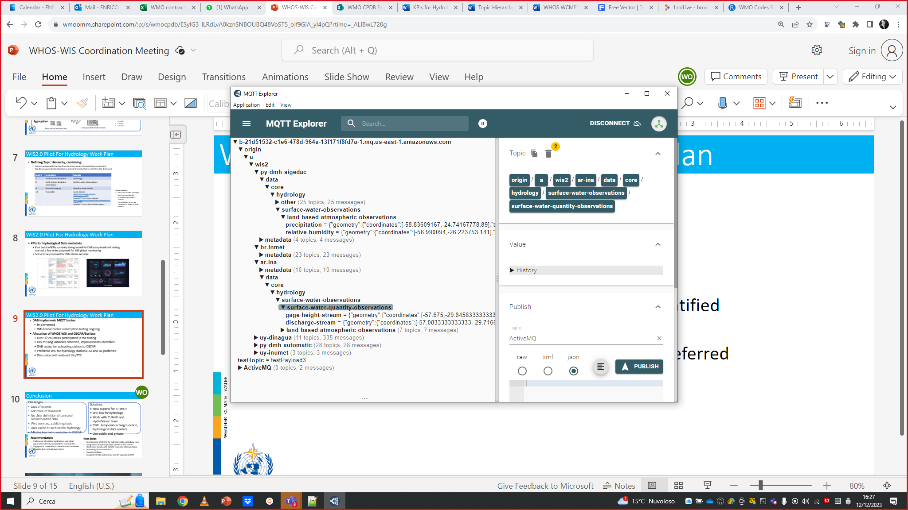
WHOS MQTT broker
WHOS MQTT broker
MQTT message broker ready (AWS cloud, Apache ActiveMQ technology);
end point available for testing
WEATHER CLIMATE WATER
Test MQTT client connecting to WHOS MQTT broker

