Slide 1
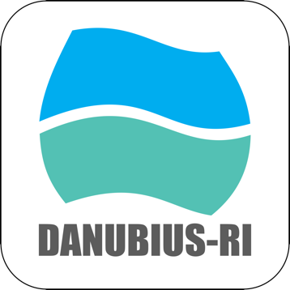
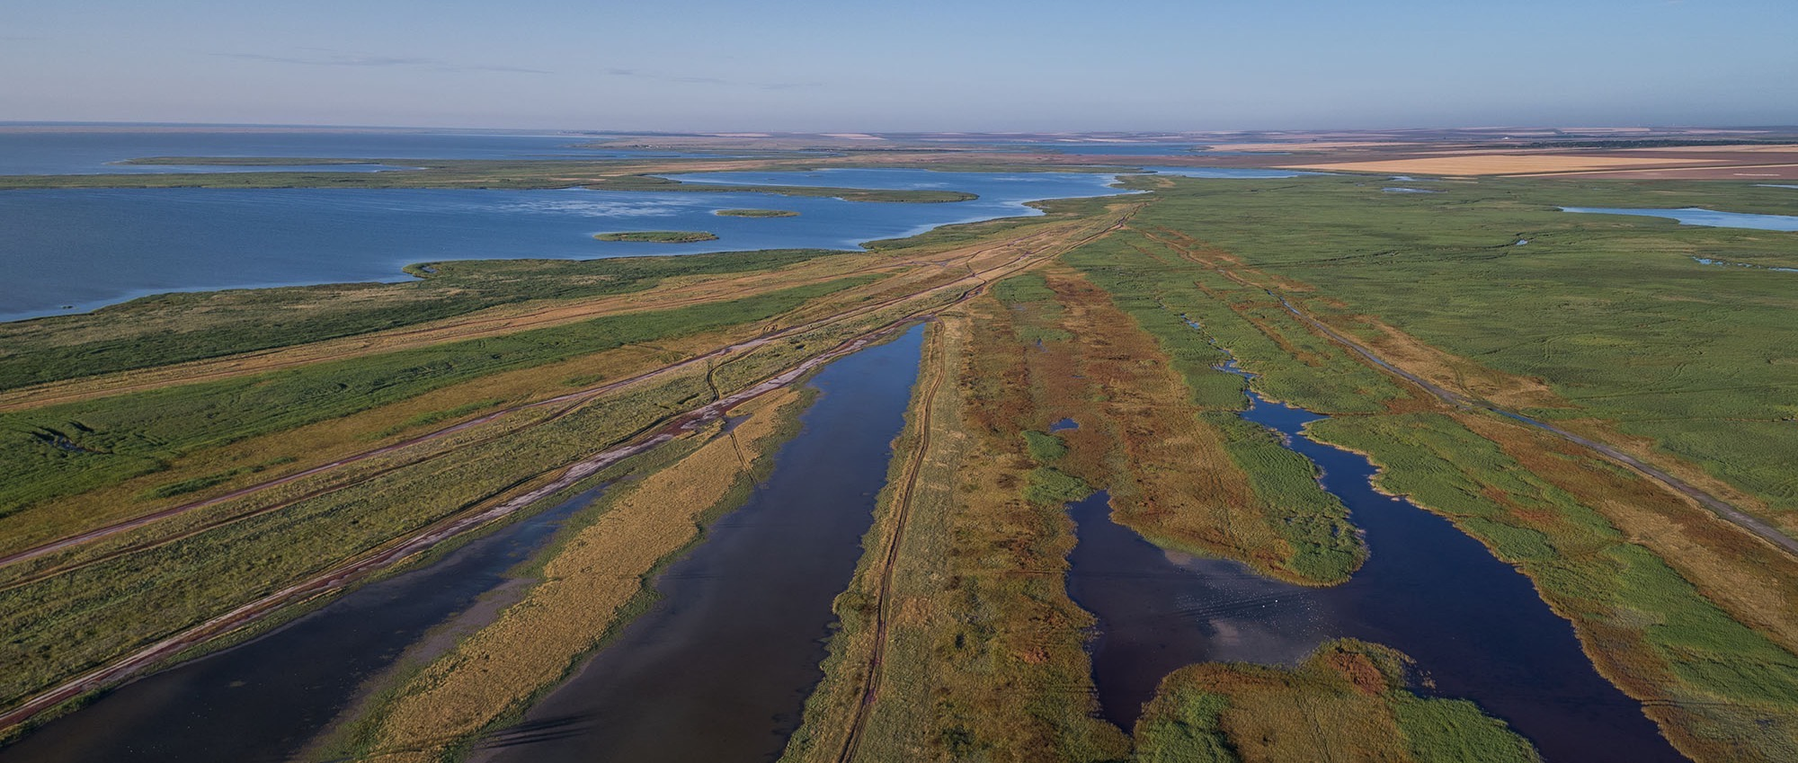

DANUBIUS-RI making River Sea systems work
Francesca De Pascalis
CNR-ISMAR
francesca.depascalis@cnr.it
Learn more
Image: The Danube Delta
OGC Member Meeting – HydroDWG Session Montreal- June 18 2024

Slide 2
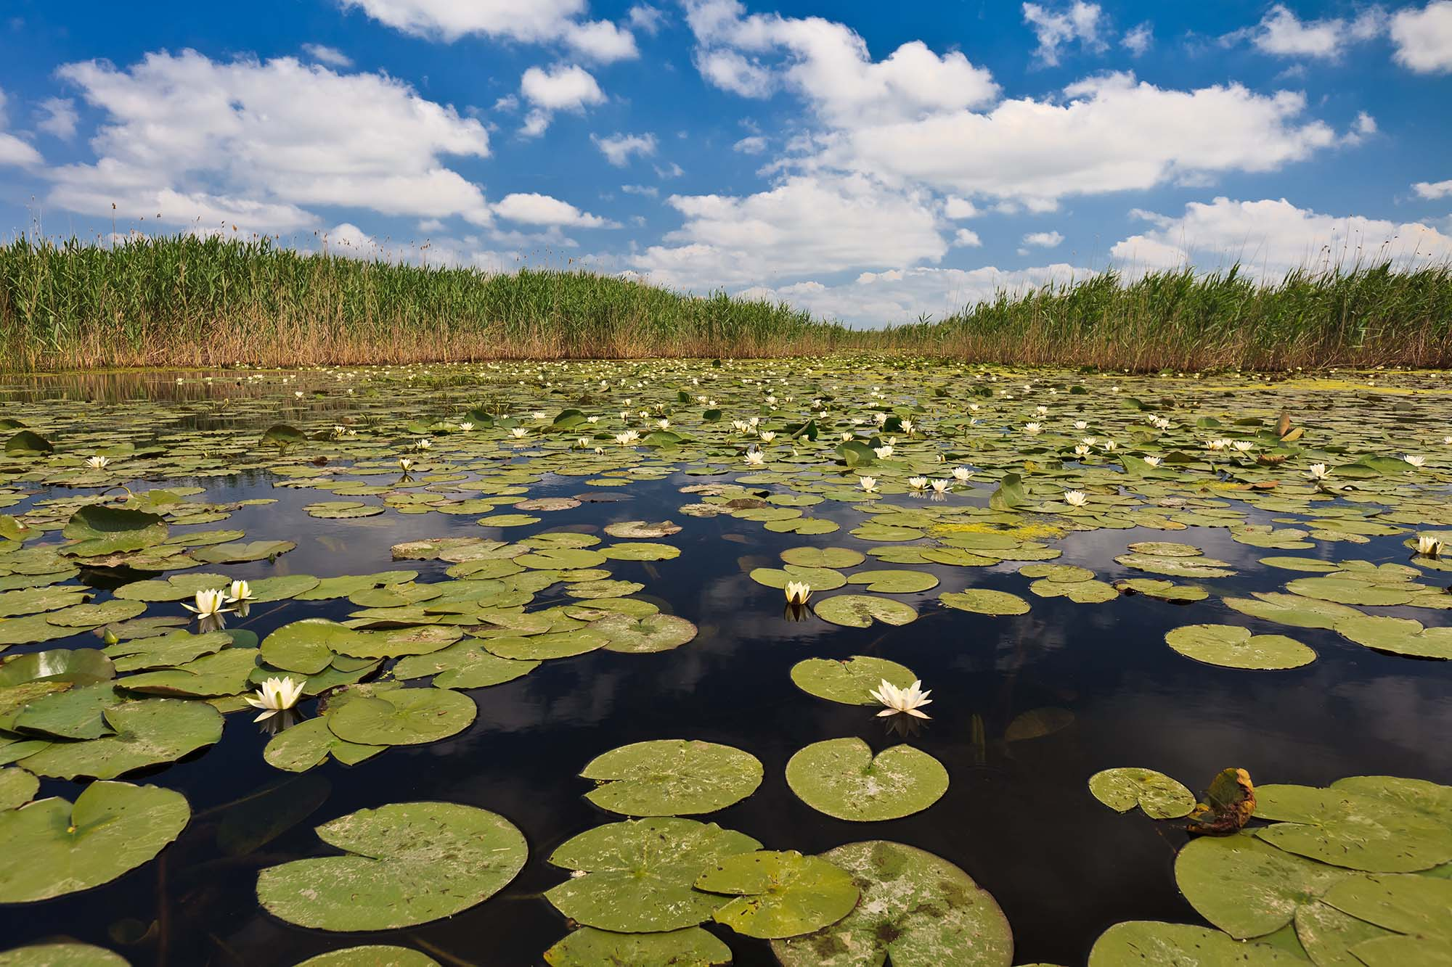
Our Vision
to achieve healthy River-Sea Systems and to advance their sustainable use, in order to live within the planet’s ecological limits by 2050.
Our Mission
to provide state-of-the art research infrastructure from river source to sea;
to facilitate excellent interdisciplinary science;
to offer integrated knowledge to manage and protect River-Sea Systems.
Our Goals
to overcome the current fragmentation of science, knowledge, data & management in rivers and seas by integrating spatial, temporal, disciplinary and sectorial thinking;
to provide scientific solutions to environmental and societal risks from climate change;
to resolve problems arising from human impacts on River-Sea Systems by using an interdisciplinary perspective, from source to sea.
OGC Member Meeting – HydroDWG Session Montreal- June 18 2024

Slide 4
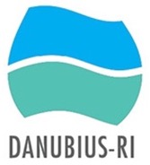
River-Sea Continuum
rain
sea
snow melt
lower river
tributaries
ground water
estuary
mountains
head waters
middle river
elevation:
high
middle
low
tide
salinity:
fresh
fresh
brackish
salt
soil
salt intrusion
nexus:
soil
sediment
sediment
sea
sediment:
production
transport
production
transport/deposition/re-suspension
tidal pumping
dominant use:
hydro-power
agriculture
agriculture & navigation
invasive species
contaminants:
source
pathway
receptor
transport /deposition/re-suspension
mixing
borders:
country x
country y
country z
region x
y
z
EU policies:
WFD/Natura2000/FD
WFD/CAP/Natura2000/FD
MSFD/MSPD

Slide 5
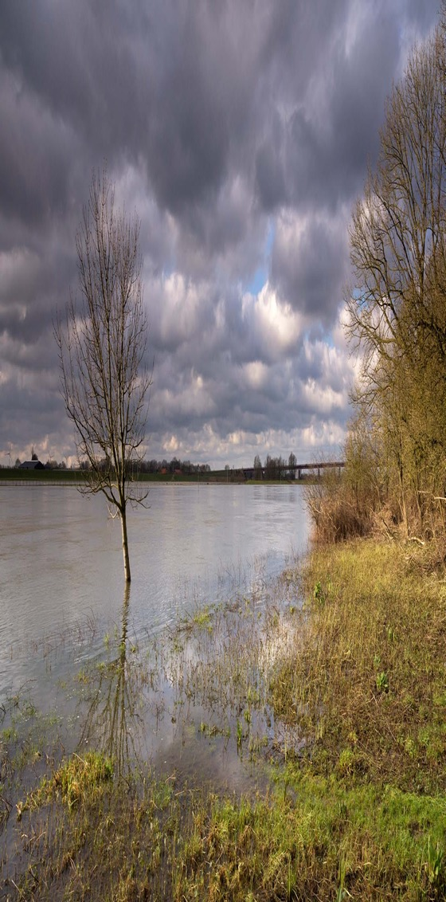
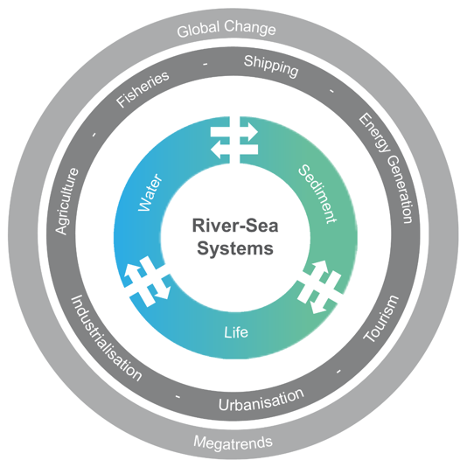
DANUBIUS-RI Research Areas and Priorities
(updated SRIA to 2027)
Image: Flooding in The Rhine
Water and Sediment
RP1 Water Quantity;
RP2 Sediment Balance;
RP3 Nutrients and Pollutants;
Global Change & Megatrends
RP4 Climate Change;
RP5 Extreme Events;
Biodiversity and Ecosystems
RP6 Protecting and Restoring Ecosystems and Biodiversity;
Multiple Impacts on River- Sea Systems
RP7 Digital Twin.
OGC Member Meeting – HydroDWG Session Montreal- June 18 2024
Notes:
• Water Quantity: understand and quantify water stores and flows across River-Sea continua for sustainable water resource management and mitigate against extreme events.
• Sediment Balance: understand and quantify sediment dynamics in source-to-sink systems, to support sustainable sediment management.
• Nutrients and Pollutants: understand and quantify the independent and combined effects of nutrients and pollutants (in both water and sediments) at River-Sea System scales, to establish the critical thresholds needed for tracking progress towards good status.
• Climate Change: support data collection and the development of innovative methods/tools to assess the ongoing impacts of Climate Change, and improve adaptation measures within and across River-Sea Systems.
• Extreme Events: understand and quantify extreme event occurrence and impact severity on River-Sea Systems, for floods and droughts, to support cost-effective nature-based solution development, disaster mitigation, and management.
• Protecting and Restoring Ecosystems and Biodiversity: understand and quantify how changing River-Sea Systems affect future ecosystem service provision, and their sustainability. Understand the relationship between biodiversity and connectivity across River-Sea Systems and its response to multiple stressors.
• Digital twin: co-design, co-develop and build elements of high resolution, multi-dimensional digital representations of River-Sea Systems, that stakeholders need from the Europe's Digital Twin endeavors.

Slide 6
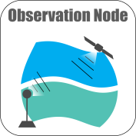
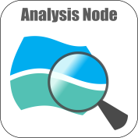
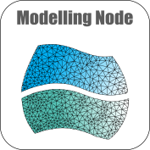
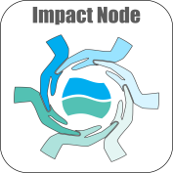
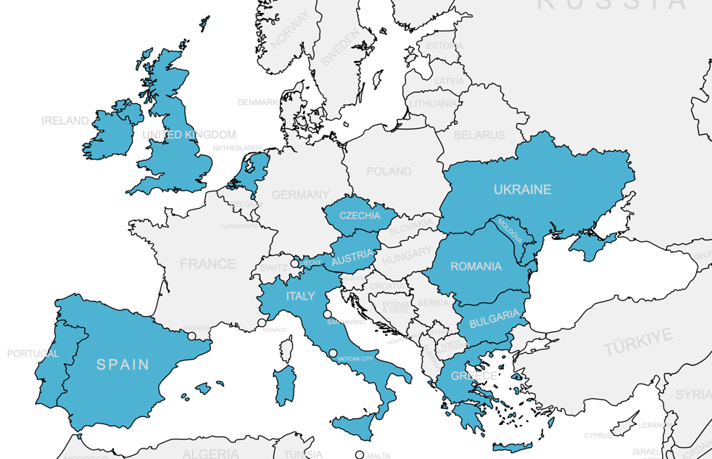
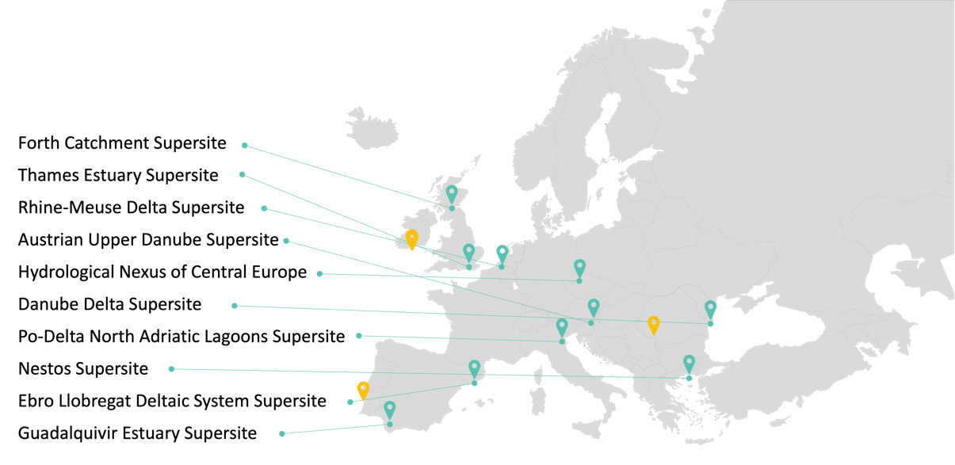
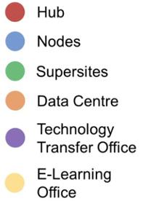
DANUBIUS-RI Architecture
4 Thematic Nodes
All Components
10 Supersites
New Supersite offers from IE, PT, RO, presented in Nov. 2023
OGC Member Meeting – HydroDWG Session Montreal- June 18 2024

Slide 7
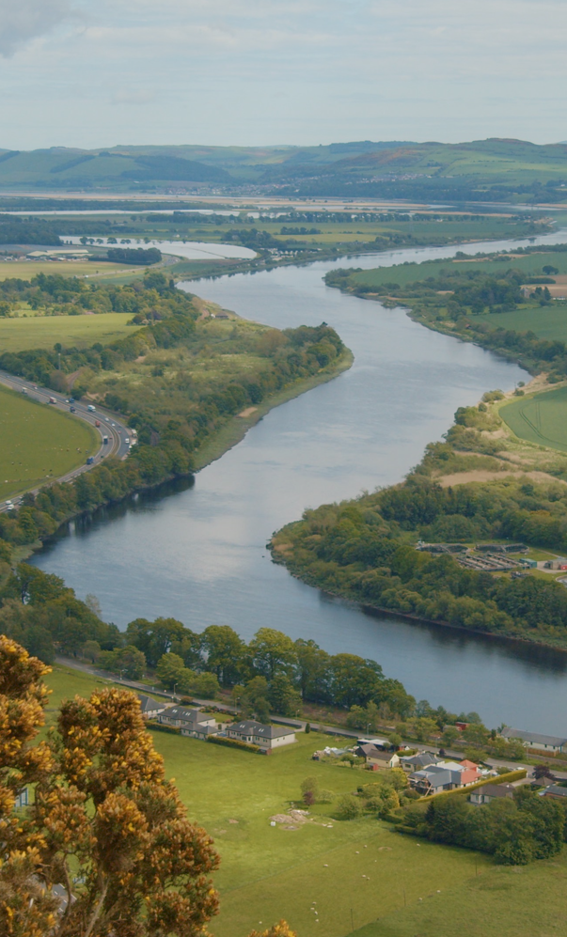
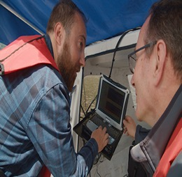
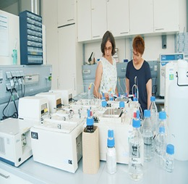
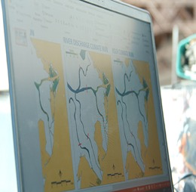
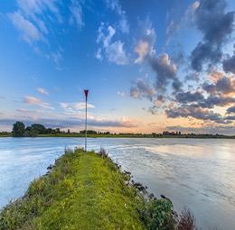
4 Nodes
Tay river
Observation (UK)
Analysis (Romania)
Modelling (Italy)
Impact (Netherlands)
Real time observation tools and instruments, new sensors, satellites, automated data processing, quality control and visualization
laboratories, instrumentation and highly innovative methodologies for samples analysis.
Development of new modelling tools in terms of new algorithm, data-models interaction, interfaces, link with socio-economic modelling.
interface between natural and social sciences developing methodologies and tools that will help to solve problems in highly complex dynamic RS systems
OGC Member Meeting – HydroDWG Session Montreal- June 18 2024

Slide 8


10 Supersites updated 3-jun-24
Forth Catchment Supersite
Thames Estuary Supersite
Rhine-Meuse Delta Supersite
Austrian Upper Danube Supersite
Hydrological Nexus of Central Europe
Danube Delta Supersite
Po-Delta North Adriatic Lagoons Supersite
Nestos Supersite
Ebro Llobregat Deltaic System Supersite
Guadalquivir Estuary Supersite
New Supersite offers from IE, PT, RO, presented in Nov. 2023
OGC Member Meeting – HydroDWG Session Montreal- June 18 2024

Slide 9
DANUBIUS-RI is made for...
Scientists
use world-class facilities (including data access) to do cutting-edge research;
connect with the community to realise first class publications;
increase opportunities to connect with collaborations and projects;
get trained as a multi-disciplinary, multi-skilled next-generation scientist or practitioner;
gain scientific knowledge, technical excellence and transferable skills.
Policy makers/managers
get more integrated, multidisciplinary, at a more appropriate spatial scale and state-of-the-art knowledge;
get operational perspectives;
get knowledge that will enable more effective and trans-boundary management and use;
get more cost-effective knowledge development through the opportunity for inter-comparison of river-sea systems and through shared use of research facilities.
Entrepreneurs
use the state-of-the-art scientific outcomes to develop commercial technologies and products and/or for ‘start-ups’;
use world-class facilities to test, improve and/or demonstrate river-sea system related commercial technologies and products;
increase chances on being involved in applied research and innovation projects to test river-sea system related commercial technology and products;
gain scientific knowledge, technical excellence and transferable skills necessary to pursue a successful career as entrepreneur.
OGC Member Meeting – HydroDWG Session Montreal- June 18 2024

Slide 10

Services
Image: Venice Grand Canal
Digital and Non-Digital Data
Tools, Methods and Expert Support
Study and Measurements
Diagnostic and Impact
Solution Development
Tests, Audit, Validation and Certification
Training
Within DANUBIUS-IP implementation phase project
Creation and organization of the DANUBIUS-RI catalogue, improving connectivity and data flow.
Creation of DANUBIUS-RI Stakeholder community (academy, agencies, policy makers, local representative of economic sectors)
Join us in shaping the services
Your help is crucial
OGC Member Meeting – HydroDWG Session Montreal- June 18 2024
Notes:
• Digital and Non-Digital Data: access to metadata, data and samples produced or collected by DANUBIUS-RI, either online for digital formats, or physical for samples such as sediment cores.
• Tools, Methods and Expert Support: access to facilities and equipment, specific methods and tools, and provide expert support for analysts.
• Study and Measurements: analyses and measurements (physical, chemical, biological, biogeochemical, ecotoxicological, hydromorphological, sedimentological, and bathymetric sampling and analyses).
• Diagnostic and Impact: modelling and impact assessment analyses that harness data from previous or expected results (diagnostic) or with forecasts (from models).
• Solution Development: connect with the right partners with wide-ranging scientific expertise to develop solutions for your specific challenges in River-Sea Systems.
• Tests, Audit, Validation and Certification: validate and quality assure observations, analyses and modelling outputs, and provide DANUBIUS Commons accreditation and Accredited Service Providers certification services.
• Training: design, develop and deliver co-designed trainings and courses to companies, innovators and authorities in the four areas of expertise (Observation, Analysis, Modelling, and Impact), and partner with you to organize bespoke conferences and workshops to address River-Sea System challenges.
Facilities, Methods & Tools: regarding (1) Observation and (2) Analysis, (3) Modelling and (4) Socio-Economic Impact along/between several River-Sea Systems
• Observation & Analysis: developing algorithms, sensor and machine learning technologies, providing earth observation and in situ data over large areas and over time, and ex situ data at representative locations over time
• Modelling & Impact: developing and providing access to model codes and manuals, coupled models (e.g. “from catchment to coast”) and “what if?” scenario applications; modelled data filling gaps from observation and analysis; developing and providing access to concepts, methods and tools to support governance, policy-making and Management
• Integration of Data: providing access to comparable data along freshwater-seawater continuum and between several River-Sea Systems
• Integration of Knowledge: advancing process and system understanding, co-creating scenarios and solutions with stakeholders, as well as research questions for further observation, analysis and modelling
• Expert Support & Training: bringing together interdisciplinary expertise and providing expert support and training regarding (1) Observation and (2) Analysis, (3) Modelling and (4) Socio-Economic Impact in River-Sea Systems

Slide 11
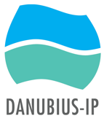
DANUBIUS-RI Timeline
Accepted
on the
ESFRI Roadmap
ERIC Step 1
submitted
2016
2020
Early
1990s
2016 -2019
2024
DANUBIUS-RI Development
Originated as Danube River-Delta-Black Sea project – Romanian Initiative (from 2010, with the orignial idea going back to the early 1990s)
Preparatory Phase
Funded by H2020 grant and developed into pan-European RI
concerned with all European River-Sea Systems
Implementation Phase
ERIC Step 2 - submitted March 2024
OGC Member Meeting – HydroDWG Session Montreal- June 18 2024

Slide 12

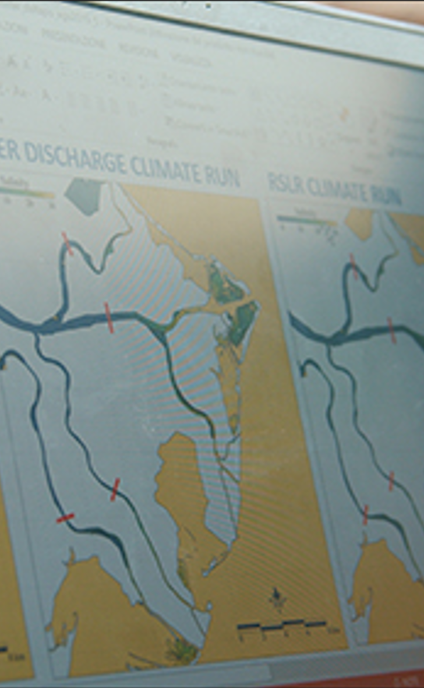


Connections
A key recommendation made by Water-ForCE for next generation Copernicus Water Services is the need for a dedicated water in situ component:
aligning with the needs of the satellite EO water community (quality & quantity)
providing FAIR data services to improve Copernicus water services
improving confidence and uptake of Copernicus water services
needs to harmonise EO products across water continuum
DANUBIUS-RI's nodes (observation, modelling & impact) and supersites will work to ensure a full validatation of EO products and services, including:
inclusion of uncertainties attached to EO products
co-development of products with professionals (DANUBIUS Commons co-development)
synergies and decision support systems for governance and decision making
training to maximise the utilisation of EO products and services
seamless integration and development of digital twins
OGC Member Meeting – HydroDWG Session Montreal- June 18 2024

Slide 13

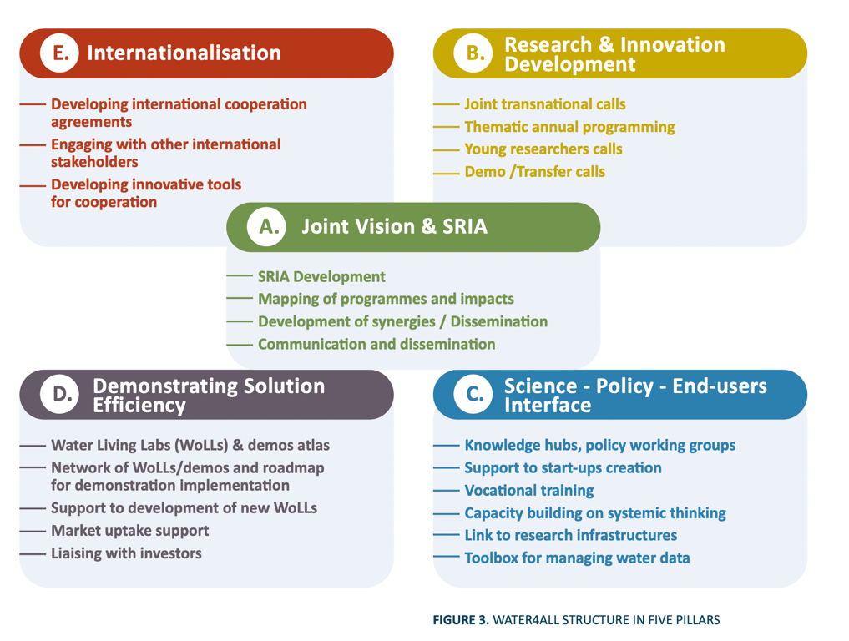

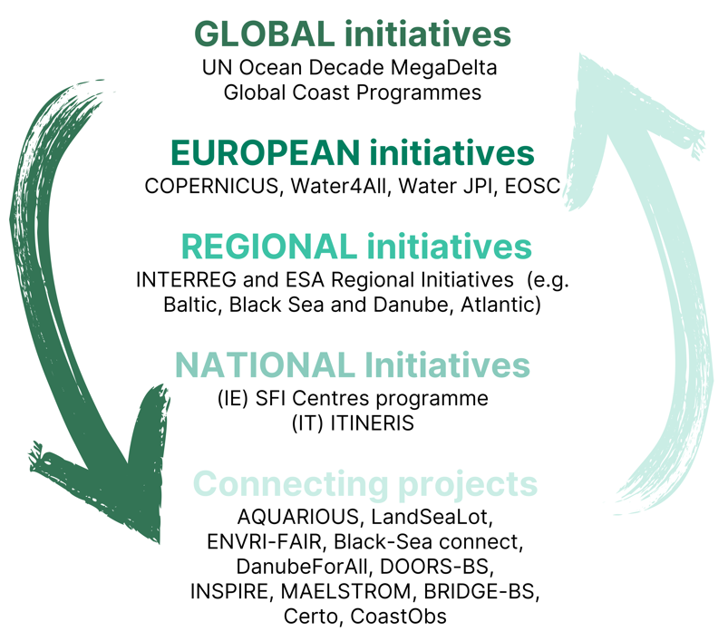
Tay river
Connections
Joint Vision & Scientific Research Innovation Agenda
OGC Member Meeting – HydroDWG Session Montreal- June 18 2024

Slide 14
Tay river
Connections
C task 4.3
1 Challenges against and opportunities for interconnection and interoperability of RIs & Observatories and Policy Makers
Possible Collaboration with DANUBIUS Nodes to facilitate the interconnection with Policy makers
2 Interconnection and interoperability of RIs & Observatories among themselves: Best Practices for data and facilities sharing and how they can be supported further by Water4All as next steps?
Possible interaction with DANUBIUS Nodes on DANUBIUS Commons also with OGC Hydrology group (e.g identification of calls for specific show cases projects for standards applications and creations where they are missing)
Co-development of tools such as digital twins for specific water issues (supersites as show cases).
Build critical mass using facilities already in place (e.g. Supersites)
OGC Member Meeting – HydroDWG Session Montreal- June 18 2024

Slide 15

Possible Collaborations on Supersites
rain
supersites (living labs)
snow melt
tributaries
Supersites Concept
region border
country border
ground water
mountains
head waters
middle river
lower river
estuary
sea
Platform for collecting, analysing, modelling and retrieving river-sea system data useful to all scientific disciplines
Harmonised instrumentation, protocols and data acquisition (DANUBIUS Commons) to guarantee quality and consistency of scientific output
Test bed for innovative sensors and solutions (deploy, test, validation, standardization and spreading)
Supersites Offer
OGC Member Meeting – HydroDWG Session Montreal- June 18 2024

Slide 16
Why do we need Commons?
DANUBIUS Commons
Commons
Components
Collaboration/ Exchange
(Data integration)
Hub
Nodes
Connection/ Organization/ Harmonization/ Quality verification
Application and
Implementation
of harmonized data and methodologies
User
TTO
Scientific, social, political organizations
Supersites
Data Center
integrity, consistency, relevance and quality of services
harmonized internal administrative and scientific work processes
mutual understanding of scientific standards, language and methodologies internally, between partners, and with
scientific, political and societal groups
OGC Member Meeting – HydroDWG Session Montreal- June 18 2024

Slide 17
DANUBIUS compatibility with other ERICs and RIs an Initiatives
Participation to the ENVRI- FAIR Project
On-going collaboration with ENVRI RIs: with EMBRC on semantic interoperability with regards to eDNA data standards through the HE MARCO-BOLO project
Participation to 13 meetings with EOSC Task Forces
As a result: 3 papers co-authored with EOSC Task Force on Semantic Interoperability (SI) and EOSC Task Force on Data Quality and FAIR Metrics
From 2021 cooperation with Ugrid Initiative on standards for the unstructured grids for numerical models
OGC Member Meeting – HydroDWG Session Montreal- June 18 2024

Slide 18

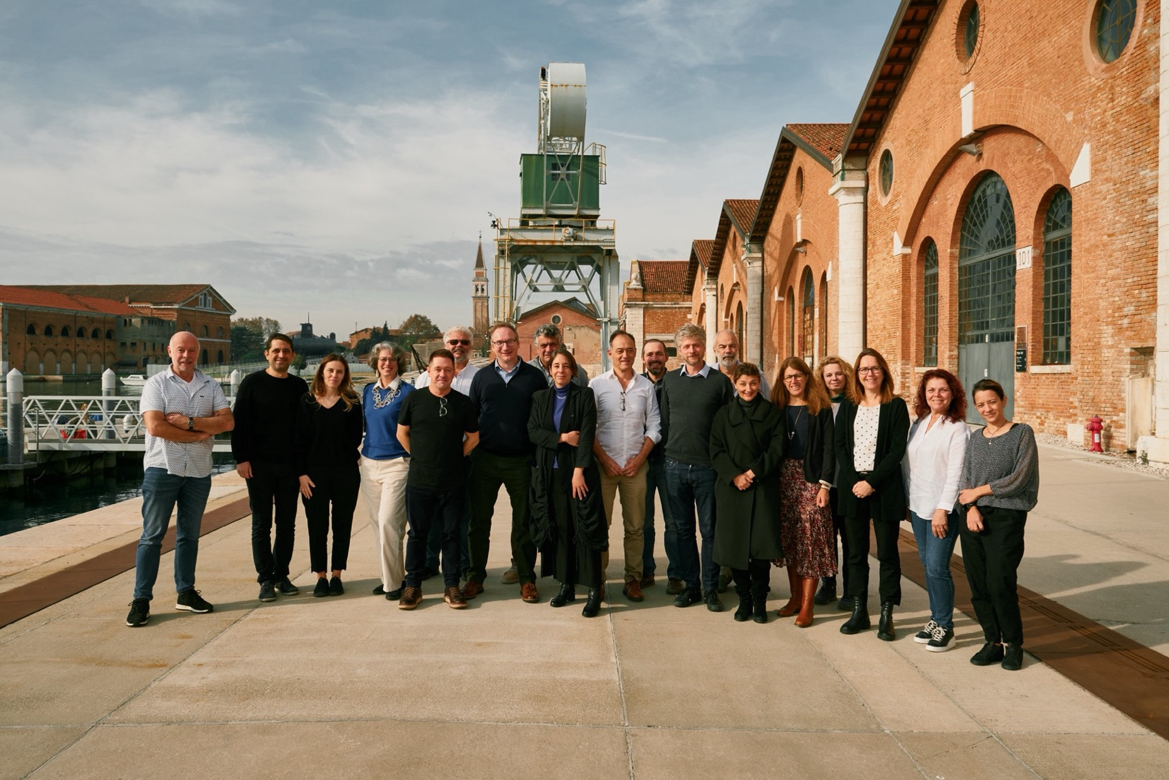
Contact us and let’s collaborate to connect to your solutions Thank you!
danubius.research@geoecomar.ro
www.danubius-ri.eu
www.danubius-ip.tumblr.com
DANUBIUS–RI “The International Centre For Advanced Studies On River-Sea Systems”

