Slide 1



OGC APIs for Hydrology Domains
Strategic Member Support by
The 129th OGC Member Meeting
Rob Atkinson, Alejandro Villar, OGC
17 June 2024
Additional Meeting Support

Slide 2
Agenda
OGC APIs
Features
Extension Mechanisms
Schemas
Building Blocks to manage
Approach
UML->JSON
Status
Draft available

Slide 3
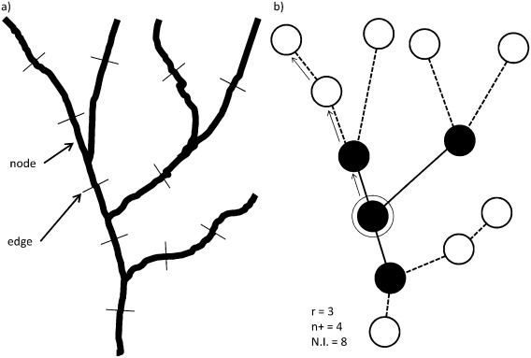
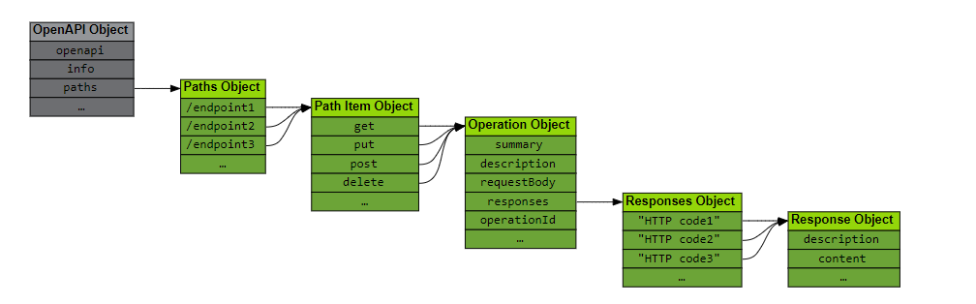
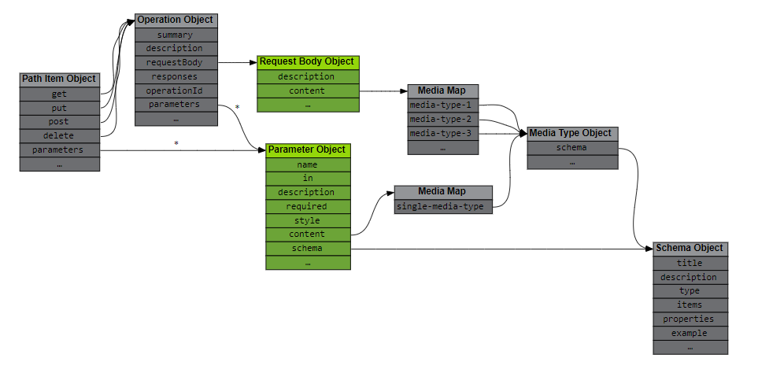
OpenAPIs
Lots of details… OpenAPI Features does this bit.
a “machine readable” specification

Slide 4
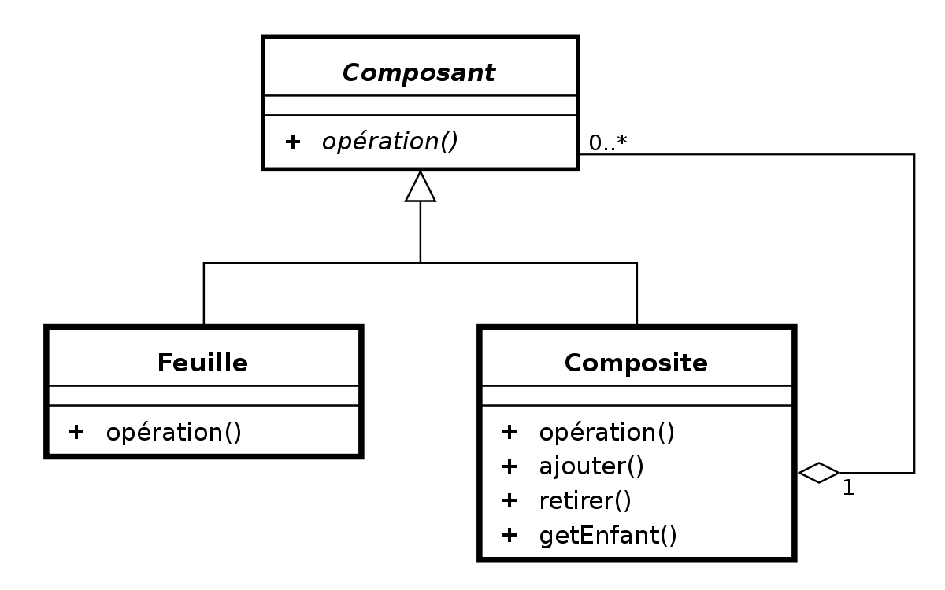
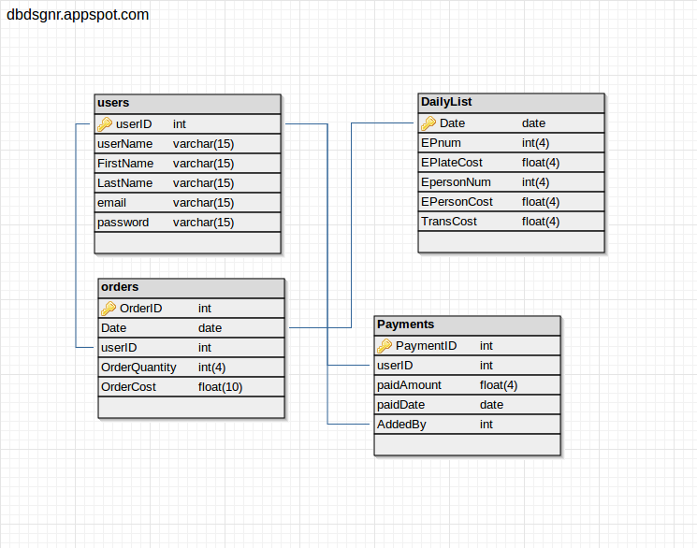
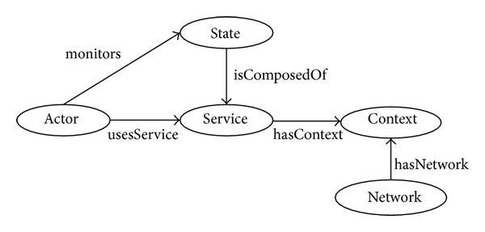
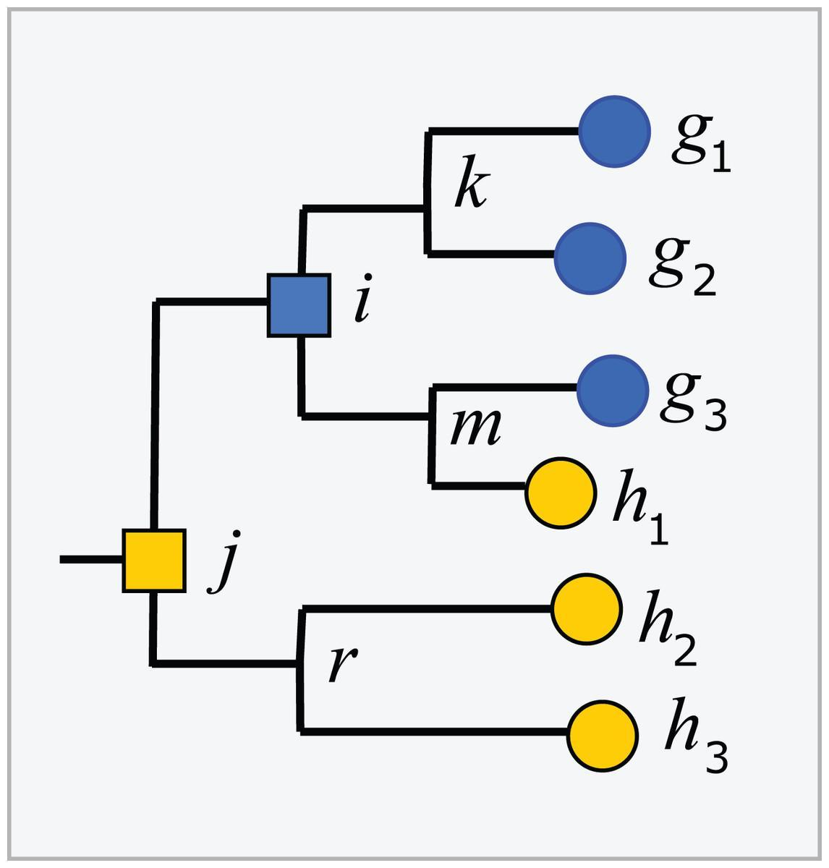
Model -> Implementation
Conceptual model
Implementation model
API
Encoding
WFS
(Feature Type)
GML
UML
OGCAPI-
Features
JSON Schema
SHACL (profiles)
Profile constraints
JSON-LD Context
Definitions
(Linked Data)
SKOS/turtle
OWL/RDFS
Concept
Taxonomy
HTML page

Slide 5
Building Blocks – why?
“make specifications more useful”
Support composition of specifications
i.e. HY_Features as Features
Feature schema needs to be tested against
And FG-JSON extensions etc.
RDF mapping in the context of Feature schema is complex
Inherit it – don’t redefine it
Building blocks can be APIs, schemas – or individual classes and datatypes.

Slide 6
OGC APIs for Hydro
OGC API Features for HY_Features?
OGC EDR, STA for timeseries observations
Timeseries (TSML) profiles of these or new (simpler?) API?
OpenAPI 3.1 is much better for the future
Modern JSON schema
Used in Connected Systems API
However 3.0 today
Building Blocks “downcompile automatically”
Design to be extensible and compatible
Building Blocks as a version neutral offering
Composable with inheritance of complex things:
Schemas
LD contexts
Validation rules

Slide 7
Status
https://github.com/opengeospatial/HY_Features/tree/master/schemas
EXT_ package => link to OGC Common or other for common patterns
Promote general patterns?
Localised names
Generalised object classifications
Building Blocks package stub:
https://ogcincubator.github.io/bblocks-hydro/

Slide 8
Open issues
Many:
Sync versions of HYF
EXT_* patterns mapped to generics from OGC APIs
Mainstems support
Identifier frameworks
Simple vs abstract
Spatial context in model vs “mySpecificLocalityTypeProperty” in data
Where are mappings from persistence layer to model happening
pyGeoAPI JSON-LD templates
Horrible if not JSON schema norm?

Slide 9

Thank You
Community

