Slide 1

U.S. Update: River Features and GWML2 GPKG
The 122nd OGC Member Meeting
Meeting sponsor
1 March 2022

Slide 2
Agenda
Early draft development of a river features data model
Progress on a gpkg encoding of GWML2
Next steps, interest in collaboration?

Slide 3
River Corridors Data Model: Use Cases
River reference system for multi-scale integration.
I want to connect river-features to a broad, multi-scale, hydrologic context but preserve the complexity of geomorphic features.
River-referenced locations with linked info.
I want to represent multiple types of data from a measurement associated with 1D, 2D, or 3D georeferenced points within the CHANNEL (or river corridor) or WATERBODY
Single valued attributes of river features.
I want to represent parameters aggregated to a cross-section or reach/segment from measurements of the CHANNEL (or river corridor) or WATERBODY.
Areal delineations of river corridor zones with a consistent characteristic.
I want to represent polygonal/areal data that describe geometric characteristics or objects of the CHANNEL (or river corridor) or WATERBODY
Curvilinear delineations of fluvial-geomorphic features.
I want to represent linear delineations of WATERBODY characteristics relative to a CHANNEL such as top of bank, streamlines, or a thalweg.

Slide 4
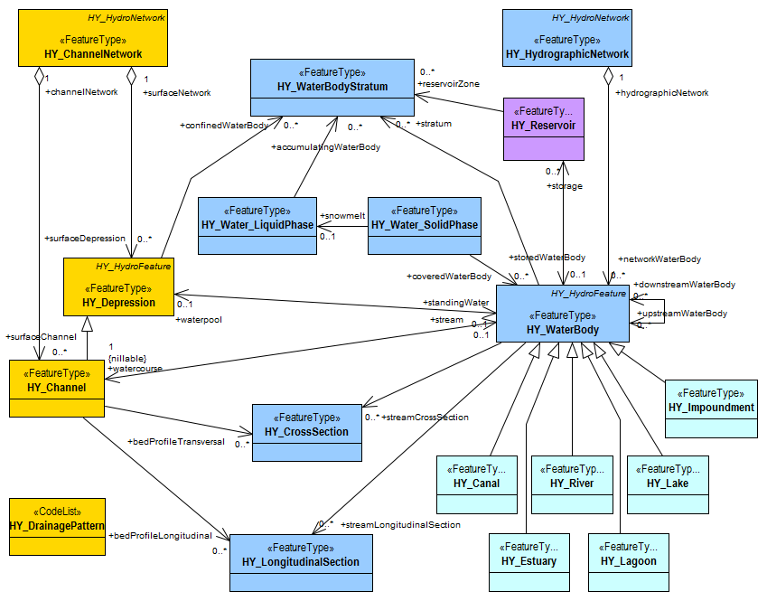
River Corridors Data Model: Model Concept
River Features form a reference system and Fluvial Features characterize specific aspects of a river corridor.
River Features overlay catchment (flowpath) and nexus networks and support (usually) linear referencing of Fluvial Features.
HY_Features Surface Hydro Features concepts apply and can be refined with specific river corridor data use cases.
Figure 37. Surface Hydro Feature - Application Schema Diagram https://docs.opengeospatial.org/is/14-111r6/14-111r6.html#figure37

Slide 5
Core Features of a River Data Model
River Lines
River lines are akin to flowpaths but don’t necessarily realize a catchment.
Cross sections are unambiguous in HY_Features.
Typed locations are like hydrologic locations, but can be on a river line too.
Polygonal and linear delineations are “simple” but require some river-referencing scheme.
River Cross Sections
Typed Locations
Polygonal Delineations
Linear Delineations

Slide 6
National Water Well Database (NWWDB)
State-managed water-well databases shared with the USGS by agencies throughout the conterminous United States
Content and structure of original data harmonized/standardized to a USGS implementation of GWML2
Only a subset of entities/attributes relating to water wells in the GWML2 conceptual model were used in the design of the National Water-Well Database (NWWDB)
Extension of the GWML2 conceptual model through the addition of entities/attributes was necessary in order to meet specific design requirements

Slide 7
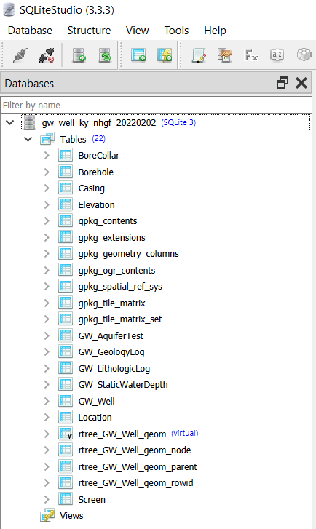
OGC GeoPackage Encoding
Relational database needed for efficient storage of many (millions of) water-well records
Adopted semantics and nomenclature of GWML2 conceptual model in GeoPackage encoding
Data stored in relational database could be converted to an XML encoding

Slide 8
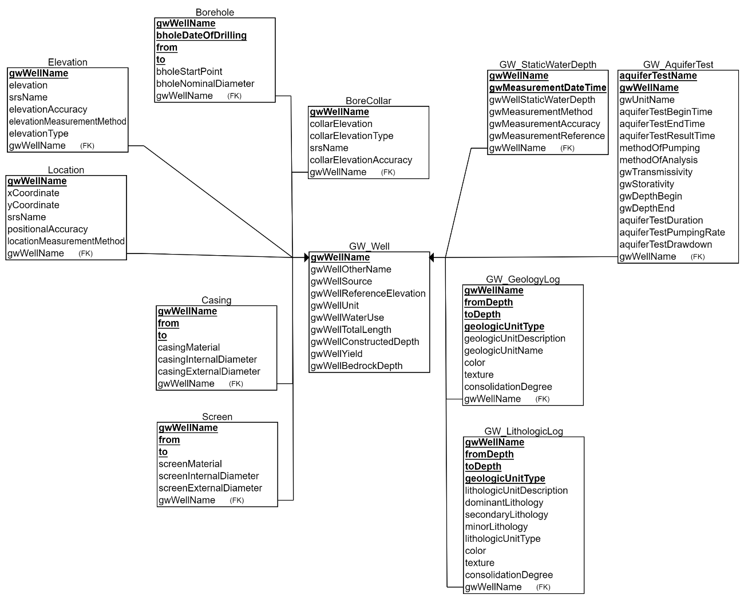
Relational Schema

Slide 9
Questions?

Slide 10

Thank You
Community

