Slide 1



Water quality IE update
The 124th OGC Member Meeting
Meeting sponsor
Sylvain Grellet, BRGM
Kyle Onda, Lincoln Institute
Tony Boston, ANU
05 October 2022

Slide 2
Context
Water Quality workshop March 2022
Kick-off : 13/09/2022
Weekly webconf every Tuesday since then : 20, 27/09, 4/10
The reference point : https://github.com/opengeospatial/WaterQualityIE/
Link to living G.Doc for minutes then GoToMeeting webconf link etc…

Slide 3
Progress
Various presentations
https://github.com/opengeospatial/WaterQualityIE/tree/master/relevant_material
Kick-off presentations
Expectations from various partners
Done : USGS / US EPA, UNEP / GEMS Water, Internet Of Water US, University Tartu, BRGM / Pole INSIDE
Upcoming : WMO La Plata river basin, DataStream, Geo Aqua Watch

Slide 4
Building Momentum
Various presentations
https://github.com/opengeospatial/WaterQualityIE/tree/master/relevant_material
Kick-off presentations
Expectations from various partners
Same pattern
expectation regarding the IE
what do the organization brings to the IE : UseCase (with data) / IT : with details
organization capacity of involvement
Done : USGS / US EPA, UNEP / GEMS Water, Internet Of Water US, University Tartu, BRGM / Pole INSIDE
Upcoming : WMO La Plata river basin, DataStream, Geo Aqua Watch

Slide 5
Next steps
Starting week after 18/10
Refining use case : whole group
Then

Slide 7
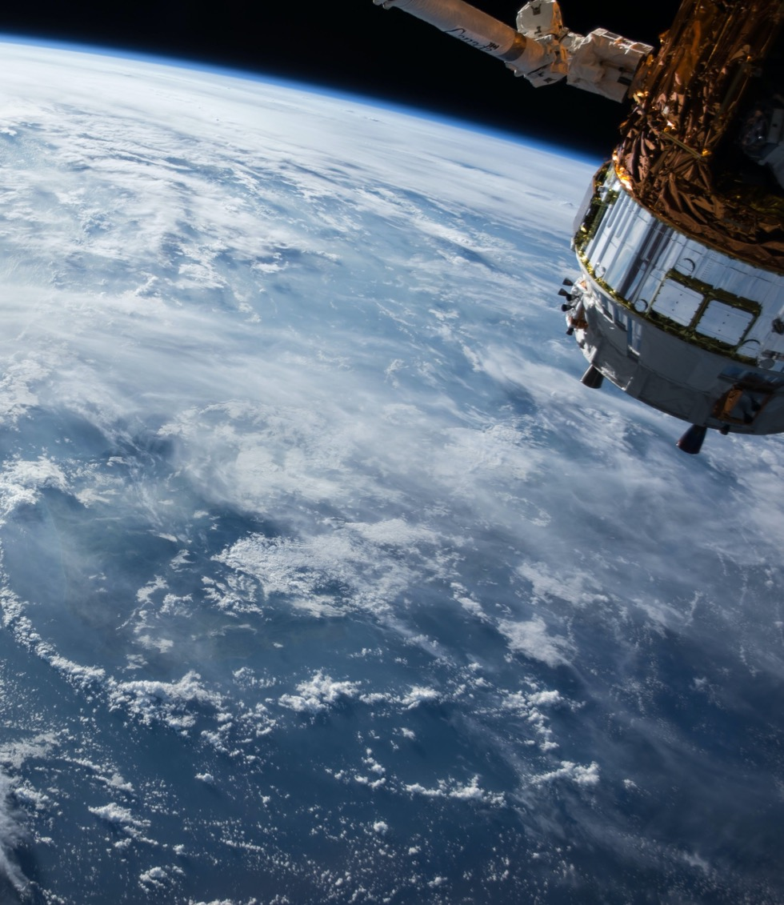
Thank You
Community

