Slide 1



Surface water - Groundwater Feature Relation Discussion
The 124th OGC Member Meeting
Meeting sponsor
Sylvain Grellet,
Florent Millet BRGM
05 October 2022

Slide 2
Context
Having a better knowledge of surface-ground water relations
Through many local studies on the field
Involving a wide diversity of technics
Leading to interpretation and identification of Flow Interface Features between both water compartment
So far, no interoperable approach agreed on to share this

Slide 3
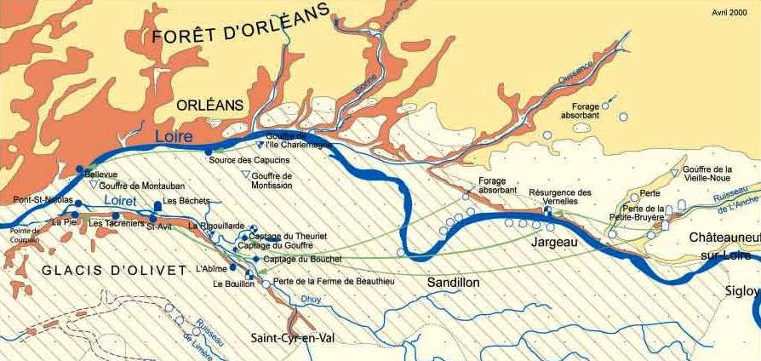
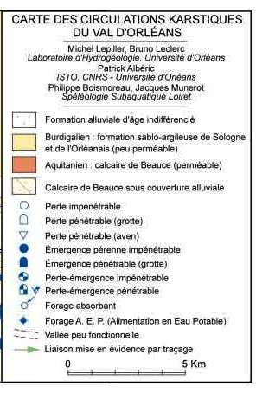
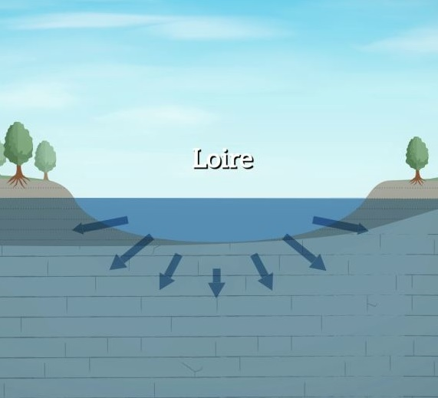
An example
The CENARI-O project : understanding river <-> aquifer relations on the Loire river near Orléans

Slide 4
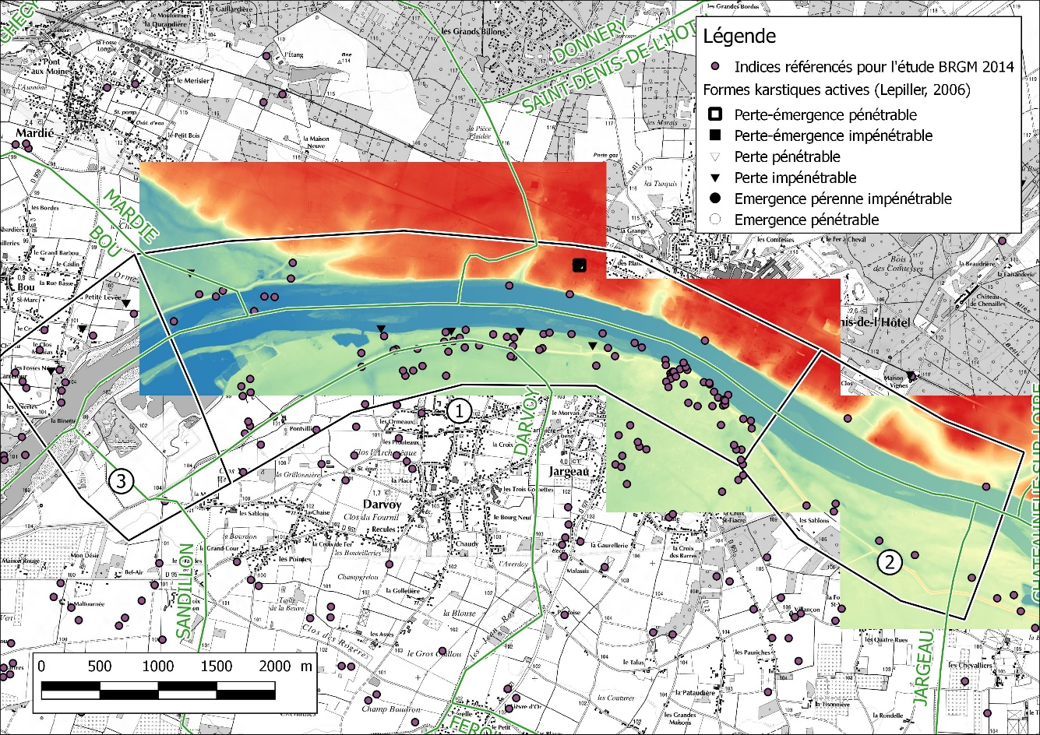
An example – observation methods
Remote sensing – identify exchange areas
LIDAR
Fine grain Topography data
Here : Loire riverbed near Jargeau => identify « hollow » zone -> water loss ?

Slide 5
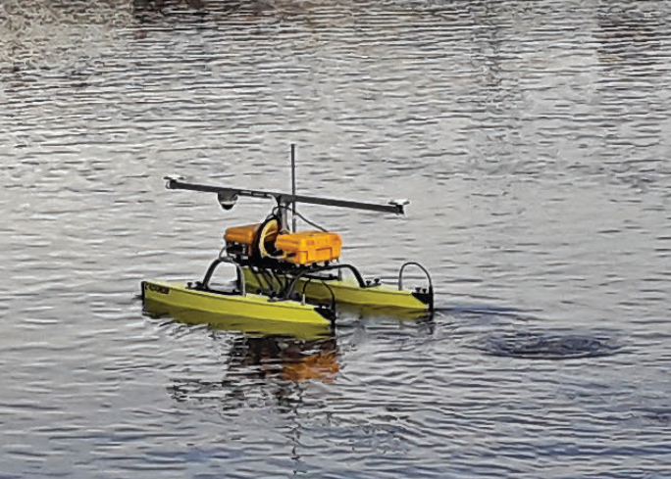
An example – observation methods
Remote sensing – identify exchange areas
Topo-bathymetry of the Loiret (a @fr ‘résurgence’ ? @en’upwelling’ of the Loire river)
Identify water exchange areas
Coupling conductivity and temperature data
Catarob drone

Slide 6
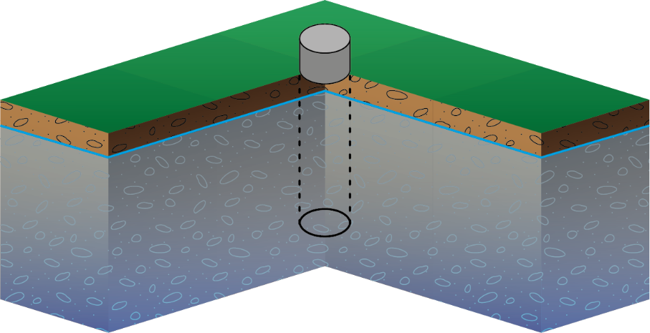
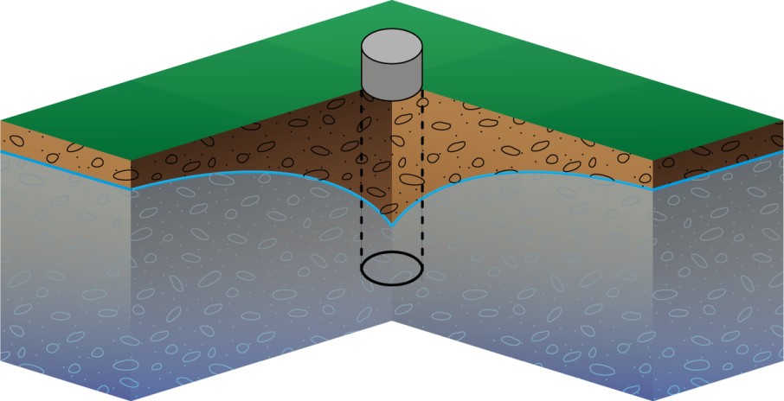
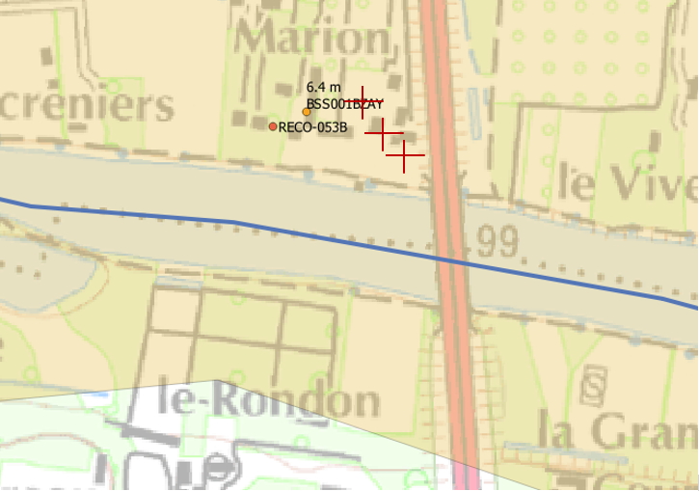
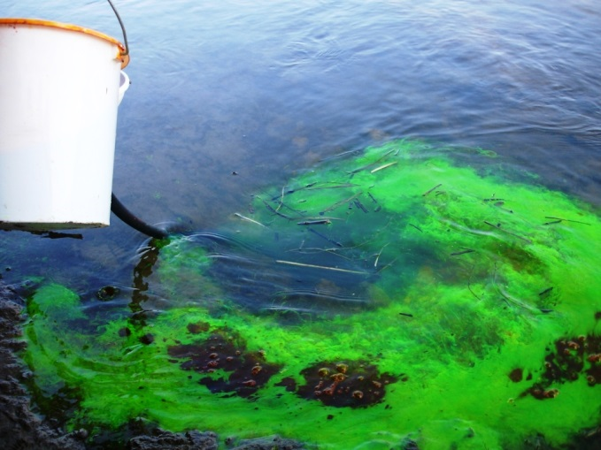
An example – observation methods
Pump test and tracing
Loiret
Puits Liger (observation well)
Puits De Koninck
(injection well)

Slide 7
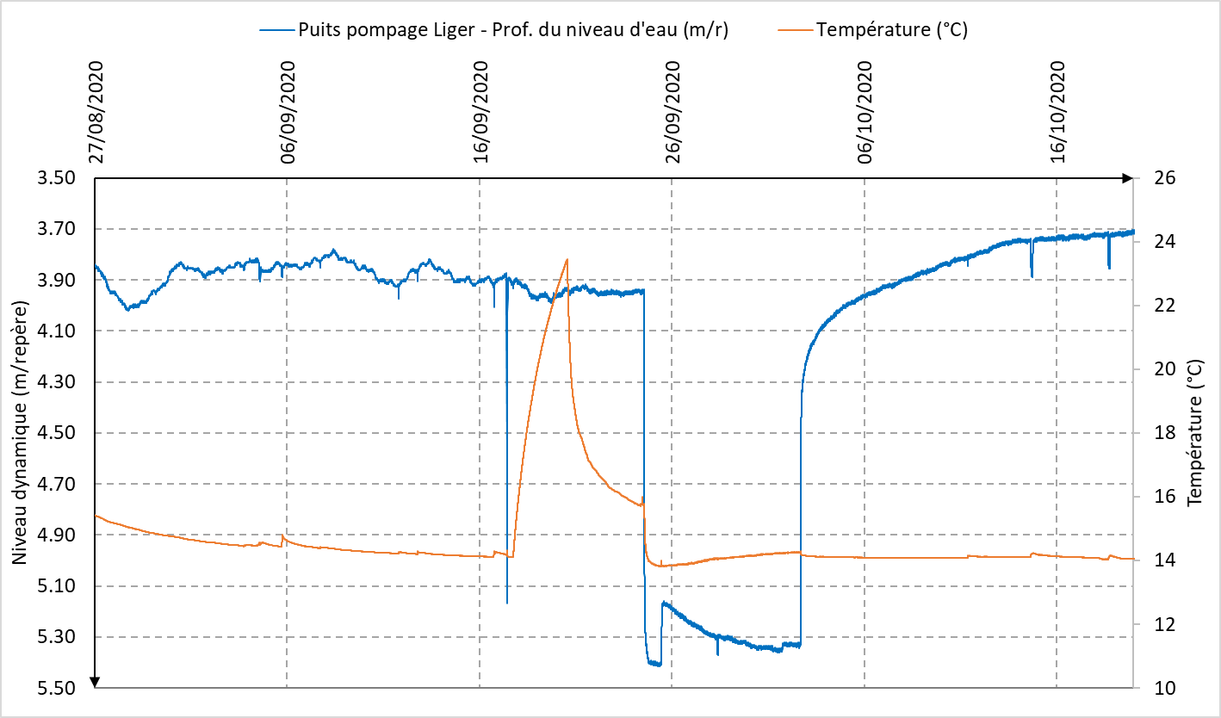
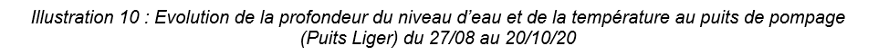
An example – observation methods
Pump test and tracing
Water temperature rising in the well
Linked to « water pool » on surface emptying (max air temp 14/09/2020 = 34.5°C)

Slide 8
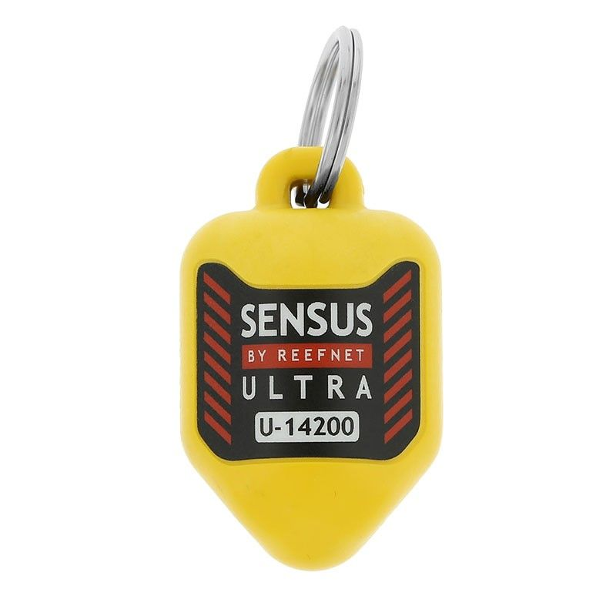

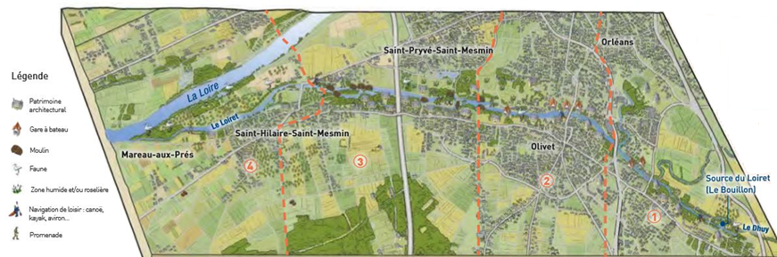
An example – observation methods
Pressure – temperature sensor
Conductivity /T°C prob: work with speleologist to define their location

Slide 9
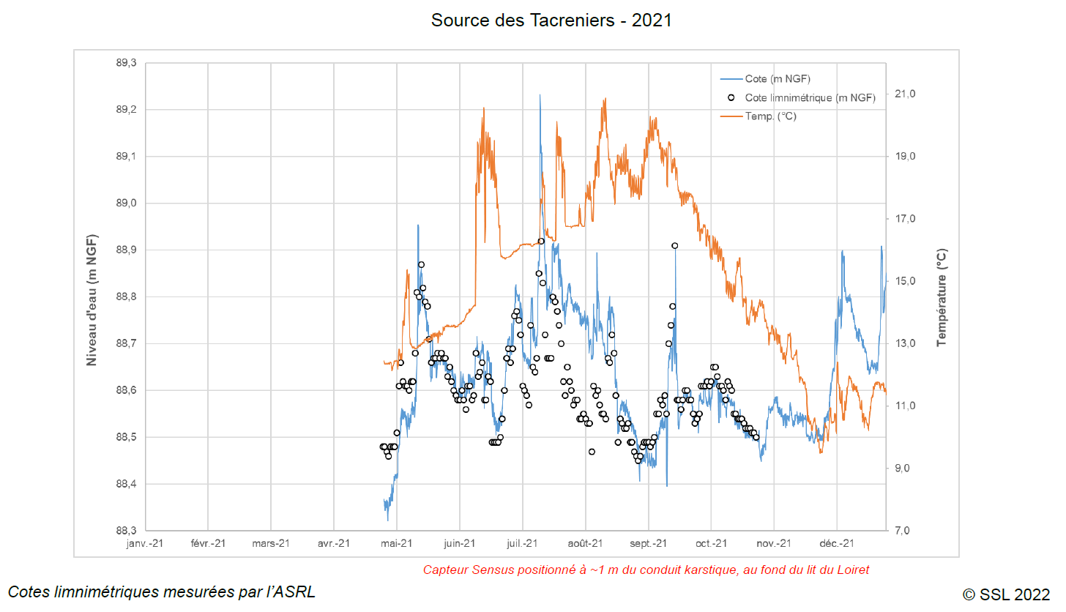
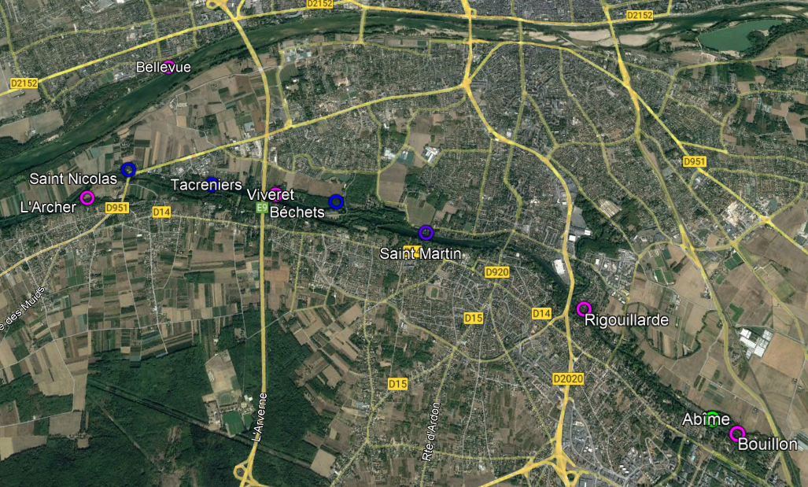
An example – observation methods
Pressure – temperature sensor

Slide 10
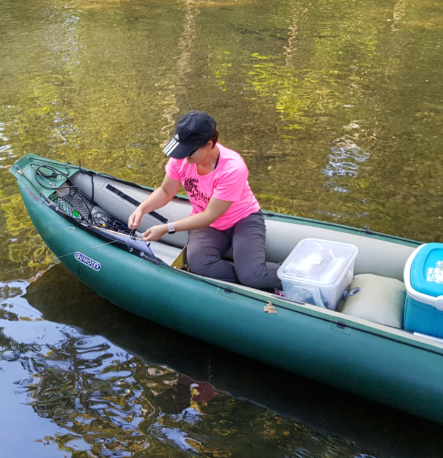
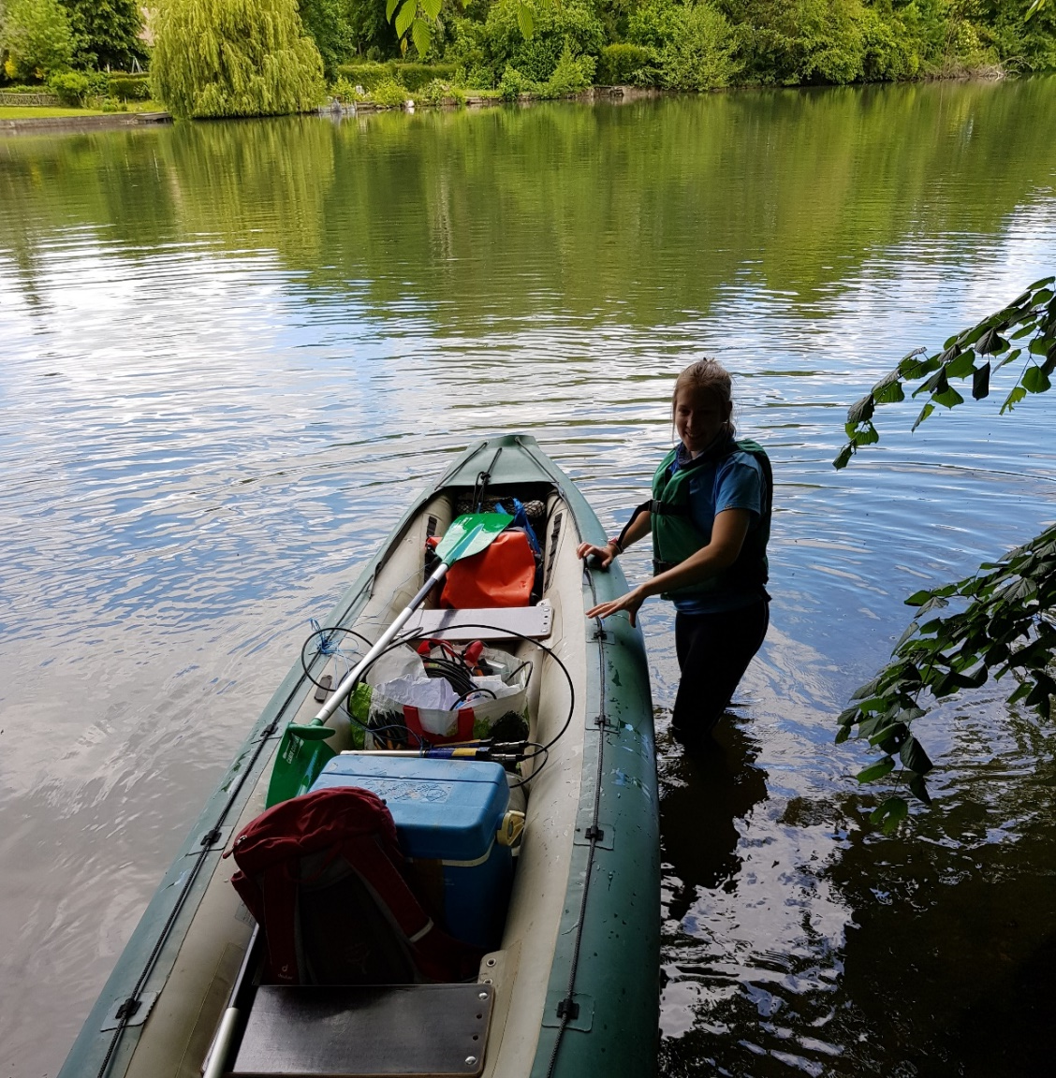
An example – observation methods
Chemical campaigns
in situ physicochemical parameters
water dating (@fr ‘datation’)
radon
organic / inorganic carbon
isotopes
piezometry
surface/ground water flow difference

Slide 11
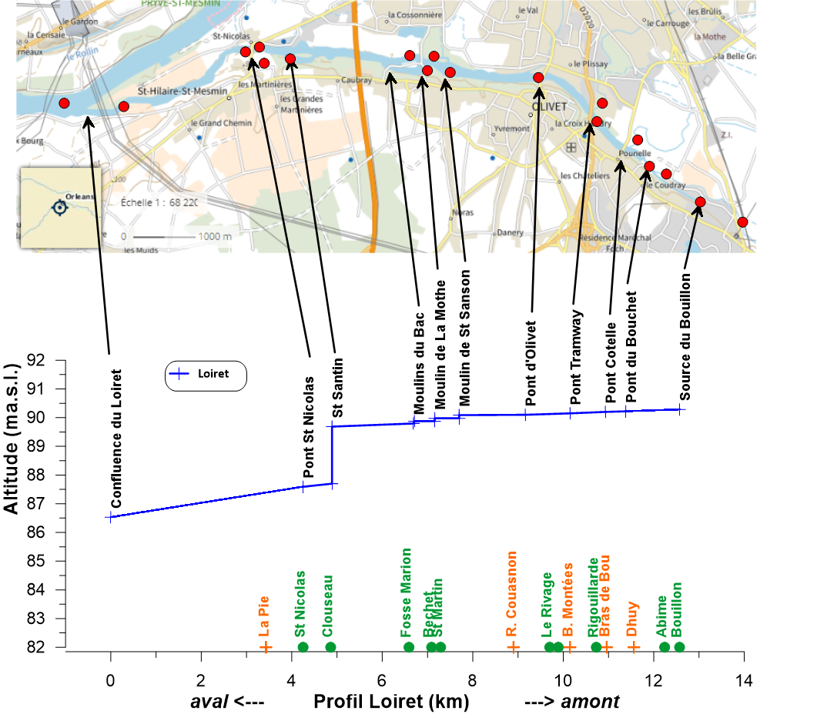
An example – observation methods
Chemical campaigns
Water dating (@fr ‘datation’) with water from the pump test (observation well)
Isotopic analysis

Slide 12
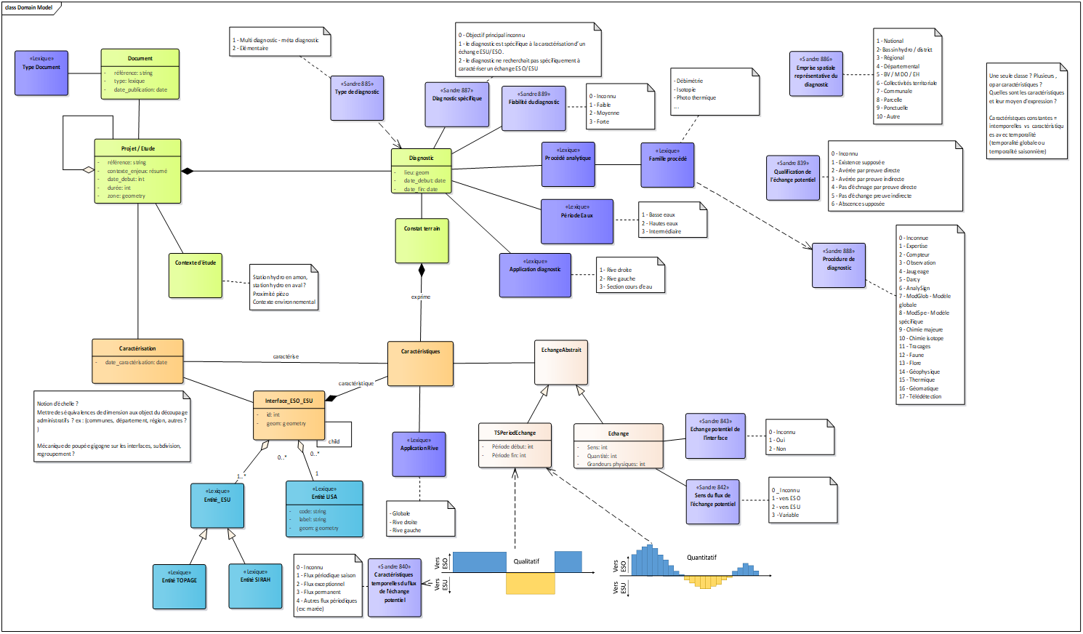
Structuring data
Draft Data Model from domain colleagues -> to be ported to an interoperable way

Slide 13
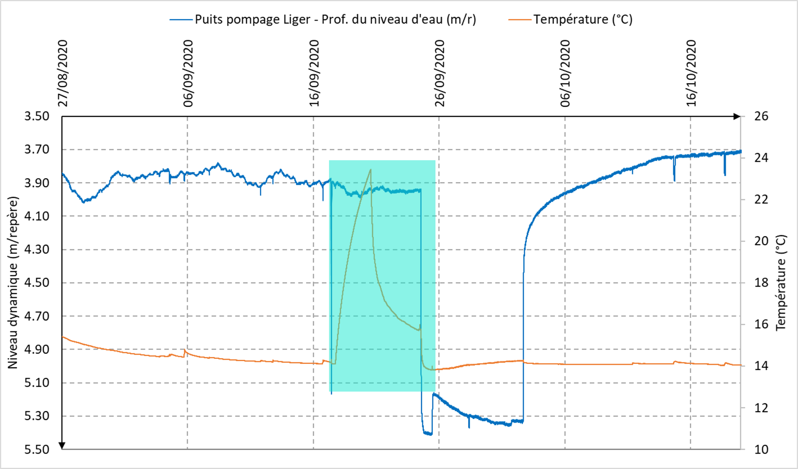


Structuring data
Underlying logic
An observation workflow based on O&M
Field observation 1: OM_Observation
relatedObservation
Observation workflow
Interpretation: OM_Observation
result
result
FlowInterfaceFeature
Field observation 3: OM_Observation
Field observation 2: OM_Observation
result
result

Slide 14
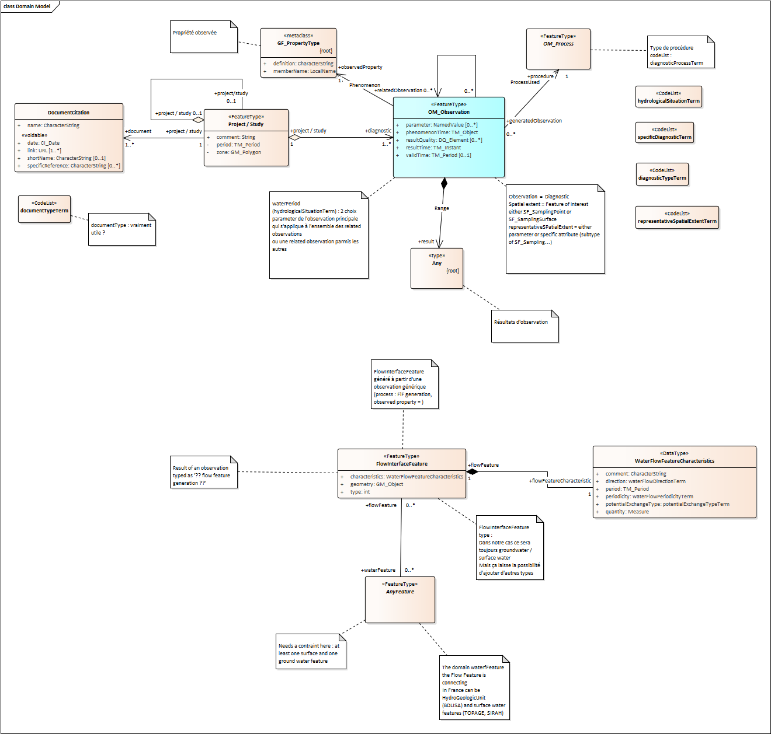
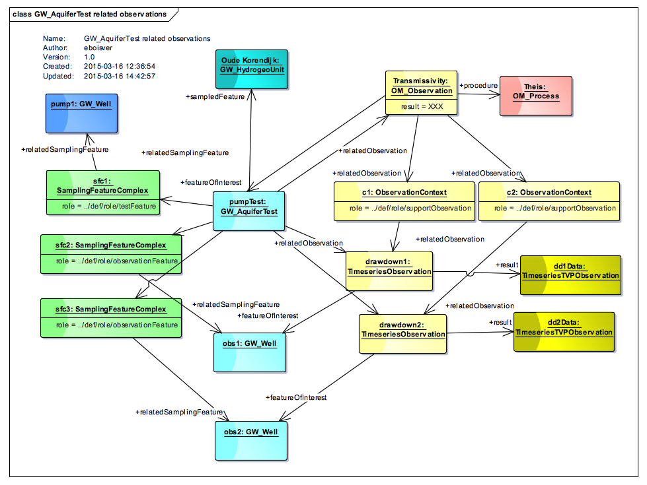
Structuring data
Enriching this
with pre-existing patterns
Ex : GroundWaterML2
GW_AquiferTest (O&M profile)
GWML2 Aquifer test
Flow Interface Feature model
I’m a draft model

Slide 15
Structuring data
I’m a draft model

Slide 16
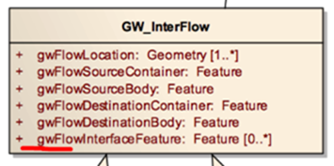
Structuring data
I’m a draft model
(ex : chararacteristics will be adjusted, FlowInterfaceFeature will point back to its parent ‘Observation’)
FlowInterfaceFeature comes from here
(GWML2 Flow package)

Slide 17
Next steps
Finalizing model
Logical Model -> Physical model + data-from CENARI-O project > APIs
Discussion with HY_Features & GWML2 group how this fits in the current puzzle

Slide 18
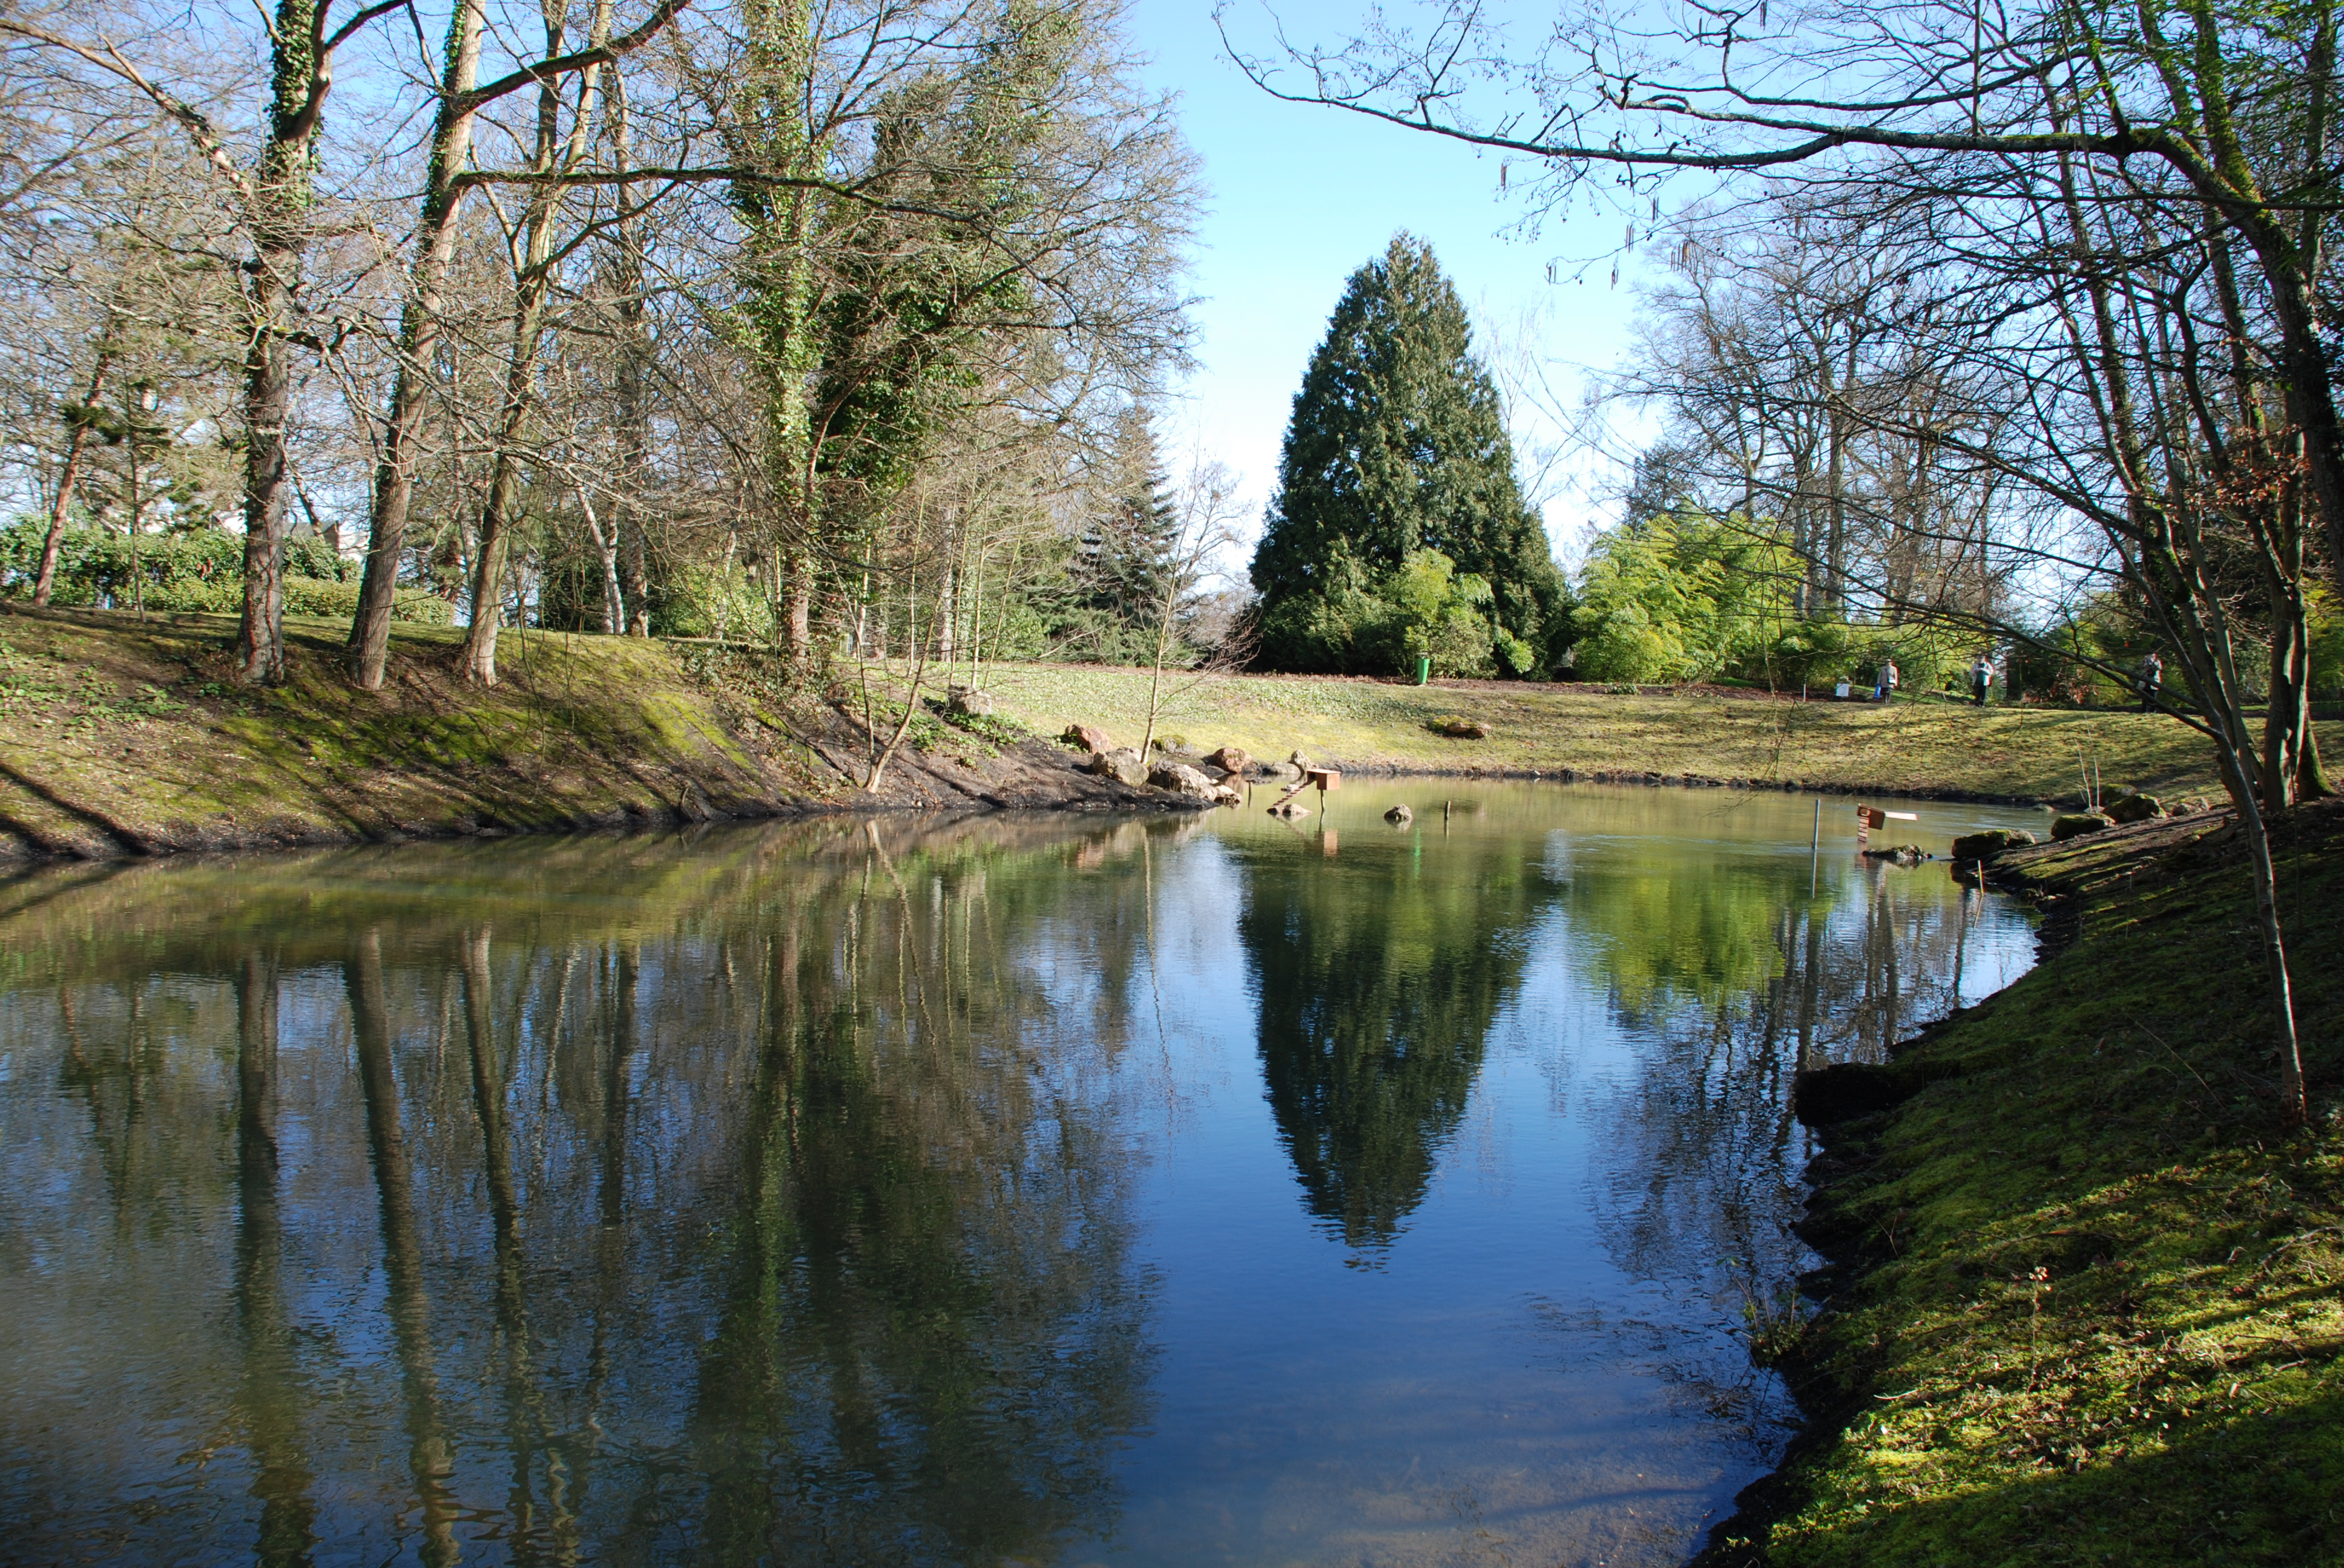

Thank you and thanks to
s.grellet@brgm.fr
fl.millet@brgm.fr
c.auterives@brgm.fr
a.brugeron@brgm.fr

Slide 19
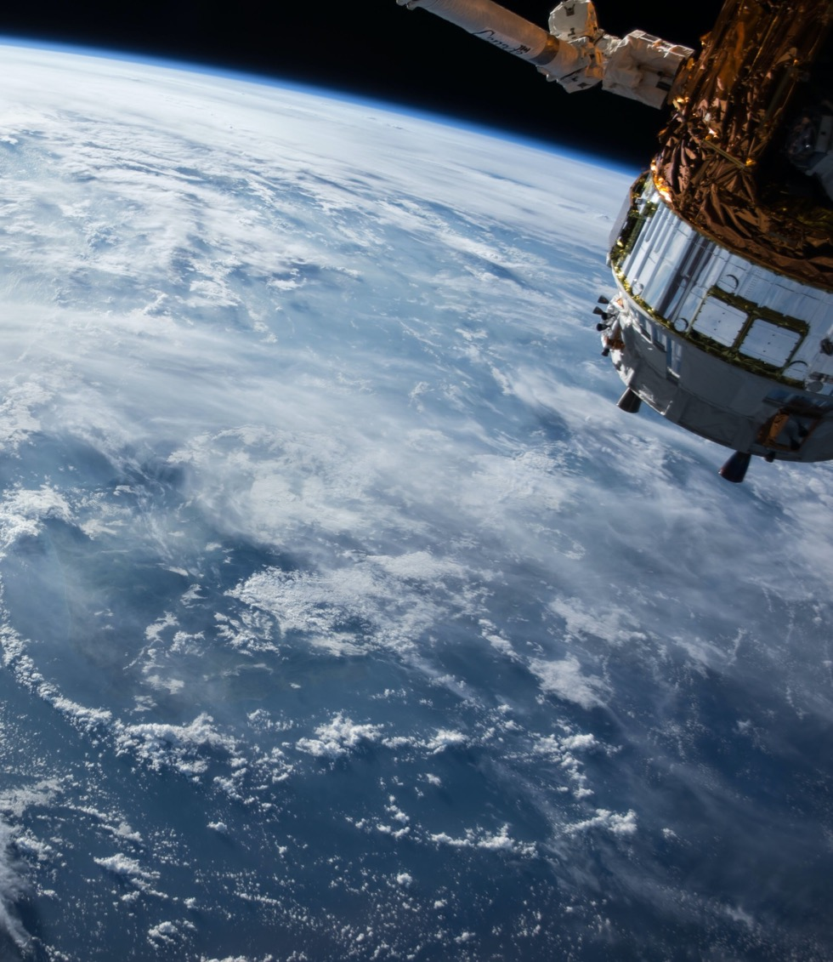
Thank You
Community

