Slide 1



Hydrologic modeling and river corridor applications of HY_Features concepts
The 124th OGC Member Meeting
David Blodgett,
J Michael Johnson,
Andy Bock,
Jess LeRoy,
Marty Wernimont
5 October 2022
Meeting sponsor

Slide 2
Agenda
Background - HY_Features history and relation to HDWG
Mainstems and drainage basin data model
Modeling and data integration use cases for hydrofabrics
Logical model overview
HY_Features change requests
Specifics regarding realization
Additional nexus realizations
Flowline concept
Catchment association to hydrogeologic unit
Motion and Discussion

Slide 3
Background – HY_Features
Envisioned for use by WMO circa 2012 (Atkinson et al., 2012)
Published as WaterML2 Part 3 in 2018 (Blodgett & Dornblut, 2018)
Canadian experimental work “CHyF” in 2019 (Sondheim & Hodgson, 2019)
U.S. experimental work 2018-present (Blodgett et al., 2021) (Ogden et al., 2021)
NOTE: this list is not exhaustive but represents work that directly informed this logical model.
Atkinson, R., Dornblut, I., & Smith, D. (2012). An international standard conceptual model for sharing references to hydrologic features. Journal of Hydrology, 424–425, 24–36. https://doi.org/10.1016/j.jhydrol.2011.12.002
Blodgett, D., & Dornblut, I. (2018). OGC® WaterML 2: Part 3 - Surface Hydrology Features (HY_Features) - Conceptual Model. (Accessed: 4 June 2018). https://docs.opengeospatial.org/is/14-111r6/14-111r6.html
Sondheim, M., & Hodgson, C. (2019). Common Hydrology Features (CHyF) v0.9. https://github.com/NRCan/chyf/
Blodgett, D., Johnson, J. M., Sondheim, M., Wieczorek, M., & Frazier, N. (2021). Mainstems: A logical data model implementing mainstem and drainage basin feature types based on WaterML2 Part 3: HY Features concepts. Environmental Modelling and Software, 135. https://doi.org/10.1016/j.envsoft.2020.104927
Ogden, F., Avant, B., Bartel, R., Blodgett, D., Clark, E., Coon, E., Cosgrove, B., Cui, S., Kindl da Cunha, L., Farthing, M., Flowers, T., Frame, J., Frazier, N., Graziano, T., Gutenson, J., Johnson, D., McDaniel, R., Moulton, J., Loney, D., … Johnson, J. (2021). The Next Generation Water Resources Modeling Framework: Open Source, Standards Based, Community Accessible, Model Interoperability for Large Scale Water Prediction. 2021, H43D-01. https://ui.adsabs.harvard.edu/abs/2021AGUFM.H43D..01O

Slide 4
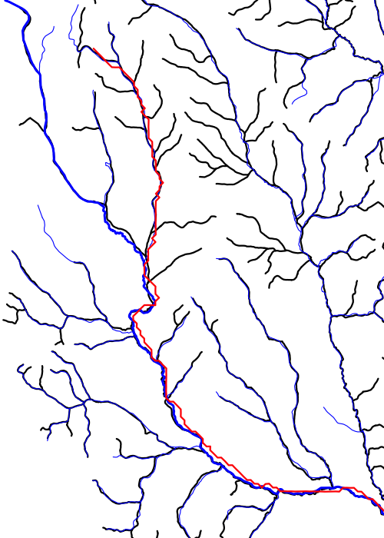
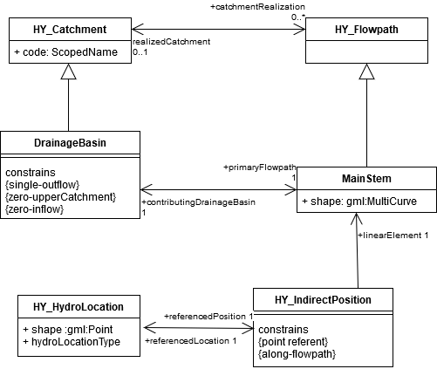
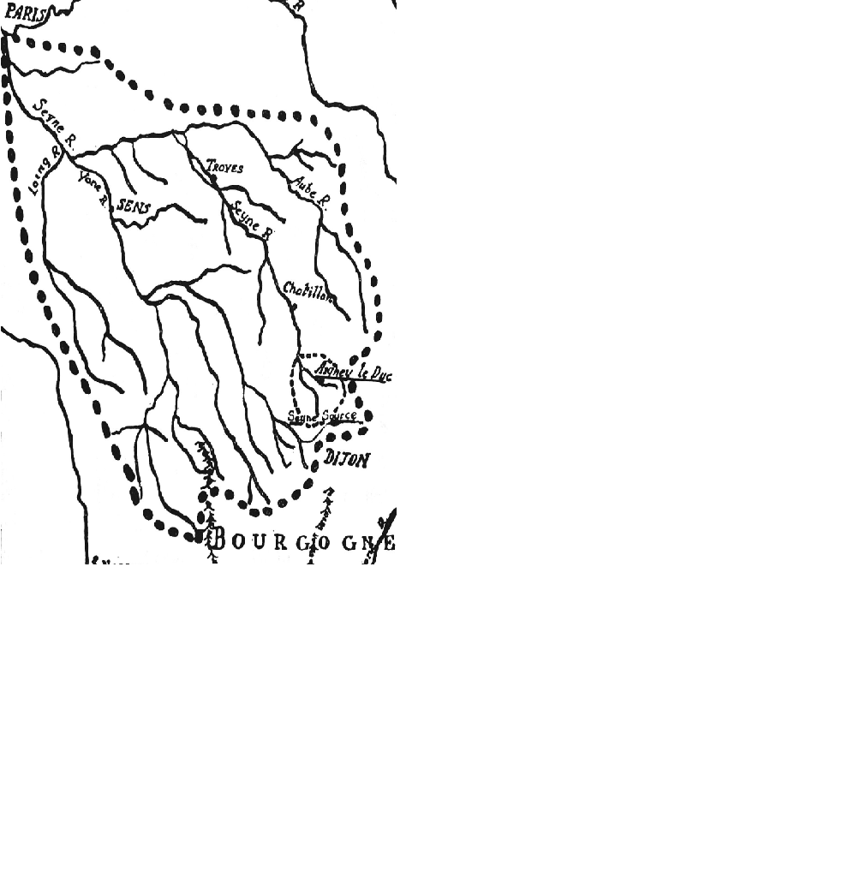
Mainstems
Catchment area study by Marriotte showing the Seine mainstem and drainage basin.
(Image from Dooge, J.C.L., 1959. Quantitative hydrology in the 17th century. La Houille Blanche 6, 799–807. )

Slide 5
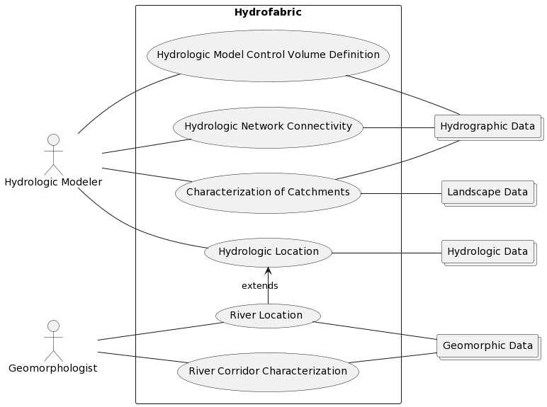
Hydrofabric Use Cases
Geospatial frameworks for hydrologic modeling
River corridor data integration
Locating information along linear network elements is a shared use case.

Slide 6
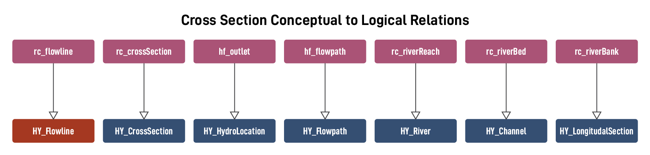
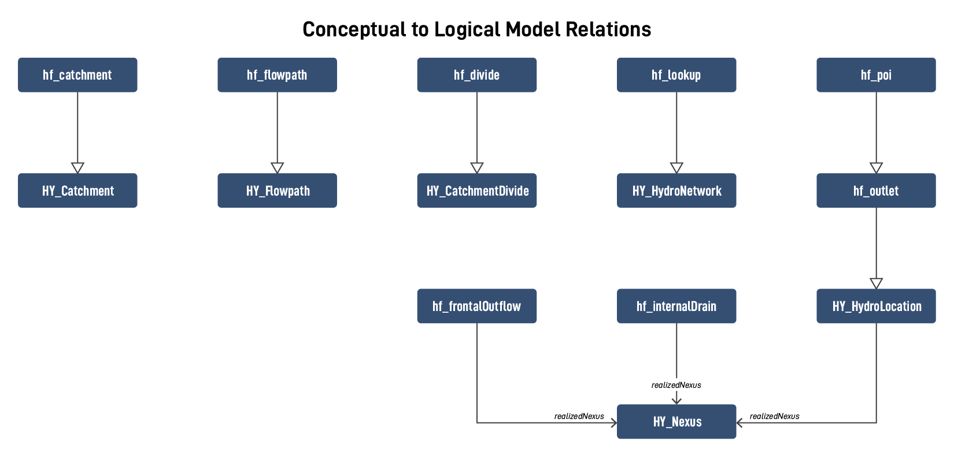
Logical Model

Slide 7
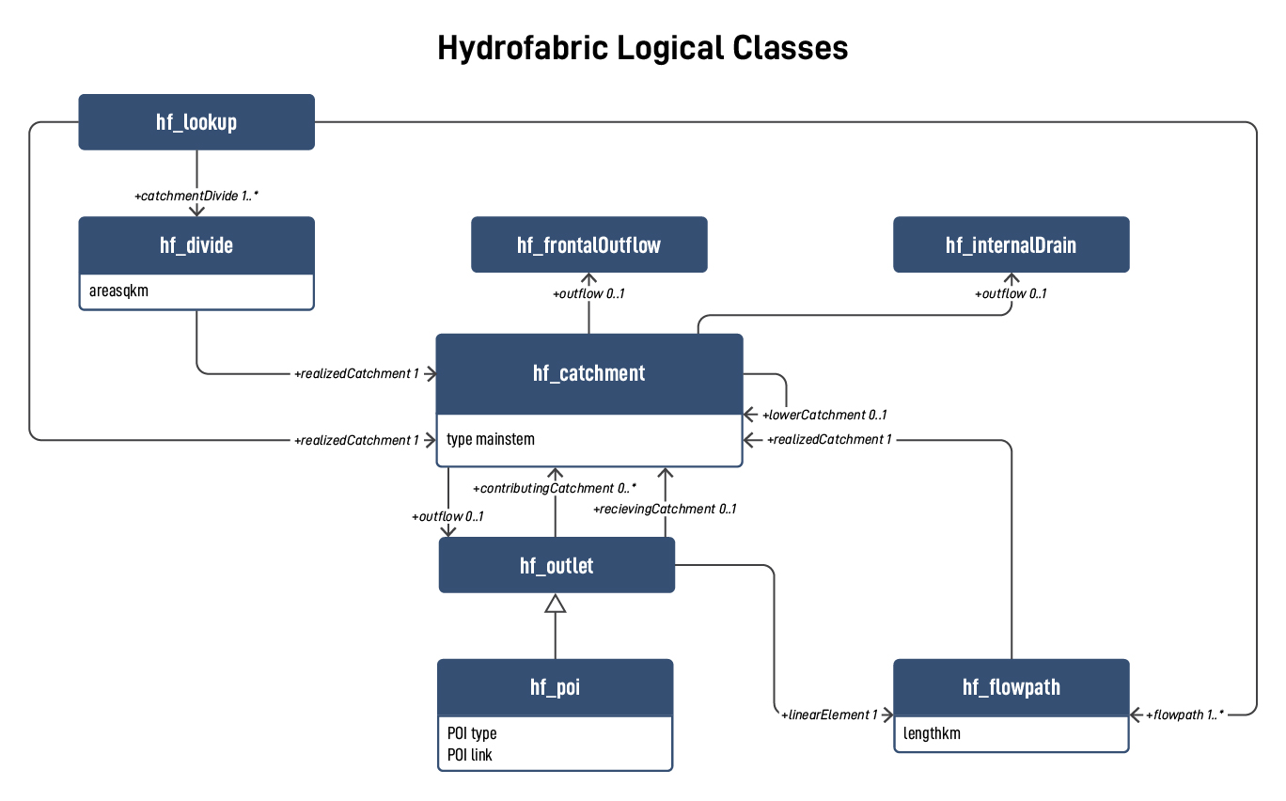
Logical Model

Slide 8
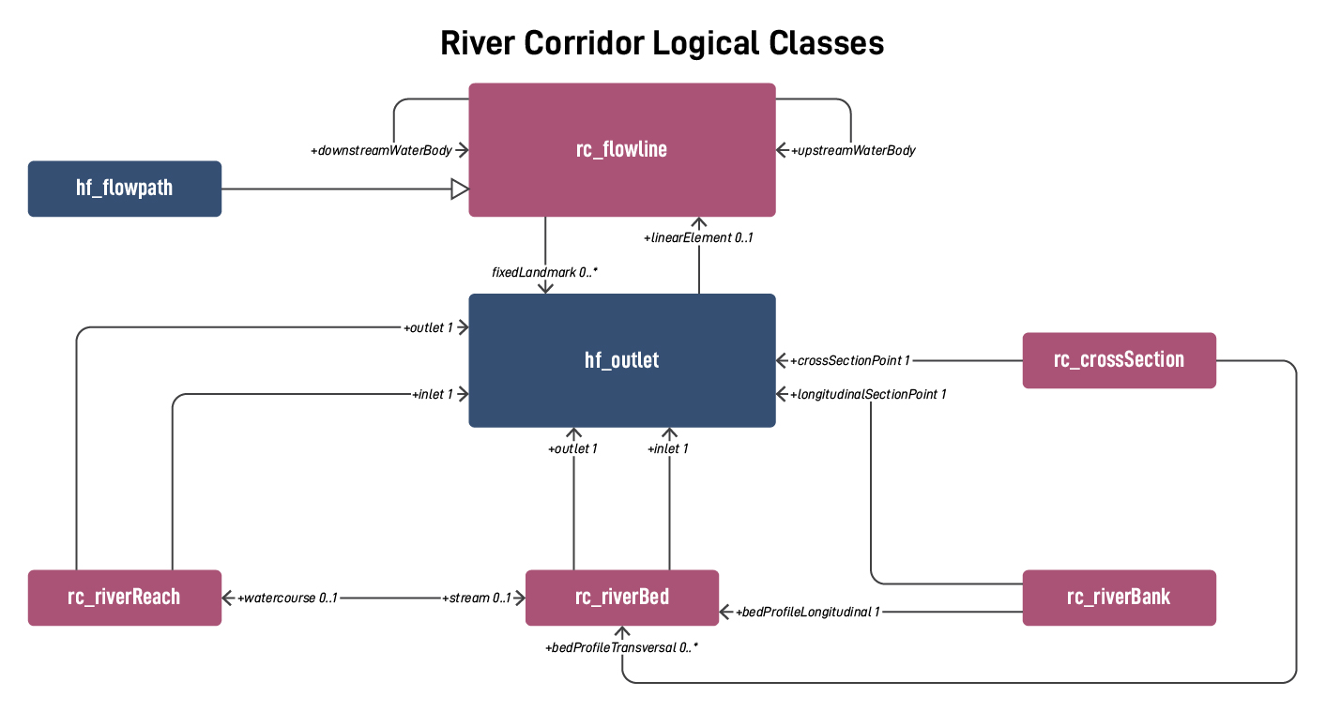
Logical Model

Slide 9
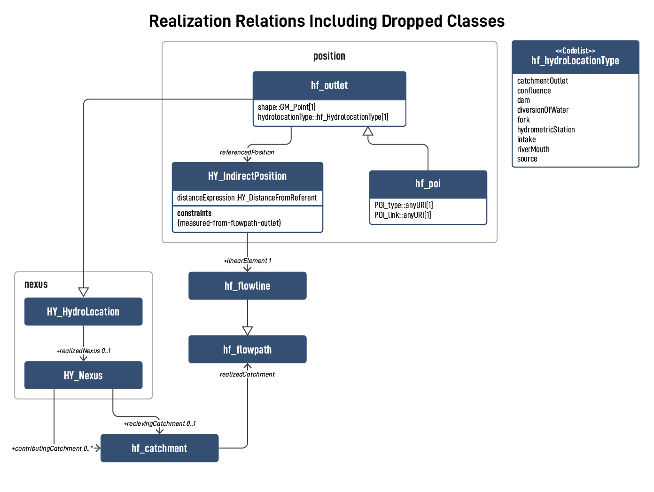
Realization and inheritance
HY_Features includes the following sentence in the definition of "hydrologic realization."
Shares identity and catchment-nexus relationships with the catchment or nexus it realizes but has hydrologically determined topological properties that express unique ways of perceiving catchments and hydrologic nexuses.
What does flowpath inherit via realizedCatchment?
What does hydrolocation inherit via realizedNexus?

Slide 10
Frontal and internal nexuses
Where does a non-flowpath catchment drain?

Slide 11
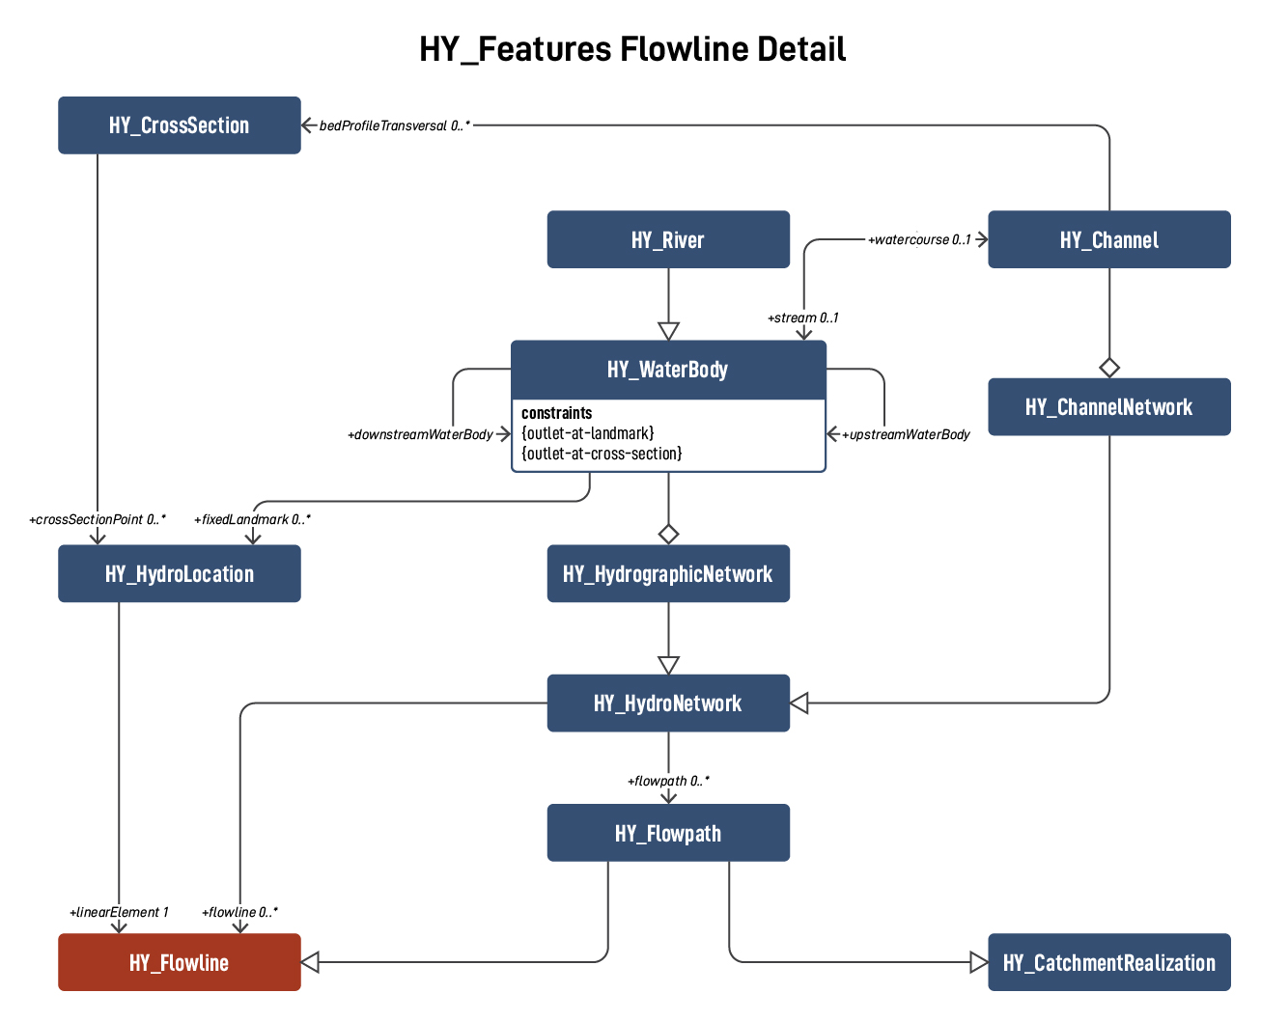
Flowline as a general flowpath
A flowline is the linear element for a flowing body of water that does not realize a catchment.
One-dimensional (linear) feature that represents a flowing body of water. A flowline is functionally similar to a flowpath but does not realize the catchment concept and, as such, does not have to flow from, or to, a nexus.

Slide 12
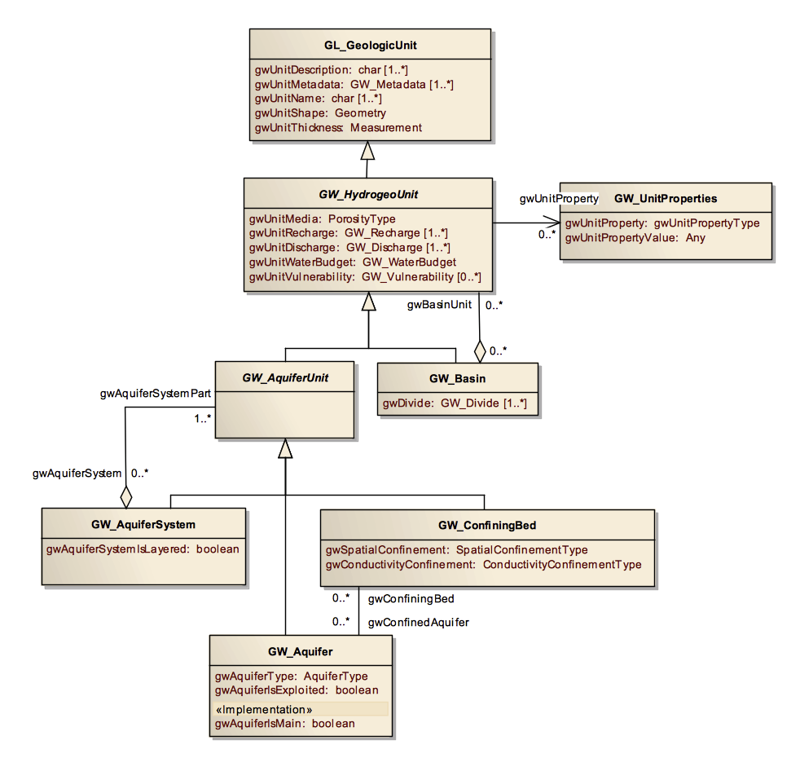
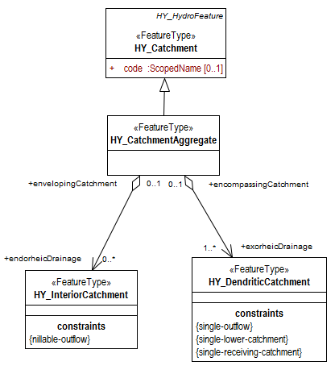

Catchment and hydrogeologic unit

Slide 13
Motion for release of OGC-22-040: Hydrologic modeling and river corridor applications of HY_Features concepts engineering report
The Hydrology DWG recommends that the OGC Technical Committee approve release of OGC-22-040 “Hydrologic modeling and river corridor applications of HY_Features concepts engineering report” as an OGC Engineering Report.
Pending any final edits and review by OGC staff
<Any Discussion Points that the TC needs to be aware of>
Motion: <Name of person making the motion>
Second: <name of the person seconding the motion>
Discussion:
If there is a hand vote, the results of the vote. Otherwise, the phrase <There was no objection to unanimous consent> should be used
This engineering report presents progress on formalizing a hydrofabric for drainage basins of the United States adhering to HY_Features concepts with focus on their use in modelling hydrologic process.

Slide 14
Next Steps?

Slide 15

Thank You
Community

