Slide 1
Mainstems: A data model and data set for surface hydrology integration
Dave Blodgett
dblodgett@usgs.gov
U.S. Geological Survey Water Mission Area
Integrated Modeling and Prediction Division
Geospatial Intelligence Branch

Slide 2
Background: Hydroinformatics
Informatics is the study of natural and engineered computational systems. [1]
Hydroinformatics deals with application of Information and Communications Technologies (ICT) to water resources, hydraulics or hydrology. ... Hydroinformatics provides a symbiosis, and even a synergy, between ICT and water science and technologies with the objective of satisfying social requirements. [2]
[1] - https://en.wikipedia.org/wiki/Informatics
[2] - https://iwa-network.org/groups/hydroinformatics-joint-iwaiahriahs/

Slide 3
Background: What’s the problem?
What monitoring do we have on River X?
I need all the monitoring and modeling data available associated with the river network upstream of my study sight.
What river is this stream gage on?
Why do we have to reindex our data to the new hydrographic network?!?

Slide 4

Infinite regress is real But we’ve got to stop somewhere.

Slide 5
Infinite regress is real But we’ve got to stop somewhere.

Slide 6
Pragmatic Epistemology
Pragmatism (philosophy): an approach that assesses the truth of meaning of theories or beliefs in terms of the success of their practical application.
Epistemology: the theory of knowledge, especially with regard to its methods, validity, and scope. Epistemology is the investigation of what distinguishes justified belief from opinion.

Slide 7
References worth reviewing…
Abbott, M.B., 1993. The electronic encapsulation of knowledge in hydraulics, hydrology and water resources. Adv. Water Resour. 16, 21–39. https://doi.org/10.1016/0309-1708(93)90027-D
“… pointed to the need to encapsulate knowledge (i.e., adding nuance and context to data) to further hydroscience integration”
Archfield, S.A., Clark, M., Arheimer, B., Hay, L.E., McMillan, H., Kiang, J.E., Seibert, J., Hakala, K., Bock, A., Wagener, T., Farmer, W.H., Andréassian, V., Attinger, S., Viglione, A., Knight, R., Markstrom, S., Over, T., 2015. Accelerating advances in continental domain hydrologic modeling. Water Resour. Res. 51, 10078–10091. https://doi.org/10.1002/2015WR017498
“… called for a machine-independent information sharing infrastructure to enable communication and integration across hydroscience domains”
Jiang, J., Zhu, A.-X., Qin, C.-Z., Liu, J., 2019. A knowledge-based method for the automatic determination of hydrological model structures. J. Hydroinformatics 21, 1163–1178. https://doi.org/10.2166/hydro.2019.029
“… described the potential value in using a knowledge-based approach to catalog and re-use specific application context for integrated hydroscience modeling”

Slide 8
References worth reviewing…
Blodgett, D., Johnson, J.M., Sondheim, M., Wieczorek, M., Frazier, N., 2021. Mainstems: A logical data model implementing mainstem and drainage basin feature types based on WaterML2 Part 3: HY Features concepts. Env. Modelling and Software 135, https://doi.org/10.1016/j.envsoft.2020.104927
“…the familiar and intuitive properties of hydrologic landscape mechanics have resulted in a general vagueness about how hydrologic features are described, referenced, and understood.”
Petts, G.E., 1996. The Fluvial Hydrosystems. Springer Netherlands, Dordrecht.
“… describes drainage basin, as a basic hydrologic unit of the landscape that encompasses a “cascading system” of connected “hillslope and channel subsystems”.”
Blodgett, D., Dornblut, I., 2018. OGC® WaterML 2: Part 3 - Surface Hydrology Features (HY_Features) - Conceptual Model. http://www.opengis.net/doc/IS/hy-features/1.0.
“… This standard describes building blocks for formalizing imprecise terminology in support of data integration and scientific reproducibility in the hydrosciences.”

Slide 9
We can decompose problems in two ways.
Spatial-domain decomposition for social and engineering reasons.
Model-concept-domain decomposition for flexible system composition.
Look for "common data model" efficiencies.
Unique stuff with adapters to common stuff. GOOD
Unique stuff with adapters to unique stuff. BAD

Slide 10
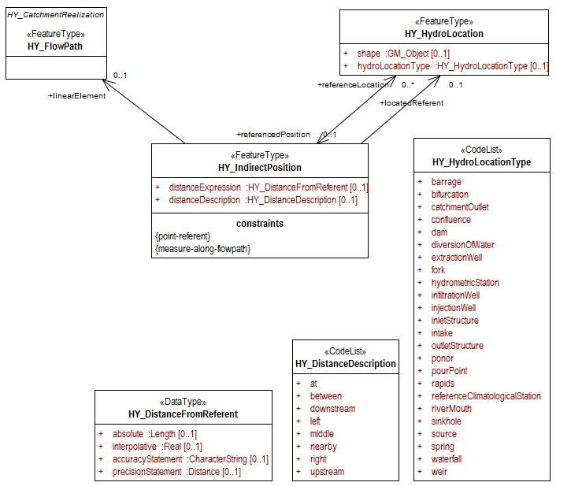
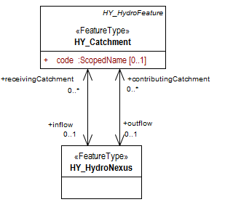
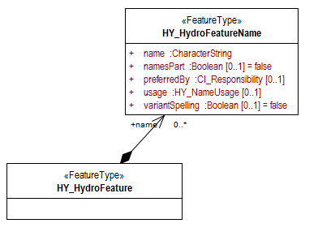
noun: class; plural noun: classes
a set or category of things having some property or attribute in common and differentiated from others by kind, type, or quality.

Slide 11
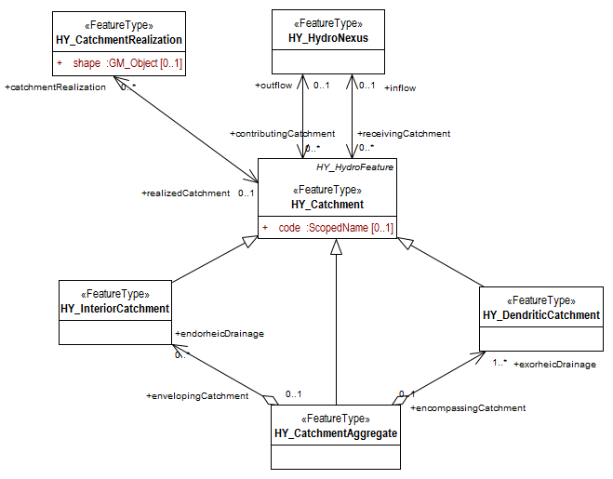
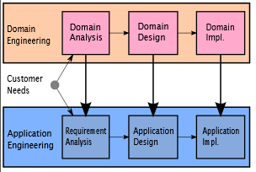
Governing Models
Methods / Sensors
Features
Observations and Predictions
Results

Slide 12
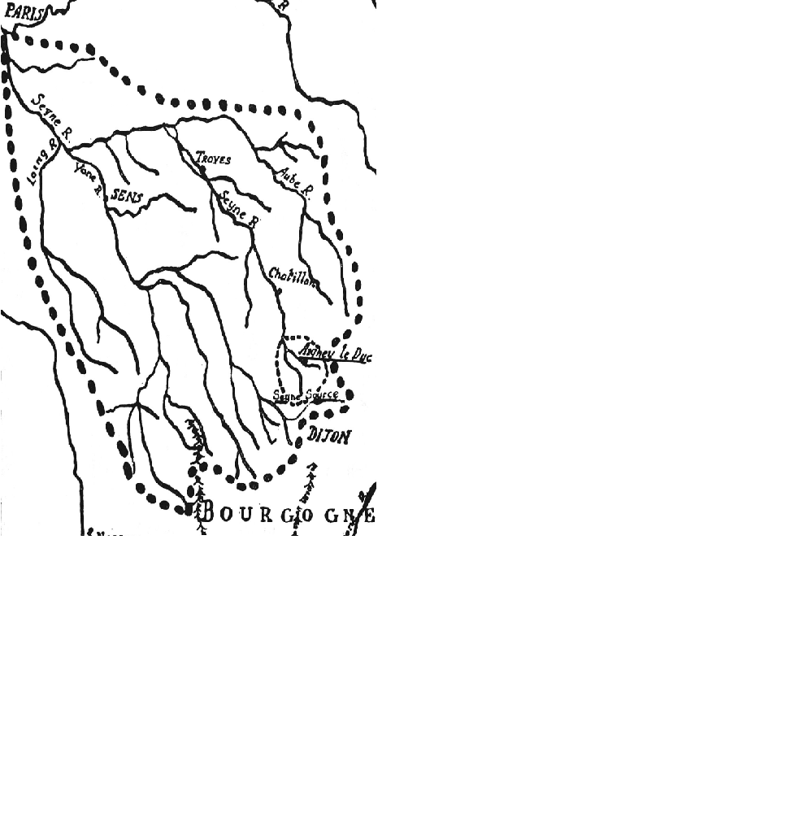
Mainstems
Catchment area study by Marriotte showing the Seine mainstem and drainage basin.
(Image from Dooge, J.C.L., 1959. Quantitative hydrology in the 17th century. La Houille Blanche 6, 799–807. )
https://doi.org/10.1016/j.envsoft.2020.104927

Slide 13
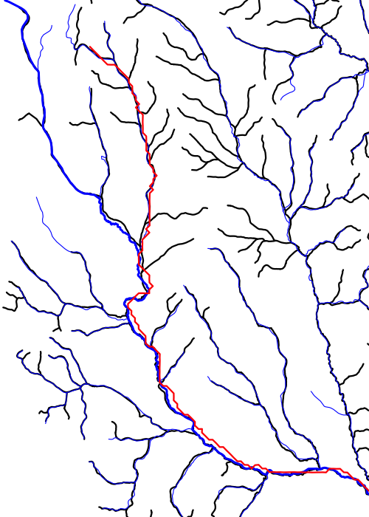
Where is a “headwater”? RF1 NHD Medium Res NHD High Res

Slide 14
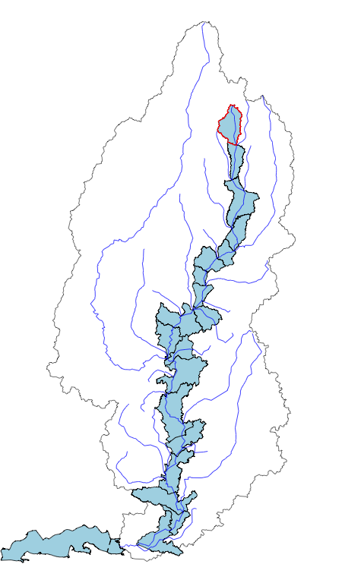
What are the defining features of a mainstem?

Slide 15
What are the defining features of a mainstem?

Slide 16
What are the defining features of a mainstem?

Slide 17
What are the defining features of a mainstem?

Slide 19
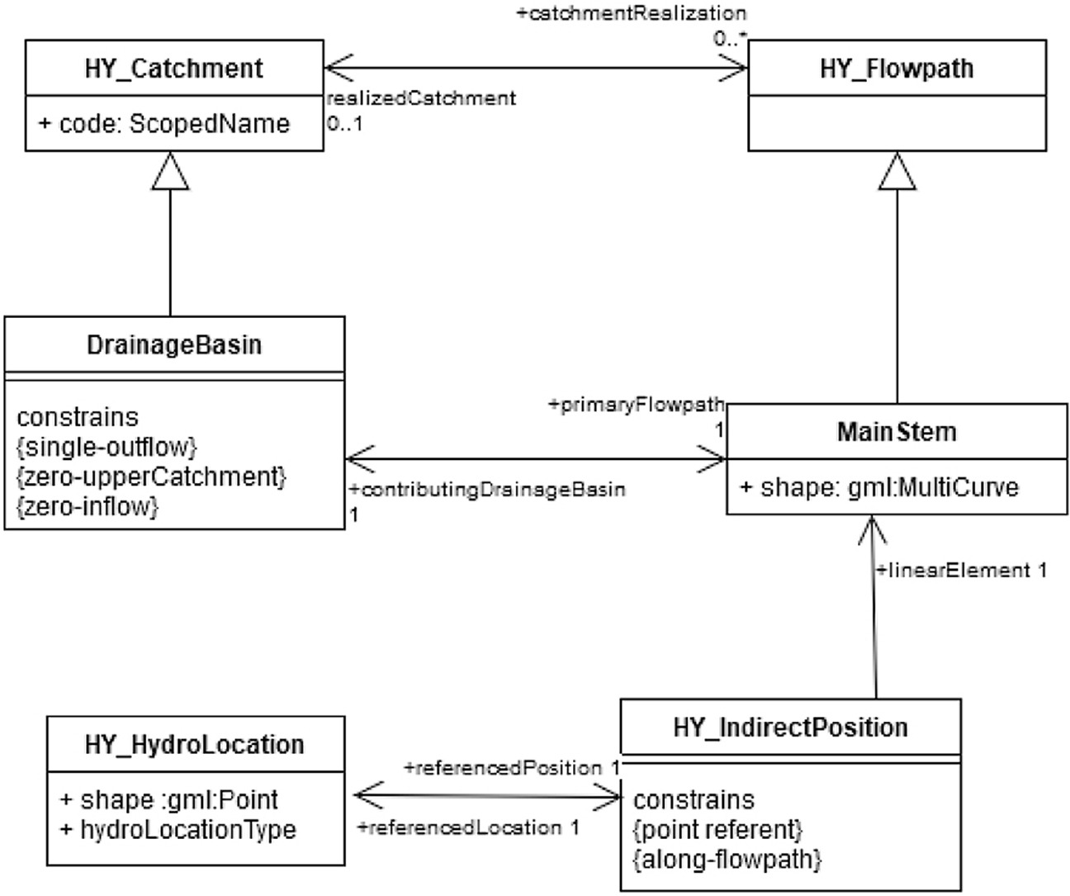

Slide 20
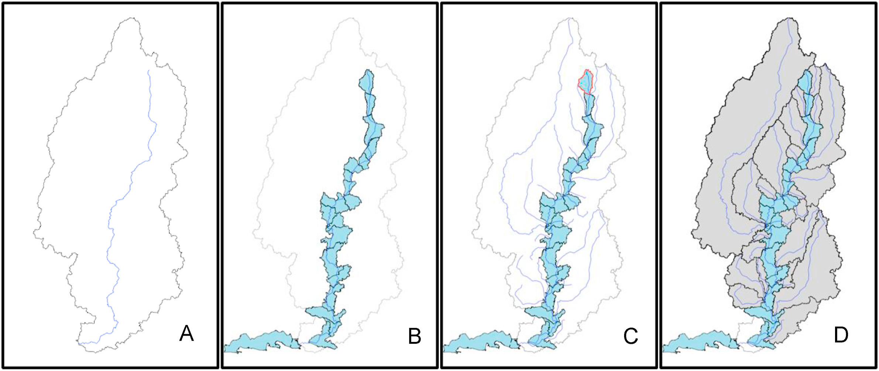
Case Study 1: NHD and the Watershed Boundary Dataset

Slide 21
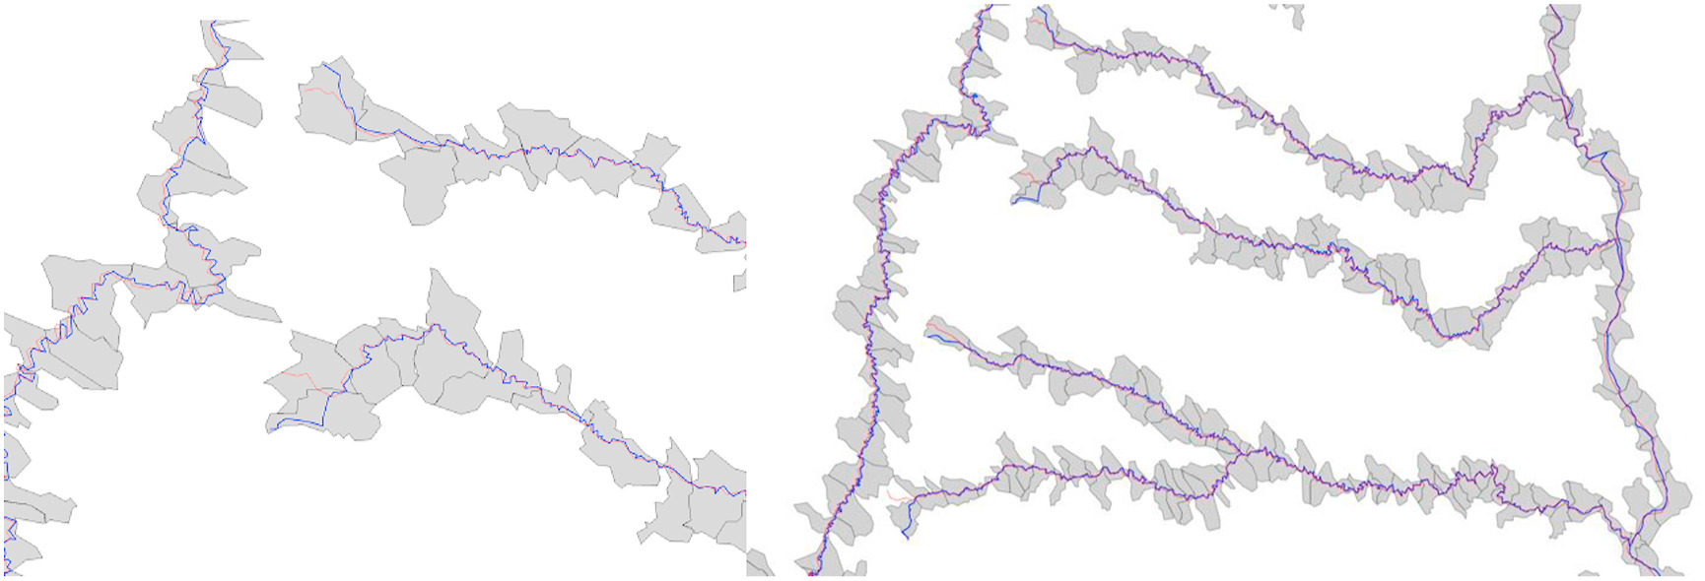
Case Study 1: NHD and the Watershed Boundary Dataset

Slide 23
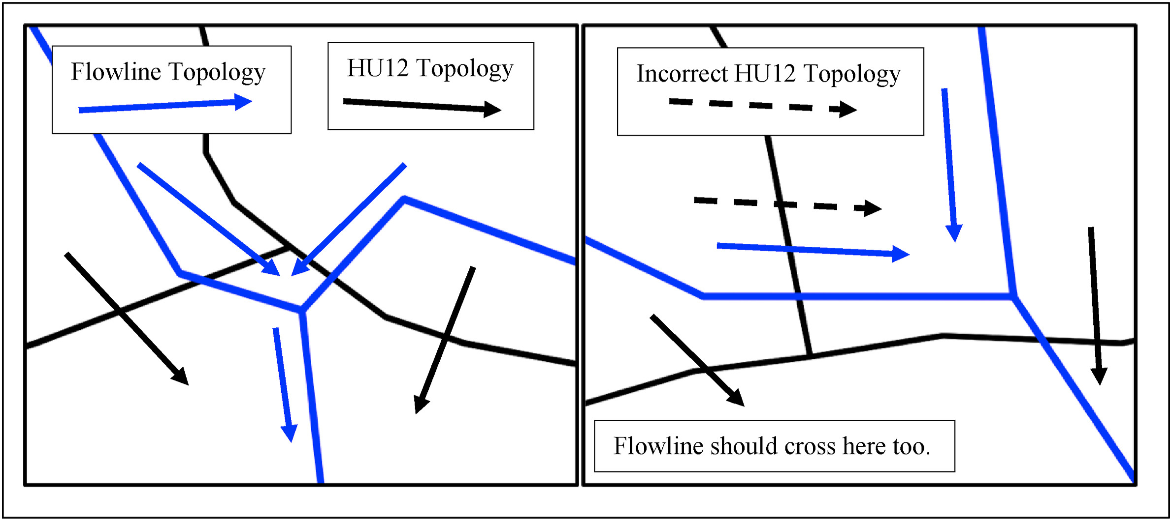
Case Study 1: NHD and the Watershed Boundary Dataset

Slide 24
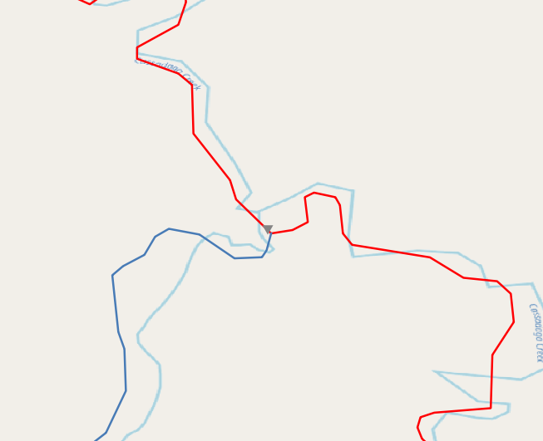
Case Study 2: National Water Information System Hydrographic Addressing
Drainage Area: 247.2 sqkm
Drainage Area: 11.7 sqkm
Drainage Area: 11.5 sqkm
What if we didn’t know drainage area?

Slide 25
Case Study 2: National Water Information System Hydrographic Addressing
Mainstem ID:
448022
Mainstem ID:
1413189
Mainstem ID:
1413189
If we know the mainstem ID, we get it right.

Slide 26
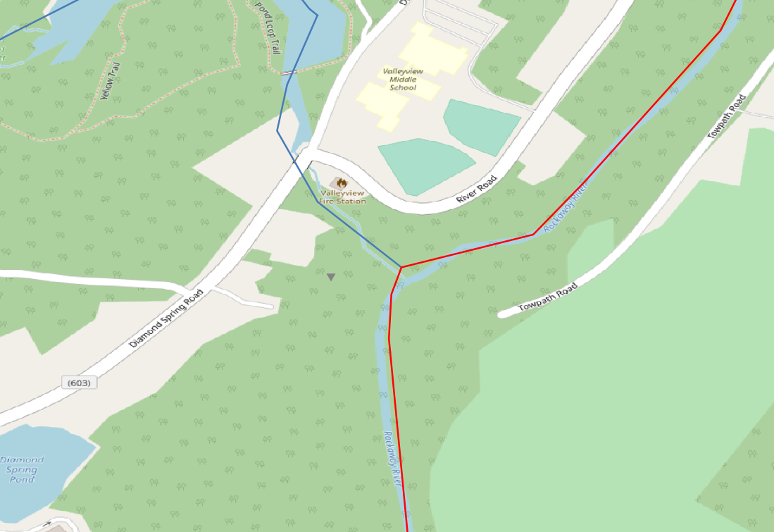
Case Study 2: National Water Information System Hydrographic Addressing
Drainage Area: 4.8 sqkm
Rockaway R trib 3 at Denville NJ –
unknown drainage area
WQ data from 1984
We get this one wrong without knowing the mainstem ID.
Drainage Area: 255.2 sqkm

Slide 27

Case Study 3: High resolution NHDPlus with other networks

Slide 28
Conclusions
A mainstem is an aggregate feature defined by a headwater area and the path downstream to its outlet.
Mainstems are a minimally sufficient set of features that unify the network with hydrologic units.
We can create identifiers for major mainstems now while improving their representation and identifying more over time.

Slide 29
Thank you!!

