Slide 1
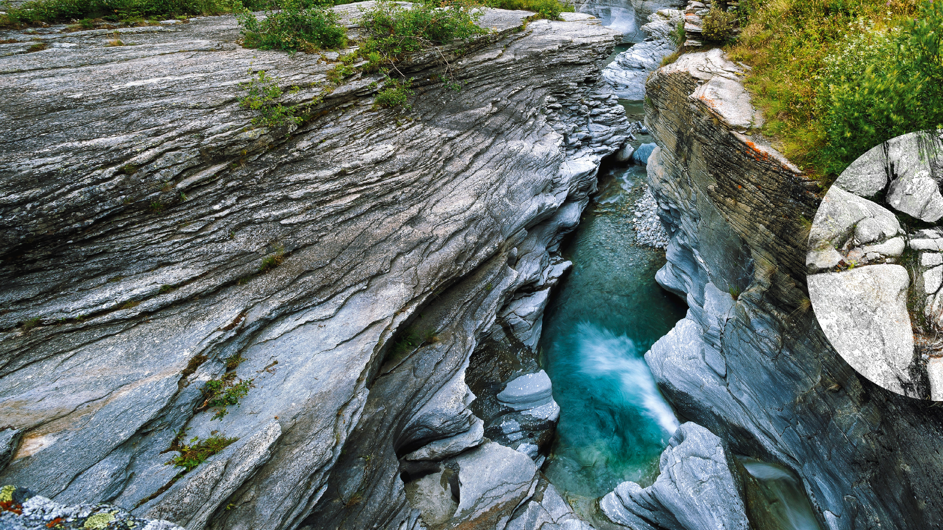


2 tests to serve French surface water quality data
OGC Hydrology DWG Water Quality (WQ) Data Seminar
17/03/2021

Slide 2
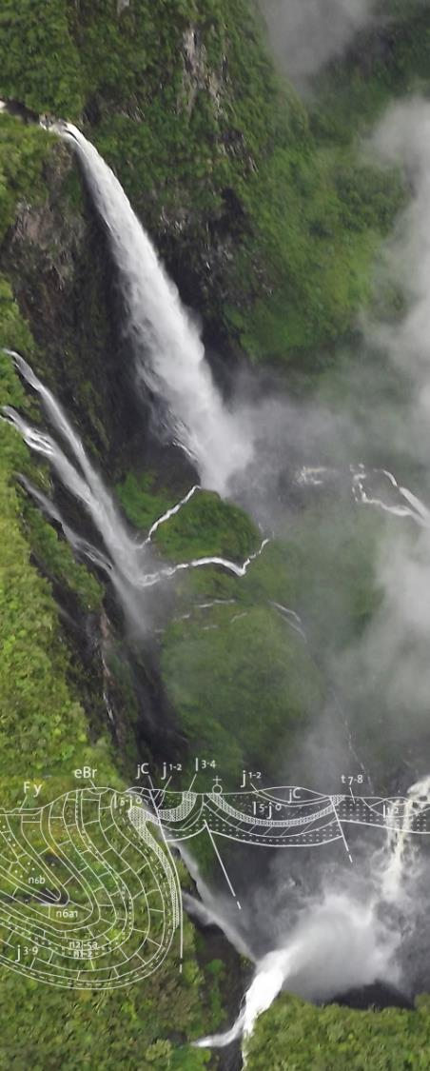
Overview
Water quality use cases overview
Test 1 - Full Linked data test
Test 2 - SensorThings API (with linkedData registries)
Analysis
Analysis

Slide 3
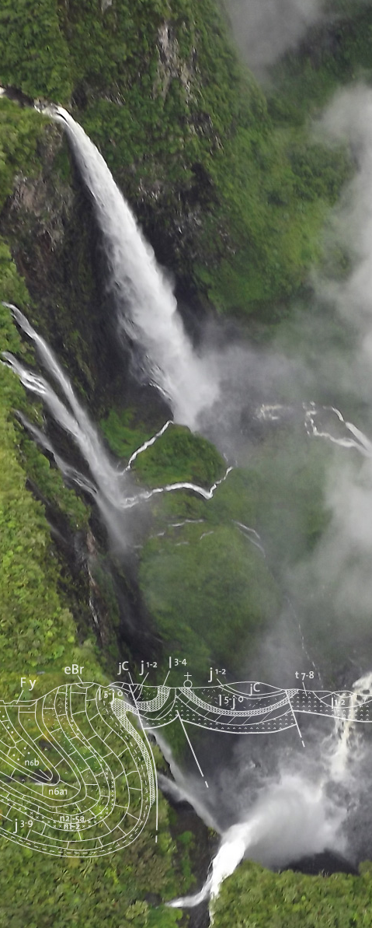
Water quality use case overview
Chemical concentration - Complete model
River
samples
Water quality station
Sampling act
Sample
Water quality sampling point
Analysis
Environmental conditions (related obs)
Sub-sample
Result…
Analysis
Result…
120 million analysis results …
Analysis
Analysis
Analysis
Result…

Slide 4
Water quality use case overview
Chemical concentration - Simplified (implemented) model
River
sampledFeature
relatedSamplingFeature
fOi
relatedObservation
Water quality station
Water
Sample
Analysis
relatedObservation
fOi
Result…
relatedObservation
relatedObservation
Analysis
Environmental conditions (related obs)
Result…
Observation
Observation result
Water Sample (SF_Specimen)
River (ultimate fOI)
Other fOIs on the side (ex : river pertains to river basin)
Environmental Monitoring Facility (EF)
EF associated information
Analysis
Analysis

Slide 5
Water quality use case overview
Biodiversity Observation – overall rationale
A lot of related Observations !
Taxon indice (ex : river fish indice)
Related obs
Taxon score
Related obs
Taxon field observation (I counted a Eel)
Related obs
Related obs
Taxon field observation (I counted 2 Salmo trutta fario)
Taxon score
Analysis
Analysis

Slide 6
Test 1 - Full Linked data test (2018)
1°/ Features from national standard mapped to international standards
River : HY_Feature
Stations : SOSA/smod:ef
Water quality observation
SOSA / O&M
And loaded in a triple store
Analysis

Slide 7
Test 1 - Full Linked data test
2°/ Map/align taxonomies
to international ones
Units of measure : QUDT
Chemical parameters ChemID+
to sister organization ones
in France : IFREMER (Marine Agency), MNHN for Taxa naming both provides the link to international reference dataset
CSIRO
Analysis

Slide 8
Test 1 - Full Linked data test
2°/ Map/align taxonomies
Chemistry
Sandre PAR/1340
CHEBI/17632
« Nitrate »
Geoscience ObjParSubs/3196
CAS code
14797-55-8
ChemID+/14797-55-8
PubChem/943
Analysis

Slide 9
Test 1 - Full Linked data test
2°/ Map/align taxonomies
Chemistry
Sandre PAR/1340
http://id.eaufrance.fr/par/1340
owl:sameAs
CHEBI/17632
« Nitrate »
Geoscience ObjParSubs/3196
http://purl.obolibrary.org/obo/CHEBI_17632
owl:sameAs
ChemID+/14797-55-8
https://data.geoscience.fr/ncl/ObjParSubs/3196
https://chem.nlm.nih.gov/chemidplus/rn/14797-55-8
PubChem/943
Analysis
https://pubchem.ncbi.nlm.nih.gov/compound/943

Slide 10
Test 1 - Full Linked data test
2°/ Map/align taxonomies
Taxa naming
MNHN TAXREF-LD/67778
Sandre APT/2221
« Salmo trutta fario »
WoRMS/ 293723
Analysis

Slide 11
Test 1 - Full Linked data test
2°/ Map/align taxonomies
Taxa naming
MNHN TAXREF-LD/67778
skos:exactMatch
http://taxref.mnhn.fr/lod/name/67778
Sandre APT/2221
« Salmo trutta fario »
skos:exactMatch
WoRMS/ 293723
https://data.geoscience.fr/ncl/apt/2221
http://www.marinespecies.org/aphia.php?
p=taxdetails&id=293723
Analysis

Slide 12
Test 1 - Full Linked data test
AlgeaBase
2°/ Map/align taxonomies
Taxa naming
MNHN TAXREF-LD/67778
skos:exactMatch
Sandre APT/2221
WoRMS/ 293723
« Salmo trutta fario »
skos:exactMatch
GBIF
skos:exactMatch
ToBe refined
IFREMER (French Marine Agency) / Quadrige² / 126281
Encyclopedia of Life
Catalogue of Life
EUNOMEN PESI
Analysis

Slide 13
Test 1 - Full Linked data test
2°/ Map/align taxonomies experience
Content exposed in a linked data registry
https://data.geoscience.fr/ncl/
Hard to have an external reference that
Is community endorsed
Have the same domain scope
Provides resolvable URI and also semantic web artefacts (SPARQL endpoint, content negotiation,…)
Sometimes one alignment provided a hook to many other repo in a given domain
Ex : chemical parameters (ChemId+)
Analysis

Slide 14
Test 1 - Full Linked data test
3°/ demos - Chemical observation
Video https://github.com/INSIDE-information-systems/EnvironmentalSemanticWeb/blob/master/demos/chemical_observation.mp4
Analysis

Slide 15
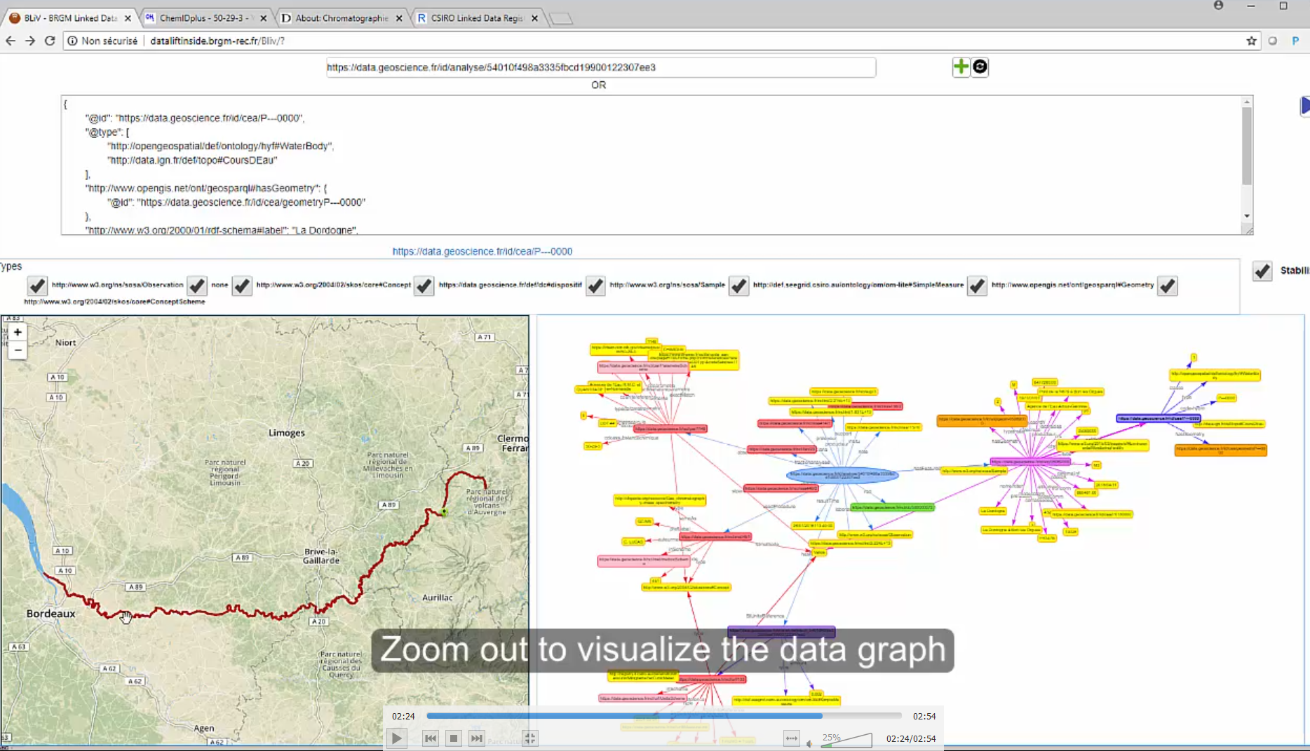
Test 1 - Full Linked data test
3°/ demos - Chemical observation

Slide 16
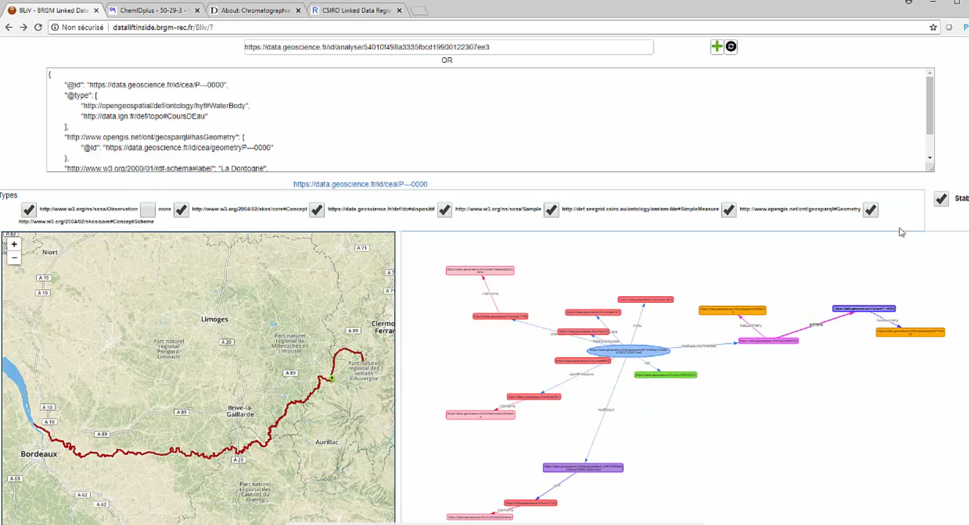
Test 1 - Full Linked data test
3°/ demos - Chemical observation
observedProperty
River
Station
procedure
Obs
result

Slide 17
Test 1 - Full Linked data test
3°/ demos - Hydrobiological observation (Taxa occurrence)
Video https://github.com/INSIDE-information-systems/EnvironmentalSemanticWeb/blob/master/demos/bio_observation.mp4
Analysis

Slide 18
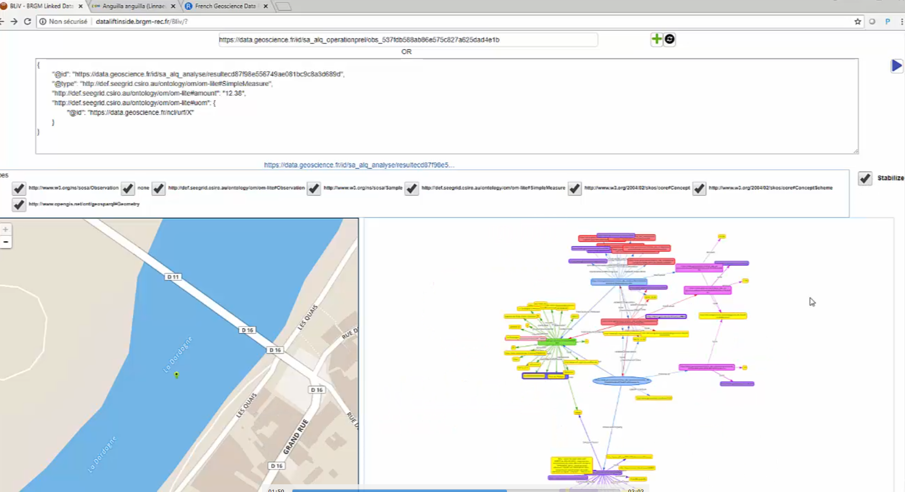
Test 1 - Full Linked data test
3°/ demos - Hydrobiological observation (Taxa occurrence)
Indice(related Observation)
Score (related Observation)
Station
Field Observation
Field obsProp

Slide 19
Test 2 – SensorThings API (2019)
New approach to lower the entry ticket
API :
OGC SensorThings API (OGC Sensor Observation Service ‘successor’)
XML -> JSON
Taxonomies : still in a linked Data Registry
No Triple store for all observation, stations and river network elements
Observations in ST API
Minimal info for Rivers & Stations in ST API (for the rest, URI -> OGC WFS & OGC API – Feature description)
Only on chemical observations
No Taxa occurrence observation in this one
Analysis

Slide 20
Test 2 – SensorThings API
Chemical concentration - Simplified (implemented) model => mapped to ST API
River
fOI
sampledFeature
relatedSamplingFeature
fOi
relatedObservation
Water quality station
Water
Sample
Analysis
fOi
Obs
Thing
relatedObservation
Result…
relatedObservation
relatedObservation
Analysis
Environmental conditions (related obs)
Result…
Obs
Observation
Observation result
Water Sample (SF_Specimen)
River (ultimate fOI)
Other fOIs on the side (ex : river pertains to river basin)
Environmental Monitoring Facility (EF)
EF associated information
SensorThings API classes
Analysis
Analysis

Slide 21
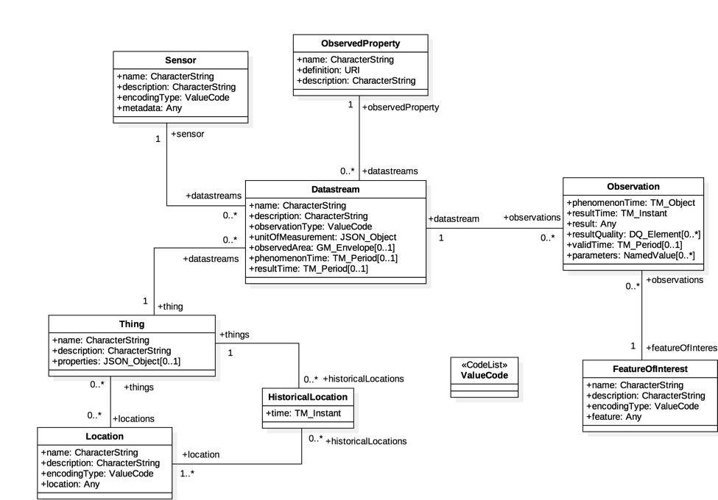
Test 2 – SensorThings API
Chemical concentration - Simplified (implemented) model => mapped to ST API
Observed property
Analysis procedure
Observation on Sample
om:parameter :
fraction, medium
Monitoring
Facility
River
Water Sample
Analysis

Slide 22
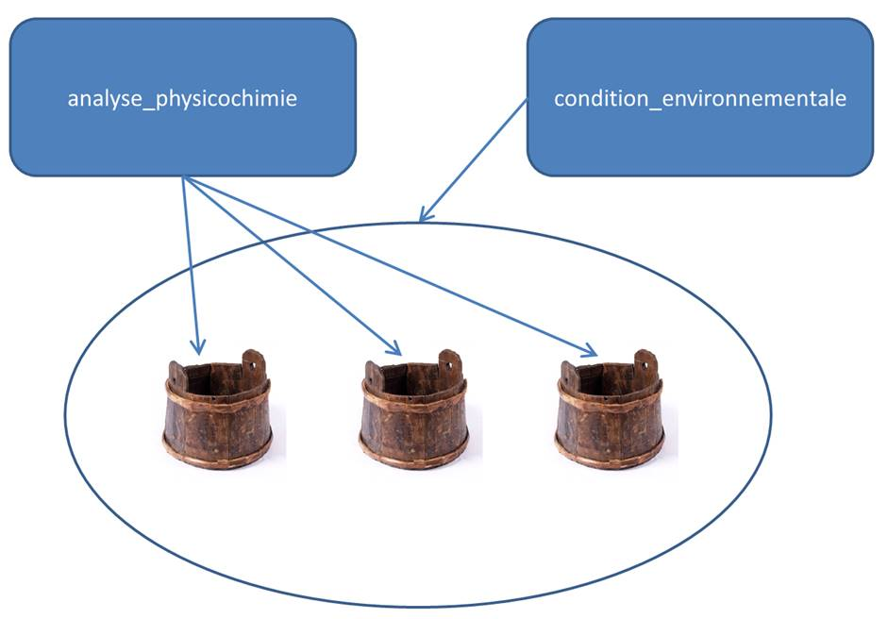
Test 2 – SensorThings API
Introducing environmental conditions (ex : weather when sampling, …)
Water Sample
Environmental conditions when sampling
Analysis

Slide 23
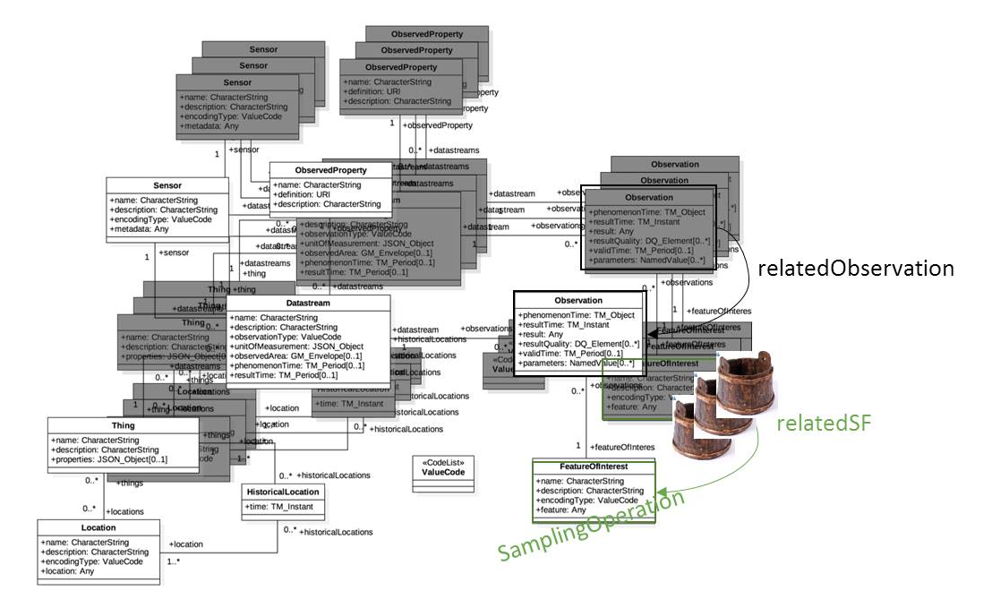
Test 2 – SensorThings API
Introducing environmental conditions (ex : weather when sampling, …)
Analysis
White : one environmental condition
datastream (at a given station, …)
Black three quality datastreams (at a
given station, obsProperty, procedure)

Slide 24
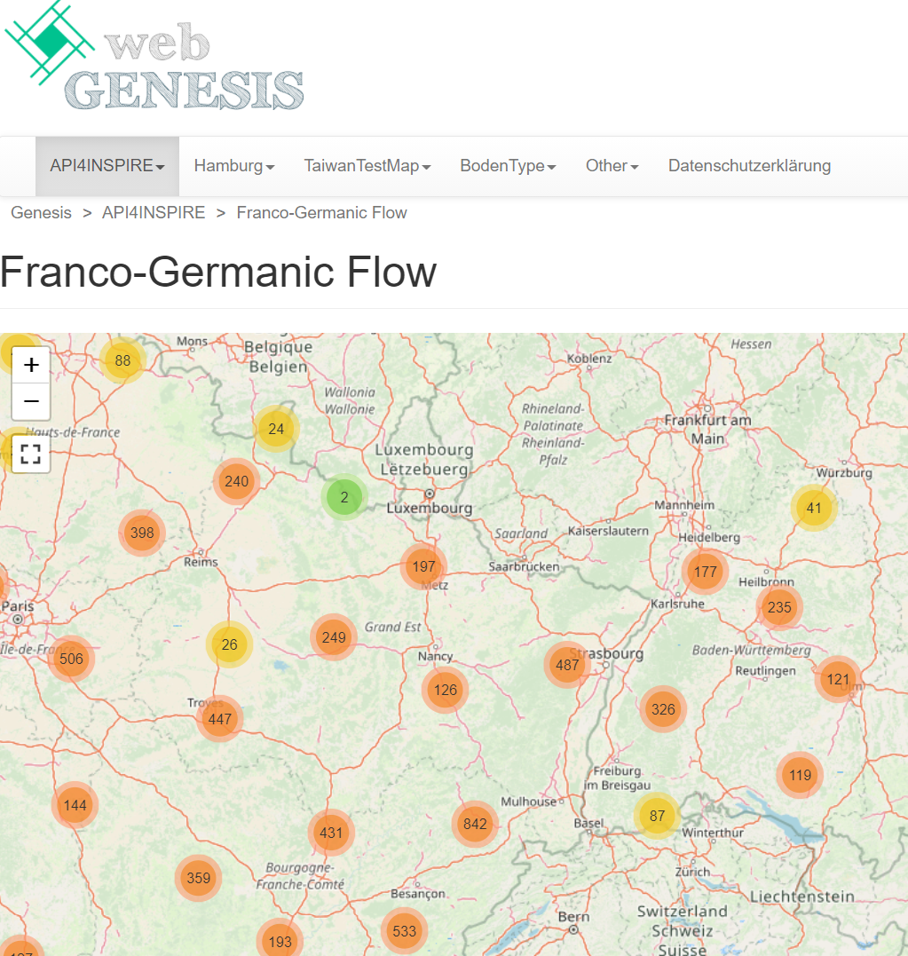
Test 2 – SensorThings API
3°/ Prototype demo
API4INSPIRE project
Data
French Biodiversity Office (OFB),
BRGM,
Land Baden-Württemberg (LUBV)
=> Several SensorThings API edpoints

Slide 25
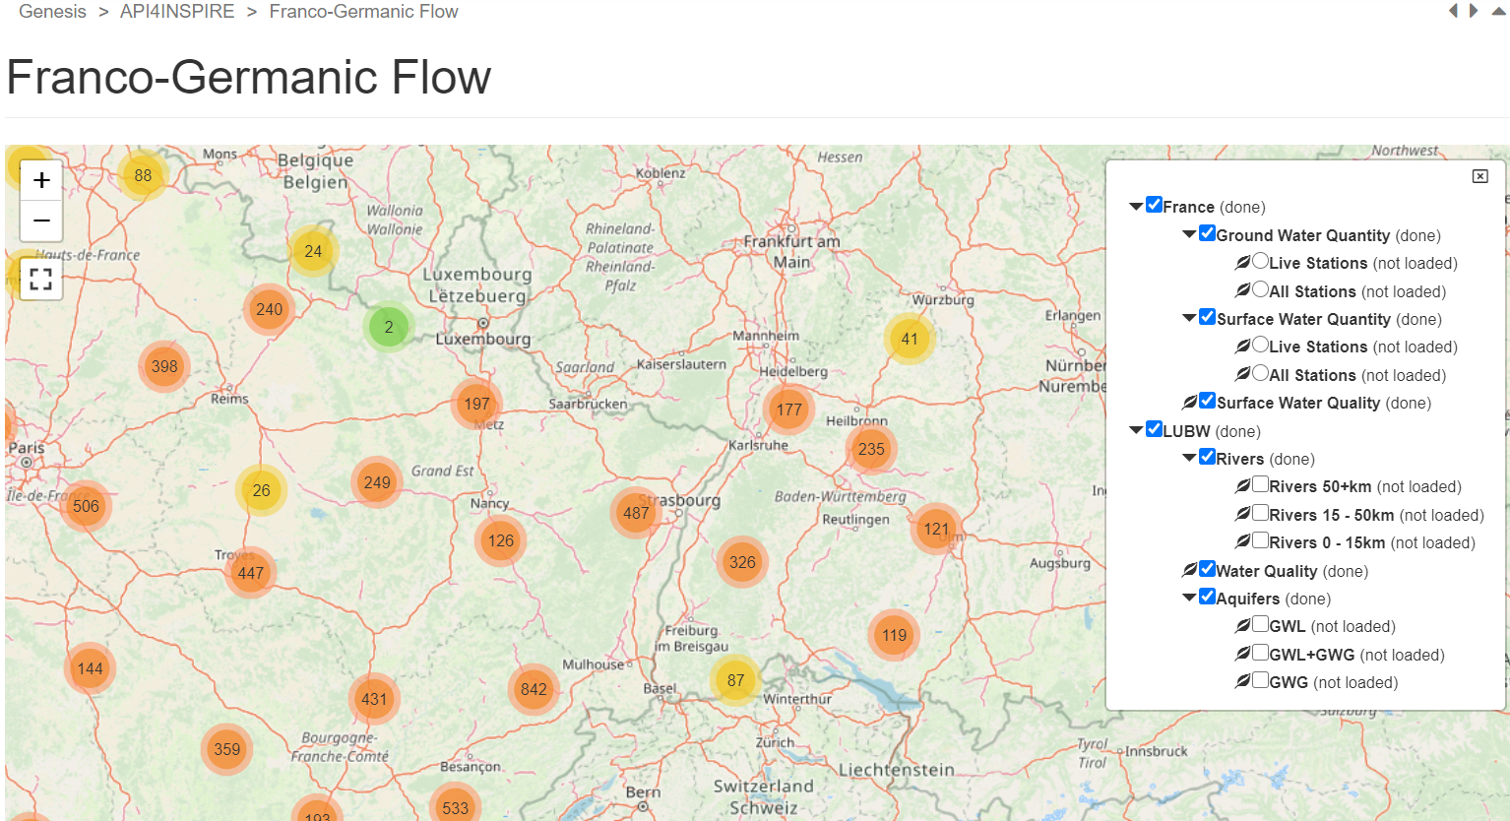
Test 2 – SensorThings API
3°/ Prototype demo

Slide 26
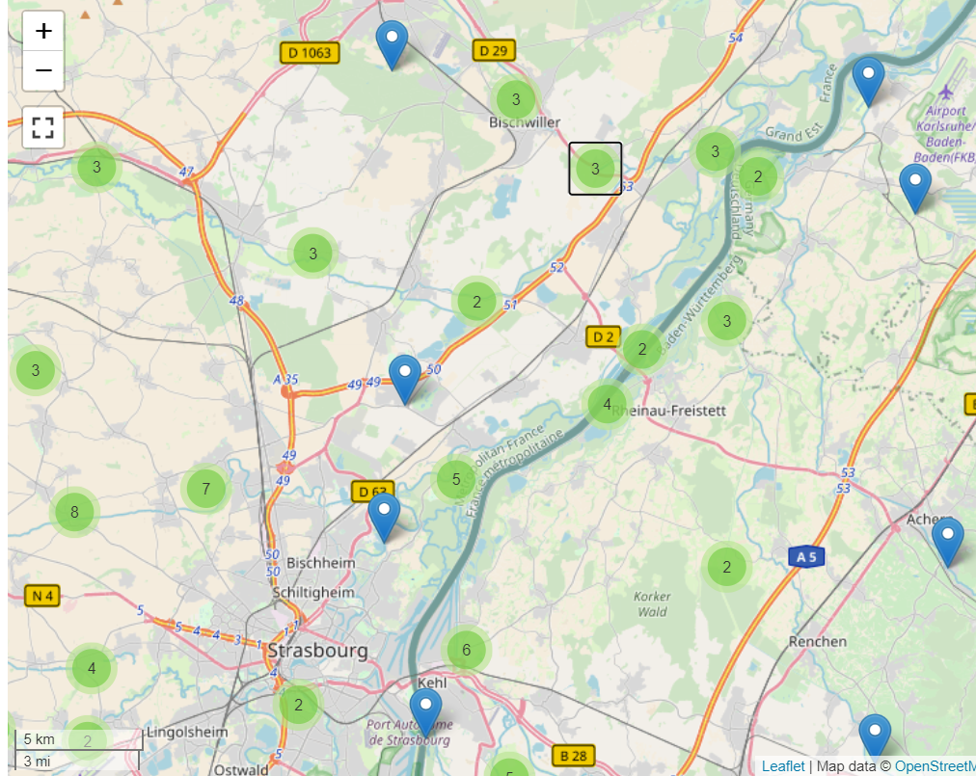
Test 2 – SensorThings API
3°/ Prototype demo
Focus on surface water quality stations

Slide 27
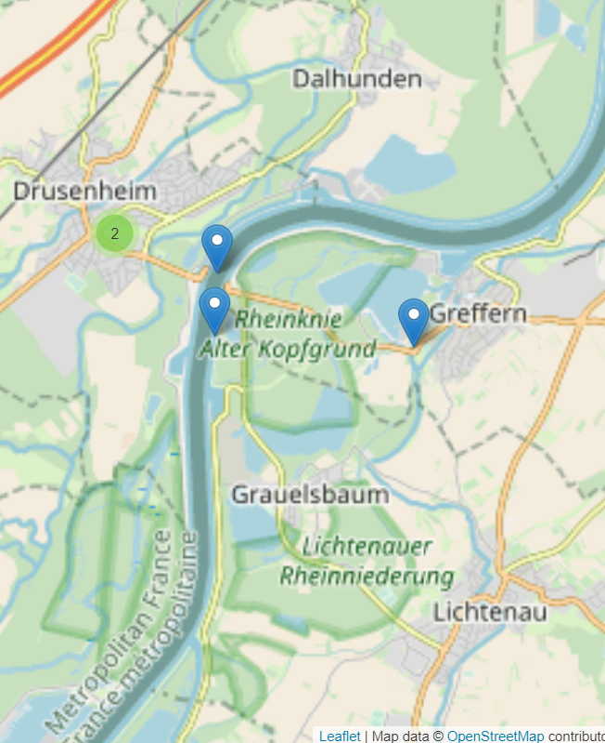
Test 2 – SensorThings API
3°/ Prototype demo
OFB : LE RHIN À DRUSENHEIM
LUBV : bei Grauelsbaum (XX317.00)

Slide 28
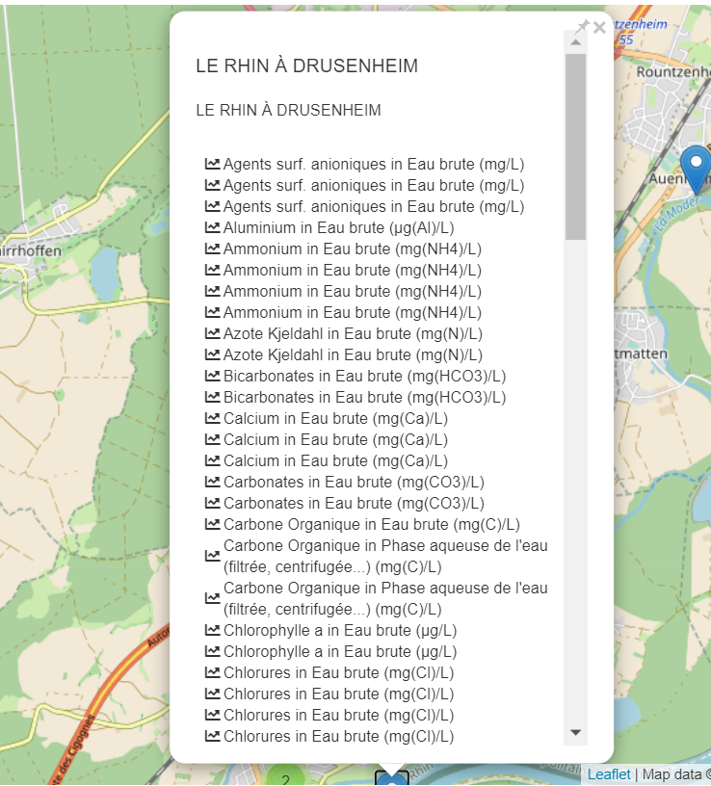
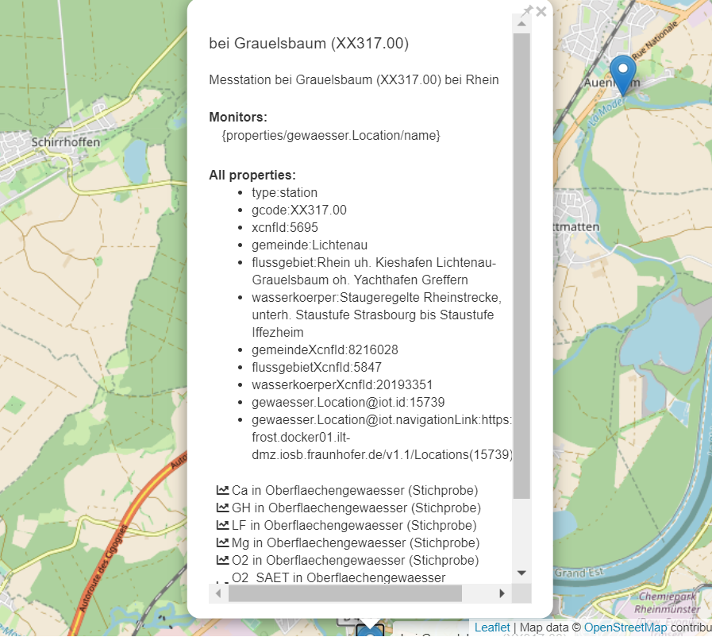
Test 2 – SensorThings API
3°/ Prototype demo
Not mapped yet,
would be the ideal next step

Slide 29
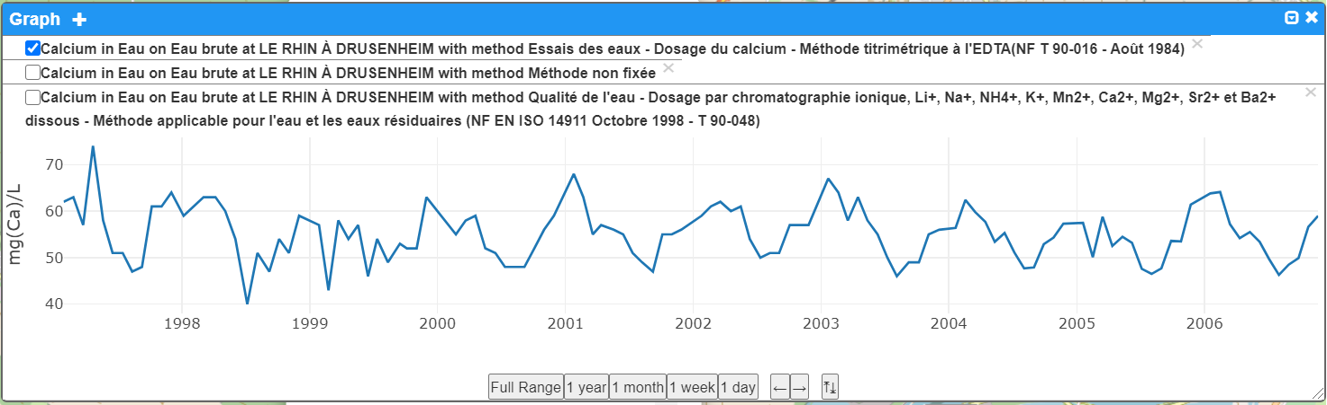
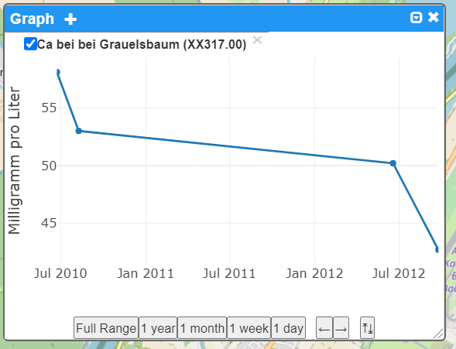
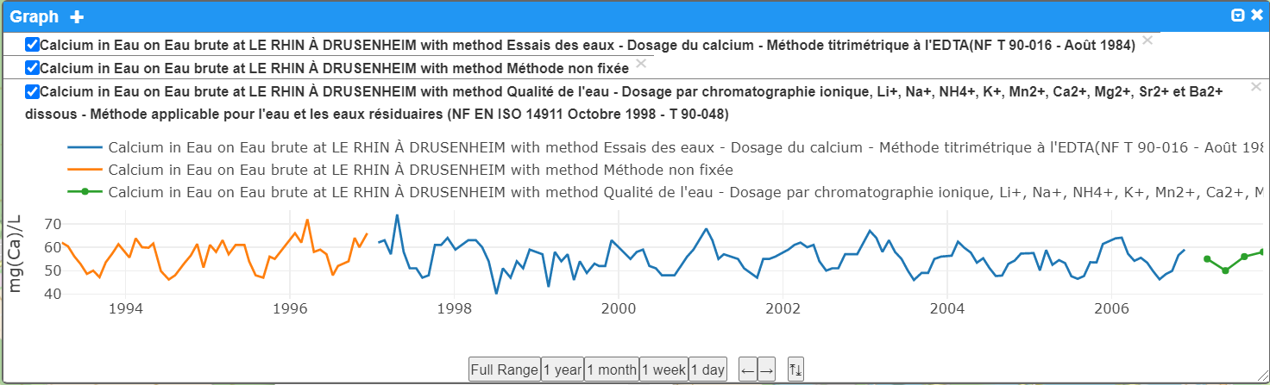
Test 2 – SensorThings API
3°/ Prototype demo
Observations regarding Calcium

Slide 30
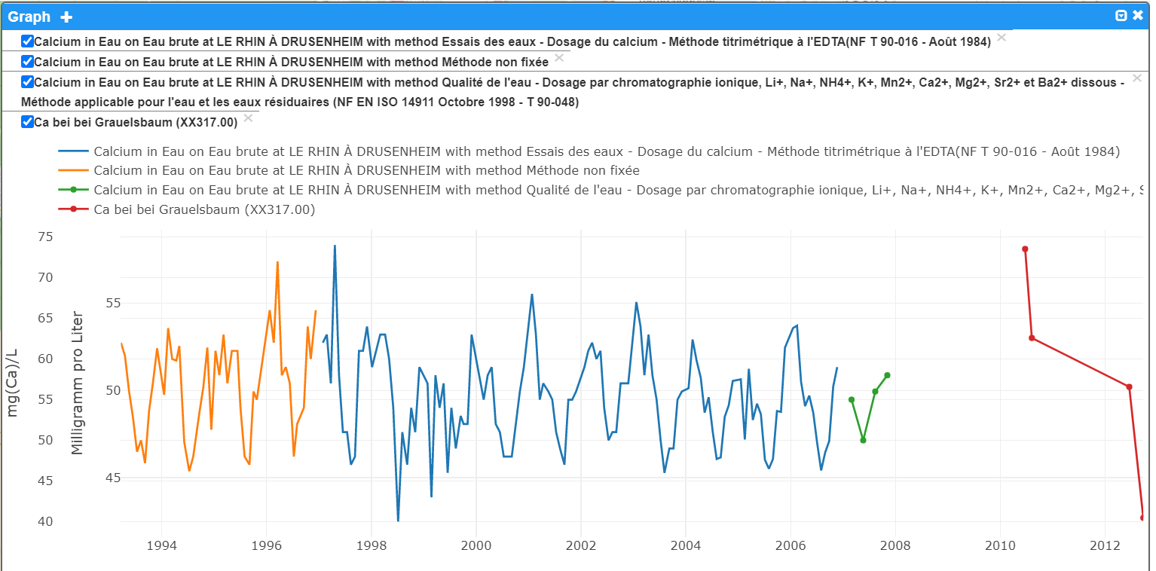
Test 2 – SensorThings API
3°/ Prototype demo
Observations regarding Calcium

Slide 31
Conclusions
Corner stone for success is in vocabularies !
Pattern arising using Observations & Measurements
From a domain point of view, water quality is more complex that automated river flow monitoring as it often involves (sub)sampling and a lot of related Observation
In GWML2 we defined a ‘pattern’ on aquifer/pump tests eventhough everything is in O&M (https://docs.ogc.org/is/19-013/19-013.html#toc49 )
We could achieve the same for WQ
Evolutions in Observations & Measurements (& samples ! ) V3 will help
Ex : on ultimateFOI / proximateFOI
Analysis

Slide 32
Conclusions
Importance of sharing communities taxonomies
Use of well-defined / shared controlled Vocab (codeLists) for Procedure, ObservedProperty etc…
We have the same context & endeavor here as many other organizations
How to we organize ourselves to trigger momentum ?
Map to each other ? to a reference point ?
At least let’s share some practices
This presentation is about SurfaceWater Quality
All this is also valid for GroundWater Quality
Analysis

Slide 33
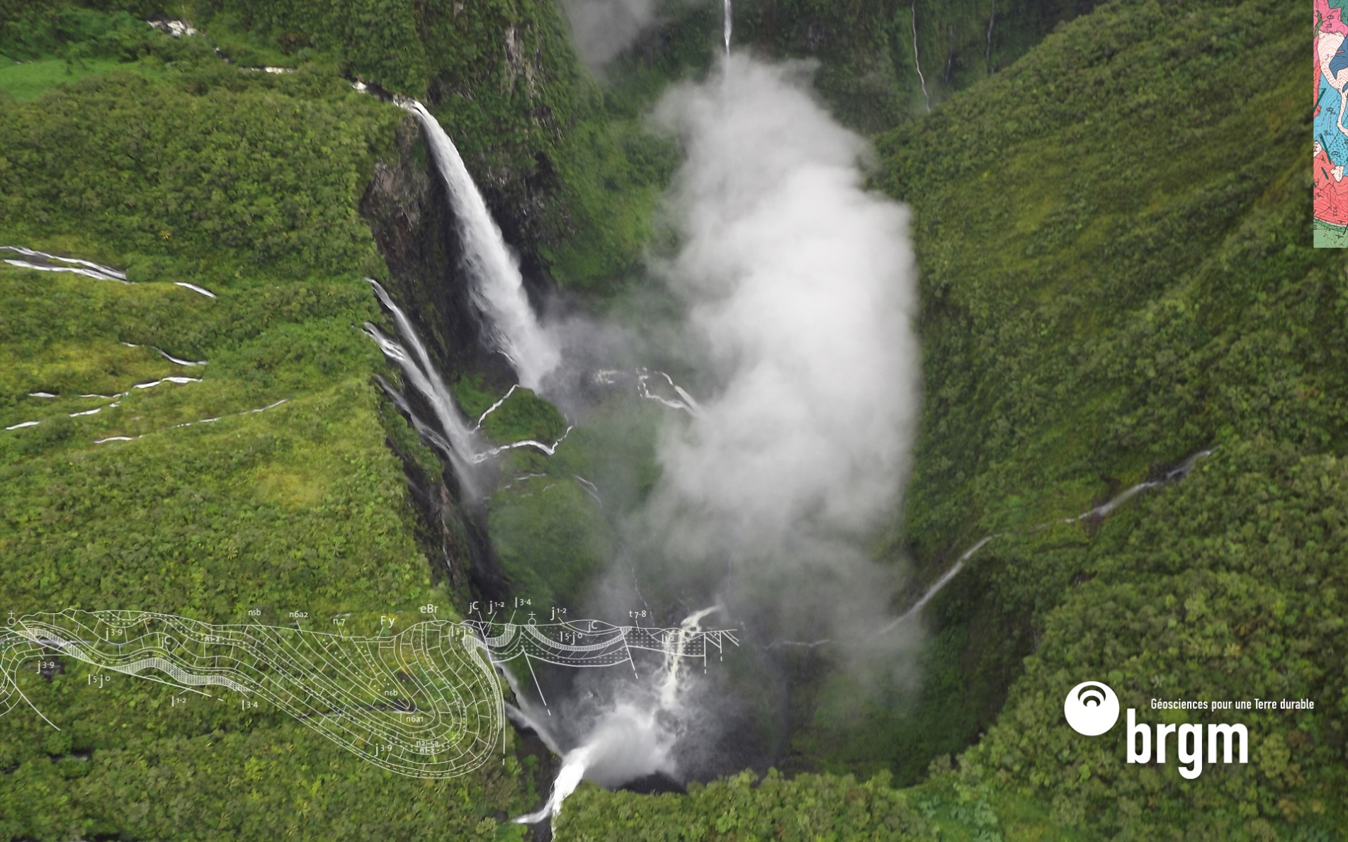
Thank you & thanks to
s.grellet@brgm.fr
a.feliachi@brgm.fr
h.bressan@brgm.fr
Kathi@DataCove.eu
hylke.vanderschaaf@iosb.fraunhofer.de

