Slide 1

Hydrology Domain Working Group web meeting, 17 March 2021
WMO long-term ambition
Water quality is known

Slide 2
PROVISIONAL AGENDA
Silvano Pecora (WMO) - WMO long-term ambition: "Water quality is known"
Philipp Saile (ICWRGC, GEMS/Water) - In-situ WQ sampling data sharing requirements and use cases
Steve Groom (Plymouth Marine Lab) - Standards/services and tools used by the remote sensing WQ community: the CERTO project
James Kreft (USGS) and Dwane Young (EPA) - US WQ data sharing requirements and use cases
Sylvain Grellet (BRGM / INSIDE - environmental information systems research center) - 2 tests to serve French surface water quality DB data : one using SemanticWeb technologies (see Ninth HydroDWG Workshop presentation) and one OGC SensorThings API
Bruce Simons (Federation University) - WQ best practice document overview and relationship to existing OGC standards
General discussion on the way forward/ next steps/ group of experts to progress...

Slide 3
WMO LONG-TERM AMBITIONS LONG-TERM FOR THE OPERATIONAL HYDROLOGICAL COMMUNITY
The Congress approved eight long-term ambitions that should guide the development of WMO activities relevant to water:
No one is surprised by a flood;
Everyone is prepared for drought;
Hydro-climate and meteorological data support the food security agenda;
High-quality data supports science;
Science provides a sound basis for operational hydrology;
We have a thorough knowledge of the water resources of our world;
Sustainable development is supported by information covering the full hydrological cycle;
Water quality is known.
Annex 1 to Resolution 5.3(1)/1 (Cg-18)

Slide 4
WATER QUALITY IS KNOWN
Surface and groundwater quality is permanently monitored as a necessary step to ensure its quality in accordance with different requirements for society and ecosystems and corrective actions are applied when necessary. A new partnership will be needed to support this goal, including existing links to the Global Environment Monitoring System-Water (GEMS-Water) (UN Environment Programme), the United Nations Educational, Scientific and Cultural Organization (UNESCO) and other relevant stakeholders.

Slide 5
The core principles necessary to achieve the long-term ambitions are:
(1) Hydrological data and products are a global public good
Free and unrestricted access to public and private high-quality hydrological data and products for all.
(2) Interoperability is key to improved services
Related disciplines, data, models, and risk management systems across all scales need to be interoperable and connected wherever it improves our analysis and optimization capabilities.
(3) Capabilities are catalysed through digital revolution
Using the full potential of the digital revolution to improve science and operations.
(4) Innovation and technology improve established systems
Benefitting from new sources of information
(5) Hydrological services are sustainable
Hydrological services are recognized as being of high priority and of public interest having clearly defined roles and responsibilities and sustainable financing.
(6) New actors are incorporated along the hydrological value chain from data to product/service

Slide 6
The conditions that need to be met/created to achieve the strategic goals are:
(1) The capabilities of national and regional entities need to be known
A comprehensive monitoring of capabilities needs to be agreed and put into routine operation.
(2) The value chains from hydrological data to products/services must be clear
The products and services needed must be defined at local, national and regional level and examples championed by WMO can serve as starting points to design the necessary links in the value chains.
(3) Capacity issues are expressed and addressed
Capacity gaps with regard to data and products are analysed and activities linked to developing the necessary value chains are harmonized with those linked to capacity building.
(4) Cooperation is wanted and supported
Cooperation must be focused and based on a common understanding so that entire system benefits equally.
(5) Policies reflect the fact that economic development is predicated on adequate hydrological infrastructure
The actions of national policymakers demonstrate that hydrological data and products are essential to economic prosperity and societal well-being.
(6) Free and unrestricted data policy is promoted among Members
(7) Users of water resources monitor and report the real usage of the resource

Slide 7
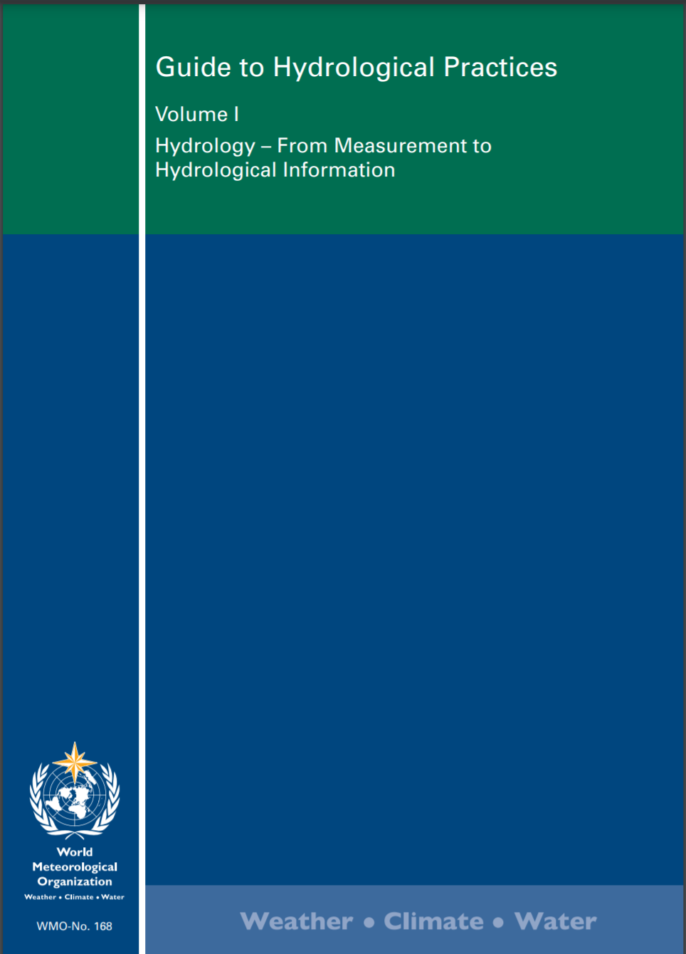
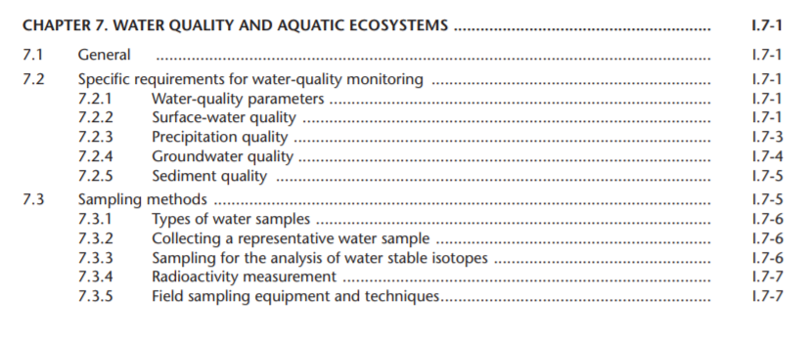
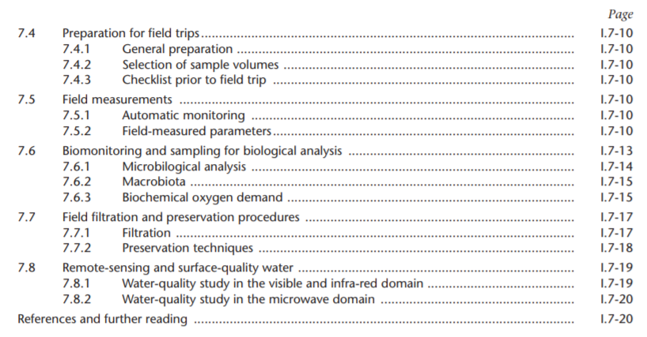

Slide 8
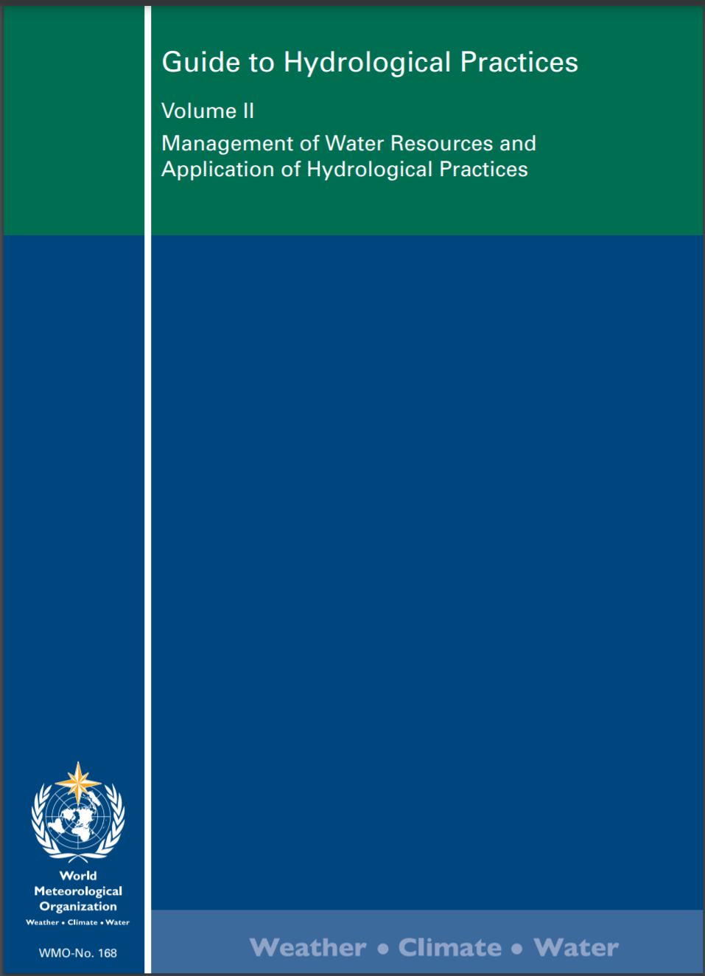
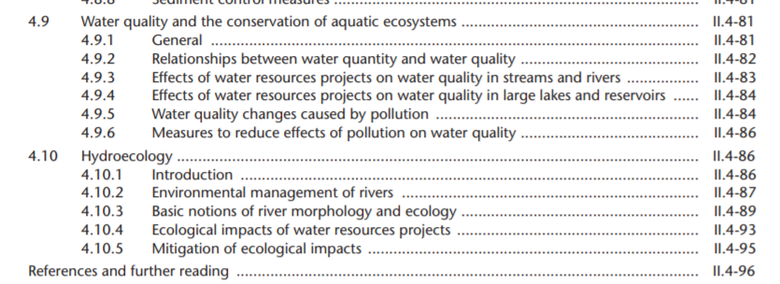

Slide 9
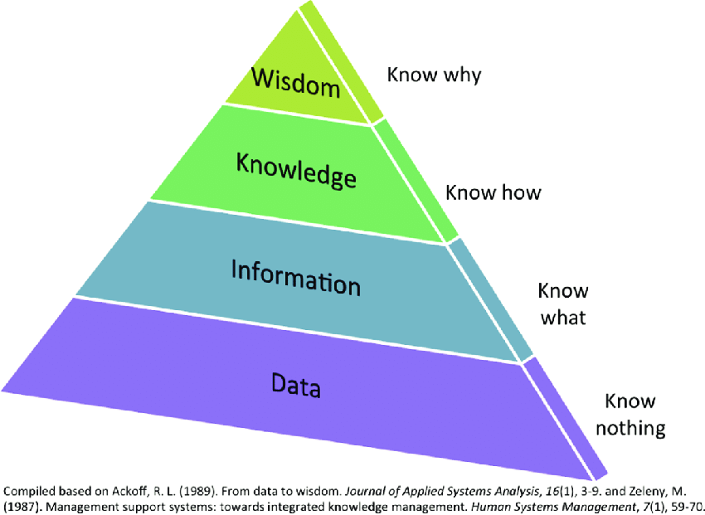
Model of knowledge evolution

Slide 10
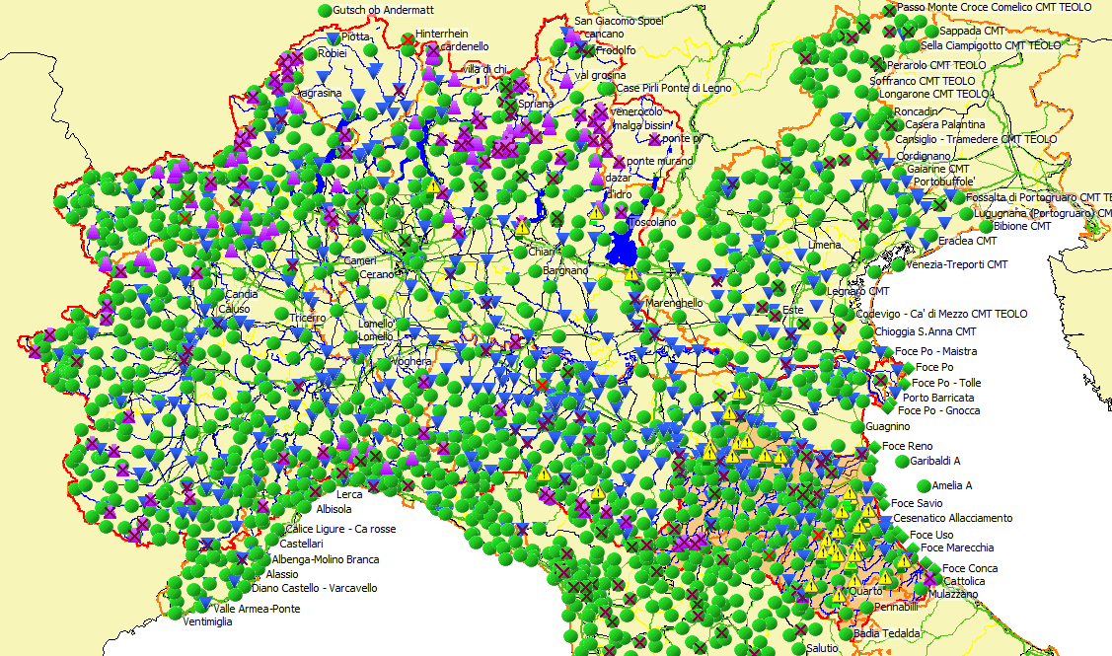
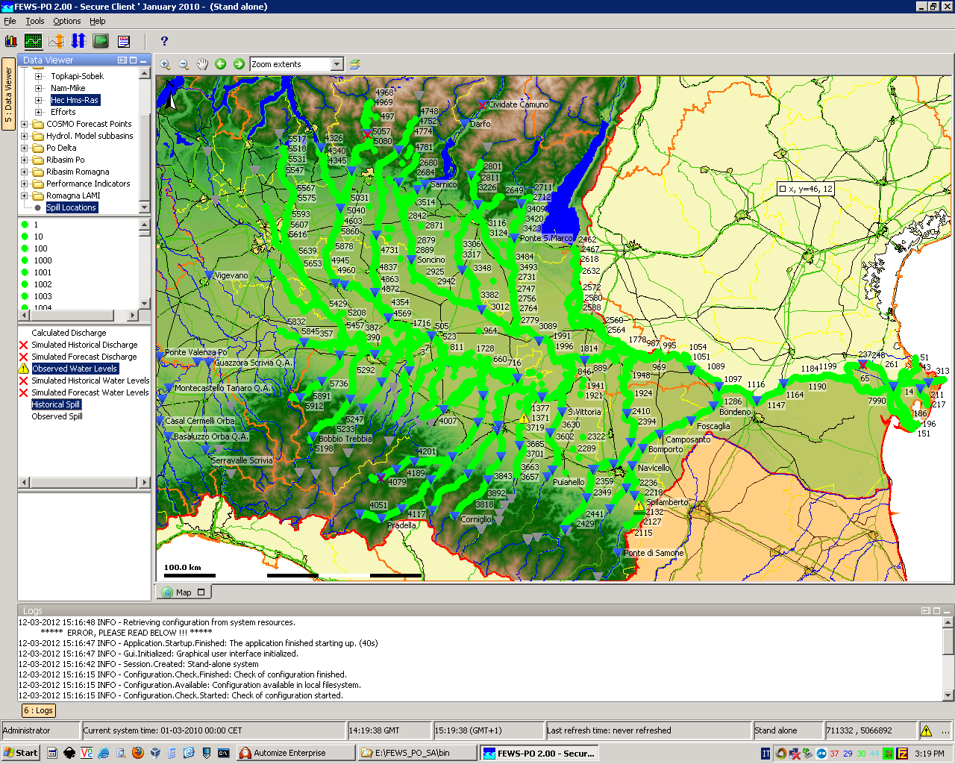
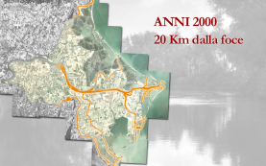
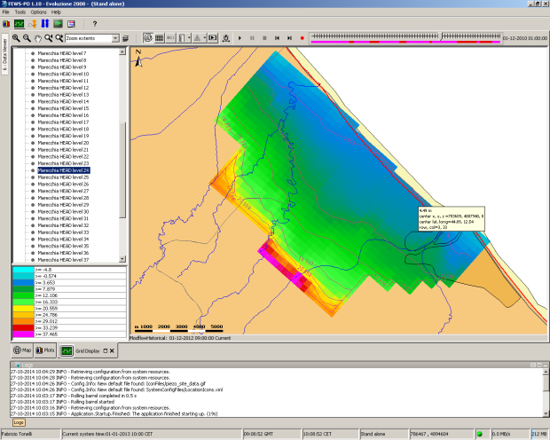
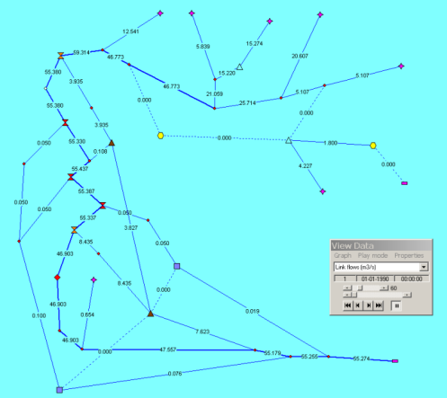
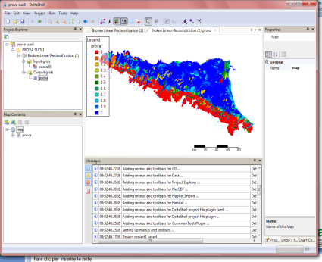
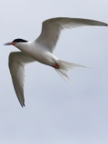
THE PO MODELLING SYSTEM
Flood
Drought
Oil spill
Salt intrusion
Groundwater
Water resources
Ecology
Habitat

Slide 11
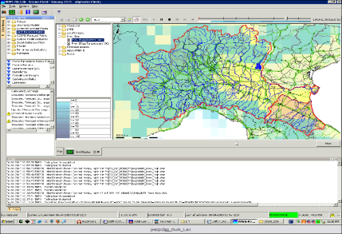
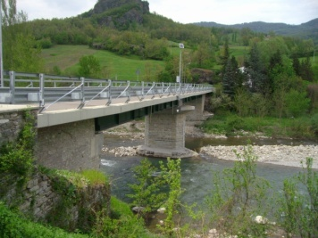
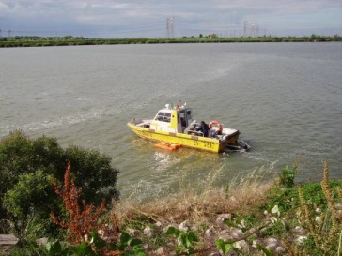
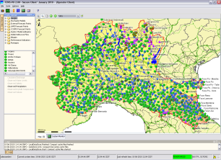
FLOOD EARLY WARNIG SYSTEM
MODELLI METEOROLOGICI
PRECIPITAZIONI
TEMPERATURA
LIVELLO/PORTATA
LM/Ensemble
Osservati/Telemisura
VALIDAZIONE, INTERPOLAZIONE
E TRASFORMAZIONE DATI
Prima catena
Seconda catena
Terza catena
Catena config dall’utente
HEC-HMS
MIKE11-NAM
TOPKAPI
HMS/NAM/TOPKAPI
HEC-RAS
MIKE11-HD
SOBEK/PAB
RAS/MIKE11/SOBEK/PAB

Slide 12



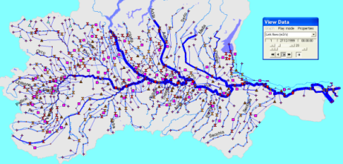
DROUGHT EARLY WARNING SYSTEM
PRECIPITAZIONI
TEMPERATURE
LIVELLI/PORTATE
VOLUMI/LIVELLI NEI SERBATOI
LIVELLI PIEZOMETRICI
MODELLI METEOROLOGICI
Osservati/Telemisura
Previsione+15 gg
Previsioni Stagionali
Scenari di Cambiamento Climatico
VALIDAZIONE, INTERPOLAZIONE
E TRASFORMAZIONE DATI
(DEWS drought early warning system)
Catena Idrologico/idraulica
TOPKAPI
Modello Idrologico
RIBASIM
Modello di bilancio idrico

Slide 13
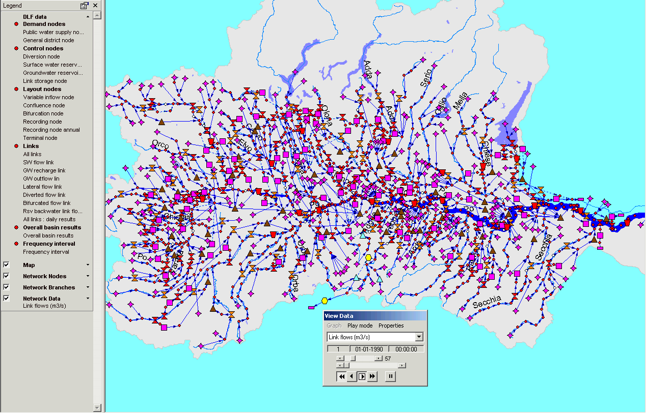
WATER RESOURCE MODELLING

Slide 14
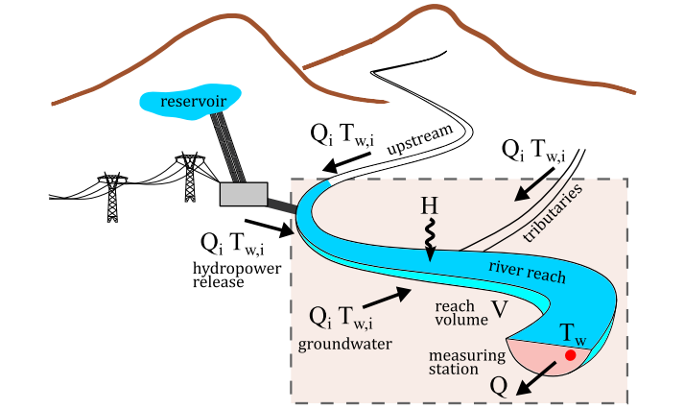
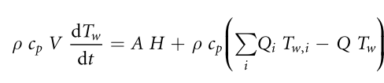




The Air2Stream model (S.Piccolroaz, M. Toffolon)
The model is based on a lumped heat budget eq.
Assuming that the heat flux H could be estimated trought a Taylor series with Ta as a proxy we obtain a simplified equation for H:
Adding continuity equation for the control volume yield to a 8 – parameter eq. :

Slide 15
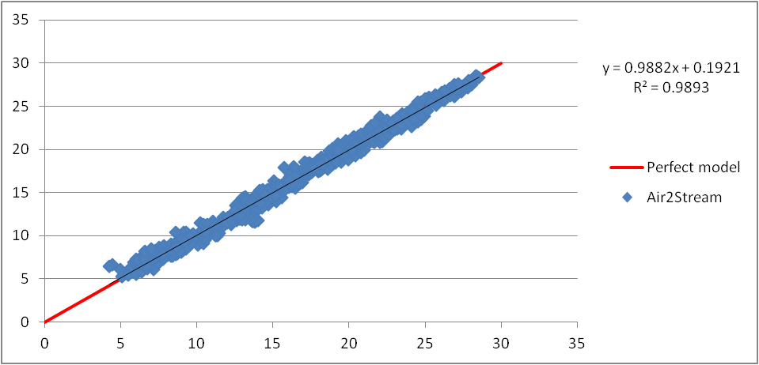
Air2Stream – Calibration

Slide 16
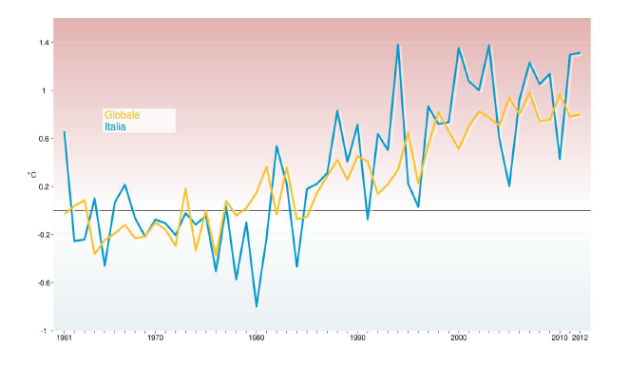
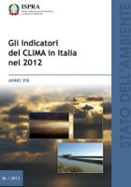
Climate change: Italy
Anomalies of global average temperature and in Italy in comparison with the period 1961-1990.
Source: NCDC/NOAA e ISPRA.

Slide 17
Trends evaluation of thermal regime of the Po river under CC scenarios

Slide 18
Trends evaluation of thermal regime of the Po river under CC scenarios
+8.6 °C / 100yrs
+3.1 °C / 100yrs
+4.3 °C / 100yrs
+1.4 °C / 100yrs

Slide 19
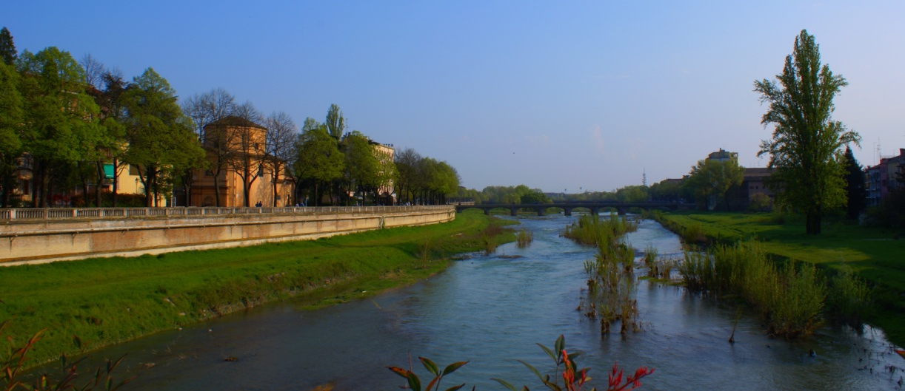
Water quality
The aim is to analyze the nutrient concentration evolution in the Parma river basin using numerical models.
Database of chemical – physical – morphological and hydrological parameters
Analysis of diffuse and point sources in the basin.
Parameters considered:
Nitrogen
Phosphorus
These parameters are fundamental for life and their biogeochemical cycle has been deeply compromised by anthropogenic actions that in very high values can lead to eutrophication.

Slide 20
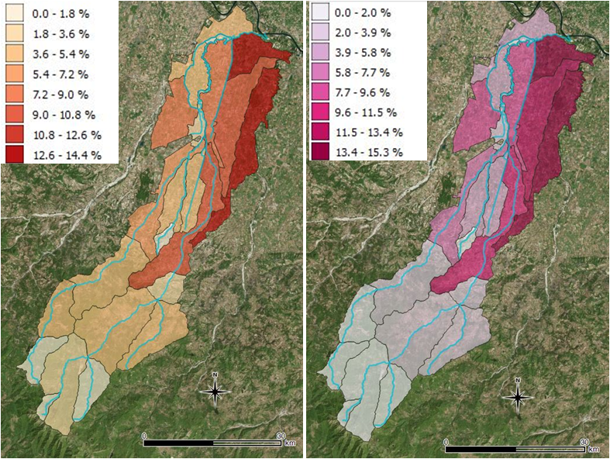
Water quality
Nitrogen
Phosphorus
The different colors represent the percentage contribution of every sub – basin over the total nitrogen and phosphorus load, calculated with NANI and NAPI.
The figures show an increased of human influence moving from the highest part of the basin to the lowest one.

Slide 21
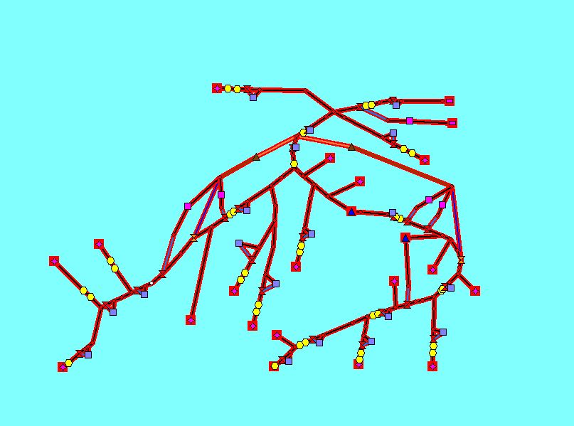

Water quality
Ribasim DELWAQ model is a component of Ribasim model that allows to evaluate the spread of pollutants in the basin. It is used to evaluate the trend of N and P into the system, therefore it allows to distribute the N-P loads over the fields. Relating the rainfall and discharges with the pollutant load, it’s possible to define the water quality.
AIR: Advanced IRrigation node
Pws: Public Water Supply node
IND_Pws: INDustry Pws node

Slide 22
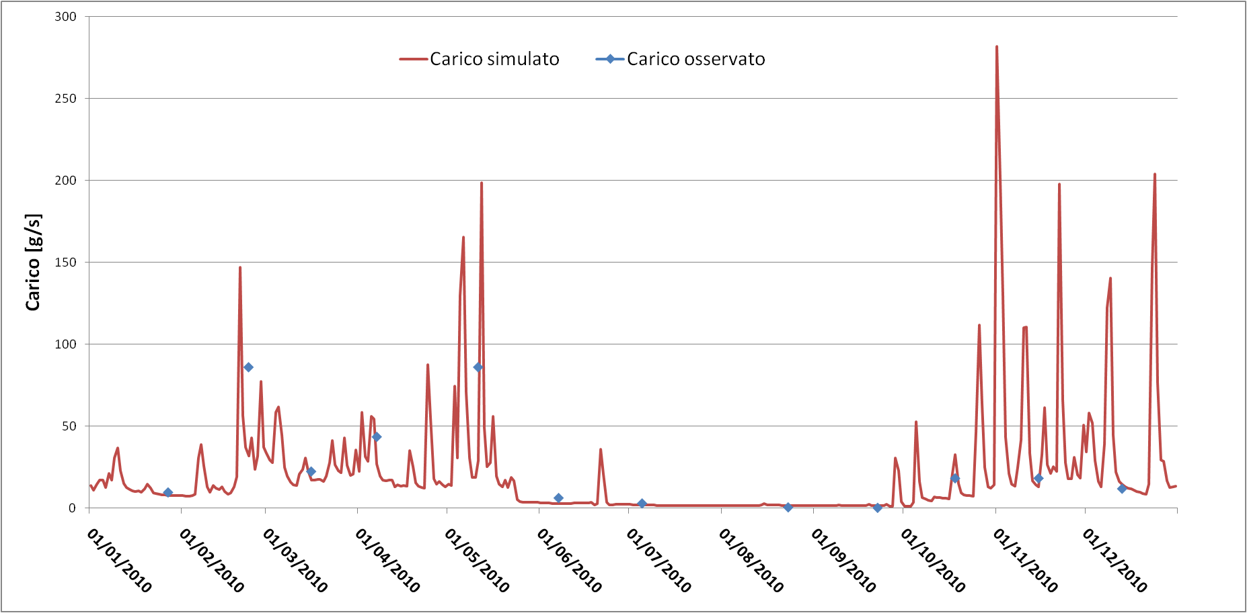
Observed data – Simulated data
Nitrogen load at Ponte Dattaro (Parma river), year 2010
Simulated load
Observed load
Load

Slide 23
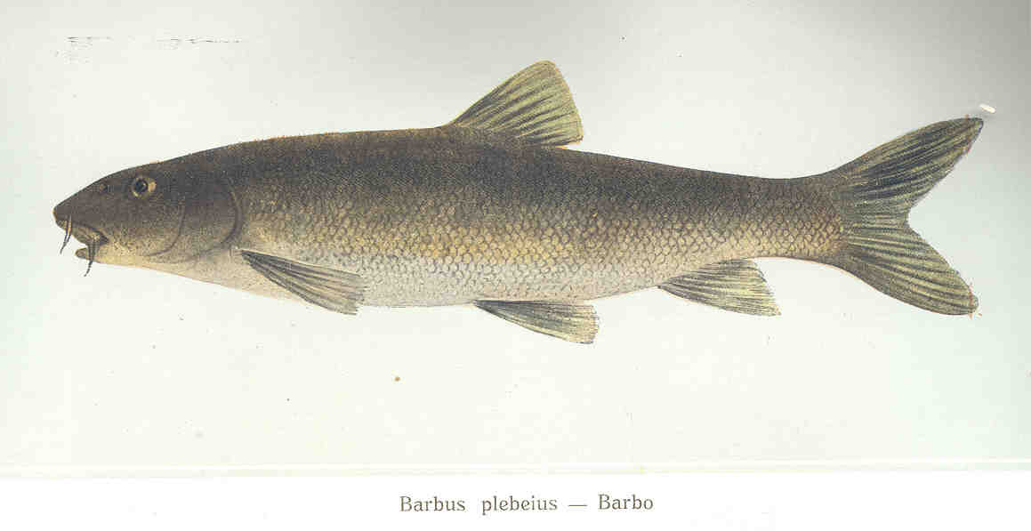
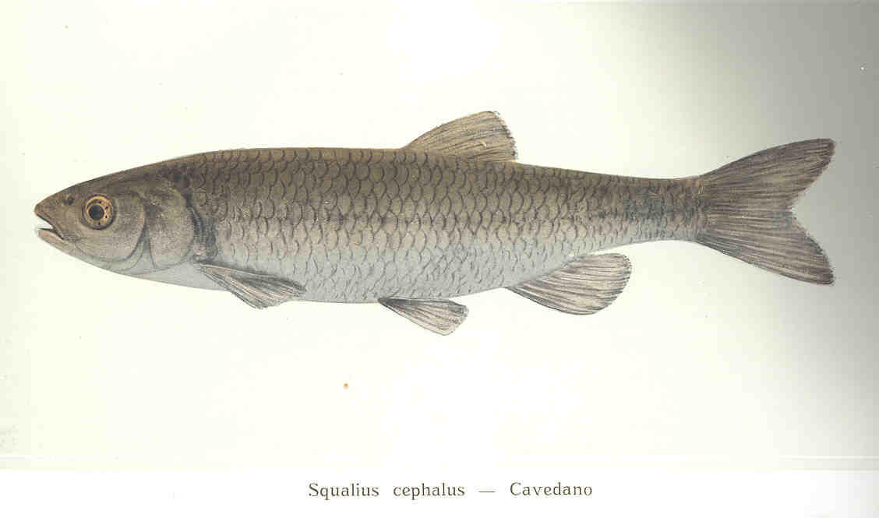
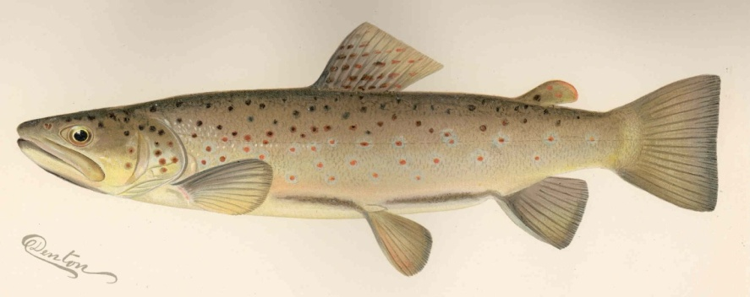
Habitat
The objective is to evaluate the variation of suitability of the habitat, in a portion of the Parma river basin, for the adult life stage of three different fish species.
Barbus plebejus
The data used are:
simulated stream flow series for the period 2000-2016
simulated stream flow series for the period 2017-2100
Weighted Usable Area (WUA) curves
Leuciscus cephalus
Salmo trutta
N.B.: the only discriminating factor considered is the STREAM FLOW

Slide 24
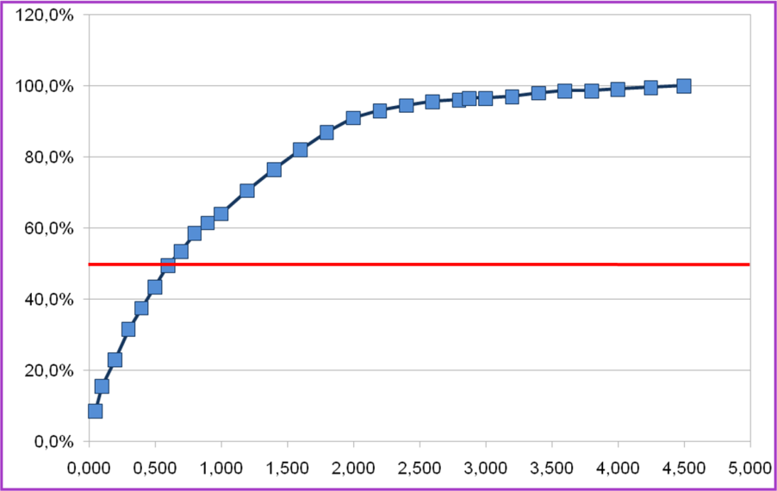
Habitat
Hypothesis:
It is possible to find a suitable habitat, from an hydraulic point of view, when the
WUA is greater than 50%.
The WUA curves show the habitat suitability for the target species, considering the discharge variations.
WUA
50%
m³s⁻¹
In order to compare the observed period (2000-2016) with the future period (2017-2100), the last one has been divided into five sub-periods with a similar timeframe.

Slide 25
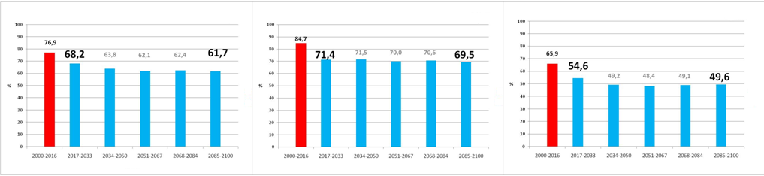
Habitat
The difference between the habitat suitability of the observed period and the future period tends to decrease moving from the highest part of the basin to the lowest one, which seems to be slightly influenced by climate change.
Barbus plebejus
Leuciscus cephalus
Salmo trutta
Observed period
Future period
These graphs show a general decrease of the habitat suitability, characterized by different trends for each sub-period.

Slide 26
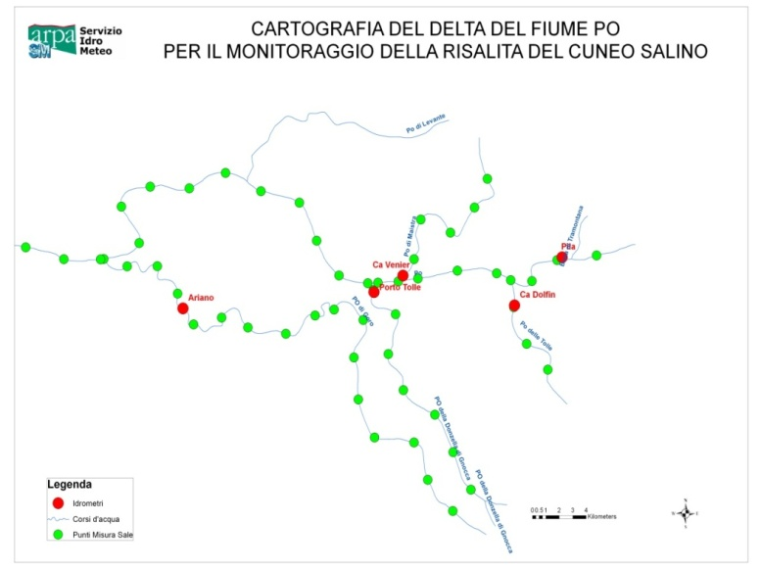
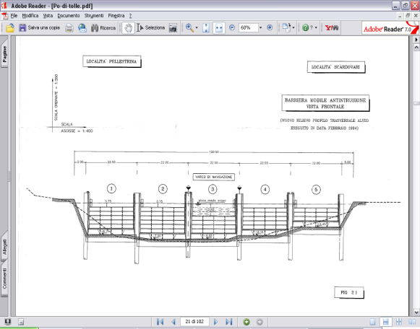
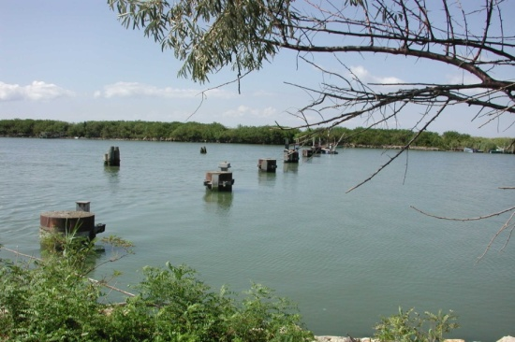
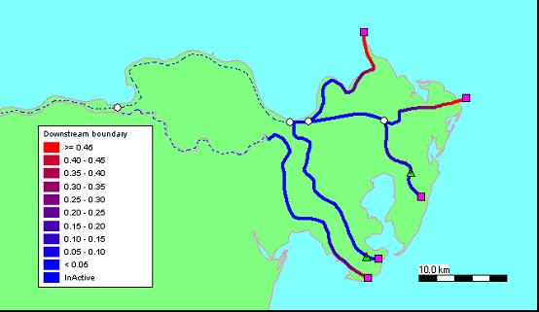
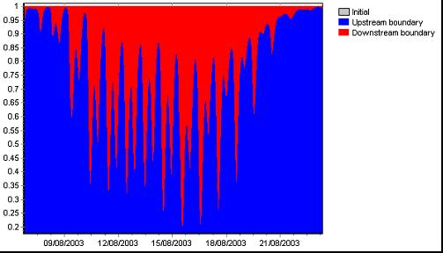
Salt Intrusion
percentuale di acqua dolce e acqua salata nel tempo in una sezione

Slide 27
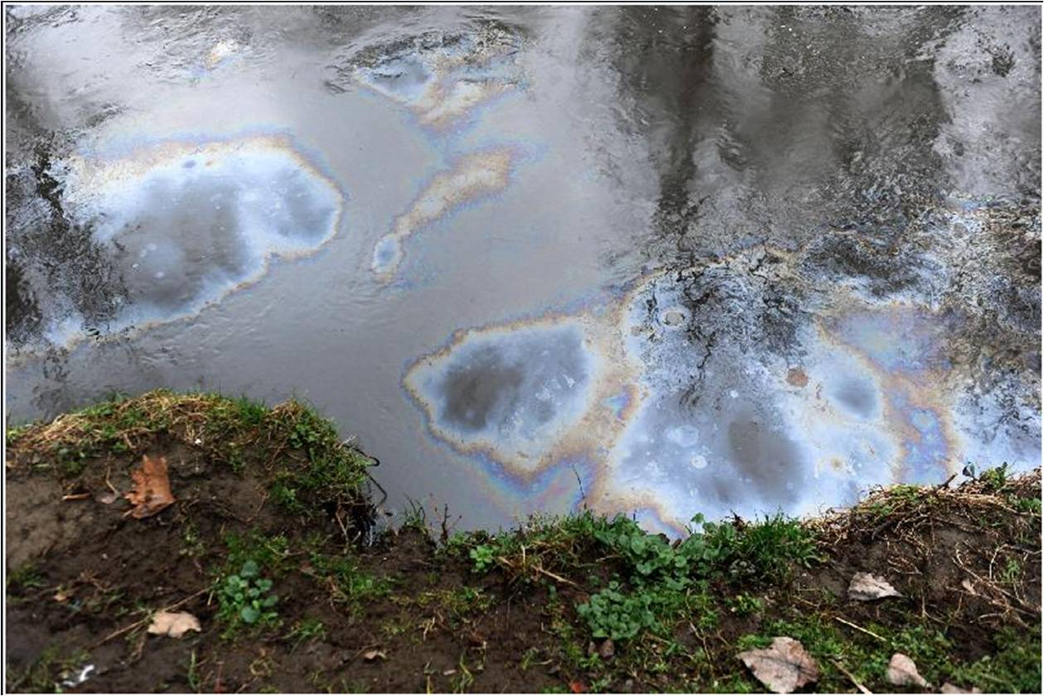
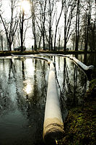
Modellistica trasporto: propagazione dello sversamento di idrocarburi nel fiume Lambro
ll disastro ebbe origine alle 3.30 della notte tra lunedì 22 e martedì 23 febbraio 2010, quando degli ignoti sabotatori entrarono nella "Lombarda Petroli” e svuotarono dolosamente il contenuto di sette "silos" carichi di petrolio per abitazioni e vari tipi di idrocarburi, il tutto pari a circa 2,5 milioni di litri (pari a circa 170 autocisterne).

Slide 28
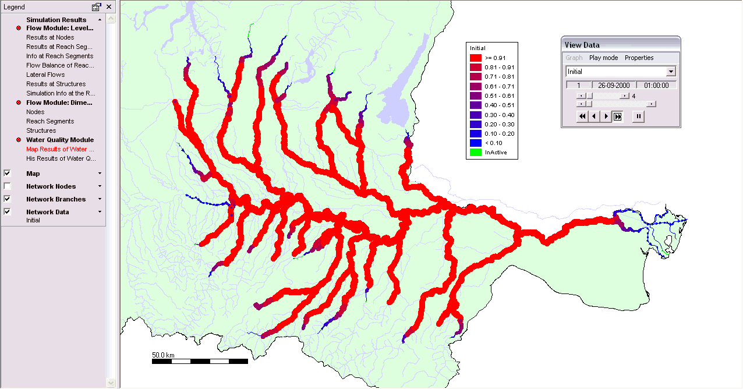
WATER QUALITY MODELLING

Slide 29
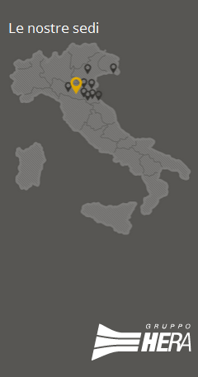
SAMPLING

Slide 30
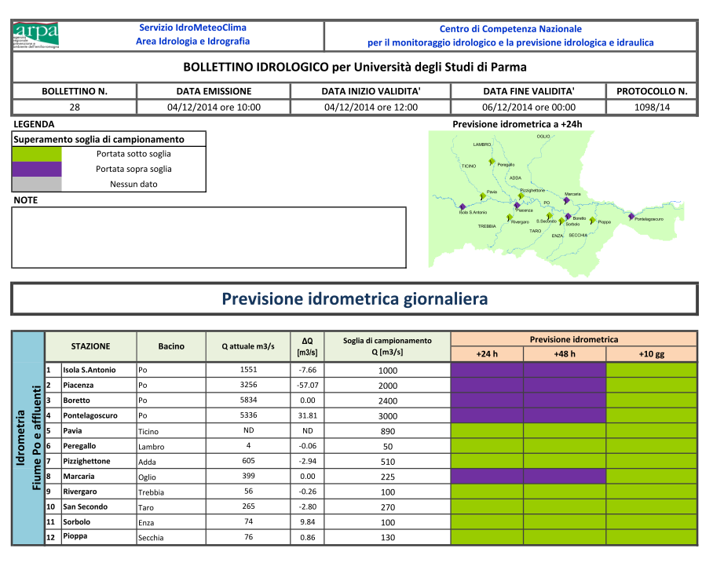
BULLETIN FOR WATER QUALITY SAMPLING

Slide 31
SAMPLING DURING A FLOOD EVENT
Peak
Rising
Recession

Slide 32
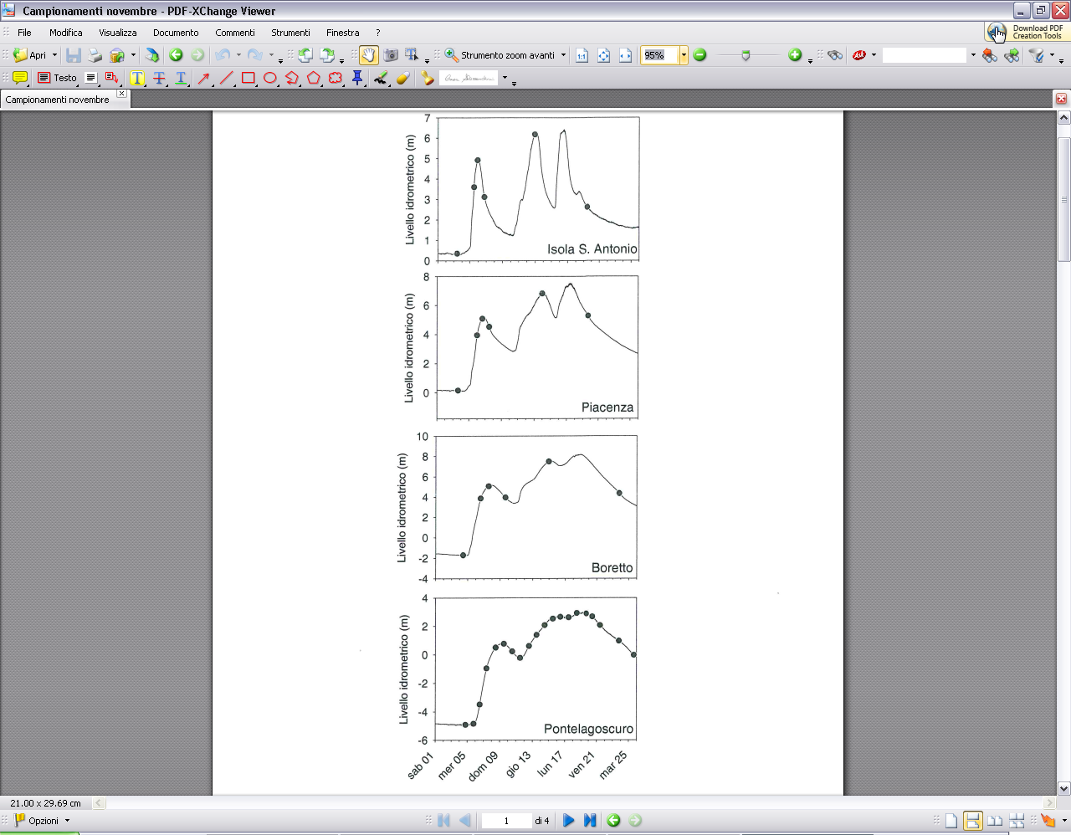
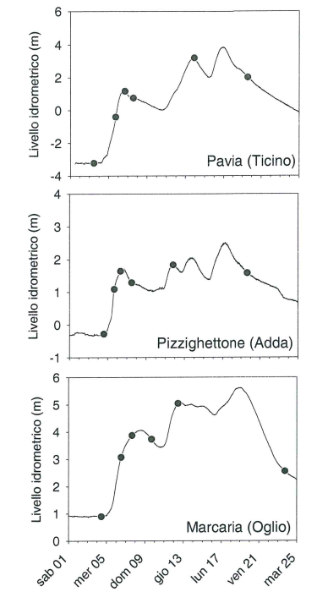
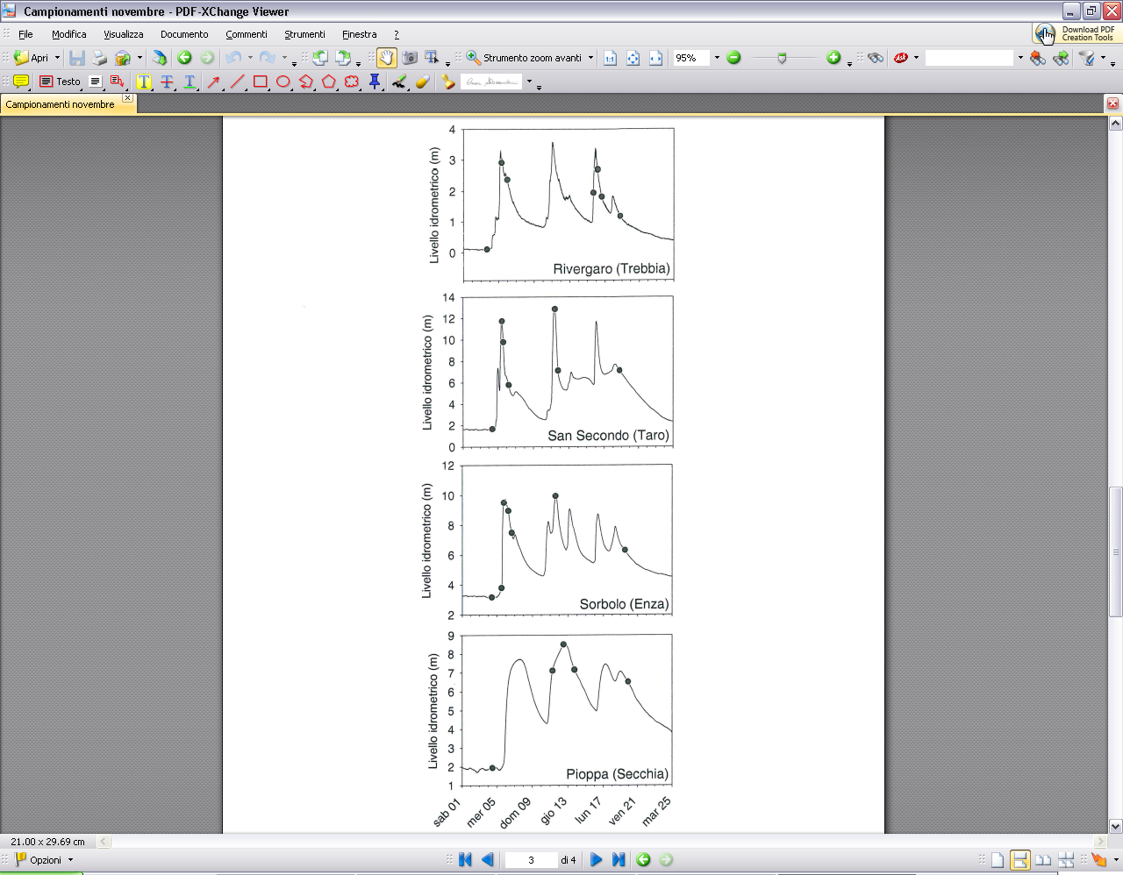
A DYNAMIC GUIDED SAMPLING

Slide 33
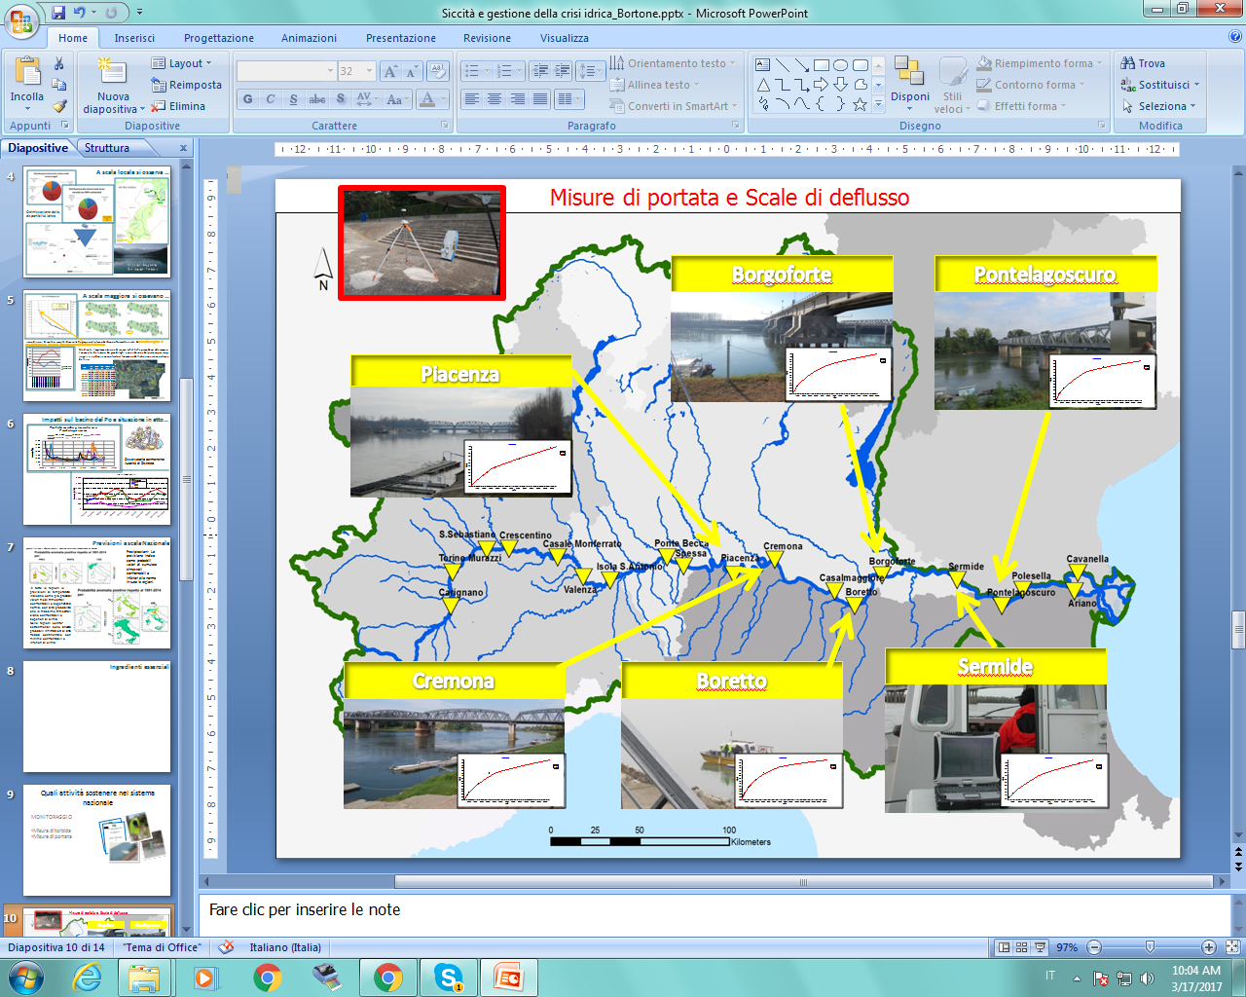
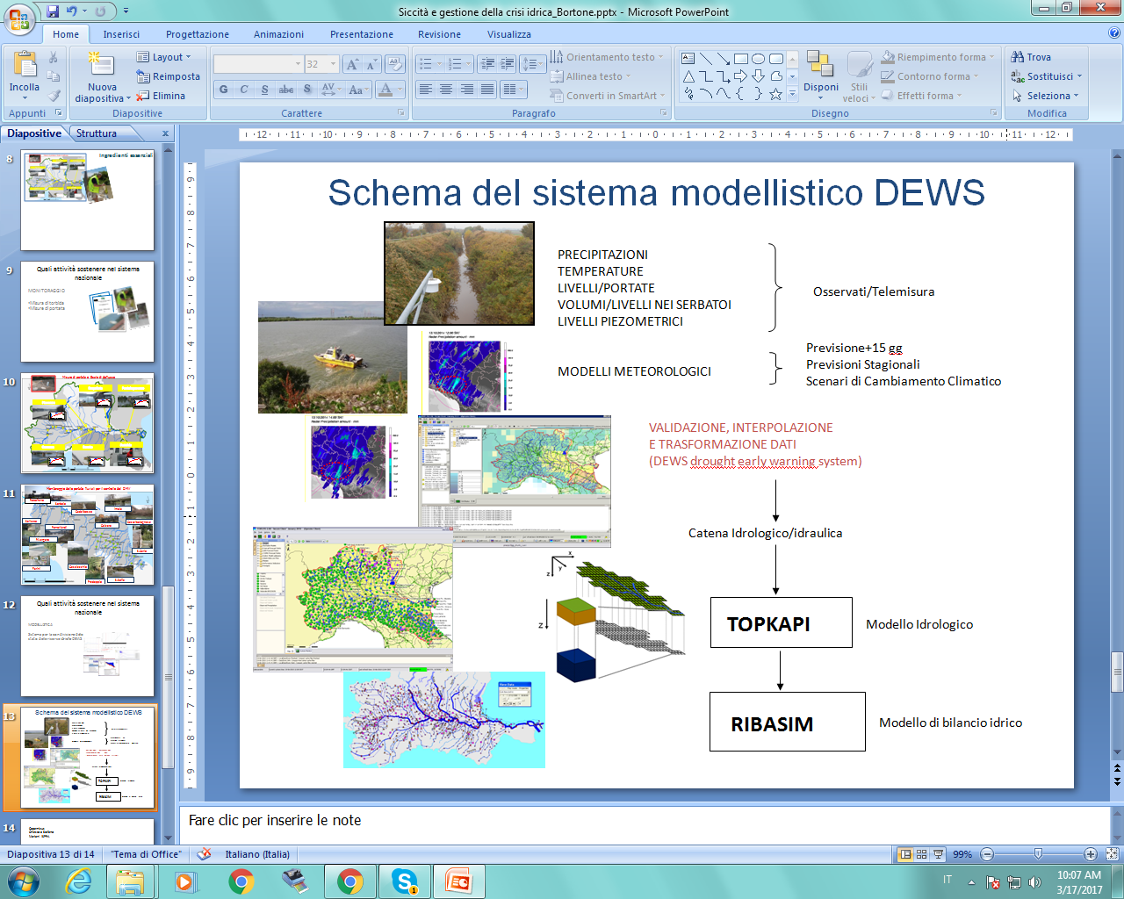
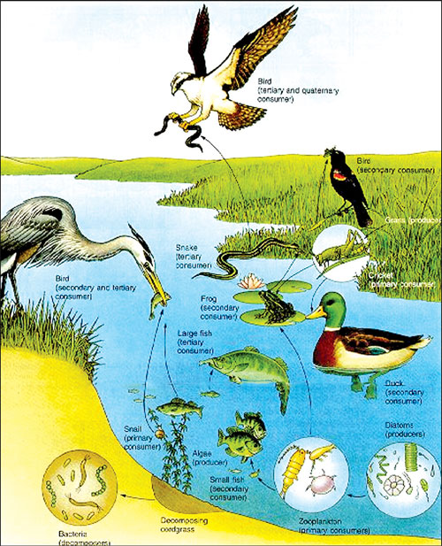
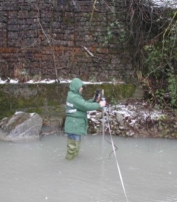





OPERATIONAL MONITORING AND MODELLING
MONITORING
E-FLOW
MODELLING

Slide 34

Thank you

