Slide 1
Water Quality Data Sharing
U.S. EPA’s Water Quality Exchange
Dwane Young, U.S. EPA Office of Water

Slide 2
Outline
Thinking about data and information
WQX History and Data Model
Data sharing through the Water Quality Portal
Future data sharing opportunities through the use of sensors

Slide 3
Thinking About Data and Information
Electronic data are more valuable than data in file cabinets
The more data are re-used, the more valuable they become
Collect once – use multiple times
Shared data are of even higher value
Provide for better planning decisions
Incentivize collaborative efforts
Make the most use of the data collection resources being invested

Slide 4
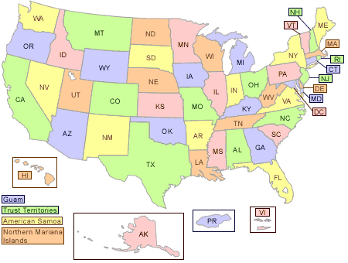
Managing Data Locally
Data sharing at a national level benefits from:
Well documented data at a local level
Well managed data at a local level

Slide 5
What is WQX?
WQX is a ‘standards’ based approach for sharing water quality monitoring data
WQX defines a common data model for communicating water quality data (sample data)
Designed to be automated
The structure of partner data systems don’t matter, so long as they can map to WQX
WQX also provides a standard format for publishing data

Slide 6
Some history on how EPA got here
From 1998-2007, EPA provided a distributed database (STORET) for partners to use to manage their data; partners could then send a ‘copy’ of their database to EPA
Numerous issues:
Partners didn’t buy-in to using the EPA database
“Keeping up with technology” was exceptionally difficult
Trying to build one system that met everybody’s needs resulted in an overly complex system

Slide 7
Why use a standards-based approach?
WQX is not dependent on a particular technology
The data sharing model is based on the science of water quality monitoring, which doesn’t change that much
Partners don’t need to run EPA’s software, but rather just need to map their data systems to WQX
EPA could focus on the ‘core’ data elements that were needed for someone to communicate water quality monitoring data

Slide 8
WQX Tells a story about water quality monitoring
WQX captures the following information:
Who: Who’s conducting the sample
What: What did they sample
When: What time of year or day was the sample taken
Where: Where was the sample taken
Why: What was the purpose of the monitoring
How: How was the sample collected, how was the sample analyzed
All of this information provides context for a value (i.e. 12 mg/l)

Slide 9
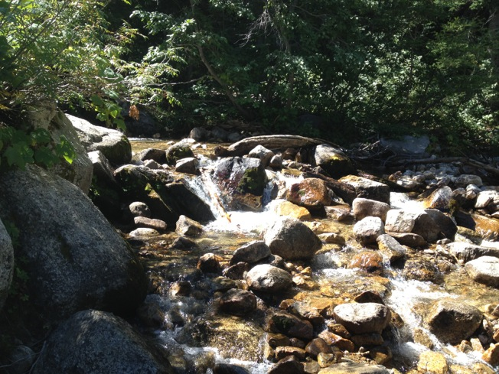
Who and Why
Who:
We use the term ‘Organization’ to define the ‘Who’ piece of our metadata, some examples
Other Federal Agencies
State environmental agencies
Tribal agencies
Citizen groups
Why:
We use the term ‘Project’ to define the ‘Why’ of our metadata
Explains the purpose of the monitoring, and may include other relevant information like the overall QA/QC process that the Organization follows

Slide 10
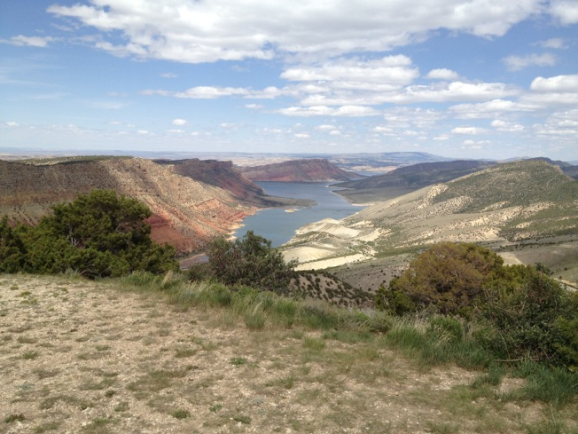
Where and What
Where:
We use the term ‘Monitoring Location’ to define the ‘Where’
This is where the sample was taken, and usually contains latitude and longitude coordinates
Also describes what type of water is being monitored
What:
We use the term ‘Characteristic’ to define the ‘What’
This very generic term can mean any analyte (i.e. NH3 or Dissolved Oxygen) or even a stream characteristic (i.e. stream width)

Slide 11
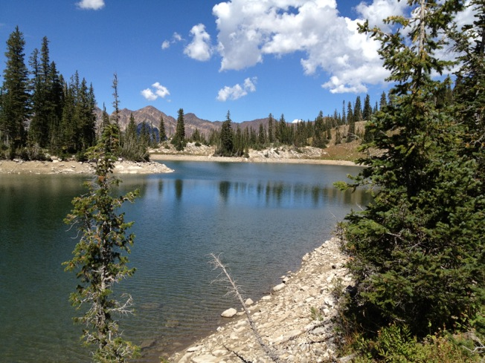
When and How
When:
We use the term ‘Activity Start Date’ and ‘Time’ to define the ‘When’
How:
We have two pieces for the ‘How’:
Field Collection Method: What method was used in the field to collect the sample or to derive the value that is reported in the field (i.e. Dissolved Oxygen Sensor)
Lab Analytical Method: What method was used in the lab to derive the concentration of the characteristic
The ‘How’ is critical to helping others know how your data can be used

Slide 12
WQX Data model
ORGANIZATION
ORG Description
ORG Electronic Address
ORG Phone
ORG Address
ACTIVITY GROUP
Activity Group Name
Activity Group Type
Activity IDs
PROJECT
Project Description
Project Binary Object
MONITORING LOCATION
Monitoring Location Identity
Monitoring Location Geospatial
Monitoring Location Binary Object
MONITORING ACTIVITY
Activity Description
Activity Location
Sample Description
Sample Prep
Subsample Description
Activity Binary Object
RESULT
Result Description
Result Binary Object
Result Analytical Method
Result Lab Info
Result Detection Quantitation Level
Lab Sample Prep

Slide 13
WQX Schema
A definition of the structure and format that data must have to be submitted through WQX.
Common set of data elements that everyone uses when submitting data
Primary components: Organization, Project, Monitoring Location, Monitoring Activity, Samples, and Results
Database independent – xml can be created out of any type of database

Slide 14
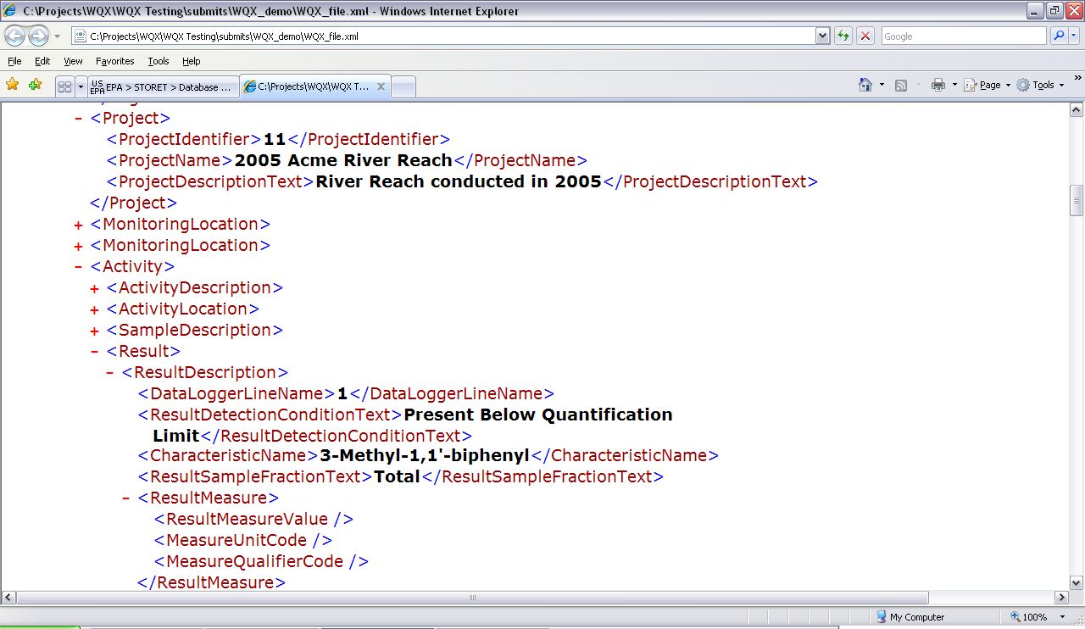
XML in a Nutshell
eXtensible Markup Language
An “XML Document” contains the Data
An “XML Schema” defines the Structure and the Rules of the data
The WQX schema is the computer definition of the Structure and Rules for WQX data
Notes:
14

Slide 15
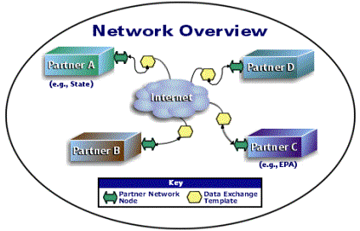
What is the Exchange Network?
Principles:
Each partner manages their own data, and is the steward for data they originate.
The Network “doesn't care” how a partner manages and stores information.
Partners who need to store copies of data locally are responsible for the design, format, and maintenance of the copy they create.
Network partners agree to use adopted technology and data standards.
HTTP servers using SOAP messaging and a common WSDL to enable synchronous and asynchronous blah-blah, blah-blah...
A common approach to sharing data that lets you use your partners’ data as if it is a part of your own systems.
An Internet and standards-based method for
exchanging environmental information between partners.
Notes:
Comments from the NH Node folks:
For the positive,
· Provides a single data standard for trading data, allowing for the easy transfer of data between exchange network partners
· Provides a simple and consistent method of submitting data to the EPA or data trading partners.
· Provides a formal agreement between data trading partners via “Trading Partner Agreement.
For Con
· The Network is fairly new and as a result data flows are constantly being updated
· The current generation vendor built network Nodes have difficulty adding new data flows (an issue that is being address in the forth coming Node 2.0)

Slide 16
What is a web service
Internet (XML)
Computer-to-computer
Uses Input parameters and outputs XML
Can be used in multiple ways by many applications

Slide 17

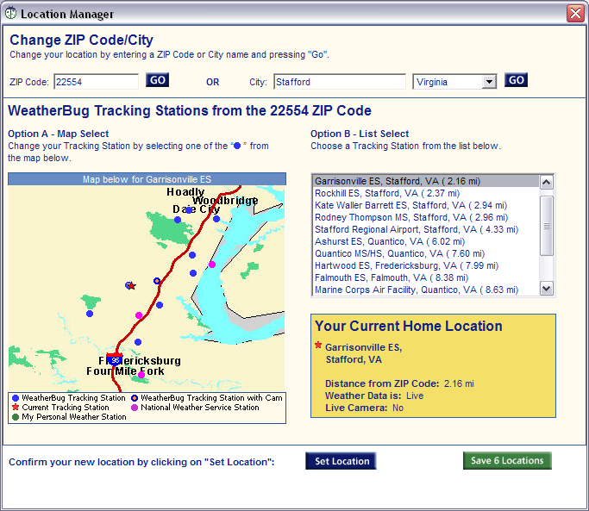
Web Service Example
Weather Network
Weatherbug is an example that many are familiar with
This is all done via a Web Service
Returns XML
Weatherbug translates XML into information for the task bar
Input Parameter: Zip Code

Slide 18
How wqx works
Approved XML
Submission
XML Submission
CDX
WQX
Parse and
Load Software
Schema Validation
Receive Error Responses
Data Context Error Report
Data Load Confirmation and Summary
Data Submitter
WQX
ODS

Slide 19



The role of WQX in Data Sharing
ARS
STEWARDS
Partner Data
Water Quality Portal
WQX
Exchange Network
EPA STORET
WQX
Web
USGS NWIS
For more information on the portal see: www.waterqualitydata.us
Notes:
The water quality data portal (an EPA/USGS partnership) provides access to over 232 million water quality results
These data are all available via web services which can be incorporated into any other third party application

Slide 20
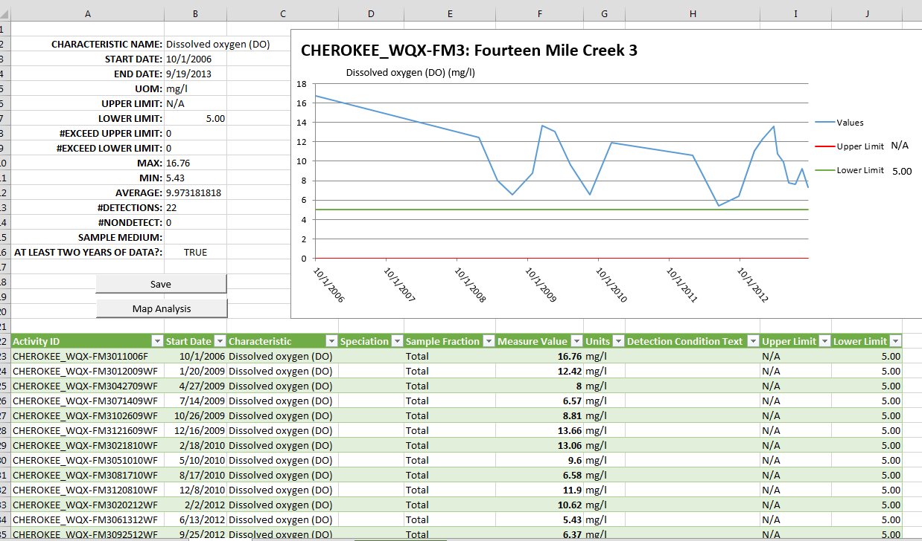
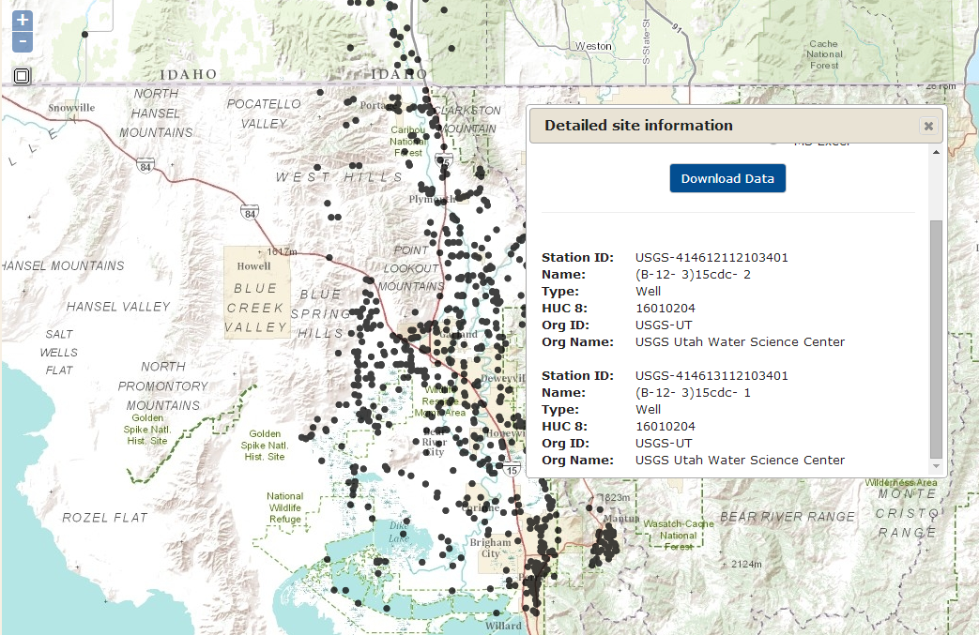
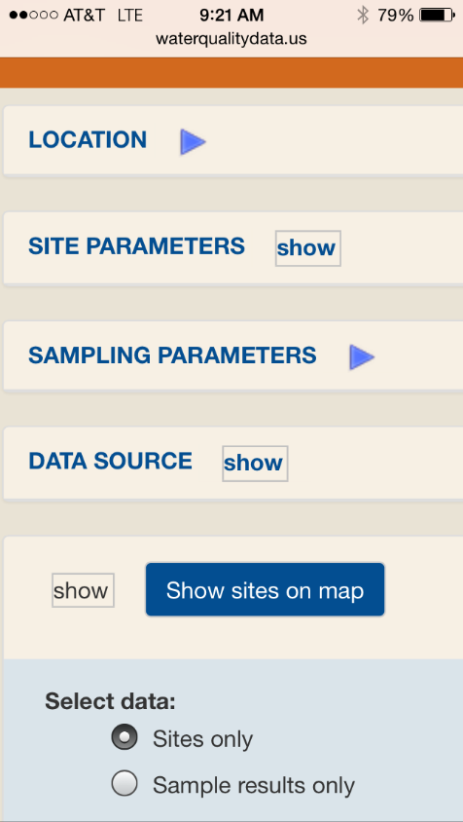
Using AN API Allows for Data to be Used in Many Different Ways
Directly into Excel Spreadsheets
Web Interfaces
Mobile Applications

Slide 21
What about Sensors and Continuous Data?
EPA is starting to see an increased emphasis on sensors
EPA has also embraced a new ‘Technology Blueprint’ that seeks to promote the use of technology to improve how we do business
With this comes some new challenges, not the least of which is what to do with the data
Notes:
New sensor technology, in addition to new telecommunication, and computing technology is opening an entire new world of possibilities
EPA is leading the Challenging Nutrients Sensor Challenge to accelerate affordable, reliable nutrient sensor development and use
At the 2014 National Water Quality Monitoring Conference, there was an entire track on sensors, and sensor data

Slide 22
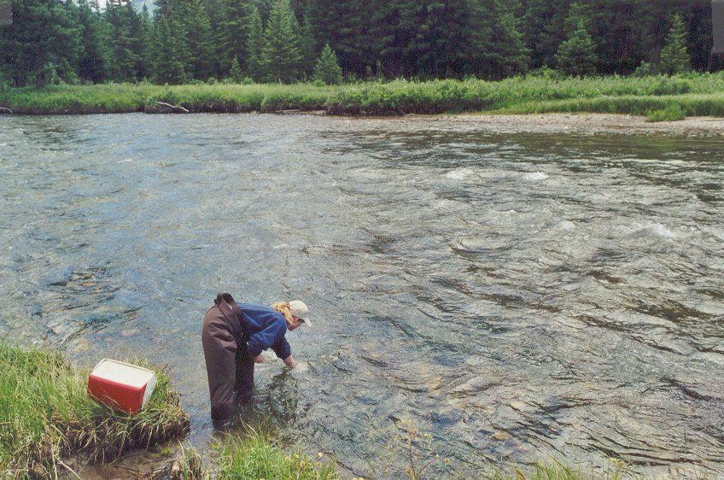
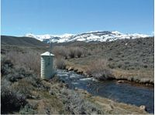
Metadata Needs Change Based on Your Data
In the water monitoring world, we can classify monitoring into two types:
Discrete Monitoring
A sample is taken and sent to a lab for further analysis
Typically a one-time event that can be repeated as needed
Continuous Monitoring
A sensor is used to record a continuous stream of data about 1 particular analyte or a small set of analytes (i.e. flow, dissolved oxygen, pH, etc).
Values are reported at set intervals (i.e. every 15 minutes, 1 hour, etc.)

Slide 23
Data Models are Likely Different for Sensor vs. Discrete Data
EPA recognizes that WQX is probably not the model for this type of data
EPA is beginning the process of looking at other approaches for continuous data
Sample
Continuous
Larger set of Metadata Describing
Single
or small
set of results
Small amount
of Metadata Describing
Many measurements

Slide 24

A path forward
Data standards exist
Sensor Observation Services (SOS)
Water Markup Language 2 (WaterML2) – (TimeSeriesML?)
These Open Geospatial Consortium Standards hold a lot of promise as the means of communicating and sharing this information
SOS: http://www.opengeospatial.org/standards/sos
WaterML 2: http://www.opengeospatial.org/standards/waterml

Slide 25
Other Glimmers of Possibility
Improvements in telecommunications:
Improved cell networks
Low-frequency radio communication (zig-zag)
Proliferation of cloud-storage options
Remote sensor management, including remote QA/QC of sensor output
New sensors coming to the market with the capability to measure new parameters

Slide 26


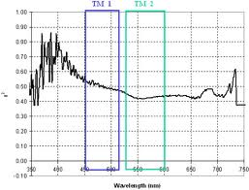
A Possible Future: A National Water Data Sharing Network
Sensor Networks
WQP
WaterML 2
WaterML 2
Cloud data compilation and reporting

Slide 27
QUESTIONS?
Dwane Young
U.S. EPA Office of Water
202-566-1214
Young.dwane@epa.gov

