Slide 1


Water Quality
Overview and relationship to existing OGC standards
Bruce Simons
Centre for eResearch and Digital Innovation (CeRDI)
18 March 2021

Slide 2
1. WaterML-WQ – an O&M and WaterML 2.0 profile for water quality data
Written by Cox and Simons in 2014
Published as a “Best-Practice” (14-003 (opengeospatial.org) )
Specializes Observations & Measurements (O&M) v2 and TimeSeriesML
An XML implementation based on OGC’s OMXML
Specifies the use of QUDT (v1) for Units of Measure
Specifies Water Quality Observed Properties from http://environment.data.gov.au/def/property

Slide 3
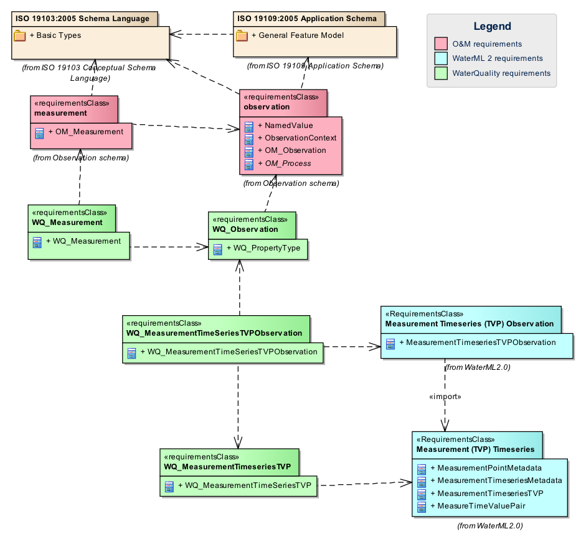
WQ Specialization
4 new classes as specializations of
O&M and TimeSeriesML classes:
WQ_Measurement
WQ_Observation
WQ_MeasurementTimeSeriesTVPObservation
WQ_MeasurementTimeseriesTVP

Slide 4
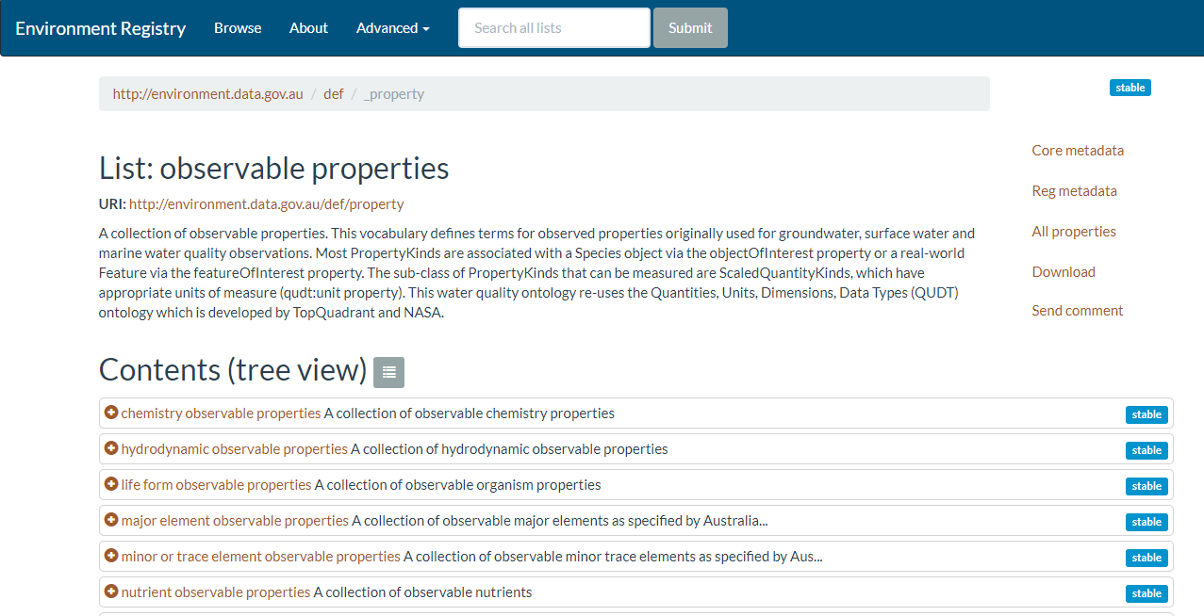
http://environment.data.gov.au/def/property

Slide 5
Rules Specifying Content
The units of measure shall come from QUDT and the WQ observed properties from a specified vocabulary
/req/xsd-xml-rules/unit-of-measure
All units of measure shall be specified using the URI for an individual from the class http://qudt.org/schema/qudt#Unit defined in http://environment.data.gov.au/def/unit
/req/observation/observed-property
The XML element om:observedProperty SHALL have an xlink:href property whose value is the URI for an individual from the class http://environment.data.gov.au/def/op#PropertyKind defined in http://environment.data.gov.au/def/property

Slide 6
Future for Best Practice document?
O&M v2 replaced by O&M v2 and/or SOSA
QUDT now v2
TimeSeriesML latest version?
Status of observed property vocabularies?

Slide 7
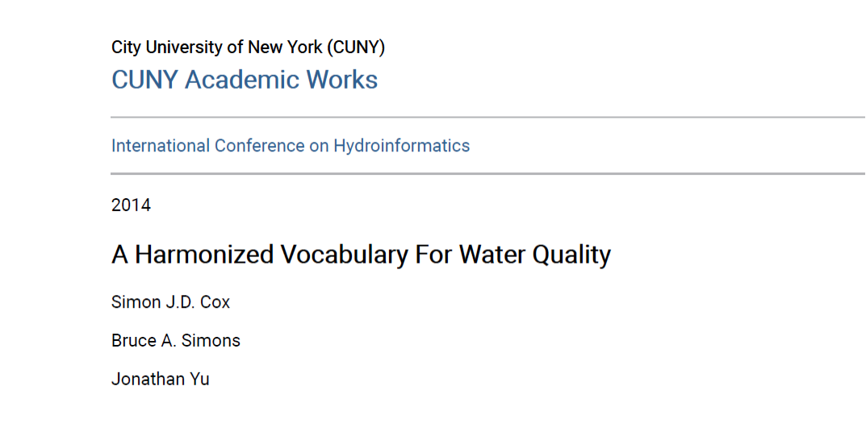
2. A Harmonized Vocabulary For Water Quality

Slide 8
Harmonizes O&M, QUDT and WQ
Problem: Most WQ vocabularies tend to conflate the various O&M concerns, such as procedure, unit of measure, observed property, substance of interest, feature of interest etc., into a single value
Formalized the WQ observable Properties model
Created an OWL ontology that extends the QUDT ‘Unit’ and ‘QuantityKind’ definitions
Produced an RDF WQ vocabulary extracted from existing WQ vocabularies

