Slide 1
Common Vocabulary of Hydrology
- addressing a problem -
2nd Hydro DWG Workshop, Delft
Irina Dornblut, Global Runoff Data Centre

Slide 2
Scope
Concern of the WMO Commission for Hydrology (CHy)
  inter-operability of observing systems relevant for hydrology¹
  exchange of hydrological data and information on a global scale
  sharing of data models and patterns in use in the hydrology domain
Abstraction of the real-world hydrology phenomenon
  Features which are object of study / reporting in hydrology
  Cross-domain assigned characteristics of hydrologic features
  Observable/observed properties (phenomena) of hydrologic features
  Observation results and data products typical for hydrology
¹ hydrology: science that deals with the waters above and below the land surfaces of the Earth, ...
(including geohydrology: branch of hydrology which deals with groundwater)

Slide 3
What is required ?
Glossary – Vocabulary – Taxonomy - Thesaurus
    Term !
    (common) Meaning !
    Multilinguality ! (which languages ?)*
    Synonyms: Y/N
    Hypernyms / Hyponyms: Y/N
    Associated terms: Y/N
Terms and definitions → glossary, dictionary, vocabulary
Predefined, authorised terms → controlled vocabulary
Hypernym/hyponym relation → taxonomy
Association relation → thesaurus
* WMO official languages: Arabic, Chinese, English, French, Russian, Spanish

Slide 4
Online available glossaries
terms searched for in 7 online available vocabularies relevant to the water theme (status: March 2011)
  Hydrology - Water body
  Surface water - Groundwater
  Catchment (area) - Basin
  River - Lake
  Glacier - Reservoir
  Water level - (River) Discharge
  Runoff - (River) Bank
  River bed

Slide 5
Online available glossaries
online available vocabularies inspected in March 2011
UNESCO-WMO Glossary (Hydrology) | http://webworld.unesco.org/water/ihp/db/glossary/glu/aglu.htm
INSPIRE Glossary | http://inspire-registry.jrc.ec.europa.eu/registers/GLOSSARY/items
AMS Glossary (Meteorology) | http://amsglossary.allenpress.com/glossary
EMWIS Thesaurus | http://www.emwis.net/portal_thesaurus/
EEA GEMET Thesaurus | http://www.eionet.europa.eu/gemet/
USGS Hydrologic definitions | http://water.usgs.gov/wsc/glossary.html
IHD, International Hydrographic Dictionary | http://www.loria.fr/projets/MLIS/DHYDRO/outils/site_edition/dictframe.html

Slide 6
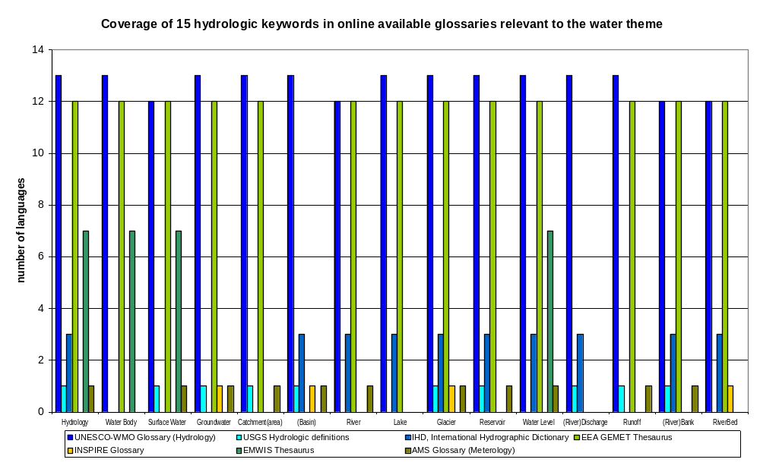
Online available glossaries

Slide 7
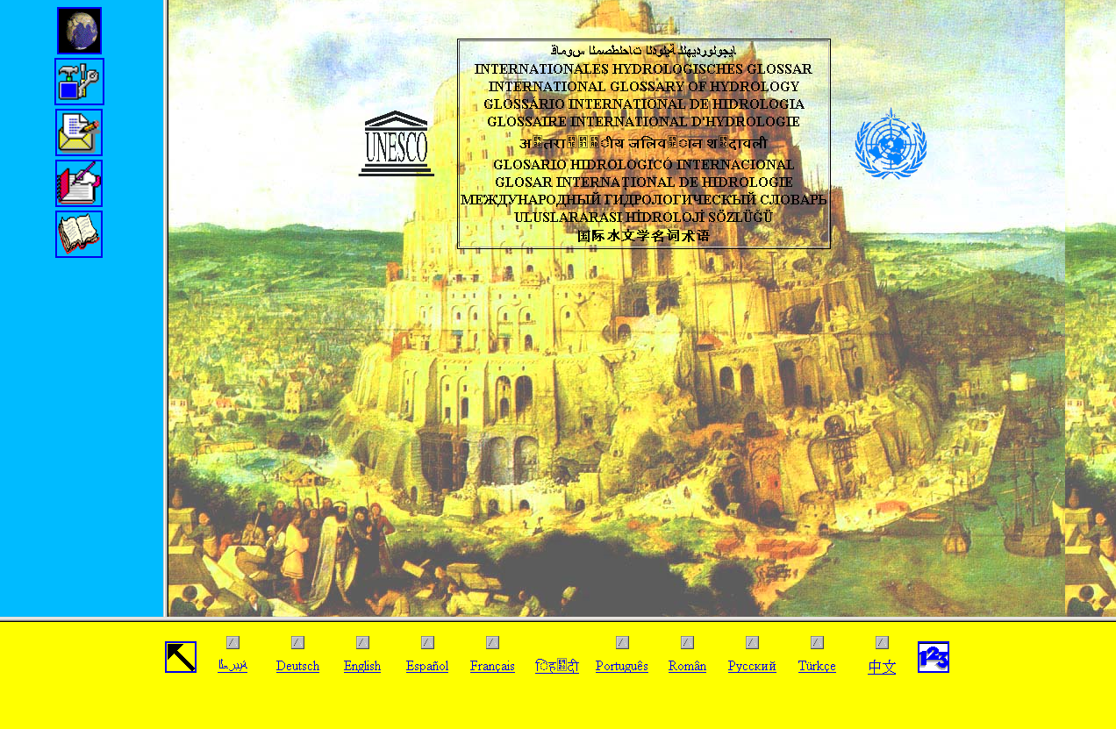
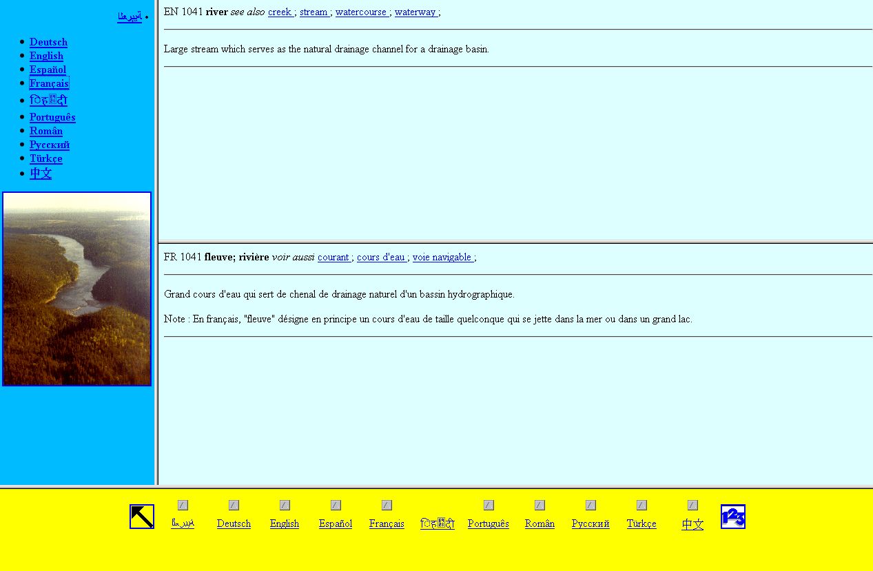
Example: UNESCO-WMO Glossary of Hydrology
Term: 1418 singularia, pluralia tantum
Scope: hydrology
Multilinguality: 13 (4) languages
Definition: WMO 1974, 1992, (2011)
Synonym: yes
Hypernym / Hyponym: in text
Associated term: a - b relation

Slide 8
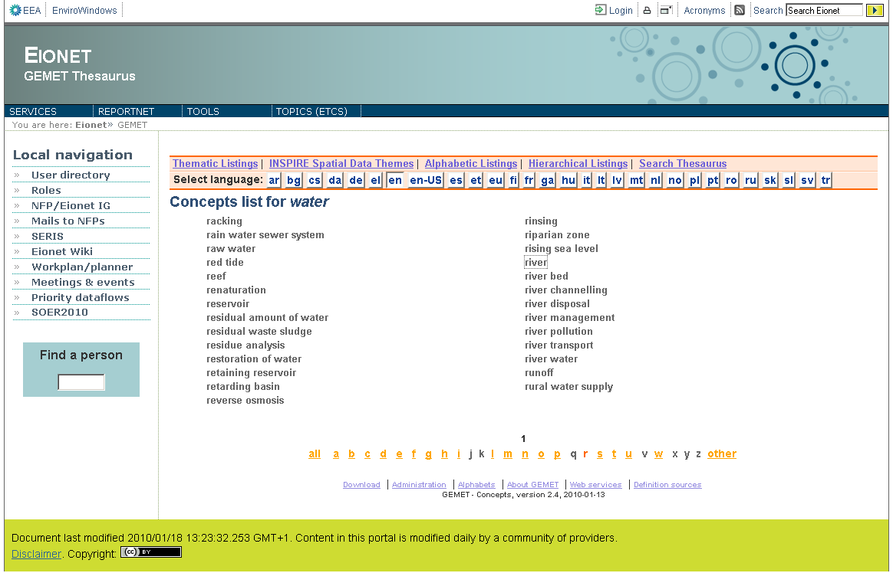
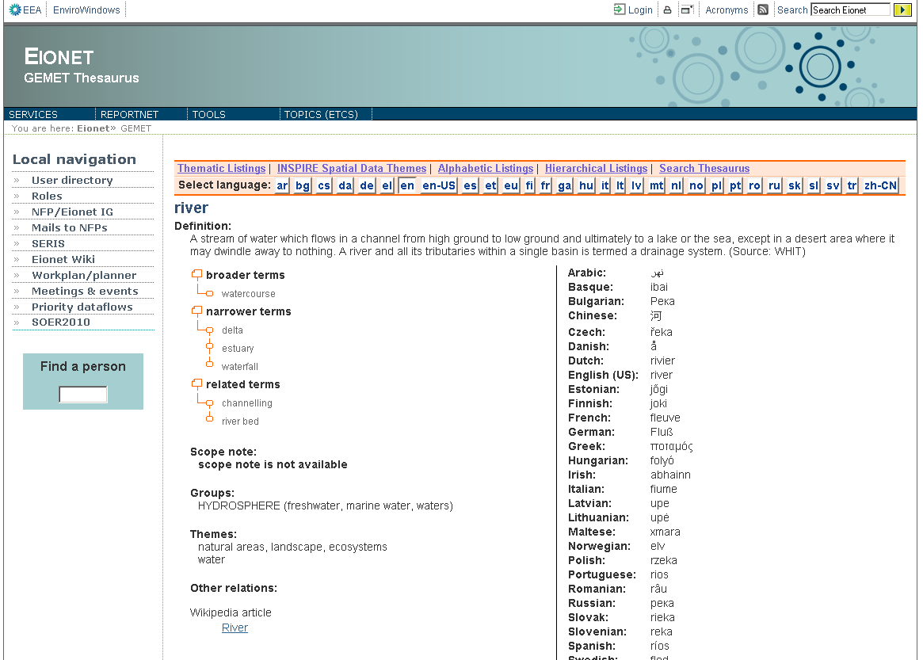
Example: EEA GEMET Thesaurus
Term: > 5000 singularia, pluralia tantum
Scope: hydrosphere, waste, waters
Multilinguality: 29 languages
Definition: from secondary sources
Synonym: no
Hypernym / Hyponym: yes
Associated terms: yes

Slide 9
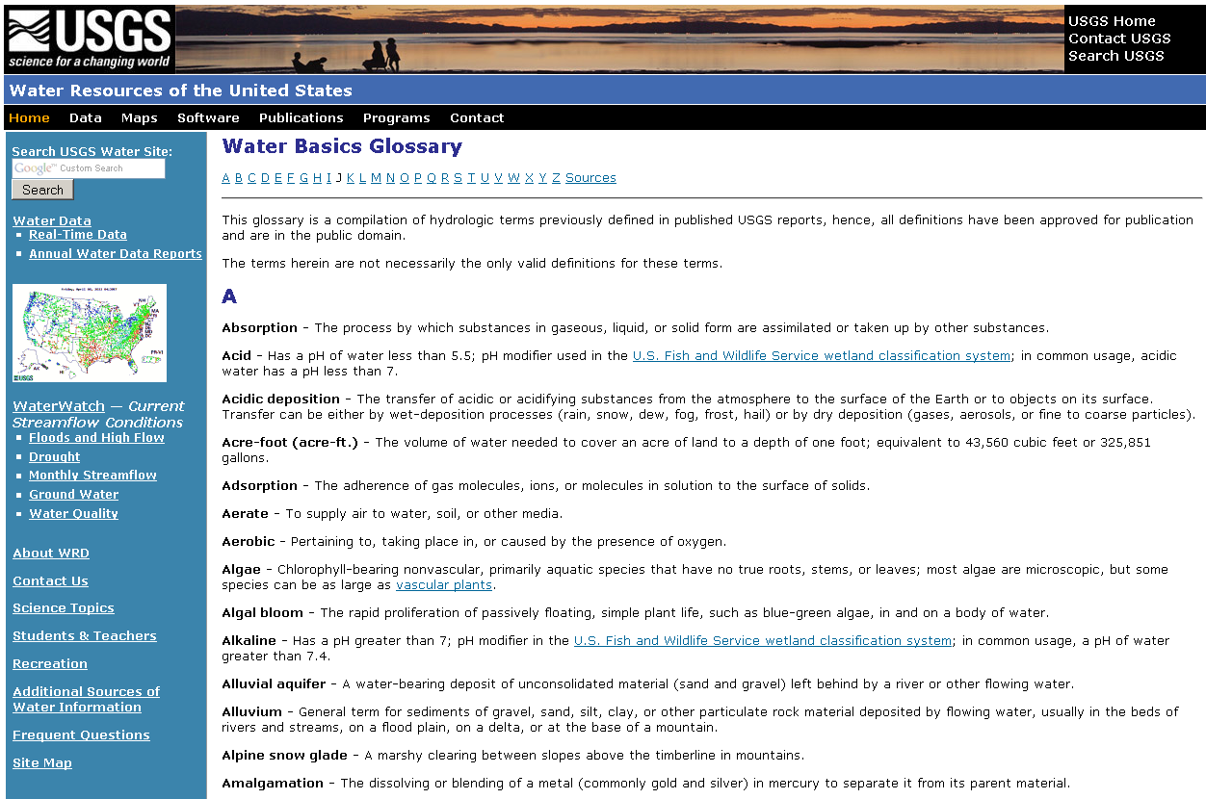
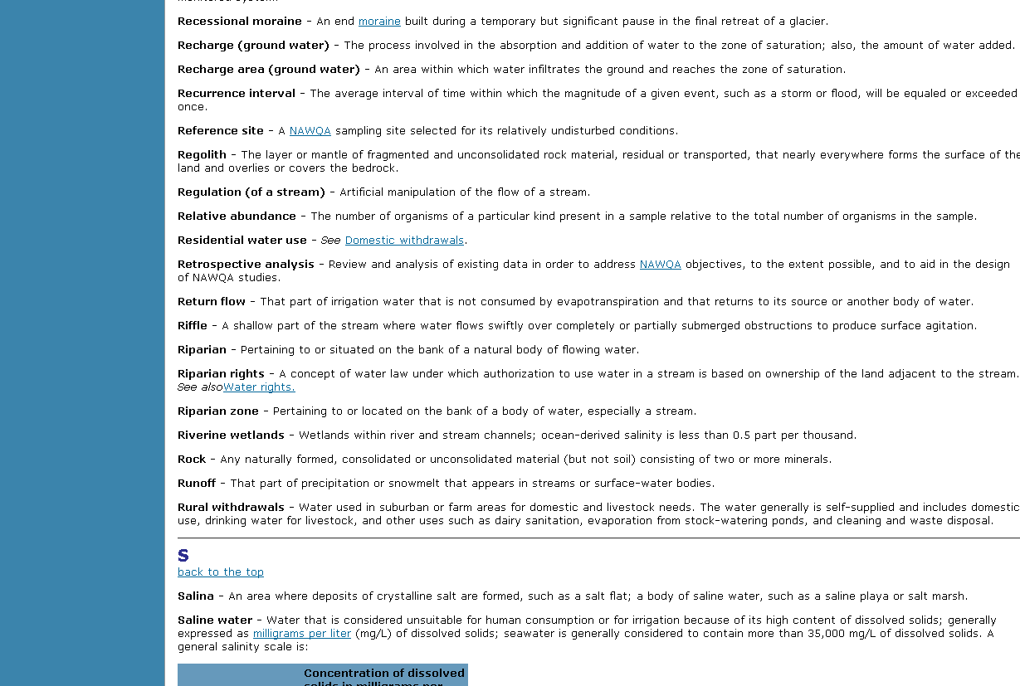
Example: USGS Water Basics Glossary
Term: ~ 300 singularia, pluralia tantum
Scope: ”Manual of Hydrology” terms
Multilinguality: no
Definition: USGS 1995
Synonym: no
Hypernym / Hyponym: in text
Associated term: in text

Slide 10
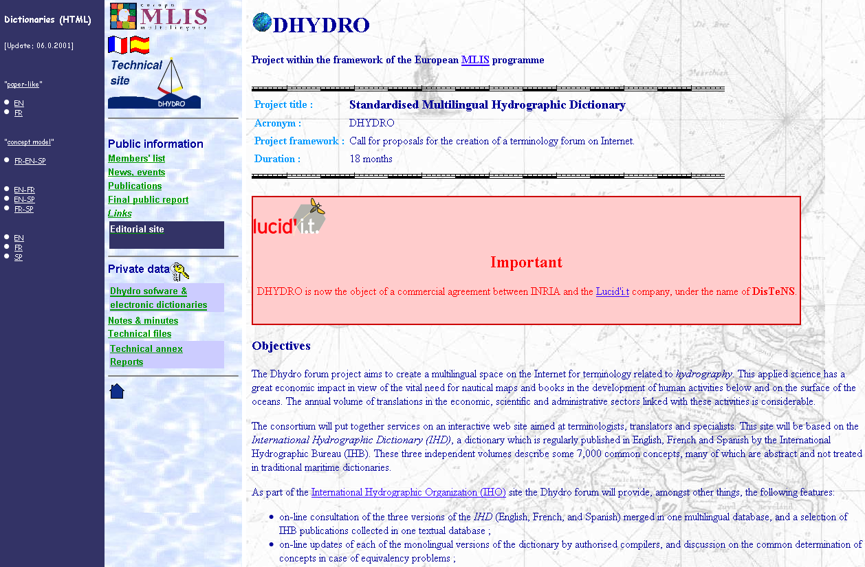
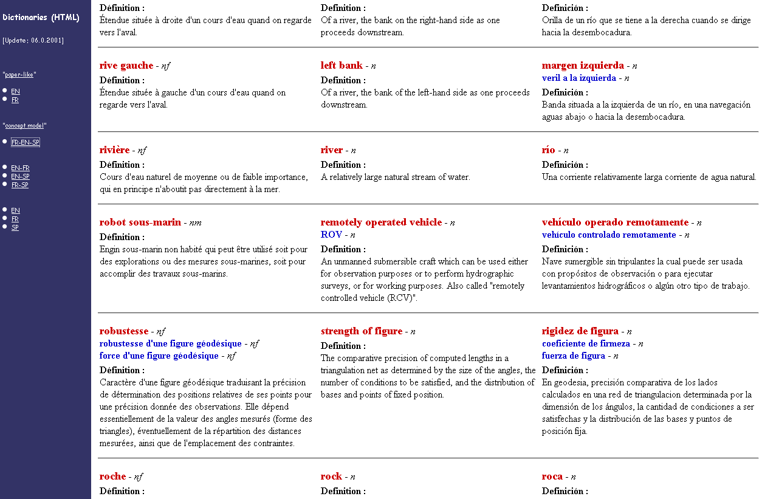
Example: IHO DHYDRO
Term: > 5000 singularia, pluralia tantum
Scope: Hydrography
Multilinguality: 3 languages
Definition: IHO 2001
Synonym: yes
Hypernym / Hyponym: no
Associated term: a - b relation

Slide 11
WMO Terminology recommended
Terminology recommended for use in the WMO community
International Glossary of Hydrology
  joint publication of UNESCO / WMO
  established in the WMO community
  printed and online version available (13 languages)
  http://webworld.unesco.org/water/ihp/db/glossary/glu/aglu.htm
Guide to Hydrological Practices
  Vol.I: Hydrology - From measurement to hydrological information
  6th edition. - WMO, 2009
  printed and digital version, not online
  not a vocabulary, provides definitions

Slide 12
What needs to be done ?
Review of available, re-usable vocabularies relevant to the water theme
Requirements definition
  Synonyms, hypernyms/hyponyms, associated terms?
  Master vocabulary required?
Concept development
Governance
  Rules to evaluate and control the vocabulary ?
  Within WMO process ?
Who is working on this?

