Slide 1
Global Runoff Data Centre Koblenz, Germany
GRDC
GRDC Examples
of Hydrological Data Exchange
OGC – Hydrology Domain Working Group
Ispra, 16 - 17 March 2010
Ulrich Looser

Slide 2
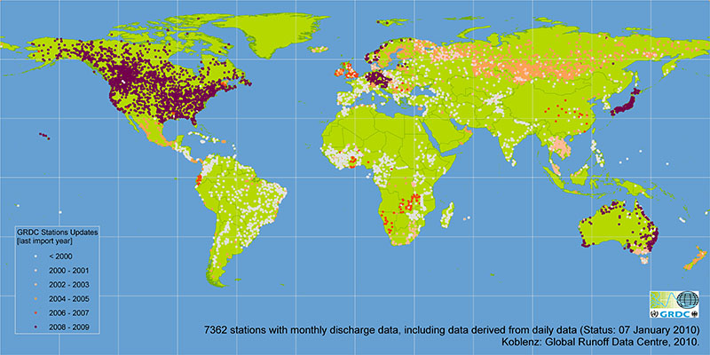
Data Acquisition for historical river discharge data
Spatial distribution of 7362 GRDC Stations from 156 countries indicated by last im-port year, (monthly discharge data including data derived from daily discharge data)
Global Runoff Data Centre Koblenz, Germany
…more than 20 Years GRDC

Slide 3
Global Runoff Data Centre Koblenz, Germany
…more than 20 Years GRDC
Historical river discharge data
Data provided in all sorts of formats on all sorts of media
GRDC requests data in the following format (GRDC Data Format):
names of the river and the station in separate lines with uppercase letters
complete date following the ISO 8601 standard (YYYY-MM-DD)
discharge value with ten digits (m³/sec)
expand each month to 31 days using –10.000 or –999.000 as non-available value
use spaces as column separator
Example for a daily data file :
CONGO
BRAZZAVILLE
1978-01-01 1860.000
1978-01-02 1865.000
1978-01-03 –999.000
:
1978-02-30 -10.000
:

Slide 4
Global Runoff Data Centre Koblenz, Germany
…more than 20 Years GRDC
GRDC currently requests the following metadata
Basic Station Information
  - station no
  - station name **
  - river name **
  - basin name
  - country name
  - latitude **
  - longitude **
  - altitude
  - catchment size **
  - daily data available from
  - daily data available until
  - percentage of missing values (daily data)
  - monthly data available from
  - monthly data available until
  - percentage of missing values (monthly data)
  - mean annual streamflow

Slide 5
Global Runoff Data Centre Koblenz, Germany
…more than 20 Years GRDC
For those stations whose data series' are delivered to the GRDC we ask to be provided with
a few further metadata entries:
  - main stream or main basin name
  - date when measurement started (YYYY-MM-DD)
  - date when measurement stopped (YYYY-MM-DD)
  - name or ID of succeeding station
  - date of station reactivation (YYYY-MM-DD)
  - information on method of measurement
  - information on data quality check
  - additional parameters measured?
  + water level (y/n)
  + water temperature (y/n)
  + sediments (y/n)
  + water quality parameters (y/n)
  (2) Information about the Data Supplier: To establish a closer collaboration and to give
  feedback about the data use the GRDC needs to know details about the data supplier
  - The full postal address of the organisation handling and delivering the data **
        - The name and email address of a focal point of the respective data provider **

Slide 6
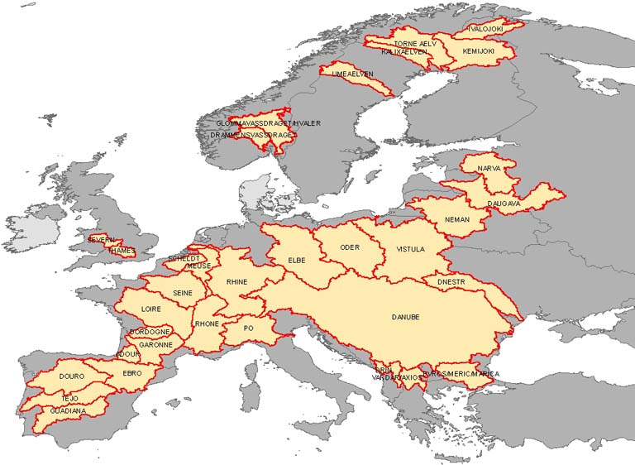
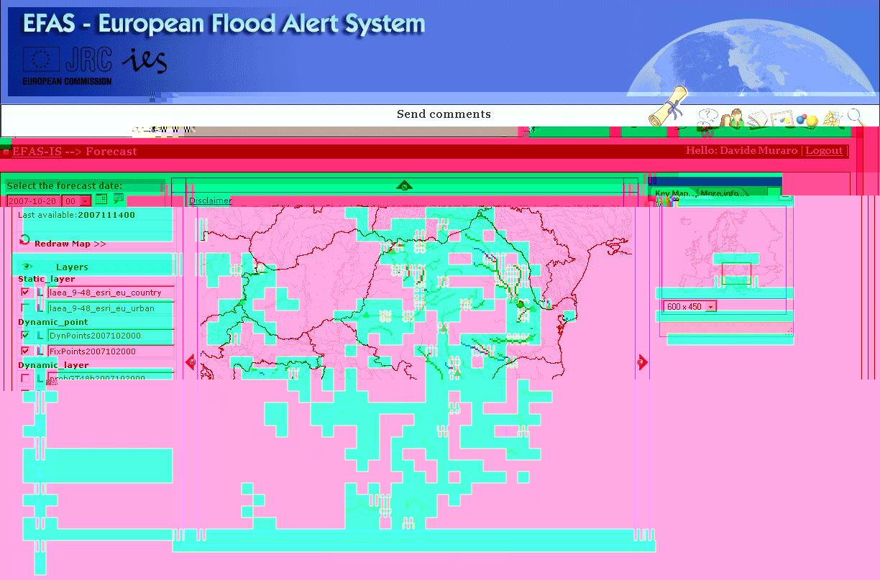
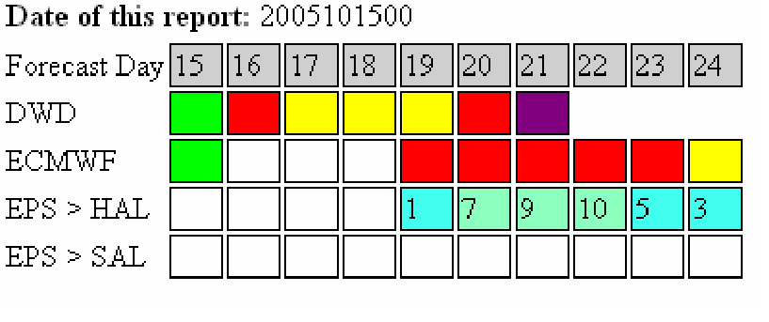
European Terrestrial Network for River Discharge (ETN-R) in support of the European Flood Alert System (EFAS)
Processing-configuration
River gauging
Data
ETN-R
Download newest
data files
Data providers
NRT-Data
Convert data files into GRDC-format
Operation in near real-time
Automated downloading, processing and harmonising
Basic quality checking
Automated delivery to EFAS
NRT
Database
Harmonise, Checks & Import
EFAS
Checks & Delivery
every 12 hours
Notes:
Keine Animation

Slide 7
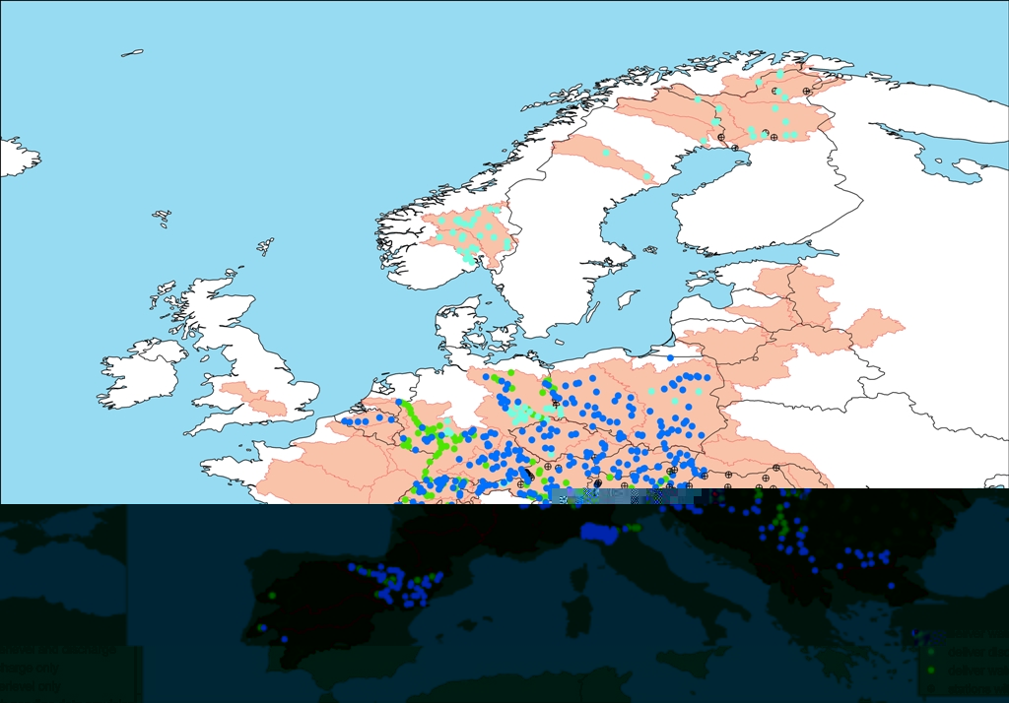
ETN-R
Spatial distribution of currently (March 2010) 711 NRT stations from 23 providers collected by the GRDC and transmitted to the EFAS every 12 hours

Slide 8
ETN-R
Near real-time river discharge and/or water level data for ETN-R
Data acquisition in all sorts of formats and different ways
GRDC requests data in the following format (GRDC NRT Data Format Version 3.1)
1. National station identifier (case insensitive string). (mandatory)
2. Timestamp of the measurement (Format is: YYYY-MM-DD hh:mm:ss)
3. Water level (number, metres)
4. Discharge (number, cubic metres per second)
5. Missing value (logical, 1= is missing / 0= is not missing) (mandatory)
6. Is value directly determined (logical) (1= directly determined/ 0= indirectly determined)
7. Is data reliable (logical, 1= is reliable / 0= is not reliable) (mandatory)
8. Aggregation (mandatory)
  a. interval (number, 0..n, if this is equal to 0, no aggregation took place) (in minutes)
  b. offset (number, negative or positive offset in minutes of the timestamp to the end of the averaging interval) (offset can be omitted if interval is 0)
9. Is ice cover (logical)
10. Is ice jam (logical)
11. Is weedage (logical)
12. Is influenced by backwater (logical)
13. Suspiciousness flags
14. Rejectedness flags

Slide 9
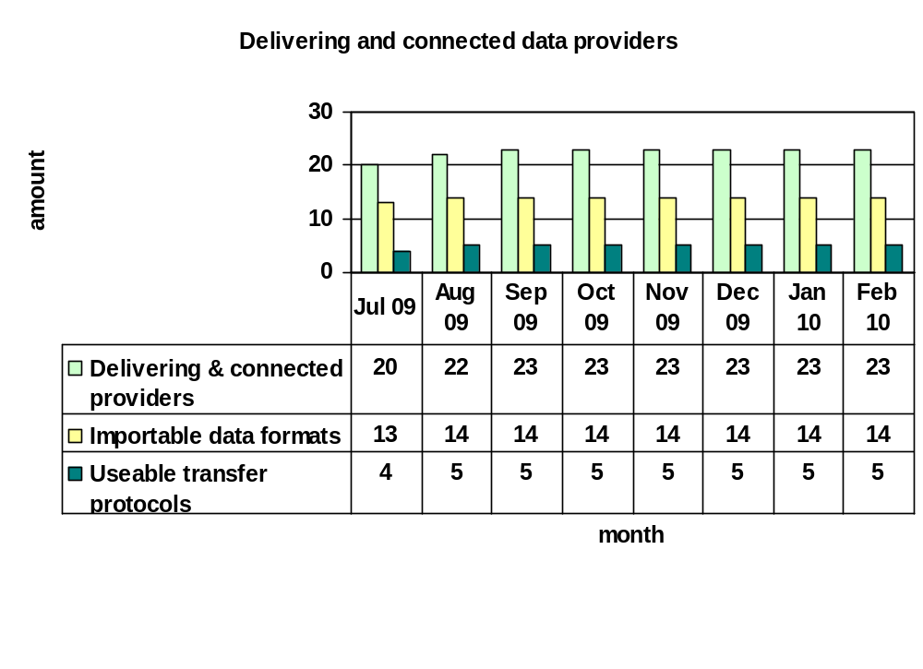
Although specified data format:
14 different interfaces needed for data collected from ftp sites or transmitted to GRDC ftp site
Data transmitted via Email
Data collected from Websites
ETN-R

Slide 10
ETN-R
        A: Provider information
        1. Institution
        2. Contact persons
        3. Data categories
        B: Data transfer information
        1. NRT data transfer options
        2. Dataset identification
        C: Information about the gauging stations
        1. Station, river and catchment information
        2. Location of the station
        3. Other information
        4. Observations at the station
        4.1. Observation mode and period
        4.2. Data availability and temporal resolution
        4.3. Evaluation of the observation
        4.4. Other information
        D: Additional information needed for NRT stations
        1. Critical discharge(s)
        2. Alert levels
        3. Highest and lowest observed discharge
        4. Stage-discharge relation
        5. Flood frequencies

Slide 11
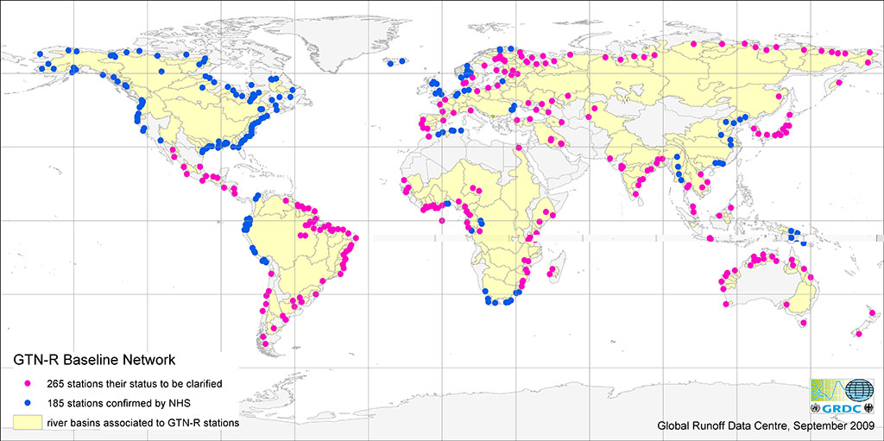
Global Terrestrial Network for River Discharge (GTN-R)
GTN-R is a contribution to the Global Climate Observing System (GCOS) and the Global Terrestrial Network for Hydrology (GTN-H)
GTN-R similar setup, data transfer and metadata requirements as ETN-R
82 identified countries
450 stations

Slide 12
Main Objectives
Please visit GRDC at
http://grdc.bafg.de
The GRDC at your service: grdc@bafg.de
Tel: +49-261-1306-5224 Am Mainzer Tor 1
Fax: +49-261-1306-5722 D-56068 Koblenz
Ulrich Looser Head GRDC Looser@bafg.de
Dr. Gerhild Boje Project Coordinator (ETN-R) Boje@bafg.de
Thomas de Couet GIS Specialist Decouet@bafg.de
Irina Dornblut Deputy Head Dornblut@bafg.de
Kirsten Hohmann Project Coordinator (ETN-R) Hohmann@bafg.de
Marion Kapp Project Assistant Kapp@bafg.de
Johannes Pauler Database Manager Pauler@bafg.de
Data Acquisition
Data Provision
Data Services
Website
Products
Cooperation
Partner Centres

