Slide 1

The use of standards in DelftFEWS
Peter Gijsbers

Slide 2
DelftFEWS
Software platform for implementation of real-time forecasting applications
Applied by agencies with operational water management task
  flood forecasting
  real time control (reservoir management, polder systems)
  seasonal water supply forecasting (GW, SW)
  coastal & storm surge forecasting
  harmful algea blooms forecasting
  temparature forecasting
  salinity forecasting
UK, Netherlands, Germany, Austria, Switzerland, Italy, Taiwan, Mekong Basin, Spain, Singapore, USA, Australia

Slide 3
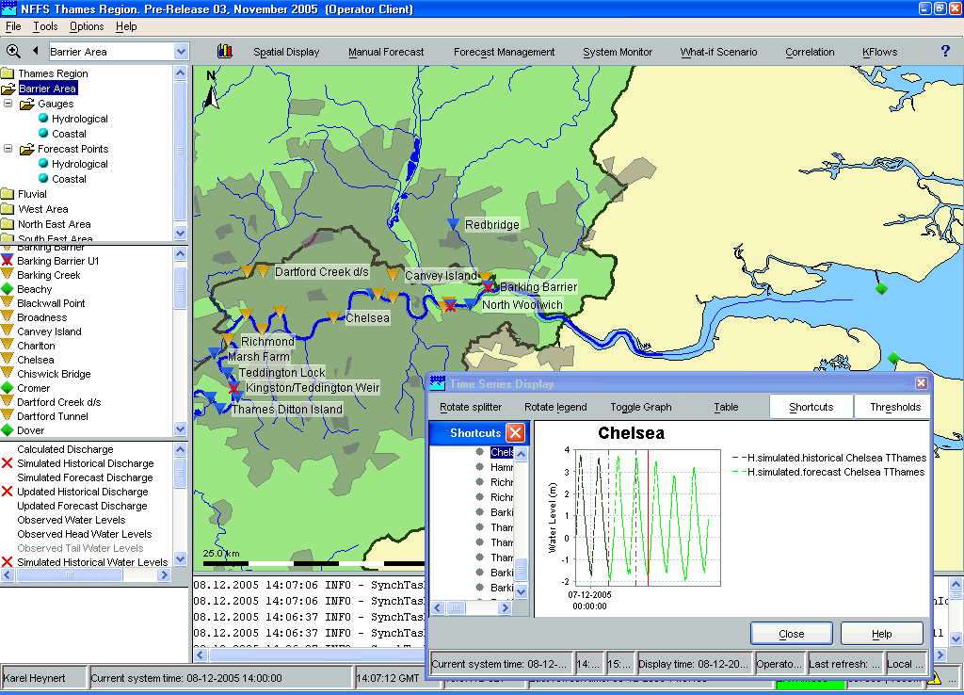
Delft FEWS philosophy
→ Focus on data handling and associated services, not on running models
→ Offer wide range of configurable service modules
→ Keep domain specific formats or content outside system design
→ Open your system for other components …
  Extendable using plugins and standardized interfaces
    Using efficient standardized data formats where appropriate
  Provides access to time-dependent data via JDBC, WebServices
→ Developments are only conducted
upon request (and pay) by clients
→ Developments are availale to all users

Slide 4
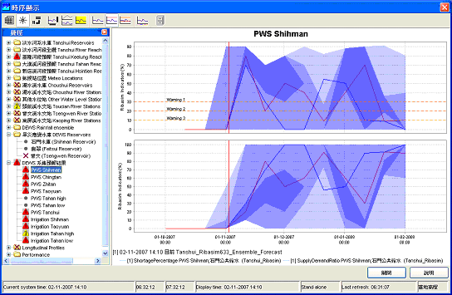
Open interface to models
Standardized data exchange format
No model intelligence in
DELFT-FEWS
Model intelligence vested in
model adapter
> 50 models
DELFT-FEWS
Generic Module Adapter
XML
Model
Adapter
Native format
Native format
Model

Slide 5
DelftFEWS Published Interface
<series>
<header>
<type>instantaneous</type>
<locationId>141801151</locationId>
<parameterId>H.obs</parameterId>
<timeStep unit="nonequidistant"/>
<startDate date="1966-02-09" time="00:00:00"/>
<endDate date="2003-05-28" time="00:00:00"/>
<missVal>NaN</missVal>
</header>
<event date="1966-02-09" time="00:00:00" value="103.24"/>
<event date="1966-03-22" time="00:00:00" value="104.21"/>
<event date="1966-05-12" time="00:00:00" value="102.99"/>

Slide 6
Data feeds
High-performance while including primary validation
Easy to develop & maintain
  → Base class library available
  → Tailored data import routines where required/requested
  → Standardized data imports where relevant (light-weight format)
  → No configurable data imports
Forecasting
System
Telemetry
Model 1
Scalar data
HD Model
Radar
Model 2
Current
Longitudinal data
Model 3
NWP / EPS
University
Spatial data

Slide 7
Support for data standards
Meteo (ingest):
  grib1, grib2, NetCDF-CF
Hydrology (ingest):
  some national standards
  waiting for international standard (WaterML 2.0)
  OGC-SWE tests not very satisfying (complex, low performance)
Models (export/import):
  DelftFEWS-Published Interface (PI-XML, netCDF)
  OpenMI 2.0 (TBD this year)

Slide 8
DelftFEWS Published Interface
<series>
<header>
<type>instantaneous</type>
<locationId>141801151</locationId>
<parameterId>H</parameterId>
<qualifierId>sim</qualifierId>
<ensembleId>GFS</ensembleid>
<ensembleMemberIndex>2</esemblememberIndex>
<timeStep unit="nonequidistant"/>
<startDate date="1966-02-09" time="00:00:00"/>
<endDate date="2003-05-28" time="00:00:00"/>
<forecastDate date="1966-02-09" time="00:00:00"
<missVal>NaN</missVal>
<longName/>
<stationName/>
<units>mAOD</units>
<sourceOrganisation/>
<sourceSystem/>
<fileDescription/>
<creationDate/>
<creationTime/>
<region/>
<thresholds/>
</header>
<event date="1966-02-09" time="00:00:00" value="103.24"/>
<event date="1966-03-22" time="00:00:00" value="104.21"/>
→maximum content

Slide 9
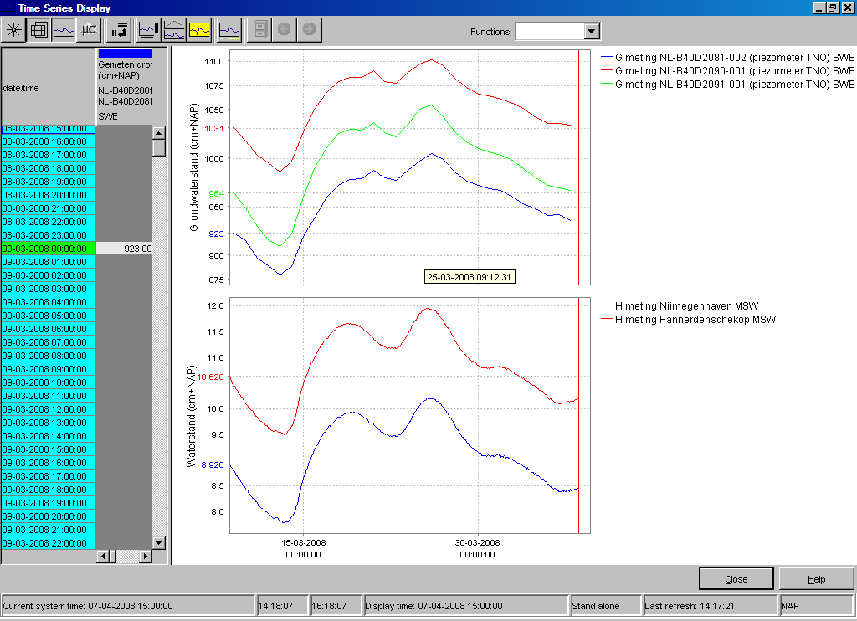
Experiences with OGC-Sensor Web Enablement
Experiences with current OGC-SWE specification (SOS/O&M):
very generic specification
XML-objects have much geo-overhead when transient data is of primary interest
unambigous interpretation by one parser impractible
complex code required to retrieve actual values
web-service response time
→ not very efficient/high-performing
WaterML 1.x not tested but looks
much better

Slide 10
Request from data standard
Format requests from forecasting perspective:
  you know what you want
  → no discovery type of requests
  → high performance
  → no unreadible data blocks
  → efficient to parse/code (using standard XML-parsers)
  is likely to neglect (much of) meta-data
Would like WaterML to cover:
  observation timeseries (point)
  forecasts (deterministic and ensemble)
  rating curves
  thresholds

Slide 11
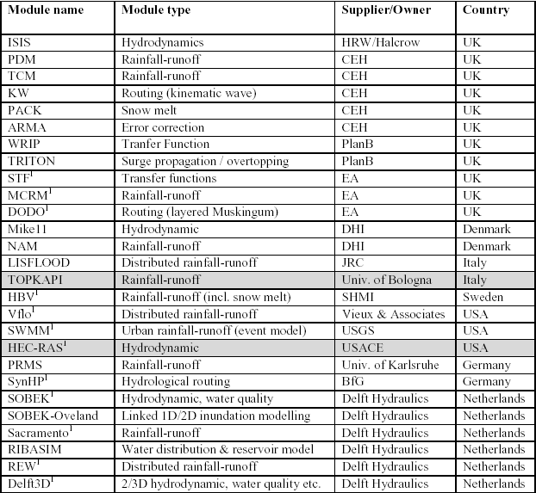
Examples of models linked to Delft FEWS…
PRTF

