Slide 1
The JRC SDI Unit
The INSPIRE Context
Martin Tuchyna & Michael Lutz
European Commission – Joint Research Centre
Institute for Environment and Sustainability
Spatial Data Infrastructures Unit
OGC Hydrology DWG, 16 March 2010, Ispra
Notes:
NOTES
1. PLACE, DATE AND EVENT NAME
1.1. Access the slide-set place, date and event name text box beneath the JRC logo from the Slide Master.
1.2. Do not change the size nor the position of that text box.
1.3. Replace the mock-up texts for the place (“Place”), the date (“dd Month YYYY”) and the event name (“Event Name”) with your own texts.
1.4. Set it in MetaPlus Book Roman, if you own the typeface. Otherwise, keep the original typeface – Arial.
1.5. Keep the original flush-left justification.
1.6. Keep the original font colour (white).
1.7. Keep the original font body size (7 pt) and the text on one single line.
2. SLIDE NUMBER
2.1. The slide number on the banner’s lower right-hand side is automatically generated.
3. SLIDES
3.1. Duplicate the first slide as needed.
3.2. Do not change the size nor the position of the slide’s text box.
3.3. Try not to place more text on each slide than will fit in the given text box.
3.4. Replace the mock-up heading text (“Joint Research Centre (JRC)”) with your own text heading.
3.5. Set it in Eurostile Bold Extended Two or in Helvetica Rounded Bold Condensed, if you own one of these typefaces. Otherwise, keep the original typeface – Arial.
3.6. Keep the original flush-left justification.
3.7. Keep the original font colour (100c 80m 0y 0k).
3.8. Keep the original font body size (28 pt) and the heading on one single line whenever possible. Reduce the font body size if needed.
3.9. Replace the mock-up text (“The European Commission’s Research-Based Policy Support Organisation)”) with your own text.
3.10. Set it in MetaPlus Book Roman, if you own the typeface. Otherwise, keep the original typeface – Arial.
3.11. Keep the original flush-left justification.
3.12. Keep the original font colour (100c 80m 0y 0k). Use black if you need a second colour.
3.13. Keep the original font body size (22 pt) or reduce it if unavoidable.
3.14. Replace the EU-27 map mock-up illustration with your own illustration(s).
3.13. Try to keep your illustration(s) right- and top- or bottom-aligned with the main text box whenever possible.

Slide 2
Outline
Data Specifications Overview
Data Specifications Process & Methodology
Annex II & III

Slide 3
Outline
Data Specifications Overview
Data Specifications Process & Methodology
Annex II & III

Slide 4


What is INSPIRE?
“Infrastructure for Spatial Information in the European Community”
Environment
Distributed infrastructure
General rules for establishment
34 spatial data themes
27 countries
23 languages
European legislation
Notes:
General rules to establish an infrastructure for spatial information in Europe
Community environmental policies
Policies or activities which impact on the environment
To be based on SDIs established and operated by the Member States
Does not require collection of new spatial data
Scope:
Spatial data held by or on behalf of a public authority
34 Spatial Data Themes laid down in 3 Annexes
Entry into force 15 May 2007

Slide 5
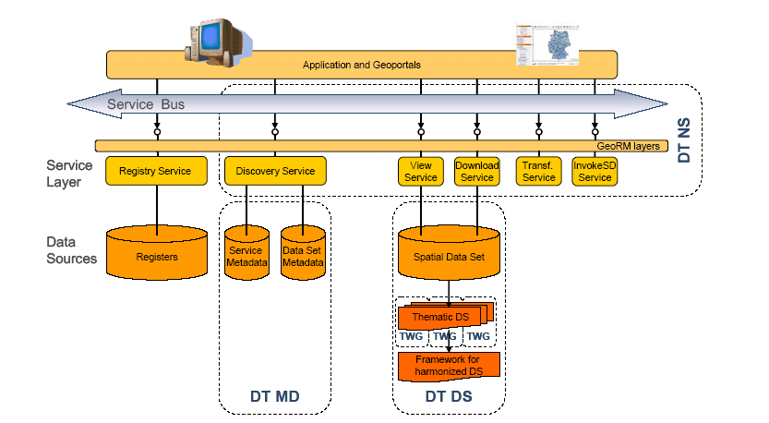
INSPIRE Status
Metadata
Metadata Regulation published 4th December 2008
2-5 years for Member States to create metadata
Metadata editor publicly available as part of prototype INSPIRE geo-portal
Network
services
Metadata
Data specs

Slide 6
INSPIRE Status
Network
services
Network Services
Discovery & View Service Regulation published 2009
Draft Amendment on Download & Transformation Service
Regulation on Invoke Service to be finalised by 2012
Initial Operating Capability Task Force to support Member States in the implementation
Metadata
Data specs

Slide 7
INSPIRE Status
Data Interoperability
Draft Regulation on data interoperability for Annex I data themes
Common UML data model for all themes
2-7 years (after adoption) for Member States to make data compliant
Work on Annex II/III data themes starting in 2010
Network
services
Metadata
Data specs

Slide 8
INSPIRE Status
Network
services
Architecture
Components
Metadata
Data specs
http://inspire-registry.jrc.ec.europa.eu/registers/FCD

Slide 9
INSPIRE Status
INSPIRE GeoPortal
Network
services
Metadata
Data specs
Notes:
Challenges
Multilinguality
The European Union comprises 23 official languages. This has significant impact on how discovery of data and services is performed.
Distribution
A European SDI is formed by regional and local SDIs that have their own Metadata models, Catalogues, etc.
Diversity
Information is represented in various data models and coordinate reference systems.

Slide 10
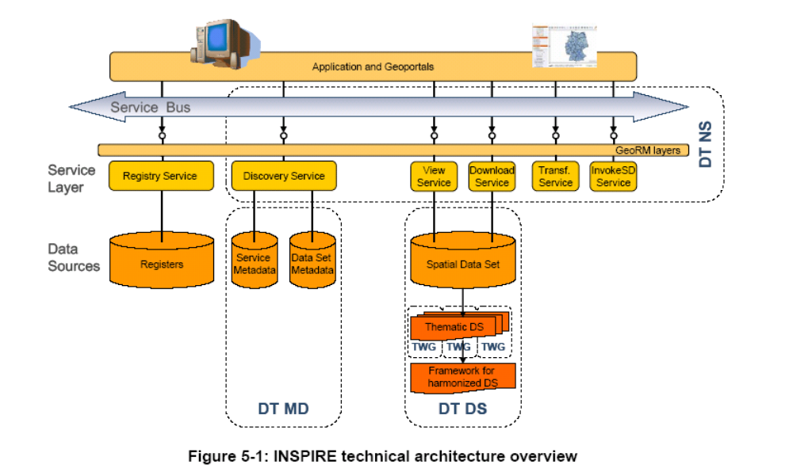
INSPIRE Architecture
Network
services
Data specifications define a harmonised model for publishing and exchanging data
Metadata

Slide 11
INSPIRE Thematic Scope
Annex I
  Coordinate reference systems
  Geographical grid systems
  Geographical names
  Administrative units
  Addresses
  Cadastral parcels
  Transport networks
  Hydrography
  Protected sites
Annex III
  Statistical units
  Buildings
  Soil
  Land use
  Human health and safety
  Utility and governmental services
  Environmental monitoring facilities
  Production and industrial facilities
  Agricultural and aquaculture facilities
  Population distribution – demography
  Area management/ restriction/ regulation zones & reporting units
  Natural risk zones
  Atmospheric conditions
  Meteorological geographical features
  Oceanographic geographical features
  Sea regions
  Bio-geographical regions
  Habitats and biotopes
  Species distribution
  Energy Resources
  Mineral resources
Annex II
  Elevation
  Land cover
  Ortho-imagery
  Geology

Slide 12
Annex II/III Themes – Scope
Open discussion on the INSPIRE Forum

Slide 13
Example: HY – The World

Slide 14
Example: HY – Mapping
Basin
SpringOrSeep
Catchment
Rapids
Shore
Wetland
Lock
Pipe
PumpingStation
Embankment
Crossing
HydroPowerPlant
Watercourse
StandingWater
OceanRegion
LandWaterBoundary

Slide 15
Example: HY – Network
WatercourseNode
WatercourseLink

Slide 16
Example: HY – Reporting
WFDCoastalWater
WFDRiver
WFDTransitionalWater
WFDLake

Slide 17
Example: HY – Complete
Data Specification
Basin
SpringOrSeep
Catchment
WFDCoastalWater
Rapids
WatercourseNode
Shore
Wetland
DamOrWeir
WatercourseLink
Lock
Pipe
PumpingStation
Embankment
Crossing
WFDRiver
HydroPowerPlant
Watercourse
StandingWater
OceanRegion
LandWaterBoundary
WFDTransitionalWater
WFDLake

Slide 18
“The Balance Challenge”
Which level of interoperability is “just right”?
Simple
Complex
Too simple:
Identified requirements can not be supported
Insufficient harmonisation
Few benefits
Too complex:
Difficult to implement
Substantial benefits available only to few users
High costs

Slide 19
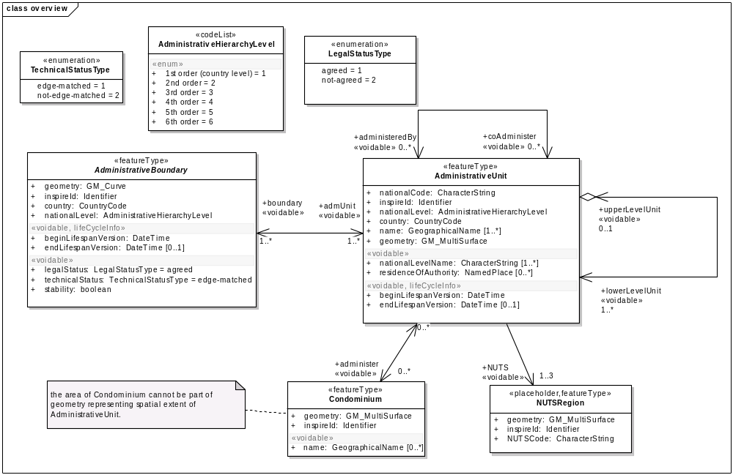
Data specifications – Content
Application schema in UML

Slide 20
Data specifications – Content
Based on ISO 19131 (Data product specification)
Application schema in UML (+OCL)
  spatial object types
  attributes & attribute values
  relationships between spatial objects
Rules for unique identifiers for spatial objects, derived from national identifiers
Theme specific metadata (including data quality)
Simple portrayal rules for the INSPIRE View Network Service

Slide 21
INSPIRE & the “Outside World”
INSPIRE data specifications no end in itself
Inspire does NOT cover specific exchange
Projects / reports require additional information
Inspire does provide an infrastructure
Solution: Extend INSPIRE specifications with specific information
Example: Water Information System for Europe
  Water directives related reporting (e.g. Water Framework Directive)
  Focus on what is to be reported and not the geography

Slide 22
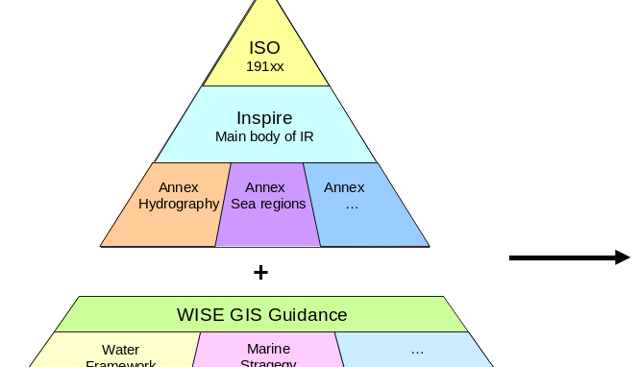
Base Model plus Extensions
Joint position of WISE and INSPIRE
One base model (INSPIRE) with extensions for specific reporting (WISE)
  WISE fully Inspire compliant
  Extensions outside IR scope
  One technical infrastructure in MS
  Additional features needed,
  e.g. River Basin Districts
  (Annex III)

Slide 23
Outline
Data Specifications Overview
Data Specifications Process & Methodology
Annex II & III

Slide 24
Data Specification Development
Use case development
Identification of user requirements and spatial object types
As-is analysis
Data specification development
Gap analysis
Implementation, testing and validation
Cost-benefit analysis

Slide 25
Data Specification Development
Use case development
Identification of user requirements and spatial object types
As-is analysis
Data specification development
Gap analysis
Implementation, testing and validation
Cost-benefit analysis

Slide 26
Data Specification Development
Use case development
Identification of user requirements and spatial object types
As-is analysis
Data specification development
Gap analysis
Implementation, testing and validation
Cost-benefit analysis

Slide 27
Data Specification Development
Use case development
Identification of user requirements and spatial object types
As-is analysis
Data specification development
Gap analysis
Implementation, testing and validation
Cost-benefit analysis

Slide 28
Data Specifications / IR Process
Text of Directive
Reference materials
Requirements
Framework Documents
Data Specifications
Draft IR
Drafting of
technical part IR
Testing, Review,
Stakeholder
consultation
Stakeholders
(SDICs, LMOs):
Reference material
Experts
Projects
Guidelines
(Updated
versions)
Guidelines
(Baseline)
IR
(Regulation )
Final Draft IR
Update
Regulatory
process
Commission
inter-service
consultation

Slide 29
Guidelines vs. Implementing Rule
Guidelines
Each data specification developed by a TWG will be published as a guideline
Technical documents
Describe full set of provisions necessary for system interoperability within INSPIRE
Contain requirements and recommendations (mandatory and optional elements), explanations and examples
Basis for the IR on Interoperability of Spatial Data Sets and Services
Full implementation not mandatory
May contribute to further coherent development of SDIs of the Member States
Implementing Rule
Reflects what is necessary to be achieved taking into account cost-benefit considerations
Text of legal relevance and technical provisions expressed in natural language (when notation is necessary, it will be explained)
Includes mandatory elements of the specifications
Implementation is mandatory within the period specified in the Directive
  2011 for newly collected or restructured Annex I data
  2016 for other Annex I data

Slide 30
Actors
Data Specifications Drafting Team (DS DT)
Consolidation Team (CT)
  JRC contact points
Thematic Working Groups (TWGs)
  TWG facilitators
  TWG editors
  Thematic experts
Stakeholders
  Legally mandated organisations (LMOs)
  Spatial data interest communities (SDICs)

Slide 31
Outline
Data Specifications Overview
Data Specifications Process & Methodology
Annex II & III

Slide 32
Annex II & III – TWGs
2 calls for expression of interest
  AMI List of experts
    facilitators and editors
    general service providers
  Experts for TWGs and reference material
Both calls open-ended, selection ongoing
Start of TWG work in April 2010

Slide 33
Annex II & III – What you can do
Register as an SDIC
  to stay informed
  to get involved (experts, consultation, testing)
Provide use cases and user requirements
  ⇒ User requirements survey
Provide reference material
  Existing data models, data exchange standards
  Legislation, systems, applications to be considered
Participate in reviews & testing
Help scoping Annex II/III themes on INSPIRE Forum

Slide 34
Relevant links
INSPIRE web site
  http://inspire.jrc.ec.europa.eu/index.cfm
INSPIRE Data Specifications web site
  http://inspire.jrc.ec.europa.eu/index.cfm/pageid/2
LMOs/SDICs Registration
  http://inspire.jrc.ec.europa.eu/index.cfm/pageid/7/type/welcome
INSPIRE Call for expression of interest (in TWGs)
  http://inspire.jrc.ec.europa.eu/index.cfm/newsid/4140
Provide reference material
  http://inspire.jrc.ec.europa.eu/documents/Data_Specifications/Call_Annex_II_III.pdf (Chapter 2.2)
  Legislation, systems, applications to be considered
Express user requirements
  http://inspire.jrc.ec.europa.eu/index.cfm/newsid/4343
Help scoping Annex II/III themes on INSPIRE Forum
  http://inspire-forum.jrc.ec.europa.eu/pg/groups/1747/inspire-data-specifications-special-interest-group/

Slide 35
Thank you!
http://inspire.jrc.ec.europa.eu

