Slide 1

The Open Modelling Interface
Peter Gijsbers
Notes:
Introduce myself.
Roger Moore from Centre for Ecology and Hydrology, UK (Colleague of Ann Calver).
However, I am here in my capacity as Chairman of the OpenMI Association.
My purpose in being here is not so much to talk about the OpenMI but to explain:
the amazing opportunities that the combination of the internet and the OpenMI are creating;
the change to the way we work that the internet and the OpenMI is bringing about.
The starting point for the OpenMI is that all our organisations are facing increasingly complex questions, e.g.:

Slide 2
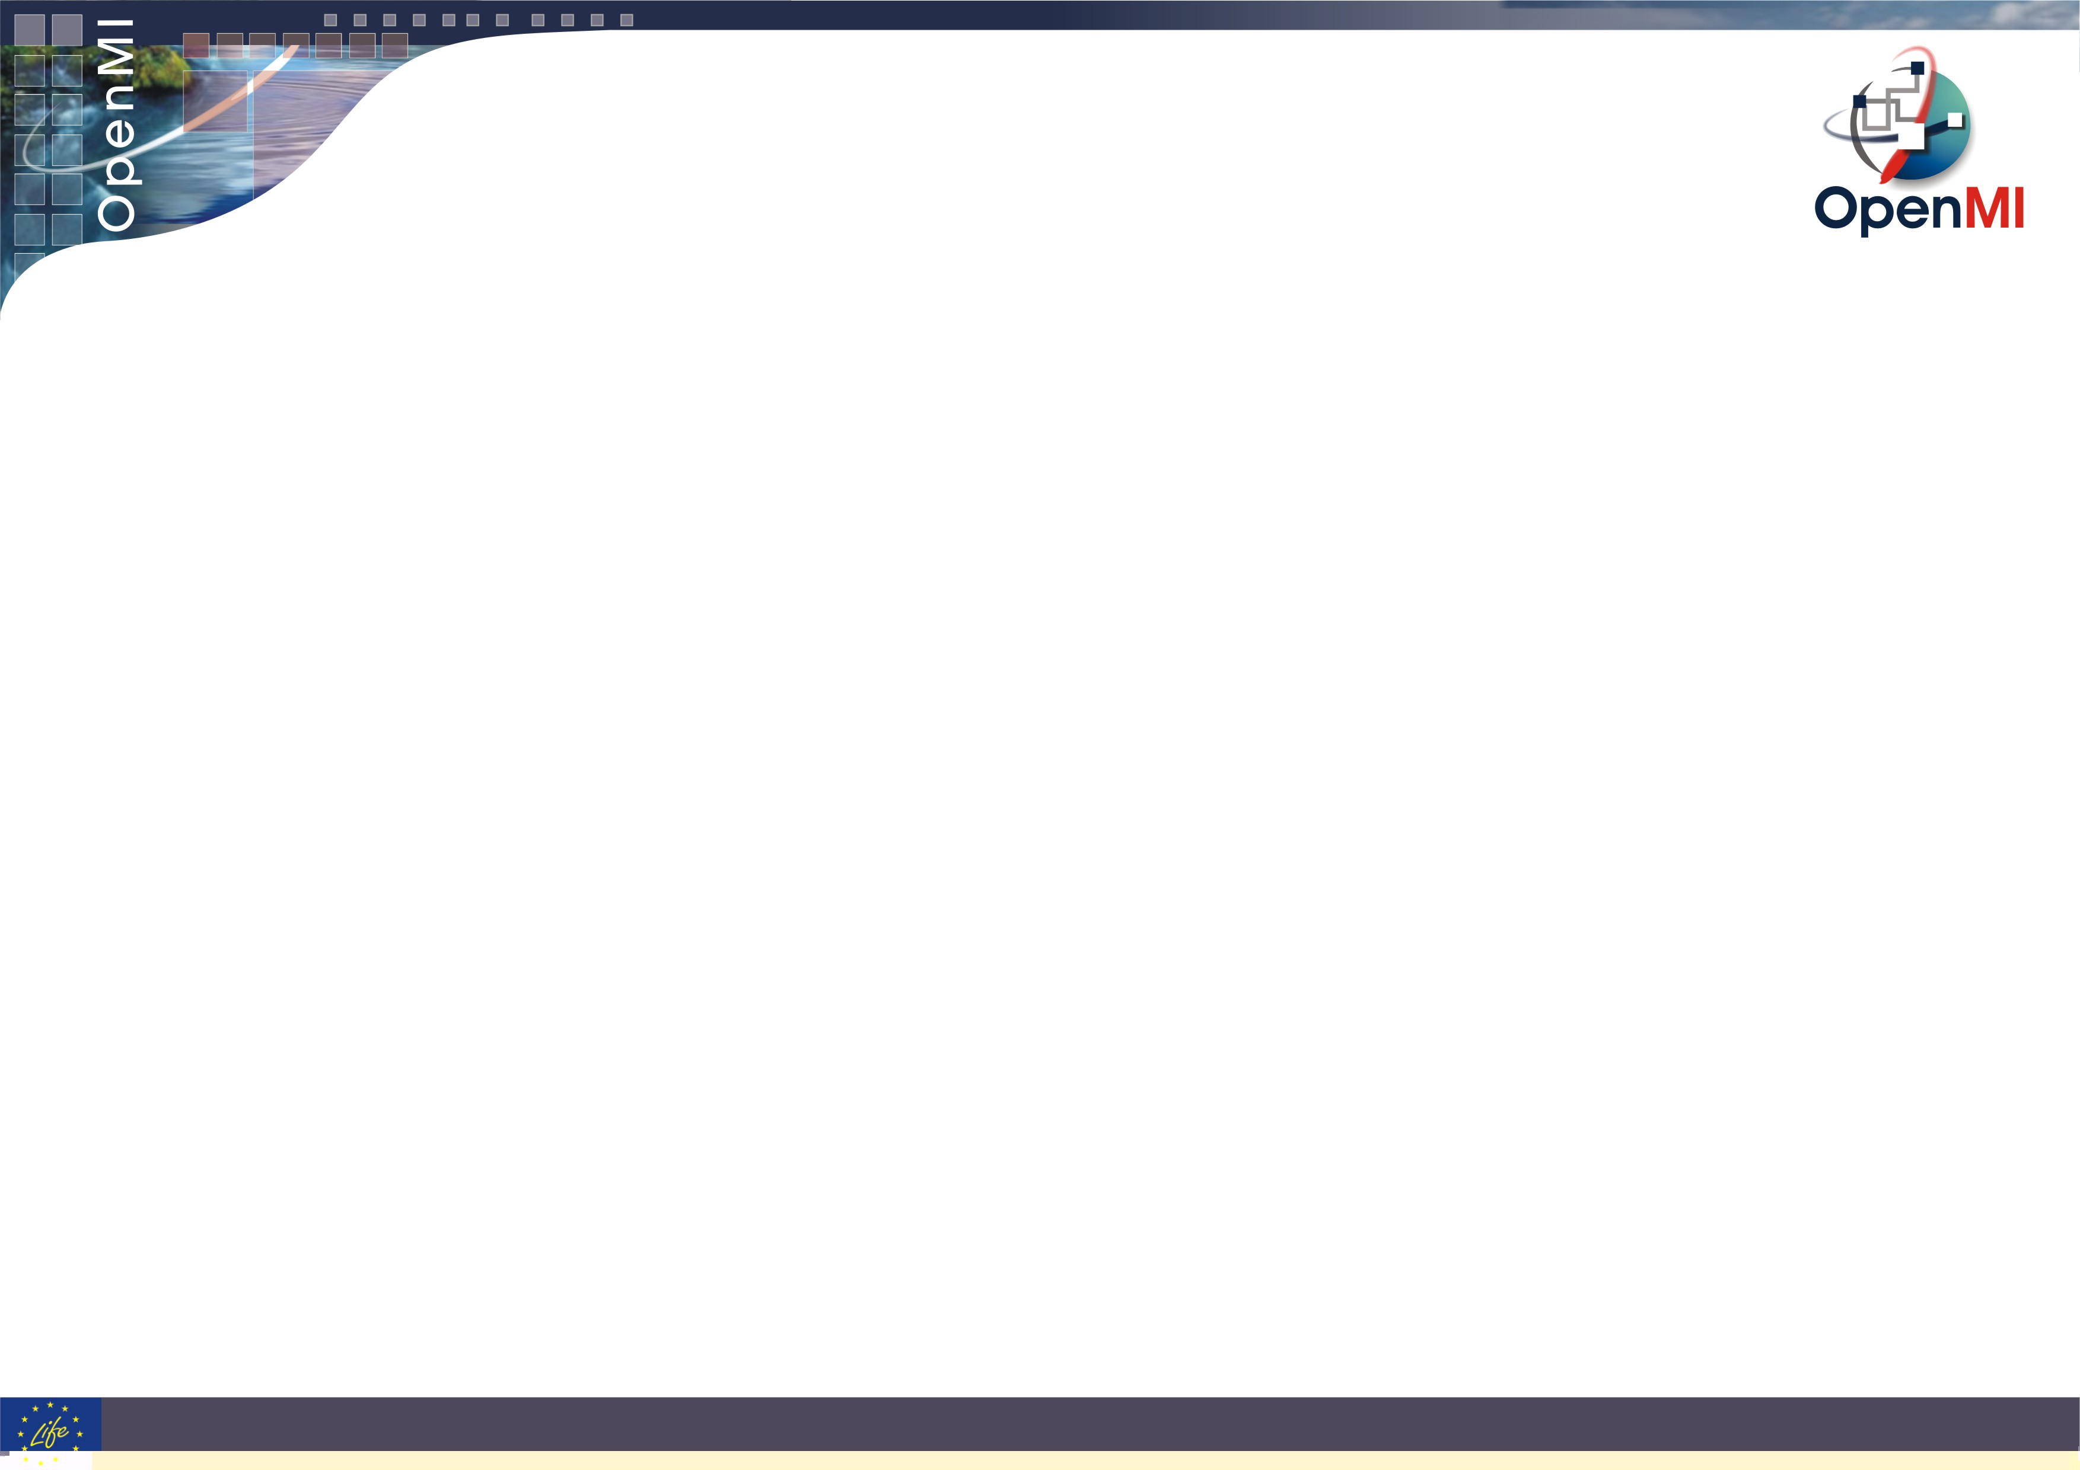
Topics
Why ?
Its history (development & application)
OpenMI 2.0 details
Notes:
Policy issues such as:
What will be the impact of climate change on flood damage costs?

Slide 3
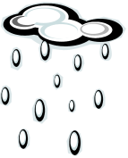








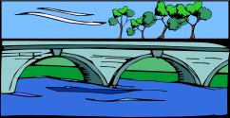
Typical issues … policy, science, operational
Agricultural runoff
Catchment and river processes
Urban runoff and human and industrial waste
Why do fish kills regularly occur here?
Any impact on human health ?
Sewage treatment
Lake processes
Why is it established ?
Notes:
Operational issues such as:
Why do fish kills regularly occur here?

Slide 4
Common themes
All the problems involve understanding and predicting multiple interacting processes
Problems span many disciplines:
  Environmental
  Social
  Economic
Modelling efforts should address integration of multiple disciplines
Open standards increase efficiencies in interdisciplinary co-operation
Why is it established ?
Notes:
All the examples have two points in common:
All the problems involve understanding and predicting multiple interacting processes
Problems span many disciplines:
Environmental
Social
Economic

Slide 5
The OpenMI Standard
Purpose:
Offer a widely used and accepted interface standard (API)
For interdisciplenary environmental modelling
To enable:
  process interaction and model integration
  interoperability with other data components and services
  DSS development
In order to
  to support better solutions and decisions in environmental management
Why is it established ?
Notes:
To address issues - need to bring together many skills
Past tendency to look inwards for expertise
To look outwards = failure
The question …
In future, where will most creativity, most knowledge lie – inside or outside your organisation?
The internet changes everything:
Facilitates communication
Provides access to knowledge
Links computing power
Global

Slide 6
What is the OpenMI?
An interface standard (API) for:
  run time data exchange between models, databases & other componentss
Whose purpose is to:
  improve ability to model complex scenarios
Application
Application
User interface
User interface
Input data
Input data
Hydraulics
Rainfall/Runoff
Output data
OpenMI
Output data
What is it ?

Slide 7
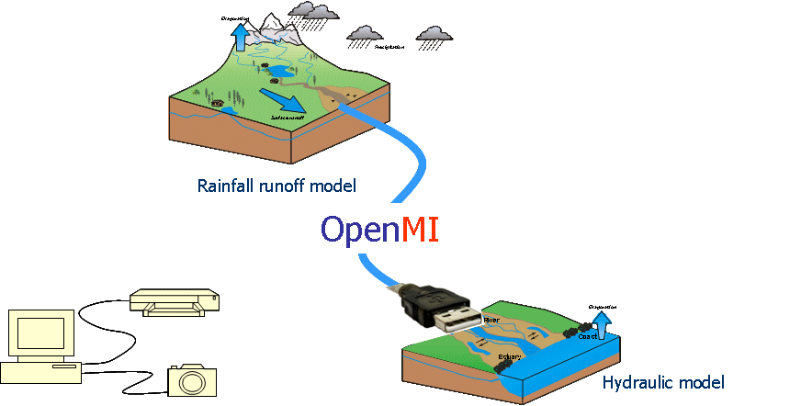
A useful analogy
The OpenMI is the modelling equivalent of a USB cable.
It changes the market from modelling systems to linkable components.
It drops the barrier to entry
What is it ?
Notes:
Policy issues such as:
What will be the impact of climate change on flood damage costs?

Slide 8
The OpenMI development history
2002-2005 Initial development in HarmonIT project
(NERC-CEH, DHI, HR Wallingford, Delft Hydraulics, RIZA, Alterra)
2006 Release version 1.0 Standard (API) + environment (.net)
2007 Release version 1.4 Standard (API) + SDK (.net/java)
2007 Establishment OpenMI Association (Dutch entity)
Now > 20 member organisations
2007-2010 Development version 2.0 Standard (API) + SDK (.net)
→ non-backward compatible
Jan-Mar 2010 Version 2.0 opened for review
Late 2010 Release version 2.0 (.net/java)
History

Slide 9
The OpenMI application history (Europe)
- some developments
2002-2005 Prototype applications with commercial hydraulic models
2006 Mike11-HD/NAM, MikeSHE, InfoworksRS/CS, MikeNET
2007 SOBEK-1D flow, Delft3D-Flow
2006-2010 OpenMI applied outside hydrological domain in various EU-projects (SEAMLESS, SENSORS, etc)
2007 HR Wallingford starts OpenWEB co-operation with UK industry & universities (development platform is based on OpenMI
2007 NL National Hydrological Instrument combines surface water-groundwater and vadose zone models with management models using OpenMI
2007-2009 Belgian and Greece authorities implements multi-supplier model combinations to test OpenMI under real world conditions
2009 SWAT becomes available a OpenMI component
2009 SWAN (waves) becomes OpenMI compliant
History

Slide 10
The OpenMI application history (USA)
- some developments
2007 CUAHSI experiments with OpenMI (ArcHydro, WaterOneFlow)
2007-2010 USACE-HEC and USGS start co-operation to link Modflow and HECRAS via OpenMI
2008-2009 CSDMS experiments with OpenMI and accepts OpenMI as the model interoperability interface on top of the CCA framework
2009 USDA implements OpenMI interface on top of OMS
2009-2010 ESMF develops prototype coupling SWAT and CCMS via ESMF and OpenMI interfaces
2010 US-EPA starts development of Frames3 based on OpenMI
History

Slide 11
Mission of the OpenMI Association
“Enabling model integration in Decision Support Systems”
Promoting model integration
Promoting data-model integration
Addressing better solutions and decisions in environmental management
…
The OpenMI Association

Slide 12
Vision (2014) – overall
(not directly influenced by OpenMI)
Integrated modelling with proces interaction (as opposed to single issue modelling) is being accepted by authorities as a better way of doing analysis for their own management decisions
Besides the natural need for such integrated modelling, this situation is stimulated by the efforts of the OpenMI Association, since it promoted the need for integrated modelling, and made integrated modelling much easier to achieve.
The OpenMI Association

Slide 13
Vision (2014) on OpenMI and OpenMI Association
OpenMI is the choice of technology for model integration
  technical focus:
    loosely coupled systems (enabling proces interaction), connectivity between suppliers
    enable models to be embedded in and manipulated via DSS
    enables linking to, but not provide basic framework for thight coupled systems (like ESMF etc.)
  domain focus:
    land and water management (inland and coastal waters)
  geography: worldwide, with initial focus on Europe and US
OpenMI has proven to be fit for daily application for each user group:
  researchers/developers grab and combine models to deliver an integrated system to a customer
  consultants grab and combine models to deliver an analysis to a customer
OpenMI is (part of) the technical solution to inter-organisation co-operation using shared modelling systems
The OpenMI Association

Slide 14
OpenMI 2.0
OpenMI 2.0 open for review untill March 31, 2010
Go to the Latest News section at www.openmi.org
Click the link for review
OpenMI 2.0

Slide 15
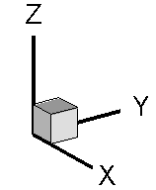

Domain Analysis:
Seven Component Types
proceeding in time /
difficulties with steps
in the past
Numerical Model
Constant Value Provider
0-Dimension, Time Series
GIS
Optimizers, Calibration tools
Scenario Managers
Analytic Function f (x,y,z,t)
Data Base or File Reader
with / without
georeference
constant in space
constant in time
ID based,
without georef.
proceeding in time
with georeference
no time
with / without
georeference
proceeding in time
exact georeference
without steps
exact time without
temporal interpolation
with / without
georeference
values of all timesteps
are available from the
beginning
OpenMI 2.0

Slide 16
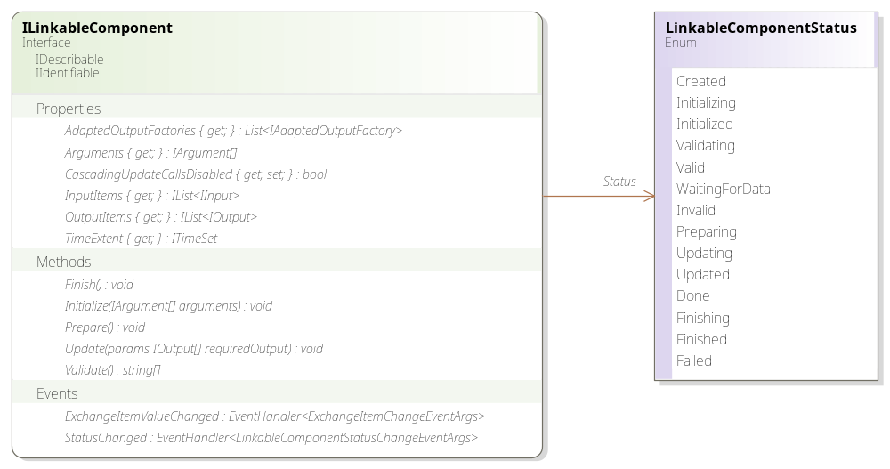
The Component
OpenMI 2.0 – the component

Slide 17
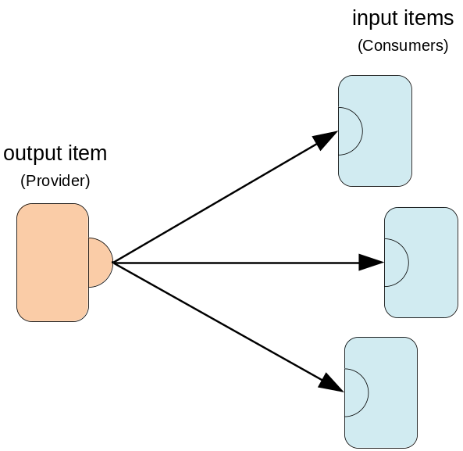
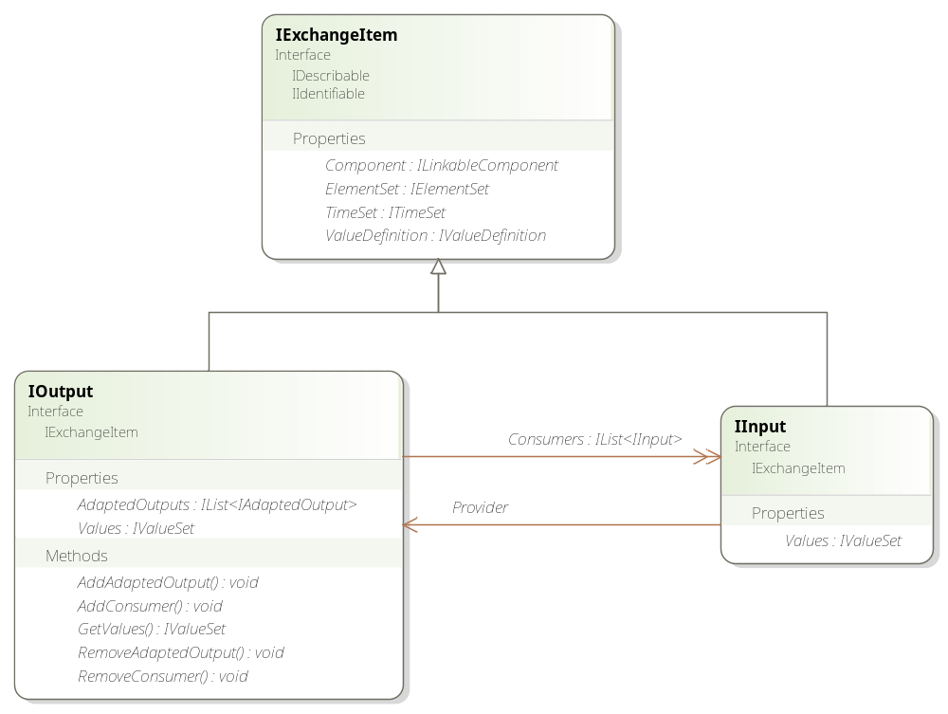
The Connection
OpenMI 2.0 – the connection

Slide 18
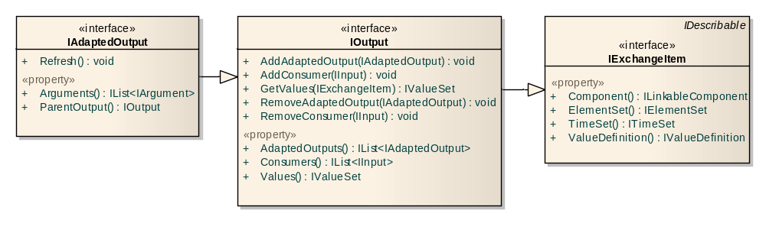
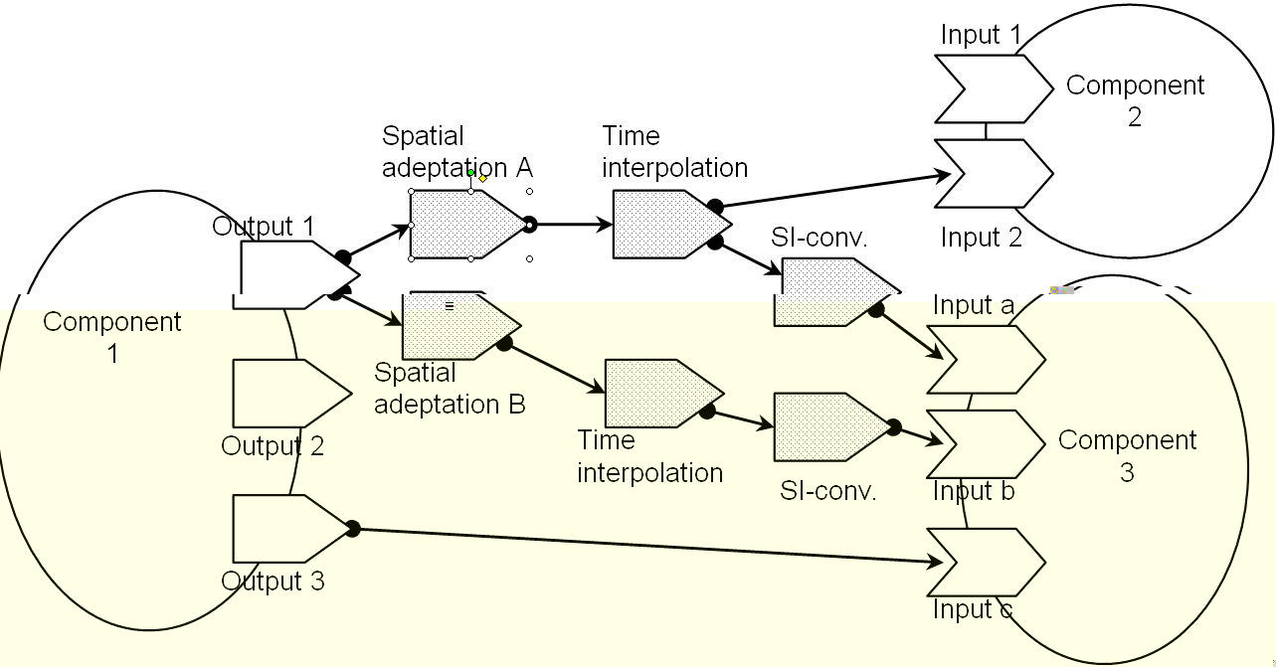
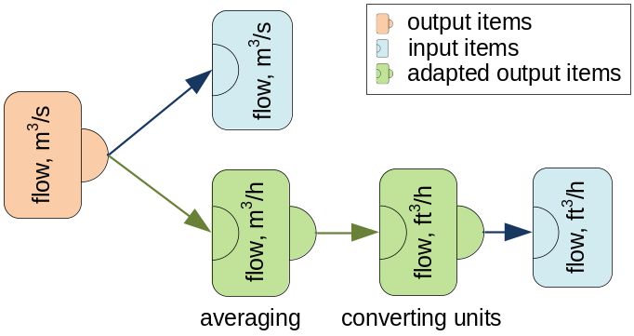
Stacking adapted connections
OpenMI 2.0 – the connection

Slide 19
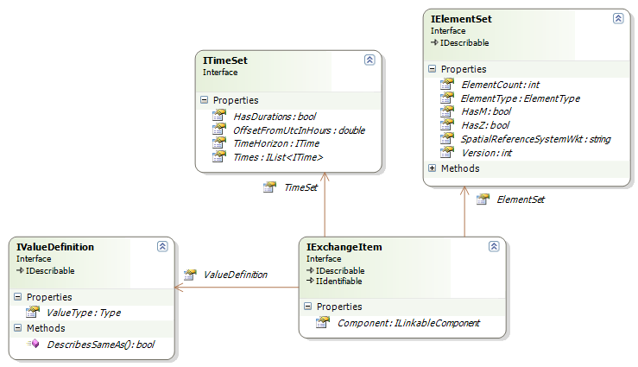
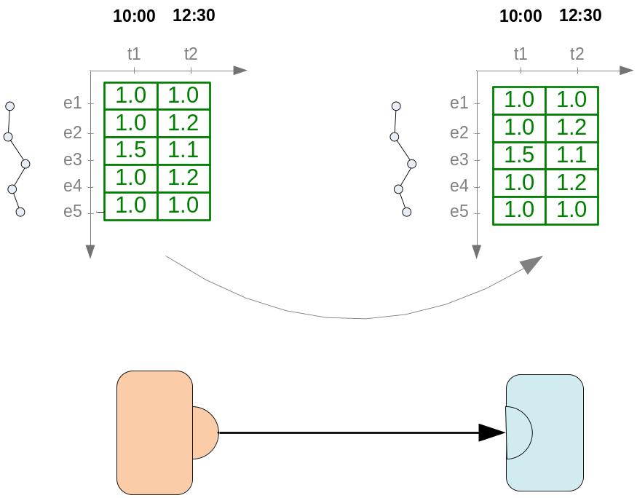
The data model
When?
Where?
What?
OpenMI 2.0 – the data model

Slide 20
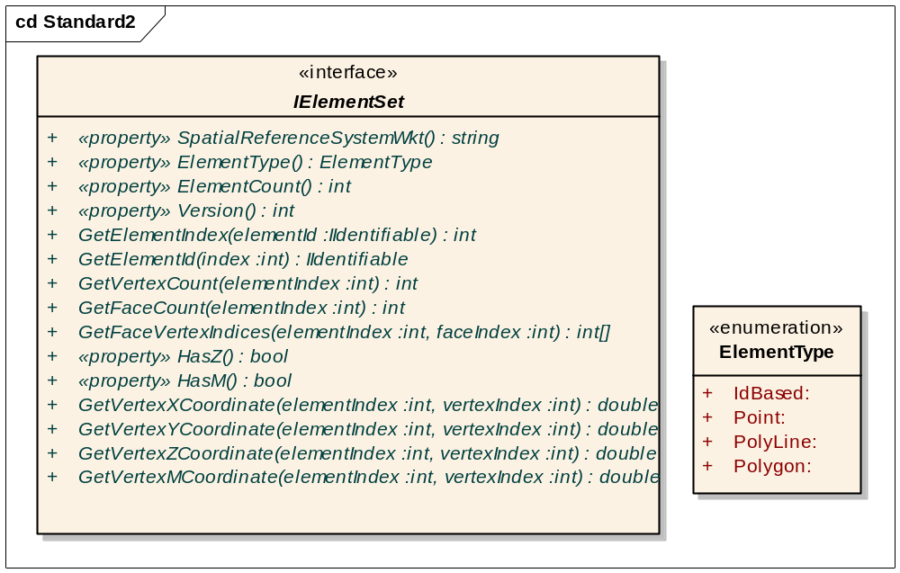
The spatial data model
Where?
OpenMI 2.0 – the data model

Slide 21
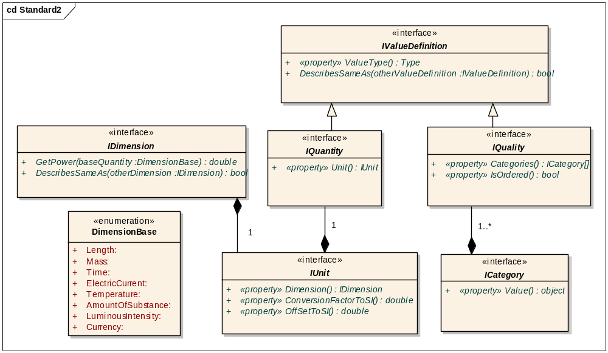
The value definition
OpenMI 2.0 – the data model

Slide 22
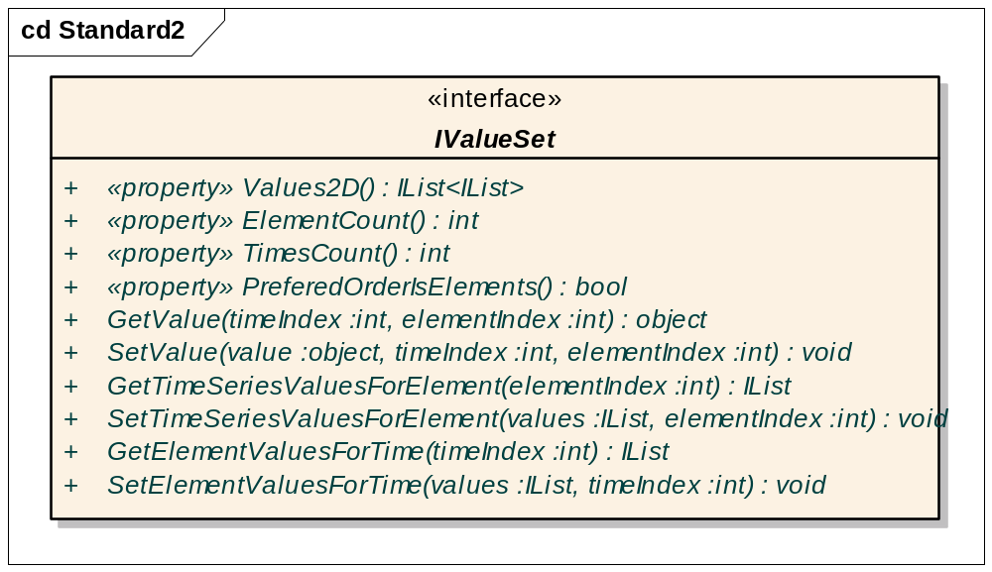
The values
OpenMI 2.0 – the data model

Slide 23
How it works
OpenMI 2.0 – how it works

Slide 24
Component status
OpenMI 2.0 – how it works

Slide 25
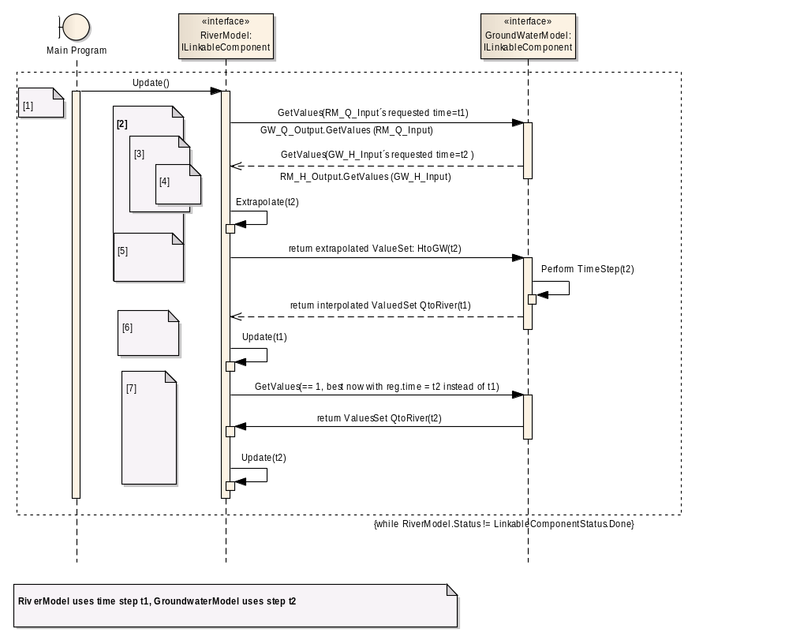
How it works
OpenMI 2.0 – how it works

Slide 26
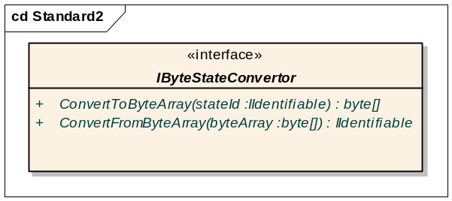
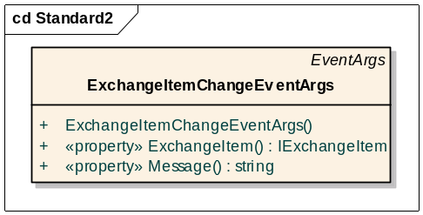
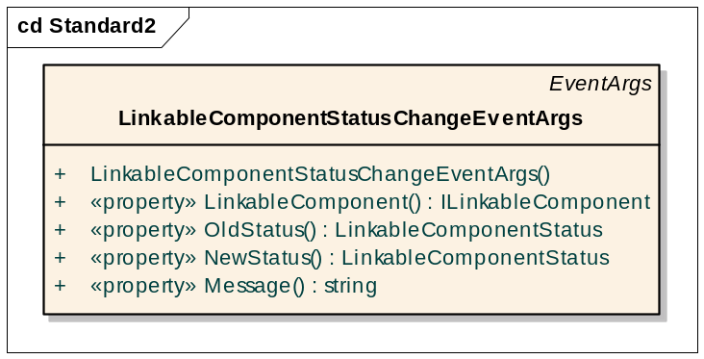
Other enhancements
persistent state management
events
OpenMI 2.0 – other enhancements

Slide 27
Summary
better object oriented
more intuitive
more efficient
better suited for numerical models, GIS, timeeseries exchange, static data providers
two modes of control flow:
  pull based (auto-update)
  loop based (externally controlled update)
What is it ?

Slide 28
The full class diagram
What is it ?

Slide 29
Currently open for review
OpenMI 2.0 open for review untill March 31, 2010
Go to www.openmi.org and click the link in the Latests News section on the review
What is it ?

Slide 30
Future development work
High Performance Computing
Remote model linking
Model based web-services
Enable connections to ontologies
Further harmonization with other standards (OGC ?)
→ Focus remains on model integration & interoperability
Products
→ SDK enhancements
→ Standard enhancements ?
The Future

