Slide 1
HydroDomainWorking Group
Surface Water Interoperability Experiment
UseCase 3
Michael Natschke,Stefan Fuest
Ulrich Looser, Irina Dornblut

Slide 2
Overall Goal
The goal for this use case is to provide automated monthly and yearly volume calculations from large rivers discharging to the oceans. Candidate locations for the experiment are from the Global Runoff Data Center (GRDC) database.
A website is developed from which users can view station locations participating in the experiment.
  The locations are found by interrogating a federated catalog of stream gages (gage has phenomena discharge for the time period of interest). Once the map is displayed,
  users can identify a gage of interest and some basic information is displayed in a popup, the watershed (catchment) is delineated and displayed.
  The user is presented with two buttons and a start and end date form. The user enters a start and end date and chooses either (1) Monthly volumes or (2) Yearly volumes.
  Once a button is pressed, the client application requests the daily or instantaneous discharge values (in various units) and the website displays a timeseries of monthly or yearly calculated volumes in both m^3 and cubic feet.
  The timeseries is displayed in a table and in a graph with the graph showing gaging station information including name, id and basin size..
© KISTERS AG KISTERS Präsentation <number> 07/11/26

Slide 3
Technologies applied
Use Case 3 will be done with KISTERS core technologies of the hydrological information system WISKI
The following components are applied
  KISTERS Database (Time Series and Meta Data)
  KISTERS TSM (Time Series and Calculation Managment)
  KISTERS Dataprovider (Serves KiTSM Data to the KISTERS Web, SOS)
  KISTERS Web application (offering the user required user functions, Consuming through SOS)
  KISTERS WISKI Client (configuration, data managment and analysis, consuming through SOS)
© KISTERS AG KISTERS Präsentation <number> 07/11/26

Slide 4
Solution Elements - KISTERS TSM – WISKI Client
© KISTERS AG KISTERS Präsentation <number> 07/11/26

Slide 5
Solution Elements - KISTERS TSM – WISKI Client
© KISTERS AG KISTERS Präsentation <number> 07/11/26

Slide 6
Solution Elements - KISTERS TSM – WISKI Client
© KISTERS AG KISTERS Präsentation <number> 07/11/26

Slide 7
Solution Elements - KISTERS TSM – WISKI Client
© KISTERS AG KISTERS Präsentation <number> 07/11/26

Slide 8
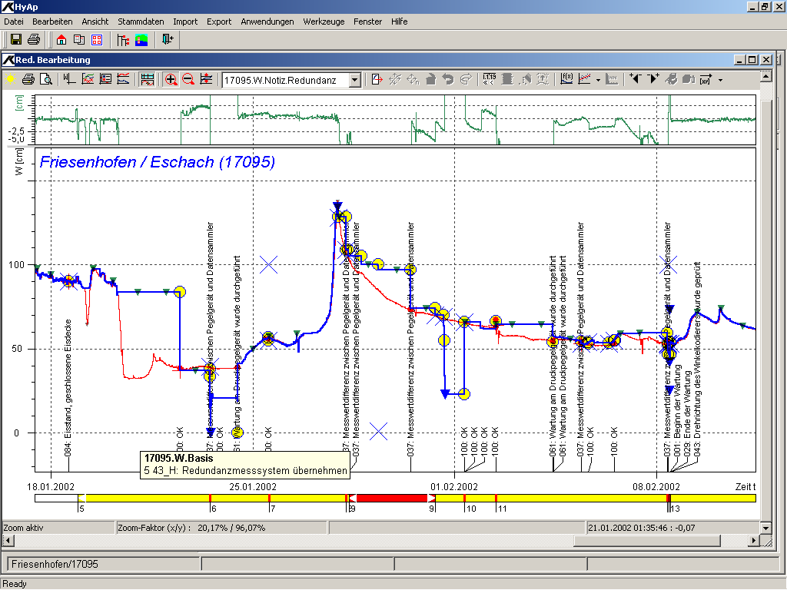
Solution Elements – Overall architecture - draft
CUASHI
WOF
KisRPC
TS Data
META
Other Sources
xyz
KiTSM
USGS
SOS
jdbc
Data provider
KisRPC
KiTSM
KisRPC
KISTERS Services
WMS, WFS, SOS
KISTERS Web
KISTERS TS Clients
Web Maps
Map Interface
WOF
xyz
SOS
© KISTERS AG KISTERS Präsentation <number> 07/11/26

Slide 9
Work plan
USE CASE | DESCRIPTION | TECHNOLOGY | DATA SORCES | OUTCOME | PARTY IN CHARGE
3 | Setting up the KISTERS System in Headquarter Aachen |  |  | Configured WISKI System | KISTERS
3 | Setting up measurement network in WISKI database | RDBMS | GRDC GTN-R Stations | Migrated structure with meta and time series data | KISTERS GRDC
3 | Setting up and configuring KiTSM | JAVA middle tier | WISKI Database | Adding aggregation time series (monthly and annual time series and calculation routines) | KISTERS
3 | Developing SOS/WaterML plugin for KiTSM | JAVA | Other SOS such as provided by the USGS | Consuming data from other SOS | KISTERS/ potentially 52°North
3 | Developing SOS/WaterML plugin for KiTSM/Dataprovider | JAVA | KiTSM | Publishing KiTSM (GRDC) data through SOS/ WaterML to WISKI Web | KISTERS
3 | Setting up WISKI Web to consume and display data according to the requirements of usecase 3 |  |  | A Web Front End that allows search, display and access of GRDC/GTN-R data | KISTERS
© KISTERS AG KISTERS Präsentation <number> 07/11/26

