Slide 1
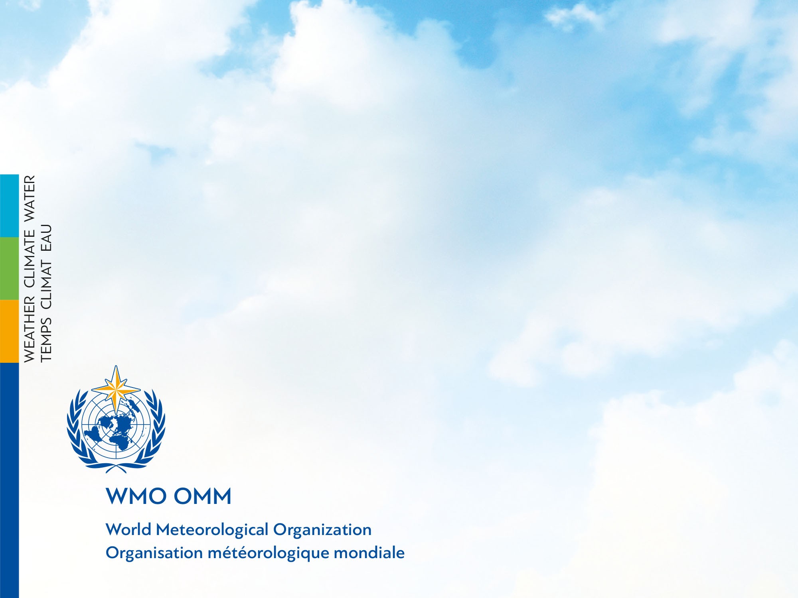
Hydrology Domain Working Group Meeting
Silvano Pecora
Vice-President of CHy
OGC TC Leuven
26 June 2019

Slide 2
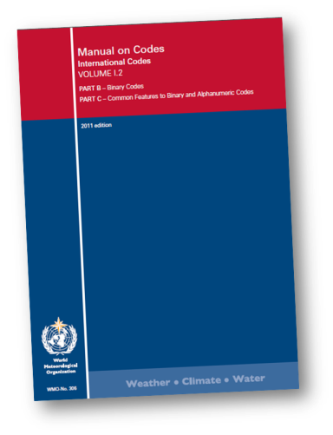
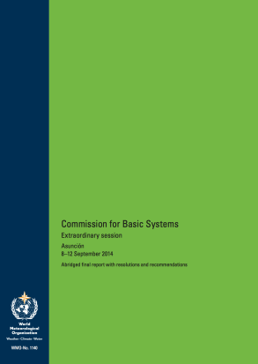
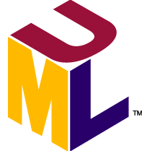
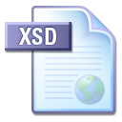
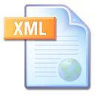
Specification to data encoding
Requirements model
WMO regulation and other specifications
Application Schema
(aka ‘conceptual model’)
XML instance documents
********
****
*******
XML Schema 1.0
Schematron .
« conforms to »
********
SCH
**
*******
**********
**
*********
« derived from »
Validatable data products
*********
Technology independent description of content and structure of information to be exchanged for a given application
Validation schema and rules

Slide 3
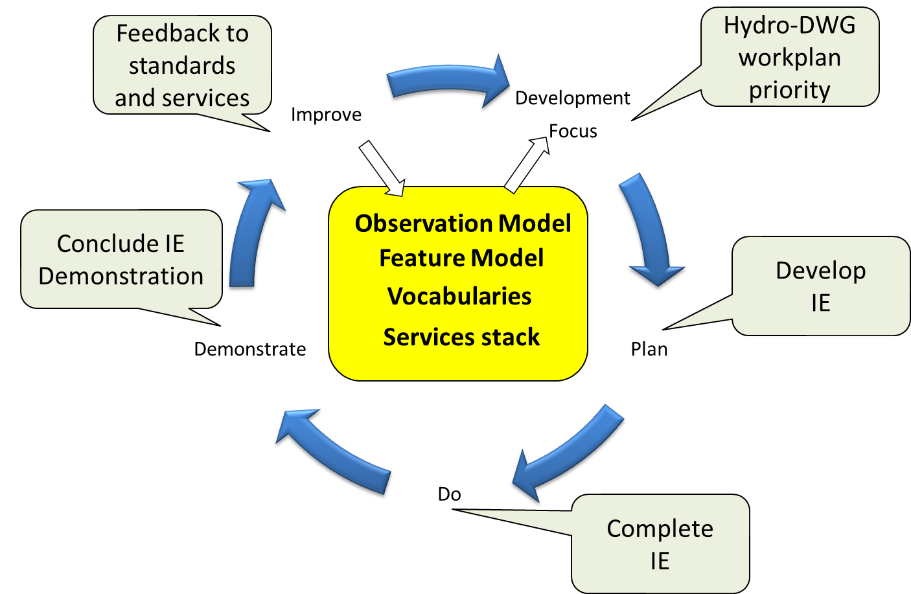
International Standardization for Water Data
OGC-WMO Hydrology Domain Working Group
standards for water data: WaterML 2.0 suite
organizing Interoperability Experiments (IEs) focused on different sub-domains of water
Chairs:
Tony Boston (Australia)
Silvano Pecora (Italy)
David Blodgett (USA)
Iterative Development
http://external.opengis.org/twiki_public/bin/view/HydrologyDWG/WebHome

Slide 4
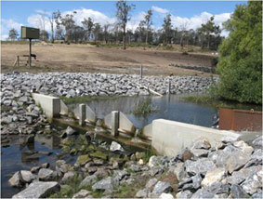
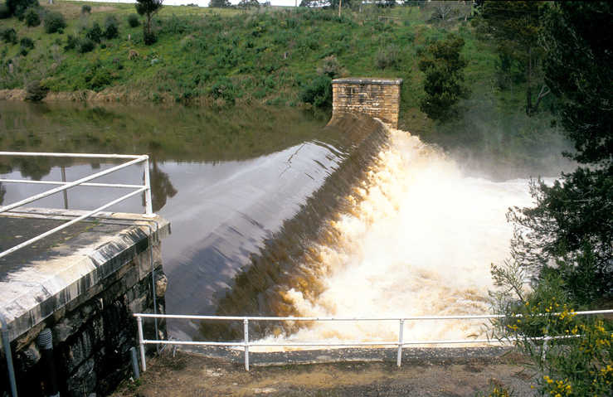
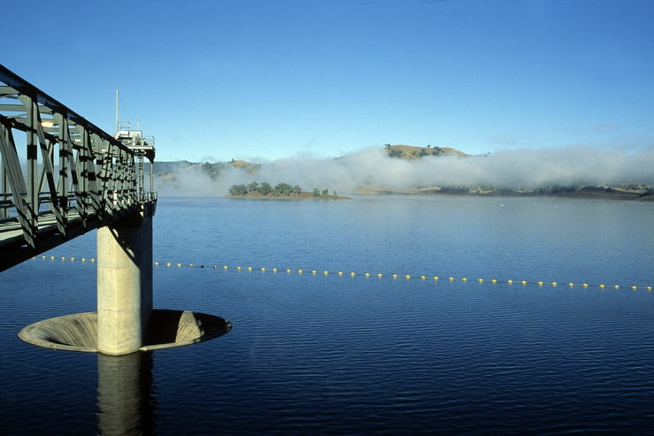
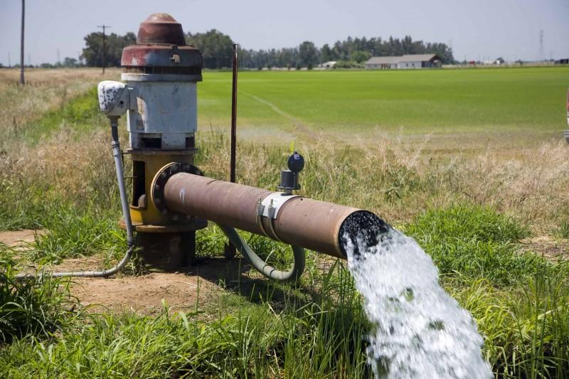
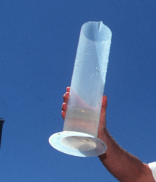
WaterML2.0 standards
Part 1 - Timeseries
Part 2 – Ratings, Gaugings and Sections
Part 3 – Surface water features
Part 4 – Groundwater
Part 5 –
Water quality (best practice)

Slide 5
ADOPTIONS by OGC and WMO
OGC adopted WaterML2 Part1 – Timeseries in February 2014, WaterML2 Part2 - Ratings, Gaugings and Sections in February 2016, the conceptual model WaterML2 Part3 - Surface Hydrology Features in January 2018, WaterML2 Part 4 - GroundWaterML2 in March 2017
WMO Executive Council 69th session meeting in May 2017 formally adopted WaterML2 Part 1 & 2 standards (p.133-134)
decides “To amend the Manual on Codes, Volume I.3 to introduce WaterML2 Parts 1 and 2 as data representations that are suitable for the exchange of hydrological information, as specified in Annex 1 of the Annex to Recommendation 12 (CBS-16)”
Notes:
EC-69: https://library.wmo.int/opac/doc_num.php?explnum_id=3645
CHy-15: https://library.wmo.int/doc_num.php?explnum_id=3404

Slide 6
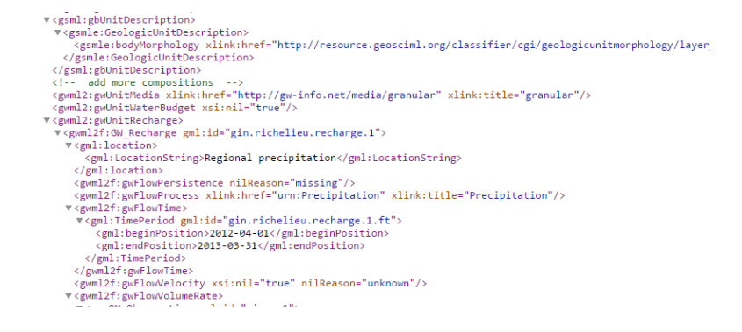
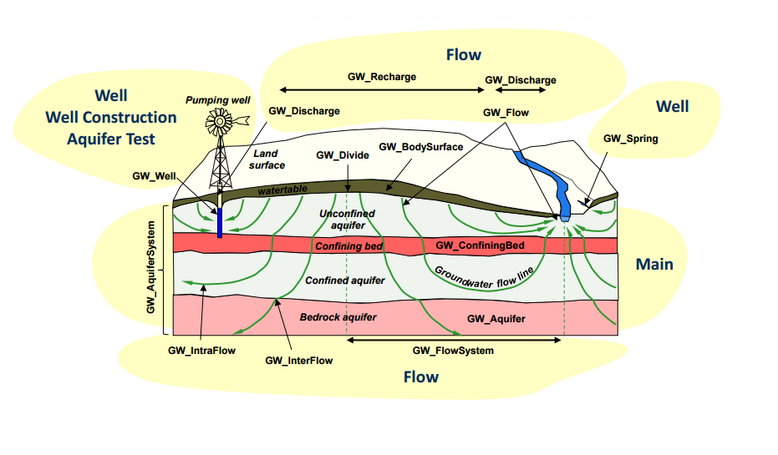
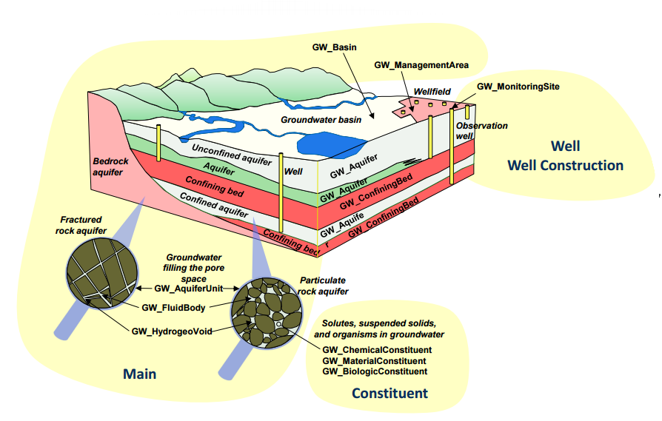
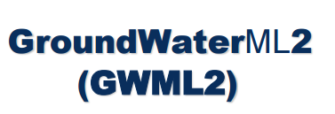
WaterML2 Part4
OGC Standard today -> WMO Standard soon

Slide 7
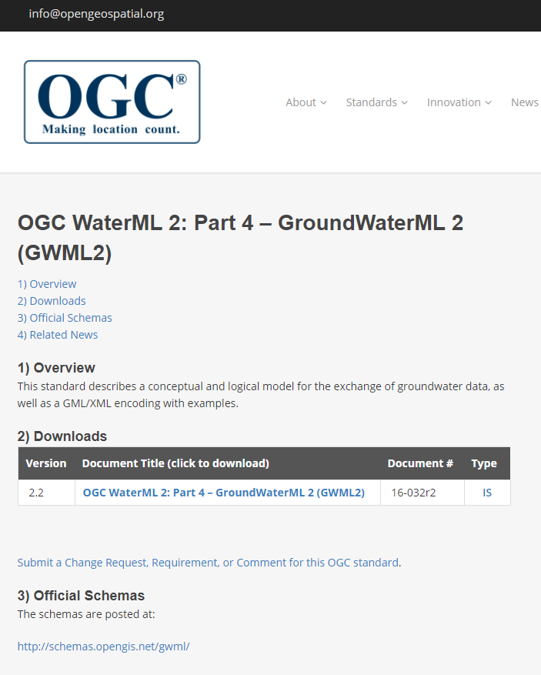
Standards Development
GroundwaterML2 (GWML2)
Open Geospatial Consortium
Geospatial standards of all kinds
Hydro Domain Working Group
WaterML2 hydro data standards
Groundwater Standards Working Group
GWML2
reuses GeoSciML, O&M, …
Hydrogeological & data experts
CAN, USA, FR, DE, AT, NZ, AU
2012-1017
final approval: March 2017

Slide 8
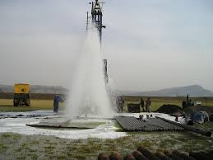
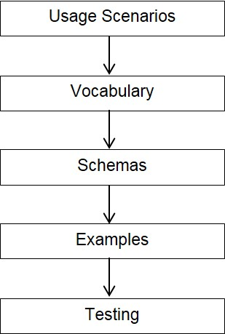



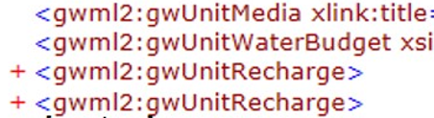
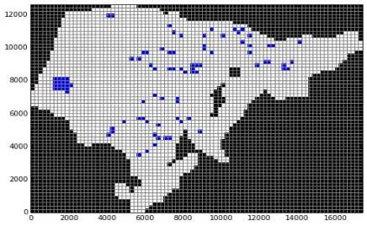
Methods
GWML2 development
well drilling
environmental
policy
flow modeling
https://water.usgs.gov/ogw/aquiferbasics/

Slide 9
Conceptual Model: GW & SW
Fluid Container Pattern: Containers, Voids, Fluids
fluid flow
container object
container matter
void
fluid body
groundwater
surface water
fluid matter

Slide 10
Conceptual Info Model: GW
GW Container Pattern: Units, Voids, Fluids
Hole-y Trinity

Slide 11
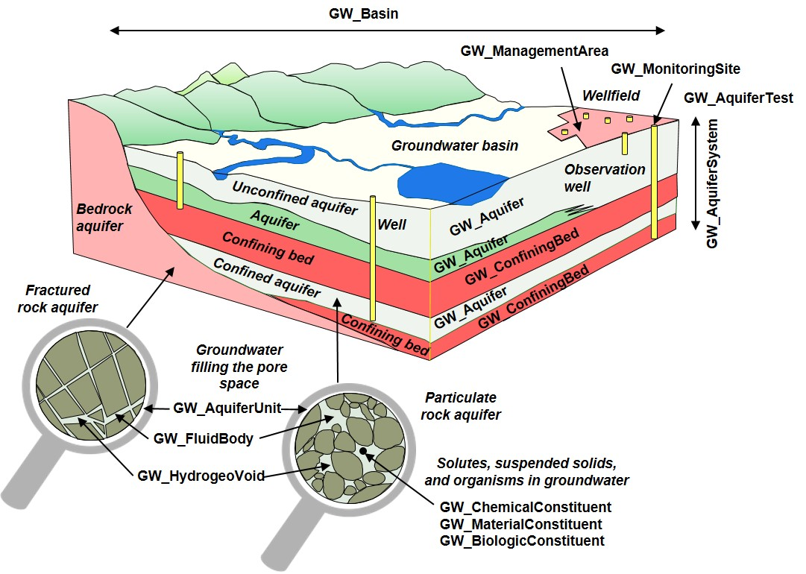
GWML2: contents
Hydrogeological Units, Voids, Fluid bodies

Slide 12
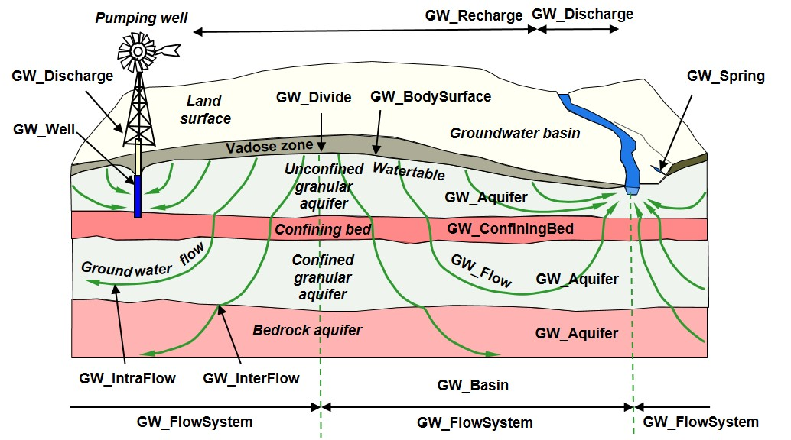
GWML2: contents
Fluid Flow, Water wells, Springs

Slide 13
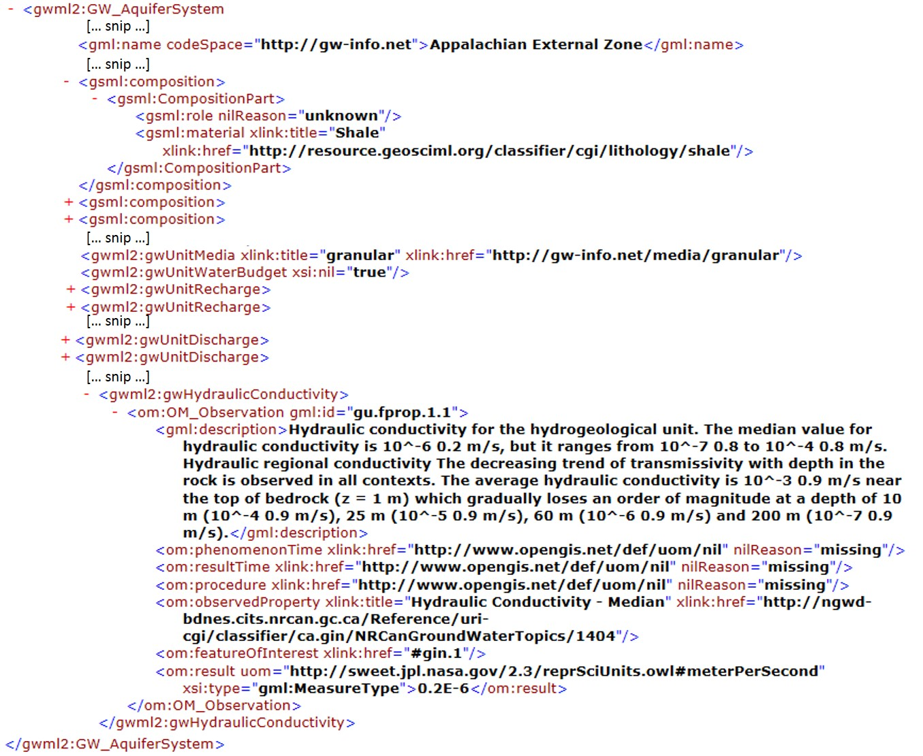
GWML2: GML-XML encoding
Aquifer System: Lithology, Hydraulic Conductivity

Slide 14
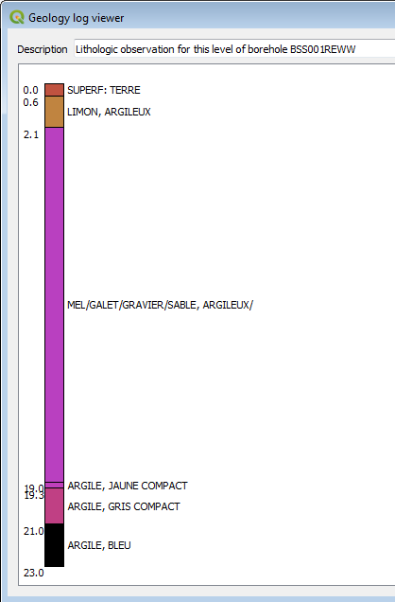
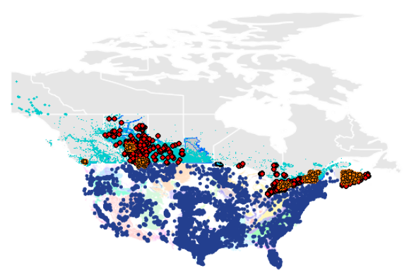
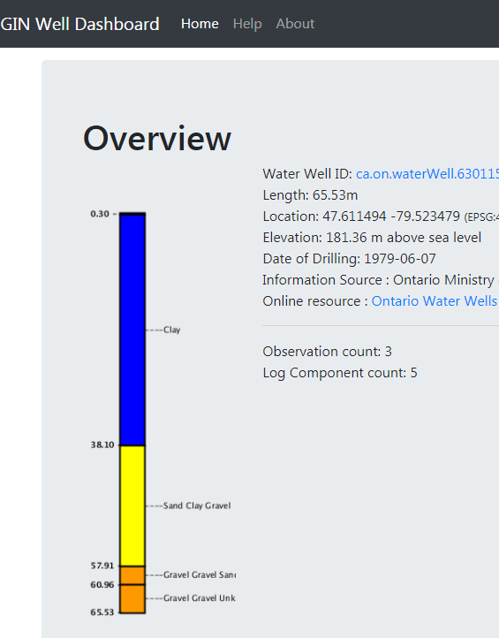

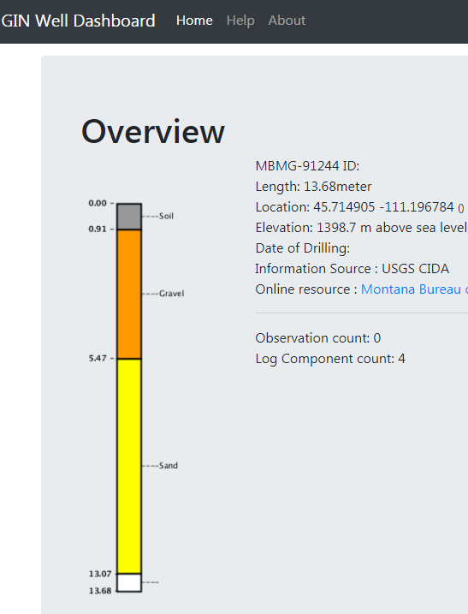
Implementation
Commercial Scenario: Wells, Units, Levels,…
Logs
GW Info Network (CAN)
QGIS
National GW Monitoring Network (USA)

Slide 15
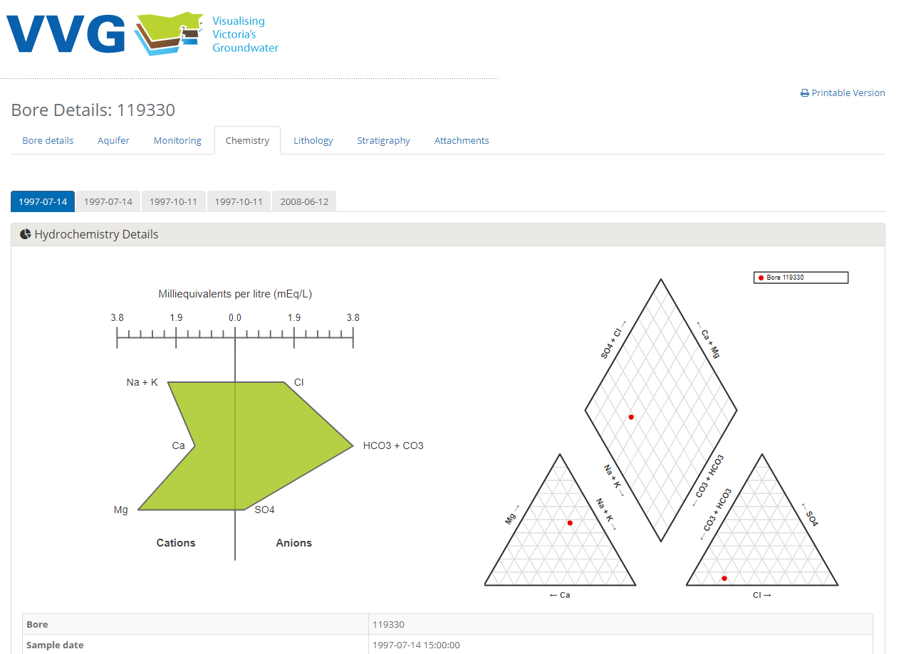
Implementation
Environmental Scenario: Monitoring, Flow,…
groundwater chemistry

Slide 16
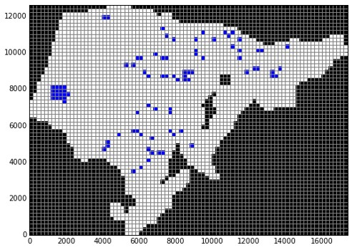
Implementation
Scientific Scenario: Units, Wells, Measurements,…
MODFLOW model from GWML2 inputs (Horowhenua, NZ)

Slide 17
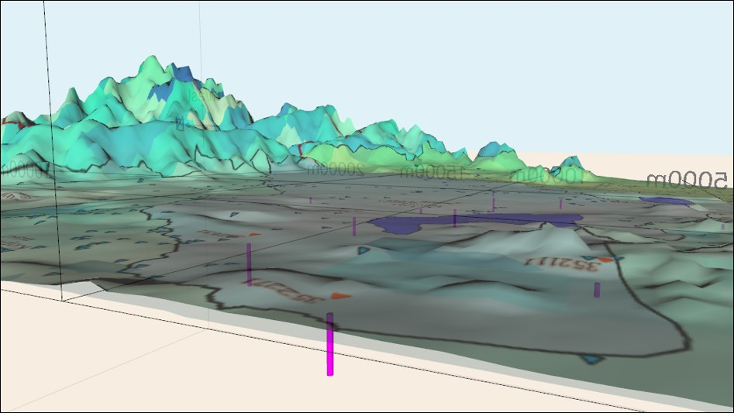
Implementation
Policy Scenario: Management Areas, Units,…
3D visualization of GWML2 data for Horowhenua Management Area (NZ)

Slide 18
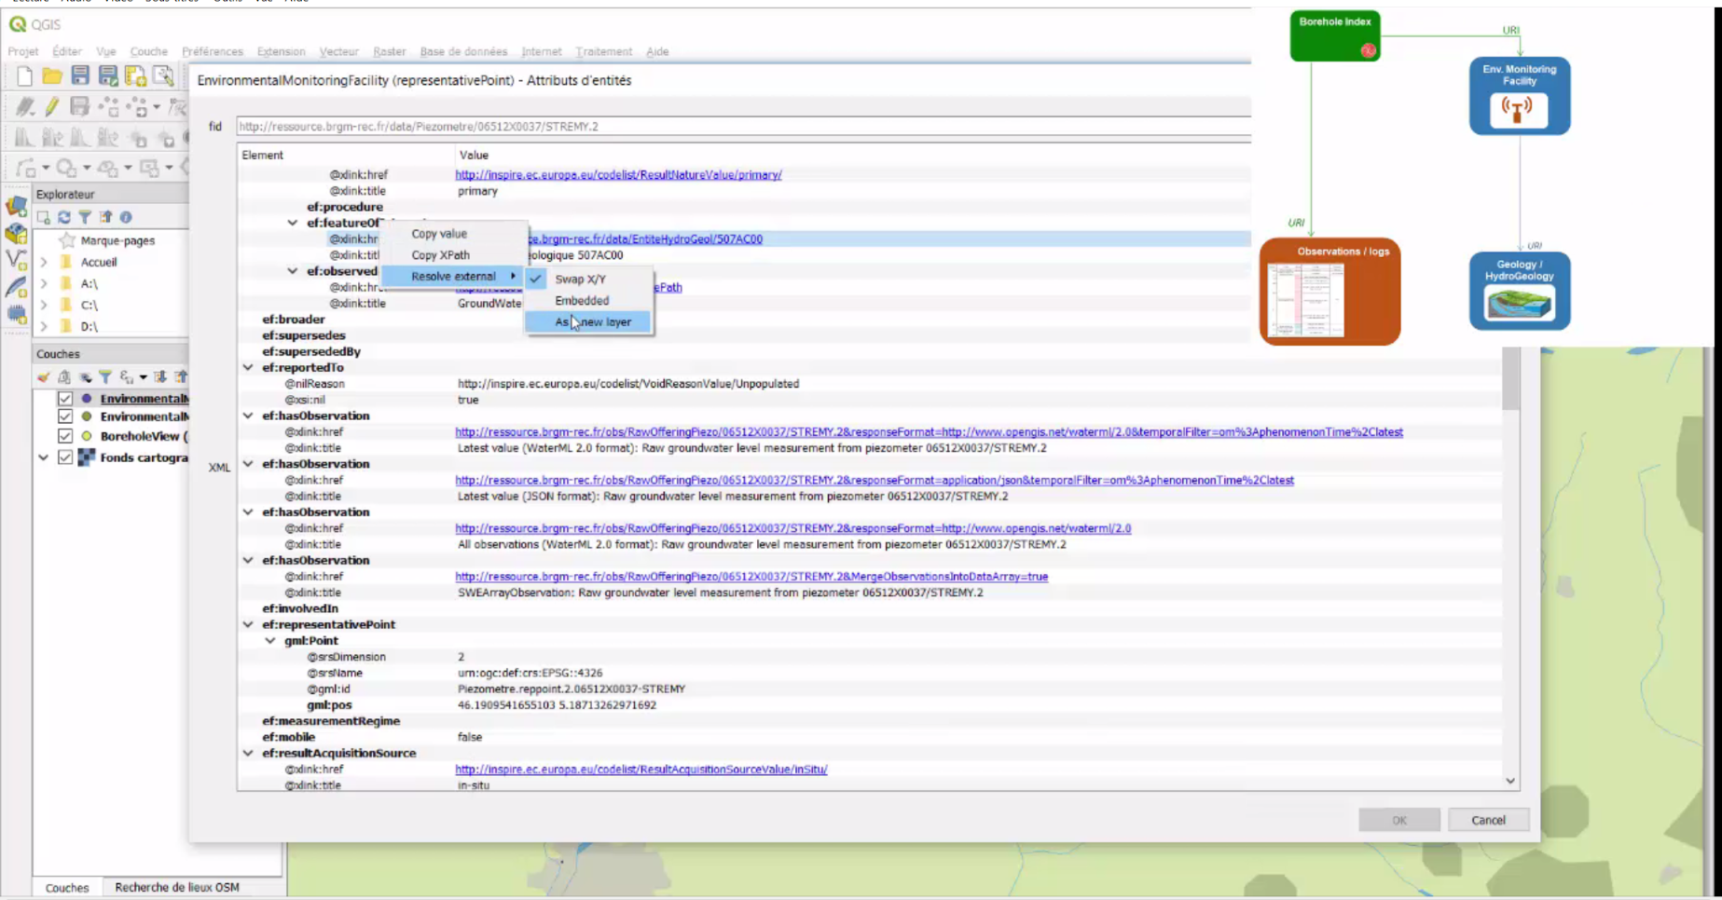
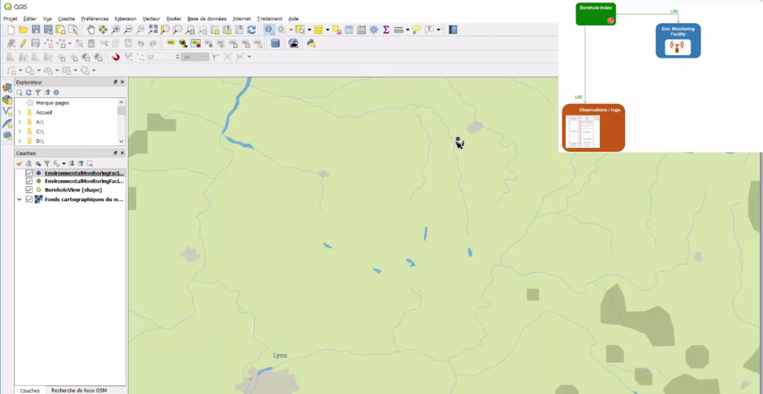
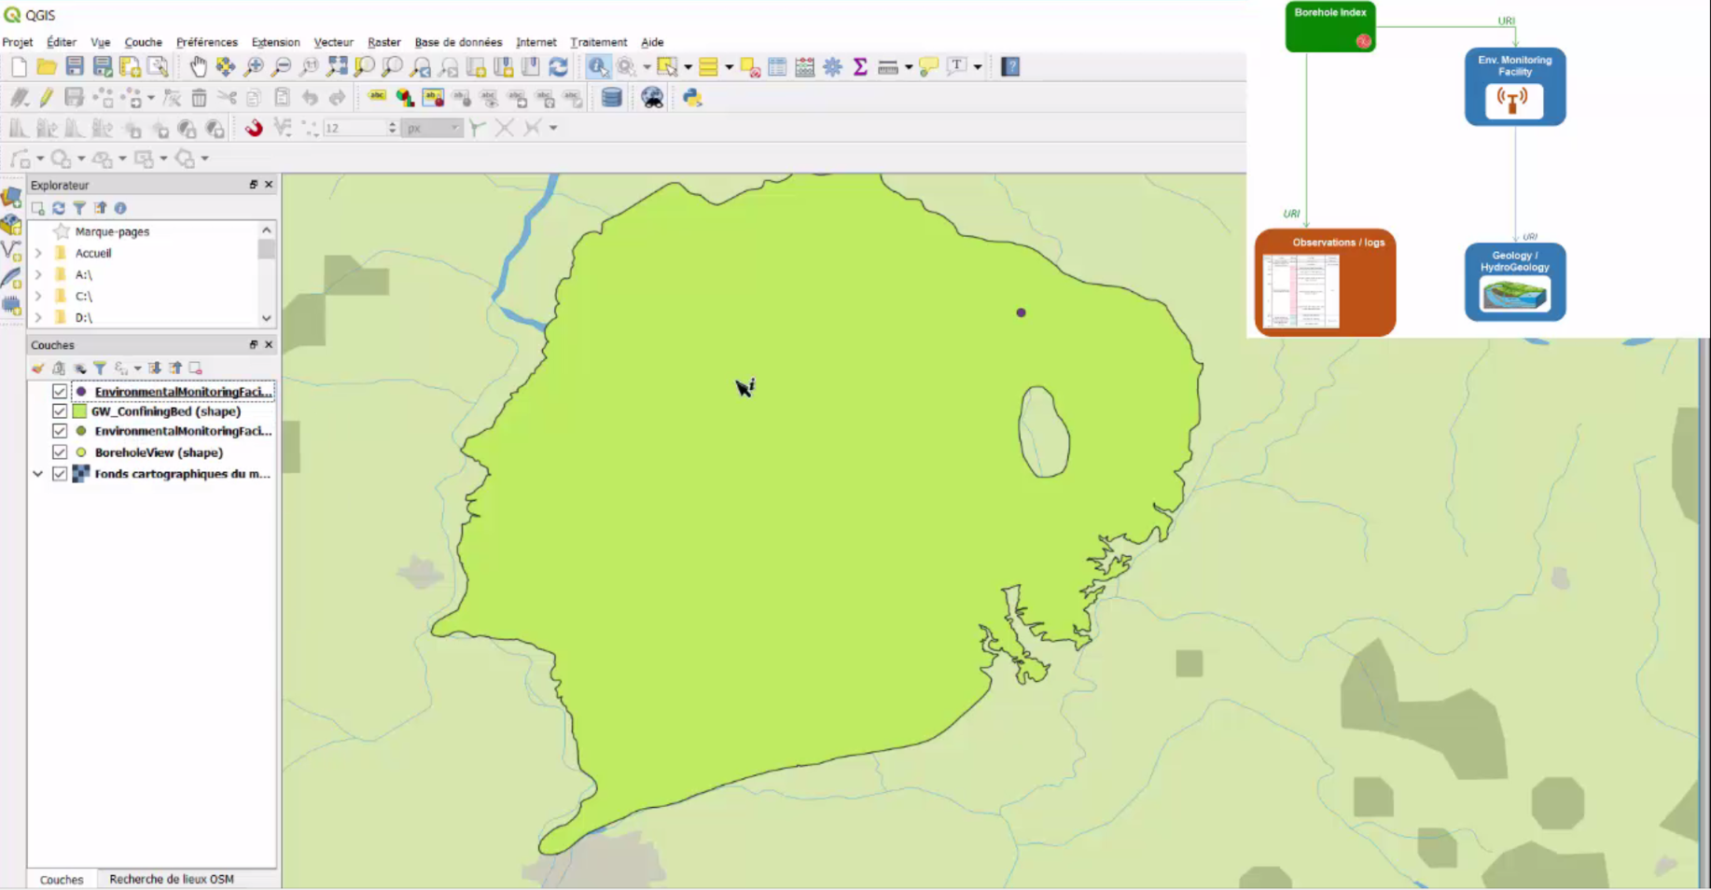
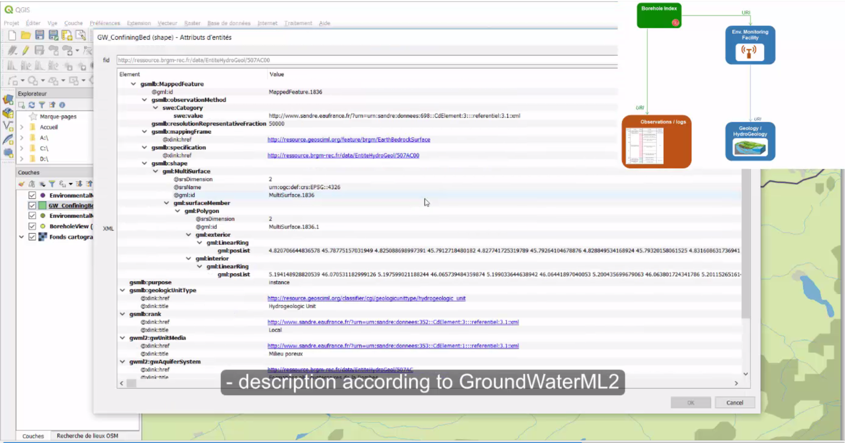
Implementation
Technical scenario: GWML2 data used in QGIS
Screenshot QGIS GMLAS toolbox interaction with French Groundwater Information Network: linking stations to aquifers description flows

Slide 19
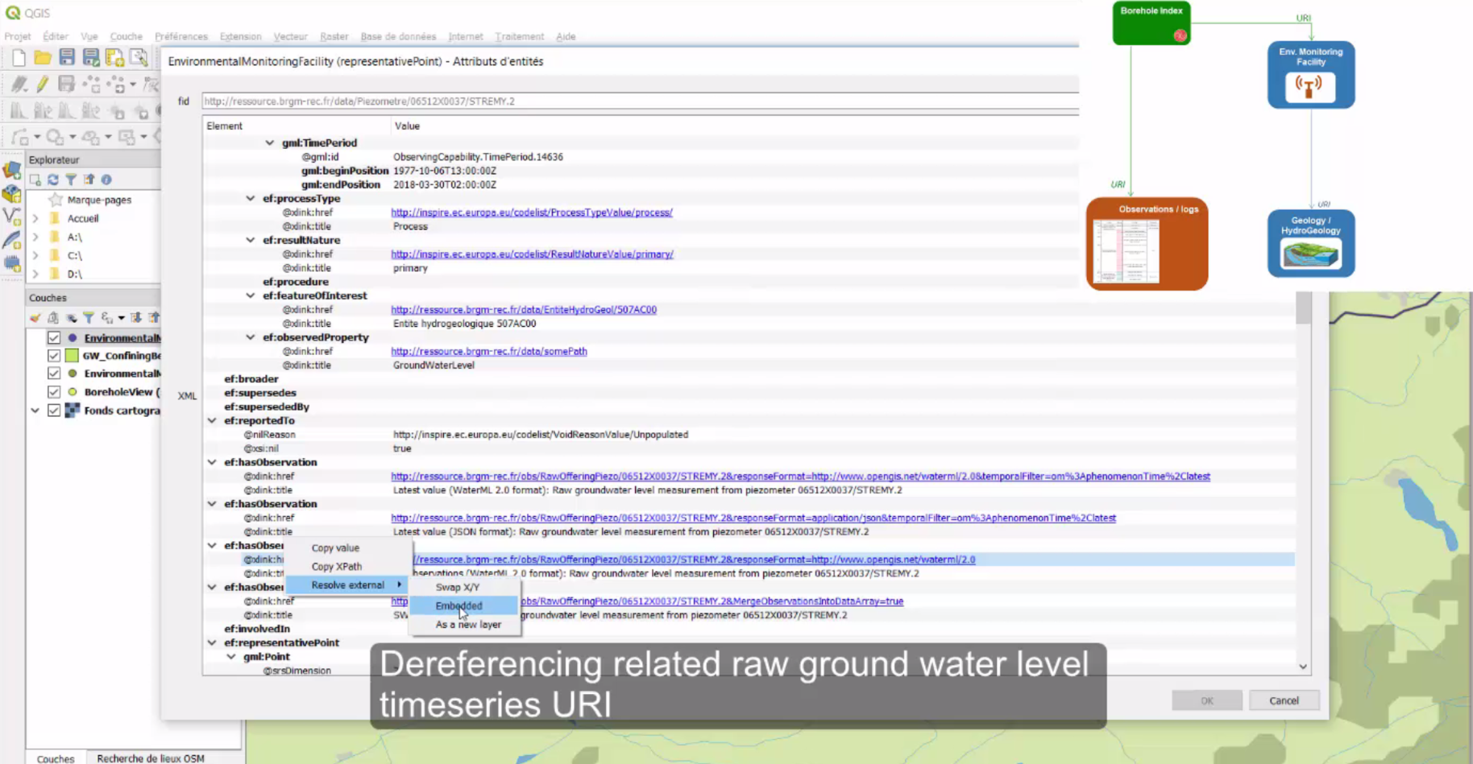
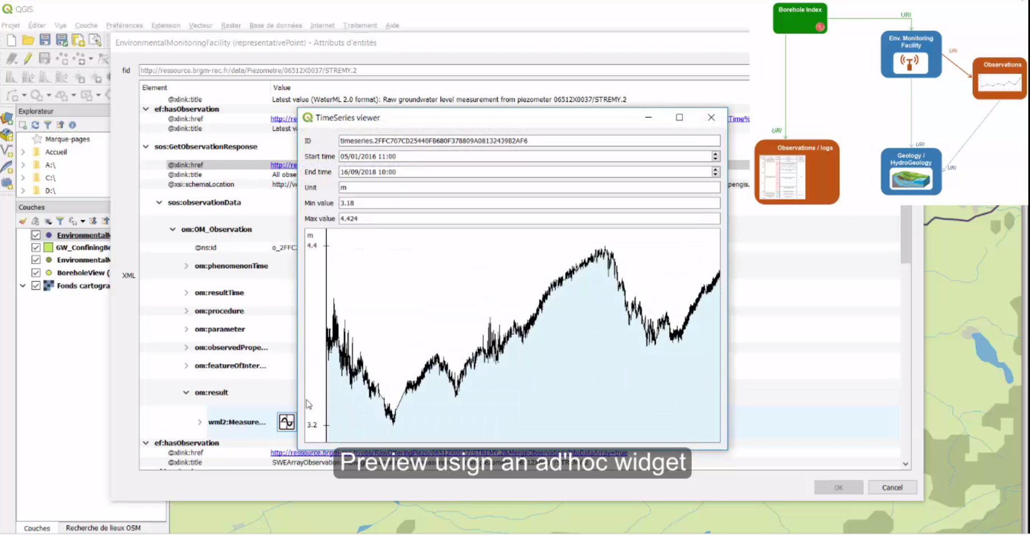
Implementation
Technical scenario: GWML2 data used in QGIS
Screenshot QGIS GMLAS toolbox interaction with French Groundwater Information Network : linking stations to groundwater level observations services

Slide 20
These are the fine people that make
WaterML2-GroundWater what it is today
Boyan Brodaric (GSC)
Dave Blodgett (USGS)
Eric Boisvert (GSC)
Francois Letourneau (GSC)
Jessica Lucido (USGS)
Sylvain Grellet (BRGM)
Laurence Chery (BRGM)
Bernhard Wagner (BGS)
Alex Kmoch (GMS/U Salz)
Peter Dahlhaus (FedUni)
Andrew MacLeod (FedUni)
Bruce Simons (CSIRO/BOM)
Thank you!

Slide 21
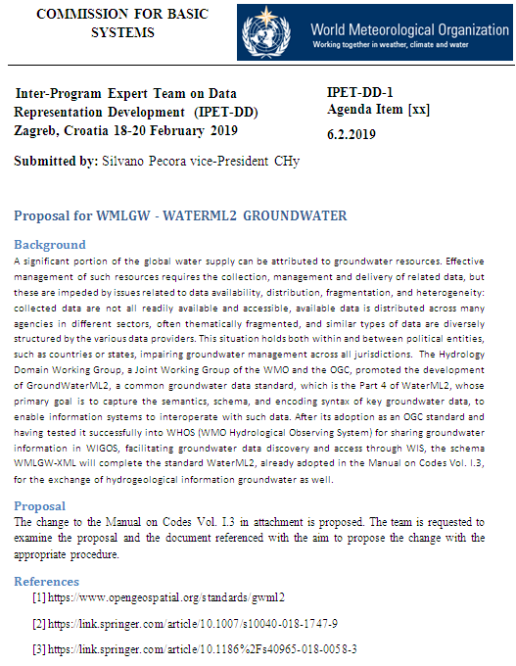

Slide 22
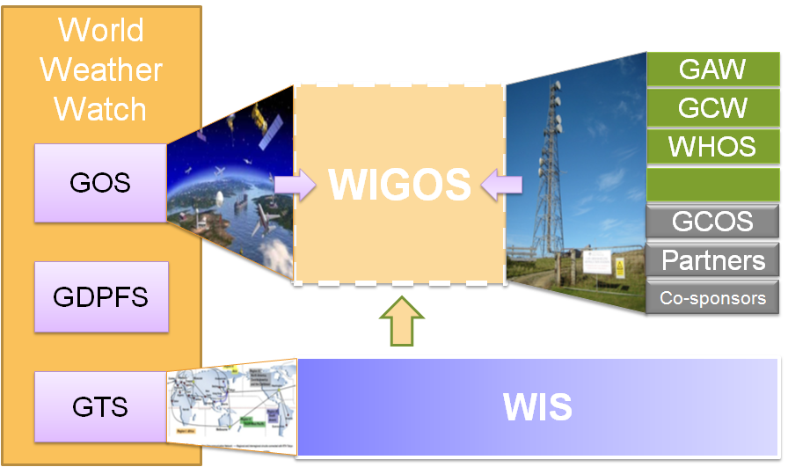
WMO INTEGRATED GLOBAL OBSERVING SYSTEM (WIGOS) and WMO HYDROLOGICAL OBSERVING SYSTEM (WHOS)
In June 2015 the President of CHy informed Cg-17 of CHy proposal to develop WHOS as the CHy contribution to WIGOS
Congress welcomed the effort and urged the president of CHy to continue guiding WHOS to full implementation
Congress urged the promotion of WHOS among NHSs and the hydrological community

Slide 23
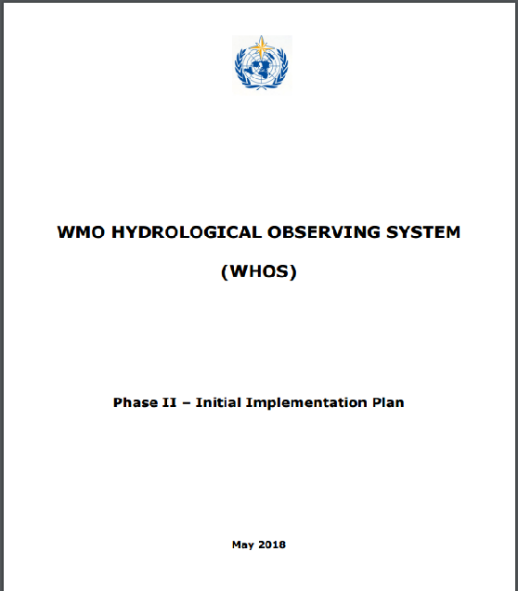
EC-70 DOCUMENT on THE INITIAL IMPLEMENTATION
http://www.wmo.int/pages/prog/hwrp/chy/whos/documents/WHOS_Phase-II_Initial_Implementation_Plan.pdf

Slide 24
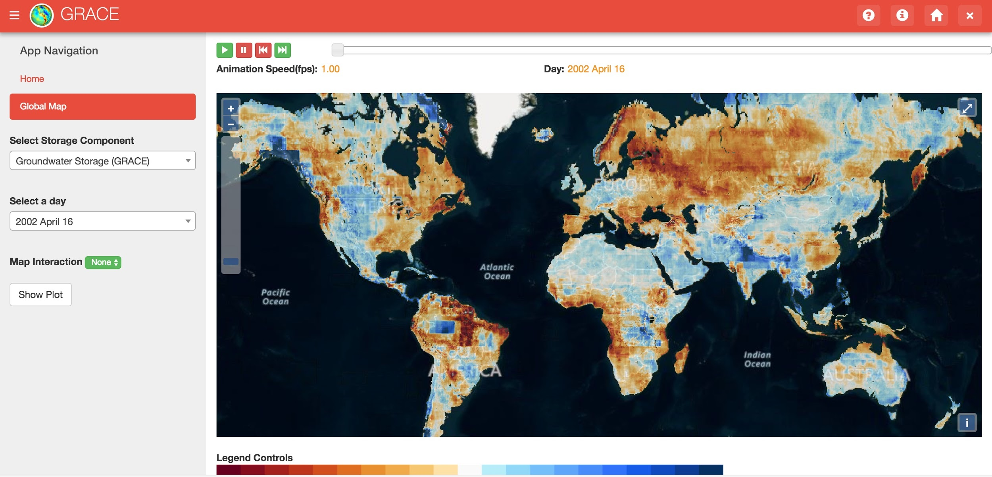
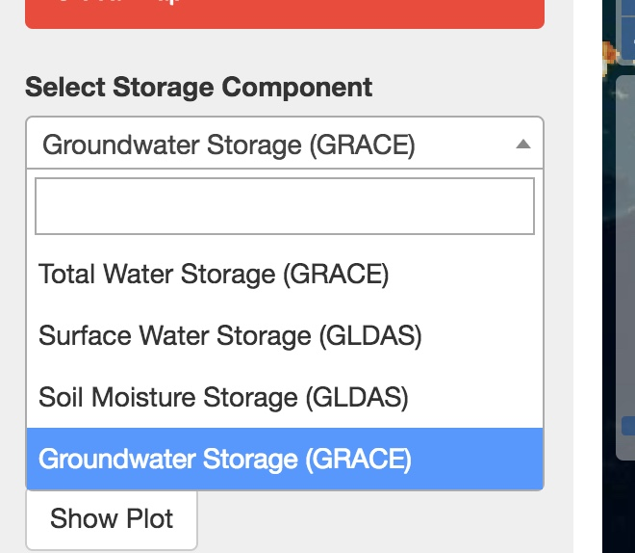
Tethys GRACE App
- GRACE Data
- GLDAS Data
- Calculated Groundwater Data
Notes:
All 4 layers (Total, Surface Water, Soil Moisture, and Groundwater storage) will be available with all of the current functionality of GRACE application
Generate a time series for a user defined point(map interaction)
Regional analysis based on user uploaded shapefile
Animation to view changes over time

Slide 25
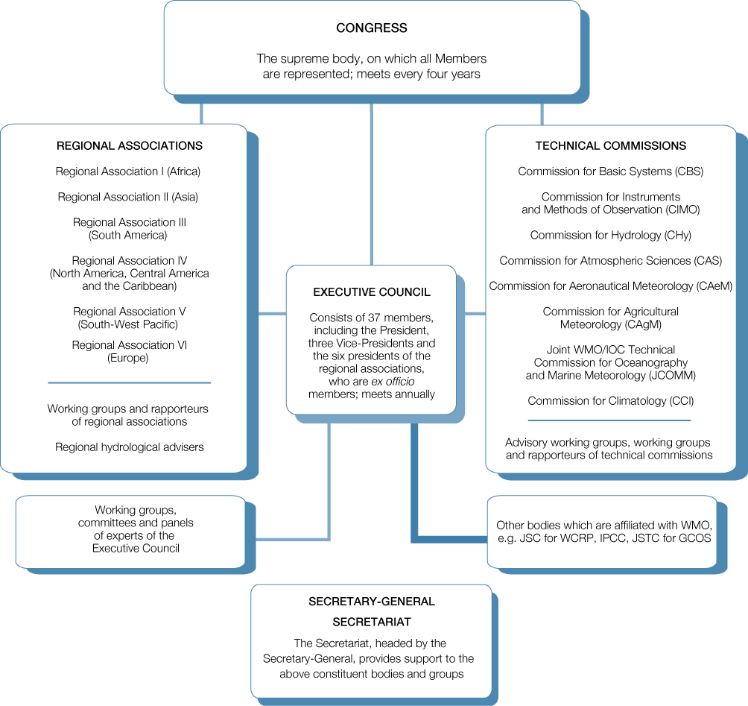

Slide 26
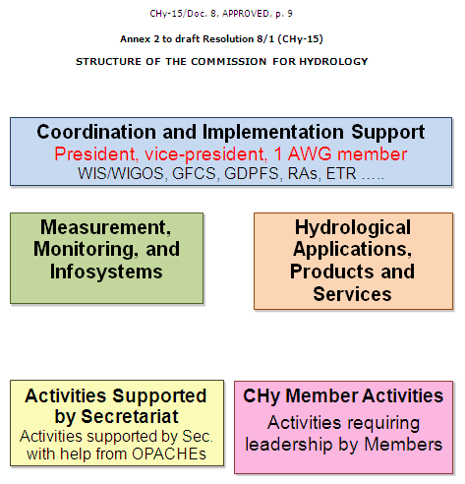

Slide 27
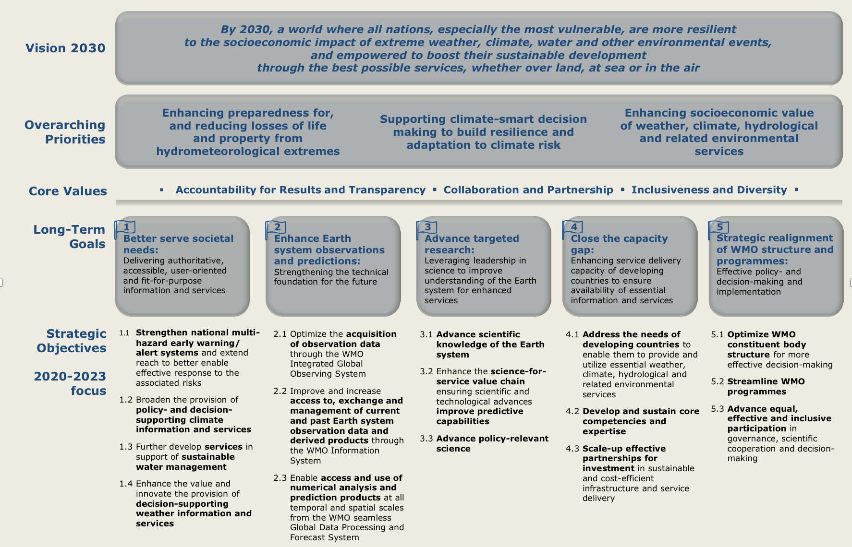
WMO Strategic Operating Plan
Objectives of CBR
WMO EC-70
Geneva, 20-29 June 2018

Slide 28

Alignment of WMO Structure
Policy, coordination, integration, foresight
Strategic Plan
Technical
Coordination
Committee
Policy Advisory Committee
Global lead/regional expertise
Long-Term Goal 1: Services
Long-Term Goal 5:
Governance
Commission for Services
Long-Term
Goal 2: Systems
Commission for Infrastructures
Joint WMO-IOC Committee for Oceanography and Meteorology
Long-Term
Goal 3: Science
Research Board
Scientific Advisory Panel
Long-Term
Goal 4: Capacity
Regional Associations
E-70C Recommendations to Congress
Established by EC-70

Slide 29
New Technical Commission structures
Work driven by WMO strategy, progress followed by the Executive Council and the Congress
President + three Vice-Presidents
Standing Committees (also joint with partners)
Conjoint sessions
2-year cycle of session of constituent bodies
Expert groups/Study groups
Regional Associations engaged in nomination process
Common procedures – Procedural Handbook
Better engagement of experts from academia and private sector

Slide 30

Commission for Observation, Infrastructures and Information Systems
The Infrastructure Commission contributes to the development and implementation of globally coordinated systems for acquiring, processing, transmitting and disseminating Earth system observations, and related standards; coordination of the production and use of standardized analysis and model forecast fields; and development and implementation of sound data and information management practices for all WMO Programmes and their associated application and services areas.
https://public.wmo.int/en/governance-reform/infrastructure-commission

Slide 31
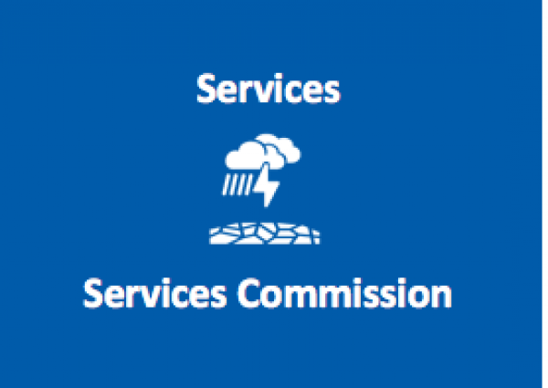
Commission for Observation, Infrastructures and Information Systems
The Services Commission contributes to the development and implementation of globally harmonized weather, climate, water, ocean and environment related services and applications to enable informed decision making and realization of socioeconomic benefits by all user communities and society as a whole.
https://public.wmo.int/en/governance-reform/infrastructure-commission

Slide 32
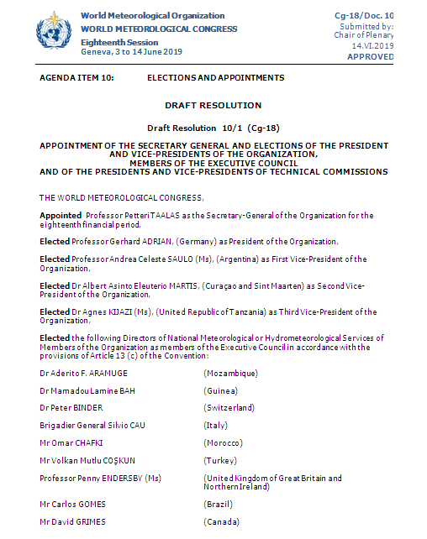
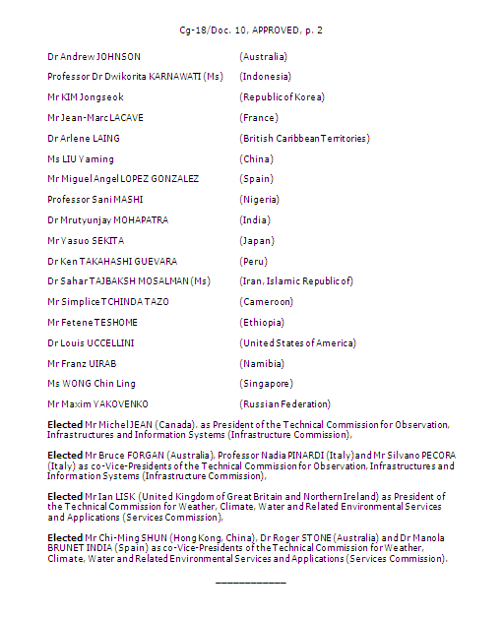

Slide 33


Slide 34
Water data standards by the Hydrology Domain Working Group of WMO and OGC – from development to implementation and adoption
Tony Boston and Dr Silvano Pecora
WaterML 2.0 is a series of information models and encodings for the representation of water features and observations data, developed for the exchange of such datasets across information systems. WaterML 2.0 consists of four parts dealing with different types of hydrological data: Part 1 (Timeseries) defines an encoding for timeseries observations enabling exchange of data such as water level or discharge; Part 2 (Ratings, Gaugings and Sections) deals with rating conversions (stage to discharge etc), gauging observations and river cross-sections which are part of most surface water monitoring programs; Part 3 (Surface Hydrology Features) is a conceptual model describing surface water hydrologic features such as rivers, lakes, catchments and drainage networks; and Part 4 (GroundWater Markup Language 2 [GWML2]) supports the description of key hydrogeological
entities such as aquifers and water wells, as well as related measurements and groundwater flows.
From 2009-2018, these water data standards were developed by the Hydrology Domain Working Group of WMO and OGC 4. The working group develops technical solutions and standards for exchanging data describing the state and location of water resources, both above and below the ground surface. The HDWG includes representatives of member organisations of the OGC drawn from government agencies, industry, universities, and non-government organisations largely from Europe, North America, and Australasia.
Implementation and adoption of WaterML 2.0 standards is a critical next step. National Meteorological and Hydrological Services (NMHSs) in many countries have already implemented WaterML 2.0 within their national water information systems. In May 2017, the WMO Executive Council formally adopted WaterML2: Parts 1 and 2 as official standards for use by NMHSs and within the WMO Hydrological Observing System (WHOS). Adoption of GWML2 by WMO is expected in the near future.
WHOS is a portal for accessing existing online hydrological data, drawing from the water information systems of countries around the world. WHOS is being developed in two phases. The first phase already completed is a map interface on the WMO website that links to those NMHSs that make their real-time and/or historical stage and discharge data freely and openly available online 5 . The second phase is a much more comprehensive undertaking aimed at developing a complete services-oriented framework linking hydrologic data providers and users through an information system that enables data registration, data discovery, and data access. Work on phase 2 of WHOS is currently being undertaken by WMO.
Keywords: water data standards, surface water, groundwater, information systems
in the session “L. Earth Observation Data to Knowledge Value Chains”

Slide 35

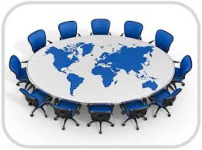
HDWG WORKSHOP by TELECONFERENCE
24 September 2019

Slide 36
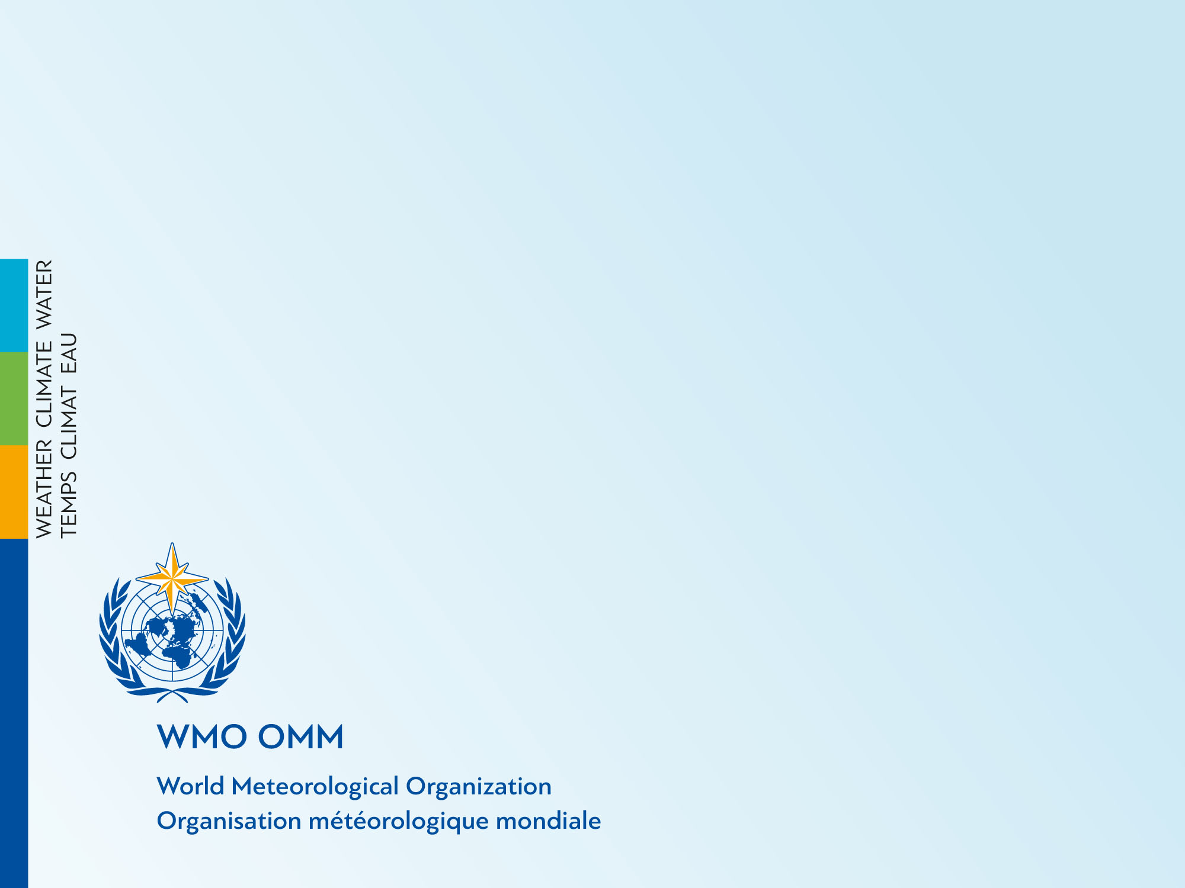
Thank you
Merci

