Slide 1
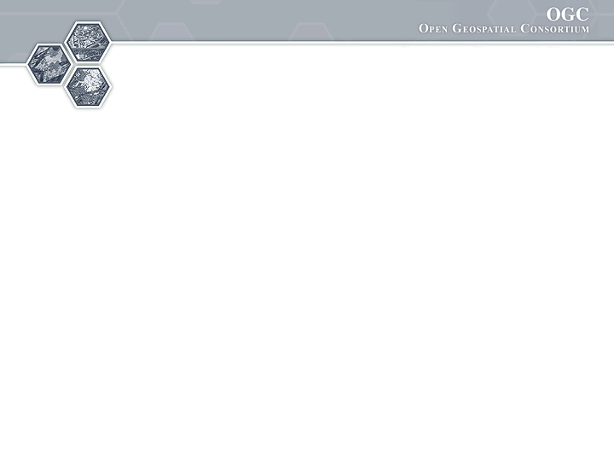

®
Sponsored and hosted by
An OGC Hydrology & Hydrogeology Interoperability Experiment
71st OGC Technical Committee
Mountain View, CA. USA
B.Brodaric, N.Booth, P.Taylor, I.Zaslavsky
December 8, 2009

Slide 2
Overview
OGC Hydrology Domain Working Group
Ground/Water Interoperability Experiment 1 (IE)
IE Description
Early Results
Early Lessons Learned
Demo

Slide 3
IE Context
GW is a significant source of water for humans
Ground/water feature and observation data
- distributed: many data providers (~1000 in Canada alone)
- heterogeneous: structure and content (e.g. level, flow, quality)
- massive instances: millions of wells (features/sensors) & time series (observ.)
- massive schema: thousands of properties (e.g. for quality)
- few standard services: very few OGC gr/water services
Existing schema standards for water
- WaterML (USA), GroundwaterML (CAN), WTDF (AU), WQX (USA), OGC O&M, SensorML,…
- consolidation in WaterML 2 via OGC HDWG
Relevant OGC Web service standards
- SOS, WFS, WMS, CSW

Slide 4
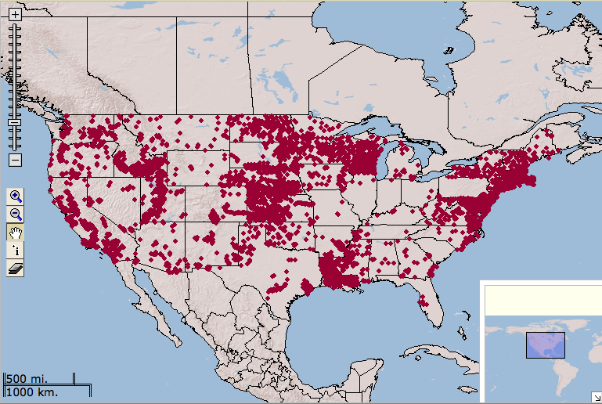
Sensor sites & well locations

Slide 5
IE Objectives
Ground/Water feature and observation interop:
Advance design of WaterML 2 schema
- harmonize existing schemas
Advance fit of OGC services with gr/water data
- SOS, WFS, WMS, CSW
Advance GW data exchange between US & CAN
- in cross-border Great Lakes area (Lake Superior) for water wells and levels

Slide 6
IE Issues
Advance design of WaterML 2 schema
- merge or link existing schemas (WaterML, O&M, GWML)?
- when to restrict: what is special about gr/water observations?
- when not to restrict: does it need to be extensible?
Advance fit of OGC services with gr/water data
- SOS 1: not designed for massive networks (i.e. GetCap lists each sensor)
- CSW: include individual sensors?
Advance GW data exchange between US & CAN
- what is a gr/water observation?
1/n sensors, 1/n time points, 1/n time series, 1/n properties?

Slide 7
IE Use-Case
View, query and download water wells & levels:
View US & CAN well/sensor locations
- WMS (GetMap)
Query on one well/sensor and display data
- WMS (GetFeatureInfo)
- well: WFS (getFeature via BBOX) or
- level: SOS (GetObservation via BBOX)
- return GWML or WaterML and display as HTML
Download cross-border wells and levels
- Zoom to area of interest (find BBOX)
- well: WFS (GetFeature via BBOX and thematic filter) or
- level: SOS (GetObservation via BBOX and time filter)
- Export as GWML, WaterML, Excell, or KML

Slide 8




IE Participants (to date--alphabetical)
CSIRO
David Lemon
Peter Fitch
Peter Taylor
GSC
Boyan Brodaric
Eric Boisvert
Heryk Julien
Francois Letourneau
Dave Sharpe
Alex Smirnoff
SDSC /
CUAHSI
David Maidment
Ilya Zaslavsky
David Valentine
USGS
Nate Booth
Dave Briar
Tom Kunicki
I-Lin Kuo

Slide 9
IE Dates, Workplan, Outputs
Dec 8, 2009: Request for Participation
- RFP closed today
Dec 8, 2009: Milestone 1
- preliminary WaterML 2 schema, example instances, documents (CSIRO)
- preliminary services: SOS & WFS (GSC), SOS (USGS), CSW (SDSC)
- preliminary demo of use-case
June 2010: Milestone 2
- intermediate results at OGC TC
Dec 2010: Final Milestone
- final results
- technology demo
- change requests re: OGC specs
- wrap and report at OGC TC and AGU 2010

Slide 10
IE Call for Participation
Role 1: Observer
- participate in discussions, meetings, etc.
Role 2: Participant
- participate in some activities:
1. WaterML development for gw data (CSIRO led)
2. SOS/WFS/WMS deployment for gw data (Great Lakes?) (GSC-USGS led)
3. CSW deployment for services (SDSC led)
Contact an existing participant

Slide 11
IE Milestone 1 Assumptions
WaterML 2 beta
Groundwater levels
- GSC from water well data
- USGS from sensors
SOS 1.0.0
- BBOX and temporal filters
Observation result is ‘Time Series’
- for single and multiple observations
- inline-feature-of-interest for observation location

Slide 12
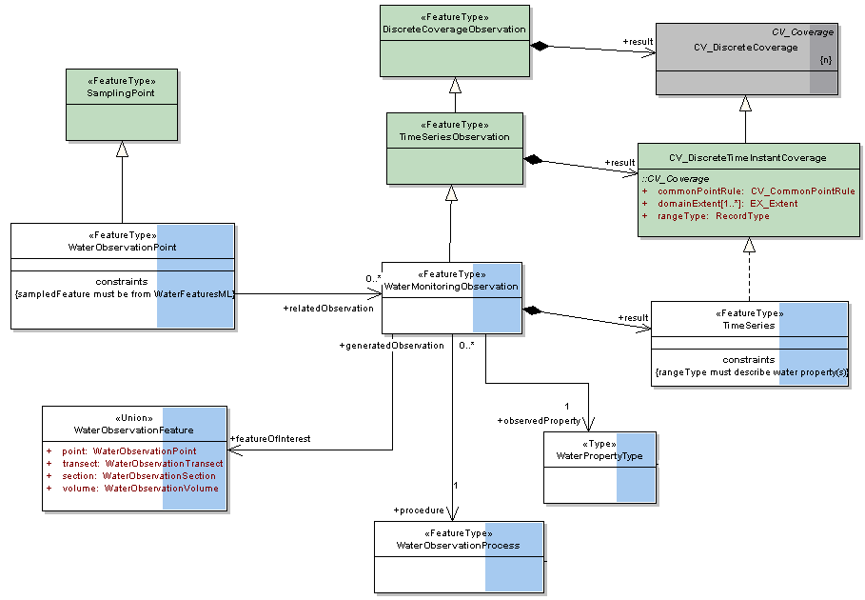
IE Milestone 1 Results
WaterML 2 schema revised
- specialize O&M from WaterML and WTDF
- link to GWML
- revised schema, instances, UML documentation

Slide 13
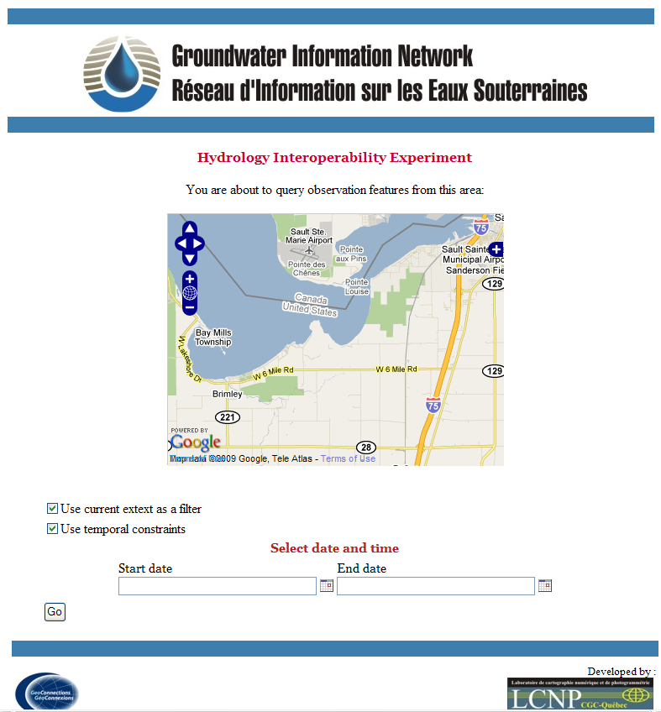
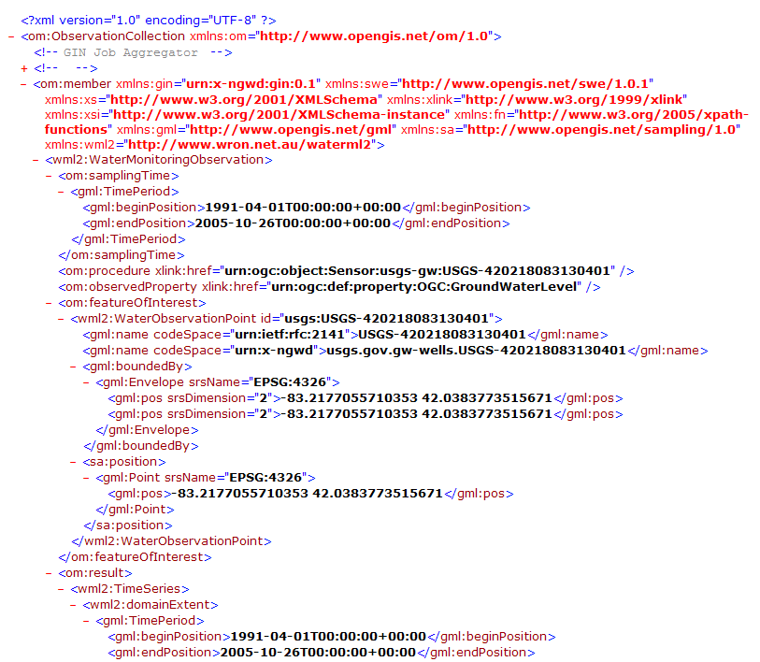
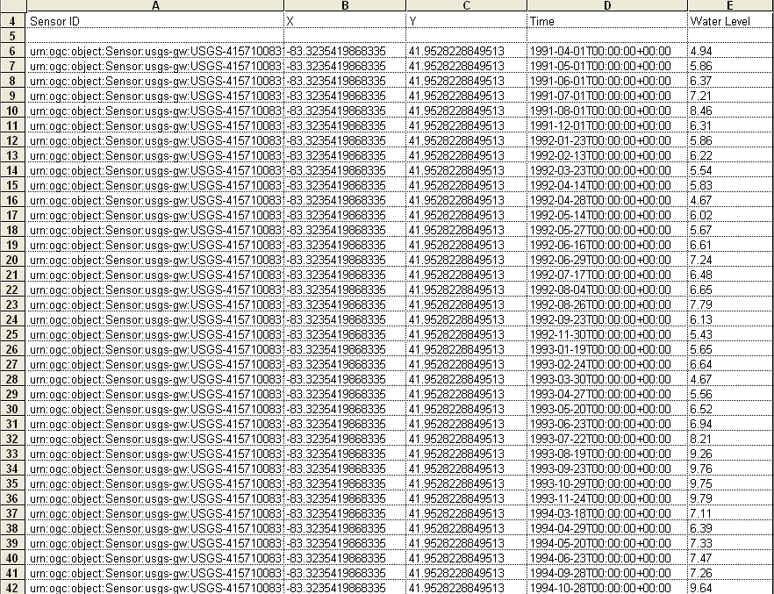
IE Milestone 1 Results
Advance fit of OGC services with gr/water data
- preliminary services established: SOS (WaterML) and WFS (GWML—GSC)
Advance GW data exchange between US & CAN
- cross-border groundwater levels displayed, queried, downloaded
query
download
view

