Slide 1

GEOSS
Architecture Implementation Pilot, Phase 3
AIP-3 Initial Plans – Drought Scenario
Sponsored and hosted by
George Percivall, OGC, AIP Task Lead
OGC Hydrology DWG, 71st OGC Technical Committee
Mountain View, CA. USA
December 8, 2009
© 2009 Open Geospatial Consortium, Inc.

Slide 2
Pilots and Experiments
Hydrology DWG Interoperability Experiment
  IEs are OGC member led activities focused on development and refinement of a specification.
GEOSS Architecture Implementation Pilot
  GEO Task conducted using OGC Pilot Procedures
  An OGC Pilot evaluates existing standards in a operational environment.
Copyright © 2009, Open Geospatial Consortium, Inc.

Slide 3
GEO Task AR-09-01b
Architecture Implementation Pilot
Develop and pilot new process and infrastructure components for the GCI and the broader GEOSS architecture
Notes:
Consistent with that, Task AR 09-01b is defined as: highlighting the development and testing of contributed components in a pilot setting, the leveraging of the GEOSS Common Infrastructure portals and clearinghouses, doing that via interoperability arrangements and serving the SBAs.

Slide 4
Context of AIP
SBA Tasks,
UIC
User
Needs,
Scenarios
requirements
Design,
Develop,
Deploy
Architecture
Implementation
Pilot (AIP)
Task AR-09-01b
support
Operational
Capability
GEOSS
Common
Infrastructure (GCI)
Task AR-09-01a
persistent
implementation
Notes:
The architecture of the AIP is based on meeting the user needs and community scenario requirements as recommended by the SBA tasks of GEO and the UIC. One of the main outcomes of the pilot is then to feed into and augment the operational capability of the GEOSS Common Infrastructure, which in turn supports the operational needs of the users.
A Call for Participation (CFP) in the GEOSS Architecture Implementation Pilot, Phase 2 was announced by the GEO Secretariat on 30 June 2008. To date, 37 responses have been received.
The CFP remains open for the duration of AIP-2.
The KO was held in Boulder Colorado, USA, Sep 25-26. Eighty five (85) persons attended the workshop over the two days.
The AIP-2 Development phase will be conducted in 9 wgs.
The 4 Community Working Groups will develop Scenarios that define the user objectives and the steps in the users decision process.
The 5 Transverse Technology Working Groups are developing Use Cases that define how GEOSS Interoperability Arrangements are used to support the steps in the user Scenarios.
AIP-2 plans to be completed in March 2009 with these results: 1) Demonstrations of the user scenarios; 2) Transition of select services to persistent operations, and 3) Select reports provided to the GEOSS Best Practices Registry.
AIP-2 CFP Responses (37 to date)
ACRF EuroCryoClim NASA World Wind
BKG GEONETCast NOAA/NASA GOES-R and GMU CSISS
Caribbean Flood Team GEO Grid NOAA IOOS
CIESIN GEO-Ukraine NOAA NCDC
CNES and ERDAS Giovanni NOAA SNAAP
Compusult ICAN Noblis
EPA AirNow ICT4EO Northrop Grumman
ERDAS Titan INCOSE Spot Image
ESA IP3 SURA/NIMSAT/GoMOOS
ESIP AQ Cluster ISPRA USGS
ESRI JAXA VIEWS
ESRI Canada Mines Paris Tech Washington University in St. Louis

Slide 5
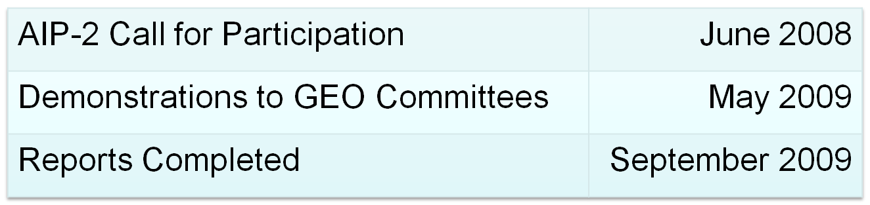
Architecture Implementation Pilot AIP-2 Achievements
Community of Practice Scenarios deployed through collaboration with SBA Tasks
Reusable Process for applying scenarios on Service oriented Architecture – GEOSS SoA
Contribution/registration of persistent services using GEOSS Interoperability Arrangements

Slide 6
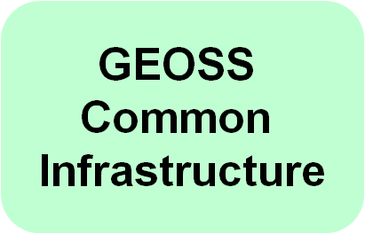
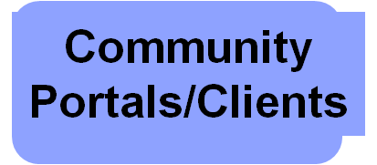
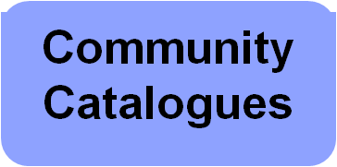
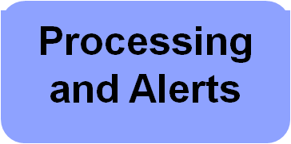
GCI and Community Components applied to CoP Scenarios in AIP-2
Community of Practice Scenarios
  Disaster Management
  Air Quality & Health
  Renewable Energy
  Biodiversity and Climate Change
Access Services
GEOSS Service Oriented Architecture
Slide <number>

Slide 7
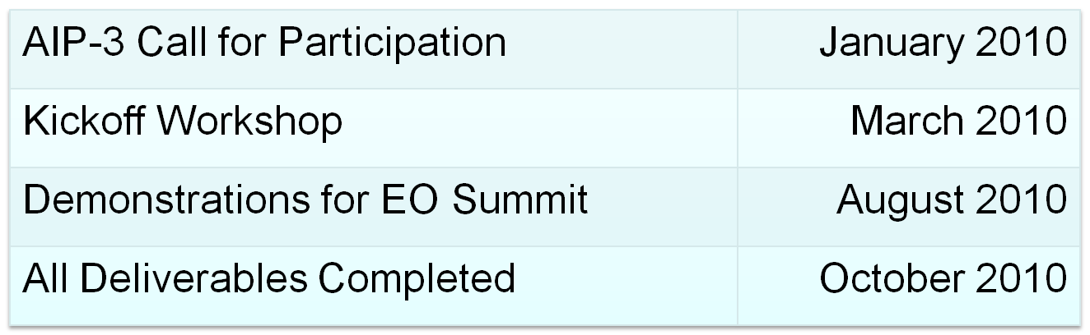
AIP-3 Plans to Build on AIP-2
Build on GCI and Community Services
  Promote mash-ups in a "link-rich" environment
  OGC continue as Task Lead
Engage additional Communities of Practice (CoP)
Focus on Data; Promote Content
Results in time to support EO Summit

Slide 8
Scenarios and Use Cases
Engineering Use Cases support Enterprise Scenarios
Scenarios: end user view of the value of GEOSS
  Focused on topics of interest to a community
  Occur in a geographic Area of Interest (AOI)
  Steps in a scenario are Use Cases
  Scenarios developed by Community WGs
Use Cases: reusable service oriented architecture
  Use cases for discovery, data access, etc
  Utilize Interoperability Arrangements
  Use Cases developed by Transverse Technology WGs

Slide 9
SBA-to-SoA Process
1.
SBA
Scenarios
2.
Enterprise
Models
Optimize
3.
Engineering
Design
Specify
Use Cases
4.
Deployment
Plan
Information Objects
Component Types

Slide 10
AIP-3 CoP/SBA Scenarios - Draft
Scenario | GEO Task/ CoP | Status/comment | AIP-3 Lead Editor
Emergency Management | DI-06-09: | AIP-2, GIGAS
Air Quality | HE-09-02b AQ CoP | AIP-2, ESIP Cluster | AQ CoP
Biodiversity and Ecosystems | (BI-07-01a) | AIP-2, EuroGEOSS, GIGAS
Energy | EN-07-03 | AIP-2
Drought management | WA-06-07c Water CoP | EuroGEOSS, SDSC, FCU, ESIP
Malaria | HE-09-03b
Water Quality Monitoring |  | EPA, EC/FP7

Slide 11
Drought Scenario in AIP-3 – Interested Parties
GEO Tasks
  Capacity Building for Water Resource Management – Asia (WA-06-07c) – Toshio Koike, University Tokyo
  GEOSS Water CoP - Rick Lawford
Responses to GEO Decision Support CFP
  Assessing and predicting climate change effects on Water Resources in South East Asia – SDSC, Univ. of Melbourne, Univ. of Malaysia.
  Assessment and allocation decision model of limited water resource by open standards-based techniques – Feng Chia University
GEO members and participating organizations interested
  EC FP7 EuroGEOSS Drought Scenario – Stefano Nativi
  ESIP Federation: Water ontologies – Bill Sonntag

Slide 12
Drought Working Group Activities in AIP-3
Develop Drought scenario for AIP-3 Call for Participation
  Scenario in CFP will identify the user needs and objectives
  Scenario in CFP does not identify specific datasets or services
Implement scenario using GEOSS architecture & services
  Scenario detailed using AIP Use Cases
  Identify specific datasets and services including CFP responses
  Develop and record Demostration of scenario
Semantic Mediation use case
  May be most applicable to Drought scenario.
  Draft of semantic mediation use case will be in the CFP

Slide 13
Scenario: Drought Monitoring and Response
Outline of Scenario to be in CFP
Overview
Context and pre-conditions
Scenario events

Slide 14
Overview
Drought: an increasingly damaging phenomena
  Growing population & agricultural stresses on surface & groundwater
  Reduced snow and glacier reservoirs
Complex phenomena
  Defined across many time scales, impacting many economic sectors
  Sea surface temperatures (SST), winds, land cover, many other factors
Scenario objectives
  Monitor & forecast drought indicators
  Assess water and drought conditions and impacts
  Plan for mitigation
  Carry out response strategy
  Consider and address multi-disciplinary and cross-border institutional communications and coordination

Slide 15
Scenario Steps (simplified)
Research staff tasked to forecast seasonal & annual precipitation, temperature, soil moisture, drought
Research staff requests data from GEOSS portal
Research results show region will have severe drought
Assess physical and economic risks and impacts of drought, identify needed actions
Deliver services, assistance, mitigation (track results)
Notify related stakeholders regarding data and results

Slide 16
Use Case: Semantic Mediation
Client access to several distributed registries to support user investigation of various ontologies, e.g.,
  User Requirements Registry - CEOS Database
  DIAS Definitions - WMO definitions
Use case steps (notional)
  User enters a term of interest into mediation client
  Mediation client access several ontologies in remote registries
  Client displays subset of ontologies and allows for creation of links between terms
  Linked ontologies used to find datasets of interest
Identify of GEOSS interoperability arrangements for nomination to the CSR and review by the SIF

