Slide 1

Introducing the
CUAHSI Hydrologic Information System Desktop Application (HydroDesktop) and Open Development Community
Jiří Kadlec,
Daniel Ames,
Teva Velupillai
Jeff Horsburgh
Idaho State University
Utah State University
Some Slides Courtesy of the CUAHSI HIS Project Team

Slide 2
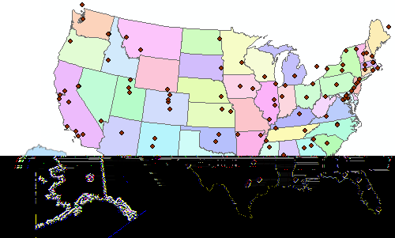
Consortium of Universities for the Advancement of Hydrologic Science, Inc.
120+ US Universities
An organization representing more than one hundred United States universities, receives support from the National Science Foundation to develop infrastructure and services for the advancement of hydrologic science and education in the U.S.
http://www.cuahsi.org/

Slide 3
What is the CUAHSI HIS?
CUAHSI HIS: NSF support through 2012 (GEO)
Partners:
Academic: 11 NSF hydrologic observatories, CEO:P projects, LTER…
Government: USGS, EPA, NCDC, NWS, state and local
Commercial: Microsoft, ESRI, Kisters
International: Australia, UK
Standardization: OGC, WMO (Hydrology Domain WG, CHy); adopted by USGS, NCDC
An online distributed system to support the sharing of hydrologic data from multiple repositories and databases via standard water data service protocols; software for data publication, discovery, access and integration.
Notes:
The CUAHSI Hydrologic Information System (CUAHSI-HIS) provides web services, tools, standards and procedures that enhance access to more and better data for hydrologic analysis.
The web services use an XML based format for communicating hydrologic data, called WaterML. HIS web services support access to National Datasets such as the USGS National Water Information System (NWIS) and EPA Storage and Retrieval System (STORET), in a standard way. Users anywhere with access to the internet can save their data in a relational database format, called ODM, and register it with CUAHSI HIS to publish their data. Popular software for working with data, such as Excel, MATLAB and a variety of computer programming languages can access HIS data directly using web services. This lets users work with familiar software rather than having to learn something new.

Slide 4
Sources of Observations Data

Slide 5
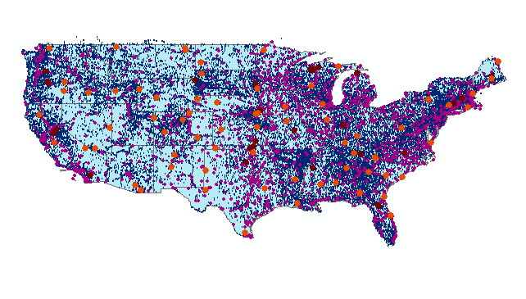
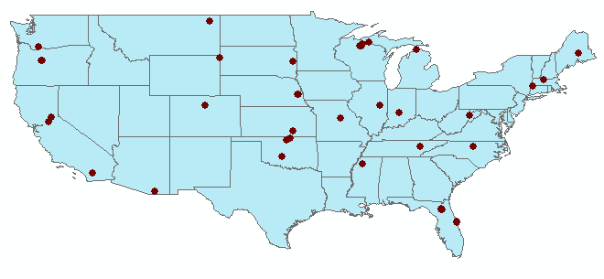
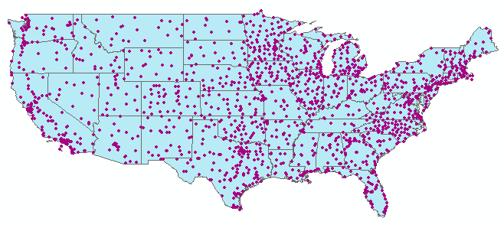
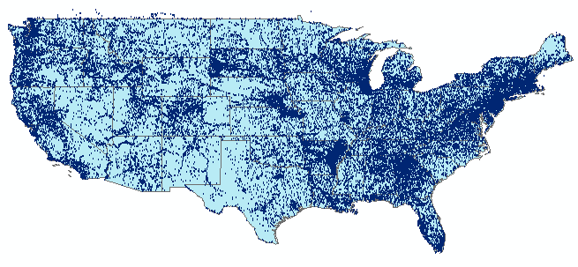
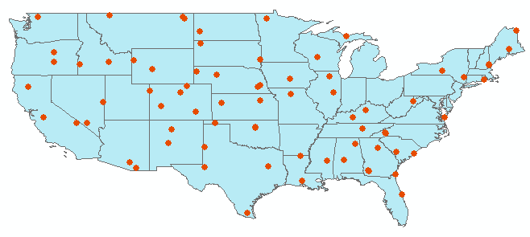
Observation Stations
Map for the US
Build a common window on water data using web services
Ameriflux Towers (NASA & DOE)
NOAA Automated Surface
Observing System
43 services
15,000 variables
1.8 million sites
9 million series
4.3 billion data
USGS National Water Information System
NOAA Climate Reference Network
Notes:
David - for each of these site files, can you include how many points are in each one.

Slide 6
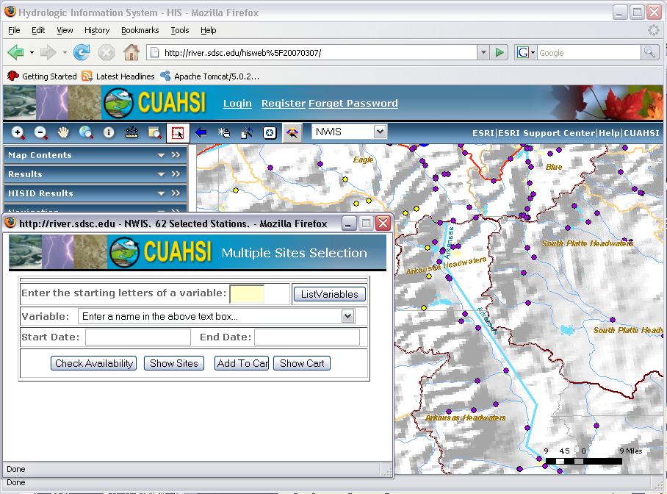
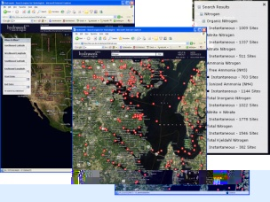
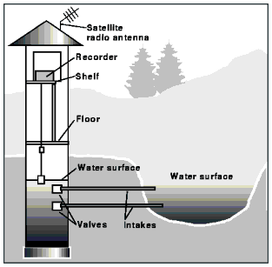



Hydrologic Information System Service Oriented Architecture
Deployment to test beds
Global search (Hydroseek)
Customizable web interface (DASH)
Other popular online clients
HTML - XML
Data publishing
Desktop clients
HIS Central
Registry & Harvester
Water Data Web Services, WaterML
Test bed HIS
Servers
WSDL - SOAP
ArcGIS
WSDL and ODM registration
Matlab
Ontology tagging (Hydrotagger)
IDL, R
Excel
ODM DataLoader
HydroDesktop
HIS Lite
Servers
Central HIS servers
External data providers
Programming (C#, VB..)
Streaming Data Loading
ODMTools
MapWindow
Server config tools
Modeling (OpenMI)
Notes:
Hydrologic Information System Service Oriented Architecture

Slide 7

HydroDesktop Client Application
Notes:
HydroDesktop is a desktop based software application that serves as a client for HIS Services. This project is being supported by CUAHSI, Idaho EPSCoR and the Inland Northwest Research Alliance.

Slide 8
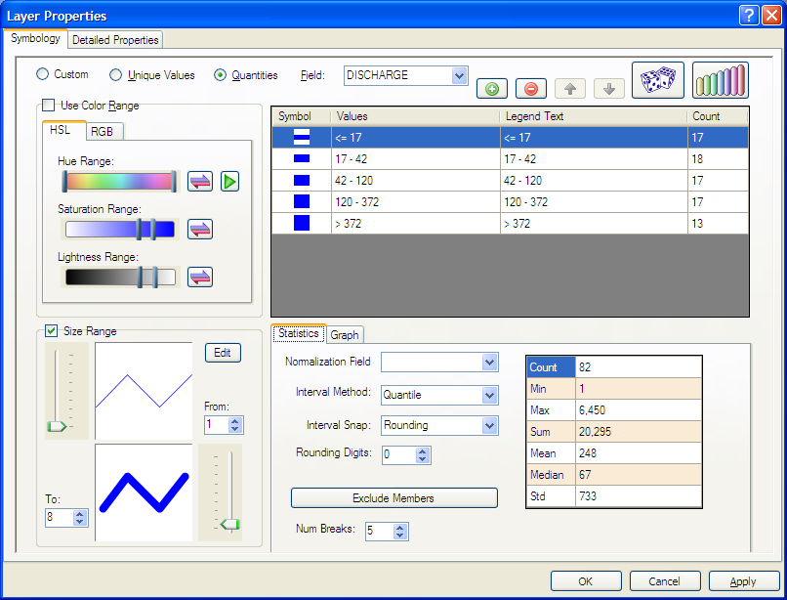
HydroDesktop Capabilities
GIS
Add shapefiles to map
Change symbology and labels
Print and export map
GIS toolbox
Hydrology
Search for data
Download data
Display time series
Export data

Slide 9
HydroDesktop Data Search
Search Criteria
Where? (geographic region)
What? (variable – keyword)
When? (time range)
Who? (data providers)
Example:
Precipitation and air temperature in the Columbia river basin,
2008 - 2009
Notes:
User can search for available data by geographic region, variable, time range and web service. The variable, time range and web service criteria are optional.

Slide 10
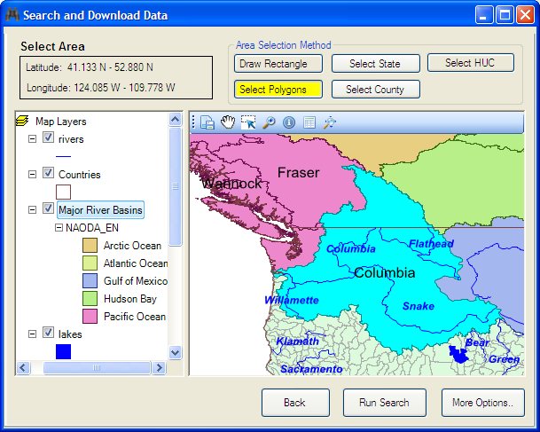
HydroDesktop Data search – select region
Region selection
Draw bounding box
Select polygons
Select Country
Select State
Select County
Select Watershed
Notes:
User can search for available data by geographic region, variable, time range and web service. The variable, time range and web service criteria are optional.

Slide 11
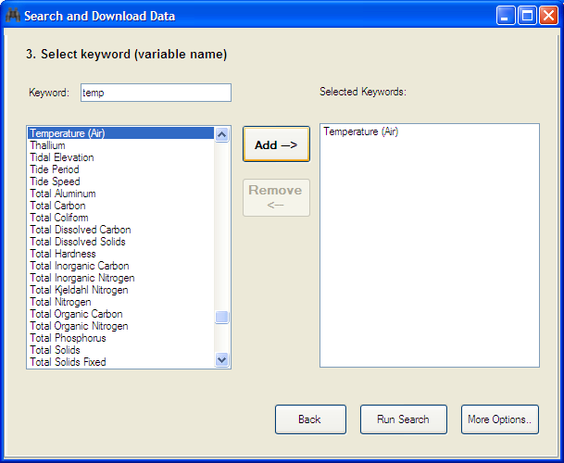
HydroDesktop Data search – select keywords
Notes:
One or more keywords can be selected. The list of available keywords is retrieved from HIS Central

Slide 12
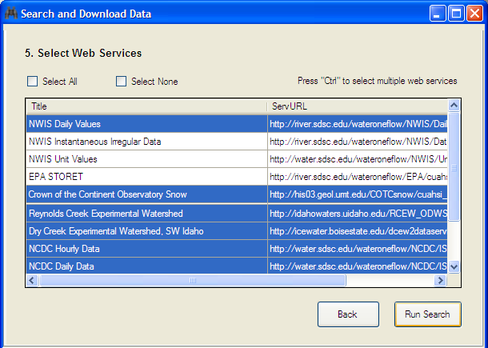
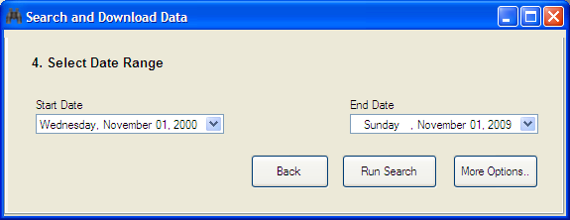
HydroDesktop data search –
Select time range and data services

Slide 13
HIS Central – Catalog and Search

Slide 14
Federal Agency Water Data Services at HISCentral (10/09)
Network Name | Site Count | Value Count | Earliest Observation | Notes
NWISDV | 29894 | 274762525 | 1/1/1900 | WaterML-compliant GetValues service from NWIS, catalog ingested
EPA | 362645 | 94349967 | 1/1/1900 | SOAP wrapper over WQX services, catalog harvested
NWISUV | 11185 | 77935488 | 60 DAYS | WaterML-compliant GetValues Service, catalog ingested
NCDC ISH | 11555 | 3000000* | 1/1/2005 | WaterML-compliant GetValues service from NCDC, catalog harvested
NCDC ISD | 24770 | 18165478 | 1/1/1892 | WaterML-compliant GetValues service from NCDC, catalog harvested
NWISIID | 369148 | 15501245 | 1/9/1867 | SOAP wrapper over NWIS web site, catalog harvested
NWISGW | 827200 | 8325633 | 1/1/1900 | SOAP wrapper over NWIS web site, catalog harvested
RIVERGAGES | 2206 | 263101295 | 1/1/2000 | WaterML compliant REST services from Army Corps of Engineers

Slide 15
Managing Varying Semantics
In measurement units…
acre feet | acre-feet
micrograms per kilogram | micrograms per kilgram
FTU | NTU
mho | Siemens
ppm | mg/kg
In parameter names…
Nitrogen: e.g. NWIS parameter # 625 is labeled ‘ammonia + organic nitrogen‘, Kjeldahl method is used for determination but not mentioned in parameter description. In STORET this parameter is referred to as Kjeldahl Nitrogen.
And: Dissloved oxygen

Slide 16
Semantic Tagging of Harvested Variables

Slide 17
HIS Central
HISCentral
Web Service
Now provides web services to search metadata:
  Sites
  Variables
  Search Keywords
Does not store actual observation data
Example: GetSitesInBox query function
Notes:
HIS is not just for people who want to get data. It can also be used to help publish data. HIS includes tools to assist with the entire chain of data publication, from storing data streamed in from sensors, to analyzing the data, to publishing the data with WaterOneFlow.

Slide 18
Semantic MediaWiki for CUAHSI Parameter Ontology

Slide 19
HydroDesktop Data search – Search Results
Precipitation and
Temperature,
Columbia River Basin
Notes:
Search results are shown in a map and in a table. User can refine the search by selecting a subset of data series in the table or map.

Slide 20
HydroDesktop Data Download
Notes:
After refining the search, HydroDesktop connects to one or more WaterOneFlow web services and downloads the observation data. The downloaded data is stored in a local SQLITE database. The measurement sites are displayed on the map as a new theme.

Slide 21
Hydrodesktop Table View
List of sites and data series
Data values table
Export and edit data values
Downloaded data is stored by default in a local SQLITE database (similar to MS Access)

Slide 22
HydroDesktop Graph View
21

Slide 23
HydroDesktop Building Blocks
Actual Data Dababase
Database Access Layer
Web Service API
MapWindow GIS Components
HIS Server
Web Services
Metadata Cache Database
HydroDesktop Main Application
HIS Central
Web Service
Plug-in Interface
Metadata plug-in
Graph View plug-in
Search plug-in

Slide 24
HydroDesktop Plug-in Development
Plug-ins
Extend Hydrodesktop functionality
c# or VB.NET
Build and copy a .dll file
Existing plugins
Metadata Fetcher
HydroModeler (Open MI)
Graph View
Search
Notes:
The functionality of HydroDesktop can be extended by plug-ins. Each plug-in needs to reference the library MapWindow.dll and implement the MapWindow 6 plugin interface. Any existing MapWindow 6 GIS plug-in can be used as a HydroDesktop plug-in. To easily access data from the HydroDesktop local database, a plugin can use functions from the HydroDesktop.Database.dll library (data abstraction layer). A plug-in can add a new menu item, toolbar or tab window to the HydroDesktop user interface.

Slide 25
HydroDesktop Collaborative Development
A web-based collaborative software development environment was set up on CodePlex.com. This site includes a discussion forum, documentation wiki, source code repository and versioning system, and bug/issue tracking system.
www.HydroDesktop.org
Notes:
HydroDesktop development is following the open source model and is housed at the Microsoft CodePlex web site. The project can be accessed through the link:www.hydrodesktop.org and is open for public participation in the project. The collaborative development portal includes a project WIKI with information about the project, a Downloads page for current installers and releases of the software, a Discussion Forum for open discussions and questions about the project, an Issue tracker for managing bugs, features, and issues. Also direct access to source code is available for anyone (authorized users are invited to contribute source code directly to the project). HydroDesktop is licensed under the BSD open source license which allows it to be used in commercial, non-commercial, academic, government or other settings as needed.

Slide 26
Thank you for your attention
www.HydroDesktop.org
www.mapwindow.org

