Slide 1

Updates on WaterML 2.0 development and the standards harmonization discussion paper
Sponsored and hosted by
71st OGC Technical Committee
Mountain View, CA. USA
Peter Taylor (CSIRO), David Valentine (CUAHSI)
December 8, 2009
© 2009 Open Geospatial Consortium, Inc.

Slide 2
Overview
Paper Updates
  Time component
  Hydrologic observations requirements
Paper Summary
WaterML 2
  First cut of schema generated
  In use by GW interoperability
© 2009 Open Geospatial Consortium, Inc.

Slide 3
Proposed methodology
The proposed methodology is the address the development of various aspects of a harmonised model in phases that relate to particular types of observations styles. The initial phase will address in-situ style observational data sets in the following areas:
  Time series structures (results);
  General metadata for the procedure used in measurement;
  Minimal metadata data for spatial features (descriptions of stations) and guidance on linking to external descriptions;
  Techniques for linking to definitions of observed phenomenon
© 2009 Open Geospatial Consortium, Inc.

Slide 4
WMO Technical Regulations
Define concepts and standard types of observations typically made within the hydrology domain as well as relevant observations from other domains such as climatology and meteorology.
The regulations break hydrometric stations into the following categories:
  (a) Hydrometric stations;
  (b) Groundwater stations;
  (c) Climatological stations and precipitation stations for hydrological purposes;
  (d) Hydrological stations for specific purposes.
© 2009 Open Geospatial Consortium, Inc.

Slide 5
Hydrometric stations
River, lake or reservoir stage;
Stream flow;
Sediment transport and/or deposition;
Temperature and other physical properties of the water of a river, lake or reservoir;
Characteristics and extent of ice cover on rivers, lakes and reservoirs;
Chemical and biological properties of the water of a river, lake or reservoir.
© 2009 Open Geospatial Consortium, Inc.

Slide 6
Climatological stations
Precipitation:
Air temperature (including extreme temperatures);
Air humidity
Wind:
Amount and type of cloud;
Snow cover:
Evaporation (measured with evaporation pan);
Solar radiation;
Sunshine;
Soil temperature;
Atmospheric pressure;
Soil moisture.
© 2009 Open Geospatial Consortium, Inc.

Slide 7
Groundwater stations
Water level;
Temperature and other physical properties of the water;
Chemical properties;
Rate and volume of abstraction or recharge.
© 2009 Open Geospatial Consortium, Inc.

Slide 8
Adopting a common model
Generating a schema from the core model that suits a deployment platform
Defining or importing other specific schema requirements
Linking a schema to vocabulary definitions
Generating documentation
Customising a validation framework
Adapting tools
© 2009 Open Geospatial Consortium, Inc.

Slide 9
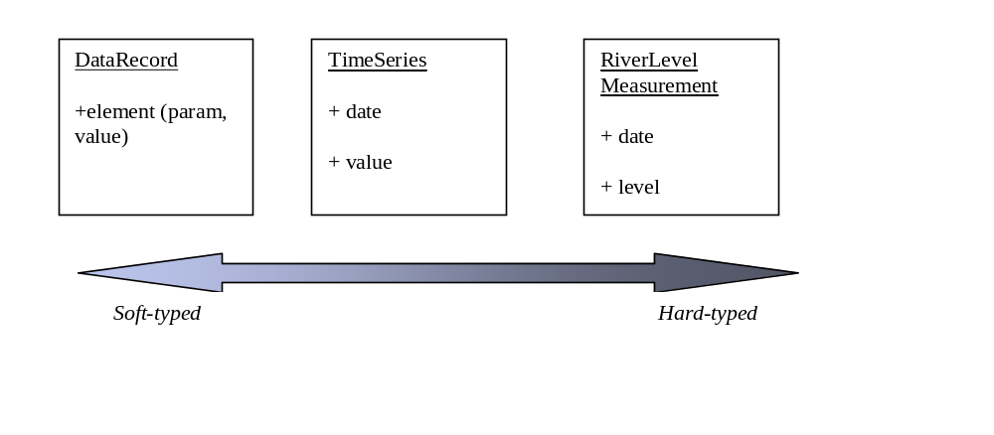
Tradeoffs
Soft-typing vs. hard-typing
Data Exchange vs Archival
  Standalone vs. Reference to information
© 2009 Open Geospatial Consortium, Inc.

Slide 10
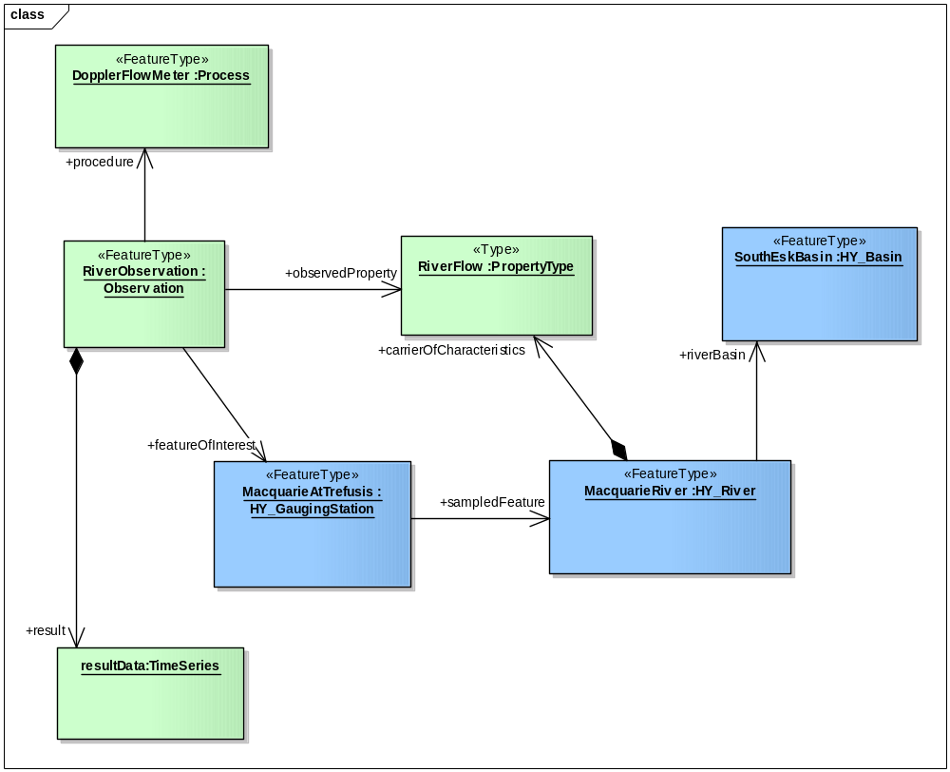
Example river flow observation in UML
A doppler flow meter was used to make a flow measurement of the Macquarie river at the Macquarie at Trefusis station.
The result of this observation was a time series. The Macquarie River is in the South Esk Basin
© 2009 Open Geospatial Consortium, Inc.

Slide 11
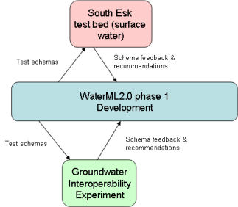
Testing the Schema
Test the generated schema will be tested in the
  Groundwater Interoperability Experiment
  South Esk test bed within Tasmania.
These two projects will provide feedback on the schema design that will be considered by the WaterML2.0 development group..
© 2009 Open Geospatial Consortium, Inc.

Slide 12
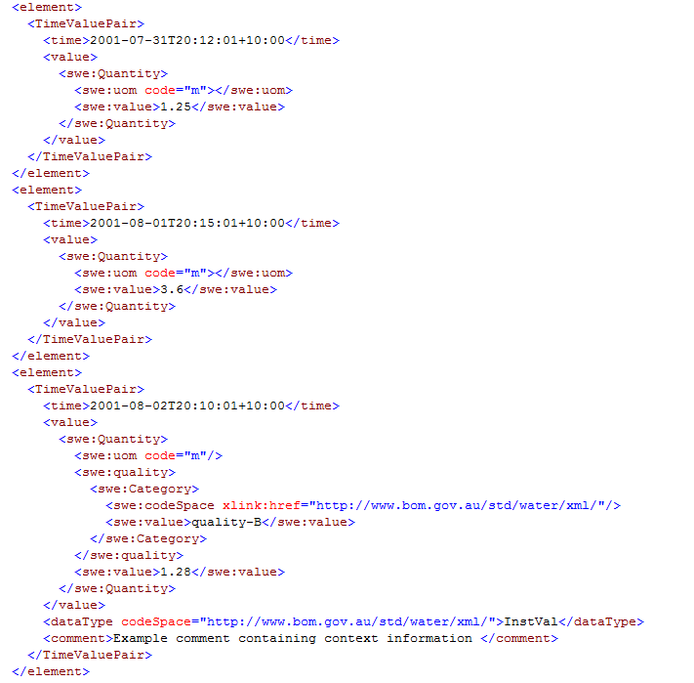
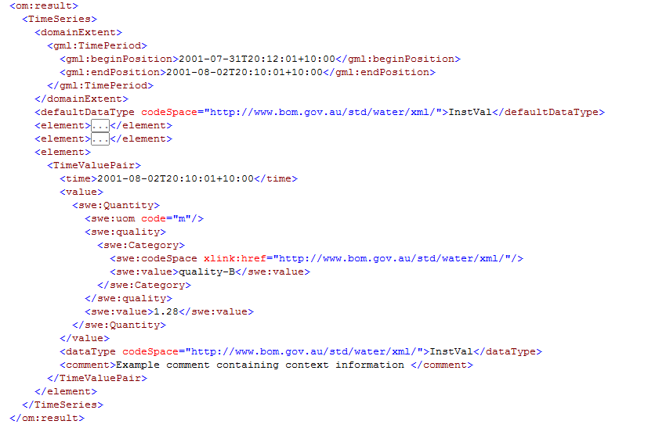
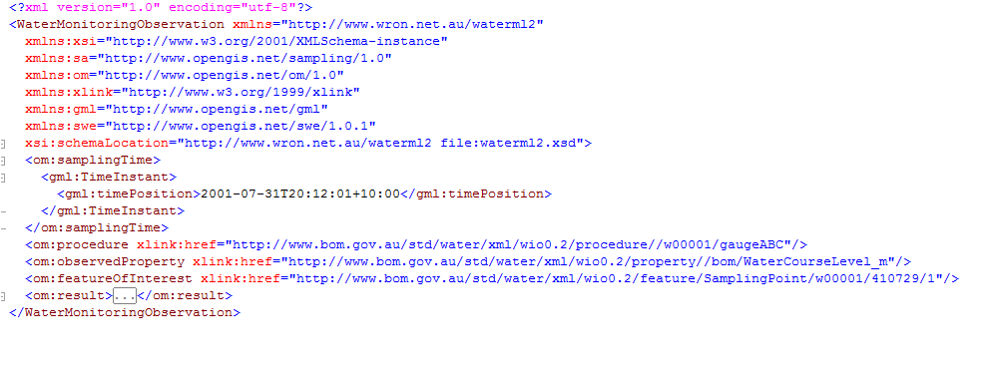
WaterML 2
© 2009 Open Geospatial Consortium, Inc.

Slide 13
WaterML 2
In use for the GW Interoperability
  Re-using SWE Common types, presently.
Need to develop a common model, so additional interoperability experiments will be needed.
To be developed further based on:
  Further discussions within WaterML2 development group (including extra international groups)
  Future interoperability experiments
© 2009 Open Geospatial Consortium, Inc.

