Slide 1


GRDC Hydrologic Metadata - core concepts -
5th, WMO/OGC Hydrology DWG
New York, CCNY, August 11 – 15, 2014
Irina Dornblut, GRDC of WMO at BfG

Slide 2
GRDC Hydrologic Metadata
WIS and WIGOS context
Hydrologic datasets and products
GRDC Hydrologic Metadata
Core Concepts
Dataset Description
Observation Description
Utilities package
Next Steps
Copyright © 2013 Open Geospatial Consortium

Slide 3
GRDC Metadata - WIS and WIGOS Context
WMO Technical Commission for Hydrology (WMO CHy)
Thematic area: Data operations and management (since Nov 2012)
Monitor and report on new developments dealing with data management issues, review progress with respect to the exchange of hydrological data and products, guide harmonization of practices
WMO Core Metadata (informal category-1 profile of the ISO19115:2003)
approved by the WMO Executive Council in 2013 (aka “WIS Metadata”)
current version, 1.3, defines the “content, structure and encoding of discovery metadata published within the future WIS DAR Catalogue”
WIGOS Metadata (under development, 2013-2015)
essential information about the observation origin of the data described by the WIS Metadata
object under observation and the observed variable, the monitoring station or platform used, the measurement process and interpretation algorithms applied
Copyright © 2013 Open Geospatial Consortium

Slide 4
GRDC datasets and products
identifiable collections of data (→ resource)
contain data generated by processing results from preceding source observations (→ source data)
processed into new data (→ observation result)
aggregated, accumulated and arranged in datasets with respect to Time and Space (→ coverages)
compiled for global exchange, disseminated using services (secondary data, i.e. not created by the user)
represent the hydrosphere phenomenon of which the property is observed (multiple representation)
Copyright © 2013 Open Geospatial Consortium

Slide 5
GRDC Hydrologic Metadata – Requirements
Shall be compliant to WMO Core Metadata Profile
Identification, representation, content, lineage, … of the data
Shall consider the information hierarchy
Identification of the dataset as result of an observation
Identification of the “source observation” as the first process step
Shall be applicable to time series (temporal coverages)
Temporal aggregation of data values (MD_SampleDimension)
Accumulation of time-related values (MD_RangeDimension)
Shall relate the observation information
Station (sampling feature), hydrologic object under observation (sampled feature), instrument or model applied (procedure), variable (observed property).
Copyright © 2013 Open Geospatial Consortium

Slide 6
GRDC Hydrologic Metadata – Core concepts
Hydrologic datasets are identifiable collections of data (resource in terms of ISO19115).
Hydrologic datasets contain observation results (lineage from observation).
Hydrologic data represent the hydrosphere phenomenon of which a characteristic property is observed (multiple representation).
Copyright © 2013 Open Geospatial Consortium

Slide 7
Identifiable collections of observation results

Slide 8
… collections of observation results …

Slide 9
… collections of observation results …

Slide 10
Identifiable collections of observation results representing a hydrosphere phenomenon

Slide 11
… representing a hydrosphere phenomenon
HY_Features

Slide 12
Supplier of Hydrologic Metadata
Copyright © 2013 Open Geospatial Consortium

Slide 13
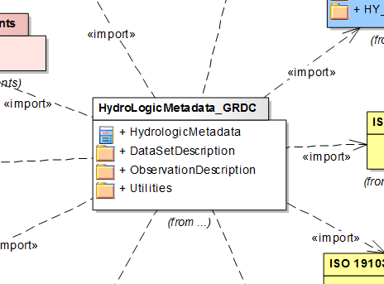
Packages of Hydrologic Metadata
Copyright © 2013 Open Geospatial Consortium

Slide 14
Dependencies of Dataset Description package

Slide 15
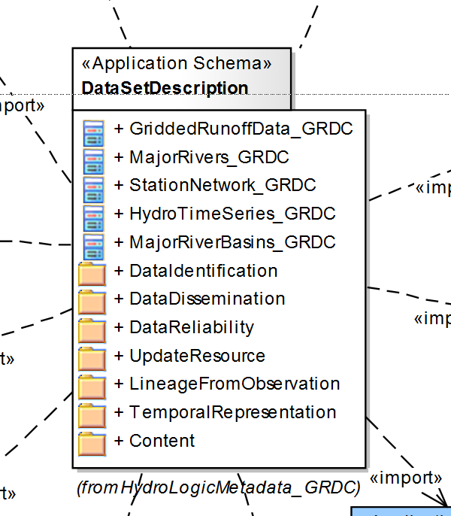
Dependencies of Dataset Description package

Slide 16
Dependencies of Observation Description package

Slide 17
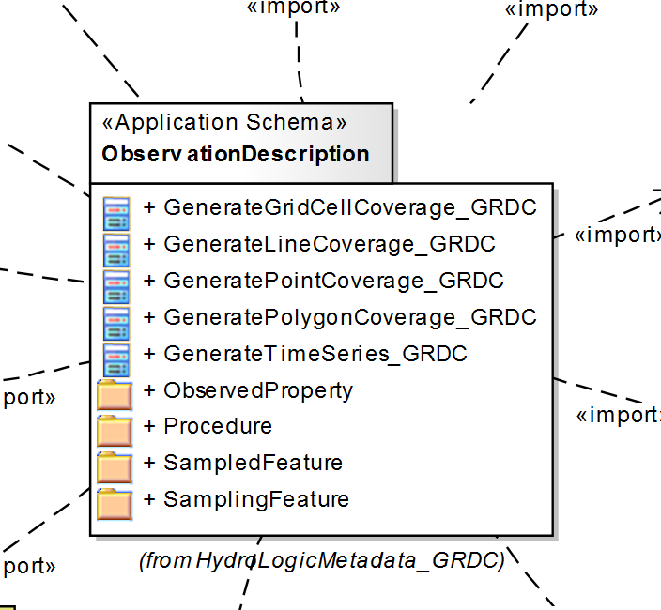
Dependencies of Observation Description package

Slide 18
Dependencies of Utilities package

Slide 19
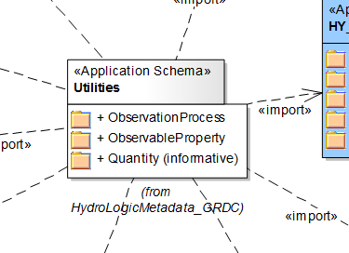
Dependencies of Utilities package

Slide 20
Observation Process and Observable Property
Specialisation Observation Process
Specialisation of Observable Property

Slide 21
Next steps
“Hydrologic Information - Metadata” (GRDC Report; 39r2) (Dec 2013) (incl. the GRDC Hydrologic Metadata Data Dictionary) http://www.bafg.de/GRDC/EN/02_srvcs/24_rprtsrs/report_39r2.html?nn=201572
Contribution (concepts) to the WIGOS Metadata (May 2014) developments
GRDC Data Management using Web services (under development)
…..
Mapping the data and metadata concepts currently in use to the GRDC Hydrologic Metadata concepts (May 2015)
….. (depending on progress and resources ) 2015/2016
Thank you !

Slide 22
Definitions
Data: notion of a documented value of some characteristics of a phenomenon.
Dataset: identifiable collection of data. [ISO19115:2003]
Data product: dataset compiled for a specific purpose, e.g. for global dissemination using Web services.
Coverage: set of attribute values arranged with respect to a particular domain. – function to return values from its range for any direct position within its spatial, temporal or spatiotemporal domain. [ISO19123:2005]
Metadata: data describing an identifiable asset or means that fulfils a requirement. [ISO19115:2003]. – aka: data about data [ISO19109:2005]
Primary data: data (attribute values) primarily collected, or compiled into a dataset, by the data user.
Secondary data: data (attribute values) collected, or compiled into sets, by a processor who is not the data user.
Variable: properties whose values may change with Space, Time, or Observation. A variable may take any value in a range of possible values [WMO, 1992].
Q

