Slide 1


OGC HY_Features model - progress report, next steps -
5th, WMO/OGC Hydrology DWG
New York, CCNY, August 11 – 15, 2014
Irina Dornblut, GRDC of WMO at BfG

Slide 2
HY_Features in support of water information
HY_Features model: implementations and use
In terms of mediation (OWS-10 CCI Hydro experience)
In terms of ontology (AU-Geofabric experience)
In terms of reference model (WatERP experience)
Where to find ? Next steps ?

Slide 3
HY_Features, implementations and use
set of inter-related Application Schemas using the GFM (ISO 19109)
expressed in UML (ISO 19103), GML (ISO 19136) and OWL (following the rules of ISO19150 under development)
HY_Features to be used:
e.g. as “inline” references in applications to avoid introducing platform-specific schemas for the referenced hydrologic features
e.g. as reference model for hydrologic features in distributed contexts such as mediation between information systems
OWS 10 CCI Hydro Model Interoperability (mediation)
WatERP ontology (mediation)
e.g. in terms of “well-known” semantics in federated contexts such as integration services aimed to retrieve and combine linked data
AU Hydrological Geo Fabric (feature type catalogue)

Slide 4
HY_Features in terms of a Mediator
The OWS-10 Cross Community Interoperability experience
OWS 10 CCI Hydro Model Interoperability:
IE to explore whether HY_Features can advance the interoperability among information systems in terms of mediation, here: NHN of Canada and NHD+ of the United States.
mapping approach was developed to map the “flowline” concepts of both models to the equivalent HY_Flowpath concept of HY_Features common model
based on these ad-hoc mappings, data from the NHN and NHD+ systems were requested, retrieved and “merged” into a new “HY_Flowpath” dataset
prototype using xLink and SPARQL to query for data, to merge data from both sources, display the combined “flowpath” and return converted data (GML) to NHD+
Recommendations:
Further explore the conditions, limitations and use of xLink for a semantic mapping
Further explore semantic interoperability of Web services, particularly WFS
OGC, to explore the need of a Semantic Mapping Framework conform to ISO baselines
Read more in OGC-ER 14-048: https://portal.opengeospatial.org/files/?artifact_id=58944

Slide 5
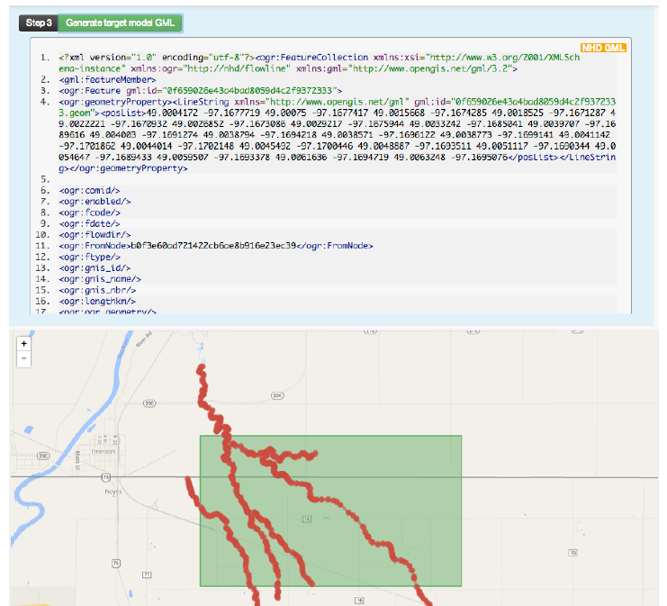
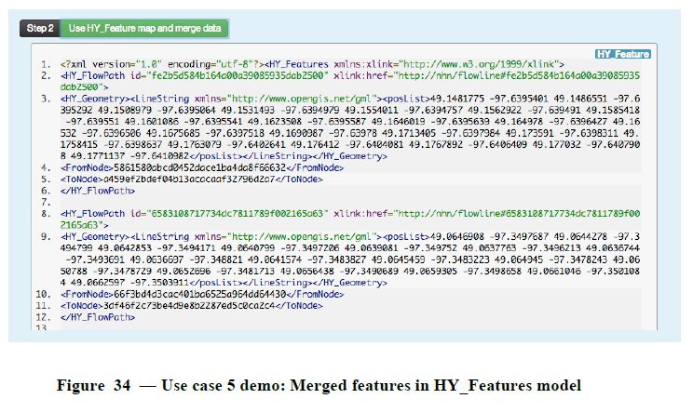
HY_Features in terms of a a Mediator
The OWS-10 CCI Hydro Thread experience
OWS 10 CCI Hydro Model Interoperability:
IE to explore whether HY_Features can advance the interoperability among information systems in terms of mediation, here: NHN of Canada and NHD+ of the United States.
mapping approach was developed to map the “flowline” concepts of both models to the equivalent concept of HY_Features (i.e. HY_Flowpath)
based on a these ad-hoc mappings, data from the NHN and NHD+ systems were requested, retrieved and “merged” into a new “HY_Flowpath” dataset
prototype using xLink and SPARQL to query for data, to merge data from both sources, display the combined “flowpath” and return converted data (GML) to NHD+
Recommendations:
Further explore the conditions, limitations and use of xLink for a semantic mapping
Further explore semantic interoperability of Web services, particularly WFS
OGC, to explore the need of a Semantic Mapping Framework conform to ISO baselines
Read more: https://portal.opengeospatial.org/files/?artifact_id=58944

Slide 6
HY_Features in terms of a reference model
The WatERP experience (within EU-FP-7 project)
WatERP ontology:
knowledge base on water supplies and water usage
representing decisional correspondence between hydrological features and how water allocation affect them
semantic mapping of the WatERP ontology to HY_Features concepts by means of the Semantic Web, e.g. definition of “owl:equivalentClass”, “owl:equivalentProperty” and “owl:sameAs” to capture equivalent and similar concepts
machine-performed reasoning by “harvesting” definitions and mappings from external conceptual models and vocabularies
Interest exists to contribute to
OGC standards relevant for the hydrology domain, particularly with respect to decision-making in the water supply sector
Utilization of Semantic Web technologies in Service-Oriented Architectures
Read more: https://portal.opengeospatial.org/files/?artifact_id=59556 ; http://www.waterp-fp7.eu/

Slide 7
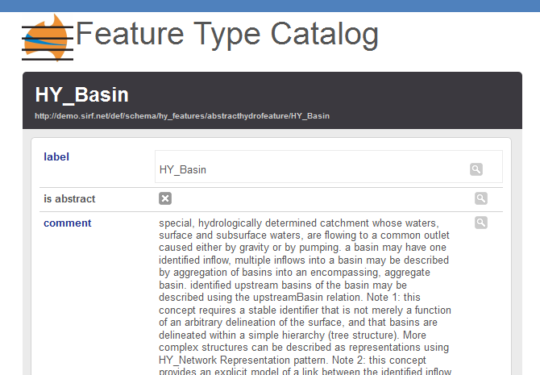
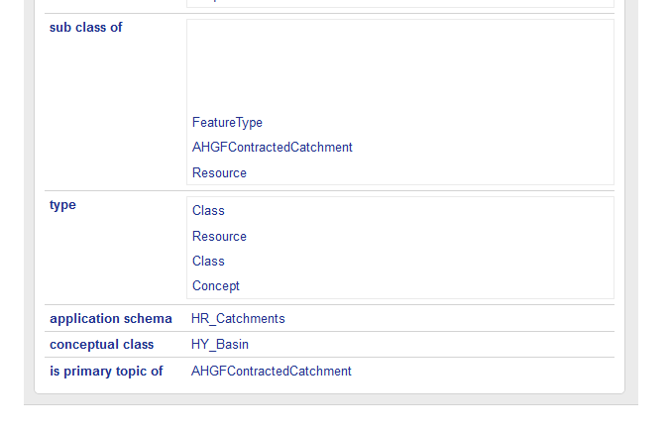
HY_Features in terms of an ontology
The AU Hydrological Geo Fabric (AHGF) experience – CSIRO, BoM
HY_Features catchment hierarchy semantics are used
to handle relationships between the AHGF objects,
A “Feature Type Catalogue” service was developed
as part of a “Spatial Identifier Reference Framework”
(SIRF) to provide the AHGF with the definitions of
HY_Features, and mappings between the HY_Features
and multiple implementation models.
Example: Catchment 100862
http://environment.data.gov.au/water/id/catchment/100862
is resolved to alternative representations of “100862”:
[is a] http://../HY_Basin [HY_Features concept] and
http://../AHGFContractedCatchment [AHGF concept];
[has a] http://.../containingCatchment [relation of HY_Basin], http://.../riverregion/9400299 [AHGF concept]
Read more: http://www.bom.gov.au/water/geofabric/index.shtml , https://wiki.csiro.au/display/SIRF/The+SIRF+API
See also: Atkinson, R.: Linked data and vocabularies (5^{th,} HDWG Meeting New York, 11-15 August 2014)

Slide 8
HY_Features in terms of an ontology
The AU Hydrological Geo Fabric (AHGF) experience – CSIRO, BoM
HY_Features catchment hierarchy semantics are used
to handle relationships between the AHGF objects,
A “Feature Type Catalogue” service was developed
as part of a “Spatial Identifier Reference Framework”
(SIRF) to provide the AHGF with the definitions of
HY_Features, and mappings between the HY_Features
and multiple implementation models.
Example: Catchment 100862
http://environment.data.gov.au/water/id/catchment/100862
is resolved to alternative representations of “100862”:
[is a] http://../HY_Basin [HY_Features concept] and
http://../AHGFContractedCatchment [AHGF concept];
[has a] http://.../containingCatchment [relation of HY_Basin], http://.../riverregion/9400299 [AHGF concept]
Read more: http://www.bom.gov.au/water/geofabric/index.shtml , https://wiki.csiro.au/display/SIRF/The+SIRF+API
See also: Atkinson, R.: Linked data and vocabularies (5^{th,} HDWG Meeting New York, 11-15 August 2014)

Slide 9
HY_Features – Where to find ?
OGC HY_Features: a Common Hydrologic Feature Model (OGC-DP 11-039r3)
https://portal.opengeospatial.org/files/?artifact_id=55157
HY_Features: a geographic information model for the hydrology domain (GRDC Report 43, 2013)
http://www.bafg.de/GRDC/EN/02_srvcs/24_rprtsrs/report_43r1.html?nn=201572
The HY_Features model is now available via a “Feature Type Catalogue Linked Data API” using a temporary namespace (for the time being at CSIRO).
Concepts in the HY_Features model may be accessed using the URI pattern: http://demo.sirf.net/def/schema/hydrology/{schemafilename}/{concept } , e.g. http://demo.sirf.net/def/schema/hy_features/abstracthydrofeature/HY_Basin or https://svnserv.csiro.au/svn/SIRF/public/def/schema/hy_features/abstracthydrofeature.rdf#HY_Basin
Atkinson, R., I. Dornblut and D. Smith (2012): An international standard conceptual model for sharing references to hydrologic features. Journal of Hydrology, 424-425(2012): p.24-36

Slide 10
HY_Features – Next steps ?
Conceptual model documented in 11-039r3 (Sep 2013)
GML 3.1.1, GML 3.2 and OWL schemas (Sep 2013)
HTML documentation (OGC 12-021r2) (Sep 2013)
GRDC Report 43 on HY_Features published (contains HY Features Data Dictionary) (Dec 2013)
Summing up experiences and lessons learned from use cases (AHGF, OWS-10, WatERP, Water MLs) (Nov 2014)
Requirements and conformance classes (Nov 2014)
Candidate standard document (Dec 2014)
RFC, Negotiate namespace, schema location, etc. (2015)
…

