Slide 1


Standards for Water Information - towards a suite of standards -
5th, WMO/OGC Hydrology DWG
New York, CCNY, August 11 – 15, 2014
Irina Dornblut, GRDC of WMO at BfG

Slide 2
Water information using standards
Water data exchange using standards
“From measurement to information”
Hydrologic information using standards
Water data exchange using WaterML2
„Water Suite“ of standards
Definitions

Slide 3
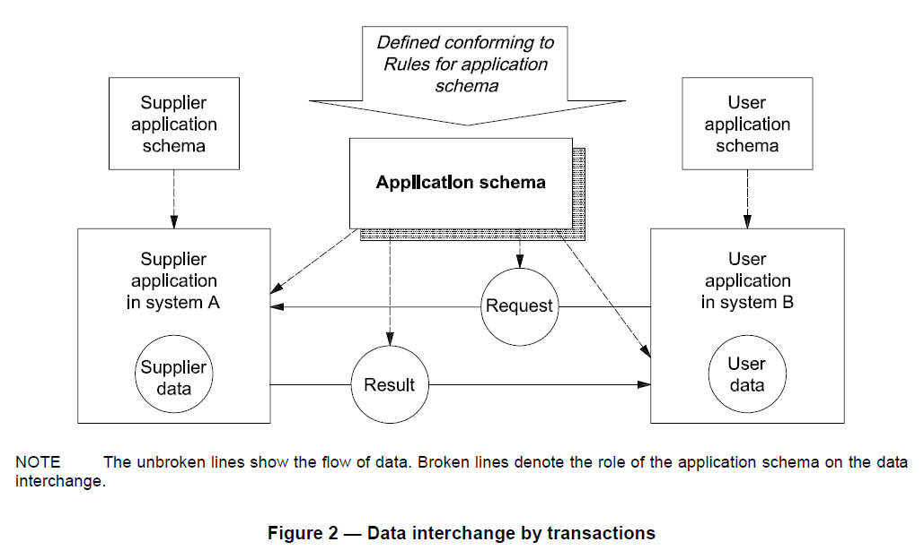
Water data exchange using standards
[ISO19109:2005, ]
Notes:
“The user application makes a request for data that is received by the supplier application. In response, the supplier
application delivers a resulting dataset. …” (ISO19109:2005, p8)

Slide 4
Water data exchange using standards
Common semantics used to define both the request and the result
[ISO19109:2005, ]
Notes:
“… Both the request and the resulting dataset are defined according to a
common application schema. The supplier application is responsible for transforming the data in system A into
the data in the exchanged dataset. After receipt, the user application is responsible for transforming the
exchanged data into data in system B. Data interchange by transaction is provided by geospatial services as
defined in ISO 19119. In particular, feature access services are defined in Geographic model/information
management services.” (ISO19109:2005, p8)

Slide 5

Water data exchange using standards
ISO19109: Rules for application schema.
Hydrology-specific application schemas
[ISO19109:2005, ]
Notes:
create and document hydrology–specific application schemas

Slide 6
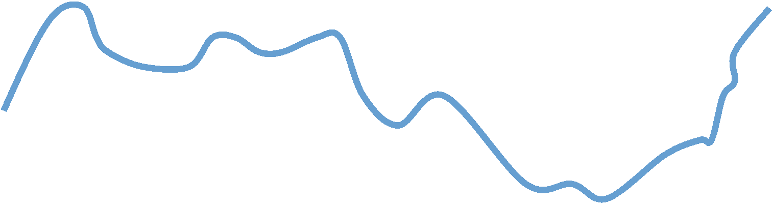
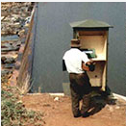
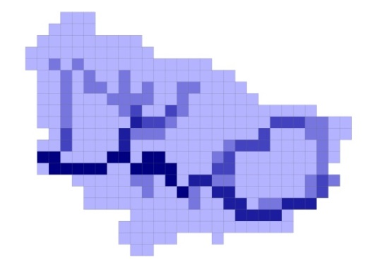
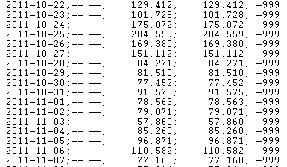
“From measurement to information” *
* WMO (2008): Guide to hydrological practices
Identify the hydrologic object of study by typical characteristics (attributes and relationships)
Q
Q
Q
Measure, or otherwise determine, values of a property carried by the object of study.
Arrange the property values with respect to the domain of discourse in datasets for display and further processing.

Slide 7
Hydrologic data in terms of ISO19156
Feature carrying Properties
observed Property
feature Of Interest
Observation
Q
procedure
Q
result
Q
data

Slide 8
Hydrologic data in terms of ISO19123
Feature carrying Properties
Observation
Q
Q
result
data
Q
range
Coverage result

Slide 9
Hydrologic data in terms of ISO19123
Feature carrying Properties
observed Property
feature Of Interest
Observation
Q
Q
result
data
domain
Q
range
Coverage result

Slide 10
Hydrologic Information in terms of ISO19109
General Feature Model (GFM)
Model of Conceptual schema language
Meta level
Hydrology-specific application schemas
Identification of hydrologic
features
Observation of hydrologic features
Representation of hydrologic features
Application level
Data, conform to a hydrology-specific application schema
Data level
Notes:
According to the layer architecture described in the rules for application schema, with respect to hydrology application schemas are required to stably identify hydrologic features, to model their observation and mutiple representation

Slide 11
Hydrologic Information in terms of ISO19109
General Feature Model (GFM)
Model of Conceptual schema language
Meta level
Hydrology-specific application schemas
Hydrologic Feature Model
(OGC11-039r3)
Observation
Model (ISO19156)
Coverage model (ISO19123)
Application level
Data, conform to a hydrology-specific application schema
Data level
Notes:
For identification, the hydro feature model was developed which provides commonly agreed concepts of the fundamental relationships between hydrologic features, particularly to the catchment they represent. (described in OGC11-039r3 DP)
For observation, the base concepts of the common observation model shall be used to provide information about hydrologic observations. (described in ISO 19156)
The coverage model can be used to provide information about the representation of hydrologic data. (described in ISO19123)

Slide 12
Hydrologic Information in terms of ISO19109
General Feature Model (GFM)
Model of Conceptual schema language
Meta level
Hydrology-specific application schemas
DOMAIN
domainElement
Hydrologic Feature
Observation
(feature)
Coverage (feature)
(discovery) metadata
Application level
RANGE
rangeElement
AttributeValues
Data level
Notes:
A coverage is a feature that has pairs of distinguished properties consisting of a geometry property and a function that is defined over the coordinate set that is defined (delineated) by the geometry (ISO19123:2011)
A (discrete) coverage couples attribute values to a (direct) position of a single geometric object in its spatio-temporal domain (set of possible positions in Time and Space).

Slide 13
Hydrologic Information in terms of ISO19109
General Feature Model (GFM)
Model of Conceptual schema language
Meta level
Hydrology-specific application schemas
HY_Features
DOMAIN
featureOfInterest
DOMAIN
domainElement
Observation (feature)
Coverage (feature)
Property (Variable)
observedProperty
(discovery) metadata
Application level
(observation) metadata
RANGE
RANGE
result
rangeElement
Any (data)
AttributeValues
Data level
Notes:
An observation is the feature that couples observation results (attribute values) to a distinct property of the feature of interest in the set of observable properties carried by the feature of interest.

Slide 14
Hydrologic Information in terms of ISO19109
General Feature Model (GFM)
Model of Conceptual schema language
Meta level
Hydrology-specific application schemas
HY_Features
DOMAIN
featureOfInterest
DOMAIN
domainElement
Variable
may take any value in a set of possible values (WMO, 1992)*
→ observed property, arranged in a coverage
→ process variable, representing the stage of a process such as streamflow, accumulation/dissolve of matter or substance, etc.
variate, when associated with a frequency or probability
* WMO/UNESCO (1992): International Glossary of Hydrology
Observation (feature)
Coverage (feature)
Property (Variable)
observedProperty
(discovery) metadata
Application level
(observation) metadata
RANGE
RANGE
result
rangeElement
Any (data)
AttributeValues
Data level
Notes:
An observation is the feature that couples observation results (attribute values) to a distinct property of the feature of interest in the set of observable properties carried by the feature of interest.

Slide 15
Hydrologic Information in terms of ISO19109
General Feature Model (GFM)
Model of Conceptual schema language
Meta level
June 2014
Hydrology-specific application schemas
HY_Features, common hydrol. feature model
(OGC11-039r3)
Water Observation
ISO 19123: Coverages
WML2P1:
Timeseries Observation
(OGC10-126r3)
WML2P2: Gauging Observation
(OGC13-021)
WML2P3: Water Quality Observation
(OGC14-003)
Application level
result
rangeElement
Any attribute values
Data level

Slide 16
Hydrologic Information in terms of ISO19109
General Feature Model (GFM)
Model of Conceptual schema language
Meta level
Hydrology-specific application schemas
HY_Features, common hydrol. feature model
(OGC11-039r3)
Water Observation
ISO 19123: Coverages
WML2P1:
(TS = temporal coverage)
WML2P2: Gauging Observation
(OGC13-021)
WML2P3: Water Quality Observation
(OGC14-003)
Application level
Any attribute values
Data level
Notes:
Time series are temporal coverages! so, there is a need to harmonise the definition of time series across the ISO/OGC standards. There was a discussion in Washington to develop a TimeseriesML on its own to get a broader area of application

Slide 17
Hydrologic Information in terms of ISO19109
Hydrology-specific application schemas
!
→ need to harmonise the definition of Time Series across the ISO/OGC standards and profiles
WML2P1:
Water … ???
(OGC10-126rX)
WML2P2: Gauging Observation
(OGC13-021rX)
WML2P3: Water Quality Observation
(OGC14-003rX)
HY_Features, common hydrol. feature model
(OGC11-039r3)
ISO19123
TimeSeriesML
Application level
Notes:
This requires to harmonise the definition of time series across the ISO/OGC standards and profiles, where observation should provide the link between feature concept and coverage concept

Slide 18
Hydrologic Information in terms of ISO19109
Hydrology-specific application schemas,
using GFM and applying a conceptual schema language
→ need for re-factoring WaterObservation
WML2P1:
Water Quantity Observation
(OGC10-126rX)
WML2P2: Gauging Observation
(OGC13-021rX)
WML2P3: Water Quality Observation
(OGC14-003rX)
HY_Features, common hydrol. feature model
(OGC11-039r3)
RiverML:
channel geometry observation
GWML2: groundwater observation
…..
…..
ISO19123
TimeSeriesML
…..
…..
“SoilML”:
water component ?
CSML3:
water component ?
Forecasting observation
(re-initiated ?)
Application level
Notes:
requires a re-factoring of the WaterML2 Part 1 in terms of a (water) observation model using (special hydrologic) feature model and a (special time-series) coverage model

Slide 19
Possible information threads (data-centric)
General Feature Model (GFM)
Model of Conceptual schema language
Meta level
Identification of hydrologic features
Observation of hydrologic features
Representation of hydrologic features
HY_Features
WaterObservation
Coverages
e.g.TimeSeries
DOMAIN
WML2
WML2
WML2
Property (Variable)
WML2
WML2
WML2
Application level
RANGE
result
Observation results, arRANGEd in a coverage
Data level
Notes:
… data from hydrologic observation understood as temporal coverage with a range of observation results in the domain of possible water observations.

Slide 20
Possible information threads (data-centric)
General Feature Model (GFM)
Model of Conceptual schema language
Meta level
Identification of hydrologic features
Observation of hydrologic features
Representation of hydrologic features
featureOfInterest
DOMAIN
HY_Features
WaterObservation
Coverages
e.g.TimeSeries
DOMAIN
WML2
WML2
WML2
Property (Variable)
WML2
WML2
WML2
observableProperty
Application level
RANGE
result
Observation results, arRANGEd in a coverage
Data level
Notes:
… data from hydrologic observation can be understood as temporal coverage with a range of observation results in the domain of possible water observations whose domain are possible features of interest carrying observable properties.

Slide 21
Possible information threads (data-centric)
General Feature Model (GFM)
Model of Conceptual schema language
Meta level
Identification of hydrologic features
Observation of hydrologic features
Representation of hydrologic features
HY_Features
featureOfInterest
WaterObservation
Coverages
e.g.TimeSeries
DOMAIN
DOMAIN
WML2
WML2
WML2
Property (Variable)
PHENOMENON
(RANGE)
WML2
WML2
WML2
observedProperty
Application level
RANGE
result
Observation results, arRANGEd in a coverage
Data level
Notes:
… data from hydrologic observation can be understood as temporal coverage with a range of observation results in the domain of possible water observations observing a range of properties (phenomenon) in a domain of possible feature of interest, which is very common perspective .

Slide 22
Possible information threads (observation-centric)
General Feature Model (GFM)
Model of Conceptual schema language
Meta level
Identification of hydrologic features
Observation of hydrologic features
Representation of hydrologic features
DOMAIN
DOMAIN
HY_Features
featureOfInterest
WaterObservation
Coverages
e.g.TimeSeries
WML2
RANGE
WML2
WML2
Property (Variable)
WML2
WML2
WML2
result
observedProperty
Application level
RANGE
Attribute values, arRANGEd in a coverage
Data level
Notes:
… water observation can be understood as observation resulting in attribute values arranged in a coverage in the domain of possible features of interest each carrying a range of observable properties.

Slide 23
Possible information threads (observation-centric)
General Feature Model (GFM)
Model of Conceptual schema language
Meta level
Identification of hydrologic features
Observation of hydrologic features
Representation of hydrologic features
DOMAIN
HY_Features
featureOfInterest
WaterObservation
Coverages
e.g.TimeSeries
WML2
RANGE
WML2
WML2
Property (Variable)
WML2
WML2
WML2
result
observedProperty
DOMAIN
Application level
RANGE
Attribute values, arRANGEd in a coverage
Data level
Notes:
… water observation can be understood as observation resulting in attribute values arranged in a coverage in the domain of possible observed properties each carried by the feature of interest.

Slide 24
Possible information threads (feature-centric)
General Feature Model (GFM)
Model of Conceptual schema language
Meta level
Identification of hydrologic features
Observation of hydrologic features
Representation of hydrologic features
(ultimate)
featureOfInterest
DOMAIN
HY_Features
WaterObservation
Coverages
e.g.TimeSeries
has observation
WML2
WML2
WML2
Property (Variable)
WML2
WML2
WML2
observedProperty
RANGE
Application level
Attribute values, arRANGEd in a coverage
Data level
Notes:
… hydrometric FOI (used as proxy) has an observation that observed a range of properties in the domain of the (ultimate) FOI …

Slide 25
Possible information threads (feature-centric)
General Feature Model (GFM)
Model of Conceptual schema language
Meta level
Identification of hydrologic features
Observation of hydrologic features
Representation of hydrologic features
(ultimate)
featureOfInterest
DOMAIN
HY_Features
DOMAIN
(sampling)
featureOfInterest
WaterObservation
Coverages
e.g.TimeSeries
has observation
WML2
WML2
WML2
Property (Variable)
WML2
WML2
WML2
has result
RANGE
RANGE
Application level
observedProperty
Property values, arRANGEd in a coverage
Data level
Notes:
… hydrometric FOI (i.e. sampling feature used as proxy) has an observation that observed a range of properties in the domain of the (ultimate) FOI which results in property values arRANGEed in a coverage in the domain of possible water observations.

Slide 26
Water data exchange using WaterML2
HY_Features
TimeSeriesML
Property (Variable)
WaterObservation
WML2
WML2
WML2
WML2
WML2
WML2
NOTE: Blue dashed lines denote the import relationship to the application schema whose concepts are to be imported.
Notes:
WaterML2.0 uses of the common OGC Observations & Measurements standard and is implemented as an application schema of the GML 3.2.1. Depending on application, a particular WaterML2 schema may use the relevant modules of the HY_Features, a common Property/Variable model as well as the future TimeSeries model.
Using WaterML2, both the user and the supplier application will conform the rules for application schema (ISO 19109).

Slide 27
Water data exchange using WaterML2
HY_Features
TimeSeriesML
Property (Variable)
WaterObservation
WML2
WML2
WML2
WML2
WML2
WML2
SOS 2.0 Hydrology Profile
NOTE: Blue dashed lines denote the import relationship to the application schema whose concepts are to be imported.
Notes:
Using WaterML2, both user an supplier application will conform the rules for application schema (ISO 19109).
Data request and response may be generated using the specific Hydrology Profile of the SOS2 implementing WaterML2 (under development).

Slide 28
Water data exchange using WaterML2
HY_Features
TimeSeriesML
Property (Variable)
WaterObservation
WML2
WML2
WML2
WML2
WML2
WML2
Supplying Service
Requesting Service
SOS 2.0 Hydrology Profile
NOTE: Blue dashed lines denote the import relationship to the application schema whose concepts are to be imported.
Notes:
Using WaterML2, both user an supplier application will conform the rules for application schema (ISO 19109).
Data request and response may be generated using the specific Hydrology Profile of the SOS2 implementing WaterML2 (under development).

Slide 29
Here we stand ! – What next ? – What is needed ?
ease / facilitate the use of water information standards
→ technical inter-operability between Web services
give water information standards a common face
→ organizational inter-operability between Web services
bundling water information standards by content
semantic inter-operability between Web services

Slide 30
progress → suite of water information standards
Jul 2012
Oct 2013
Mar 2014
Aug 2014
„some structure … in order to present a common face “
“suite of components to support the water community”
OGC Change request 13-123 re “Repackaging WML2 P1”
Discussion in NY at the HydroDWG workshop
Notes:
The OGC request pointed again to the suite of water standards

Slide 31
To be discussed in NY
What do we hope to get from the “Water Suite”? Which use cases can be addressed ?
Scope and content of the “Water Suite” ?
Suite of standards ← → suite of guidelines / tools
Role of existing / future WaterML2 components
How to structure ?
by typical use cases: Quantity Observation, Quality Observation, Gauging Observation, ...
by abstraction level: information/conceptual models, application schemas, implementations, profiles and formats, ...
Framework: OGC – WMO – ISO ?
Roadmap (priorities, actors, timelines)

Slide 32
Water Suites → Hand ling water information
e
What do we hope to get from the water suite?
D-Suite (Data): Tools and services for the exchange of hydrologic data using Web services (→ technical interoperability)
F-Suite (Features): Tools and services for referencing hydrologic features, for the “mapping” of semantic concepts to preserve context and meaning across applications and domains (→ mediation)
G-Suite (Geographic Water Information): Tools and services to share water-related geographic information using Web services (→ semantic interoperability)

Slide 33
D - Water Suite (Data exchange)
Tools and services to exchange hydrologic data, e.g.
Schema implementation and encoding, such as WaterML2 series
Hydrology-specific APIs, such as the Hydro Profile of SOS 2.0
Encoding of mappings and bindings, e.g. using xLink etc.
Hydrology-specific visualization, such as hydrograph, duration curve, etc.
…..

Slide 34
F - Suite (Features in water information)
Identification ←→ Observation ←→ Representation of features
Mapping semantics with respect to hydrologic features between information models (a lesson learned from the OWS-10 CCI Hydro thread)
Formalisation of schema mapping (between ISO19109 application schemas) based on Semantic Web technologies
…..
WaterObservation
WML2
WML2
WML2
WML2
WML2
WML2
HY_Features
Coverages
(e.g.TimeSeries)
Property (e.g.Variable)
Application schemas

Slide 35
G - Suite (Geographic Water Information)
Tools and services to share water information
Referencing multiple represented hydrologic features
Separation of concerns (content-related information)
Reasoning / Inference (share data via content information)
Link hydrologic data via a shared, spatial reference (catchment)
Ontology-based mapping of application-specific concepts
Semantic Interoperability of Web services

Slide 36
Thank You ! Questions ?
Standards for Water Information - towards a suite of standards -
5th, WMO/OGC Hydrology DWG
New York, CCNY, August 11 – 15, 2014
Irina Dornblut, GRDC of WMO at BfG

Slide 37
Definitions
Data: notion of a documented value of some characteristics of a phenomenon.
Dataset: identifiable collection of data. [ISO19115:2003]
Coverage: set of attribute values arranged with respect to a particular domain. – function to return values from its range for any direct position within its spatial, temporal or spatiotemporal domain. [ISO19123:2005]
Feature: abstraction (abstract notion) of real-world phenomena. [ISO19101:2002]; the fundamental unit of geographic information. [ISO19109:2005]
Hydrologic Feature: abstract notion of the hydrology phenomenon. [OGC 11-039r3]
Property: notion of a characteristic property of a real-world phenomenon.
Observation: act of observing a property or phenomenon, with the goal of producing an estimate of the value of the property. [ISO19156:2011]
Variable: feature properties whose values may change with Space, Time, or Observation. A variable may take any value in a range of possible values [WMO, 1992].
Q

