Slide 1

Water ML 2 Part 2
Ratings Gaugings and Sections
Interoperability Experiment Report
OGC Hydrology Domain Working Group
2014 Workshop
City University New York

Slide 2
Presentation Outline
Introduction and overview
IE Design Overview
Service offering demonstrations
Client demonstrations
Engineering report
API - where to from here?
SWG Formation

Slide 3
WaterML2.0 parts
●part 1 - timeseries: exchange of time-series and monitoring points
●part 2 - exchange of Rating tables, Gaugings, Cross-sections (RGS)

Slide 4
Requirements
Initial requirements drafted at workshop in the UK, 2012
Available in online spreadsheet
Further iterations resulted in detailed service requirements:
User reqs
API reqs

Slide 5
Information model
Draft was published as discussion paper in 2013
Interoperability Experiment kicked off in 2013

Slide 6
Technical objectives
Test WaterML2.0 part 2 information model
Test compatibility with existing OGC services (WFS and SOS)
explore options for RESTful services;
Test encodings using GML/XML, and investigate alternative encodings, such as JSON.

Slide 7
Domain objectives
1. Advance exchange processes between the Bureau and Australian water agencies;
2. Enhance the exchange of ratings between USGS, NWS and the US Army Corps of Engineers (USACE);
3. Provide web-accessible ratings and gaugings data for the UK’s National River Flow Archive, enabling understanding of rating quality, and with a view to future exchange between agencies.

Slide 8
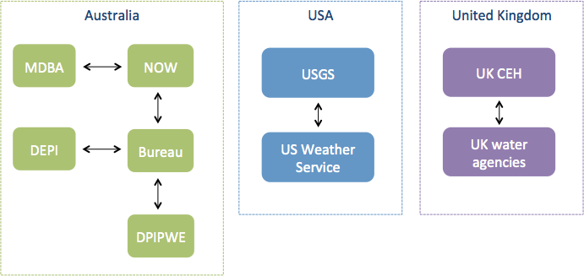
IE scenarios

Slide 9
Scenarios for exchange
Flood forecasting (US) - Exchange between USGS and US National Weather Service
Inter-agency exchange (AUS) - exchange between the Aus Bureau, MDBA, NSW Office of Water, Tas DPIPWE, Vic DEPI
Public data publishing (UK) - publication of the UK’s National River Flow archive

Slide 10
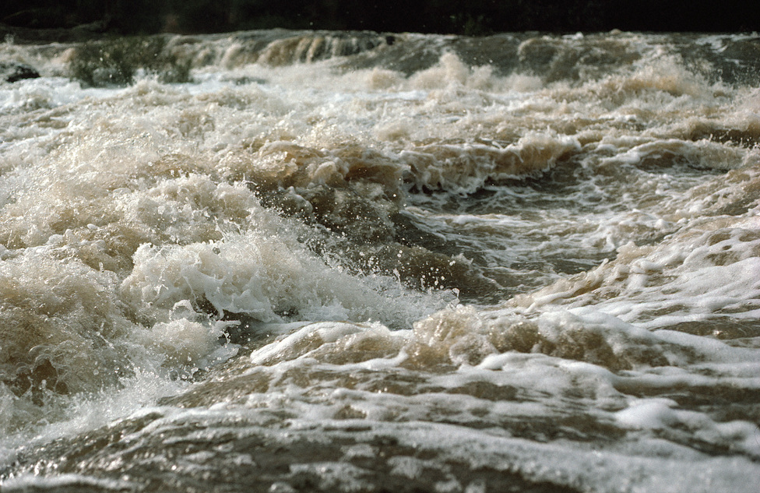
Image: CSIRO
IE Design Overview

Slide 11
Encodings
Most OGC standards use XML encodings
There is an XML encoding of the RGS model
However, the IE is using JSON to test the model
Lower barrier to entry
Better support for web development
Broader interest in use of JSON for data exchange standards

Slide 12
Service choice
OGC services could be used for RGS data:
SOS - for gauging observations and cross-sections
WFS - for rating tables
However, there is overhead in implementing these specifications
We decided to use a RESTful API for the experiment

Slide 13
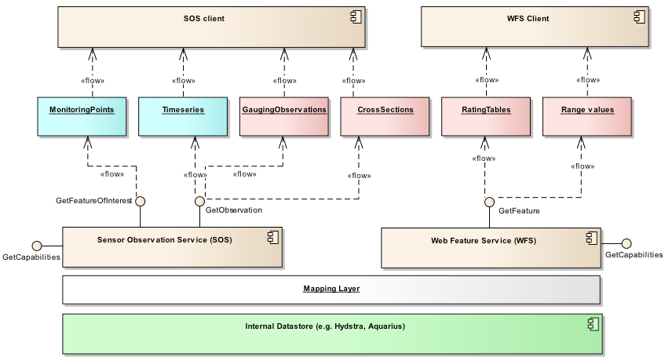
OGC services approach

Slide 14
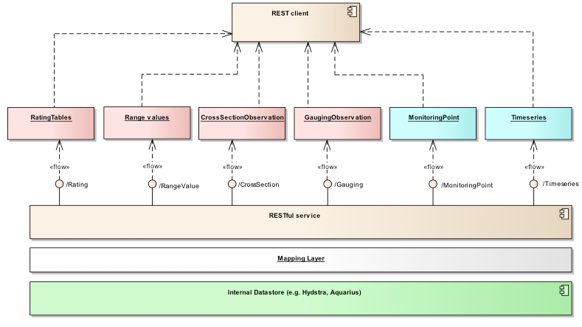
RESTful service approach

Slide 15
API
Base RESTful API calls
Returns | URL | Description
MonitoringPoint | /monitoring-point/ | Returns a list of all monitoring points. Current returns fully encoded descriptions rather than simple references.
MonitoringPoint | /monitoring-point/<mp-id> | Returns description of a specific monitoring point by ID.
ConversionGroup | /conversion-group/ | Returns a list of all available conversion groups (combinations of monitoring-points/paramFrom/paramTo
ConversionGroup | /conversion-group/<cg-id> | Returns a specific conversion group description.
Conversion | /conversion/ | Returns a list of all available conversions. Get latest rating also available.
Conversion | /conversion/<conv-id> | Returns a specific conversion by its identifier.
ConversionPeriod | /conversion-period/ | Returns a list of all available conversion periods.
Gauging | /gauging/ | Returns all available gauging observations.
Gauging | /gauging/<gauging-id> | Returns a specific gauging observation by its identifier.

Slide 16
Information model
The IE implementation model simplifies the full WaterML2.0 part 2 model
Collapses some classes
Restricts ‘in-line’ and ‘by-reference’ associations
More restrictive cardinalities

Slide 17
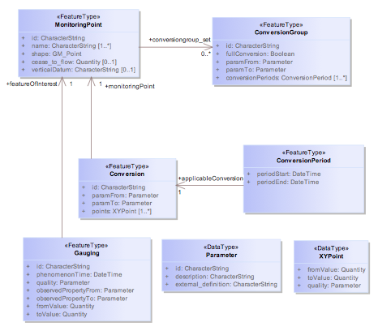
IE Information Model

Slide 18
Validation
A validation script was developed, available here
Also wrapped as a web-based validator, available here: http://waterml2.csiro.au/validator

Slide 19
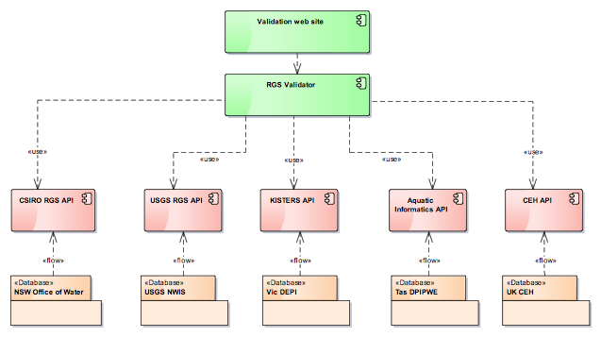
IE Service Validator

Slide 20
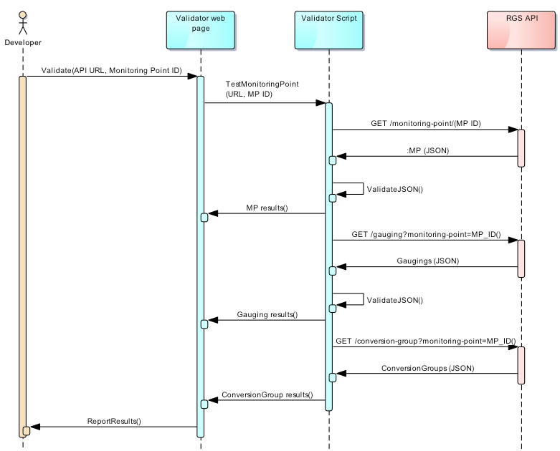
The validation workflow

Slide 21
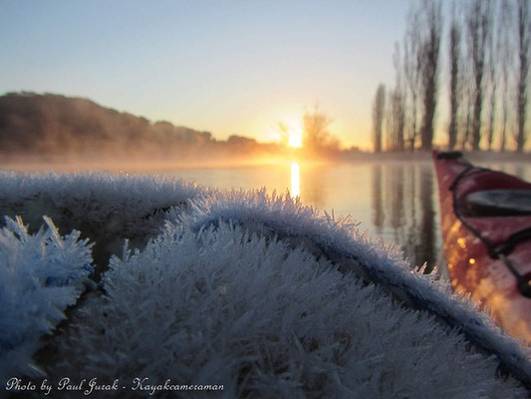
Service offering demos
http://www.canberratimes.com.au/photogallery/act-news/canberra-freezes-through-record-cold-spell-20140806-3d7rz.html?aggregate=&selectedImage=0
Service offering demos

Slide 22
CSIRO API demo
Documentation
Example calls
MP
XML/JSON response examples
XML MP
Gauging temporal subset, XML
Conversion groups for specific MP

Slide 23
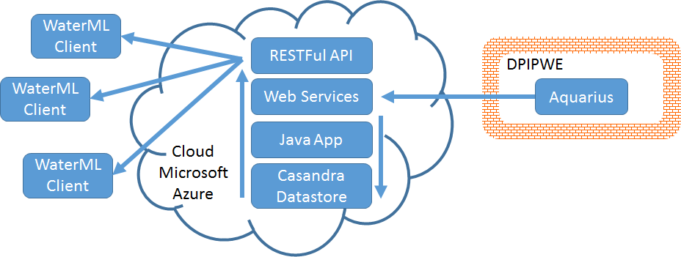

Aquatic Informatics - WaterML 2 Part 2 Implementation
DPIPWE - Department of Primary Industries, Parks, Water and Environment

Slide 24
Challenges
Data model
Shifts: thanks Pete & Paul !
Objects: IDs and addressability
Rating: how to convert equation to rating table
Performance
Paging
challenging to implement efficiently
Verbosity (e.g., gaugings)
Data normalization
embed or link related data when responding to requests
Vocabulary (ontologies)
Values can be exchanged but the semantics are missing (e.g., metadata, parameters)
Continues to be a major issue for us

Slide 25
Value Proposition?
Data standards & interoperability
a public good
Optimal outcomes for individual actors don’t necessarily imply an optimal outcome in aggregate - Thomas Schelling
OGC leadership is critical in realizing this good
Aquatic Informatics
Our clients are asking for it
Contributing to a public good
Knowledge sharing
Client (DPIPWE)
“In a nutshell it will improve the service we provide to our clients and reduce our maintenance effort … and enable us to meet data supply needs into the foreseeable future” - Donald Hine

Slide 26

Centre for Ecology and Hydrology - UK
1000 monitoring points
Stage - flow conversions only
Time variant ratings, 1:1 ratio between period and rating
Each has multiple “parts” - stage range
Ratings for each “part” is an equation
http://www.ceh.ac.uk/data/nrfa/data/peakflow.html?52011

Slide 27
Centre for Ecology and Hydrology - UK
Use cases:
Provide ratings and gaugings to enable users to understand rating history and assess uncertainty of ratings and flow data
Provide ratings to enable users to convert stage - flow
Future exchange with data providers

Slide 28
Centre for Ecology and Hydrology - UK
http://www.ceh.ac.uk/nrfa/rgs-api/monitoring-point/
http://www.ceh.ac.uk/nrfa/rgs-api/conversion?monitoring-point=54012
http://www.ceh.ac.uk/nrfa/rgs-api/conversion/1222
http://www.ceh.ac.uk/nrfa/rgs-api/gauging?monitoring-point=54012

Slide 29
Centre for Ecology and Hydrology - UK
Implemented in java alongside existing web-services
REST API relatively simple to implement
No paging
Currently no concept of conversionperiod_set, conversion-period: IDs constructed.
Considering how to keep equation information alongside conversion table

Slide 30
Kisters
Implementation over Hydstra
Deployed at the Department of Environment and Primary Industries (DEPI)
WISKI implementation is being investigated also

Slide 31
Kisters
Landing page: http://203.12.195.133/rest.htm
Get monitoring point:
http://203.12.195.133/cgi/waterml2/monitoring-point?monitoring-point=225201A
Conversion group:
http://203.12.195.133/cgi/waterml2/conversion-group?monitoring-point=225201A

Slide 32
United States Geological Survey
Current ratings depot contains “corrections” and “ratings” files for 14,000+ sites/locations
RGS-API is simple wrapper on the production depot
Old RDB (tab-delimited) format is default output of USGS ADAPS timeseries-processing software
Aquarius software does not support that old RDB format nor will we “teach” it to do so
Therefore, starting in August 2015 the RGS schema will be the only ratings format supplied by NWIS

Slide 33
United States Geological Survey
Conversion: http://staging.waterdata.usgs.gov/nwisweb/cgi-src/conversion
Conversion-group: http://staging.waterdata.usgs.gov/nwisweb/cgi-src/conversion-group
Gauging: http://staging.waterdata.usgs.gov/nwisweb/cgi-src/gauging
Monitoring-point: http://staging.waterdata.usgs.gov/nwisweb/cgi-src/monitoring-point

Slide 34
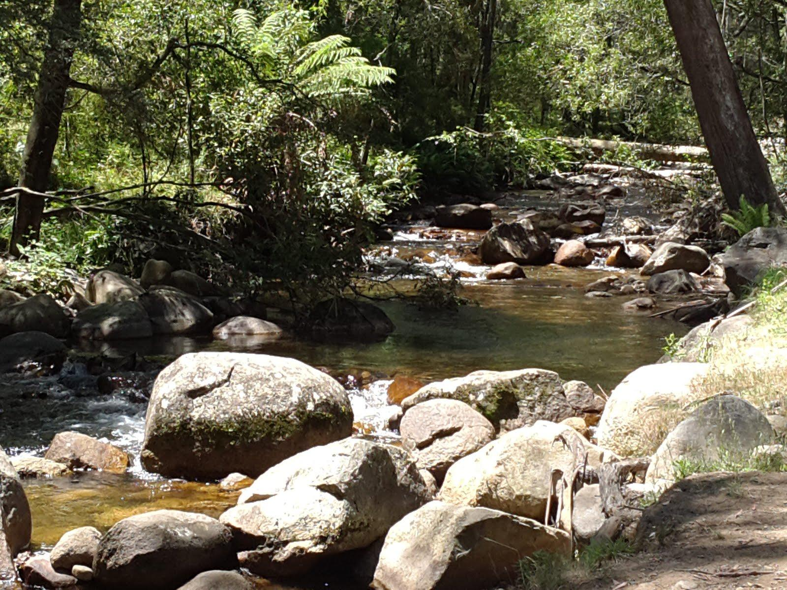
Client demonstrations

Slide 35
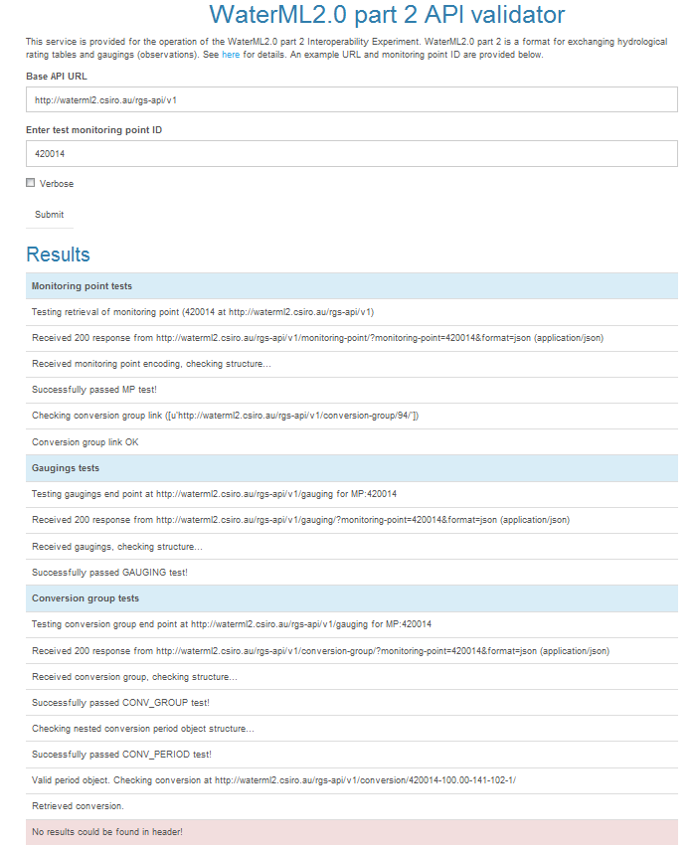
Validation service
http://waterml2.csiro.au/validator

Slide 36
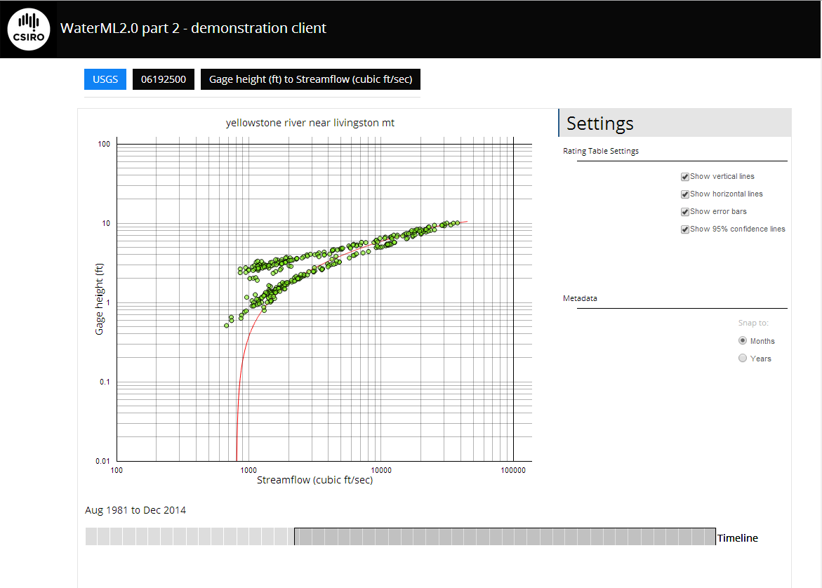
Web client demo
http://waterml2.csiro.au/rgs-api/v1/viz/

Slide 37
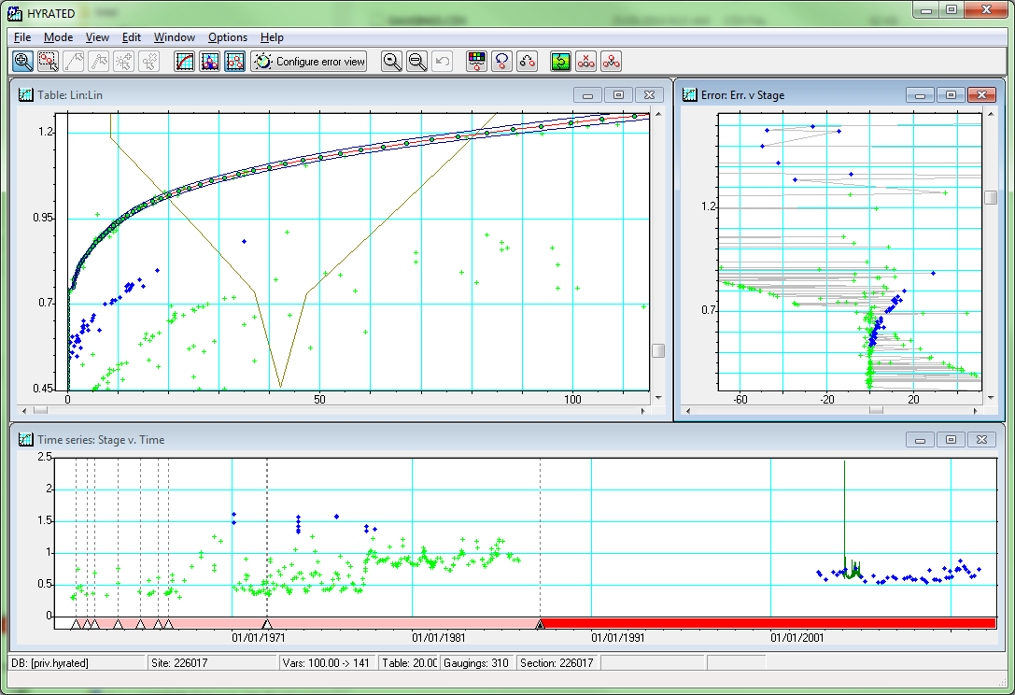
Hydstra import demo

Slide 38
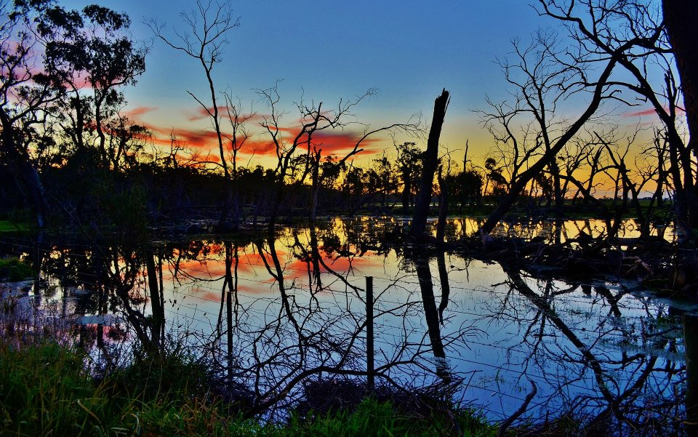
Engineering report
https://www.facebook.com/bureauofmeteorology/photos/pb.170992086298033.-2207520000.1407302407./760652073998695/?type=3&theater
Engineering report

Slide 39
IE Report
Close to final version
Will be submitted as OGC Engineering Report

Slide 40
What worked
Choice to use RESTful APIs allowed 5 separate implementations of the API
JSON encoding lowered development effort
Allowed focussing on more important part of testing the information model
The clients work across all 5 services with no code differences

Slide 41
What worked
Achieved the both the technical and domain level objectives
Tested and refined the WaterML2.0 part 2 model
Now in a good position to standardise
Agencies involved getting positive outcomes

Slide 42
Challenges
Mapping to internal data structures
Handling large service responses
Separation of information model and web service
Optimizing API return collections

Slide 43
Challenges
Identifiers
No common approach for JSON encodings
Handling US practice of rating shifts

Slide 44

http://scienceblogs.com/startswithabang/files/2013/10/960x332-foot-in-water-26430848.jpg
Next steps

Slide 45
API - where to from here?
Being drafted as a RESTful API and JSON discussion paper
Have had interest from software vendors to put into commercial implementations
Best practice at next TC meeting?

Slide 46
Where to from here?
SWG Formation
Engineering report

Slide 47









Many thanks to all contributors!

Slide 48

the end

