Slide 1
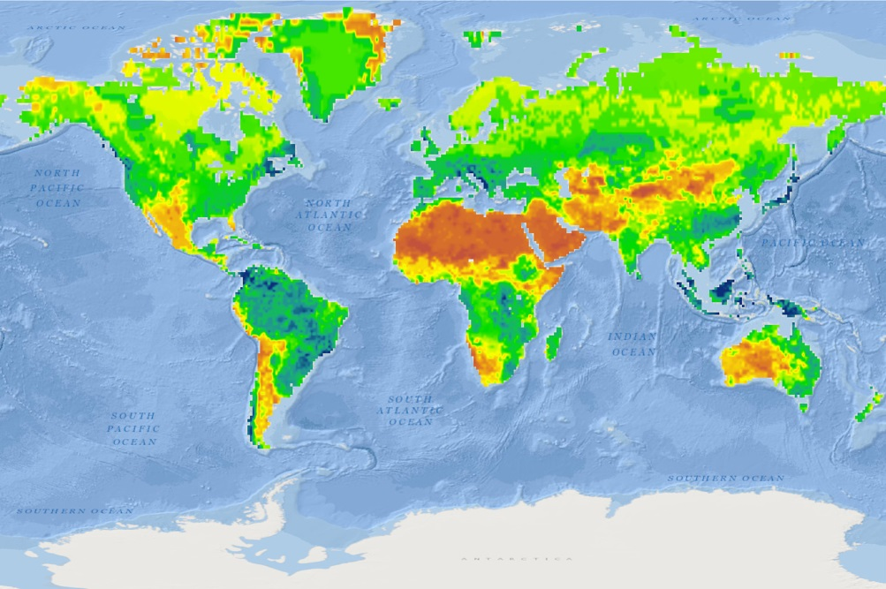


EarthCube Building Block for Integrating Discrete and Continuous Data (DisConBB)
David Maidment, University of Texas at Austin (Lead PI)
Alva Couch, Tufts University
Ethan Davis, Unidata
Dan Ames, Brigham Young University
OGC/WMO HDWG Workshop, CCNY, August 11-15, 2014
David Arctur, University of Texas at Austin (Project Manager)

Slide 2
Discrete & Continuous Data: Project Outline
Discrete spatial domains: GIS features (point, line and area) with observations & measurements
Continuous spatial domains: Grids of measured or modeled variables in geophysical fluid sciences
Spatially discrete or continuous data may also vary discretely or continuously in time: one-time samples vs. random points of time vs. regularly spaced intervals of time
Water Property
Common Information Model
+
Data migration
+ Server & user tools
Precipitation
Evaporation
Soil Moisture
Streamflow
Groundwater
Reservoirs
Past
Present
Future
Phase 1: Describe water & atmospheric properties over a domain of space and time
History
Current conditions
Forecasts
Phase 2: Apply concepts and methods in other domains
Solid Earth
Cryosphere
Oceans
Notes:
These slides are for a 5-min presentation about our EC BB project, given the following instructions:
1. What are the overall aims of your project?
2. How will your project contribute to the overall success for EarthCube?
3. What are the key milestones and deliverables for your project?
This slide presents the primary motivation and goals, and explains what we mean by the terms discrete & continuous.
Developed for EarthCube Portfolio Workshop, Boulder CO, Feb 12-14, 2014

Slide 3
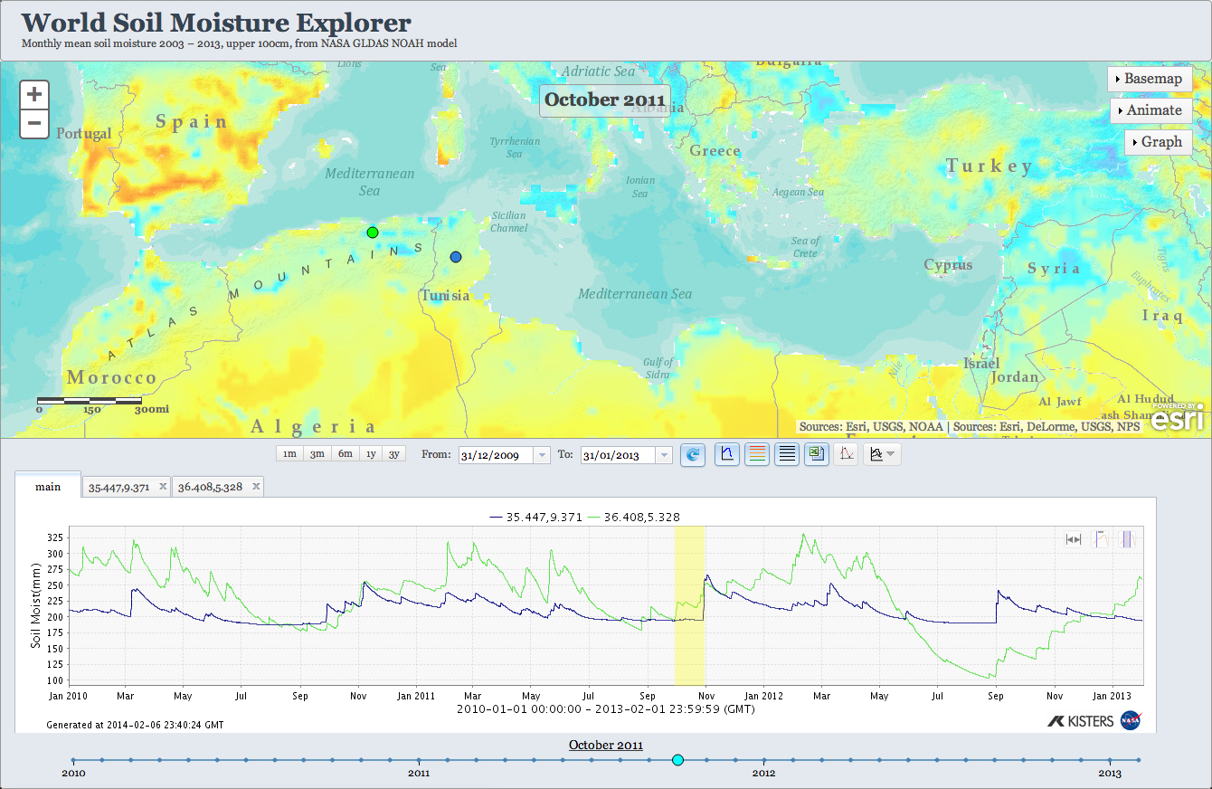
Prototype: Soil Moisture Map & Time Series
This is a common pattern across geosciences –
Solid Earth: seismic activity, soil chemistry over deep time, …
Oceans: sea surface temperature, acidification, …
Cryosphere: snow/ice depth, trapped gas content, ...
Notes:
This web app displays a global soil moisture map (gridded data) with overlaid time series below for 2 selected locations. The user can change the global map by selecting a different date on the time line at bottom. Another option for the time series display is to overlay multiple years at a single location, for year-to-year comparisons.
These relationships for water and atmospheric variables are analogous to physical properties in other domains, such as:
solid earth (seismic activity, soil chemistry over deep time, etc),
oceans (SST, acidification, etc),
cryosphere (ice thickness, trapped gas content, etc)

Slide 4
Addressing Target User Needs
Easier visualization & browsing of regional and global multidimensional geoscience data
Improved ability to validate model results (gridded data) vs. observation (feature data)
Improved understanding of geoscience in locations where measurements have not / cannot be made

Slide 5
Target User Needs NOT Addressed
Interpolation between observations or grid values
Requires location-dependent understanding of environmental context and physics, e.g., interpolation of precipitation between grid values in mountainous area – notoriously difficult to model

Slide 6
Initial Plan for 2014-2015 UT Austin + CUAHSI + Unidata + BYU
Develop common Information Model:
CUAHSI Ontology;
OGC web services & WaterML2;
CF Conventions
Store water data time series in netCDF;
develop server-based conversion tools
Visualize and analyze
2014 Outreach Workshop 1 CUAHSI + Unidata Users Committees
Examine interoperability of hydrologic & atmospheric data
WS BB / GeoSoft
Metadata & Data Services
BCube / GEOSS
Brokering
2014 Deliverables:
Information model, server & client tools, and web architecture documentation
Outreach Workshop 1 – Austin, Oct/Nov: Hydro + Atmospheric communities
2015 Tasks:
Continue development based on workshop results; what further work is needed?
Coordinate with Solid Earth, Oceans, and Cryosphere domains & scenarios
Outreach Workshop 2 – Boulder, summer/fall: All participating communities
Notes:
The blue boxes represent primary tasks for our DisConBB team. The green boxes represent likely coordination with other EC BB’s

Slide 7
We are here…
Activities (separate workflows, not integrated)
Unidata converting netCDF content to WaterML2
CUAHSI converting WaterML 1.1 data to netCDF4 “classic” (using netCDF3 api)
BYU converting between WaterML 1.1 & 2
Tool-chain development for WaterML2-like data in NetCDF
development of WaterML2 writing in NetCDF-Java/THREDDS
IDV visualization capabilities
TBD
Information models & mappings documented; gaps & conflicts reconciled
Round-trip conversion testing
Testing with GEOSS Discovery & Access Broker’s converters

Slide 8
And that’s just the mechanics
Still need to set up and demonstrate useful scenarios, applications (see Target User Needs slide earlier)
USGS: Archiving and distribution of hydrologic and other model results
Validate model results (gridded data) vs. observations (feature data)
Land surface dynamics, integrating multiple variables for cross-domain hydro-atmospheric studies
National Flood Interoperability Experiment

Slide 9
For more info: David Arctur david.arctur AT utexas.edu

