Slide 1
Some Concluding Thoughts
David R. Maidment Center for Research in Water Resources University of Texas at Austin
OGC/WMO Hydrology Domain Working Group City University of New York
14 August 2014

Slide 2
HDWG – Secrets of Success
Keep the group small (15-20 people)
Have representatives of data producers (water agencies) and data consumers (commercial companies producing water software)
Keep the scope of each step narrow
Have a single technical expert who does the core code development, provides a verification service, and a web client for integrated display of services from the individual project participants
Have a coordinator who acts to define scope and monitor progress in meeting it.

Slide 3
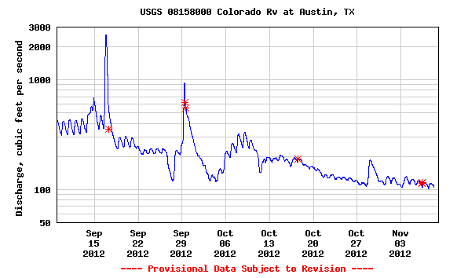
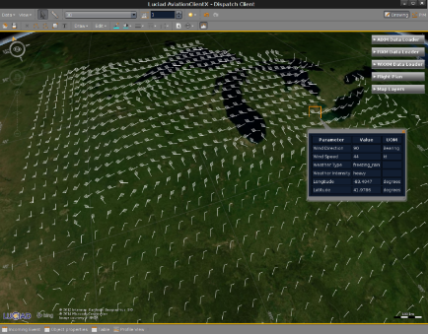
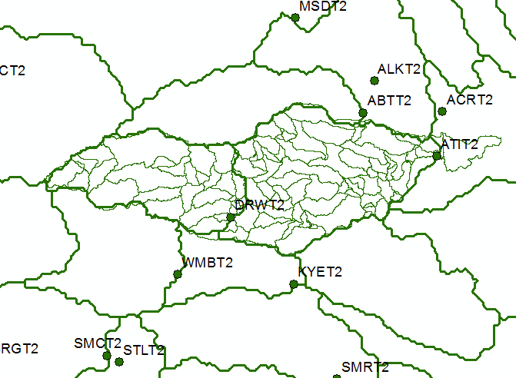
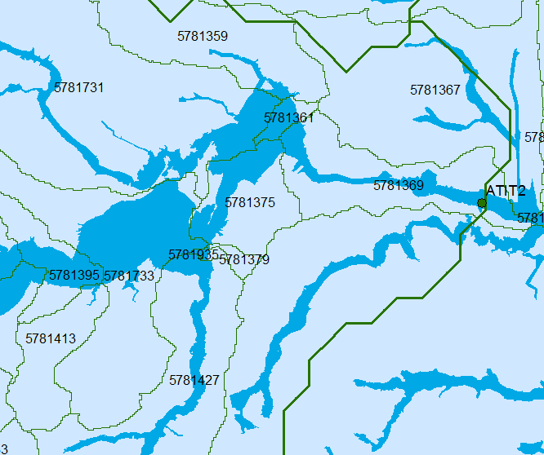
National Flood Interoperability Experiment Data Framework
Time Series
(WaterML2 and .csv)
Multidimensional Arrays
(WCS and netCDF)
Temporal
Hydrology
(RFC Basins,
NHDPlus Catchments)
Hydraulics
(National Flood Hazard Layer,
Flood Inundation Map Libraries)
Geospatial

Slide 4
Relating to Hy_Features
Its all about the catchment….
Core definition from WMO – a water basin is a region that has a single water outlet
All the objects spatially within the catchment are related to the catchment
Network
Water bodies
Structures
NHDPlus model is a “container” model with the additional constraint that “one area contains one line”
An alternative model is “one area contains many lines”
The catchment is a “container”

Slide 5
RiverML – where to next?
A very simple version further considered by HDWG
Core primitive is a flood inundation map
Applies for steady flow
Attributed with a specific discharge
Could be attributed with a reference elevation at a specific location
The more fully configured version developed by Stephen Jackson is further considered within our HydroShare project as a conceptual model for “Digital Watershed”
Strong link to Hy_Features

